Slide 1


.NET Framework Overview
.NET Framework, CLR, MSIL, Assemblies, CTS, etc.
.NET Framework

Slide 2


Table of Contents
What is .NET?
  Microsoft .NET platform architecture
What is .NET Framework?
  .NET Framework Architecture
Common Language Runtime (CLR)
Managed Code
Intermediate Language MSIL
Assemblies and Metadata
.NET Applications
2

Slide 3

Table of Contents (2)
Common Language Infrastructure (CLI) and integration of different languages
  Common Language Specification (CLS)
  Common Type System (CTS)
Framework Class Library
Integrated Development Environment Visual Studio
3

Slide 4

.NET Framework
Microsoft's Platform for Application Development

Slide 5
What is the .NET Platform?
The .NET platform
  Microsoft's platform for software development
  Unified technology for development of almost any kind of applications
    GUI / Web / mobile / server / cloud / etc.
5

Slide 6

What is .NET Framework?
.NET Framework
  An environment for developing and executing .NET applications
  Unified programming model, set of languages, class libraries, infrastructure, components and tools for application development
  Environment for controlled execution of managed code
6

Slide 7
.NET Framework Components
Common Language Runtime (CLR)
  Environment for controlled execution of programmed code – like a virtual machine
  Executes .NET applications
Framework Class Library (FCL)
  Standard class library for .NET development
  Delivers basic functionality for developing: XML, ADO.NET, LINQ, ASP.NET, WPF, WCF, WWF, Silverlight, Web services, Windows Forms, ...
SDK, compilers and tools
7

Slide 8

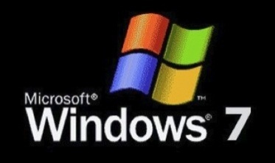


.NET Framework Architecture
  The OS manages the resources, the processes and the users of the machine
  Provides to the applications some services (threads, I/O, GDI+, DirectX, COM, COM+, MSMQ, IIS, WMI, …)
  CLR is a separate process in the OS
Operating System (OS)
8

Slide 9
.NET Framework Architecture (2)
  CLR manages the execution of the.NET code
  Manages the memory, concurrency, security, ...
CLR
Common Language Runtime (CLR)
Operating System (OS)
9

Slide 10
.NET Framework Architecture (3)
  Rich object-oriented library with fundamental classes
  Input-output, collections, text processing, networking, security, multi-threading, …
Base Class Library (BCL)
Common Language Runtime (CLR)
Operating System (OS)
10

Slide 11
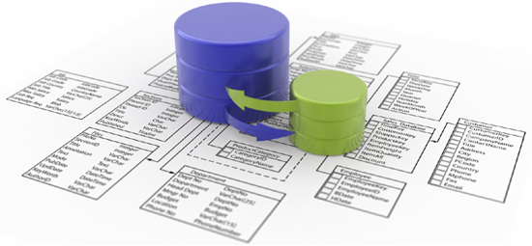
.NET Framework Architecture (4)
  Database access
  ADO.NET, LINQ, LINQ-to-SQL and Entity Framework
  Strong XML support
ADO.NET, LINQ and XML (Data Tier)
Base Class Library (BCL)
Common Language Runtime (CLR)
Operating System (OS)
11

Slide 12
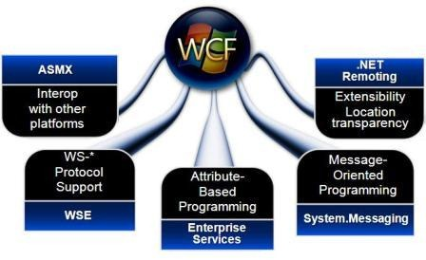
.NET Framework Architecture (5)
  Windows Communication Foundation (WCF) and Windows Workflow Foundation (WWF) for the SOA world
WCF and WWF (Communication and Workflow Tier)
ADO.NET, LINQ and XML (Data Tier)
Base Class Library (BCL)
Common Language Runtime (CLR)
Operating System (OS)
12

Slide 13
.NET Framework Architecture (6)
  User interface technologies: Web based, Windows GUI, WPF, Silverlight, mobile, …
ASP.NET
Web Forms, MVC, AJAX
Mobile Internet Toolkit
Windows
Forms
WPF
Silverlight
WCF and WWF (Communication and Workflow Tier)
ADO.NET, LINQ and XML (Data Tier)
Base Class Library (BCL)
Common Language Runtime (CLR)
Operating System (OS)
13

Slide 14
.NET Framework Architecture (7)
  Programming language on your flavor!
C#
C++
VB.NET
J#
F#
JScript
Perl
Delphi
…
ASP.NET
Web Forms, MVC, AJAX
Mobile Internet Toolkit
Windows
Forms
WPF
Silverlight
WCF and WWF (Communication and Workflow Tier)
ADO.NET, LINQ and XML (Data Tier)
Base Class Library (BCL)
Common Language Runtime (CLR)
Operating System (OS)
14

Slide 15


Common Language Runtime (CLR)
The Heart of .NET Framework

Slide 16

Common Language Runtime (CLR)
Managed execution environment
  Controls the execution of managed .NET programming code
Something like virtual machine
  Like the Java Virtual Machine (JVM)
Not an interpreter
  Compilation on-demand is used
    Known as Just In Time (JIT) compilation
Possible compilation in advance (Ngen)
16

Slide 17

Responsibilities of CLR
Execution of the IL code and the JIT compilation
Managing memory and application resources
Ensuring type safety
Interaction with the OS
Managing security
  Code access security
  Role-based security
17

Slide 18

Responsibilities of CLR (2)
Managing exceptions
Managing concurrency – controlling the parallel execution of application threads
Managing application domains and their isolation
Interaction with unmanaged code
Supporting debug / profile of .NET code
18

Slide 19
CLR Architecture
Base Class Library Support
Thread Support
COM Marshaler
Type Checker
Exception Manager
Security Engine
Debug Engine
IL to Native
JIT Compiler
Code
Manager
Garbage
Collector
Class Loader
19

Slide 20

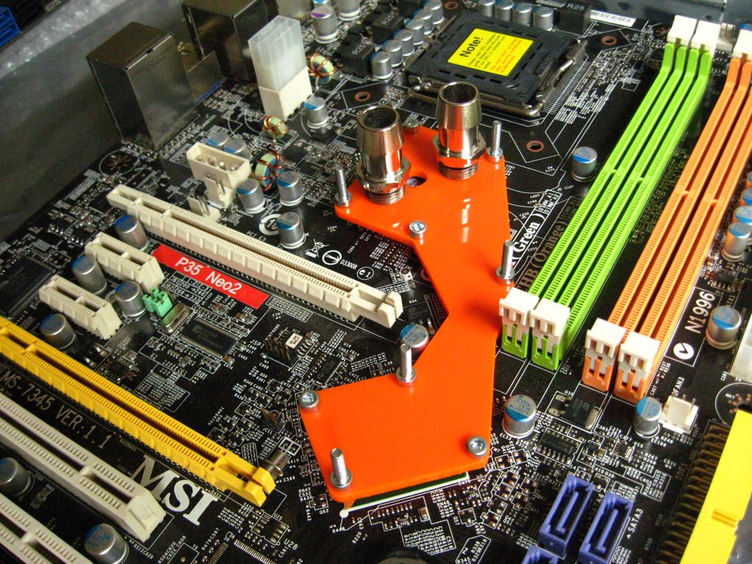
Managed and Unmanaged Code
What is the Difference?

Slide 21
Managed Code
CLR executed code is called managed code
Represents programming code in the low level language MSIL (MS Intermediate Language)
Contains metadata
  Description of classes, interfaces, properties, fields, methods, parameters, etc.
Programs, written in any .NET language are
  Compiled to managed code (MSIL)
  Packaged as assemblies (.exe or .dll files)
21

Slide 22

Managed Code (2)
Object-oriented
Secure
Reliable
  Protected from irregular use of types (type-safe)
Allows integration between components and data types of different programming languages
22

Slide 23
Unmanaged (Win32) Code
No protection of memory and type-safety
  Reliability problems
  Safety problems
Doesn’t contain metadata
  Needs additional overhead like
Compiled to machine-dependent code
  Need of different versions for different platforms
  Hard to be ported to other platforms
23

Slide 24
Memory Management
CLR manages memory automatically
  Dynamically loaded objects are stored in the managed heap
  Unusable objects are automatically cleaned up by the garbage collector
Some of the big problems are solved
  Memory leaks
  Access to freed or unallocated memory
Objects are accessed through a reference
24

Slide 25

Intermediate Language (MSIL)

Slide 26

Intermediate Language
(MSIL, IL, CIL)
Low level language (machine language) for the .NET CLR
Has independent set of CPU instructions
  Loading and storing data, calling methods
  Arithmetic and logical operations
  Exception handling
  Etc.
MSIL is converted to instructions for the current physical CPU by the JIT compiler
26

Slide 27

Sample MSIL Program
.method private hidebysig static void Main() cil managed
{
.entrypoint
// Code size 11 (0xb)
.maxstack 8
ldstr "Hello, world!"
call void
[mscorlib]System.Console::WriteLine(string)
ret
} // end of method HelloWorld::Main
27

Slide 28









Compilation and Execution
Assembly
(.EXE or
.DLL file)
Compilation
Source code
Language compiler
Code
MSIL
Metadata
When given method is called for the first time
Execution
Pre-compilation during the install (NGEN)
Machine code
JIT compiler
28

Slide 29

How CLR Executes MSIL?
.EXE / .DLL
Class libraries
Class Loader
trusted
code
Verifier
already compiled code
JIT
compiler
Call un-compiled method
Machine code
Code
Manager
Security
Engine
Execution
29

Slide 30

.NET Applications
Assemblies, Metadata and Applications

Slide 31
.NET Assemblies
.NET assemblies:
  Self-containing .NET components
    Stored in .DLL and .EXE files
  Contain list of classes, types and resources
  Smallest deployment unit in CLR
  Have unique version number
.NET deployment model
  No version conflicts (forget the "DLL hell")
  Supports side-by-side execution of different versions of the same assembly
31

Slide 32
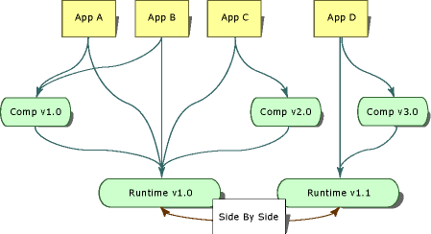
Side-by-side execution
Ability to run multiple versions of an application or component on the same computer.
32

Slide 33
Versioning
Each assembly has a version number as part of its identity. The version number is stored in the assembly manifest along with other identity information like relationships and identities of other assemblies connected with the application.
<major version>.<minor version>.<build number>.<revision>
1.21.123.1
33

Slide 34

Metadata in the Assemblies
Metadata in the .NET assemblies
  Data about data contained in the assembly
  Generated by the .NET languages compiler
  Describes all classes, their class members, versions, resources, etc.
34
Notes:
Metadata
Information about program structure is language-agnostic, so that it can be referenced between languages and tools, making it easy to work with code written in a language you are not using.
.NET metadata, in the Microsoft .NET framework, refers to code that describes .NET CIL (Common Intermediate Language) code. A .NET language compiler will generate the metadata and store this in the assembly containing the CIL. Metadata describes all classes and class members that are defined in the assembly, and the classes and class members that the current assembly will call from another assembly. The metadata for a method contains the complete description of the method, including the class (and the assembly that contains the class), the return type and all of the method parameters. When the CLR executes CIL it will check to make sure that the metadata of the called method is the same as the metadata that is stored in the calling method. This ensures that a method can only be called with exactly the right number of parameters and exactly the right parameter types.

Slide 35

Metadata in Assemblies
Type Description
Classes, interfaces, inner types, base classes, implemented interfaces, member fields, properties, methods, method parameters, return value,
attributes, etc.
Assembly Description
Name
Version
Localization
[digital
signature]
Dependencies on other assemblies
Security permissions
Exported types
35

Slide 36
Global Assembly Cache
Assemblies can be either private or shared.
By default, assemblies are private, and types contained within those assemblies are only available to applications in the same directory as the assembly.
But every computer with the .NET Framework installed also has a global assembly cache (GAC) containing assemblies that are designed to be shared by multiple applications.
36
Notes:
Metadata
Information about program structure is language-agnostic, so that it can be referenced between languages and tools, making it easy to work with code written in a language you are not using.
.NET metadata, in the Microsoft .NET framework, refers to code that describes .NET CIL (Common Intermediate Language) code. A .NET language compiler will generate the metadata and store this in the assembly containing the CIL. Metadata describes all classes and class members that are defined in the assembly, and the classes and class members that the current assembly will call from another assembly. The metadata for a method contains the complete description of the method, including the class (and the assembly that contains the class), the return type and all of the method parameters. When the CLR executes CIL it will check to make sure that the metadata of the called method is the same as the metadata that is stored in the calling method. This ensures that a method can only be called with exactly the right number of parameters and exactly the right parameter types.

Slide 37
.NET Applications
Configurable executable .NET units
Consist of one or more assemblies
Installed by "copy / paste"
  No complex registration of components
Different applications use different versions of common assemblies
  No conflicts due to their "strong name"
Easy installation, un-installation and update
37

Slide 38

Common Language Infrastructure
CLI
How .NET Supports Multiple Languages?

Slide 39
Common Language Infrastructure
Common Language Infrastructure (CLI)
  Open specification developed by Microsoft (ECMA – 335)
  Multiple high-level languages run on different platforms without changes in the source code or pre-compilation
  Standardized part of CLR
  .NET Framework is CLI implementation for Windows
  Mono is CLI implementation for Linux
39
Notes:
The Common Language Infrastructure (CLI) is an open specification developed by Microsoft that describes the executable code and runtime environment that form the core of the Microsoft .NET Framework. The specification defines an environment that allows multiple high-level languages to be used on different computer platforms without being rewritten for specific architectures.
To clarify, the CLI is a specification, not an implementation, and is often confused with the Common Language Runtime (CLR), which contains aspects outside the scope of the specification.

Slide 40


Common Language Infrastructure (2)
CLI describes following aspects:
  The Common Type System (CTS)
  Assemblies and metadata
  Common Language Specification (CLS)
40
Notes:
The Common Type System (CTS)
A set of types and operations that are shared by all CTS-compliant programming languages.
Metadata
Information about program structure is language-agnostic, so that it can be referenced between languages and tools, making it easy to work with code written in a language you are not using.
Common Language Specification (CLS)
A set of base rules to which any language targeting the CLI should conform in order to interoperate with other CLS-compliant languages.
Virtual Execution System (VES)
The VES loads and executes CLI-compatible programs, using the metadata to combine separately generated pieces of code at runtime.
All compatible languages compile to Common Intermediate Language (CIL), which is an intermediate language that is abstracted from the platform hardware. When the code is executed, the platform-specific VES will compile the CIL to the machine language according to the specific hardware.

Slide 41
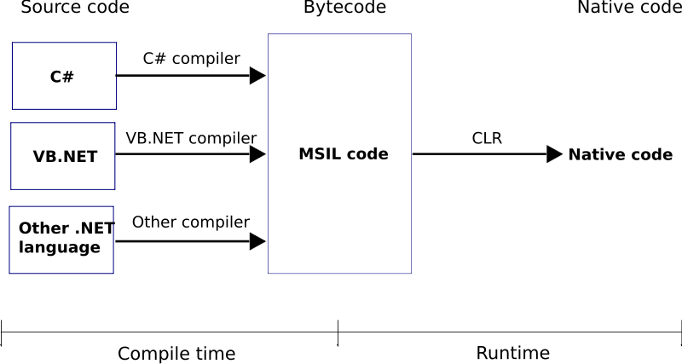
.NET Code Compilation and Execution
41

Slide 42
Common Type System (CTS)
CTS defines the CLR supported types of data and the operations over them
Ensures data level compatibility between different .NET languages
  E.g. string in C# is the same like String in VB.NET and in J#
Value types and reference types
All types derive from System.Object
42

Slide 43
Common Language Specification (CLS)
CLS is a system of rules and obligations, that all .NET languages must obey
  Ensures compatibility and ease of interaction between .NET languages
Example: CLS enforces all .NET languages to be object-oriented
When using non-CLS-compliant programming techniques you lose compatibility with the other .NET languages
43

Slide 44

The .NET Languages
C#
VB.NET
Managed C++
F#
J#
C#, VB.NET, C++, J#, F#, etc.

Slide 45
.NET Languages
.NET languages by Microsoft
  C#, VB.NET, Managed C++, J#, F#, JScript
.NET languages by third parties
  Object Pascal, Perl, Python, Ruby, COBOL, Haskell, Oberon, Scheme, Smalltalk…
Different languages can be mixed in a single application
Cross-language inheritance of types and exception handling
45

Slide 46
C# Language
C# is mixture between C++, Java and Delphi
  Fully object-oriented by design
In C# all data types are objects
  Example: 5.ToString() is a valid call
46

Slide 47

C# Language – Example
Example of C# program:
using System;
class NumbersFrom1to100
{
static void Main()
{
for (int i=1; i<=100; i++)
{
Console.WriteLine(i);
}
}
}
47

Slide 48

Visual Studio IDE
Powerful Development Environment for .NET

Slide 49

Visual Studio
Visual Studio is powerful Integrated Development Environment (IDE) for .NET Developers
  Create, edit, compile and run .NET applications
  Different languages – C#, C++, VB.NET, J#, …
  Flexible code editor
  Powerful debugger
  Integrated with SQL Server and IIS
  Strong support of Web services, WCF and WWF
49

Slide 50
Visual Studio (2)
Visual programming
  Component-oriented, event based
Helpful wizards and editors
  Windows Forms Designer
  WPF / Silverlight Designer
  ASP.NET Web Forms Designer
  ADO.NET / LINQ-to-SQL / XML Data Designer
Many third party extensions
50

Slide 51
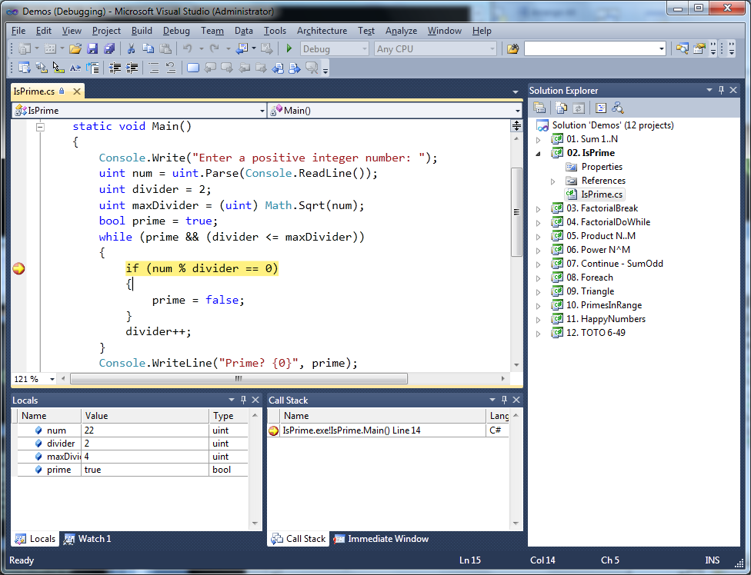
Visual Studio IDE
51

Slide 52
.NET Framework Overview
?
?
?
?
?
Questions?
?
?
?
?
?

Slide 53
Note – Shared Assembly
Create Key File
  sn -k “C:\[Path]\[Name].snk”
Associate key file with assembly
  <Assembly: AssemblyKeyFile (“C:\[Path]\[Name].snk”)>
Put assembly file in GAC
  gacutil -I "C:\[PathToBinDirectoryInVSProject]\ [Name].dll"
53

