Slide 1
Migrating to ASP.NET Core
Challenges & Opportunities
Dino Esposito

Slide 2
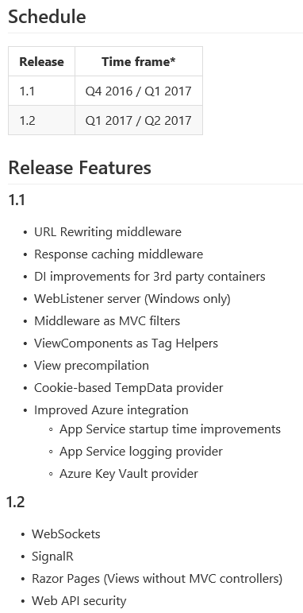
#NoEstimates
#LongWayToTipperary
#WorkInProgress
#PlansSubjectToChange
See You in H2 2017
(and that will be at most v2.0)

Slide 3
.NET Core and friends
is more crucial for Microsoft than the rest of us
(but it’s still a relevant update)

Slide 4
It’s a relevant update …
FOR EVERYBODY?

Slide 5
Migration?
Challenges
Opportunities
MVC only
C# only
New API
New hosting model
No IIS-centrism
New .NET FX
X-platform
Improved API
Same MVC paradigm
YOU DECIDE.

Slide 6
What We Have Now…

Slide 7
.NET Framework
CURRENT
ASP.NET
Web Forms
MVC
Web API
INTEGRATED PIPELINE
system.web
AD HOC
OWIN
IIS

Slide 8
FUTURE
.NET Framework
ASP.NET
MVC
OWIN
INTEGRATION
WEB SERVER

Slide 9
Changes
Tight coupling between ASP.NET and IIS
  Presented as a big win only a few years ago
Platform dependence
  Windows only
System.web is legacy code
  Devised back in 1997

Slide 10
When they took SYSTEM.WEB apart …

Slide 11
From EMPTY to FUNCTIONAL in Visual Studio 2015

Slide 12
ASP.NET CORE has a nice programming interface and an interesting set of new programming features.

Slide 13
Would be the perfect vN+1

Slide 14
It’s a complete change of platform and to some extent also tools and habits

Slide 15
Migration Facts
Find out who moved the cheese
  ASP.NET CORE has a high cost of setup
  Costs tend to zero over time
Find out why they moved the cheese
  Some good reasons
  Some "other" reasons

Slide 16
Good Reasons
New runtime environment
  Unification of ASP.NET and WebAPI pipelines
  Old system.web dropped
  Memory footprint
All web app services decoupled to interfaces
  Authentication
  Static files management
  Exception handling and logging

Slide 17
Microsoft’s Motivation
Taking more people to the cloud
Loyal customers moved already to Azure or are likely to do it
What about other perspective customers?
  Oh yes, they’re using Mac computers and Linux …

Slide 18
DECISION POINT
You and IIS
Having problems with IIS?
  Looking for Apache Server?
Some node.js nostalgia?
  Wishing to call yourself a "geek" again?
cmd.exe
C:\> _

Slide 19
DECISION POINT
You and ASP.NET
Having problems with Web Forms?
  Looked into ASP.NET MVC and/or plain SPAs?
Having problems with ASP.NET MVC?
  Looked into Web Forms and/or plain SPAs?
Sure it’s not your code that sucks?

Slide 20
There’s not much left that can be added to ASP.NET
Battle-tested, well-known and stable
Room for small improvements
  Razor
  DI
  Azure integration
  Pipeline customization

Slide 21
What if you’re planning a complete rewrite?

Slide 22
What’s different?
Configuration, startup, pipeline
  Free IoC though ☺
  Full rewrite of HTTP modules (including tools)
New ways of doing old things
  Core authentication (except Identity)
  Embedded resources
  Project management
Development experience
  Test, build, deploy, manage dependencies

Slide 23
ASP.NET MVC
No support for Web Forms
Migrating code is overall doable
Switching to ASP.NET Core mindset is easy
  Aside a few new APIs to learn, it’s all the same
  Plus minor features in Razor

Slide 24
The underlying .NET
.NET Framework
  As above
.NET Core (x-platform)
  EF Core
  No SignalR
  No 3rd party frameworks (if not ported)
  Subset of the .NET Framework (and no VB)

Slide 25
Plan moving to ASP.NET Core especially if you’re experiencing any of the following:
  Issues with IIS and system.web
  Issues with the app on the cloud
  Performance issues in the core runtime
  … or see a business opportunity in x-plat hosting

Slide 26

Inevitably the future. But nobody knows when the future will be.

