Slide 1
.NET MAUI
Roman Jašek
Software Architect @ Riganti s.r.o. | Microsoft MVP
roman.jasek@riganti.cz

Slide 2








.NET Multi-platform App UI
.NET 6
Cross-platform, native UI
Single project system, single codebase
Deploy to multiple devices, mobile & desktop
.NET MAUI
Android
iOS
macOS
Windows
Notes:
Next I want to talk about .NET MAUI.
.NET MAUI is the evolution of Xamarin.Forms designed to help you deliver high-performance, cross-platform, native desktop & mobile apps all from a single codebase.
.NET MAUI under the hood uses technologies out there today for building native apps on Windows with WinUI, Mac Catalyst for macOS, and of course, iOS and Android. .NET MAUI abstracts all those frameworks into a single framework built on .NET 6.
.NET MAUI on Windows supports WinUI allowing these apps to use all the newest native features on supported versions of Windows 10.
That means you can build all these apps for any device from a single codebase and project system. Instead of learning different stacks and languages for each, you can use one language, one set of libraries, and one UI stack for all of them.
It will release early spring next year. You can watch the progress and help contribute on GitHub in the /dotnet/maui repo.

Slide 3
How It Works - Structure
Platform specific frameworks
  .NET for Android
  .NET for iOS
  .NET for MacOS
  Windows UI (WinUI) library
Common BCL - .NET 6
.NET Runtimes
  Mono – Android, iOS, MacOS
  WinRT/Win32 – Windows

Slide 4
How It Works - UI
Platform specific UI
  Different platforms - different ways of defining UI
  Can be defined separately using platform specific APIs
  .NET for Android, .NET for iOS, .NET for MacOs, WinUI
Common UI
  Single framework for defining UI – mobile & desktop
  XAML

Slide 5
How It Works - Android
C# compiles to intermediate language (IL)
IL + JIT in app
IL
+
JIT
.NET
JIT
.AAB
C#
Bindings
Runs
natively
Notes:
AAB – Android App Bundle

Slide 6
How it Works - iOS
Fully ahead-of-time (AOT) compiled to native ARM binary
ARM
BINARY
.NET
AOT
.IPA
C#
Bindings
Runs
natively

Slide 7
How It Works – MacOS & Windows
MacOS
  Using Mac Catalyst
    Apple’s solution to bring iOS Apps to desktop
    Provides access to Mac OS APIs
Windows
  WinUI 3 library
  Native apps and UWP

Slide 8
How It Works – Application Startup
.NET Generic Host – DI, logging, configuration…
Static MauiProgram class
  Create builder, register dependencies..
  Create a MauiApp instance
App class
  Derives from Application
  Initializes application, sets initial page
Separate startup points for each platform (Platforms folder)
  MainApplication.cs (Android), Program.cs (iOS)
  App.xaml.cs (Windows), Program.cs (Mac Os)

Slide 9
How .NET MAUI Works
Application Code
.NET MAUI
.NET for Android
.NET for iOS
.NET for Mac
WinUI 3
.NET BCL
Mono Runtime
Win32/WinRT
Android
iOS
macOS
Windows

Slide 10
.NET MAUI
Collection of Controls
Layout engine for pages
Navigation – pages, drawers
Customizable handlers – enable platform specific controls
APIs for native device features – GPS, accelerometer…
Graphics library for 2D drawing code
Single project, multi-targeting system
.NET hot reload

Slide 11
.NET MAUI Essentials
Extension library, continuation of Xamarin Essentials
Cross-platform APIs for native device features
Included directly in MAUI, no need for extra Nuget packages

Slide 12
.NET MAUI Essentials
Accelerometer | App Actions | App Information
App Theme | Barometer | Battery
Clipboard | Color Converters | Compass
Connectivity | Contacts | Detect Shake
Display Info | Device Info | Email
File Picker | File System Helpers | Flashlight
Geocoding | Geolocation | Gyroscope
Haptic Feedback | Launcher | Magnetometer
MainThread | Maps | Media Picker
Open Browser | Orientation Sensor | Permissions
Phone Dialer | Platform Extensions | Preferences
Screenshot | Secure Storage | Share
SMS | Text-to-Speech | Unit Converters
Version Tracking | Vibrate | Web Authenticator

Slide 13
Project structure
One project for all platforms
Shared code & resources (fonts, images, icons, splash screens…)
Platforms folder:
  Android – system colors, manifest
  iOS – launch screen, Info.plist
  Windows – package manifest, app manifest
  Mac OS – Info.plist
  Each platform
    Application startup point
    Custom handlers for application specific controls

Slide 14




Platforms
Official support
*
Community
* Tizen .NET supported by Samsung

Slide 15
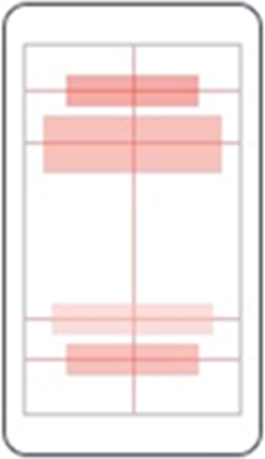

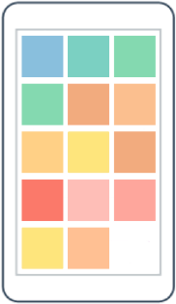
Layouts – multiple components
AbsoluteLayout
RelativeLayout
FlexLayout

Slide 16
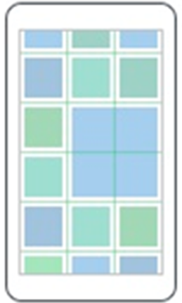

Layouts – multiple components
Grid
StackLayout

Slide 17
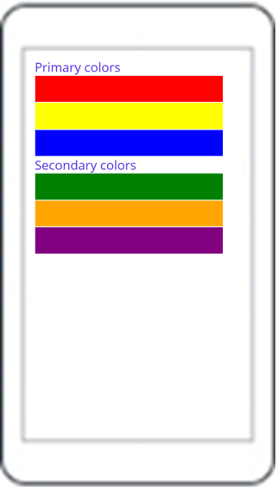
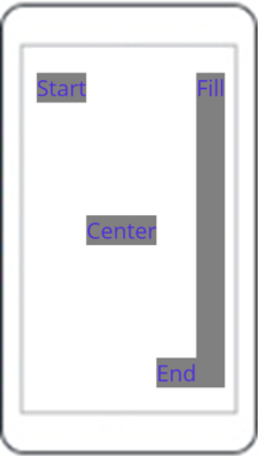
Layouts – StackLayout
StackLayout
VerticalStackLayout
HorizontalStackLayout

Slide 18
StackLayout…
HorizontalLayout, VerticalLayout
  Individual layouts for single direction
  Separate LayoutManagers with Measure methods
  Recommended
StackLayout
  Wraps HorizontalStackLayout and VerticalStackLayout
  Has Orientation
  Useful for adaptive layouts

Slide 19
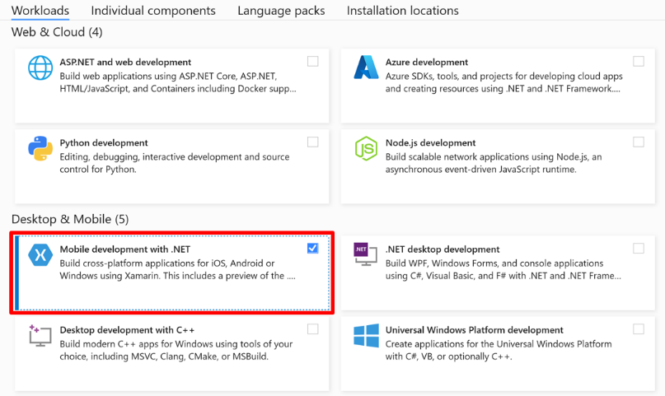
Installation
VS - install “Mobile development with .NET” workload in VS
CLI
  dotnet workload install maui

Slide 20
Demo Time!

Slide 21
Windows desktop
Win32/WinRT
WinUI 3
OnPlatform
OnIdiom
Separate views
Access to native stuff – yeah, I guess?

Slide 22
.NET MAUI Blazor
Use Blazor in applications
Razor, standard Blazor code
Hosted in WebView
Runs natively
  No SignalR, no WebAssembly
  Access to system APIs (file access, network access…)
But why?
  Blazor/web developer using razor – develop mobile applications
  Use Blazor components in any .NET applications (MAUI, WPF, UWP…)
  The cross-platform UI stuff is already solved – it’s in a browser!

Slide 23
MAUI vs. Xamarin
.NET 6, C# 10
Single project
  Unified working with images, fonts, splash screen and other resources
  Custom Renderers -> Handlers
IoC/DI
Unified working with WinRT
Official support for Mac OS
MAUI Blazor
Support for MVU pattern
New Project property pages

Slide 24
From Xamarin to MAUI
Current solution - manual process
  Create new project
  Copy code files
  Bulk rename Xamarin namespaces to MAUI namespaces
  Update dependencies to target .NET 6 and MAUI
Expected solution - .NET upgrade assistant
  Automatically migrate to single project and swap namespaces
  Update dependencies (manual)
  Register compatibility services or renderers (manual)
Community Toolkit solution
  MauiCompat steps https://github.com/xamarin/XamarinCommunityToolkit/blob/main/MauiCompatSteps.md
  MauiCompat.sh https://github.com/xamarin/XamarinCommunityToolkit/blob/main/MauiCompat.sh

Slide 25
Application Startup
Starting in MauiProgram.cs
Use MauiAppBuilder (similar to WebApplicationBuilder etc.)
Register dependencies – IServiceCollection
  Including Views and ViewModels
Register handlers
Configure resources (fonts etc.)
Build MauiApp instance
Register routes (if using Shell)

Slide 26
Namespaces
Xamarin.Forms -> Microsoft.Maui.*
  Microsoft.Maui.Controls, Microsoft.Maui.Graphics…
xmlns="http://xamarin.com/schemas/2014/forms"
-> xmlns="http://schemas.microsoft.com/dotnet/2021/maui"

Slide 27
XAML
Controls have the same names
Mostly the same properties
Some differences in default values
  Grid.RowSpacing, Grid.ColumnSpacing, StackLayout.Spacing…
Sometimes something doesn’t work
  ToolbarItems in Shell
  Applying default Style (without x:Key)
  …

Slide 28
Behaviors, Converters, Effects
Only change the namespace
It’s expected that Effects will be used less – use Handlers instead

Slide 29
Custom Renderers – what you need
Interface inherits from IView (i.e., ICustomEntry)
  Define required properties
Class inherits from View and implements the interface (i.e., CustomEntry)
  Properties usually as bindable properties
Handler inherits from ViewHandler (i.e., CustomEntryHandler)
  Use the interface and platform view as generic parameters
  Use PropertyMapper to use individual properties in platform view
  Override CreatePlatformView() to initialize the platform view
Register the handler in MauiAppBuilder
  use conditional compilation for individual platforms

Slide 30
Handlers – Why?
(old) ExportRenderer attribute – lead to assembly scanning in startup (slow)
(old) OnElementChanged method – confusion (OldElement, NewElement, events…)
(old) Private methods in native controls – lack of access
ViewHandler does not create a parent element
ConnectHandler() – initialize, subscribe events, etc.
DisconnectHandler() – dispose, unsubscribe events, etc.

Slide 31
Custom Renderers – Compatibility Package
You can use the existing custom renderers
Package Xamarin.CommunityToolkit.MauiCompat
Use custom renderers from Xamarin
Change the namespace
Register the individual renderers in MauiAppBuilder
builder.ConfigureMauiHandlers(handlers =>
{
handlers.AddCompatibilityRenderer(typeof(CustomEntry), typeof(CustomEntryRenderer));
});
Or use AddCompatibilityRenderers() for all renderers in an assembly

Slide 32
From Xamarin to MAUI
Application Startup
Namespaces
XAML
Behaviors
Converters
Effects
Renderers

Slide 33
Platform specific – Platfom folders
Inidividual folders for each platform
Build tasks pre-configured to use contents only for specific platforms

Slide 34
Platform specific – Filename convention
Suffixes for individual platforms
  ButtonHandler.Android.cs
  ButtonHandler.Standard.cs
  ButtonHandler.Tizen.cs
  ButtonHandler.Windows.cs
  ButtonHandler.cs
  ButtonHandler.iOS.cs
  IButtonHandler.cs
Build tasks also pre-configured

Slide 35
Platform specific – Conditional compilation
Options for use in #if directive
  ANDROID
  IOS
  MACCATALYST
  TIZEN
  WINDOWS
Can be even more specific: WINDOWS10_0_17763_0_OR_GREATER
IntelliSense should respect them (at some point)

Slide 36
Platform Specific – OnPlatform, OnIdiom
Useful in XAML
OnPlatform – specify different value for different platforms (Android, iOS, MacCatalyst, Tizen, WinUI)
OnIdiom – specify different value for different idioms (Phone, Tablet, Desktop, TV, Watch)

Slide 37
Platform Specific - DeviceInfo
In runtime, useful in code
Contains useful information about the device
  DeviceType (Physical, Virtual)
  Idiom (Phone, Tablet, Desktop, TV, Watch)
  Manufacturer
  Model
  Name (Device name)
  Platform (Android, iOS, MacCatalyst, Tizen, WinUI)
  Version (OS version)

Slide 38
What to keep in mind
When creating new content (i.e. ContentPage) – watch which template is used (Xamarin vs. MAUI templates)

Slide 39
What doesn’t work (yet)
ToolbarItems in Shell (but works in pages after shell)
Setting page background color on Windows
Local path for images behaves differently for individual platforms
Maps (.NET 7)

Slide 40
Current state
Implementation
  Basic API ready
  Working on bugs, default values, etc.
VS integration
  Project templates available
  Compilation, errors, warnings, syntax highlighting, IntelliSense
Documentation
  Installation, Getting started, Sample application, Basics...
  Release notes for Preview versions
  Areas specific to MAUI (control handlers…)
  New controls documentation added every month
  Animations, Graphics, Styles, Theming
  ...

Slide 41
What about 3rd party controls?
Syncfusion – working on it, plan for 2022
  10+ controls already supported in preview
Telerik
  20+ controls already supported in preview
DevExpress
  7 controls already supported in preview
Infragistics – part of plan for 2021/2022
…

Slide 42
Current state
Current release: GA – version 6.0.312 (23. 5. 2022)
Visual Studio Preview (17.3.0 Preview 1.1)
Next GA release – synced with .NET 7 release
Roadmap: https://github.com/dotnet/maui/wiki/Roadmap

Slide 43
Would I use .NET MAUI now?
iOS, Android
Windows
Windows & Mac OS
What about the future?

Slide 44


.NET – build anything
Desktop
Web
Cloud
Mobile
Gaming
IoT
AI

Slide 45
Application Development Overview
.NET MAUI
Blazor
Blazor + MAUI
WinForms, WPF, WinUI
Reach
Power
Site
PWA
Native App
with WebView
Native App
Web
Hybrid
Native

Slide 46
Sample Code
https://github.com/jasho/cookbook-maui

Slide 47
Q&A
Roman Jašek
Software Architect @ Riganti s.r.o. | MVP
roman.jasek@riganti.cz

