Slide 1
Segments
Introduction: slides 3-12 5 minutes – will skip some
Scheduling: slides 13 – 15 10 minutes
Benefits: slides 16-18 10 minutes
Liabilities: slides 19-20 10 minutes
Starting: slides 21, 25, 26 10 minutes
Synchron: slides 28, 31, 32 10 minutes

Slide 2
Windows and .Net Threads
Jim Fawcett
CSE681 – Software Modeling and Analysis
Fall 2017

Slide 3
Windows API
Create, style, and manage windows
Manage Files and Directories
Create and manage processes, threads, and synchronizers
Load and Unload Dynamic Link Libraries
Create and manage timers
Read and write to the registry

Slide 4
Windows Resources - MSDN
Windows System Services
Processes and Threads
Synchronization
  Using Synchronization
  Synchronization Reference
System.Threading Namespaces
  System.Threading Namespace
  Thread Class
  System.Threading.Tasks Namespace
    Task Class
    Task<TResult> Class

Slide 5
Other Threading Resources
7 ways to start a Task in .NET C#
Best Practices in Asynchronous Programming
Asynchronous Programming with Async and Await – MSDN
Event-based Asynchronous Pattern
Async in 4.5: Worth the Await

Slide 6
Windows Processes and Virtual Memory
Windows Processes are containers for:
  Threads – one primary thread at process start
  File handles
  Other windows objects
  Allocated memory
  Process Diagram
Windows uses a paged virtual memory system
  Virtual Memory Diagram

Slide 7
Windows Objects
Windows supports internal objects and provides an API to access and manage them through handles.
Kernel Objects – named, secured, system-wide
  Devices, Files, Symbolic links, Registry keys, Threads and Processes, Events, Mutexes, Semiphores, Memory-mapped files, Callbacks, pipes
User Objects – GUI objects
  Window, Menu, Icon, Hook, …
GDI Objects – Drawing objects
  Brush, Pen, DeviceContext, Bitmap, Metafile, …

Slide 8
Windows Objects and Handles
A windows object is a data structure that represents a system resource, e.g., file, thread, bitmap
  Windows objects are created and accessed using the Win32 API
  They reside in Kernel32.dll, User32.dll, or GDI32.dll
An application accesses those resources through a handle, usually returned from a Create function
Each handle refers to an entry in an internal object table that contains the address of a resource and means to identify the resource type.

Slide 9
Object API
The Windows API provides functions which:
  Create an object, returning a handle
  Get an object handle using other information
  Get and set information about an object
  Close the object handle, possibly destroying the internal object
    Objects are reference counted and will be destroyed when all referring handles have been closed
  Kernel objects have security functions that manage ACLs

Slide 10
Kernel Objects
Kernel objects are operating system resources like processes, threads, events, mutexes, semaphores, shared memory, and files
Kernel objects have security attributes and signaled state.
  A kernel object is always either signaled or unsignaled.
  An object in the unsignaled state will cause any thread that waits on the object’s handle to block.
  An object in the signaled state will not block a thread that called wait on its handle.

Slide 11
Threads
A thread is a path of execution through a program’s code, plus a set of resources (stack, register state, etc) assigned by the operating system.
A thread lives in one and only one process. A process may have one or more threads.
Each thread in the process has its own call stack, but shares process code and global data with other threads in the process.
  Thus local data is unique to each thread
Pointers are process specific, so threads can share pointers.

Slide 12
Starting a Process
Every time a process starts windows creates a primary thread.
  The thread begins execution with the application’s startup code that initializes libraries and enters main
  The process continues until main exits and library code calls ExitProcess.
You will find demo code for starting a Windows process here:
  http://www.ecs.syr.edu/faculty/fawcett/handouts/Coretechnologies/ThreadsAndSynchronization/code/ProcessDemoWin32/
Here is a demo for starting up a process using C#:
  http://www.ecs.syr.edu/faculty/fawcett/handouts/Coretechnologies/ThreadsAndSynchronization/code/ProcessDemoDotNet/

Slide 13
Scheduling Threads
Windows is a preemptive multi-tasking system. Each task is scheduled to run for some brief time period before another task is given control of a CPU core.
Unlike Unix and Linux, in Windows threads are the basic unit of scheduling. A thread can be in one of three possible states:
  Running
  Blocked or suspended, using virtually no CPU cycles, but consuming about 1 MB of memory per thread
  Ready to run, using virtually no CPU cycles

Slide 14
Scheduling Activities
A running task is stopped by the scheduler if:
  It is blocked waiting for some system event or resource
  Its time slice expires and is placed back on the queue of ready to run threads
  It is suspended by putting itself to sleep for some time, e.g., waiting on a timer
  It is suspended by some other thread
  It is suspended by Windows while the OS takes care of some critical activity
Blocked threads become ready to run when an event or resource they wait on becomes available, e.g., its handle becomes signaled
Suspended threads become ready to run when their suspend count is zero

Slide 15
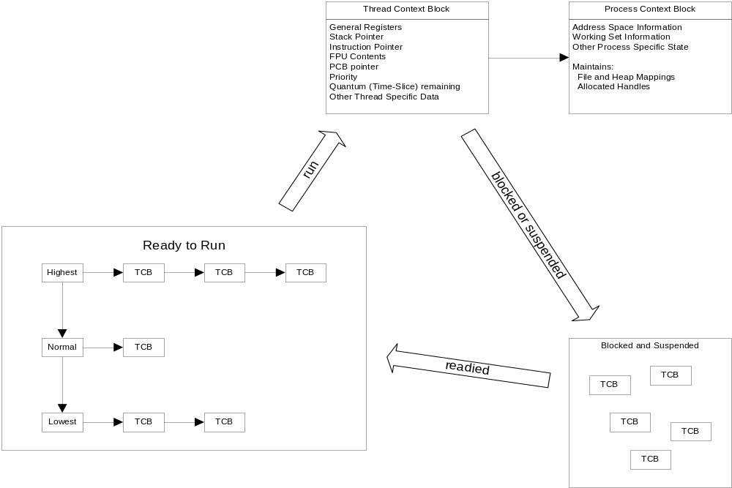
Scheduling Threads

Slide 16
Benefits of Using Threads
Keep user interfaces responsive even if required processing takes a long time to complete.
  Handle background tasks with one or more threads
  Service the user interface with a dedicated UI thread
Your program may need to respond to high priority events, so you can assign that event handler to a high priority thread.
Take advantage of multiple cores available for a computation.
Avoid low CPU activity when a thread is blocked waiting for response from a slow device or human, allowing other threads to continue.

Slide 17
More Benefits
Support access to server resources by multiple concurrent clients.
For processing with several interacting objects the program may be significantly easier to design by assigning one thread to each object.

Slide 18
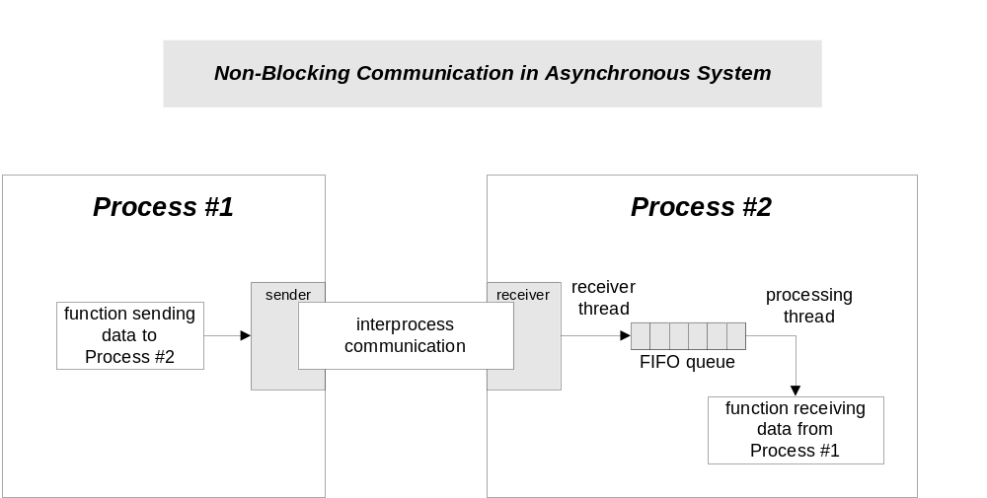
Using Threads to Avoid Blocking

Slide 19
Potential Problems with Threads
Conflicting access to shared memory
  One thread begins an operation on shared memory, is suspended and leaves the memory region incompletely transformed.
  A second thread is activated and accesses the shared memory in the incomplete state, causing errors in its operation and potentially errors in the operation of the suspended thread when it resumes.
Race conditions occur when:
  Correct operation depends on the order of completion of two or more independent activities.
  The order of completion is not deterministic due to use of threads.

Slide 20
More Problems with Threads
Starvation
  A high priority thread dominates CPU resources, preventing lower priority threads from running often enough or at all.
Priority Inversion
  A low priority task holds a resource needed by a higher priority task, blocking it from running.
Deadlock
  Two or more tasks each own resources needed by the other preventing either one from running so neither ever completes and never releases its resources.

Slide 21
UI and Worker Threads
User interface (UI) threads create windows and process messages sent to those windows.
Worker threads receive no direct input from the user.
  Worker threads must not directly access a window’s member functions. This will cause exceptions.
  Worker threads communicate with a program’s windows by calling the Win32 API PostMessage and SendMessage functions.
  With modern GUI frameworks that is handled by calling Form.Invoke or Dispatcher.Invoke passing a delegate to the UI thread bound to a function that handles the worker’s data.

Slide 22
Creating Win32 Threads
Call CreateThread(…) only if you won’t be using ANY language libraries, as these are not initialized by Win32 API functions.
HANDLE hThrd =
(HANDLE)_beginthread(ThreadFunc, 0, &ThreadInfo);
ThreadFunc – the function executed by the new thread
  void _cdecl ThreadFunc(void *pThreadInfo);
pThreadInfo – pointer to input parameters for the thread
For threads created with _beginthread the thread function, ThreadFunc, must be a global function or static member function of a class. It can not be a non-static member function.

Slide 23
Creating Win32 Threads
HANDLE hThrd = (HANDLE)_beginthreadex( // returns 0 on failure
pSecurity, stack_size, ThreadFunc, pThreadInfo, initflg, pThrd
);
SECURITY_ATTRIBUTES *pSecurity – null for user priviledges
unsigned int stack_size – size of stack to use, 0 gives default size
ThreadFunc – the function executed by the new thread
unsigned _stdcall ThreadFunc(void *pThreadInfo); // returns exit code
void *pThreadInfo – pointer to input parameter structure for use by ThreadFunc
Enum initflg – 0 to start running or CREATE_SUSPENDED to start suspended
Int32 *pThrdID – returns pointer to threadID if non-null on call, otherwise not used
For threads created with _beginthreadex the thread function, ThreadFunc, must be a global function or static member function of a class. It can not be a non-static member function.

Slide 24
Thread Priority
You use thread priority to balance processing performance between the interfaces and computations.
  If UI threads have insufficient priority the display freezes while computation proceeds.
  If UI threads have very high priority the computation may suffer.
  We will look at an example that shows this clearly.
Thread priorities take the values:
  THREAD_PRIORITY_IDLE
  THREAD_PRIORITY_LOWEST
  THREAD_PRIORITY_BELOW_NORMAL
  THREAD_PRIORITY_NORMAL
  THREAD_PRIORITY_ABOVE_NORMAL
  THREAD_PRIORITY_HIGHEST
  THREAD_PRIORITY_TIME_CRITICAL

Slide 25
Creating .Net Threads using C#
Thread t = new Thread(new ThreadStart(tProc));
t.Start()
  void tProc() is a static or non-static member function of some class.
Thread t = new Thread(new ParameterizedThreadStart(tProc))
t.Start(inputArgument)
  where void tProc(object inputArgument) is a static or non-static function of some class.

Slide 26
Thread Properties
IsBackground – get, set
  Process does not end until all Foreground threads have ended.
  Background threads are terminated when application ends.
CurrentThread – get, static
  Returns thread reference to calling thread
IsAlive – get
  Has thread started but not terminated?
Priority – get, set
  Highest, AboveNormal, Normal, BelowNormal, Lowest
ThreadState – get
  Unstarted, Running, Suspended, Stopped, WaitSleepJoin, ..

Slide 27
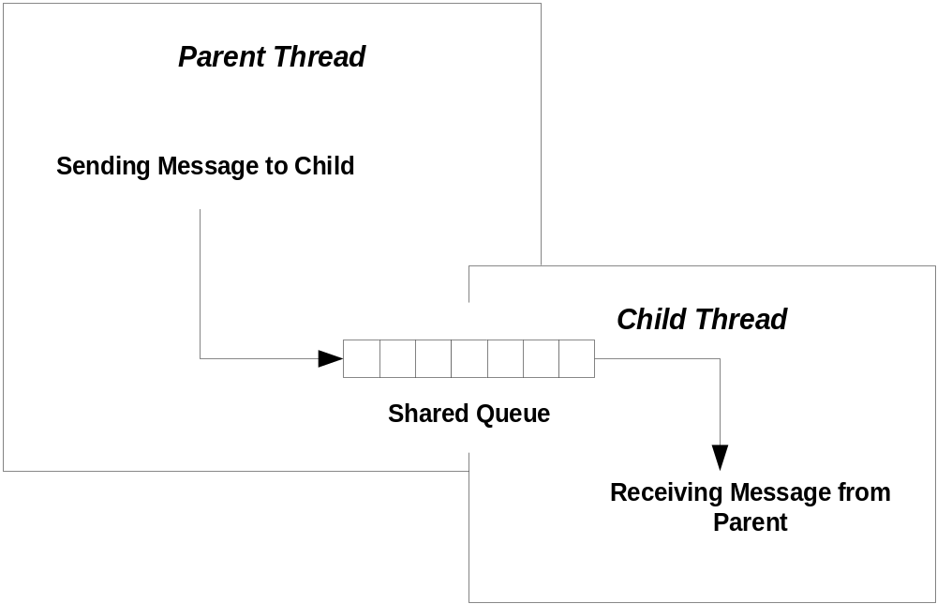
Shared Resources
A child thread often needs to communciate with its parent thread. It does this via some shared resource, like a queue.

Slide 28
Synchronization
A program may need multiple threads to share some data.
If access is not controlled to be sequential, then shared data may become corrupted.
  One thread accesses the data, begins to modify the data, and then is put to sleep because its time slice has expired. The problem arises when the data is in an incomplete state of modification.
  Another thread awakes and accesses the data, that is only partially modified. The result is very likely to be corrupt data.
The process of making access serial is called serialization or synchronization.

Slide 29
Wait for Objects
WaitForSingleObject makes one thread wait for:
  Termination of another thread
  An event
  Release of a mutex
  Syntax: WaitForSingleObject(objHandle, dwMillisec)
WaitForMultipleObjects makes one thread wait for the elements of an array of kernel objects, e.g., threads, events, mutexes.
  Syntax: WaitForMultipleObjects(nCount, lpHandles, fwait, dwMillisec)
  nCount: number of objects in array of handles
  lpHandles: array of handles to kernel objects
  fwait: TRUE => wait for all objects, FALSE => wait for first object
  dwMillisec: time to wait, can be INFINITE

Slide 30
Win32 Thread Synchronization
Synchronizing threads means that every access to data shared between threads is protected so that when any thread starts an operation on the shared data no other thread is allowed access until the first thread is done.
The principle means of synchronizing access to shared data within the Win32 API are:
  Interlocked increment
    only for incrementing or decrementing integral types
  Critical Section
    Good only inside one process
  Mutex (kernel object)
    Named mutexes can be shared by threads in different processes.
  Event (kernel object)
    Useful for synchronization as well as other event notifications.
  Semiphore (kernel object)
    Allows a specified number of threads to use a resource
  SlimReaderWriter lock
    Supports concurrent reads while making writes and reads sequential
  Condition Variable (kernel object)
    Used in conjuction with a Critical Section or Mutex to signal an event that allows one or more threads to proceed.

Slide 31
.Net Synchronization
.Net wraps most of the Win32 synchronizers:
Monitor
  Wraps a Critical Section and a Condition Variable to support both locking and notification
Lock
  Encapsulates a Monitor and try {} finally {} to ensure that the lock is released even if an exception is thrown
Mutex
  Wraps the Win32 mutex
ReaderWriterLock
  Wraps the Win32 SlimReaderWriter
Interlocked
  Wraps the Win32 Interlocked
SpinLock
  Supports low overhead short-term locks
Semaphore
  Wraps the Win32 Semaphore
WaitHandle
  Threads block by calling WaitOne on the handle. They are released by the kernel object to which the handle refers

Slide 32
Tasks and Async Await Pattern
.Net 4 introduced some new asynchronous programming constructs centered on the Task class.
Task.Run(…) runs a task defined by an Action or lambda that has no return value on a thread-pool thread.
Task<T>.Run(…) runs a task defined by a Funct<T> or lambda that returns an instance of T.
This topic is quite accessible if you look at some simple code demos:
Tasks, Threads, and Continuations
Abstract Task Model
WPF Thread Demos

Slide 33
Appendix
More details on some of the Synchronization Operations

Slide 34
Win32 Interlocked Operations
InterlockedIncrement increments a 32 bit integer as an atomic operation. It is guaranteed to complete before the incrementing thread is suspended.
long value = 5;
InterlockedIncrement(&value);
InterlockedDecrement decrements a 32 bit integer as an atomic operation:
InterlockedDecrement(&value);

Slide 35
.Net Interlocked – atomic operations
  static int count = 0;
  Interlocked.Increment(ref count);
  Interlocked.Decrement(ref count);
  Interlocked.Exchange(ref count, 1);
  Long cnt = Interlocked.Read(ref count);

Slide 36
Win32 Critical Sections
Threads within a single process can use critical sections to ensure mutually exclusive access to critical regions of code. To use a critical section you:
  allocate a critical section structure
  initialize the critical section structure by calling a win32 API function
  enter the critical section by invoking a win32 API function
  leave the critical section by invoking another win32 function.
  When one thread has entered a critical section, other threads requesting entry are suspended and queued waiting for release by the first thread.
The win32 API critical section functions are:
  CRITICAL_SECTION critsec;
  InitializeCriticalSection(&critsec);
  EnterCriticalSection(&critsec);
  TryEnterCriticalSection(&critsec);
  LeaveCriticalSection(&critsec);
  DeleteCriticalSection(&critsec);

Slide 37
.Net Lock – most commonly used
  static object synch_;
  Lock(synch_)
  {
  // use shared resource safely
  // lock is released if exception is thrown in
  // locked region
  }
  Note: synch_ must be a reference type, as shown here

Slide 38
.Net Monitor
Used for locking and signaling
  static object sync_;
  Monitor.Enter(sync_); // enters protected region
  Monitor.Exit(sync_); // leaves protected region
  Monitor.Pulse(resource); // notifies waiting thread
  Monitor.PulseAll(resource);

Slide 39
Win32 Mutexes
Mutually exclusive access to a resource can be guaranteed through the use of mutexes. To use a mutex object you:
  identify the resource (section of code, shared data, a device) being shared by two or more threads
  declare a global mutex object
  program each thread to call the mutex’s acquire operation before using the shared resource
  call the mutex’s release operation after finishing with the shared resource
The mutex functions are:
  hMutex = CreateMutex(0,FALSE,0);
  WaitForSingleObject(hMutex,INFINITE);
  WaitForMultipleObjects(count,MTXs,TRUE,INFINITE);
  ReleaseMutex(hMutex);
  CloseHandle(hMutex);

Slide 40
.Net Mutex
Used for system wide synchronization
  Mutex mutex = new Mutex(false);
  mutex.WaitOne(); // enter protected region
  mutex.ReleaseMutex(); // leave protected region
  mutex.Close(); // decrement object’s ref count

Slide 41
Win32 Events
Events are objects which threads can use to serialize access to resources by setting an event when they have access to a resource and resetting the event when through. All threads use WaitForSingleObject or WaitForMultipleObjects before attempting access to the shared resource.
Unlike mutexes and semaphores, events have no predefined semantics.
  An event object stays in the nonsignaled stated until your program sets its state to signaled, presumably because the program detected some corresponding important event.
  Auto-reset events will be automatically set back to the non-signaled state after a thread completes a wait on that event.
  After a thread completes a wait on a manual-reset event the event will return to the non-signaled state only when reset by your program.

Slide 42
Win32 Events Continued
Event functions are:
  HANDLE hEvent = CreateEvent(0,FALSE,TRUE,0);
  OpenEvent – not used too often
  SetEvent(hEvent);
  ResetEvent(hEvent);
  PulseEvent(hEvent);
  WaitForSingleObject(hEvent,INFINITE);
  WaitForMultipleObjects(count,Events,TRUE,INFINITE);

Slide 43
.Net ManualResetEvent
  static ManualResetEvent mre = new ManualResetEvent(false);
  mre.Set(); // threads will not block on WaitOne()
  mre.Reset(); // threads that call WaitOne() will block
  mre.WaitOne();
  mre.close()

Slide 44
End of Presentation

