Slide 1
1/12
FlowGuard: stop burning silicon before it exists
▸ Feasibility-aware optimization for the open-source SKY130 flow
▸ Frozen 15.8 ns boundary + 5-way shootout · winner QoR 0.103
▸ Winner layout render committed; raw GDS remains server-local — Purdue CHIPSandAI
Every figure from trials.jsonl · rerun-safe

Slide 2
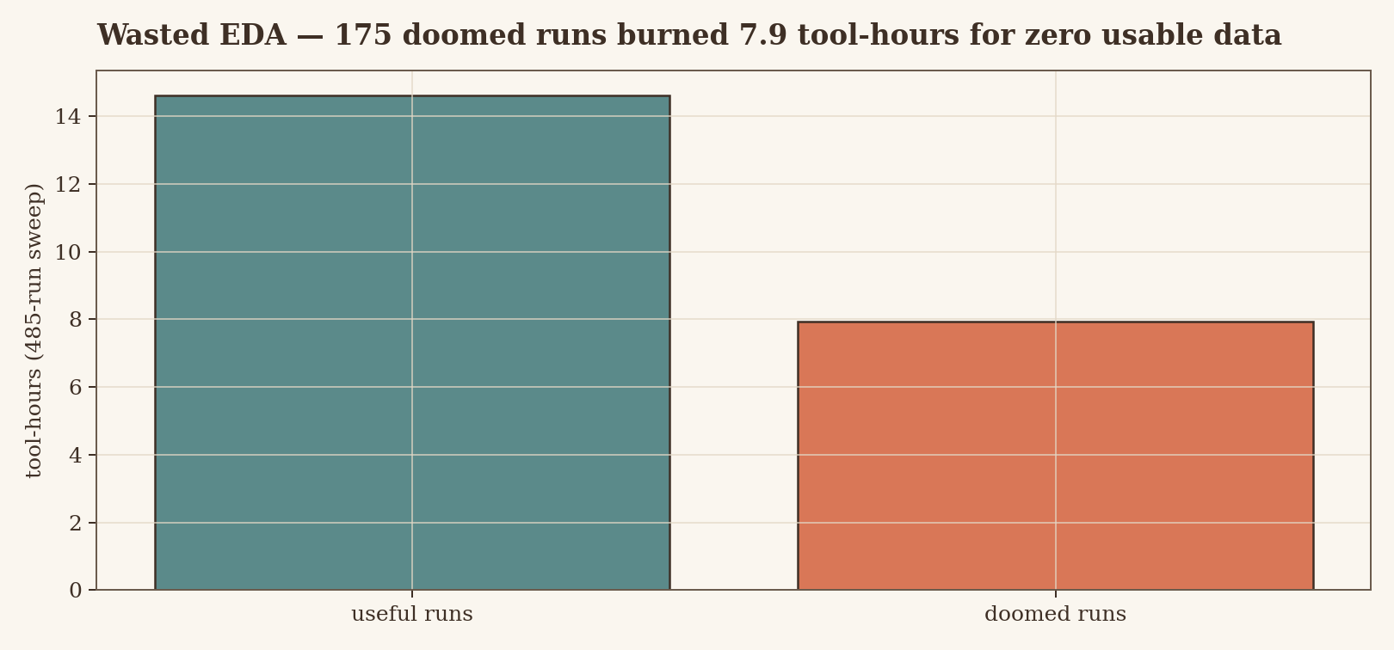
2/12
The wasted-EDA problem
▸ 175 doomed runs burned 7.93 tool-hours for zero data
▸ Failures arrive late, at signoff — after the compute is spent
▸ Blind search re-samples dead regions instead of learning them
Exhaustive sweep: 485 runs

Slide 3
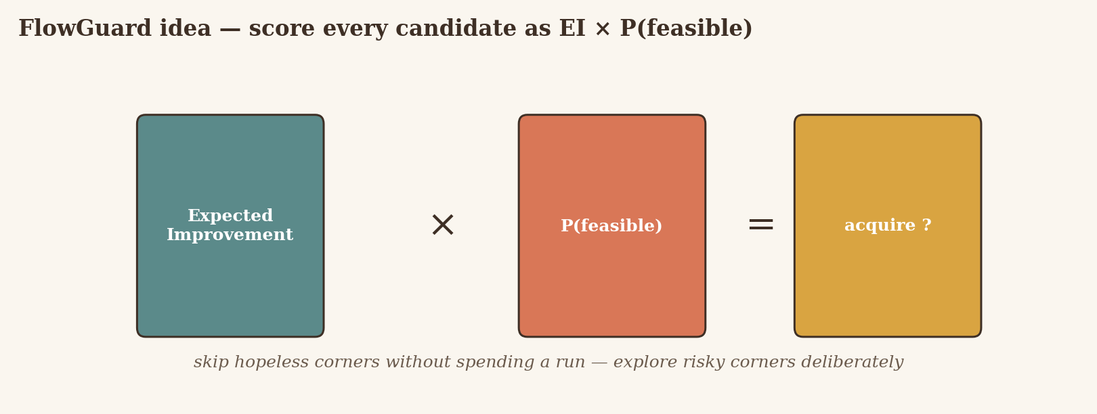
3/12
The FlowGuard idea: EI × P(feasible)
▸ Quality predictor × feasibility classifier — one score per candidate
▸ Calibration only with ≥3 obs/class, else declared uncalibrated
▸ Every pick logged: scores, seeds, hashes, model versions
No hard risk threshold · audit by replay

Slide 4
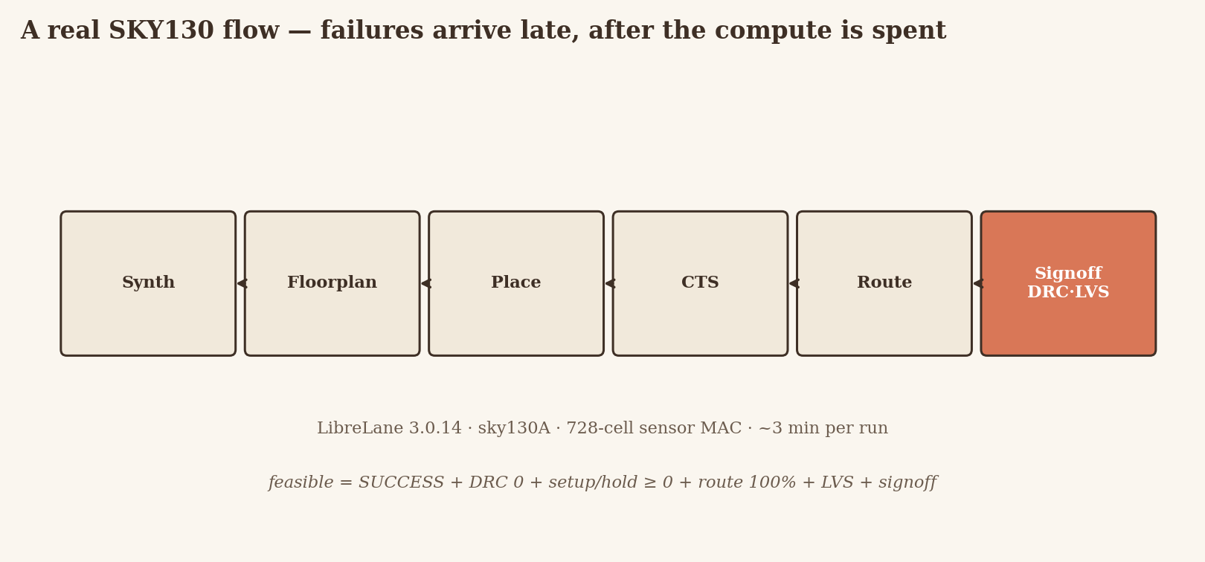
4/12
A real SKY130 flow, not a toy
▸ LibreLane 3.0.14 · sky130A · 728-cell sensor-MAC stress block
▸ Feasible = SUCCESS + DRC 0 + setup/hold ≥ 0 + route 100% + LVS + signoff
▸ 72-candidate pool · 8 shared seeds + 16 adaptive picks per method
Frozen 2026-09-16 · QoR weights 0.5 / 0.3 / 0.2

Slide 5
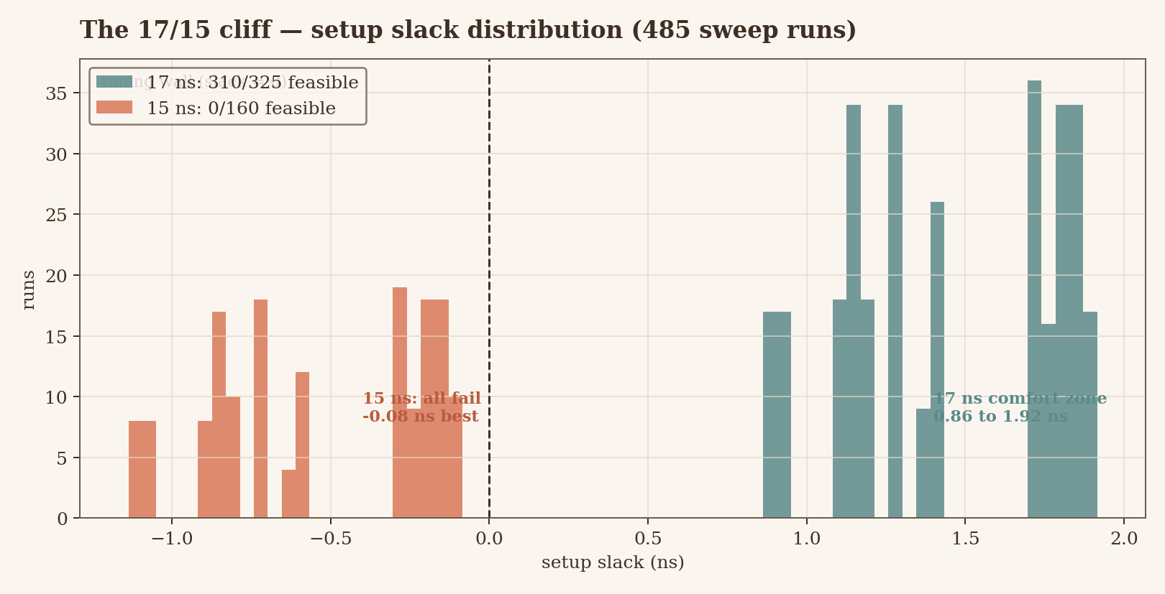
5/12
The 17/15 cliff
▸ 17 ns: 310/325 pass, slack 0.863–1.915 ns
▸ 15 ns: 0/160 pass — 159 × TIMING_FAIL
▸ No slope between regimes: hunt the boundary, don't guess it
485 sweep runs

Slide 6
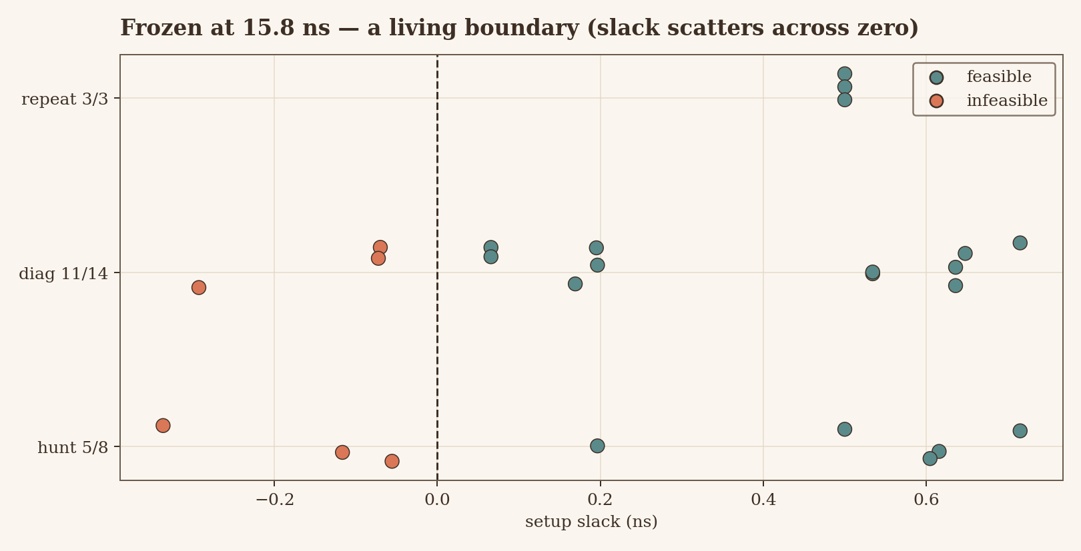
6/12
Frozen at 15.8 ns: a living boundary
▸ Hunt 5/8 · diag 11/14 · repeat 3/3 identical
▸ Slack scatters across zero (−0.34 to +0.72 ns): knobs decide
▸ 3/3 identical repeats — signal, not tool noise
Mixed boundary = learnable structure

Slide 7
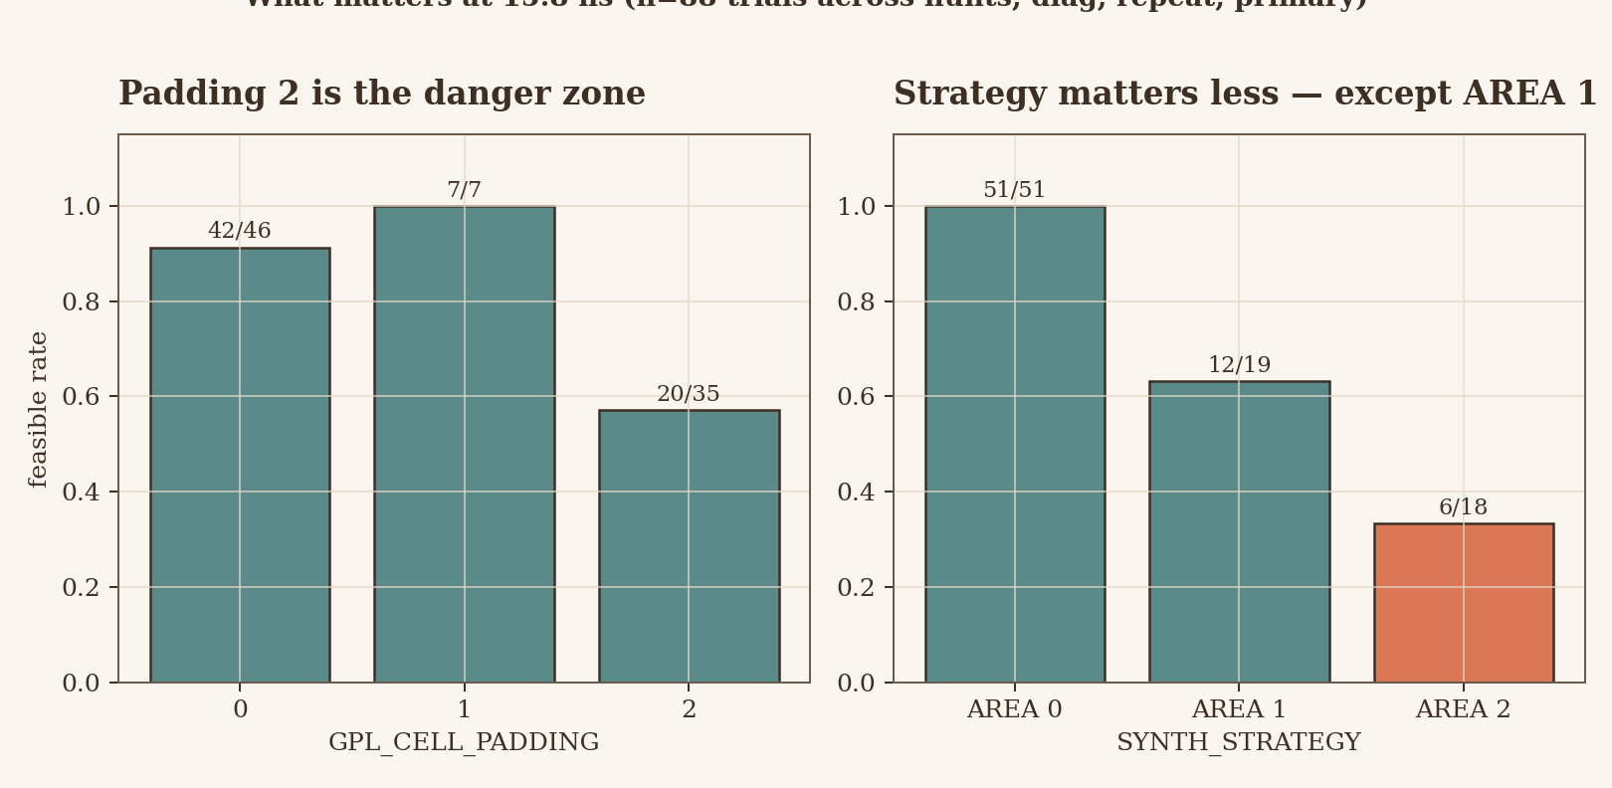
7/12
What matters: padding & strategy
▸ Padding 2 fails far more often than 0/1 at 15.8 ns
▸ AREA 1 + high padding = the diagnostic grid's only failures
▸ Low padding + AREA 0 passes consistently (n=72 @15.8 ns)
A feasibility model should beat blind search here

Slide 8
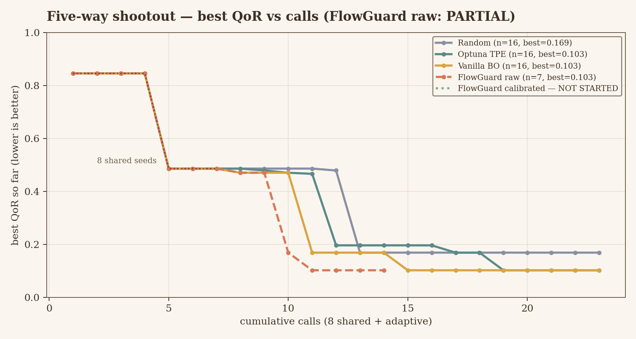
8/12
Five-way shootout: best QoR vs calls
▸ Vanilla BO & Optuna → 0.103 · FlowGuard raw → 0.103 at adaptive call 11
▸ Random trails at 0.169 · FlowGuard raw recorded (11/16 feasible)
▸ FlowGuard calibrated: NOT STARTED (gated on calibration threshold)
Shared 8 seeds + adaptive · lower is better

Slide 9
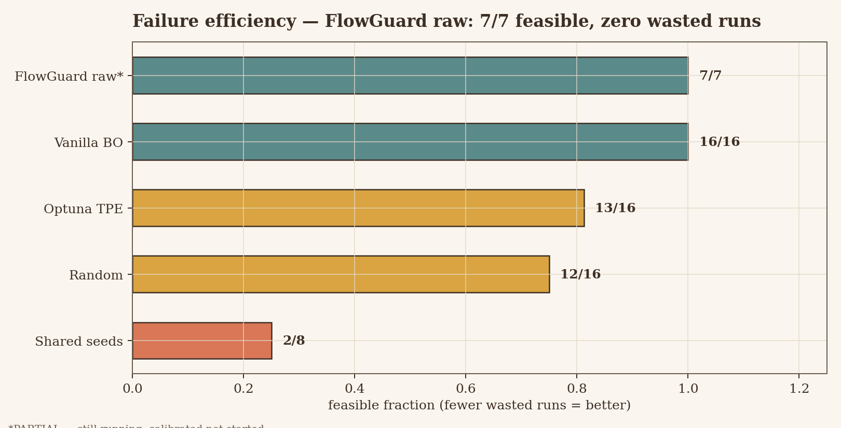
9/12
Failure efficiency
▸ Vanilla BO 16/16 · FlowGuard raw 11/16 · Optuna 13/16 · random 12/16
▸ Shared seeds only 2/8 — this does not support a fewer-failures claim
▸ Every avoided failure returns ~3 min of budget to useful search
*PARTIAL — still running; calibrated not started

Slide 10
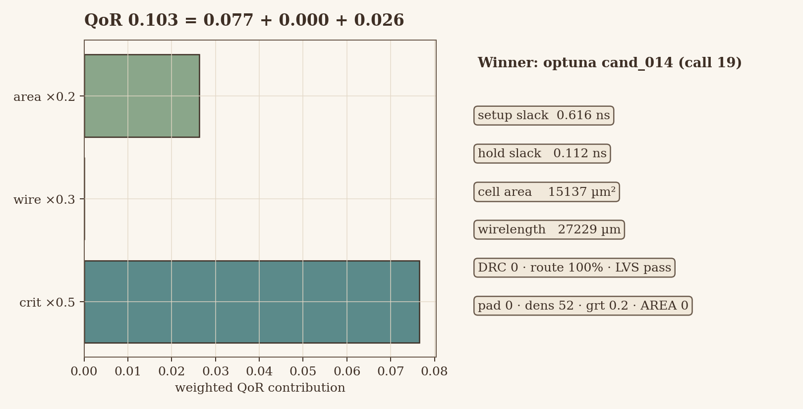
10/12
The winner + GDS hero
▸ Selected cand_014: QoR 0.103 · ws 0.6159 ns · hold 0.1122 ns
▸ 15137 µm² · 27229 µm wire · pad 0 / dens 52 / grt 0.2 / AREA 0
▸ No klayout here → metrics panel from signoff data: pitch/renders/FlowGuard-recovery__results__primary-optuna_tpe-v1__runs__trial_primary-optuna_tpe-cand_014__final__gds__tt_um_flowguard_stress.gds.png
GDS embedded as path reference

Slide 11
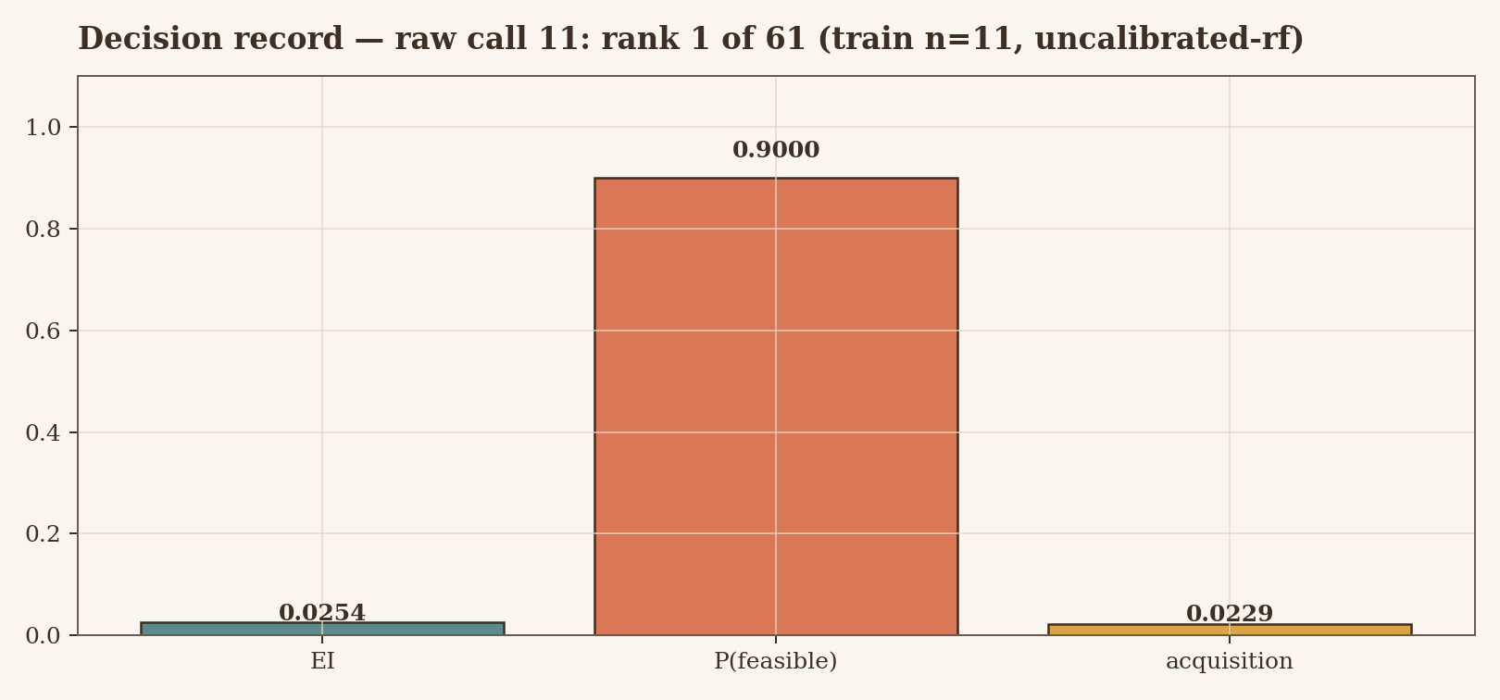
11/12
One AI decision, fully replayable
▸ Raw call 11: rank 1 of 61 · EI 0.0254 · P(feas) 0.90
▸ Seed 1340 · data 8dfeaf7d3fee… · uncalibrated-rf
▸ Same hash + versions = same pick. Lore-free optimization.
Provenance row in trials.jsonl

Slide 12
12/12
Integrity + the ask
▸ Running traces marked recorded · calibrated not started · tile assumed 2×1, unvalidated
▸ Nothing extrapolated or cherry-picked — rerun builder refreshes all numbers
▸ Ask: collaborators + compute — finish calibrated, add a 2nd design, harden provenance
Come talk: never run a doomed job again

