Slide 1
PURPOSE
Make feasibility a first-class search signal
A controlled physical-design experiment about where EDA time goes.
FlowGuard asks a practical question: when every RTL-to-GDS run costs real minutes, can a search policy spend fewer of them on configurations that were never physically viable?
EI × P(feasible)
same budget / different allocation
The claim is about failed-run compute, not a promise of better final QoR.
Scope: crossbar-v2 / fixed 19.9 ns / 36-config oracle
FLOWGUARD / 01
Notes:
Set the frame: this is a resource-allocation question. The design, flow, and evaluation budget stay fixed; only the acquisition policy changes.

Slide 2
BOUNDARY
One crossbar. Two physical outcomes.
The 19.9 ns crossbar-v2 boundary is a 36-configuration oracle, not the older stress benchmark.
Same crossbar, fixed constraints, different outcomes: six feasible configurations and thirty failures.
FEASIBLE REGION
FAILURE REGION
6 / 36 · positive checks
30 / 36 · recorded failures
candidate settings → physical result
candidate settings → physical result
19.9 ns
Authoritative crossbar-v2 oracle: 36 configs, 6 feasible, 30 failed. Older stress evidence is excluded.
FLOWGUARD / 02
Notes:
The crossbar oracle is the evidence here: 36 configurations at fixed 19.9 ns, with 6 feasible and 30 failed. Do not import older stress characterization.

Slide 3
MODEL
Quality plus feasibility, separated on purpose.
FlowGuard learns what is good only where a run is physically valid—and learns validity from every attempted trial.
QUALITY MODEL
FEASIBILITY MODEL
GP → expected improvement
RF → P(feasible)
×
trained on feasible trials only
trained on all attempted trials
acquisition = EI × P(feasible)
Production objective qor_v1: 0.5 critical delay + 0.3 wirelength + 0.2 cell area (normalized).
FLOWGUARD / 03
Notes:
The product is deliberately simple: expected improvement is discounted when the feasibility model says the physical outcome is unlikely. This is not a hard rejection rule.

Slide 4
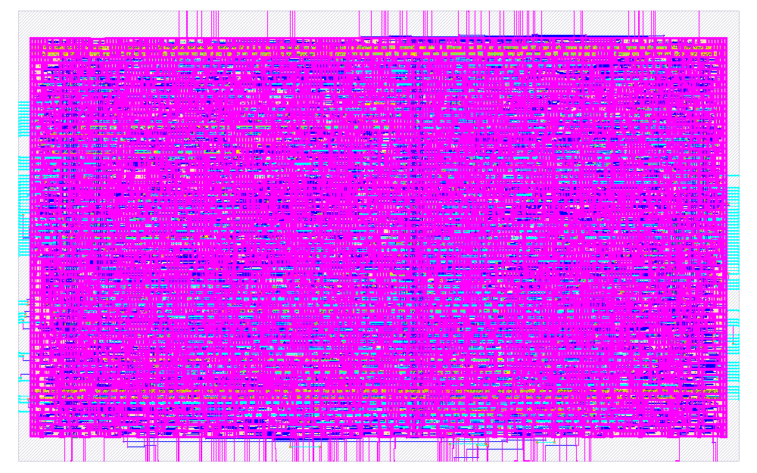
EVIDENCE
One decision. One authentic physical artifact.
Replay selects cb36_002; the layout image comes from its separate banked physical run.
FlowGuard-Calibrated · seed 11 · call 10
selected cb36_002
EI 0.0 × P(feasible) 0.08 · rank 1 / 27
feasible · QoR −0.093068 · setup +0.190903 ns
DRC 0 · routing 100 · LVS/signoff pass
cb36_002 · SHA-256 35fbbd7e…a12dc5de
separate-run artifact
Replay launched zero physical runs; PNG is from earlier trial_cb36_002. SHA-256 verified against 06_demo.json.
FLOWGUARD / 04
Notes:
Show the authentic PNG and keep provenance separate: the replay is offline and launches zero EDA processes. The image is attached by candidate ID from an earlier banked physical run, with the exact SHA recorded in 06_demo.json.

Slide 5
PROTOCOL
Freeze the comparison before interpreting it.
A matched 24-evaluation replay across 13 seeds and three methods.
Design | crossbar_datapath_v2
Clock | 19.9 ns (fixed)
Pool | 36 configurations · 6 / 30 oracle
Budget | 24 evaluations: 8 shared init + 16 adaptive
Methods | Vanilla · FlowGuard · EI-only
No replay EDA: the bundle replays committed outcomes; physical metrics are banked oracle results.
FLOWGUARD / 05
Notes:
The crossbar protocol is fixed at 19.9 ns with 36 configurations. Each method gets 24 evaluations, including the same eight shared initializations, across 13 seeds. Replay launches no EDA.

Slide 6
HEADLINE RESULT
Feasibility weighting reduced failed-run compute by 4.1%
FlowGuard versus matched EI-only search across 13 replay seeds
10.28 fewer minutes spent on failed configurations per replay, on average
−4.11%
derived: (14994.8−14378.0) / 14994.8
same final QoR and best-call outcome; total cost slightly higher
Derived from verified failed means 14994.8 s and 14378.0 s: 616.8 s = 10.28 min. Editable zero-based chart; sequential EDA-runtime estimate.
FLOWGUARD / 06
Notes:
Click the chart and show the editable data. The 10.28 minutes is (14994.8−14378.0) seconds divided by 60. The 4.11 percent is 616.8 divided by 14994.8. All methods tie final QoR; FlowGuard matches EI-only on best-call across all 13 seeds.

Slide 7
SUPPORT COMPARISON
Three methods. Vanilla spends least.
Across 13 seeds, all three tie final QoR; cost separates failed and total runtime means.
Method | Mean feasible | Failed EDA mean (s) | Total EDA mean (s) | Final QoR | Best-call
Vanilla | 6.00 | 13046.8 | 17230.7 | −0.093068 | baseline
FlowGuard | 4.38 | 14378.0 | 17307.3 | −0.093068 | = EI-only
EI-only | 3.38 | 14994.8 | 17272.8 | −0.093068 | = FlowGuard
Vanilla is lowest on both failed EDA mean and total EDA mean; final QoR ties three ways.
Means from final_evidence_bundle/03_recomputed_aggregates.json; feasible counts are seed means.
FLOWGUARD / 07
Notes:
This is the complete crossbar support table. Vanilla has the lowest failed and total EDA means, while the primary endpoint is tied. FlowGuard and EI-only reach the best call identically across all 13 seeds.

Slide 8
REPRODUCIBILITY
Reproduce the decision, not just the layout.
Crossbar replay is an oracle/cache process, not a new physical campaign.
Older TPE / layout image
FlowGuard / decision record
physical artifact ≠ decision record
seed · call · hash · scores · rank
keep separate from crossbar evidence
cb36_002 replay record is traceable
Limitations: no standalone combined-13 verification log; replay/oracle outcomes attach banked physical runs; older stress evidence is excluded.
Bundle facts: 07_FACTS.md and VALIDATION.md. Physical image provenance is explicit on slide 4.
FLOWGUARD / 08
Notes:
Separate the older TPE layout image from the FlowGuard decision record. The authoritative crossbar result is a replay/oracle process with banked physical outcomes. There is no standalone combined-13 verification log, and older stress evidence is excluded.

Slide 9
INVITATION
Reproduce the replay. Then run the hardware.
The crossbar bundle makes the decision traceable; the next step is independent physical confirmation.
Run `python3 experiments/replay_demo.py`, inspect cb36_002, then verify the banked artifact independently.
REPRODUCE
then falsify
1 freeze
2 run
3 inspect
Next test: independently reproduce the 13-seed tie and validate the separate physical artifact chain.
Command from the crossbar-v2 replay workflow; no replay EDA is launched.
FLOWGUARD / 09
Notes:
Close with the exact demo command: python3 experiments/replay_demo.py. It reproduces the trace, not a new physical run. Invite independent hardware confirmation of the separate artifact.

