Slide 1

www.slidesgo.com
Text compression
using Huffman and LZ77

Slide 2
Huffman Coding:
Huffman coding is a lossless data compression algorithm that is used to compress data files.
It assigns variable-length codes to different characters in the input file, with more frequently occurring characters having shorter codes and less frequently occurring characters having longer codes.
This results in efficient compression since the most common characters are represented by fewer bits.

Slide 3
Process
File Selection: The process begins by selecting a file for compression using a file dialog. The chosen file will be compressed using the Huffman coding algorithm.
Frequency Calculation: The algorithm reads the selected file and calculates the frequency of occurrence for each character.
It uses a dictionary (freq_lib) to store the frequencies.

Slide 4
Building the Huffman Tree:
The algorithm builds a binary heap based on the frequencies. Each node in the heap represents a character and its frequency.
The two nodes with the lowest frequencies are combined to create a new node with a cumulative frequency.
This process continues until a single tree (the Huffman tree) is formed.

Slide 5
Code generation
Generating Huffman Codes: Starting from the root of the Huffman tree, the algorithm assigns binary codes to each character. The left child represents a '1', and the right child represents a '0'.
By traversing the tree from the root to each character, a unique binary code is obtained.

Slide 6
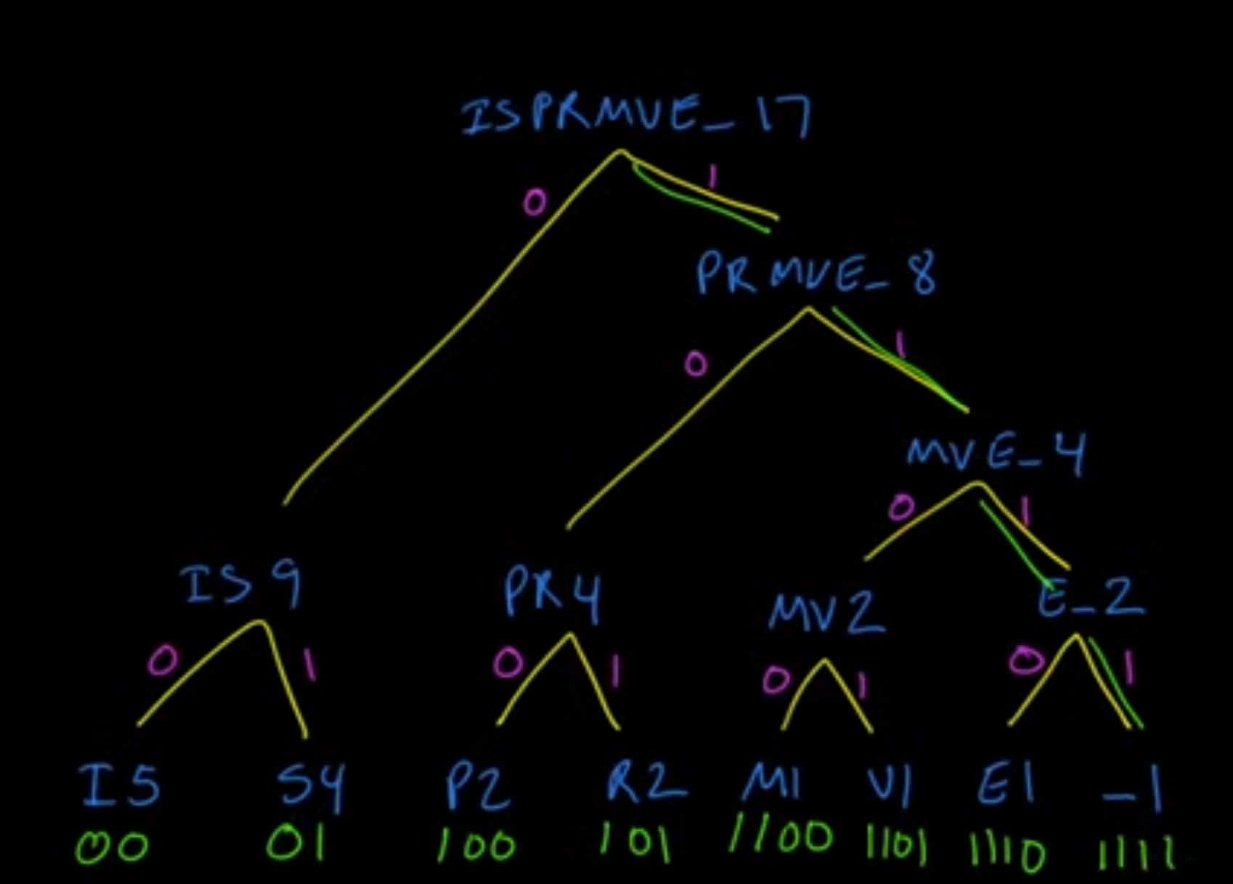
How code is made

Slide 7
Compression
Encoding the File: Using the generated Huffman codes, the algorithm reads the selected file again and replaces each character with its corresponding Huffman code. The encoded text is stored as a sequence of bits.

Slide 8
Decompression
Decoding the File: The encoded bits are decoded using the Huffman dictionary.
Starting from the root of the Huffman tree, the algorithm traverses the tree based on the bits until a character is found.
The process is repeated until the entire encoded text is decoded.

Slide 9
Lz77 Algorithm

Slide 10
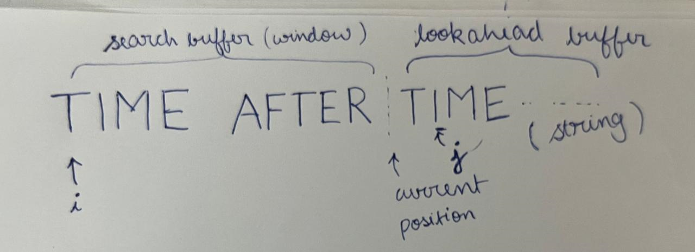
Finding the longest match
It is implemented using a function whose return values are
(i) longest match length and it’s,
(ii) distance from the current position.
This finds the longest match within the sliding window(search buffer) for the text in window starting from the current position.
Each iteration of the outer loop selects a substring of increasing length from the current position from lookahead buffer.
Each iteration of the inner loop compares the selected substring with a substring from the sliding window.
The goal is to find longest match for sequence of lookahead buffer in the search buffer / window.

Slide 11
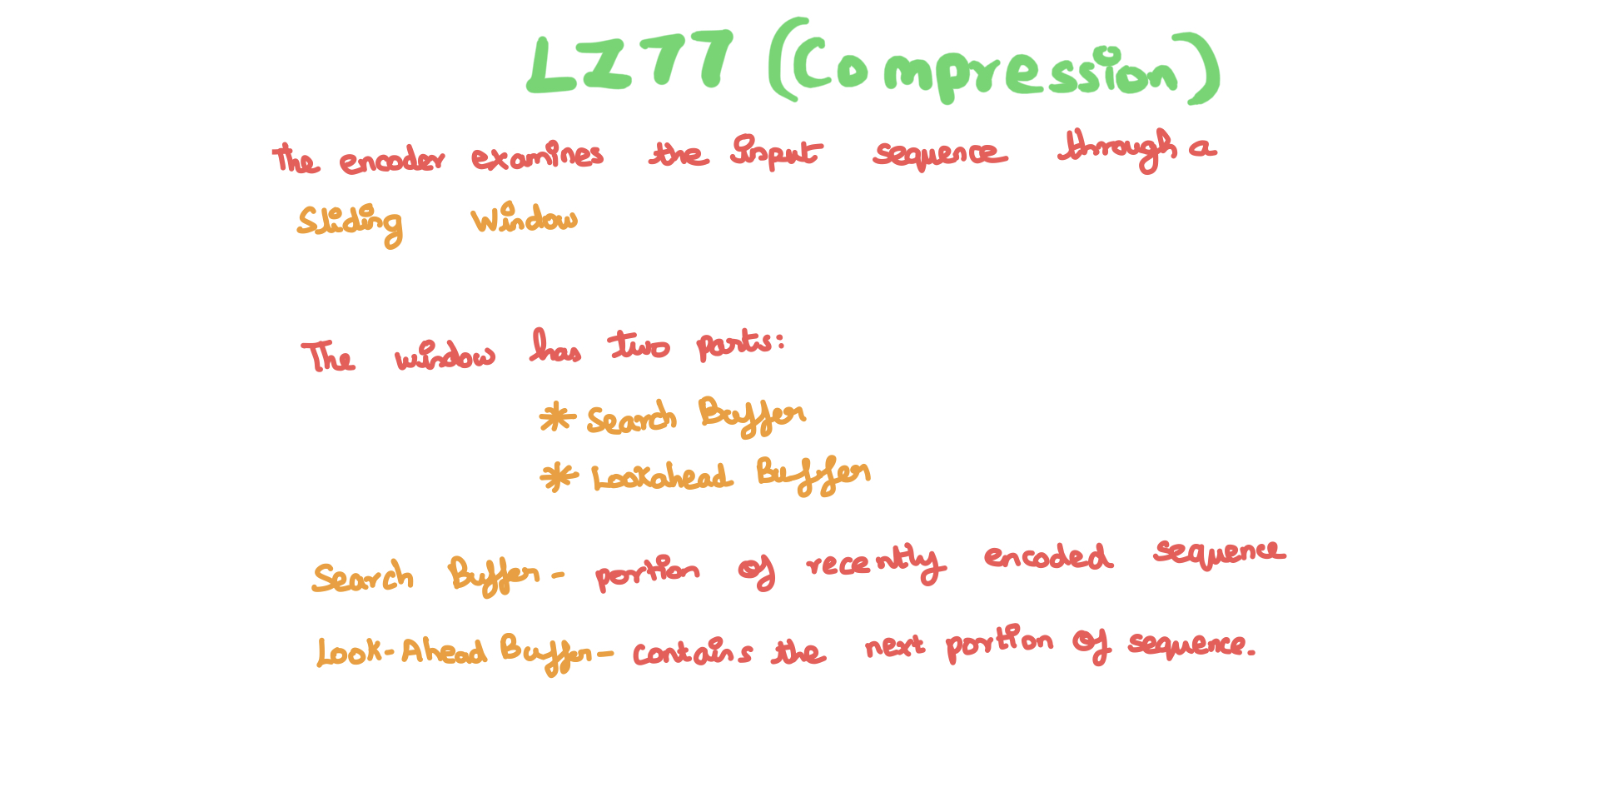
LZ77 Compression

Slide 12
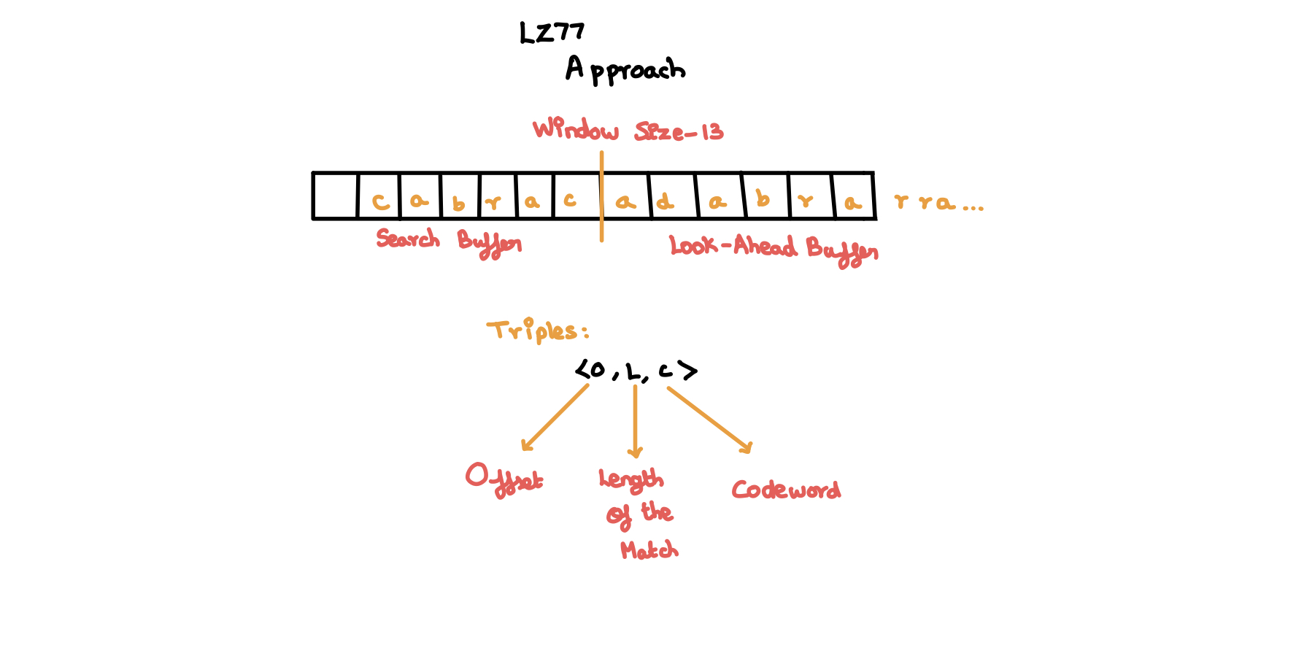

Slide 13
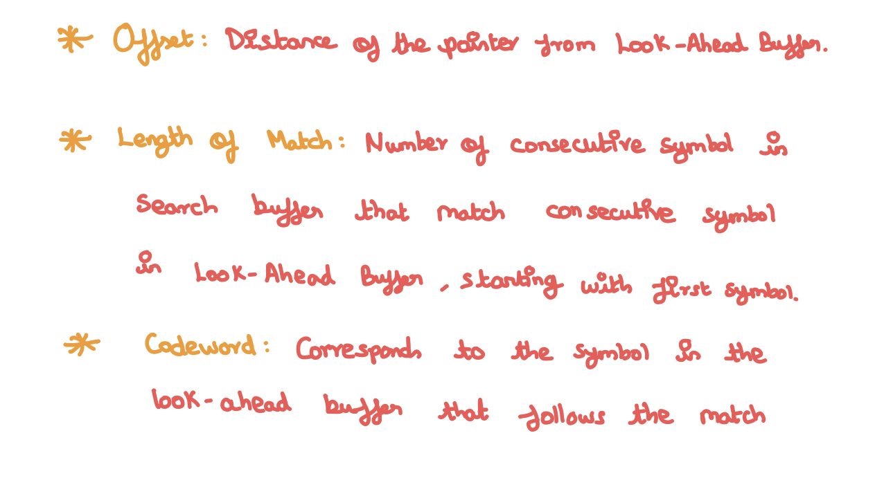

Slide 14
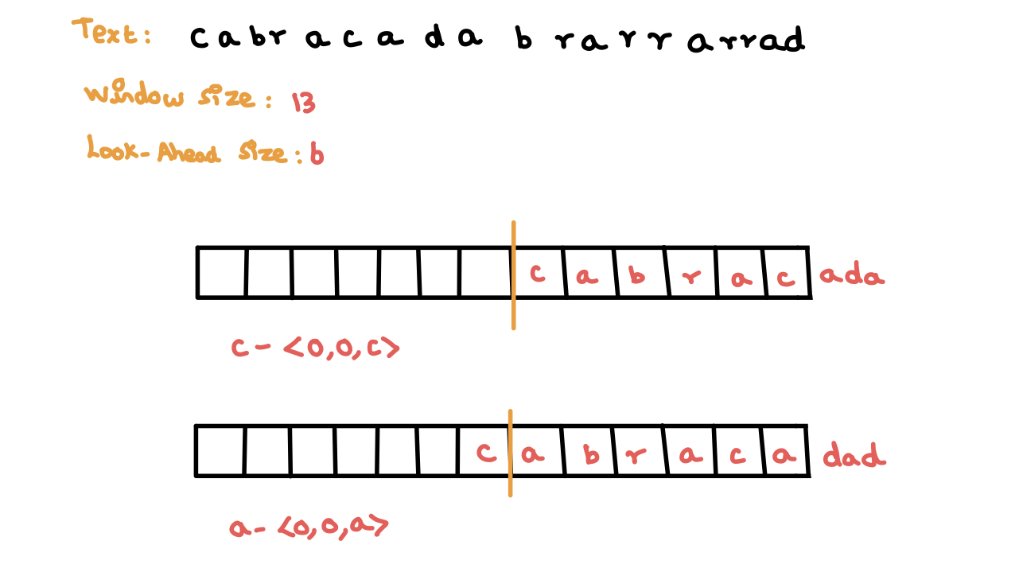

Slide 15
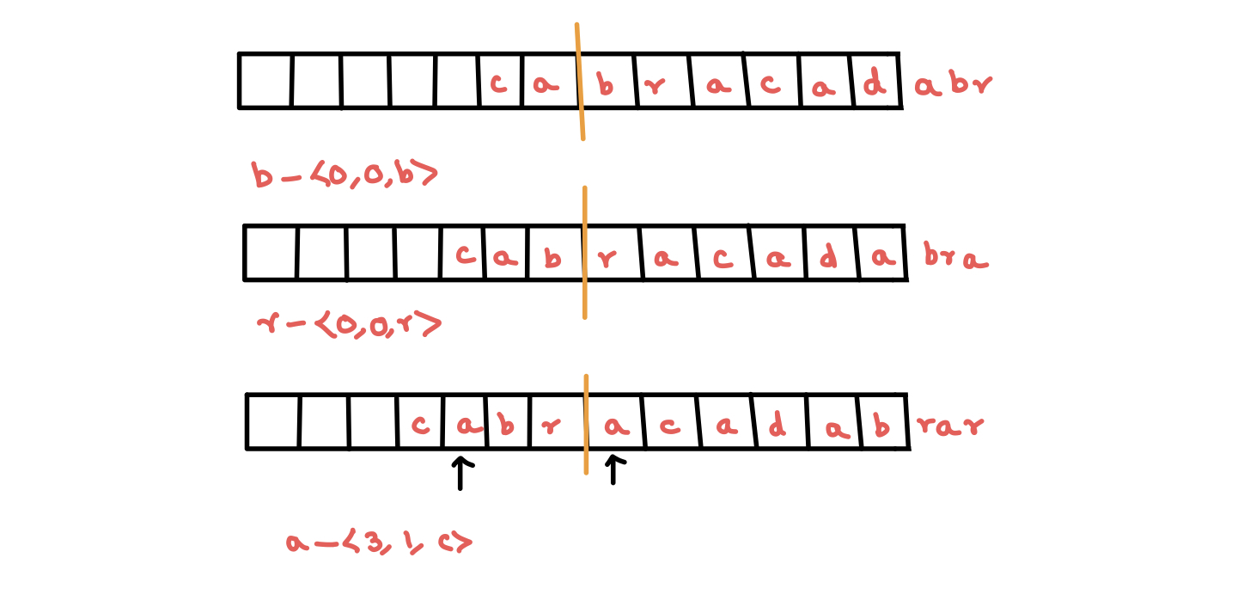

Slide 16
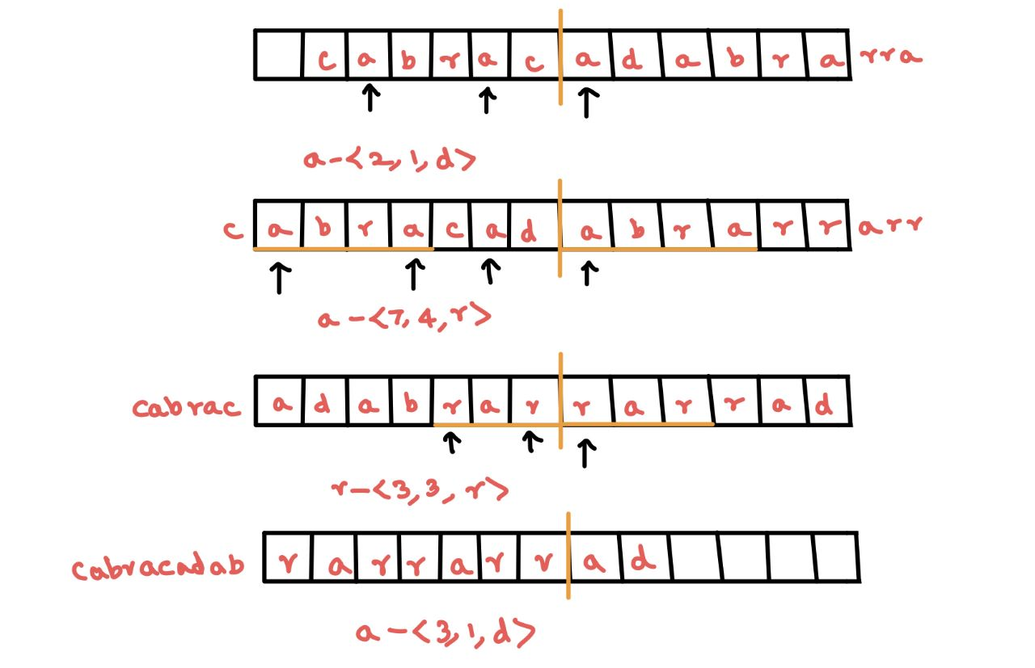

Slide 17
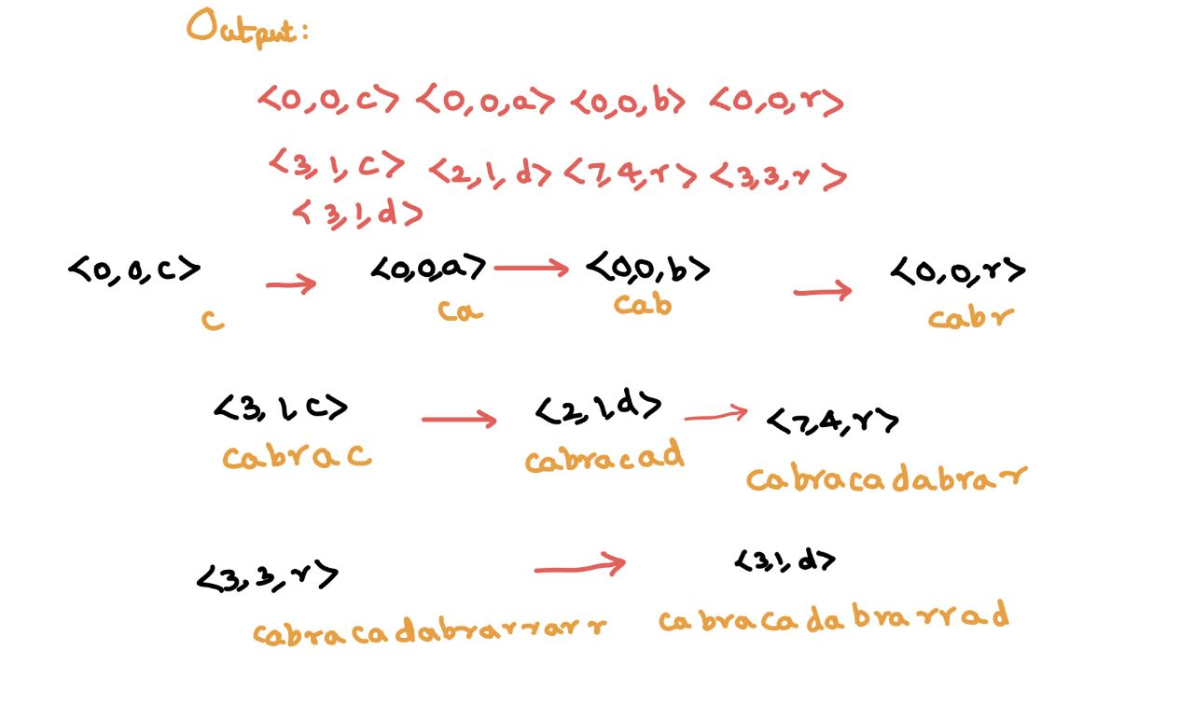

Slide 18
DECOMPRESSION

Slide 19
ALGORITHM BEHIND DECOMPRESSION
We create a new bitarray named as data
We create a new list named as output_buffer to store the decompressed text inside it
Now using open command , we open the compressed text to decompress it

Slide 20
Contd..
We check the binary code now,
If the first bit of the binary number is Zero(0) , it represents false i.e., there is no letter matching with the search buffer
So, in such case it appends next 8 bits of the binary number to a value thereby assigning it the value of an English Alphabet

Slide 21
Contd..
If the first bit is One(1) , it represents True i.e., there is a letter matching with the search buffer.
Now it creates two bytes named as byte1 and byte2 to store the 16 bits binary value as 8bits into respective bytes from the compresed file
Now , the 16bit value from the compressed file will be deleted to avoid repeating the same binary number
Now , as the case is true, for the distance , we left shift the byte1 to 4bits then ORing with right shift of 4bits for byte2.
distance = (byte1 << 4) | (byte2 >> 4)
Then for the length , we are ANDing the byte2 with 15
length = (byte2 & 0xf) [Here 0xf represents that the output is a hexadecimal value of 15]

Slide 22
Contd..
Now , we have a for loop which runs for the length times to append n letters in the output

