Slide 1
Data Structures and Algorithms

Slide 2

Data Structures and Algorithms
Algorithm: Outline, the essence of a computational procedure, step by step instructions
Program : An implementation of an algorithm in some Programming Language
Data Structure : Organisation of data needed to solve the problem.

Slide 3
The Algorithm
“Algorithm:
A finite set of unambiguous instructions performed in a prescribed sequence to achieve a goal”.
In computer science, algorithm has come to refer to a method that can be used by a computer for the solution of a problem.

Slide 4
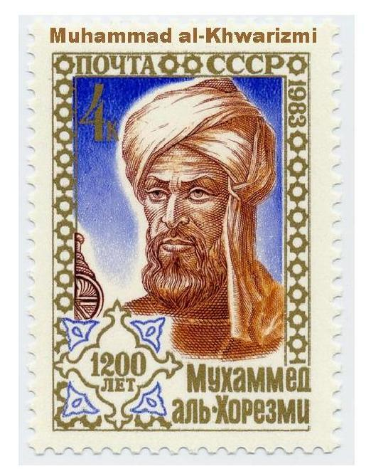
The Algorithm
The word algorithm comes from the name of a Persian author, Abu Ja'far Mohammed ibn Musa al Khowarizmi(c.825A.D.),who wrote a book on calculating with Hindu numerals in the 9th century A.D. When translated to Latin, a pluralized form of his name (algorismus) became synonymous with a system of calculation.

Slide 5
This word has taken on a special significance in computer science,where "algorithm" has come to refer to a method that can be used by a computer for the solution of a problem.
This is what makes algorithm different from words such as process, technique,or method.

Slide 6
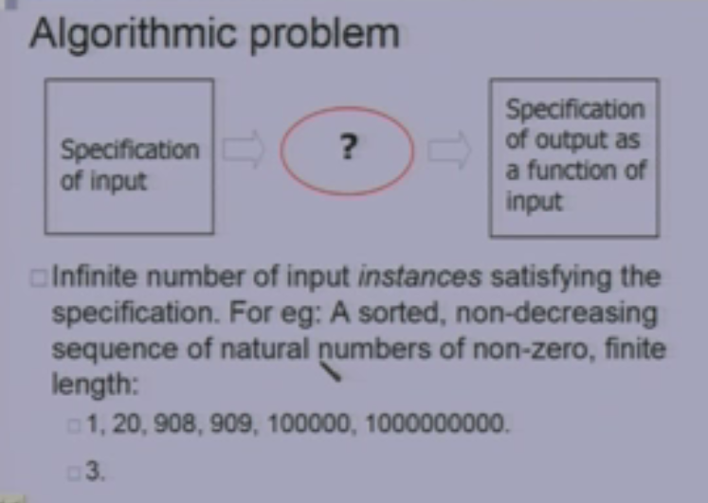

Slide 7
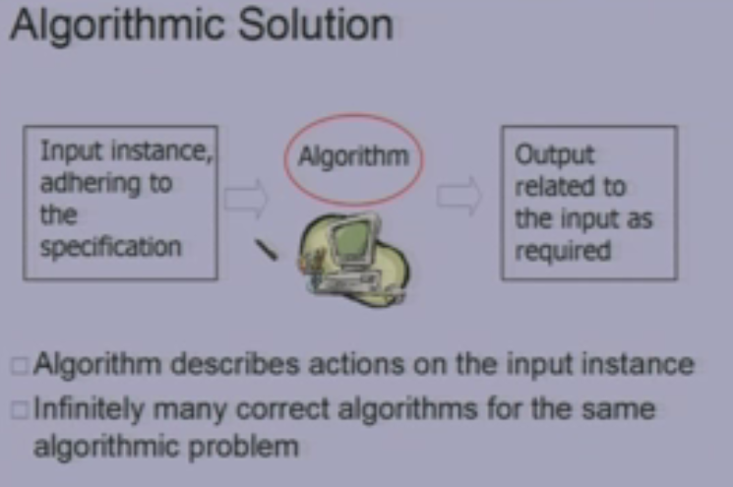

Slide 8
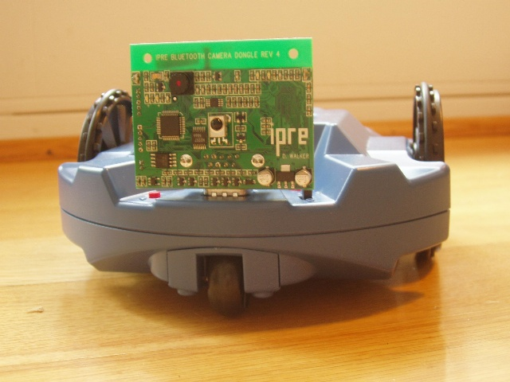
Programs - Algorithms at Work
Programs are the way we communicate with a computer
Specify the algorithm

Slide 9

The Algorithm
Defn.: An algorithm is a finite set of instructions that, if followed, accomplishes a particular task. In addition, all algorithms must satisfy the following criteria:
1. Input : Zero or more quantities are externally supplied.
2. Output : At least one quantity is produced.
3. Definiteness: Each instruction is clear and unambiguous.(compute 10/0 etc. are not permitted.)

Slide 10
The Algorithm
4. Finiteness : If we trace out the instructions of an algorithm, then for all cases, the algorithm terminates after a finite number of steps. (eg.Given position in a game of chess is a winning position.)
5. Effectiveness: Every instruction must be very basic,(so that it can be carried out, in principle, using a pencil and paper.) i.e., it must be feasible. (eg.,performing arithmetic on integers is effective, but not with real numbers.)

Slide 11
The Algorithm.
Algorithms that are definite and effective are also called computational procedures.
Eg. For computational procedures is operating system of digital computer. This procedure is designed to control the execution of jobs, in such a way that when no jobs are available, it does not terminate but continues in a waiting state until a new job is entered.

Slide 12
The Algorithm
To achieve the criterion of definiteness algorithms are written in a programming language.
A program is the expression of an algorithm in a programming language.
Such languages are designed so that each legitimate sentence has a unique meaning.

Slide 13
Study of algorithms
The study of algorithms includes many important and active areas of research. The four distinct areas of study one can identify are:
1. How to device algorithms
2. How to validate algorithms
3. How to analyze algorithms
4. How to test a program.

Slide 14
Study of algorithms
1. How to device algorithms :
Creating an algorithm is an art which may never be fully automated.
We can study various design techniques that have been proven to be useful in yielding good algorithms.
By mastering these design strategies, it will become easier to devise new and useful algorithms.
All the approaches we consider have applications in a variety of areas including computer science

Slide 15

Study of algorithms
2. How to validate algorithms:
Once the algorithm is devised it is necessary to show that it computes the correct answer for all possible legal inputs. This is referred to as algorithm Validation. Though it might not yet be expressed as program.
The purpose of validation is to assure us that this algorithm will work correctly independently of the issues concerning the programming language it will eventually be written in.
Once the validity of the method has been shown, a program can be written and a second phase begins. This phase is referred to as program proving or program verification.

Slide 16
Study of algorithms
3. How to analyze algorithms:
Analysis of algorithms: As an algorithm is executed, it uses the CPU to perform operations and its memory to hold program and data.

Slide 17
Analysis of algorithms or performance analysis refers to the task of determining how much computing time and storage an algorithm requires.
This sometimes requires great mathematical skill.
This allows to make quantitative judgments about the value of one algorithm over another.
Will allow to predict whether the software will meet any efficiency constraints that exist.
How well an algorithm performs in the best case, in worst case or average

Slide 18
Study of algorithms
4. How to test a program.
Testing a program consists of two phases :
Debugging and profiling(or performance measurement.)
Debugging is the process of executing programs on sample data sets to determine whether faulty results occur and if so to correct them.
In cases in which we cannot verify the correctness of output on sample data, the following strategy can be employed - more than one programmer can develop programs for the same problem, and compare the outputs produced by these programs. If outputs match then there is a good chance that they are correct.

Slide 19
Study of algorithms
A proof of correctness is much more valuable than a thousand tests (if that proof is correct) since it guarantees that the program will work correctly for all possible inputs.
Profiling or performance measurement is the process of executing a correct program on data sets and measuring the time and space it takes to compute the results.
These timing figures are useful in that they may confirm a previously done analysis and point out logical places to perform useful optimization.

Slide 20
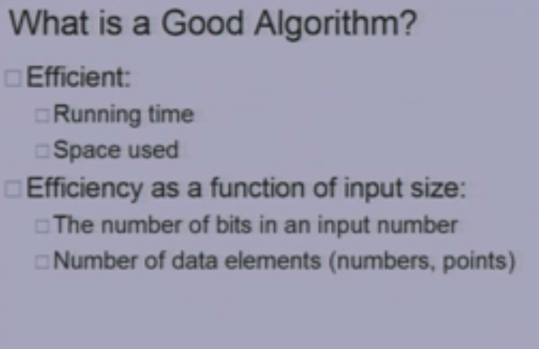

Slide 21
Pseudocode
Pseudocode is a compact and informal high-level description of a computer programming algorithm that uses the structural conventions of a programming language, but is intended for human reading rather than machine reading.
Pseudocode typically omits details that are not essential for human understanding of the algorithm, such as variable declarations, system-specific code and subroutines.
The programming language is augmented with natural language descriptions of the details, where convenient, or with compact mathematical notation.

Slide 22
Pseudocode
The purpose of using pseudocode is that it is easier for humans to understand than conventional programming language code, and that it is a compact and environment-independent description of the key principles of an algorithm.
It is commonly used in textbooks and scientific publications that are documenting various algorithms, and also in planning of computer program development, for sketching out the structure of the program before the actual coding takes place.

Slide 23
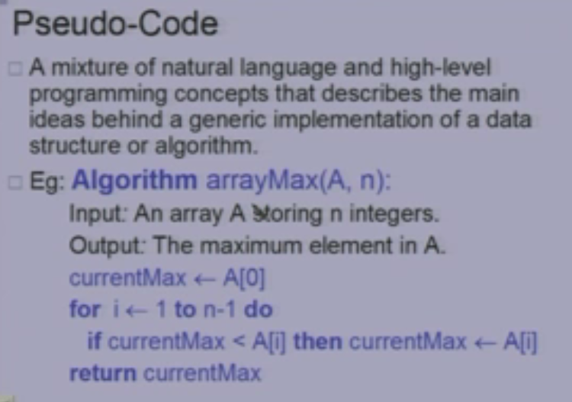

Slide 24
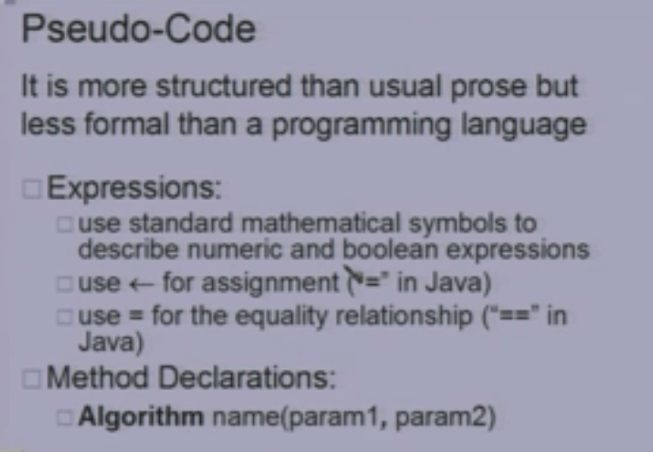

Slide 25
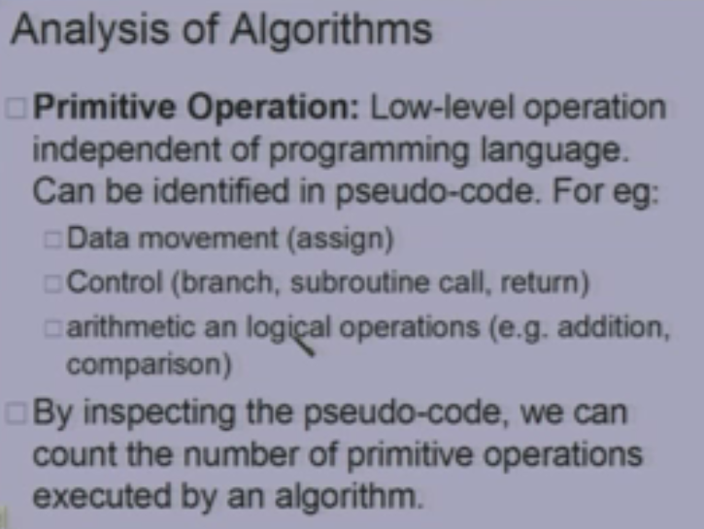

Slide 26
Pseudocode
No standard for pseudocode syntax exists, as a program in pseudocode is not an executable program.
Pseudocode resembles, but should not be confused with, skeleton programs including dummy code, which can be compiled without errors.
Flowcharts can be thought of as a graphical alternative to pseudocode.

Slide 27
1.Comments begin with // and continue until the end of line.
2. Blocks are indicated with matching braces:
{ and }.
A compound statement (i.e.a, collectionof simple statements)can be represented as a block. The body of a procedure also forms a block. Statements are delimited by ;.

Slide 28
3. An identifier begins with a letter. The data types of variables are not explicitly declared. The types will be clear from the context.
Whether a variable is global or local to a procedure will also be evident from the context. We assume simple data types such as integer, float, char, boolean,and so on. Compound data types can be formed with records.

Slide 29
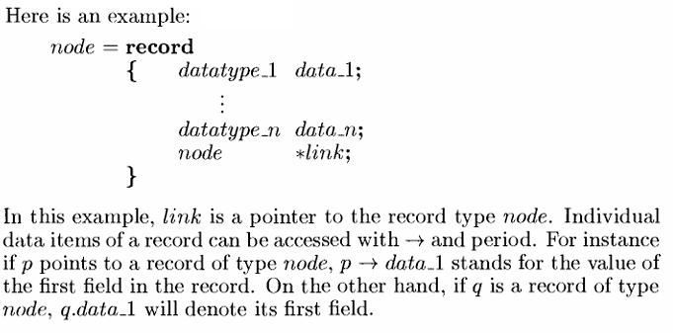

Slide 30
4. Assignment of values to variables is done using the assignment statement
(variable):=(expression);
5.There are two Boolean values true and false. In order to produce these values, the logical operators ‘and’, ‘or’, and ‘not’ and the relational operators <,<,=,/,>,and > are provided.
6. Elements of multidimensional arrays are accessed using [ and ]. For example: if A is a two dimensional array, the (i,j)th element of the array is denoted as - A[i,j].

Slide 31
7. The following looping statements are employed : for, while, and repeat until.
The while loop takes the following form:
while <condition>do
{
<statement 1>
.
.
.
<statement n>
}

Slide 32

The general form of a for loop is
for variable := value to value2 step step do
{
<statement1>
.
.
<statementn>
} Here valuel, value2,and step are arithmetic expressions.
A variable of type integer or real or a numerical constant is a simple form of an arithmetic expression

Slide 33
A repeat-until statement is constructed as follows:
repeat
  <statement1>
  .
  .
<statementn>
until <condition>
The statements are executed as long as <condition>is false. The value of <condition>is computed after executing the statements.

Slide 34
8. A conditional statement has the following forms:
if <condition> then <statement>
if <condition> then <statement1> else <statement2>
Here <condition> is a boolean expression and <statement>, <statement1> and <statement2> are arbitrary statements(simple or compound).
We also employ the following case statement:
case
{
: <condition 1>: <statement 1>
:<condition n>: <statement n>
:else:<statement n + 1>
}

Slide 35
9. Input and output are done using the instructions read and write. No format is used to specify the sizeof input or output quantities.
10.There is only one type of procedure Algorithm. An algorithm consists of a heading and a body.

Slide 36
The heading takes the form
Algorithm Name(<parameter list>)
Where Name is the name of the procedure and (<parameter list>) is a listing of the procedure parameters. The body has one or more (simple or compound) statements enclosed within braces{and }.
An algorithm may or may not return any values. Simple variables to Procedures are passed by value. Arrays and records are passed by reference. An array name or a record name is treated as a pointer to the respective data type.

Slide 37
As an example, the following algorithm finds and returns the maximum of n given numbers:
Algorithm Max(A, n)
// A is an array of size n.
{
Result:=A[1];
for i :=2 to n do
  if A[i] >Result then Result:=A[i];
  return Result;
}
In this Algorithm called Max, A and n are procedure parameters.
Result and i are local variables.

Slide 38
Recursive Algorithms :
A recursive function is a function that is defined in terms of itself. Similarly, an algorithm is said to be recursive if the same algorithm is invoked in the body. An algorithm that calls itself is direct recursive.
Algorithm A is said to be indirect recursive if it calls another algorithm which in turn calls A. These recursive mechanisms are extremely powerful, but even more importantly, many times they can express an otherwise complex process very clearly.

Slide 39
Algorithm Factorial(n)
{
if (n==1)
  { return 1; }
  else
  return n*factorial(n-1);
  }

Slide 40
The Towers of Hanoi
Algorithm TowersOfHanoi(n,x,y, z)
// Move the top n disks from tower x to tower y.
{
if (n >= 1)then
{
TowersOfHanoi(n-1,x,z,y);
write ("move top disk from tower",x, "to top of tower",y);
TowersOfHanoi(n-1,z,y, x);
}
}

Slide 41

PERFORMANCE ANALYSIS
For making evaluative judgments about algorithms, there are many criteria upon which we can judge an algorithm.
For instance:
1. Does it do what we want it to do?
2. Does it work correctly according to the original specifications of the task?
3. Is there documentation that describe show to use it and how it works
4. Are procedures created in such a way that they perform logical sub-functions?
5. Is the code readable?

Slide 42
There are other criteria for judging algorithms that have a more direct relationship to performance.
These have to do with their computing time and storage requirements.
Definition: [ Space/Timecomplexity ]
The space complexity of an algorithm is the amount of memory it needs to run to completion.
The time complexityof an algorithm is the amount of computer time it needs to run to completion.

Slide 43
Performance evaluation can be loosely divided into two major phases:
(1) a priori estimates and
(2) a posteriori testing.
We refer to these as performance analysis and performance measurement respectively

Slide 44

Space Complexity
The space occupied by algorithm is seen to be the sum of the following components:
1. A fixed part that is independent of the characteristics (e.g.,number, size)of the inputs and outputs.This part typically includes the instruction space(i.e.,space for the code),space for simple variables and fixed-size component variables (also called aggregate), space for constants, and so on.
2. A variable part that consists of the space needed by component variables whose size is dependent on the particular problem instance being solved, the space needed by referenced variables(this depends on instance characteristics), and the recursion stack space (also depends on the instance characteristics).

Slide 45
The space requirement S(P) of any algorithm P may therefore be written as
S(P) = c + Sp (instance characteristics), where c is a constant.
When analyzing the space complexity of an algorithm,we concentrate solely on estimating Sp (instance characteristics).
For any given problem,we need first to determine which instance characteristics to use to measure the space requirements, this is very problem specific.

Slide 46
Algorithm Sum(a,n)
{
s:=0.0;
  for i :=1 to n do
s:=s+ a[i];
return s;
}
S(Sum) >= n+3
The problem instances for Algorithm Sum are characterized by n, the number of elements to be summed.
The space needed by n is one word, since it is of type integer
The space needed by a is the space needed by variables of type array of floating point numbers. This is at least n words, since a must be large enough to hold the n elements to be summed.

Slide 47
Algorithm RSum(a,n)
{
If (n <= 0) then
return 0;
else
return (RSum(a,n-1) + a[n]);
}

Slide 48
The recursion stack space includes space for the formal parameters, the local variables, and the return address.
Assume that the return address requires only one word( natural unit of data) of memory.
Each call to RSum requires at least three words (including space for the values of n, the return address,and a pointer to a[]).
Since the depth of recursion is n + 1,the recursion stack space needed is >=3(n+ 1).

