Slide 1




SMART INDIA HACKATHON 2026
  Problem Statement ID – SIH26033
  Problem Statement Title- Multiple intermediaries reduce farmers’ earnings & increase consumer prices
  Theme- Agriculture, FoodTech & Rural Development
  PS Category- Software
  Team Name- AgriLink

Slide 2
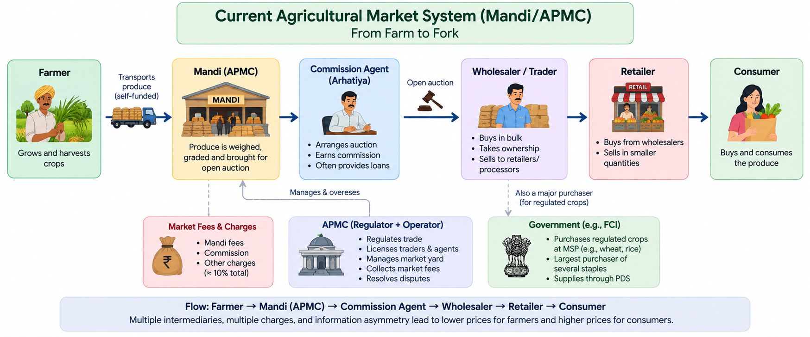
PROPOSED SOLUTION
AgriLink
* Generated with the help of AI
2
Notes:
2

Slide 3
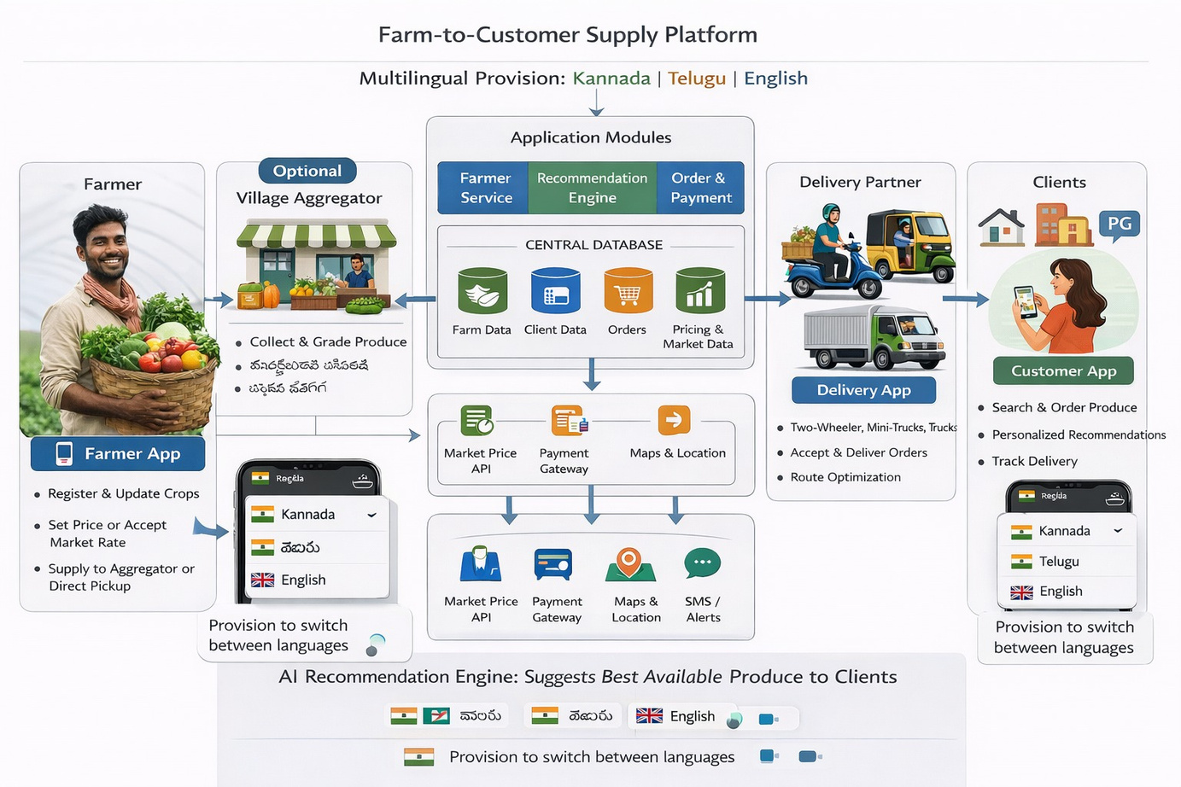
PROPOSED SOLUTION
AgriLink
* Generated with the help of AI
2
Notes:
2

Slide 4
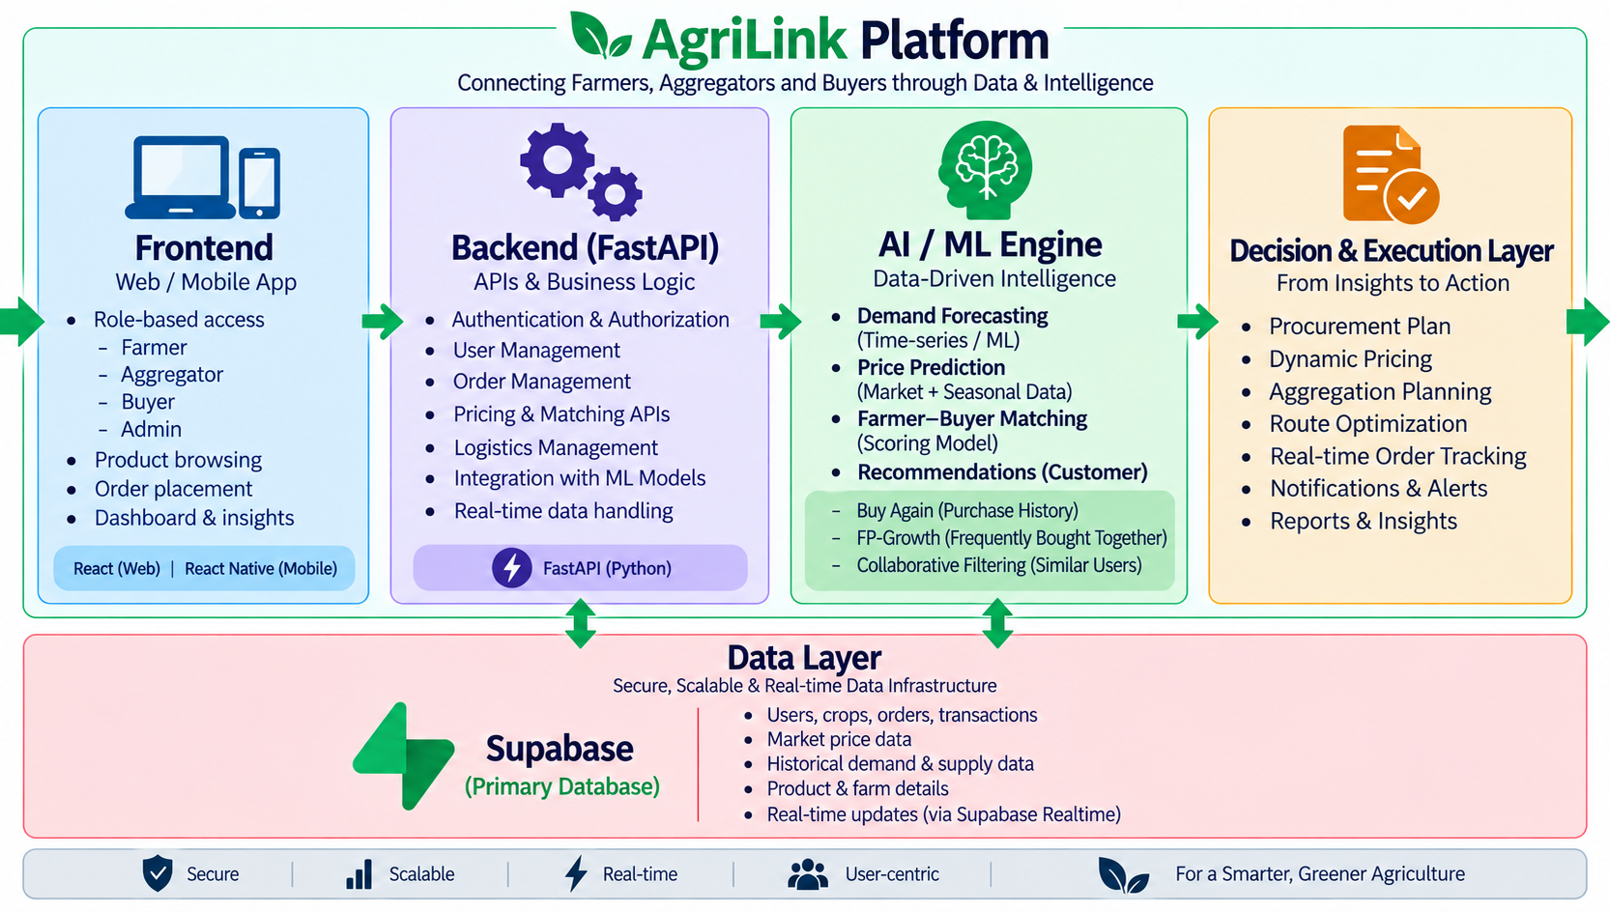
AgriLink
TECHNICAL APPROACH
* Generated with the help of AI
3
Notes:
3

Slide 5
FEASIBILITY AND VIABILITY
AgriLink
  Proven & Low-Cost Tech: Runs on basic smartphones via Flutter, FastAPI, and low-cost Layer-2 blockchain.
  Uses Existing Infrastructure: Leverages established rural FPOs and PACS hubs within a 15–30 km radius.
  Asset-Light & Profitable: Generates consistent revenue through an 8% platform fee with zero inventory holding risk.
  Strong Win-Win Economics
  Tamper-Proof & Low Waste: Blockchain prevents price manipulation; smart routing cuts transit food spoilage from 28% to <4%.
4
Notes:
4

Slide 6
IMPACT AND BENEFITS
AgriLink
  Farmers earn more, reliably — 14–19% higher than mandi net, paid faster, less dependence on commission agents.
  Fair pricing for buyers — bulk produce near mandi price, with delivery cost shown separately.
  Creates rural employment — local aggregator and delivery roles, especially for rural women and youth.
  Cuts middlemen and waste — fewer intermediary layers, shorter transit, less spoilage.
  Scalable financial inclusion — fair market access for small farmers, room to grow into inputs and credit.
5
Notes:
5

Slide 7
RESEARCH & REFERENCES
AgriLink
  Agmarknet (Directorate of Marketing & Inspection, Govt. of India) — daily APMC mandi arrival & price data
  NITI Aayog, Report of the Committee on Doubling Farmers’ Income (2022) — intermediary margin analysis
  National Agriculture Market (e-NAM) inter-mandi trading framework
  Glaros, A. et al. (2023), “Digital technologies in local agri-food systems,” Frontiers in Sustainable Food Systems
  Sedek, K. A. et al. (2021), “Smart Agro E-Marketplace Architectural Model,” Journal of Physics: Conference Series
  Gumbi, Gumbi & Twinomurinzi (2023), “Towards Sustainable Digital Agriculture for Smallholder Farmers,” Sustainability
  Kissankonnect Case Study (Scribd) — brand/support challenges
  Trustpilot — Kisankonnect Reviews
  SparxIT — KisanKonnect App Redesign Case Study
  Techreviewer.co — KisanKonnect / SparxIT Case Study
  Agriculture Institute — Understanding the Agricultural Produce Market Committee (APMC) System — https://agriculture.institute/agripreneurship/understanding-apmc-system/
6
Notes:
6

