Slide 1
Group 8
Subject : Psychology
Submitted to : Mam Umber Tayyab
Submitted by :
Sawera Aslam 8178
Isha Iman 8179
Noman Khan 8180
Arsalan Saeed 8182
Submission Date : 22-Nov-2024

Slide 2
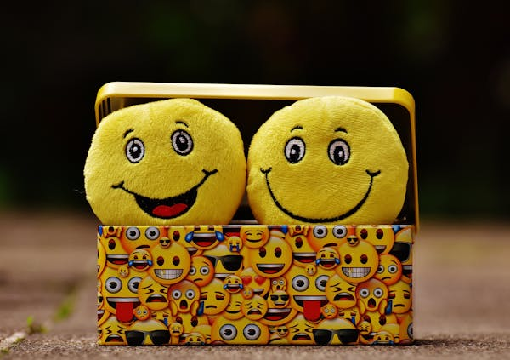
Emotions

Slide 3
Emotions
Defination of Emotions
Types of Emotions
Characteristics and Measurement of Emotions

Slide 4
Emotions:
Emotions are feelings that come from our experiences, thoughts, or events around us.
They help us understand how we feel about something and guide how we react.
These feelings help us understand what’s happening and decide what to do next.
For example:
Happiness: When you get a good grade in school or spend time with friends, you feel happy. It makes you smile and feel good inside.
Sadness: If you lose a favorite toy or hear bad news, you might feel sad. This can make you cry or feel quiet.
Anger: If someone breaks your things or treats you unfairly, you might feel angry. You may want to shout or show frustration.
Fear: If you see a scary animal like a snake, you might feel afraid. Your heart beats faster, and you want to move away.
Surprise: If someone throws you a surprise birthday party, you might feel surprised. Your eyes open wide, and you might gasp.

Slide 5
Proper Defination of Emotions:
Emotions in psychology are complex psychological states that involve three core components:
1. Subjective Experience: This is how an individual personally experiences an emotion, which can vary greatly from one person to another. For instance, the feeling of happiness might be triggered by success for one person and by spending time with loved ones for another.
2. Physiological Response: Emotions are often accompanied by physical changes, such as a racing heart, sweating, or a change in breathing. These responses are regulated by the autonomic nervous system and prepare the body for action (e.g., "fight or flight" responses).
3. Behavioral Expression: Emotions can be expressed through facial expressions, body language, and vocal tone. For example, smiling is commonly associated with happiness, while frowning might indicate sadness.

Slide 6
Types of Emotions:
Psychologists categorize emotions into several types, often distinguishing between basic emotions and complex emotions:
1. Basic Emotions:
These are universal and biologically hardwired, as proposed by psychologist Paul Ekman. They include:
Happiness
Sadness
Anger
Fear
Disgust
Surprise
Complex Emotions

Slide 7
Types of Emotions:
These are influenced by social and cultural factors and may require self-awareness. Examples include:
Pride
Guilt
Shame
Love

Slide 8
Characteristics of Emotions:
1. Subjective Experience:
Emotions are personal and unique to each individual. For example, two people might feel differently
about the same event—one may find a joke funny, while another might find it offensive.
2. Adaptive and Functional:
Emotions help individuals respond to their environment. For example, fear helps you avoid danger,
and love encourages connection with others.
3. Short-lived:
Emotions are temporary and often change based on the situation. You might feel angry one moment
and calm the next after resolving the issue.

Slide 9
Characteristics of Emotions:
4.Universal and Culturally Influenced:
Basic emotions like happiness, sadness, and anger are universal across cultures. However, the way
people express or interpret emotions can vary based on cultural norms.
5. Complexity:
Some emotions are simple (e.g., fear or joy), while others are
more complex and involve a mix of feelings, like jealousy or pride.

Slide 10
Measurement of Emotions:
Psychologists measure emotions using various methods, which can be divided into three categories:
1. Self-Report Methods:
These involve asking people to describe their emotions through surveys, questionnaires, or interviews.
Example Tools:
Likert Scales: Respondents rate their emotional intensity on a scale (e.g., 1 to 5).
PANAS (Positive and Negative Affect Schedule): Measures levels of positive and negative emotions.
2. Physiological Measurements:
These methods assess physical changes in the body associated with emotions.
Examples:
Heart Rate: Indicates excitement or fear.
Galvanic Skin Response (GSR): Measures sweating, often linked to stress or arousal.
Brain Imaging (fMRI or EEG): Identifies areas of the brain activated by certain emotions.

Slide 11
Measurement of Emotions:
3. Behavioral Observations:
Observers assess emotions based on facial expressions, body language, or vocal tone.
Example:
Facial Action Coding System (FACS): Analyzes facial muscle movements linked to emotions (e.g., smiling for happiness or frowning for sadness).
4. Experimental Techniques:
Researchers use controlled experiments to study emotions, such as exposing participants to specific stimuli (e.g., images, videos) and measuring their responses.
5. Technology-Based Methods:
Emotion AI: Uses algorithms to analyze facial expressions, speech patterns, or text for emotional content.
Wearable Devices: Track physiological changes like heart rate and skin conductance in real-time.

Slide 12


