Slide 1



Newcastle University Investment Fund
Newcastle University Investment Fund Training Programme
Session 1: What is a Stock Pitch?
Royal BAM Group – (XAMS: BAMNB) – (EUR/USD is 1.1512 USD)
Long: Target Price €9.77 - (17.9% Upside)
Head Analyst:
Samuel, Bundy
Analysts:
Jack, Stevens
Euan, Burn
Henri, Allen
Going from "It's a good company" to "It's a good investment"
Notes:
Good morning. Last week, we defined the argument—our 'Big Idea'. Today, we gather the evidence."
"Session 4 is about comparative analysis, or 'Comps'. This is how we move from a qualitative hypothesis to a quantitative, data-driven assessment by answering a simple question: Is this company better or worse than its peers?

Slide 2
Table of Contents
  Executive Summary
  Company Overview
  Industry Overview
  Market Expectations
  Thesis
  Valuation
  Risks and Catalysts
  Appendix
  Disclaimer
Newcastle University Investment Fund Training Programme
Session 1: What is a Stock Pitch?
Going from "It's a good company" to "It's a good investment"
29/10/25 Royal Bam Group – (XAMS: BAMNB)
Notes:
Good morning. Last week, we defined the argument—our 'Big Idea'. Today, we gather the evidence."
"Session 4 is about comparative analysis, or 'Comps'. This is how we move from a qualitative hypothesis to a quantitative, data-driven assessment by answering a simple question: Is this company better or worse than its peers?

Slide 3
Executive Summary
Market is anchored on UK execution noise — missing BAM’s multi-year reinvestment and cash generation recovery.
Street's view
Our variant view
UK rail cutbacks shrink the addressable market, Dutch permitting will keep projects stuck, and Ireland’s big plans won’t move fast enough.
Given persistent execution challenges, backlog expansion offers limited upside reassurance.
Sees BAM as entering sustainable margin expansion phase
Thesis 1
Sees BAM as structurally constrained and cyclical.
Spending is being reallocated with UK CP7 renewals and city-region transport create many mid-sized packages well suited to BAM.
The Netherlands operates with multi-year, pre-budgeted programs (MIRT/Mobility Fund), so projects are reprofiled rather than cancelled.
Ireland is ramping exchequer-funded transport—Metrolink/DART—building a multi-year tender flow that improves visibility and reduces single-project risk.
Pitch Narrative
The market overweight's UK execution headwinds and Dutch permitting delays, overlooking BAM’s improving balance sheet, rising quality of backlog, and visibility on multi-year infrastructure programs in the Netherlands, UK, and Ireland.
Reinvestment discipline and project selectivity are driving higher-margin growth.
As normalisation continues, BAM’s cash yield and valuation gap vs peers (e.g. Balfour Beatty, Skanska) should close.
Newcastle University Investment Fund Training Programme
Session 1: What is a Stock Pitch?
Going from "It's a good company" to "It's a good investment"
Valuation Summary
Thesis 2
Consensus treats BAM’s UK problems as structural, expecting margins to drift back toward cycle lows and cash generation to fade.
Buybacks and dividends look fragile, so the shares get marked to a plain cyclical multiple rather than a quality premium.
Mix has shifted toward regulated civil frameworks (rail renewals, strategic roads, flood/energy civils) with tighter risk sharing, which supports durable margins and steadier cash.
Balance sheet can fund disciplined growth and distributions. At a mid-single-digit EV/EBITDA, Royal BAM has long-dated cash flows at a discount to peers, leaving room for a clean re-rating as the company delivers.
Bull
Base
Bear
Target Price
€11.72
€ 9.77
€8.30
Return
41.1%
17.9%
0.1%
Probability
20%
60%
20%
Probability-Weighted Target Price
€2.35
€5.86
€1.66
Weighted Return
€9.87 per share
29/10/25 Royal Bam Group – (XAMS: BAMNB)
Notes:
Good morning. Last week, we defined the argument—our 'Big Idea'. Today, we gather the evidence."
"Session 4 is about comparative analysis, or 'Comps'. This is how we move from a qualitative hypothesis to a quantitative, data-driven assessment by answering a simple question: Is this company better or worse than its peers?

Slide 4

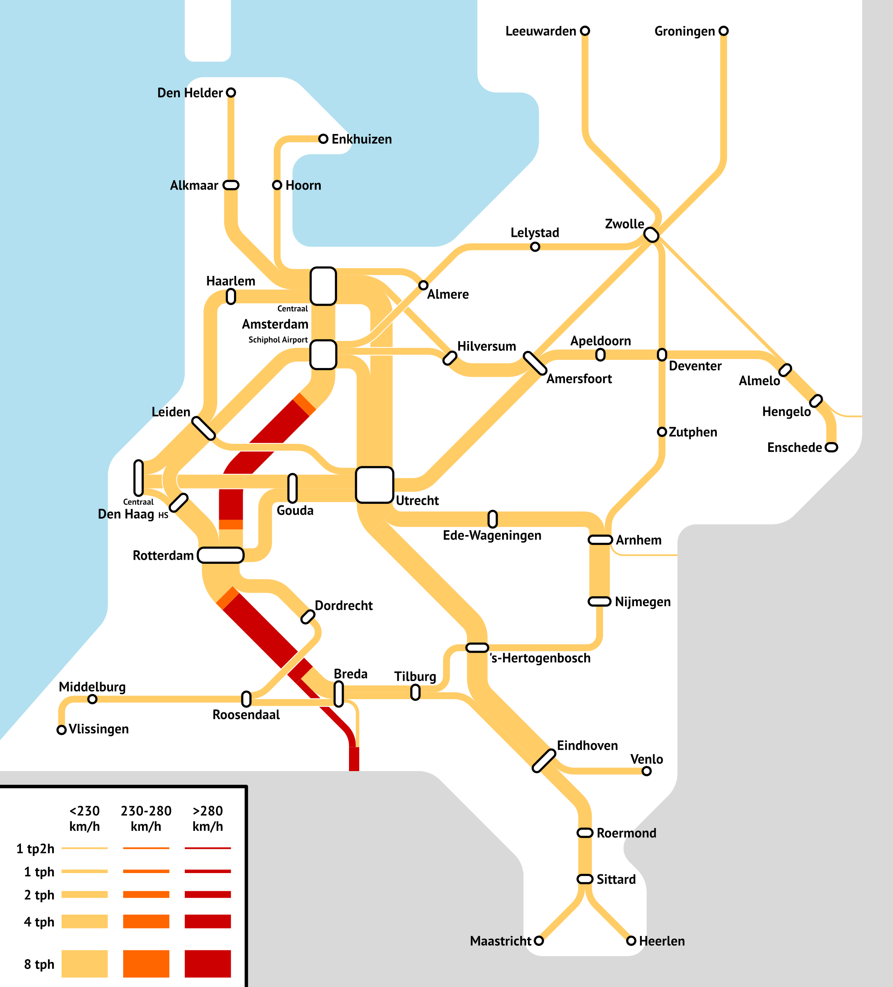
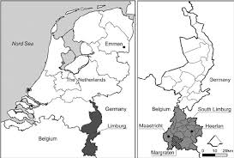



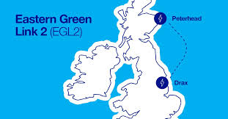
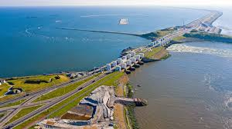
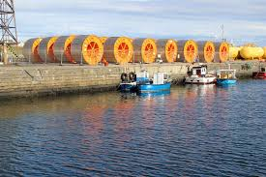
Company Overview
Diversified European construction and civil engineering leader.
Project Portfolio: Diversified Across Europe
Leading European construction and civil engineering company headquartered in the Netherlands, operating across the Netherlands, UK, Ireland, Belgium, and Germany.
BAM’s 2021-2026 strategy emphasises Focus, Transform, Expand, aligned with sustainability, digitalisation and predictable profitability
Provides integrated solutions in building, infrastructure, and public-private partnerships, with a strategic focus on sustainable and digital construction.
Past Projects
Current Projects/ Backlogs
HSL‑Zuid high‑speed rail line
Energy & water supply network
€6.9 billion for the full PPP project BAM’s share via consortium (≈ 45 %)
Construction 2001‑2006 then 25‑year maintenance/ availability concession
Contract value approx. €600 million
Future‑proof energy & water supply network
12-year cooperation agreement; works start end-2025
Newcastle University Investment Fund Training Programme
Session 1: What is a Stock Pitch?
Wildparkstadio renewal project
Eastern Green Link 2
Historical financials:
€100 million as of BAM press release
4.5 to 5 years between 2018-2023
Converting backlog into revenue, in line with sustainability goals
Up to £700 million for BAM
Target completion ~2029
UK’s single largest electricity transmission project ever
Going from "It's a good company" to "It's a good investment"
Afsluitdijk Reinforce Project
Orkney‑Caithness Subsea Link
Contract value €550 million
Duration of the full contract (including maintenance) spans 25 years
Represents longevity in maintenance contracts
Estimated £900 million investment
Full energisation expected by 2028
14 km underground cable + 53 km subsea cable
Revenues are on an upward trend, recent 2025 H1 reports show accurate forecasting for 5% growth YoY. EBITDA margins are 1.2% above industry average (4%). Highlights relative-outperformance.
Revenues are prioritised in construction and civil engineering, with relative growth in UK and Ireland over the last 5 years.
29/10/25 Royal Bam Group – (XAMS: BAMNB)
Notes:
Good morning. Last week, we defined the argument—our 'Big Idea'. Today, we gather the evidence."
"Session 4 is about comparative analysis, or 'Comps'. This is how we move from a qualitative hypothesis to a quantitative, data-driven assessment by answering a simple question: Is this company better or worse than its peers?

Slide 5

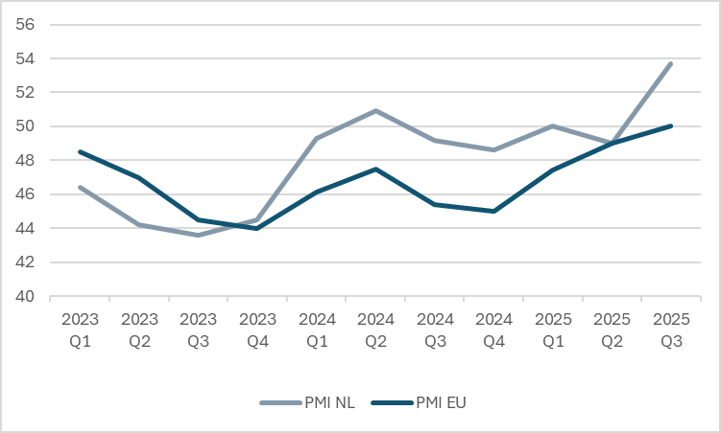
Industry Overview
Resilient public investment, accelerating energy-transition projects, and sustained urban renewal
Driven by infrastructure investment, energy transition, sustainable building, and infrastructure renewal.
Sustainability and net-zero targets accelerating demand for low-carbon, circular, and modular construction.
Digitalisation, industrialised construction, and off-site manufacturing driving productivity improvements.
09/01
CINEA announced €422 million in EU funding for alternative fuels infrastructure, boost to transport-infrastructure, and energy transition sub-sectors
03/05
Europe’s construction outlook from Fitch Solutions indicated moderate growth, emphasises the importance of scale, efficiency, and picking the right segments which BAM is doing
24/07
BAM’s H1 2025 results showed revenue up 7%, adjusted EBITDA up ~40% with margin ~5.2%. The company pointed to robust demand for energy transition, infrastructure and affordable housing.
Boost to transport-infrastructure and energy-transition sub-sectors, favourable for BAM given its infrastructure capabilities.
06/02
Tailwinds
Headwinds
  Large public infrastructure and energy transition programmes. Renewals of transport, utilities, housing and energy provide long-term revenue pipelines in UK and NE. Proven through commitments by governments.
Supply‑chain / labour constraints. Material and labour cost inflation, shortages of skilled workers, and supply‑chain delays are squeezing margins
Dutch PMI sits comfortably above the EU average at 53.7 showing signs of economic momentum.
This environment supports rising demand and stronger order books
Industrial activity and infrastructure demand is expanding
Reflective of improved business sentiment and tendering conditions
Investors likely to favour Dutch-listed firms such as BAM
  Digitalisation and productivity gains. The industry is increasingly adopting digital tools, modular construction, off‑site manufacturing and data‑driven delivery, which can improve efficiency and open new project types
  Public‑spending uncertainty. Infrastructure pipelines may face slower phasing or budget constraints. UK output growth is forecast low (~1%) and subject to public‑spend squeeze
29/10/25 Royal Bam Group – (XAMS: BAMNB)
Notes:
Good morning. Last week, we defined the argument—our 'Big Idea'. Today, we gather the evidence."
"Session 4 is about comparative analysis, or 'Comps'. This is how we move from a qualitative hypothesis to a quantitative, data-driven assessment by answering a simple question: Is this company better or worse than its peers?

Slide 6
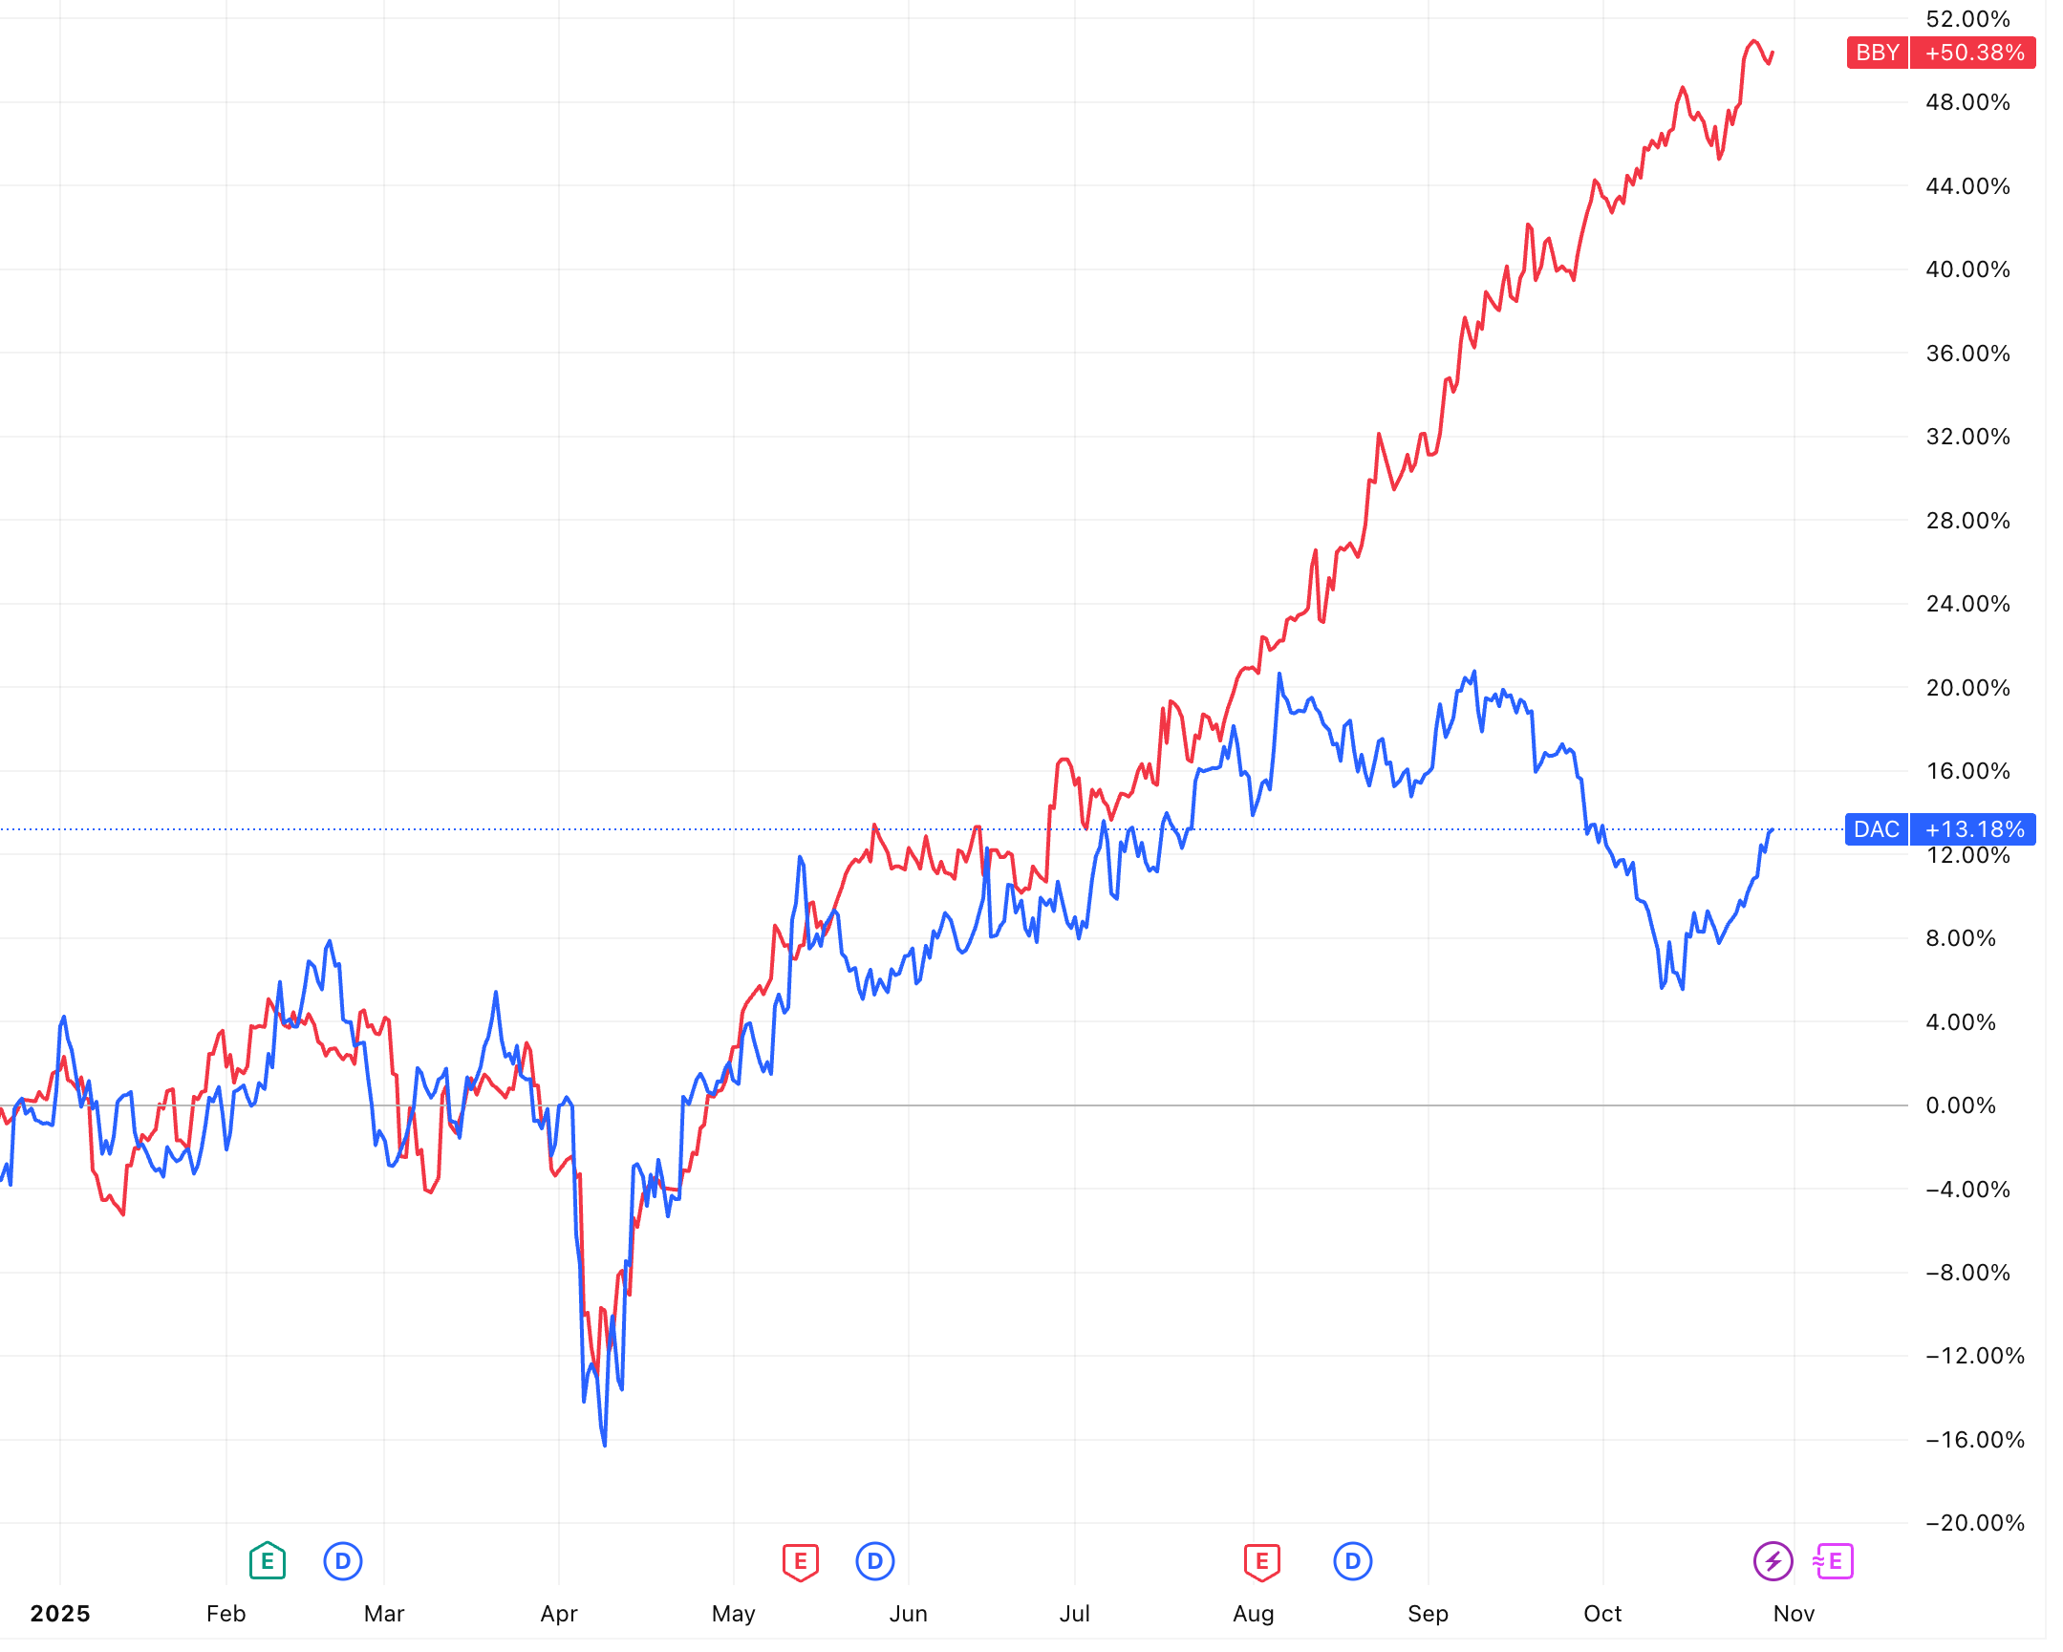
Market Expectations
What moves the needle?
Company | Year | FCF/EBITDA % (pre-IFRS16)
Royal BAM Group | FY2024 / FY2023 | 51.6% / 9.23%
Balfour Beatty | FY2024 / FY2023 | 68.9% / 68.4%
Kier Group | FY2024 / FY2023 | 97.8% / 86.3%
Recent Share Price Action
Price implies <60% FCF/EBITDA; framework peers deliver ~70–90%+.
What the Market Misses
2
BAM’s portfolio is shifting from lump-sum building toward frameworks, renewals and target-cost work. That profile has delivered ~70–90% pre-IFRS 16 FCF/EBITDA at peers.
We expect BAM’s conversion to converge to that range as mix shifts and legacy fixed-price exposure rolls off.
Proof Points
Operating cash flow positive in both recent halves: H1-2025 €151m; H2-2024 ~€173m
Portfolio tilt to frameworks continues: Recent Awards Northumbrian Water AMP8 “Living Water Enterprise” framework (Jan-2024) Southwest Water AMP8 Engineering Capital Delivery Programme (May-2024) TRU West Alliance, next phase (£2bn alliance; BAM c.£800m) (Sep-2024) TenneT EU367 multi-year framework, Moerdijk–Tilburg 380 kV section (Apr-2025)
1
1
Silvertown Tunnel opening, M28 Cork–Ringaskiddy motorway contract, Hither Green station accessibility upgrade led to a ~34% jump in the next month
2
Royal BAM Group (BAMNB) dropped ~13% after ABN AMRO analyst (Den Drijver) put BAM on the sell list, flagging fresh risks on projects in Dublin and the Fehmarnbelt Denmark–Germany tunnel
29/10/25 Royal Bam Group – (XAMS: BAMNB)
Notes:
Good morning. Last week, we defined the argument—our 'Big Idea'. Today, we gather the evidence."
"Session 4 is about comparative analysis, or 'Comps'. This is how we move from a qualitative hypothesis to a quantitative, data-driven assessment by answering a simple question: Is this company better or worse than its peers?

Slide 7
Thesis
United Kingdom
UK 10 Year Infrastructure Project provides a strong macroeconomic tailwind, promising over £725bn in public infrastructure over the next decade
Ireland
National Development Plan refresh confirms a record $€$275bn capital envelope to 2035 across transport, health, education, water and energy
National Development Plan refresh confirms a record €275bn capital envelope to 2035 across transport, health, education, water and energy
Netherlands
Delta Programme 2025 is the national plan across flood risk management, freshwater, and climate-resilient spatial planning. Plans across the coming years involve upgrades in which BAM has already been selected for (e.g. Meuse dyke strengthening)
Eastern Green Link 2 green-lit by Ofgem, BAM positioned to deliver both converter stations and positioned for repeat business in the Great Grid Upgrade
BAM re-appointed in EA’s Collaborative Delivery Framework, ramping toward £5bn of capital
Afsluitdijk – a giant sea well protecting Netherlands from flooding, BAM selected to build and now maintain for next 25 years
TenneT plans around £200bn of investments until 2034 across energy grid infrastructure
EirGrid – a 2030 roadmap to ~80% renewables target, delivered via Grid Implementation plan 2023-2028, including hundreds of grid projects
OPW Flood Relief Programme – state committed €1.3bn for flood schemes until 2030
Disciplined backlog. Rising Margins. Rerate ahead.
Leaner footprint, tighter execution
Strategic exits from Germany and Belgium 2021-2023
  Geographical shifts to focus on markets where they have “scale and competitive advantage” i.e. Netherlands, UK, and Ireland
  Success evinced in a 33% gain in order book, which they’ve maintained going into 2025 H1 while simultaneously increasing revenue by 7%
Smarter order book
  “Be selective and strengthen control: focus on predictable product market combinations with two-stage, medium sized projects”
  Pursuing higher risk/reward opportunities, involving earlier contractor involvement in low-surprise delivery models – managed risk transfer
Execution upgrade
  Improvement and deployment of company wide workflows including digital modelling with BIM, VR/AR, robotics allows for easier execution and less reworks
Newcastle University Investment Fund Training Programme
Session 1: What is a Stock Pitch?
Oddo BHF (equity research), recently cut its expectation of BAM to Underperform, from a previous stance of neutral, arguing the stock was pricing in too much margin optimism.
BAM has already proven it can operate consistently at the 5% margin. Order book steady at €13bn with visible public pipelines.
We believe that BAM’s 5% margin is sustainable and not cyclical. The recent derating overstates legacy risk, and ongoing returns should unlock a rerate
Going from "It's a good company" to "It's a good investment"
29/10/25 Royal Bam Group – (XAMS: BAMNB)
Notes:
Good morning. Last week, we defined the argument—our 'Big Idea'. Today, we gather the evidence."
"Session 4 is about comparative analysis, or 'Comps'. This is how we move from a qualitative hypothesis to a quantitative, data-driven assessment by answering a simple question: Is this company better or worse than its peers?

Slide 8
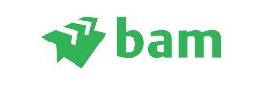
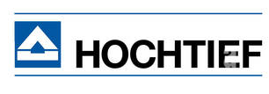
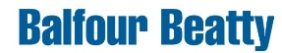

Valuation
Valuation techniques indicates 15–20% upside potential
Royal BAM trades at a discount on EV/EBITDA while delivering one of the strongest FCF yields in its peer group. DCF supports re-rating as margins and cash conversion normalise.
Relative Valuation
Scenario analysis
Bull Case – Upside from Execution
EBIT margin +50bps from selective tendering
CapEx stable at 2.0% of revenue, FCF yield > 10%
Base Case – Normalised operations
EBIT margin ~3%, D&A ratio ~0.9x, CapEx Reinvestment 0.8-0.9x D&A
Revenue CAGR ~4.2%, stable working capital
Bear case – Cost pressure risk
Margin erosion to 2% from cost inflation
CapEx rising to 2.5% of revenue
WACC –60bps with improved market perception
WACC 10.5%, g = 2.0%
WACC +60bps on market risk premium
7.3 Industry Median
6.2
Valuation impact (€/share):
Bull: ~€11.5–12.0 | Base: €9.8 | Bear: €8.3–8.5
Royal BAM trades below peers on EBITDA while offering one of the highest FCF yields in the sector. Our DCF base case indicates ~18% upside to €9.8 per share, with limited downside and clear re-rating potential as profitability and cash conversion strengthen.
10.2
Sensitivity Analysis
Conservatively weighted DCF shows strong upside potential
Growth rate (g)
5.5 Industry Median
 |  | 1.6% | 1.8% | 2% (Base) | 2.2% | 2.4%
 | 9.9% |  | 27.9% | 31.5% | 36.3% | 41.1%
 | 10.2% | 17.0% | 20.6% | 24.2% | 27.9% | 32.3%
 | 10.5% (Base) | 11.0% | 14.6% | 17.9% | 21.8% | 25.5%
 | 10.8% | 6.2% | 9.8% | 13.4% | 17.0% | 20.6%
 | 11.1% | 0.1% | 3.7% | 8.6% | 12.2% | 15.8%
WACC
24.2%
29/10/25 Royal Bam Group – (XAMS: BAMNB)
Notes:
Good morning. Last week, we defined the argument—our 'Big Idea'. Today, we gather the evidence."
"Session 4 is about comparative analysis, or 'Comps'. This is how we move from a qualitative hypothesis to a quantitative, data-driven assessment by answering a simple question: Is this company better or worse than its peers?

Slide 9
Risks and Catalysts
  Fixed price projects can quickly increase in cost (e.g. design changes, ground conditions, inputs)
  Suffer from margin drop late in project, spike in variations/claims
  Major contract wins in Netherlands and UK&I (Cardiff Central Station, M40/42 Interchange, electricity grid Limburg)
  Margin confirmation / beat FY25 results (>5% adjusted EBITDA target)
Stricter contract selection moving forward with a focus on target-cost + index linked contracts
Newcastle University Investment Fund Training Programme
  Cash arrives in uneven milestones and clients hold retentions: profit can look fine while cash lags
  Weak cash conversion leads to lower bidding capacity and capital returns via dividends/buybacks
  Dividend increase or buyback announcement as net-cash remains positive
  Continued strength in FCF (€218m LTM, highest since 2021), rerating from Oddo BHF
Session 1: What is a Stock Pitch?
Invoicing and payment cycle terms embedded in contracts, maintains high cash balance and solvency
  Cyclical exposure via slowdown in public capex could lead to less bids and smaller margins
  ECB/BoE lowering interest rates lowers financing costs and stimulates public/private investment
  Strong policy tailwinds with EU Green Deal, Dutch housing and flood programmes, UK 10-Year Infrastructure plan
Going from "It's a good company" to "It's a good investment"
Long term contracts (e.g. 12 years Enexis grid upgrades), breadth across countries and sectors
BAM’s key risks involve fixed-price execution, cash conversion, and public-capex cyclicality. A strategic pivot toward longer-term, early-involvement frameworks, focusing on and tighter billing discipline mitigates these exposures. Near-term catalysts are a sustained ≥5% adj. EBITDA margin, unlocking a rerate from Oddo BHF, and consistent bid wins. Strong macroeconomic tailwinds allow for sustained revenue and order book growth over the coming decade.
29/10/25 Royal Bam Group – (XAMS: BAMNB)
Notes:
Good morning. Last week, we defined the argument—our 'Big Idea'. Today, we gather the evidence."
"Session 4 is about comparative analysis, or 'Comps'. This is how we move from a qualitative hypothesis to a quantitative, data-driven assessment by answering a simple question: Is this company better or worse than its peers?

Slide 10
Appendix
 |  | Hist. | Proj. | Proj. | Proj. | Proj. | Proj.
 |  | Period 0 | Period 1 | Period 2 | Period 3 | Period 4 | Period 5
 | All figures in millions unless otherwise stated
Discounted Cash Flow
 | Tax rate | 18.0%
 | Long term growth rate | 2.0%
 | WACC | 10.5%
 | Share price | 8.29
 | Shares outstanding | 272.0
 | Year count |  | 1.0 | 2.0 | 3.0 | 4.0 | 5.0
 | EBIT |  | 227.8 | 250.5 | 250.4 | 248.8 | 241.5
 | Tax on EBIT |  | (41.0) | (45.1) | (45.1) | (44.8) | (43.5)
 | + Depreciation and amortization |  | 145.3 | 163.7 | 176.2 | 190.2 | 201.2
 | - Capital expenditure |  | (101.7) | (122.8) | (141.0) | (161.7) | (181.1)
 | Change in operating working capital |  | (16.0) | (11.0) | (11.0) | (4.0) | (12.0)
 | Free cash flow |  | 214.4 | 235.3 | 229.5 | 228.5 | 206.1
 | Terminal value |  |  |  |  |  | 2,473.3
 | Discount factor |  | 90.5% | 81.9% | 74.1% | 67.1% | 60.7%
 | Present value of free cash flows |  | 194.0 | 192.7 | 170.1 | 153.3 | 125.1
 | Sum of present value of free cash flows | 835.3
 | Present value of terminal value | 1,501.3
 | Enterprise value | 2,336.6
 | + Cash | 763.0
 | - Debt | (440.0)
 | Implied equity value (intrinsic value) | 2,659.6
 | Market capitalization | 2,254.9
 | Intrinsic value premium to market capitalization | 404.7 | 17.9%
(€ millions) | 2022 | 2023 | 2024 | 2025 | 2026 | 2027 | 2028 | 2029
Division Netherlands
Revenue | 2,917.0 | 3,007.0 | 3,231.0 | 3,412.0 | 3,583.0 | 3,744.0 | 3,894.0 | 4,030.0
YoY Growth % | 3.29% | 3.09% | 7.45% | 5.60% | 5.01% | 4.49% | 4.01% | 3.49%
(€ millions) | 2022 | 2023 | 2024 | 2025 | 2026 | 2027 | 2028 | 2029
Division UK + Ireland
Revenue | 3,134.0 | 3,139.0 | 3,111.0 | 3,305.9 | 3,496.3 | 3,680.0 | 3,854.8 | 4,018.6
YoY Growth % | 10.30% | 0.16% | -0.89% | 6.26% | 5.76% | 5.25% | 4.75% | 4.25%
(€ millions) | 2022 | 2023 | 2024 | 2025 | 2026 | 2027 | 2028 | 2029
Division Germany, Belgium, Etc
Revenue | 569.0 | 125.3 | 112.6 | 103.6 | 77.7 | 51.6 | 26.0 | 0.0
YoY Growth % | 4.17% | -77.98% | -10.17% | -7.97% | -24.99% | -33.59% | -49.61% | -100.00%
(€ millions) | 2022A | 2023A | 2024A | 2025E | 2026F | 2027F | 2028F | 2029F
Company
Revenue | 6,620.0 | 6,271.3 | 6,454.6 | 6,821.5 | 7,157.0 | 7,475.6 | 7,774.8 | 8,048.6
YoY Growth % | -9.53% | -5.27% | 2.92% | 5.68% | 4.92% | 4.45% | 4.00% | 3.52%
EBITDA Margin | 4.17% | 4.44% | 3.90% | 4.85% | - | - | - | -
EBIT Margin % | 2.41% | 2.45% | 1.85% | 3.34% | 3.50% | 3.35% | 3.20% | 3.00%
EBIT (calc.) | 159.5 | 153.6 | 119.4 | 227.8 | 250.5 | 250.4 | 248.8 | 241.5
Newcastle University Investment Fund Training Programme
Session 1: What is a Stock Pitch?
Going from "It's a good company" to "It's a good investment"
Rf = 2.77% (Dutch 10-year government bond) Rp= 8.96%
Beta = 1.05 - slightly higher cyclicality than the market
29/10/25 Royal Bam Group – (XAMS: BAMNB)
Notes:
Good morning. Last week, we defined the argument—our 'Big Idea'. Today, we gather the evidence."
"Session 4 is about comparative analysis, or 'Comps'. This is how we move from a qualitative hypothesis to a quantitative, data-driven assessment by answering a simple question: Is this company better or worse than its peers?

Slide 11
Disclaimer
Analyst Disclaimer
This communication is prepared by students at the Newcastle University for the sole and educational purpose of the Newcastle University Investment Fund. The Newcastle University Investment Fund is not authorised, supervised, nor regulated by any financial authority in the world to provide financial services or advisory. The Newcastle University Investment Fund may hold a position in any security mentioned and may change that position at any time, without public announcement.
General Disclaimer
The information in this pitch is not intended to be and does not constitute investment or financial advice. You should not make any decision based on the information provided without conducting independent due diligence. This communication may contain an investment recommendation, however, the Newcastle University Investment Fund and all members disclaim all liability for providing this investment recommendation and accept no liability whatsoever for any direct, indirect or consequential loss arising from its use. Not all investment strategies are appropriate at all times, and past performance is not necessarily a guide to future performance. You should consider yourself warned that following the investment recommendations of untrained University students is unlikely to be a profitable investment strategy.
Any opinions or estimates expressed herein reflect the judgment of the author(s) as of the date the presentation was prepared and are subject to change at any time without notice. Unless otherwise stated, the information or opinions presented, or the research or analysis upon which they are based, are valid at the point of publication, as they are not updated in real time to take account of changes in the financial markets or new news about the issuer or financial instruments. The author(s) may provide hyperlinks to websites of entities mentioned in this investment recommendation, however the
inclusion of a link does not imply that the Newcastle University Investment Fund endorses, recommends or approves any material on the linked page or accessible from it.
Royal Bam Group – (XAMS: BAMNB)
Notes:
Good morning. Last week, we defined the argument—our 'Big Idea'. Today, we gather the evidence."
"Session 4 is about comparative analysis, or 'Comps'. This is how we move from a qualitative hypothesis to a quantitative, data-driven assessment by answering a simple question: Is this company better or worse than its peers?

