Slide 1




N
U
Newcastle University Investment Fund
Newcastle University Investment Fund
Newcastle University Investment Fund Training Programme
Newcastle University Investment Fund Training Programme
Session 1: What is a Stock Pitch?
Name of Company + Name of Exchange It Operates On + TICKR Symbol
Session 1: What is a Stock Pitch?
Enphase Energy, Inc - Nasdaq - ENPH
Long: Target Price (target price) - (amount of upside predicted)
Long: Target Price $52.65 - (67.4% Upside)
Going from "It's a good company" to "It's a good investment"
Going from "It's a good company" to "It's a good investment"
Head Analyst:
(First Name, Last Name)
Analysts:
(First Name, Last Name)
(First Name, Last Name)
(First Name, Last Name)
Head Analyst:
George Chatterton
Analysts:
Jamie Setch
Jaime Allen
Amaan Mughal
Company Logo

Slide 2
Table of Contents
  Executive Summary
  Company Overview
  Industry Overview
  Thesis 1
  Thesis 2
  Thesis 3
  Comparables
  Discounted Cash Flow Analysis
  Risks and Mitigants
Newcastle University Investment Fund Training Programme
Session 1: What is a Stock Pitch?
Going from "It's a good company" to "It's a good investment"
29/10/25 Enphase Energy, Inc – (Nasdaq: ENPH)

Slide 3
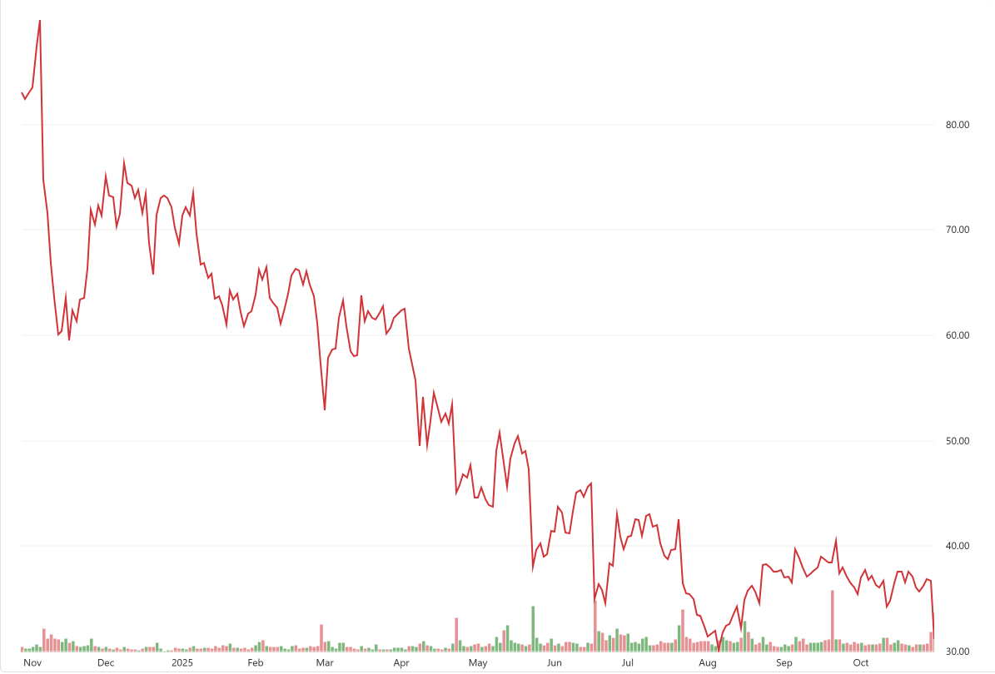
Executive Summary
Enphase Energy, Inc. is a U.S.-based leader in residential solar solutions, specialising in microinverters, energy-storage batteries, and software for monitoring and energy management. Its business model combines hardware and digital platforms, creating an integrated ecosystem that enhances performance, customer retention, and recurring revenue potential. The company maintains strong margins (~45–50%) but faces challenges from tariffs, regulatory changes, and competitive pressures in solar and storage markets. Growth opportunities lie in expanding storage, software/services, and international markets.
Newcastle University Investment Fund Training Programme
As at 29/10, Enphase trades at $31.46. Our Discounted Cash Flow Analysis implies a target price of $52.65 (base case), signalling 67.4% upside.
Session 1: What is a Stock Pitch?
We believe Enphase is undervalued because the market underestimates Enphase’s ability to evolve from a pure-play microinverter company into an integrated energy operating system, where storage, load control, and grid-services software meaningfully increase ARPU and margins.
Going from "It's a good company" to "It's a good investment"
29/10/25 Enphase Energy, Inc – (Nasdaq: ENPH)

Slide 4
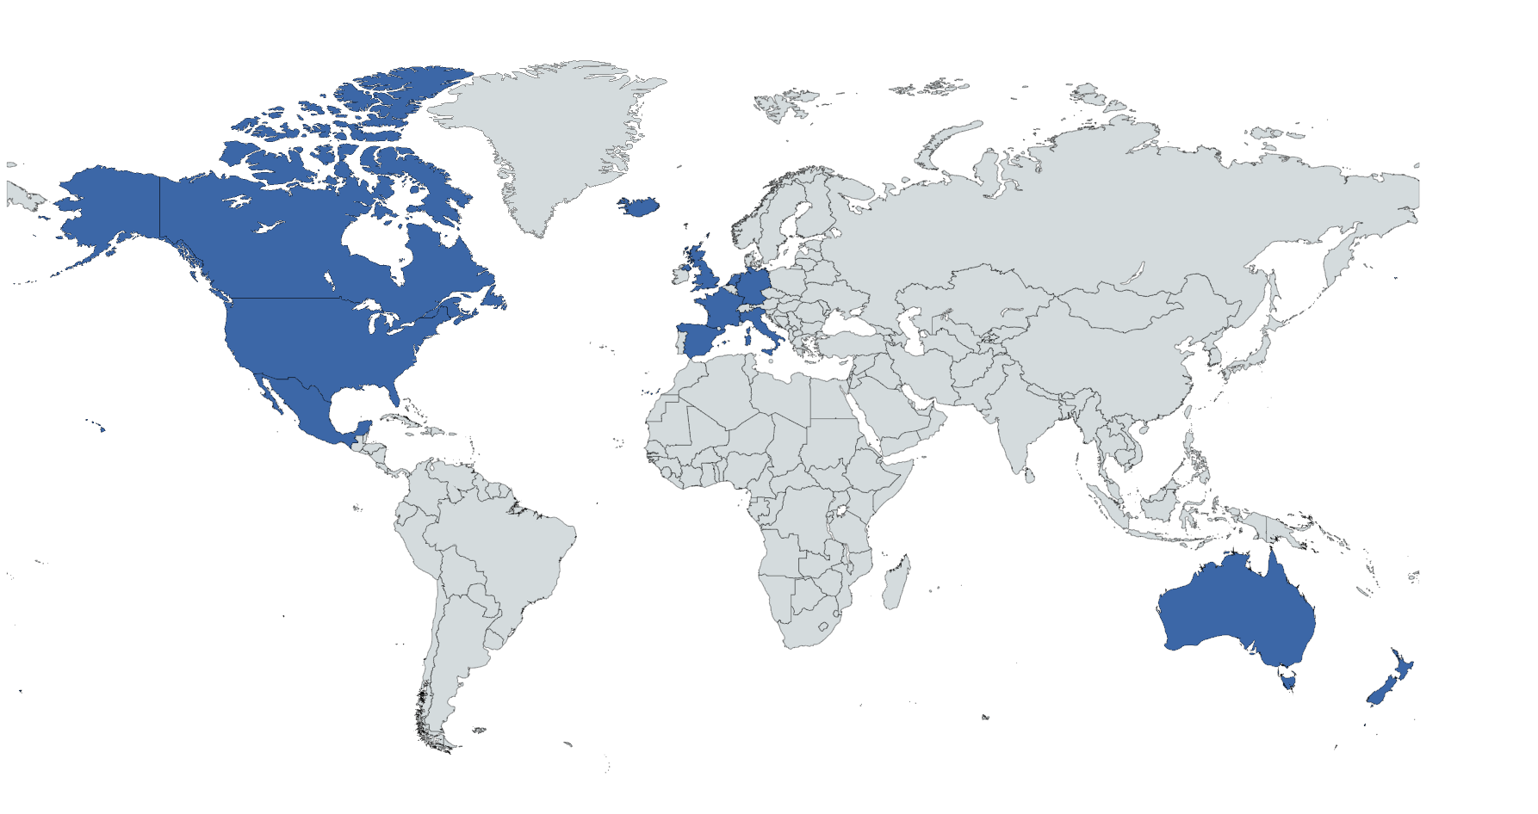
Company Overview
Leading the industry in renewable energy solutions within the solar energy sector
Product Mix within the solar industry
Key operational insight
Management
Micro inverters
Home energy management software
Accessory products
Energy storage/batteries
They operate with a significant level of operations being part of the micro inverter industry, with smaller focus yet growing interest in the energy storage industry as signalled by management. Then further backed with minority market interest in lines such as accessories and home management software
Management continuously considers tariffs, supply chain constraints and inventory risks which signals strong awareness of operational risks
Management also demonstrates strict prudence with regards to future sustainability through maintenance of a strong balance sheet, which contains significant cash reserves alongside marketable securities
Management have also proven significant capability in recent quarters to maintain and improve margins while also providing strategic insight into future operations
Consistent focus on their share repurchase program signals confidence within the near future
They make significant use of outsourcing allowing for an asset-light structure. This allows the company to adapt to changing demand levels without implications of factory slowdown. This lowers exposure to risk with minimal capital expenditure
Use of data programs with increasing focus on monitoring and detecting supply chain risks, limiting their overall exposure to negative implications
They also signal future movement to more domestic operational solutions, indicating a potential for an improved asset portfolio and less risk to international trade regulations
Newcastle University Investment Fund Training Programme
Session 1: What is a Stock Pitch?
Going from "It's a good company" to "It's a good investment"
They make use of a widely diversified geographical market
Mergers and Acquisitions
Enphase have employed M&A as a strategy to provide rapid growth, further helping them expand. Although not acquiring a firm since GreenCom Networks AG (2022) they have a history of paying cash for acquisitions thus reinforcing their strong balance sheet position
Key business components
Reliability with solar components with consistent innovative improvements. Partnered with significant R&D investment.
They offer an easily accessible service providing all necessary solar components, acting as a one stop shop, for your home renewable solar infrastructure.
Experience with being one of the market leaders within the solar development industry.
Increased exposure to growing solar renewable markets.
Allows for lower susceptibility to market fluctuations.
Allows firm to benefit from various national solar subsidy schemes.
29/10/25 Enphase Energy, Inc – (Nasdaq: ENPH)

Slide 5
Industry Overview
Inputs
Production
Distribution and retail
Leading the market within the Micro Inverter industry
Industry vertical
Regulatory factors
Subsidies for domestic manufacturing (e.g., domestic-content bonuses) strengthen local supply chains.
Renewable Portfolio Standards (RPS) require utilities to source a set share of electricity from renewables, indirectly boosting demand for solar projects
Grid access & interconnection reforms – including updated grid codes and distributed-generation rules– streamlining hook-ups and support higher solar penetration
Tariffs and trade policies can hinder cross-border integration of solar markets, though they haven’t stopped the industry’s overall globalisation
Newcastle University Investment Fund Training Programme
Collection of raw minerals and components such as polysilicon on an international scale
Completion of micro inverter devices through both in house and outsourcing methods
They will either distribute devices themselves to provide solar components or use selected and contracted distributors
Session 1: What is a Stock Pitch?
Renewable energy comparison
Key Market Factors
Technological factors
Solar is the leading renewables industry due to the overall efficiency for energy output and level of compatibility, significantly outperforming other industries with a renewable market share upwards of 40%
Declining levelised cost of energy marking it as an increasingly cheap form of new power generation
Rising grid prices are encouraging households to adopt rooftop solar and batteries—typically as grid-connected systems
Going from "It's a good company" to "It's a good investment"
Efficiency improvements
Development of battery storage capabilities allows for elements such as dispatchable power – critical for grid stability and renewable penetration
Advancements in technological capability increases efficiency in micro inverters, allowing for higher power output
Environmental & Energy transition factors
Climate change and emission goals are part of both national and organisational targets making solar an essential pillar of the energy transition
Energy security is backed up by the capability to provide domestic, renewable, and geographically secure energy supplies, reducing dependence on imported and finite fossil fuels
Solar energy has fewer land and resource constraints compared to other renewables. Rooftop installations and floating solar on water bodies are highly location-compatible and avoid the use of agricultural land, unlike wind farms which often compete with such areas
Financing capabilities are continuously growing with greater access to green bonds, solar leases, PPAs and community solar financing models
Corporate and industrial demand is growing as pledges are being adopted e.g. net zero
Economies of scale
Use of AI and cloud monitoring has drastically improved system performance with optimised predictive maintenance and grid coordination
Global manufacturing scale has dramatically driven cost declines in solar modules, with higher levels of automation and better supply gain integration
29/10/25 Enphase Energy, Inc – (Nasdaq: ENPH)

Slide 6
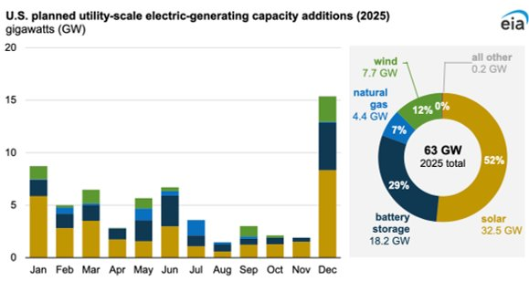

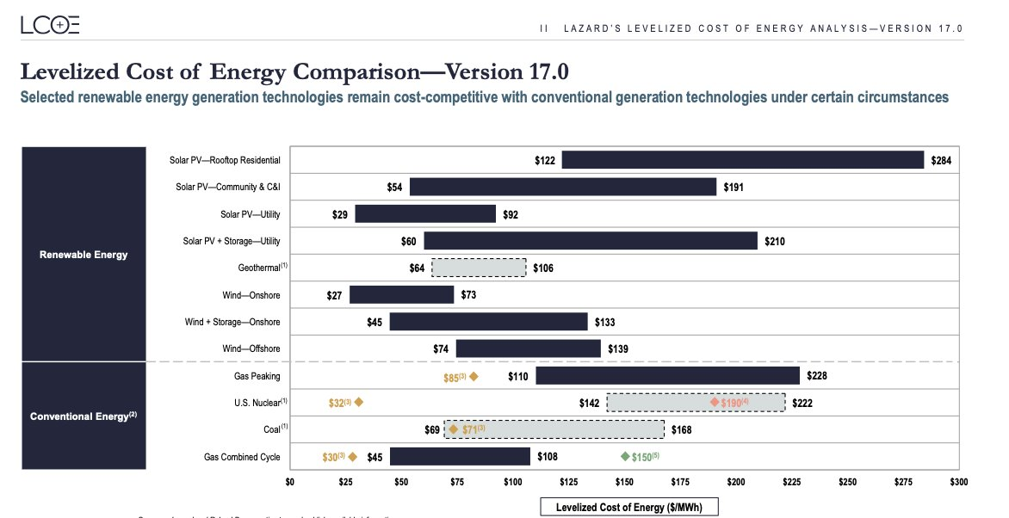
Thesis 1: Strong Fundamental Business
Enphase’s closed-loop ecosystem drives customer retention & recurring revenue through platform integration
Solar set to supply largest share of new U.S. capacity by 2025-26…
U.S. IEA report solar will account for 52% of all new U.S. generation capacity additions in 2025, totalling around 32.5 GW. Battery storage follows at 18.2 GW (29%), while natural gas and wind make up smaller shares at 7% and 12%
Newcastle University Investment Fund Training Programme
Key drivers behind Solar's growth include:
Falling installation costs: Utility-scale solar costs have declined by over 70% in past decade, outpacing efficiency improvements in competing technologies
Federal incentives: The inflation reduction act (IRA) extends long-term investment and production tax credits for both standalone solar and hybrid solar-plus-storage projects, driving sustained investment. However, this is due to be phased out at end of year 2025
Strong consumer demand: Rising retail electricity prices & increasing adoption of electric vehicles & home electrification boost rooftop & distributed adoption
Session 1: What is a Stock Pitch?
Going from "It's a good company" to "It's a good investment"
…as its cost advantage over gas and nuclear continues to widen…
Levelised cost of energy (LCOE) data from Lazard & EIA shows that Solar's LCOE is now 40-60% lower than new-build natural gas/nuclear (even before subsidies)
This sustained cost advantage positions solar (and integrated technology providers like Enphase) to capture the majority of new generation capacity in the coming decade
Enphase is directly exposed to this growth through its integrated ecosystem (below). This aligns directly with the rapid expansion of solar-plus-storage capacity in the U.S
Solar panels
Micro
inverters
Batteries
App/ IQ management
29/10/25 Enphase Energy, Inc – (Nasdaq: ENPH)

Slide 7
Thesis 1: Strong Fundamental Business
Enphase’s closed-loop ecosystem drives customer retention & recurring revenue through platform integration
These factors create switching friction, recurring revenue, and margin stability
Newcastle University Investment Fund Training Programme
As evidenced in their 2025 Q2 earnings report (compared to Q1):
Switching Friction | Recurring Revenue | Margin Stability
1.53 M microinverters – of which 1.41M were U.S.-manufactured & eligible for IRA 45X credits, reinforcing domestic scale & integration​ | 210 MWh enrolled in VPP programmes – generating recurring grid services income across the U.S., Europe, & Australia​ | 48.6% gross margin (non-GAAP) – stable QoQ despite tariff headwinds; 37.2% excluding IRA benefits​
190.9 MWh batteries (+12%) – record quarter for IQ Battery 5P, now launched in France, Spain, and the Nordics​ | Solargraf AI platform – enhanced with design automation & financing integrations; software subscriptions expanding installer stickiness​ | +4% QoQ operating income – driven by product mix improvement & cost discipline​
11.7 K installers (+7%) – expanding network creates high switching costs & stronger customer retention​ | IQ Energy Management rollout – enables optimisation of energy use, creating long-term SaaS-like recurring revenue​ | $1.53B cash + positive FCF – supports continued buybacks & R&D spend without leverage risk​
Session 1: What is a Stock Pitch?
Going from "It's a good company" to "It's a good investment"
Together, Enphase’s integrated product suite, expanding software ecosystem, and strong balance sheet reinforce its long-term structural moat – generating sticky customers, recurring platform income, and resilient margins
29/10/25 Enphase Energy, Inc – (Nasdaq: ENPH)

Slide 8
Thesis 2: Grid Modernisation & Integration
U.S. strength growing into Global Opportunity
Over 2,600 GW of generation + storage sit in U.S interconnection queues; 3x growth in 5 years
This represents a 3x increase in 5 years, highlighting rapid renewable build-out potential
Solar & storage account for >80% of this queued capacity
This indicates that the U.S. grid is testing ground for next-generation distributed energy systems
Implication for Enphase: positions in microinverters & storage systems are at the heart of this scaling trend, especially as utilities modernise interconnection & grid management
Newcastle University Investment Fund Training Programme
Session 1: What is a Stock Pitch?
Going from "It's a good company" to "It's a good investment"
Utilities are investing heavily in grid flexibility & reliability to support decentralised systems
$62.8 Bn requested in grid-modernisation & smart grid investments by the 50 largest U.S. investor –owned utilities (EEI, 2024)
Total utility CapEx projected at $1.4 Tn (2025-2030) – nearly double the previous decade
Grid infrastructure spending up 220% since 2003, with $17.4 Bn on overhead & $11.3 Bn on underground systems
Why it matters: utilities’ focus on flexibility, automation, & decentralisation aligns directly with Enphase’s distributed energy model
- Grid modernisation = increased interoperability with home batteries, VPPs, & smart inverters
- Enphase’s U.S. leadership gives it a proven blueprint
29/10/25 Enphase Energy, Inc – (Nasdaq: ENPH)

Slide 9
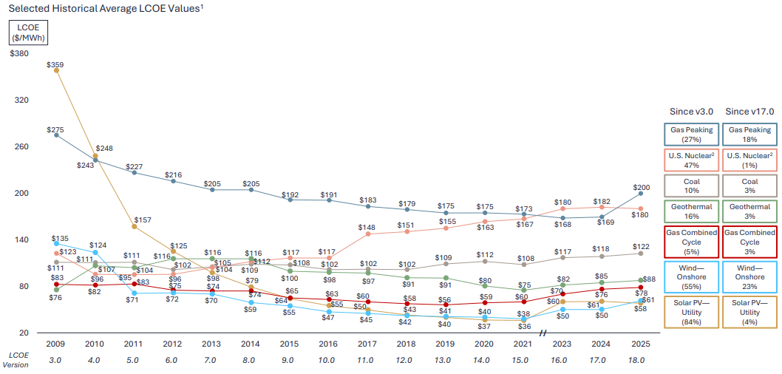
Thesis 2: Grid Modernisation & Integration
Solar + storage LCOE continues to decline, widening its cost gap over gas and nuclear (even before incentives)
IRA-driven cost advantages and domestic manufacturing scale created exportable cost leadership for U.S. companies like Enphase
As a result, distributed solar became the backbones of smart grids globally (due to it being flexible, resilient, and low-cost)
Enphase’s opportunity:
Leverage U.S. technology credibility to expand into Europe (Germany, France, Spain) & Asia-Pacific (Australia, Japan)
Localised product launches (IQ Battery 5P, IQ EV charger 2) demonstrate its ability to adapt to regional markets
Software & VPP capabilities offer scalable recurring-revenue models as utilities worldwide adopt similar decentralised frameworks
Newcastle University Investment Fund Training Programme
Session 1: What is a Stock Pitch?
Going from "It's a good company" to "It's a good investment"
The U.S. grid’s transition toward decentralisation is both a stress test & blueprint for the world. Enphase’s proven integration of solar, storage, & grid-interactive technologies positions it to export its model globally – from regulatory partnerships to VPP-enabled smart energy systems
29/10/25 Enphase Energy, Inc – (Nasdaq: ENPH)

Slide 10
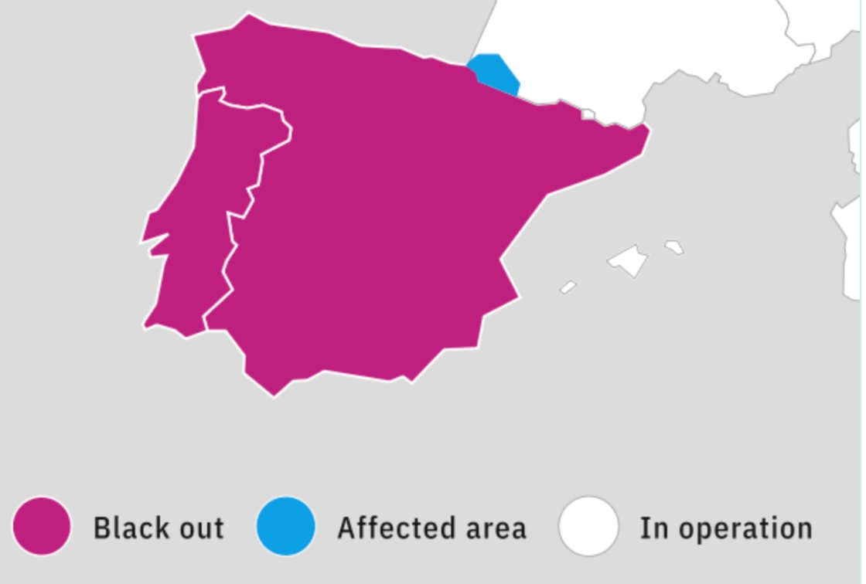
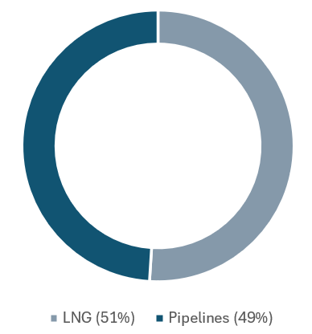
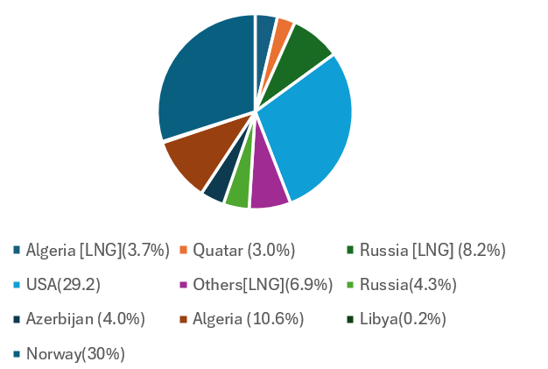
Thesis 3: Shift toward European markets
Geopolitical tension & grid instability accelerate Europe’s renewable self-sufficiency
Spain’s >40% renewable share & April 2025 blackout revealed weak storage & grid stability…
Newcastle University Investment Fund Training Programme
This highlighted Europe’s lack of grid-balancing capacity despite high renewable penetration
With renewables now exceeding 40% of total generation, Spain exemplifies a continent-wide challenge: integrating variable energy while maintaining reliability
This has driven EU utilities & governments to prioritise investment in Energy storage, distributed control systems, and smart grid software
Session 1: What is a Stock Pitch?
Going from "It's a good company" to "It's a good investment"
U.S./Qatar LNG tensions expose reliance on external energy supply
The EU imports ~70% of its natural gas, with 16% from the U.S. & 4% from Qatar
Ongoing geopolitical risk & LBG price volatility have pushed the EU to fast-track domestic solar, battery, & hydrogen production
Reducing import dependence is now both an energy security & industrial policy goal, reinforcing EU demand for distributed, locally-produced energy
This creates long-term structural demand for solar + storage systems at national & household levels
29/10/25 Enphase Energy, Inc – (Nasdaq: ENPH)

Slide 11
Thesis 3: Shift toward European markets
New EU regulations push for local, sustainable energy systems
The Corporate Sustainability Due Diligence Directive (CSDDD) and complementary ESG rules now tie energy sourcing to corporate compliance
Firms must demonstrate decarbonised supply chains, which is driving on-site solar and behind-the-metre storage adoption across industrial & commercial sectors
EU Green Deal funding channels, REPowerEU, & state aid frameworks collectively support decentralised rollout
This policy backdrop directly supports Enphase’s distributed energy architecture
Newcastle University Investment Fund Training Programme
Session 1: What is a Stock Pitch?
Enphase continues to expand across Europe
Going from "It's a good company" to "It's a good investment"
Active presence in Germany, France, Spain, Portugal, Sweden, & the Netherlands, with product localisation to meet grid & regulatory standards
IQ Battery 5P & IQ EV charger 2 now shipping to multiple EU markets, enabling both self-supply & flexible load management
SolarGraf AI platform and IQ Energy Management integrate with European feed-in & tariff systems, strengthening customer retention
EU-27 annual solar PV market scenarios from 2024-2030 (based on SolarPower Europe projections)
These forces together accelerate demand for smart, decentralised solar
EU-27 solar installations expected to grow 3x between 2024 & 2030
Grid instability, energy independence, & policy incentives all converge to create a structural tailwind for integrated platforms like Enphase
Enphase Energy, Inc - Nasdaq - ENPH

Slide 12
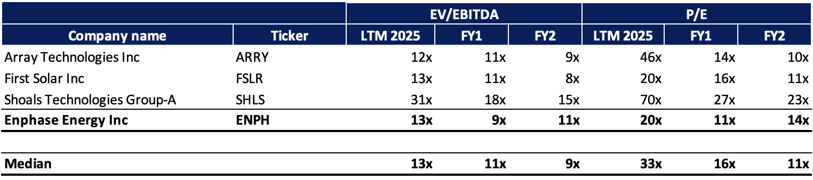
Comparable Companies Analysis
Newcastle University Investment Fund Training Programme
Session 1: What is a Stock Pitch?
Going from "It's a good company" to "It's a good investment"
29/10/25 Enphase Energy, Inc – (Nasdaq: ENPH)

Slide 13
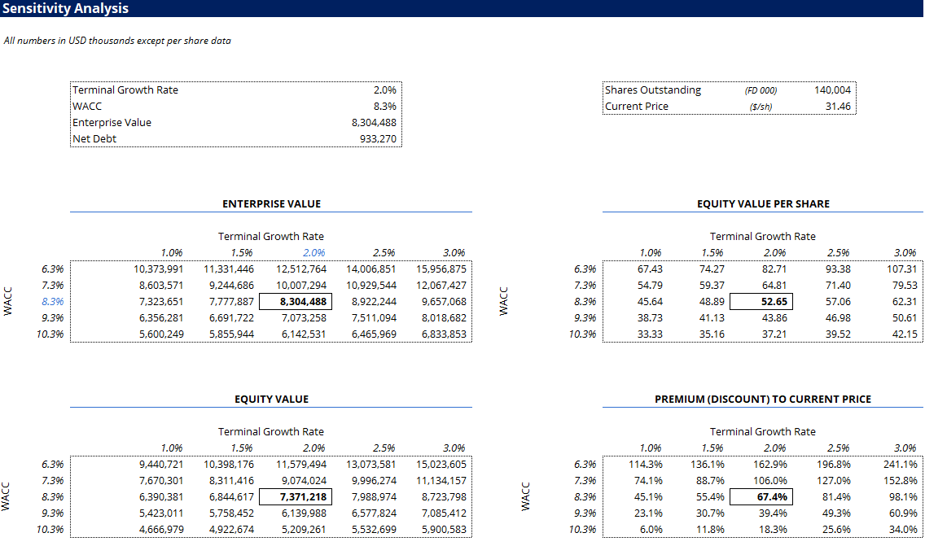
Discounted Cash Flow Analysis
Newcastle University Investment Fund Training Programme
Session 1: What is a Stock Pitch?
Going from "It's a good company" to "It's a good investment"
29/10/25 Enphase Energy, Inc – (Nasdaq: ENPH)

Slide 14
Risks and Mitigants
Prolonged Macro & Demand Slump
Persistent high interest rates and solar oversupply continue to suppress volume and margins, overshadowing ENPH's solid ecosystem strategy.
ENPH's focus is on preserving margin and pushing the higher-value solar-plus-storage bundle to increase revenue per customer.
Major Legal Overhang
The ongoing securities lawsuit and SEC investigation concerning past channel stuffing allegations create a significant credibility and financial overhang.
The company is defending itself vigorously and has operationally rectified the core issue by right-sizing European distributor inventory.
Geopolitical Trade Escalation
Current administration is likely to expand tariffs, directly impacting supply chain costs and complexity.
ENPH's diversified manufacturing footprint (U.S., Mexico, Romania, India) provides a crucial "local-for-local" buffer against regional trade disputes.
Execution in Saturated Markets
Core markets (Europe, California) are saturated and hyper-competitive, which risks damaging market share and pricing power.
Strategy hinges on increasing battery attachment rates in the U.S. and geographic expansion into less-penetrated European countries.
29/10/25 Enphase Energy, Inc – (Nasdaq: ENPH)

Slide 15
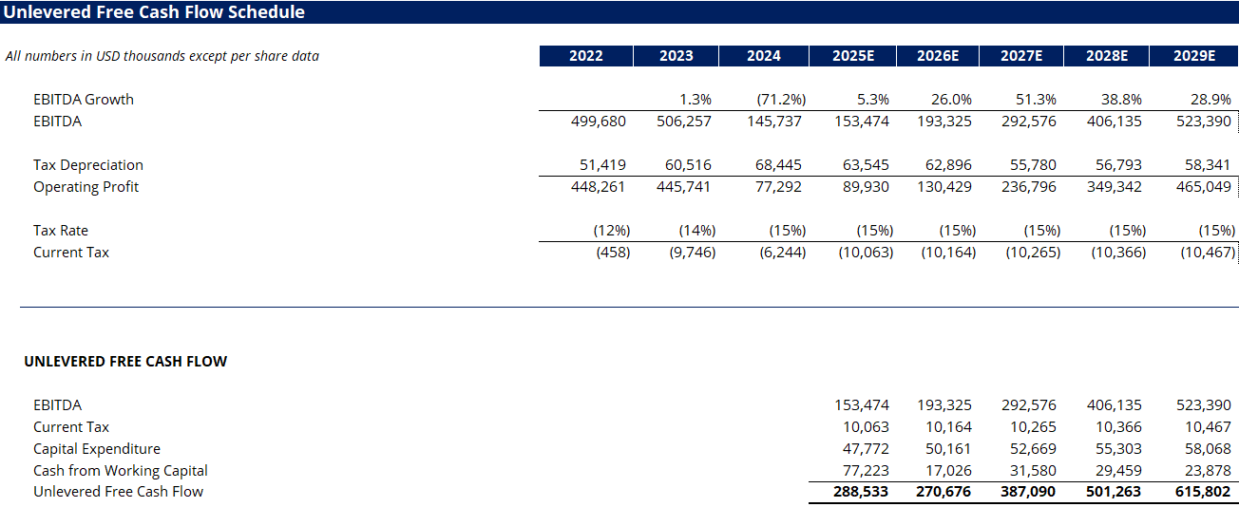
Appendix
Newcastle University Investment Fund Training Programme
Session 1: What is a Stock Pitch?
Going from "It's a good company" to "It's a good investment"
29/10/25 Enphase Energy, Inc – (Nasdaq: ENPH)

Slide 16
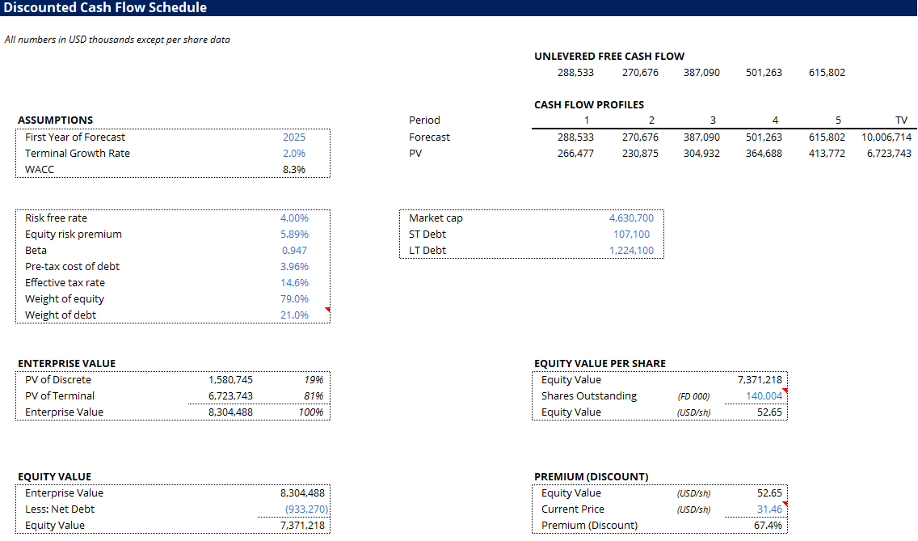
Appendix
Newcastle University Investment Fund Training Programme
Session 1: What is a Stock Pitch?
Going from "It's a good company" to "It's a good investment"
29/10/25 Enphase Energy, Inc – (Nasdaq: ENPH)

Slide 17
Reference
Enphase Energy (2024) Enphase Energy acquires SolarLeadFactory. Available at: https://newsroom.enphase.com/news-releases/news-release-details/enphase-energy-acquires-solarleadfactory/ (Accessed: 29 October 2025).
International Energy Agency (2024) Renewables 2024 – Analysis. Available at: https://www.iea.org/reports/renewables-2024 (Accessed: 29 October 2025).
Lazard (2025) Lazard's levelized cost of energy analysis—version 19.0. Available at: https://www.lazard.com/research/ (Accessed: 29 October 2025).
Enphase Energy (2025) Enphase Energy reports financial results for the first quarter of 2025. Available at: https://investor.enphase.com/news-releases/news-release-details/enphase-energy-reports-financial-results-first-quarter-2025 (Accessed: 29 October 2025).
Enphase Energy (2025) Enphase Energy reports financial results for the second quarter of 2025. Available at: https://investor.enphase.com/news-releases/news-release-details/enphase-energy-reports-financial-results-second-quarter-2025(Accessed: 29 October 2025).
Lawrence Berkeley National Laboratory (2024) Queued up: 2024 edition. Available at: https://emp.lbl.gov/sites/default/files/2024-04/Queued%20Up%202024%20Edition_0.pdf (Accessed: 29 October 2025).
Newcastle University Investment Fund Training Programme
Session 1: What is a Stock Pitch?
Going from "It's a good company" to "It's a good investment"
29/10/25 Enphase Energy, Inc – (Nasdaq: ENPH)

Slide 18
Disclaimer
Analyst Disclaimer
This communication is prepared by students at the Newcastle University for the sole and educational purpose of the Newcastle University Investment Fund. The Newcastle University Investment Fund is not authorised, supervised, nor regulated by any financial authority in the world to provide financial services or advisory. The Newcastle University Investment Fund may hold a position in any security mentioned and may change that position at any time, without public announcement.
General Disclaimer
The information in this pitch is not intended to be and does not constitute investment or financial advice. You should not make any decision based on the information provided without conducting independent due diligence. This communication may contain an investment recommendation, however, the Newcastle University Investment Fund and all members disclaim all liability for providing this investment recommendation and accept no liability whatsoever for any direct, indirect or consequential loss arising from its use. Not all investment strategies are appropriate at all times, and past performance is not necessarily a guide to future performance. You should consider yourself warned that following the investment recommendations of untrained University students is unlikely to be a profitable investment strategy.
Any opinions or estimates expressed herein reflect the judgment of the author(s) as of the date the presentation was prepared and are subject to change at any time without notice. Unless otherwise stated, the information or opinions presented, or the research or analysis upon which they are based, are valid at the point of publication, as they are not updated in real time to take account of changes in the financial markets or new news about the issuer or financial instruments. The author(s) may provide hyperlinks to websites of entities mentioned in this investment recommendation, however the
inclusion of a link does not imply that the Newcastle University Investment Fund endorses, recommends or approves any material on the linked page or accessible from it.
Newcastle University Investment Fund Training Programme
Session 1: What is a Stock Pitch?
Going from "It's a good company" to "It's a good investment"
29/10/25 Enphase Energy, Inc – (Nasdaq: ENPH)

