Slide 1
Mall customers Segmentation
Samraddhi Shrivastava​

Slide 2
Introduction
Identify those customers who would be interested in certain products, offers, and services. The store may strategize its offerings in such a way that it targets only the right customers for specific products. This helps in creating a win-win situation for both the store (in terms of revenue and more customers through customer recommendation) and the customer (discounts, offers, reward points, gifts, etc.).

Slide 3
Business Objective
To create a Customer cluster to identify the different types of customers

Slide 4
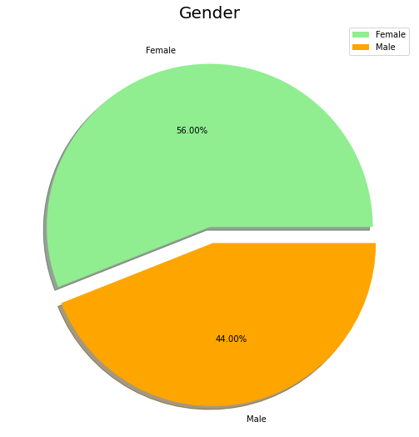
Data visualization
Interpretation ::::
By looking at the above pie chart which explains about the distribution of Gender in the Mall
Interestingly, The Females are in the lead with a share of 56% whereas the Males have a share of 44%, that’s a huge gap especially when the population of Males is comparatively higher than Females.
Female | 112
Male | 88

Slide 5
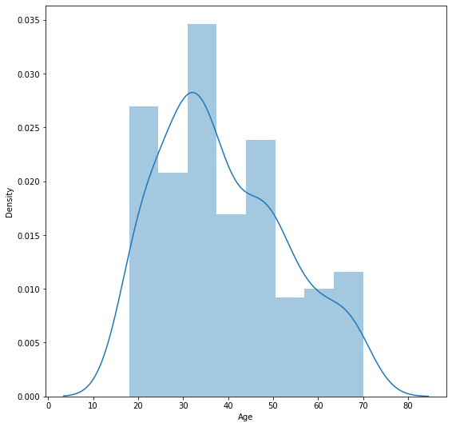
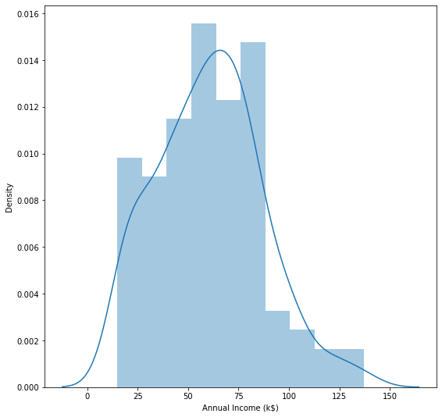
Distribution plot of Age and Annual Income
Minimum | 18
Maximum | 70
Minimum | 15
Maximum | 137
Interpretation ::::
from the above graph we can say that the highest customer age range is from 30 to 40, and after that number of customers are decreasing.
Interpretation ::::
By looking at the above distribution plot we can say that t highest annual income of our customers is 60k−75𝑘−75k.

Slide 6
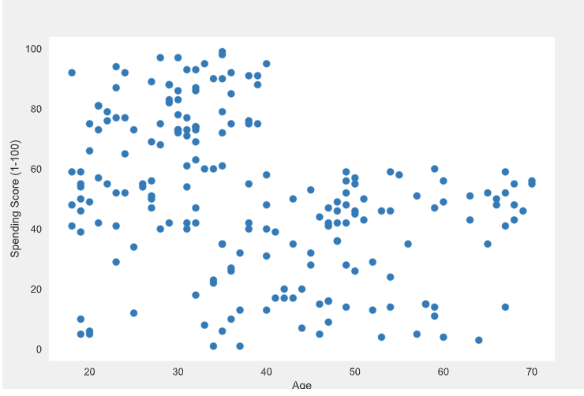
Spending score vs Age
Interpretation ::::
In age vs spending score, we can say as age increases the spending score decreases, also we can see the highest spending score is between the range of 20 to 40.
From here we can say that people of age till 40 are more fascinated to buy high priced products,
And customers with family and customers of old age are likely to spend less, but they are our customers, Soo, we can keep medium range products for such group.

Slide 7
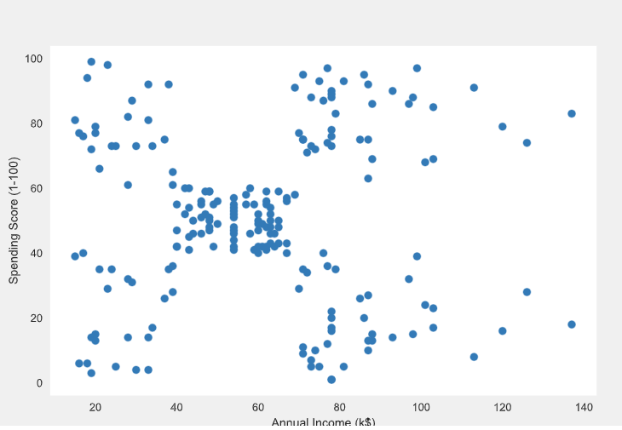
Spending score vs Annual Income
Interpretation ::::
Annual income and spending scores are divided into different groups, from here we can see that there are groups of customers earning less as well as spending less, then customers who are earning well but their spending score is very less, then medium one who earn and spend equally, then people who are earning high with high spending score and some who do not earn high but have high spending score.

Slide 8
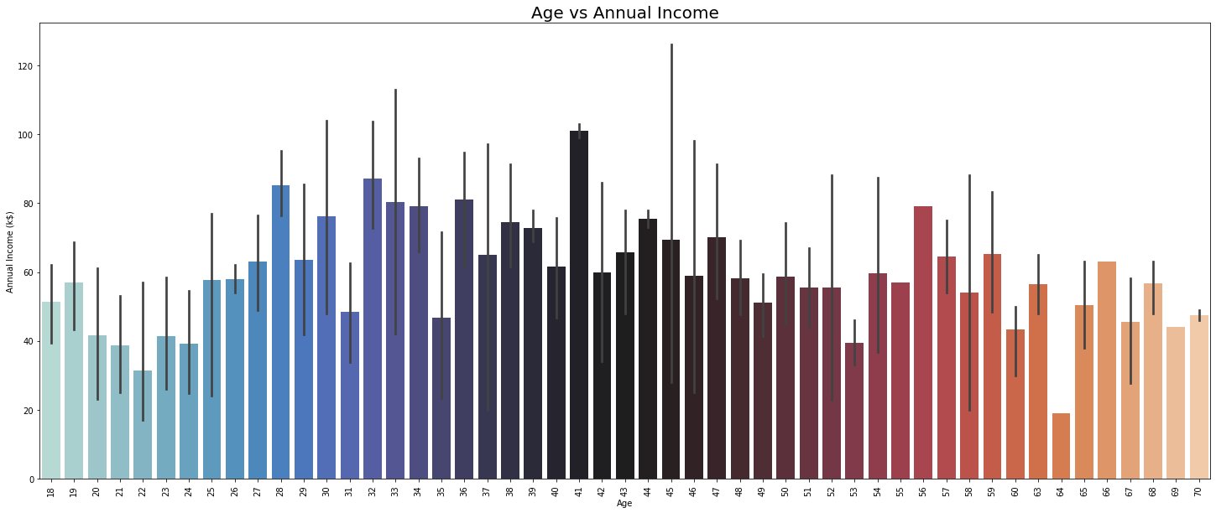
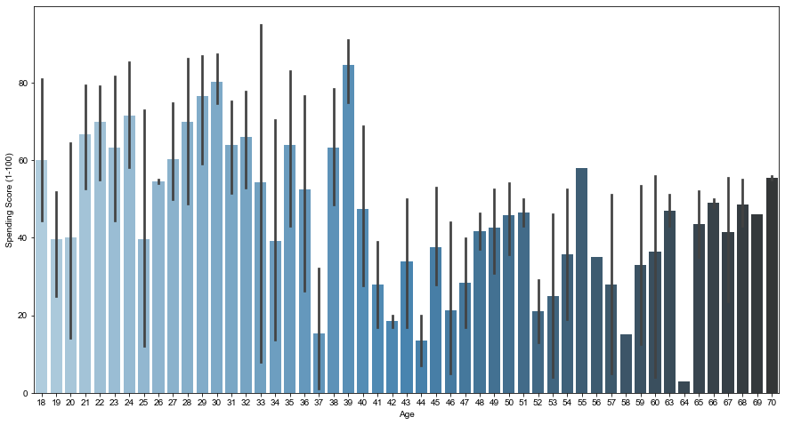
Age vs Annual Income
Age vs Spending Score
Interpretation ::::
The annual income is maximum at the age of 33 and 42
Interpretation ::::
We can see that the age between 20 and 40 get the maximum spending score and the reason behind it is that their annual income is very high.

Slide 9
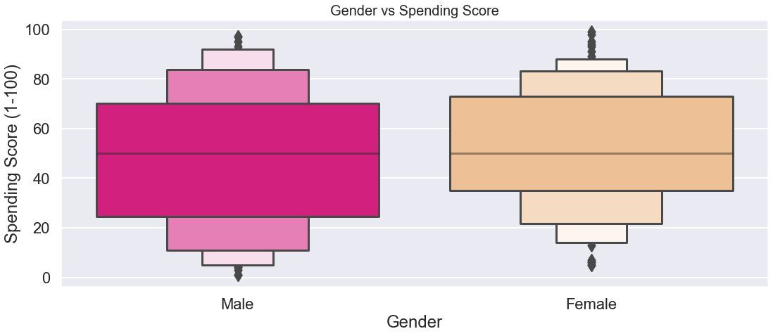
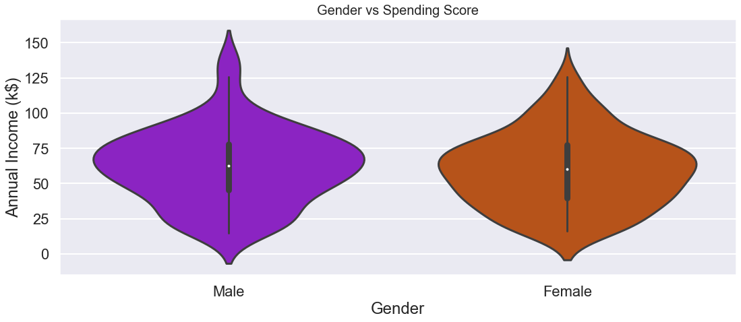
Gender vs Spending Score
Gender vs Annual Income
Interpretation ::::
It is clearly visible that most of the males have a Spending Score of around 25k US Dollars to 70k US Dollars whereas the Females have a spending score of around 35k US Dollars to 75k US Dollars. which again points to the fact that women are Shopping Leaders.
Interpretation::::¶
From the above graph, we can see that there are more males who get paid more than females. But, The number of males and females is equal in number when it comes to low annual income

Slide 10
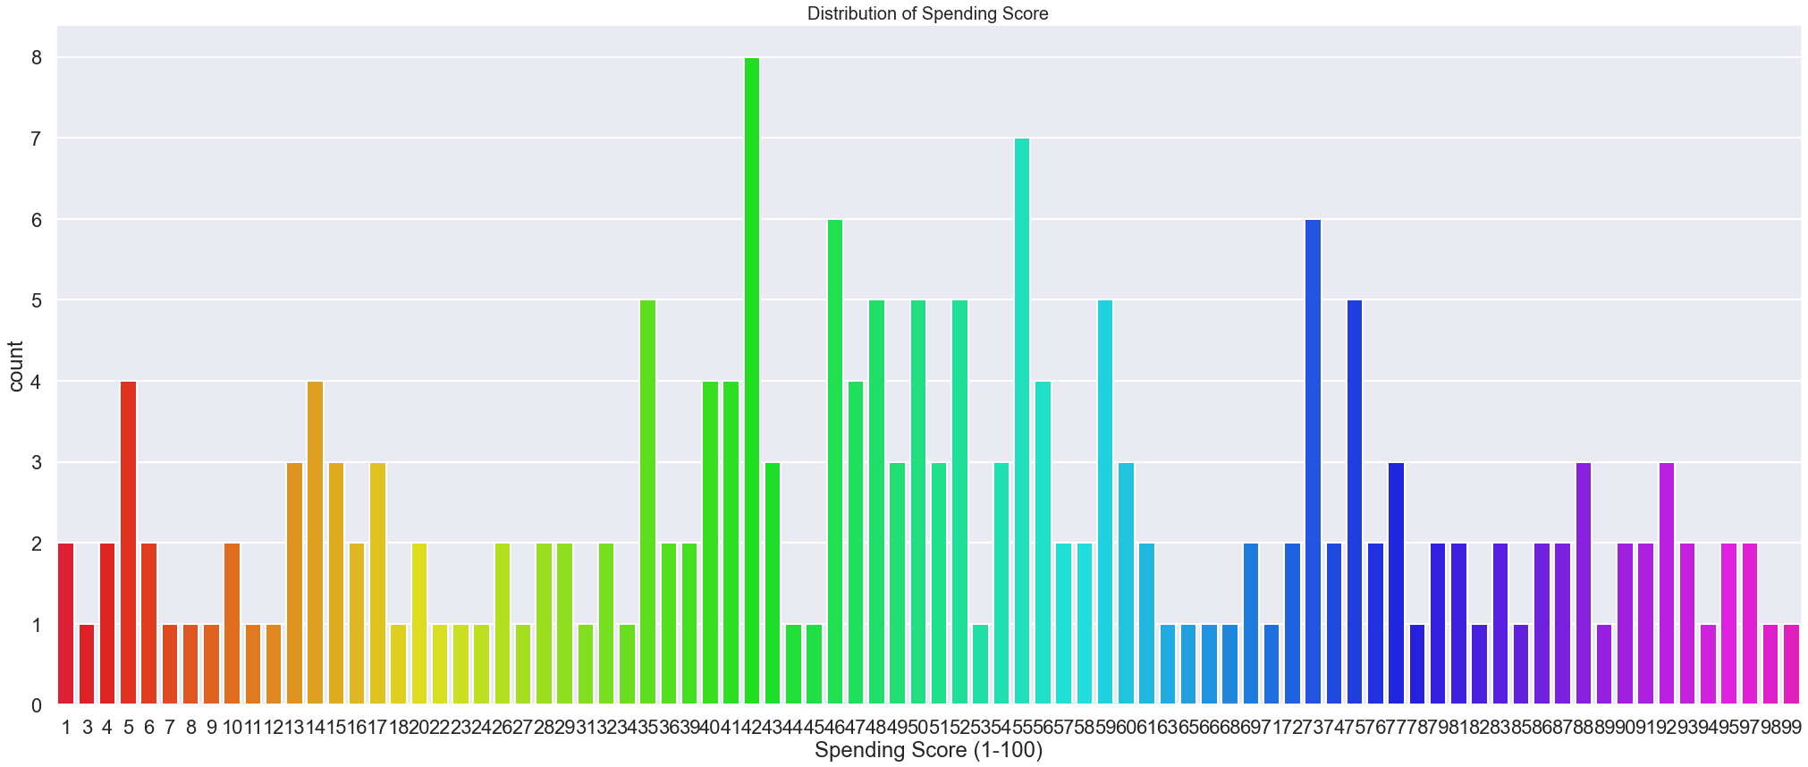
Distribution of Spending Score
Interpretation ::::¶
From the above graph, we can see that the total spending score by a single person is 99 and the maximum person get 42 as the total spending score.

Slide 11
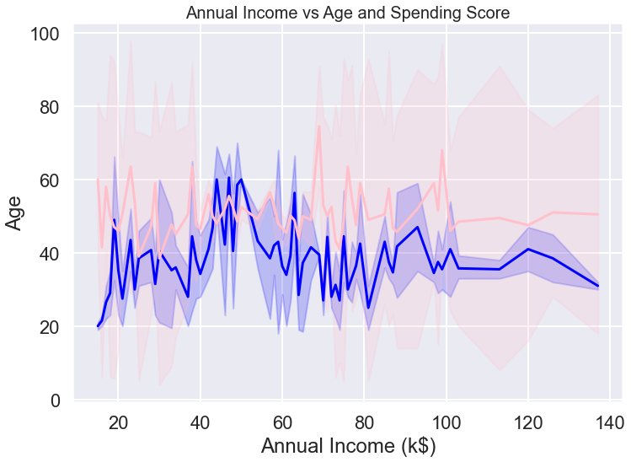
Annual Income vs Age and Spending Score
Interpretation ::::
The above Plot Between Annual Income and Age represented by a blue color line and a plot between Annual Income and the Spending Score is represented by a pink color. It shows how Age and Spending Vary with Annual Income.

Slide 12
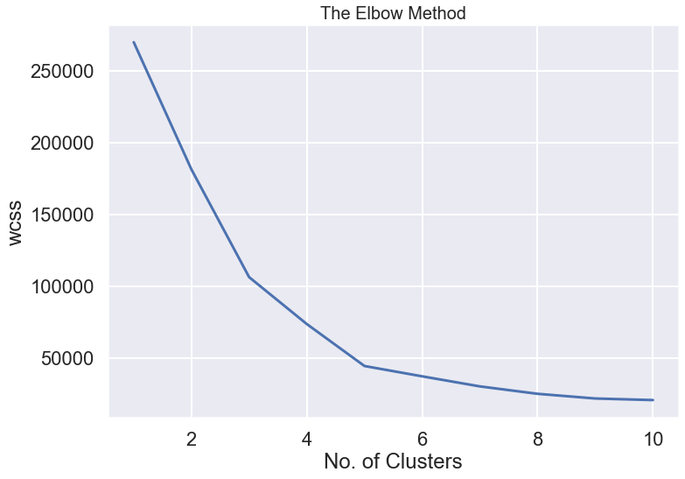
Elbow Method to Find the Number of Optimal Clusters
For n_clusters = 2 The average silhouette score is : 0.2968969162503008
For n_clusters = 3 The average silhouette score is : 0.46761358158775435
For n_clusters = 4 The average silhouette score is : 0.4931963109249047
For n_clusters = 5 The average silhouette score is : 0.553931997444648
For n_clusters = 6 The average silhouette_score is : 0.5376203956398481 For n_clusters = 7 The average silhouette_score is : 0.5270287298101395 For n_clusters = 8 The average silhouette_score is : 0.4572211842776841

Slide 13
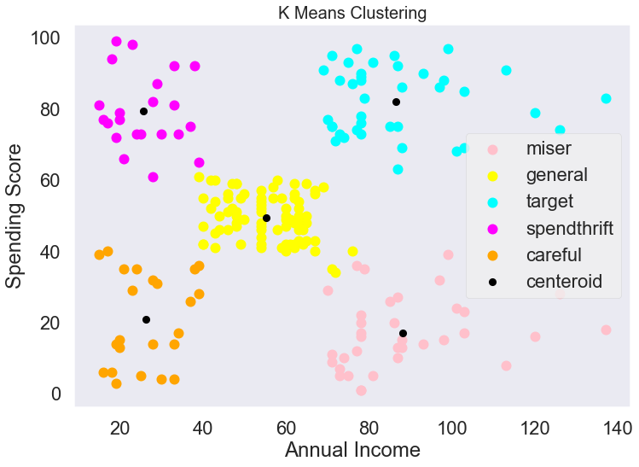
Visualizing Clusters Obtained from Kmeans clustering

Slide 14
Project Synopsis:::::
This is a project of clustering over shopping mall customer data set. First I implemented K means clustering then I implemented hierarchical clustering. I finally get 5 clusters from the to scatter plot diagram. In hierarchical clustering, I plotted a dendrogram graph. 5. In each clustering we have got a centroid which is equidistance.
Final Interpretation::::
**The males have a Spending Score of around 25k US Dollars to 70k US Dollars whereas the Females have a spending score of around 35k US Dollars to 75k US Dollars. which again points to the fact that women are Shopping Leaders.
** We can see that the age between 25 and 40 get the maximum spending score and the reason behind it is that almost we all got settled till this age in our career, also this age is of less responsibility and good income, also we have already analysed they have a high annual income
Analysis by cluster::::
1)A miser is a label I have given to the people who earn very well but do not like to spend, they are on those who are in the age above 40.
2)general is the label given to people who earn a medium amount of money monthly and whose spending score is average.
3)target people who earn more than 70k and whose spending score is also high, these are the people we need to focus on, they may be working as bachelor’s or family with good income sources.
For such customer attraction, we can increase clothes and fashion accessories, home decor products, watch range, and perfume collections from good brands.
4) Some people are not even earning but spend a lot that may be the college students but they are not our target customers.
5) people who even do not earn well also cant spend.

Slide 15

Thank you

