Slide 1




DAY 6
AI Architecture & Backend Integration
TEAM CONTRIBUTIONS
OBJECTIVE
Design AI system architecture
Finalize backend APIs
Standardize request-response communication
Project Lead / Backend (Ritika)
AI/ML Engineer
Frontend Developer
QA Engineer
Prepare frontend integration
Finalized AI API endpoints
Designed LangGraph multi-agent architecture
Built reusable UI components
Reviewed AI workflow
Designed JSON request-response contracts
Defined AI workflow
Prepared API integration
Validated API contracts
Planned backend integration flow

Slide 2



Backend APIs for AI Module
Endpoints exposed by FastAPI to the AI module
POST
POST
POST
/analyze-company
/lead-score
/generate-email
Company Intelligence
AI Lead Scoring
AI Outreach Generator
STANDARD JSON COMMUNICATION
REQUEST
RESPONSE
{ "company": "Google", "industry": "Technology" }
{ "lead_score": 92, "grade": "A", "priority": "High" }

Slide 3




AI Integration Flow
Click through to reveal each hop of the request lifecycle
Frontend
FastAPI Backend
Gemini / LangGraph
JSON Response
Frontend Dashboard
Streamlit
REST layer
AI reasoning
Structured data
Rendered insight
BENEFITS
Modular Architecture
Easy Integration
Fast Response
Scalable APIs
Presenter tip: animate these five boxes and connecting arrows to appear one-by-one in PowerPoint (Animations → Appear / Fade, click sequence) to walk the audience through Frontend → Backend → AI → Backend → Frontend.

Slide 4
System Architecture Flow
How a single request travels from the UI through the AI services and back
Streamlit UI
FastAPI Backend
Analyze Company
Lead Score
Email Generator
Gemini AI API
JSON Response
Streamlit Dashboard
The FastAPI backend fans a request out to three specialized services, each calling Gemini AI, then returns structured JSON that Streamlit renders on the dashboard.

Slide 5
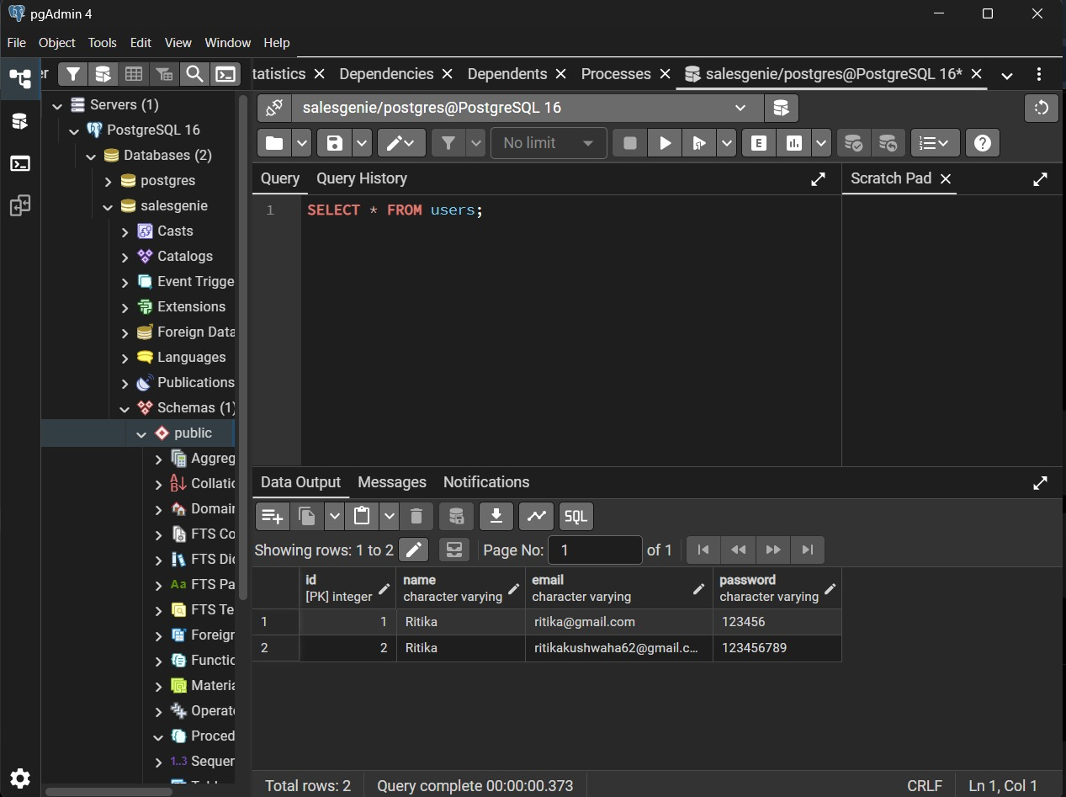
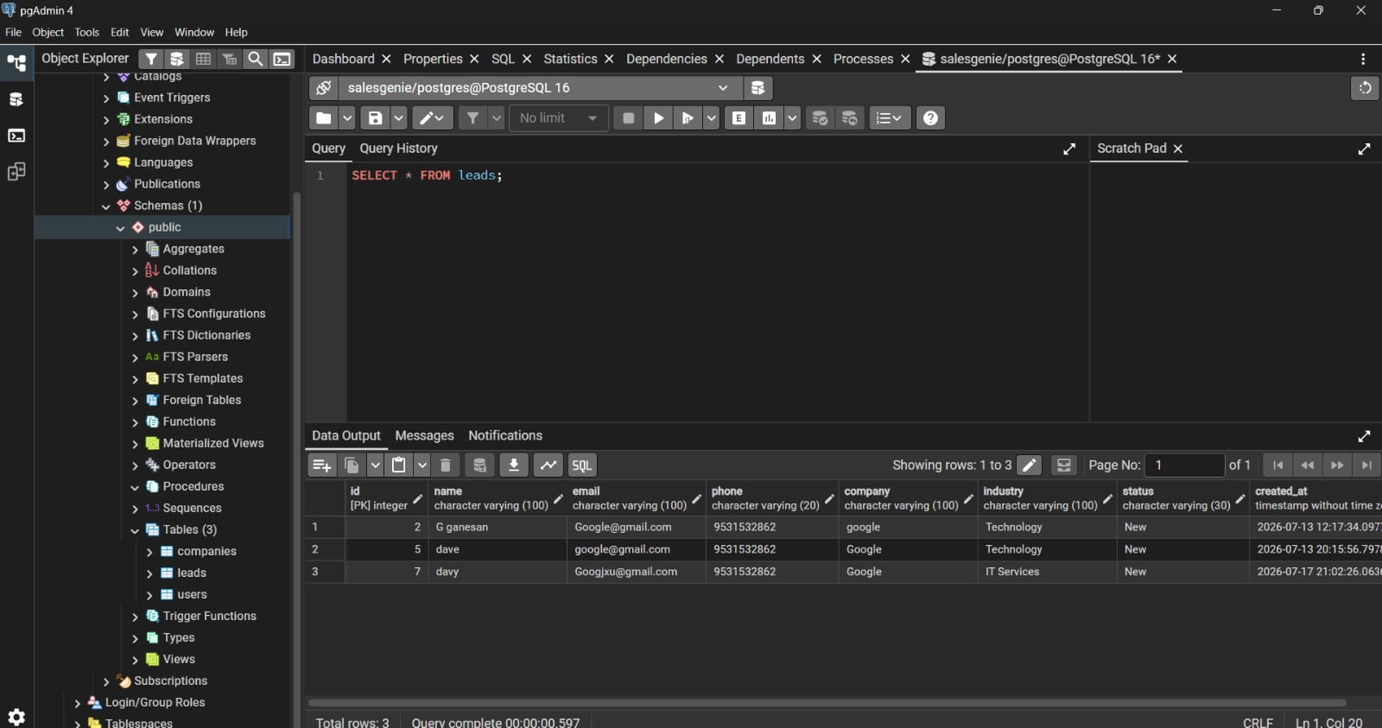
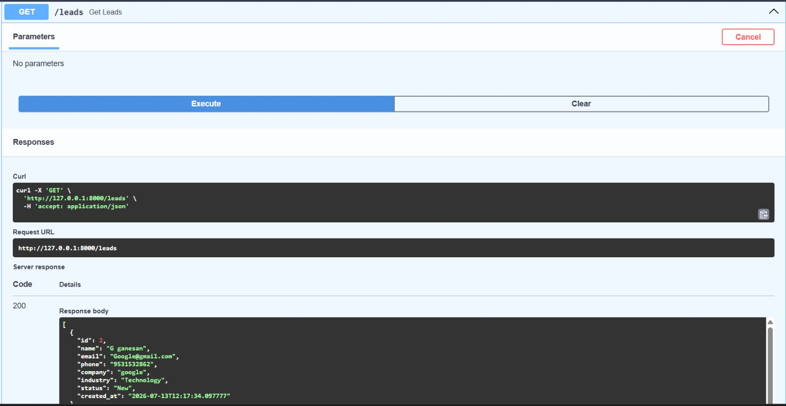
Users Table Verification
pgAdmin confirms user records persist correctly in PostgreSQL
USERS TABLE
SELECT * FROM users — 2 records stored

Slide 6
Leads Table Verification
pgAdmin confirms lead records persist correctly in PostgreSQL
LEADS TABLE
SELECT * FROM leads — 3 records captured

Slide 7
API Response Verification
FastAPI Swagger console verifies the /leads endpoint response
API RESPONSE
GET /leads → 200 OK, JSON verified

Slide 8
Team Progress
Day 6 completion snapshot across the team
MEMBER
WORK COMPLETED
Ritika
Backend AI APIs & JSON Contracts
Samrajyam
LangGraph AI Architecture
Tejashwini
Reusable UI Components
Aditi
Database review for AI modules
Rushikesh
API & Workflow Testing

