Slide 1


Direct marketing campaigns (phone calls) of a Portuguese banking institution
Executive Summary:
The main focus of this project is to Predict whether the client will open a term deposit (variable y) using sociodemographic, social and economic context attributes and account attributes.
Different supervised classification models were used and the most important features for the high score model (Ridge) explored are:
Consumer price index, Communication type cellular
Contact Month Jul, Consumers confidence Index
Age, Job technician
The results show that the Logistic regression model (using Ridge algorithm) is the best model for prediction.
Notes:
Data Exploration
The dataset comes from Kaggle,
Related to direct marketing campaigns (phone calls) of a Portuguese banking institution.
More than one contact to the same client was required, in order to access if the product (bank term deposit) would be ('yes') or not ('no') subscribed.
Goal: The classification goal is to predict whether the client will subscribe (1/0) to a term deposit (variable y).

Slide 2

Objective:
To predict whether potential consumers will put deposits.
To find out what machine learning model can predict the target variable better than other used ones
to find out what features affect consumer decision to put deposits

Slide 3

Dataset Overview
Feature Variables (21)
Age | communication type | outcome of the previous marketing campaign(poutcome)
Job | month | Employee variation rate
Marital | last_contact_day | consmer_price_indx
Education | last_contact_duration | Consumer confidence index
Have_credit by default | Number of contacts with client | euribor 3 month rate
Housing loan | Number of days client was contacted in prev_campaign | employed staff rate
Personal loan | no_contct_bef_campaign_wth_samepersn
Target is ‘open deposit account or not’.
Dataset Size → 2999 observations with 21 feature.

Slide 4
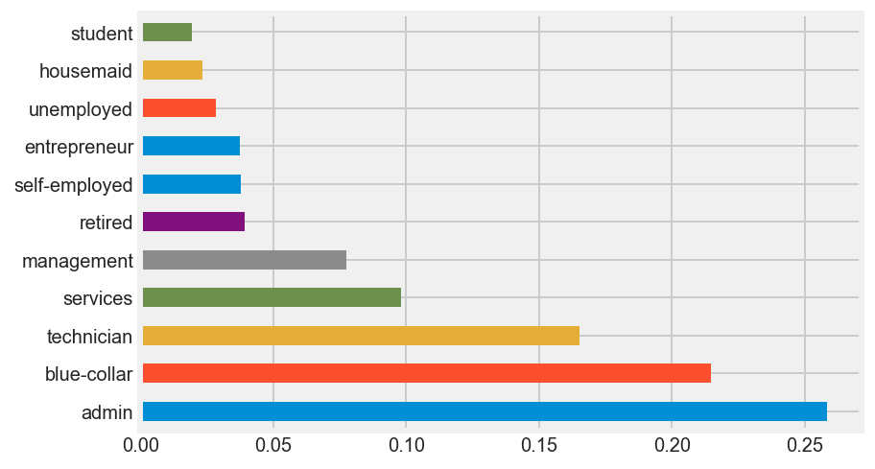
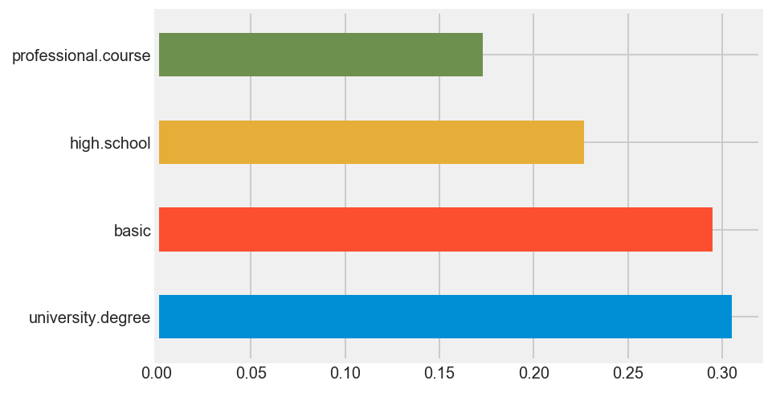
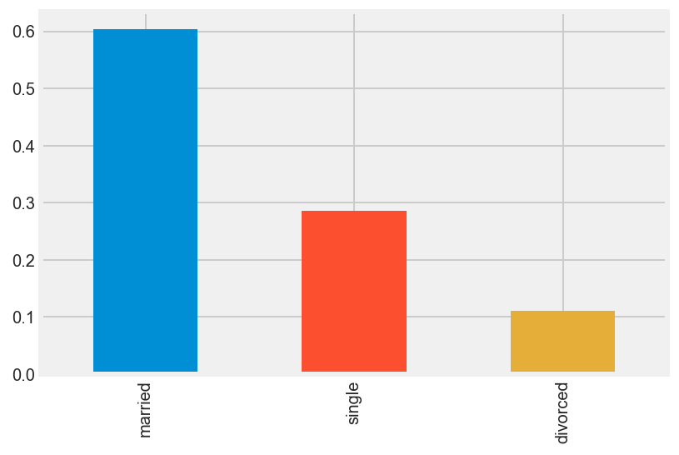
Exploratory Data Analysis Part1
Percentage of education levels
Percentage of different job types
Percentage of Marital status
Percentage
Majority of potential customers are either highly educated or have basic level of education
About 50% are either have admin (26%) or blue-collar jobs(22%).
More than 60% are married
Notes:
blue-collar worker, whose job requires manual labor

Slide 5
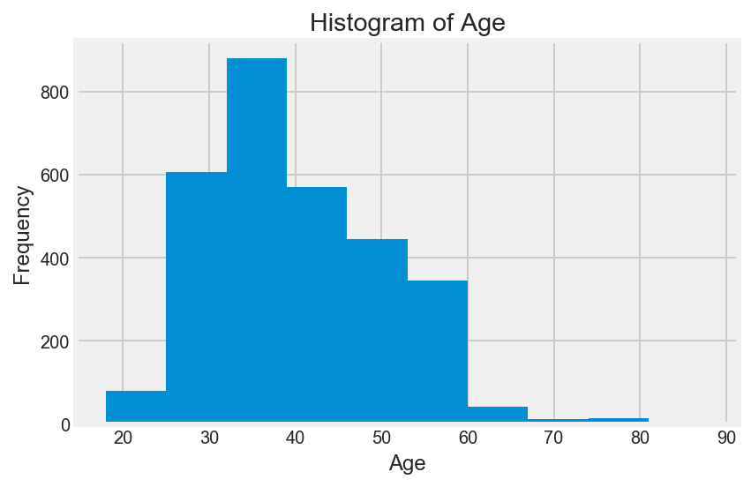
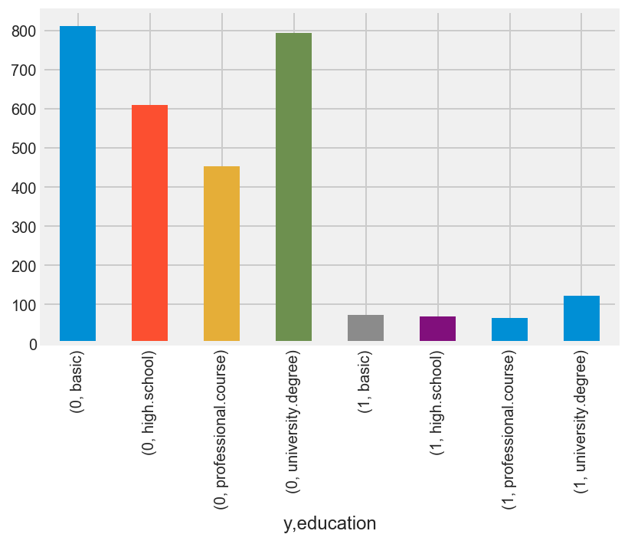
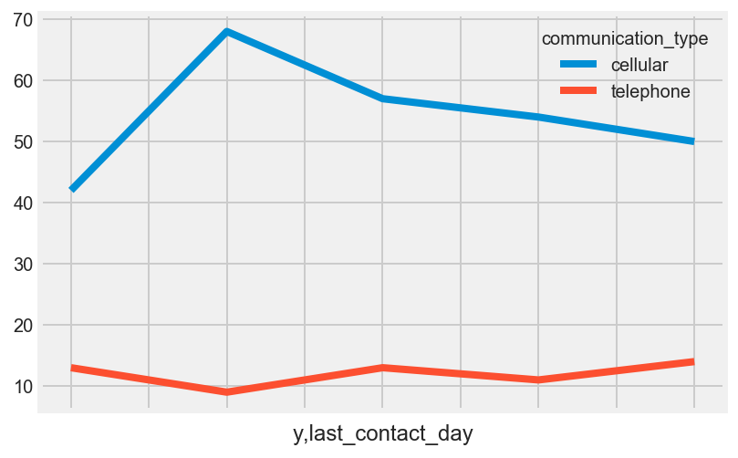
Exploratory Data Analysis2
Majority of customers were age bet ween 30-40(Gen Y)
Char: Majority of them use the web and are mobile web user.
They seek out info and engage in two-way brand conversation.
Monday
No wonder that majority of them use cellular phones
Majority of contacts who put deposits for cellphone users were contacted on Mondays
y=1
Notes:
Majority of them use the web and are mobile web user.
They seek out info and engage in two-way brand conversation.

Slide 6
Feature Engineering Part 1 - Dealing with Multicollinearity
Used VIF Variance Inflation Factor to detect multicollinearity.
The Variance Inflation Factor (VIF) is a measure of collinearity among predictor variables within a multiple regression.
Benchmark: If the VIF is between 5-10, multicollinearity is likely present and you should consider dropping the variable.
Columns deleted
nr_employees (Number of employees)
euribor3m (Euro rate for last 3 months)
Previous_campaign_outcome (previous campaign outcome)

Slide 7

Feature Engineering Part 2 - Dealing with Imbalanced Dataset
Problem –
Imbalance dataset:
88%: Didn’t put a deposit.
In other words the baseline accuracy was 88%
Solution – The word is SMOTE !!!

Slide 8
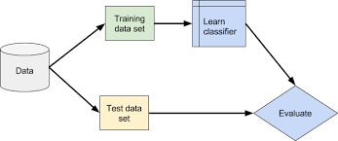
Modeling Workflow
SMOTE
Train-test split on your original data, for myself. 0.1:0.9.
On the train data set, upsampling to make it a 50-50 split because of class imbalance.
GridsearchCV on the training data set for all the learning algorithms.
Check the baseline on the training set.
Put in your test set on your best_estimator for each learning algorithm.
Used the AUCROC score here to comapare models

Slide 9
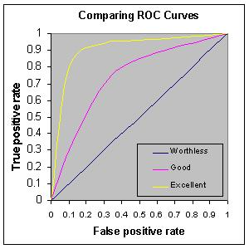
Model Evaluation and Metrics
.
Accuracy score is influenced by imbalanced dataset.
Used AUROC
Not influenced by imbalance dataset.
The true positive rate is plotted in function of the false positive rate
For Demo only, not model results
Notes:
AUC means Area Under Curve ; you can calculate the area under various curves though. Common is the ROC curve which is about the tradeoff between true positives and false positives at different thresholds. This AUC value can be used as an evaluation metric, especially when there is imbalanced classes. true positive (TP) : predicted to be positive and the actual value is also positive false positive (FP) : predicted to be positive but the actual value is negative true negative (TN) : predicted to be negative and the actual value is also negative false negative (FN) : predicted to be negative but the actual value is positive AUROC NOT INFLUECNED BY IMBALNCE DATASET AND ACCURACY IS influenced. test of comparison between true positive rate compare to false positive

Slide 10
Various Model Results
Baseline=0.5
Notes:
Baseline=0.5
A super important fact we need to notice about ridge regression is that it enforces the βcoefficients to be lower, but it does not enforce them to be zero. That is, it will not get rid of irrelevant features but rather minimize their impact on the trained model.

Slide 11
Notes:
Sort_value=Ridge

Slide 12
Important features
No | Ridge | SVM | ExtraTree | Lasso | Random Forest
1 | Consumer price index | month_jun | communication_type_cellular | Consumer price index | age
2 | Communication type cellular | n_days_clcontact_prev_campaign | n_days_clcontact_prev_campaign | n_days_clcontact_prev_campaign | conmrs_confidnc_indx
3 | Contact Month Jul | month_oct | conmrs_confidnc_indx | month_mar | consmr_price_indx
4 | Consumers confidence Index | month_mar | housing_loan_no | conmrs_confidnc_indx | n_days_clcontact_prev_campaign
5 | age | communication_type_cellular | marital_single | housing_loan_no | marital_single
6 | Job technician | age | month_jun | age | housing_loan_no

Slide 13
Conclusion
Economic factor (Macro economical factor) :
The Consumer Price Index (CPI) is a measure that examines the weighted average of prices of a basket of consumer goods and services
Social: Communication type: cellular
Target this group through social media in platforms they are active
Month-July:
Is the time people may receive the end of financial year
Economic factor(Macro economical factor ): Consumer confidence
The degree of optimism that consumers are expressing through their activities of savings and spending.

Slide 14


