Slide 1
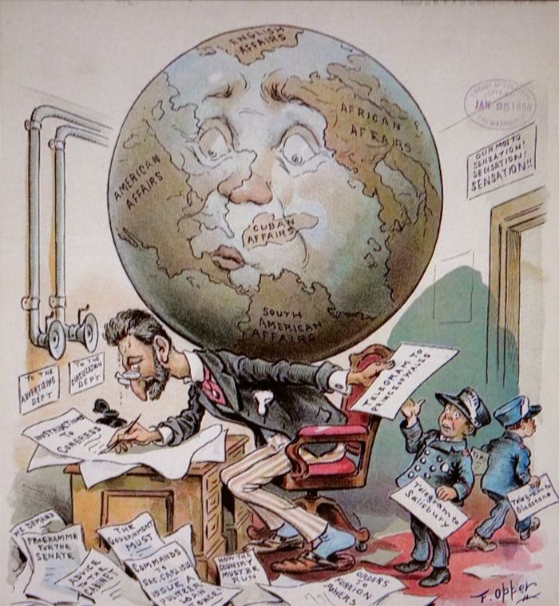
Detecting Bangla Fake News With Machine Learning: Multi-Algorithm Approach

Slide 2
Submitted By | Supervised By
 | Mahmuda Khatun Assistant Professor, Dept. of CSE Comilla University
MD. Samrat Hossen | ID: 11808050
Maymuna Akter | ID: 11808026
Jannatul Ferduse | ID: 11808002

Slide 3
Outlines
Introduction
Objectives
Motivation
Literature Review
Methodology
Result
Conclusion
Reference

Slide 4

Introduction
Fake news can be defined as fake news appearing as true news.
Our goal is to develop a model that can predict if a piece of news is real or false using machine learning techniques with an increased chance to stop negativity and confusion across the country.
False news is spread to incite racism, feed people's anxieties, and fuel bullying and violent acts against the defenseless.

Slide 5
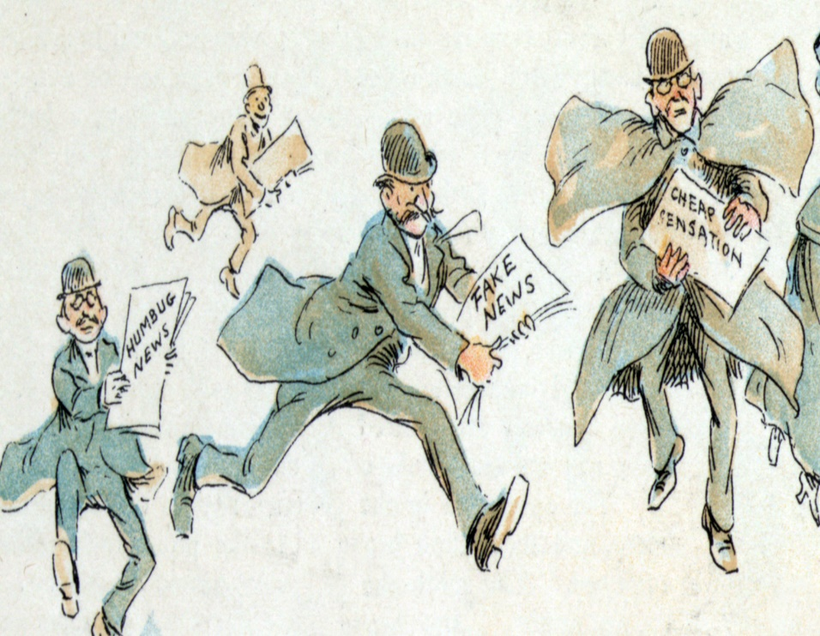
Fake news is like cancer, it spreads at a very speed rate.
Fake News causes a lot of unwanted incidents.
Ensuring decrease of fake news as much as possible to avoid causalities happening around our country for fake news.
Spreading fake news has become one of the main problems in every country.
Motivation

Slide 6
Objectives
Preserving information integrity
Enhancing Media Literacy
Maintaining Trust in Media
Mitigating Social Polarization
Contributing to technological Advancements

Slide 7
Contribution
Enhancing Performance
Multi-model integration
Real time detection system
Specializing for Bangla news
Ethical and Fair Solutions

Slide 8
Literature Review
No | Author/year | Title | Methodoloy | Accuracy | Limitation/Gaps
1 | Shaina Raza,Chen Ding( 30 January 2022) | Fake news detection based on news content and social contexts: a transformer-based approach. | A Deep Neural Network Architecture,Transformer Architecture,BERT Model | FND-NS :0.748 SVM-L : 0.415 BERT: 0.640 XGBoost : 0.510 Tranf: 0.62 | Represent a limited amount of fake news detection analysis over a given period. Only use a small portion of users profiles from the currently available dataset.
2 | Md Gulzar Hussain, Md Rashidul Hasan, Mahmuda Rahman, Joy Protim and Sakib Al Hasan.( 2020) | Detection of Bangla Fake News using MNB and SVM Classifier. | Machine learning algorithms, Multinomial Naive Bayes (MNB) and Support Vector Machine (SVM). | Achieved 93.32% accuracy. | Classifiers are limited to only the Bangla language and generate poor macro F1 scores. Need to require additional text capabilities and fusion features
3 | Chih-Yuan Li, Navya Martin Kollapally , Soon Ae Chun , James Geller.(2023) | Fake News Detection and Behavioral Analysis: Case of COVID-19. | Natural Language Processing (NLP) techniques,r Deep Learning algorithms, and SVM. | LSTM:86.64% BERT:93.5% DistilBERT:70.4% | Not able to work on achieving better transferability for fake news data from different domains. Not building detection models that can identify cross-domain fake news.
4 | Maaz Amjad, Oxana Vitman, Grigori Sidorov, Alisa Zhila, and Alexander Gelbukh.(June,2023) | Analysis of Fake News Detection Methods. | Machine Learning Algorithms, Logistic Regression, Random Forest, Support Vector Machines, AdaBoost, Convolutional Neural Network. | RF, Adaboost, MLP, SVM: 0.787 SVM: 0.703 | Only work on fake Urdu news and show that limited amount of fake news detection analysis over a given period. They were not able to work on huge dataset.
5 | Sainyali Trivedi, Mayank Kumar Jain, Dinesh Gopalani, Yogesh Kumar Meena, and Yogendra Gupta.(2020) | Fake News Detection. | Machine learning,Logistic Regression,Support Vector Machine,Naive Bayes, AdaBoost. | Accuracy ratings of 98.4%. | Using multimodal data to identify fake news is still a difficult and unexplored topic that can not requires. They can’t include more perspectives and not develop a more effective model that runs faster.
06 | Shaina Raza,Chen Ding( 30 January 2022) | A hybrid model for fake news detection: Leveraging news content and user comments in fake news | Recurrent neural network (RNN) and support vector machine (SVM). | 9.12% accuracy for PolitiFact datasets & 80.2% for GossipCop datasets. | One SVM limitation is that its performance depends on feature vector size. As the feature vector becomes larger, performance goes up, but performance decreases for small feature vectors.
07 | Monti, F., Frasca, F., Eynard, D., Mannion, D. and Bronstein, M.M., 2019. | An Effective Fake News Detection on Social Media and Online News Portal by Using Machine Learning | Strategic Relapse (LR), Choice Tree Arrangement (DTC), Supporting Classifier (GBC), Arbitrary Backwoods Classifier (RFC), Direct SVC (SVC), Inactive Forceful Classifier (Dad), K Neighbors Classifier (KNC), and Multinomial NB (MNB). | 95.7% accuracy in testing and 99.3% accuracy in training using the SVC model. | For this system to become more effective at detecting things, it needs additional data. Additionally, applications must be created to integrate this foundation with various forms of virtual entertainment.
08 | Hossain, M.M., Awosaf, Z., Prottoy, M.S.H., Alvy, A.S.M. and Morol, M.K., 2022, October. | Approaches for Improving the Performance of Fake News Detection in Bangla: Imbalance Handling and Model Stacking . | Baseline Model(Logistic Regression, Support Vector Machine, Multinomial Na¨ıve Bayes, Bernoulli Na¨ıve Bayes, Random Forest Classifier, and Decision Tree Classifier), SMOTE, Near-Miss, ADASYN (N) etc. | 98.7% using Logistic Regression. F1-score: 67.6% for Baseline, 93.1% F1-score for SMOTE. | They only focused exclusively on the text’s content and omitted any other features

Slide 9
Methodology
Data Collection
Data Preprocessing
Analyzing Performance
Training the model

Slide 10
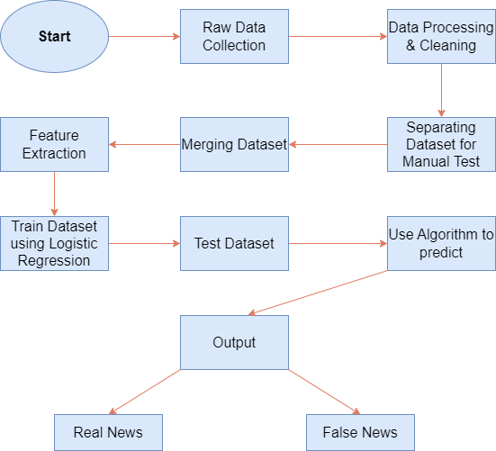
Workflow Diagram

Slide 11
Data Collection
Online Newspaper
Social Media
Online portals

Slide 12
Data Training and testing Models
Logistic Regression
Decision Making Classifier
Gradient Boosting Classifier
Random Forest Classifier
K-Nearest Neighbor
Support Vector Machine

Slide 13


Analyzing Performance
Accuracy of Algorithms:
Algorithm | Accuracy
Logistic Regression | 0.981051507872965
Decision Tree | 0.9776487856952228
Gradient Boosting Classifier | 0.9835201494528957
Random Forest Classifier | 0.9784494262076328
KNN | 0.9766479850547104
SVM | 0.982586068855084

Slide 14
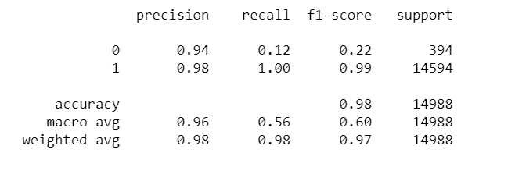
Analyzing Performance
Classification Reports for KNN:

Slide 15
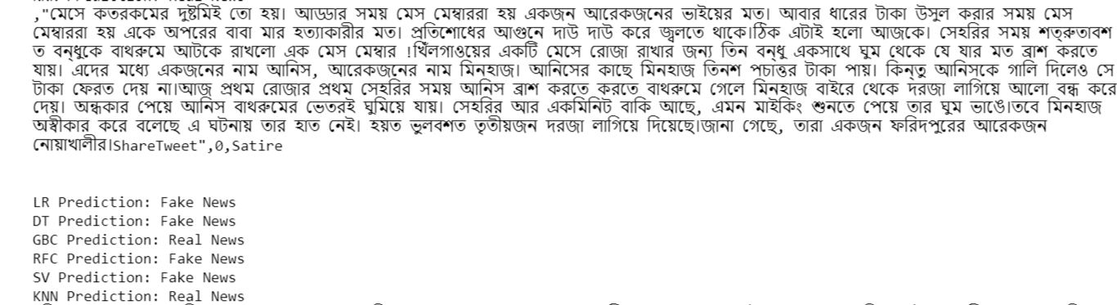
Results
Test 1

Slide 16
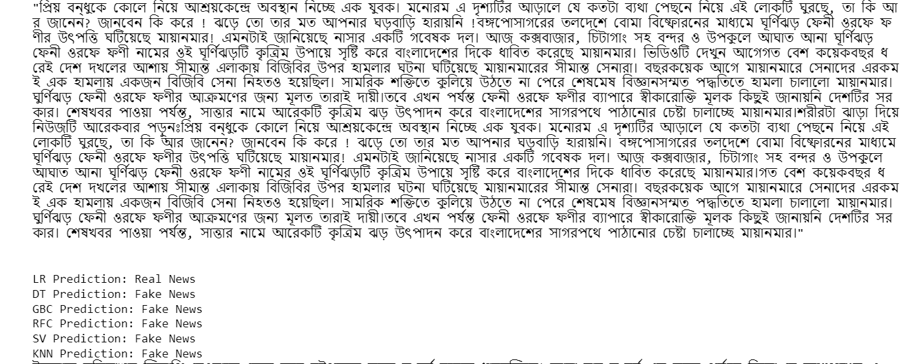
Test 2

Slide 17
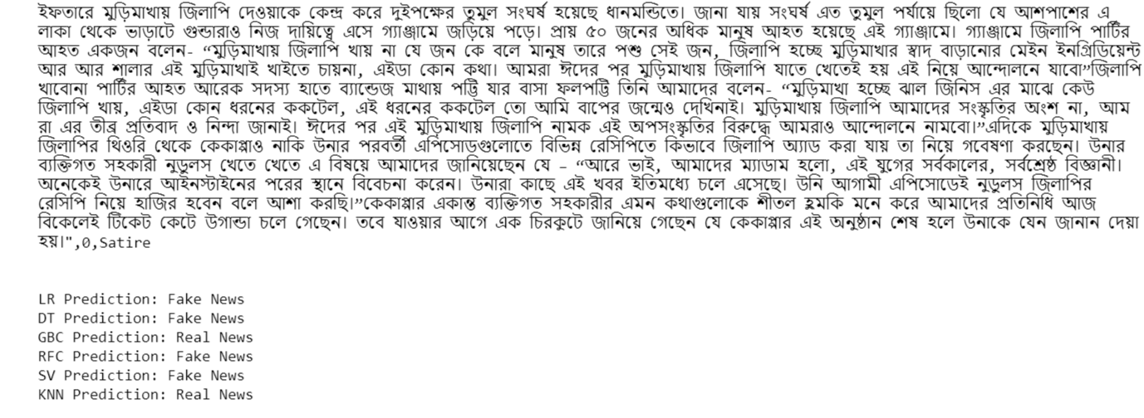
Test 3

Slide 18
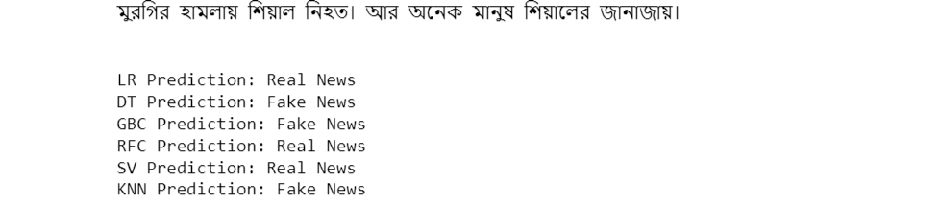
Test 4
N.B: Small news can’t be detected accurately

Slide 19
Conclusion
The utilization of multiple machine learning algorithms for detecting fake news represents a significant advancement in our ongoing battle against misinformation.
We've covered key insights and important takeaways that underscore the significance of our topic.
We have achieved more robust and reliable results, highlighting the potential of ensemble methods in various classification tasks.

Slide 20
Limitations
Small news can’t be detected accurately.
Sometimes models predict a fake news as a real news.
Memory cost is more due to large dataset.

Slide 21
Future Work
We will try to use neural network.
Will develop also for English Fake News
Will try to use more models to increase accuracy

Slide 22

THANK YOU

Slide 23

Reference
[1] Raza, S. and Ding, C., 2022. Fake news detection based on news content and social contexts: a transformer-based approach. International Journal of Data Science and Analytics, 13(4), pp.335-362.
[2] Albahar, M., 2021. A hybrid model for fake news detection: Leveraging news content and user comments in fake news. IET Information Security, 15(2), pp.169-177.
[3] Gulzar Hussain, M., Rashidul Hasan, M., Rahman, M., Protim, J. and Al Hasan, S., 2020. Detection of Bangla Fake News using MNB and SVM Classifier. arXiv e-prints, pp.arXiv-2005.
[4] Monti, F., Frasca, F., Eynard, D., Mannion, D. and Bronstein, M.M., 2019. Fake news detection on social media using geometric deep learning. arXiv preprint arXiv:1902.06673.
[6] Zhang, D. and Zadorozhny, V.I., 2020. Fake news detection based on subjective opinions. In Advances in Databases and Information Systems: 24th European Conference, ADBIS 2020, Lyon, France, August 25–27, 2020, Proceedings 24 (pp. 108-121). Springer International Publishing.
[7] Li, C.Y., Kollapally, N.M., Chun, S.A. and Geller, J., 2023. Fake News Detection and Behavioral Analysis: Case of COVID-19 (preprint).
[8] Rasel, R.I., Zihad, A.H., Sultana, N. and Hoque, M.M., 2022, December. Bangla Fake News Detection using Machine Learning, Deep Learning and Transformer Models. In 2022 25th International Conference on Computer and Information Technology (ICCIT) (pp. 959-964). IEEE.
[9] Amjad, M., Vitman, O., Sidorov, G., Zhila, A. and Gelbukh, A., 2023, June. Analysis of Fake News Detection Methods. In Recent Developments and the New Directions of Research, Foundations, and Applications: Selected Papers of the 8th World Conference on Soft Computing, February 03–05, 2022, Baku, Azerbaijan, Vol. II (pp. 131-144). Cham: Springer Nature Switzerland.
[10] Hossain, M.M., Awosaf, Z., Prottoy, M.S.H., Alvy, A.S.M. and Morol, M.K., 2022, October. Approaches for Improving the Performance of Fake News Detection in Bangla: Imbalance Handling and Model Stacking. In Proceedings of International Conference on Fourth Industrial Revolution and Beyond 2021 (pp. 723-734). Singapore: Springer Nature Singapore.

