Slide 1
OS Design Goals

Slide 2
Manage Physical Resources
Virtualization
Concurrency
Persistency
Abstraction – for easy use
High Performance
Protection & Security
Isolation – isolating of processes
Reliability
Energy Efficiency
Mobility

Slide 3
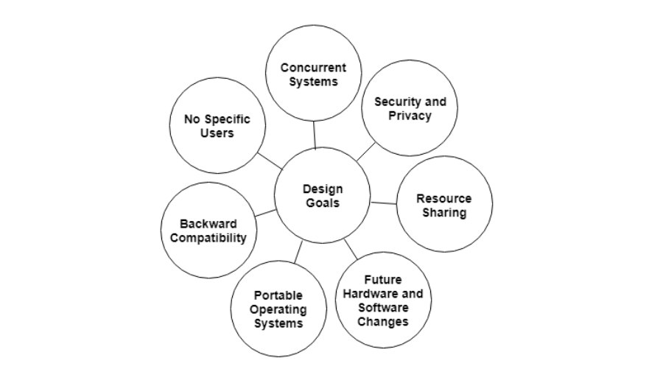

Slide 4
OS Architecture Models
Monolithic OS
Layered OS
Client/Server or Micro Kernel OS

Slide 5
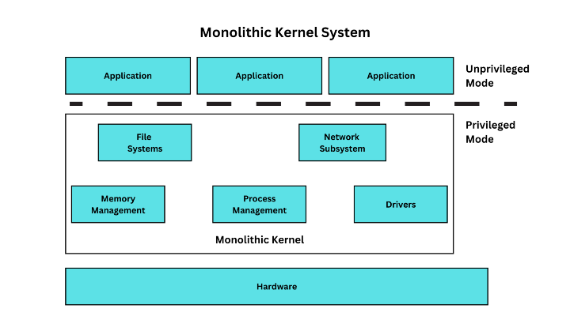
Monolithic?

Slide 6
A Monolithic Operating System is a straightforward operating system where the kernel directly manages file management, device management, process management, and memory management

Slide 7
What is a Layered Operating System?
A layered operating system is one that has distinct layers for managing user software and system software. Core system software is handled by the lower layers, whilst application software is handled by the upper layers.

Slide 8
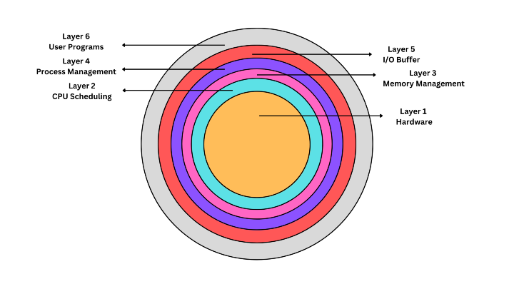

Slide 9
Characteristic | Monolithic Operating System | Layered Operating System
Definition | A relatively straightforward operating system where file management, device management, process management, and memory management are directly managed by the kernel. | An operating system is organized into distinct layers, with each layer responsible for a specific function, such as managing core system software and application software.
Modularity | Limited modularity, makes it challenging to add new features or make changes without affecting the entire system | Modular design allows for easier addition or modification of features without impacting the entire system.
Complexity | The high degree of complexity, can make bug fixing and addressing security flaws difficult. | More intricate design, which may be more challenging to create and maintain.
Maintenance | Maintenance can be problematic as updating or modifying a single component may require changing the entire system. | Easier management and debugging as individual tests and debugging can be performed on each layer
Performance | High performance due to tight integration of operating system components into a single executable code | Overhead due to inter-layer communication may affect system performance.
Adaptability | Less adaptable as modifications in one area may impact other parts, requiring thorough testing before implementation. | More adaptable and configurable as each layer can be changed or replaced without affecting others.
Debugging | Debugging and managing the system can be simpler as all a single executable file. | Complexity may make it more challenging to find and address bugs or security flaws.
System-wide Impact | Higher chance of system wide failure or security vulnerabilities due to tight interconnections between components. | Faults and security flaws are better isolated within individual layers, reducing system-wide impact
Memory Usage | Uses more memory as all components are loaded into memory | Fewer layers need to be loaded into memory, resulting in lower memory usage.
Hardware Compatibility | Wide range of hardware and software compatibility | Easier portability to other hardware platforms or architectures as each layer can be ported separately.
Addition of New Parts | Adding new parts can be challenging due to dependencies and lack of modularity. | Adding new parts can be challenging due to dependencies and lack of modularity.

