Slide 1
CPU Scheduling

Slide 2
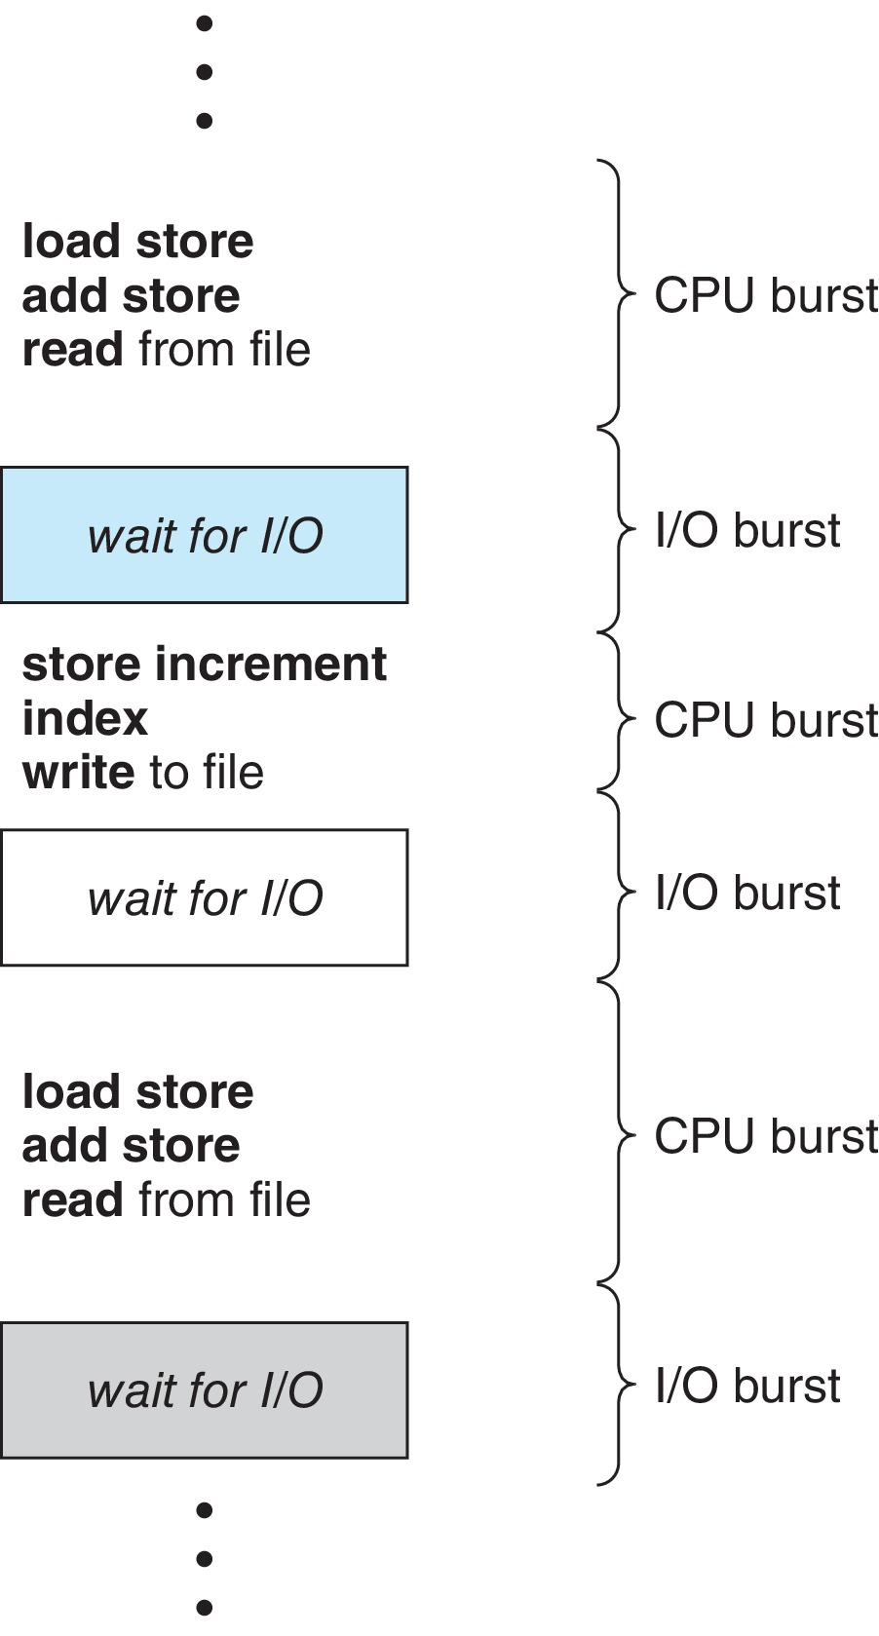
Basic Concepts
Maximum CPU utilization obtained with multiprogramming
CPU–I/O Burst Cycle – Process execution consists of a cycle of CPU execution and I/O wait
CPU burst followed by I/O burst
CPU burst distribution is of main concern

Slide 3
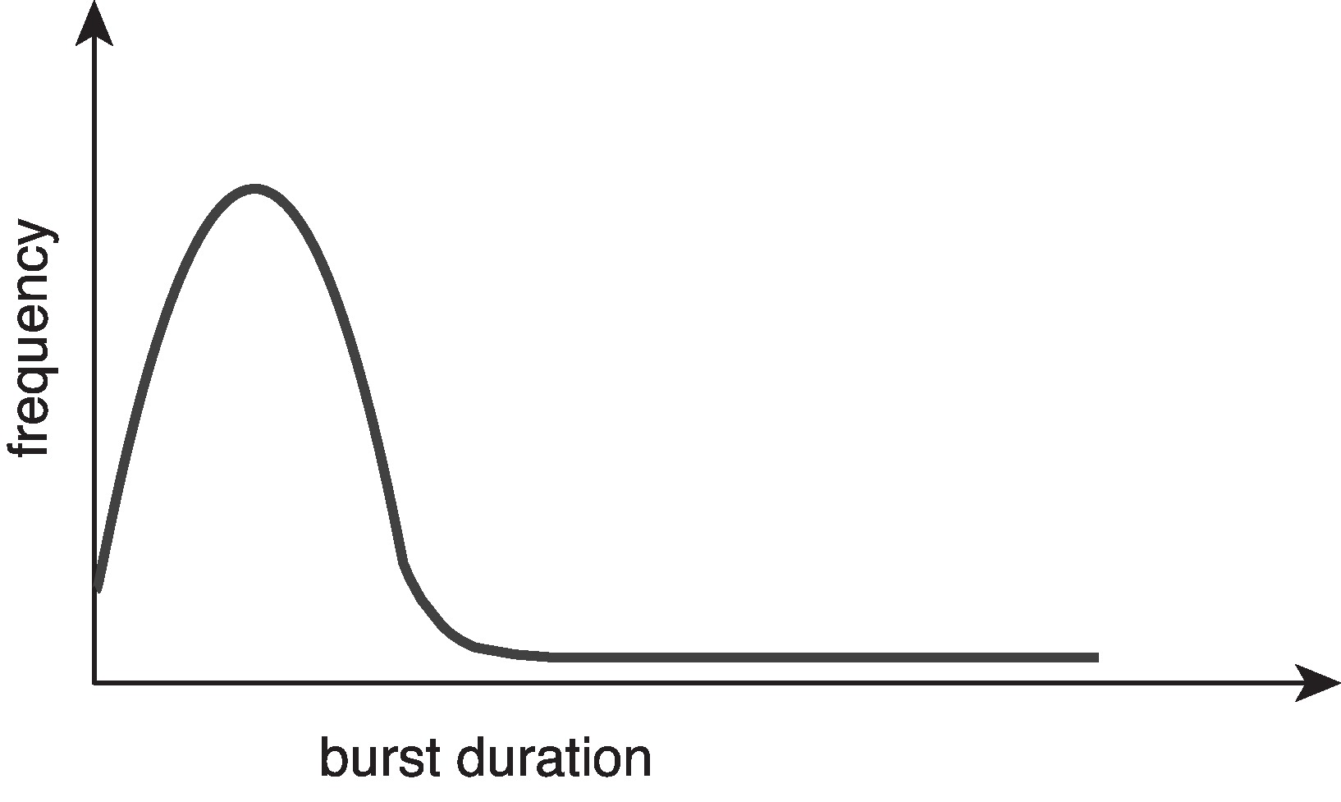
Histogram of CPU-burst Times
Large number of short bursts
Small number of longer bursts

Slide 4
CPU Scheduler
The CPU scheduler selects from among the processes in ready queue, and allocates a CPU core to one of them
  Queue may be ordered in various ways
CPU scheduling decisions may take place when a process:
  1. Switches from running to waiting state
  2. Switches from running to ready state
  3. Switches from waiting to ready
  Terminates
For situations 1 and 4, there is no choice in terms of scheduling. A new process (if one exists in the ready queue) must be selected for execution.
For situations 2 and 3, however, there is a choice.

Slide 5
Preemptive and Nonpreemptive Scheduling
When scheduling takes place only under circumstances 1 and 4, the scheduling scheme is nonpreemptive.
Otherwise, it is preemptive.
Under Nonpreemptive scheduling, once the CPU has been allocated to a process, the process keeps the CPU until it releases it either by terminating or by switching to the waiting state.
Virtually all modern operating systems including Windows, MacOS, Linux, and UNIX use preemptive scheduling algorithms.

Slide 6
Preemptive Scheduling and Race Conditions
Preemptive scheduling can result in race conditions when data are shared among several processes.
Consider the case of two processes that share data. While one process is updating the data, it is preempted so that the second process can run. The second process then tries to read the data, which are in an inconsistent state.

Slide 7
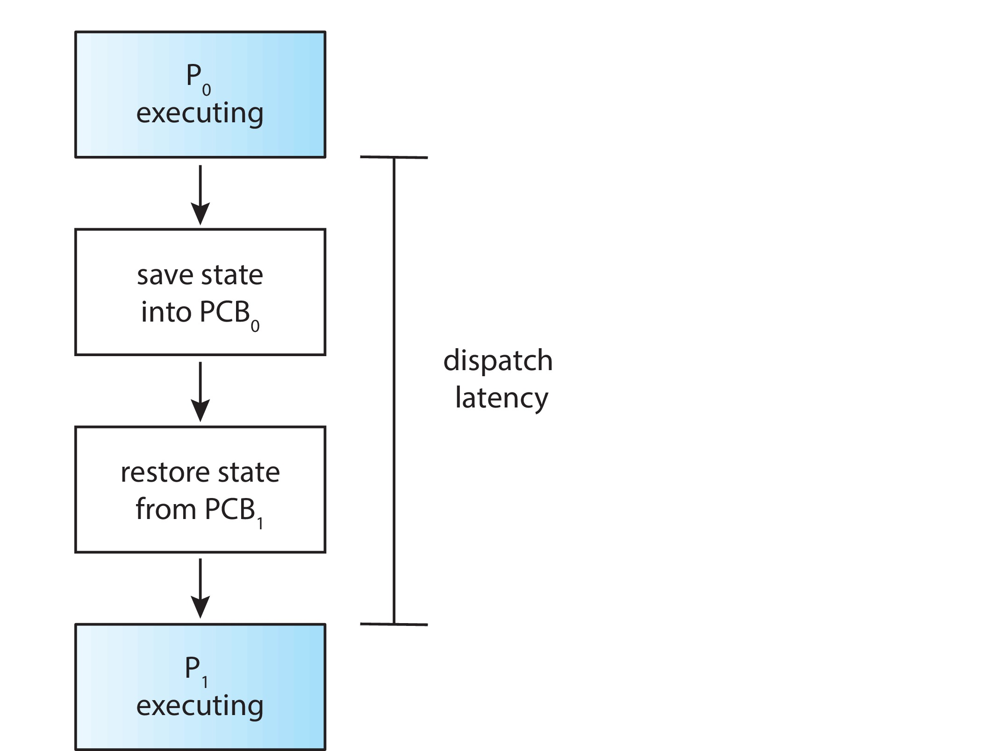
Dispatcher
Dispatcher module gives control of the CPU to the process selected by the CPU scheduler; this involves:
  Switching context
  Switching to user mode
  Jumping to the proper location in the user program to restart that program
Dispatch latency – time it takes for the dispatcher to stop one process and start another running

Slide 8
Scheduling Criteria
CPU utilization – keep the CPU as busy as possible
Throughput – # of processes that complete their execution per time unit
Turnaround time – amount of time to execute a particular process
Waiting time – amount of time a process has been waiting in the ready queue
Response time – amount of time it takes from when a request was submitted until the first response is produced.

Slide 9
Scheduling Algorithm Optimization Criteria
Max CPU utilization
Max throughput
Min turnaround time
Min waiting time
Min response time

Slide 10
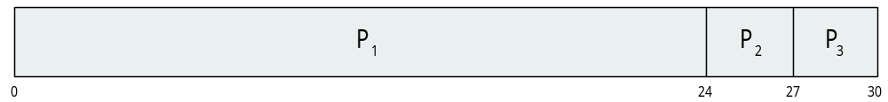
First- Come, First-Served (FCFS) Scheduling
Process Burst Time
P₁ 24
P₂ 3
P₃ 3
Suppose that the processes arrive in the order: P₁ , P₂ , P₃
The Gantt Chart for the schedule is:
Waiting time for P₁ = 0; P₂ = 24; P₃ = 27
Average waiting time: (0 + 24 + 27)/3 = 17

Slide 11

FCFS Scheduling (Cont.)
Suppose that the processes arrive in the order:
P₂ , P₃ , P₁
The Gantt chart for the schedule is:
Waiting time for P₁ = 6; P₂ = 0; P₃ = 3
Average waiting time: (6 + 0 + 3)/3 = 3
Much better than previous case
Convoy effect - short process behind long process
  Consider one CPU-bound and many I/O-bound processes

Slide 12
Shortest-Job-First (SJF) Scheduling
Associate with each process the length of its next CPU burst
  Use these lengths to schedule the process with the shortest time
SJF is optimal – gives minimum average waiting time for a given set of processes
Preemptive version called shortest-remaining-time-first
How do we determine the length of the next CPU burst?
  Could ask the user
  Estimate

Slide 13
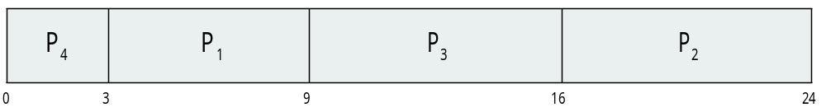
Example of SJF
Process Burst Time
P₁ 6
P₂ 8
P₃ 7
P₄ 3
SJF scheduling chart
Average waiting time = (3 + 16 + 9 + 0) / 4 = 7

Slide 14
Shortest Remaining Time First Scheduling
Preemptive version of SJN
Whenever a new process arrives in the ready queue, the decision on which process to schedule next is redone using the SJN algorithm.
Is SRT more “optimal” than SJN in terms of the minimum average waiting time for a given set of processes?

Slide 15

Example of Shortest-remaining-time-first
Now we add the concepts of varying arrival times and preemption to the analysis
Process i Arrival TimeT Burst Time
P₁ 0 8
P₂ 1 4
P₃ 2 9
P₄ 3 5
Preemptive SJF Gantt Chart
Average waiting time = [(10-1)+(1-1)+(17-2)+(5-3)]/4 = 26/4 = 6.5

Slide 16
Round Robin (RR)
Each process gets a small unit of CPU time (time quantum q), usually 10-100 milliseconds. After this time has elapsed, the process is preempted and added to the end of the ready queue.
If there are n processes in the ready queue and the time quantum is q, then each process gets 1/n of the CPU time in chunks of at most q time units at once. No process waits more than (n-1)q time units.
Timer interrupts every quantum to schedule next process
Performance
  q large ⇒ FIFO (FCFS)
  q small ⇒ RR
Note that q must be large with respect to context switch, otherwise overhead is too high

Slide 17

Example of RR with Time Quantum = 4
Process Burst Time
P₁ 24
P₂ 3
P₃ 3
The Gantt chart is:
Typically, higher average turnaround than SJF, but better response
q should be large compared to context switch time
  q usually 10 milliseconds to 100 milliseconds,
  Context switch < 10 microseconds

Slide 18
Priority Scheduling
A priority number (integer) is associated with each process
The CPU is allocated to the process with the highest priority (smallest integer ≡ highest priority)
  Preemptive
  Nonpreemptive
SJF is priority scheduling where priority is the inverse of predicted next CPU burst time
Problem ≡ Starvation – low priority processes may never execute
Solution ≡ Aging – as time progresses increase the priority of the process

Slide 19
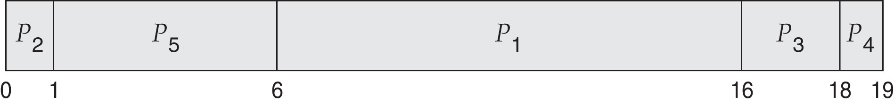
Example of Priority Scheduling
Process Burst Time Priority
P₁ 10 3
P₂ 1 1
P₃ 2 4
P₄ 1 5
P₅ 5 2
Priority scheduling Gantt Chart
Average waiting time = 8.2

Slide 20
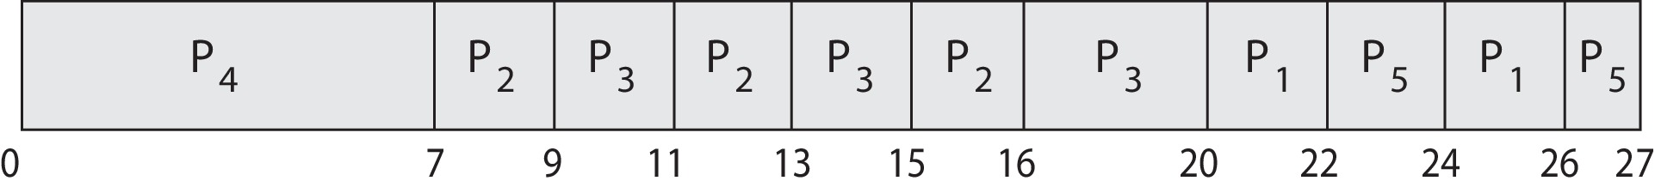
Priority Scheduling w/ Round-Robin
Run the process with the highest priority. Processes with the same priority run round-robin
Example:
Process a Burst Time Priority
P₁ 4 3
P₂ 5 2
P₃ 8 2
P₄ 7 1
P₅ 3 3
Gantt Chart with time quantum = 2

Slide 21
Multilevel Queue
The ready queue consists of multiple queues
Multilevel queue scheduler defined by the following parameters:
  Number of queues
  Scheduling algorithms for each queue
  Method used to determine which queue a process will enter when that process needs service
  Scheduling among the queues

Slide 22
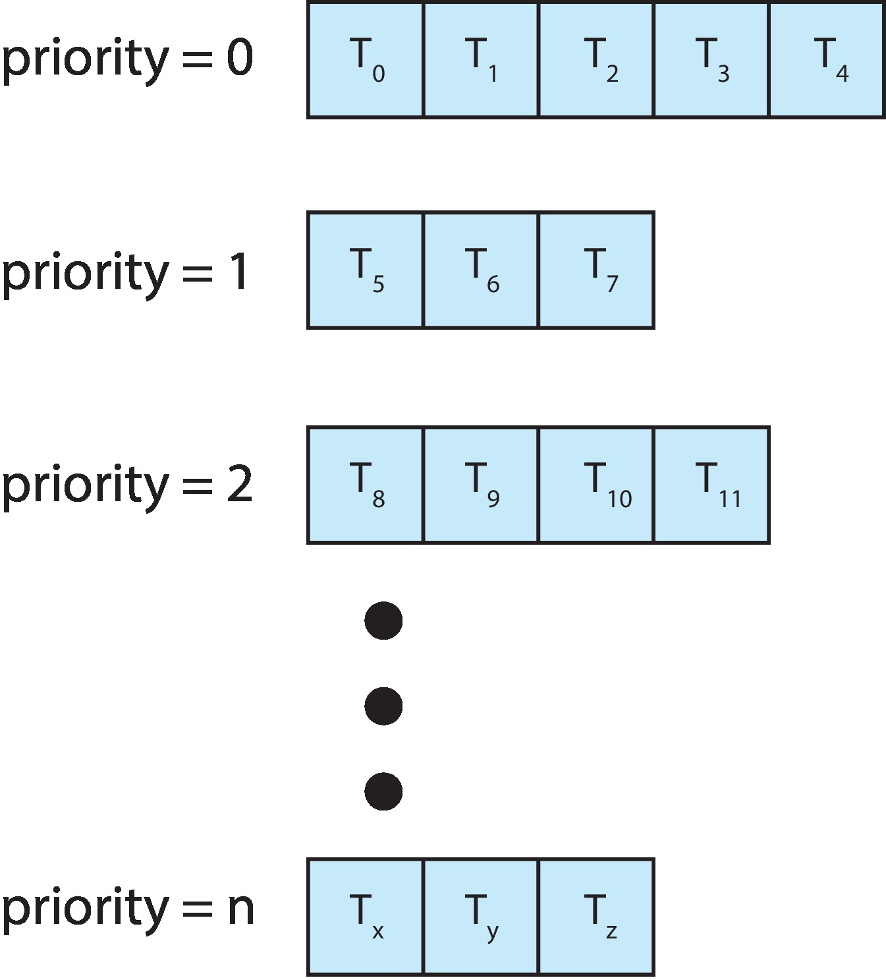
Multilevel Queue
With priority scheduling, have separate queues for each priority.
Schedule the process in the highest-priority queue!

Slide 23
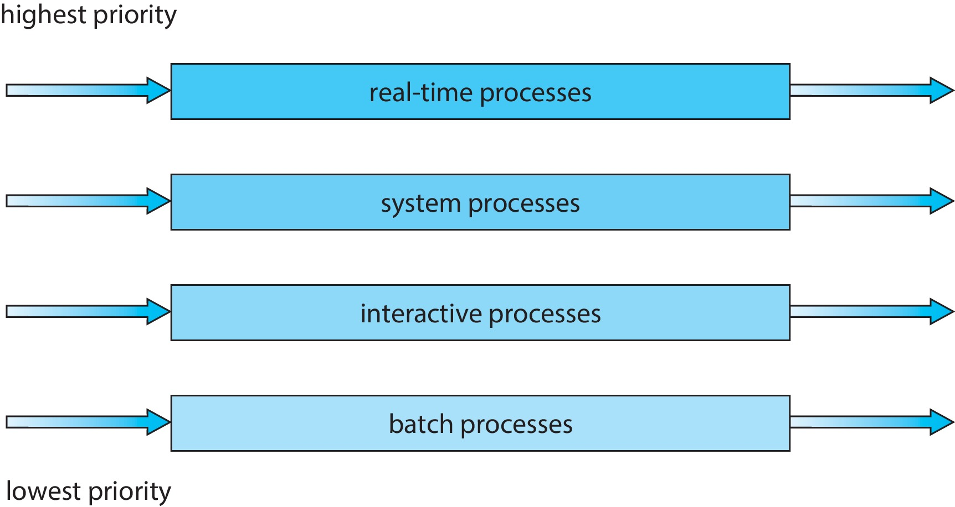
Multilevel Queue
Prioritization based upon process type

Slide 24
Multilevel Feedback Queue
A process can move between the various queues.
Multilevel-feedback-queue scheduler defined by the following parameters:
  Number of queues
  Scheduling algorithms for each queue
  Method used to determine when to upgrade a process
  Method used to determine when to demote a process
  Method used to determine which queue a process will enter when that process needs service
Aging can be implemented using multilevel feedback queue

Slide 25

Example of Multilevel Feedback Queue
Three queues:
  Q₀ – RR with time quantum 8 milliseconds
  Q₁ – RR time quantum 16 milliseconds
  Q₂ – FCFS
Scheduling
  A new process enters queue Q₀ which is served in RR
    When it gains CPU, the process receives 8 milliseconds
    If it does not finish in 8 milliseconds, the process is moved to queue Q₁
  At Q₁ job is again served in RR and receives 16 additional milliseconds
    If it still does not complete, it is preempted and moved to queue Q₂

Slide 26
Multiple-Processor Scheduling
CPU scheduling more complex when multiple CPUs are available
Multiprocess may be any one of the following architectures:
  Multicore CPUs
  Multithreaded cores
  NUMA systems
  Heterogeneous multiprocessing

Slide 27
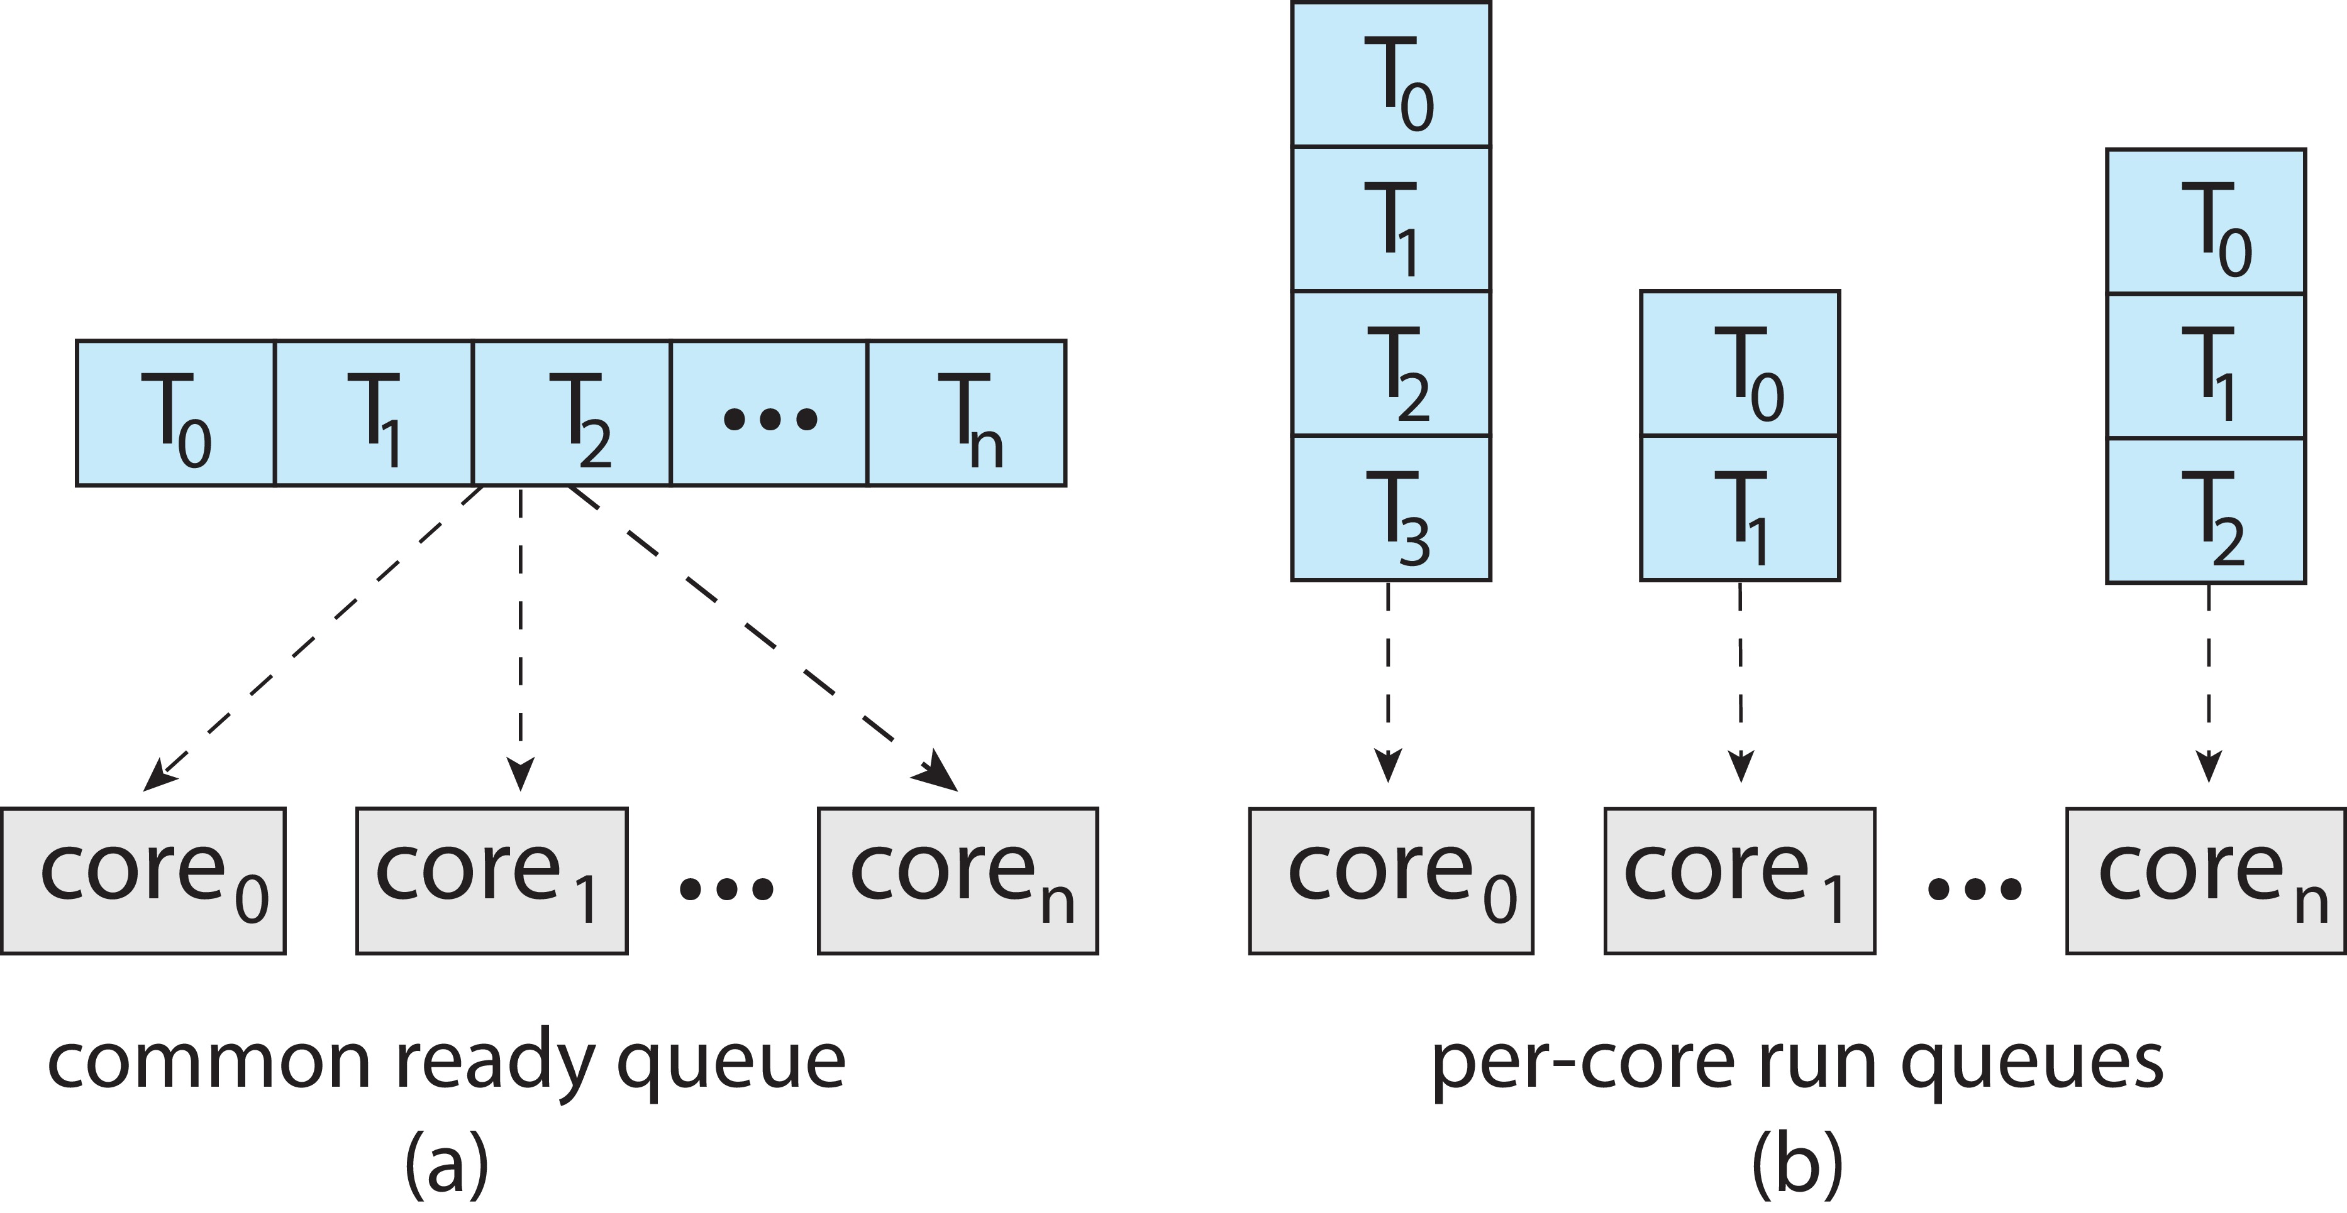
Multiple-Processor Scheduling
Symmetric multiprocessing (SMP) is where each processor is self scheduling.
All threads may be in a common ready queue (a)
Each processor may have its own private queue of threads (b)

Slide 28
Multiple-Processor Scheduling – Load Balancing
If SMP, need to keep all CPUs loaded for efficiency
Load balancing attempts to keep workload evenly distributed
Push migration – periodic task checks load on each processor, and if found pushes task from overloaded CPU to other CPUs
Pull migration – idle processors pulls waiting task from busy processor

Slide 29
Thank You

