Slide 1
BCSE303L - Operating Systems
Module III: Scheduling
  Processes Scheduling -CPU Scheduling: Pre-emptive, non-pre-emptive - Multiprocessor scheduling – Deadlocks - Resource allocation and management - Deadlock handling mechanisms: prevention, avoidance, detection, recovery.

Slide 2
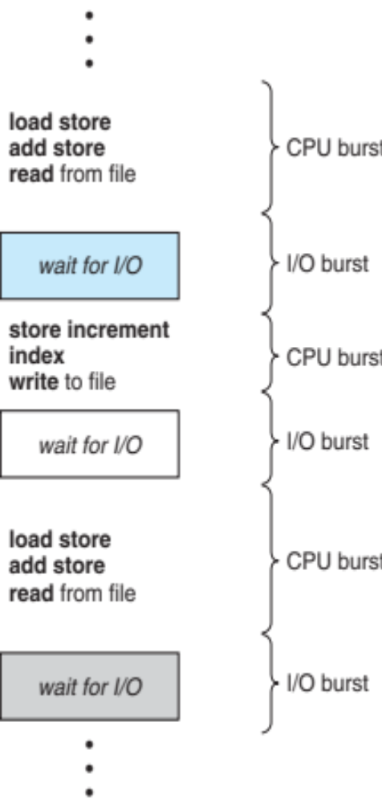
CPU Scheduling : Basic Concepts
Maximum CPU utilization obtained with multiprogramming
CPU–I/O Burst Cycle – Process execution consists of a cycle of CPU execution and I/O wait
CPU burst followed by I/O burst
CPU burst distribution is of main concern

Slide 3
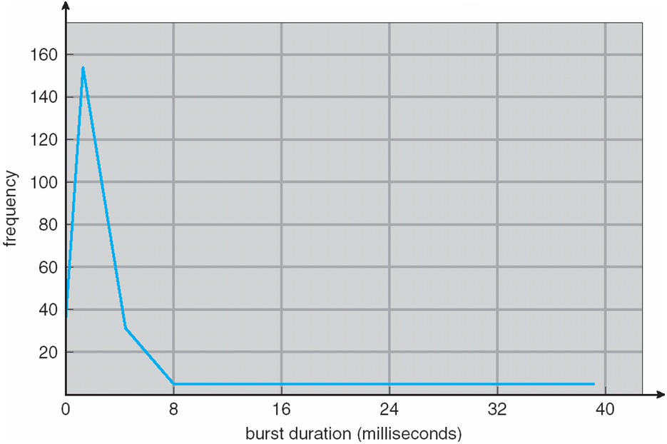
Histogram of CPU-burst Times
Large number of short bursts
Small number of longer bursts

Slide 4
CPU Scheduler
Short-term scheduler selects from among the processes in ready queue, and allocates the CPU to one of them
  Queue may be ordered in various ways
CPU scheduling decisions may take place when a process:
  1. Switches from running to waiting state
  2. Switches from running to ready state
  3. Switches from waiting to ready
  Terminates
Scheduling under 1 and 4 is nonpreemptive
All other scheduling is preemptive
  Consider access to shared data
  Consider preemption while in kernel mode
  Consider interrupts occurring during crucial OS activities

Slide 5
Preemptive and Nonpreemptive Scheduling
When scheduling takes place only under circumstances 1 and 4, the scheduling scheme is nonpreemptive.
Otherwise, it is preemptive.
Under Nonpreemptive scheduling, once the CPU has been allocated to a process, the process keeps the CPU until it releases it either by terminating or by switching to the waiting state.
Virtually all modern operating systems including Windows, MacOS, Linux, and UNIX use preemptive scheduling algorithms.

Slide 6
Preemptive Scheduling and Race Conditions
Preemptive scheduling can result in race conditions when data are shared among several processes.
Consider the case of two processes that share data. While one process is updating the data, it is preempted so that the second process can run. The second process then tries to read the data, which are in an inconsistent state.

Slide 7
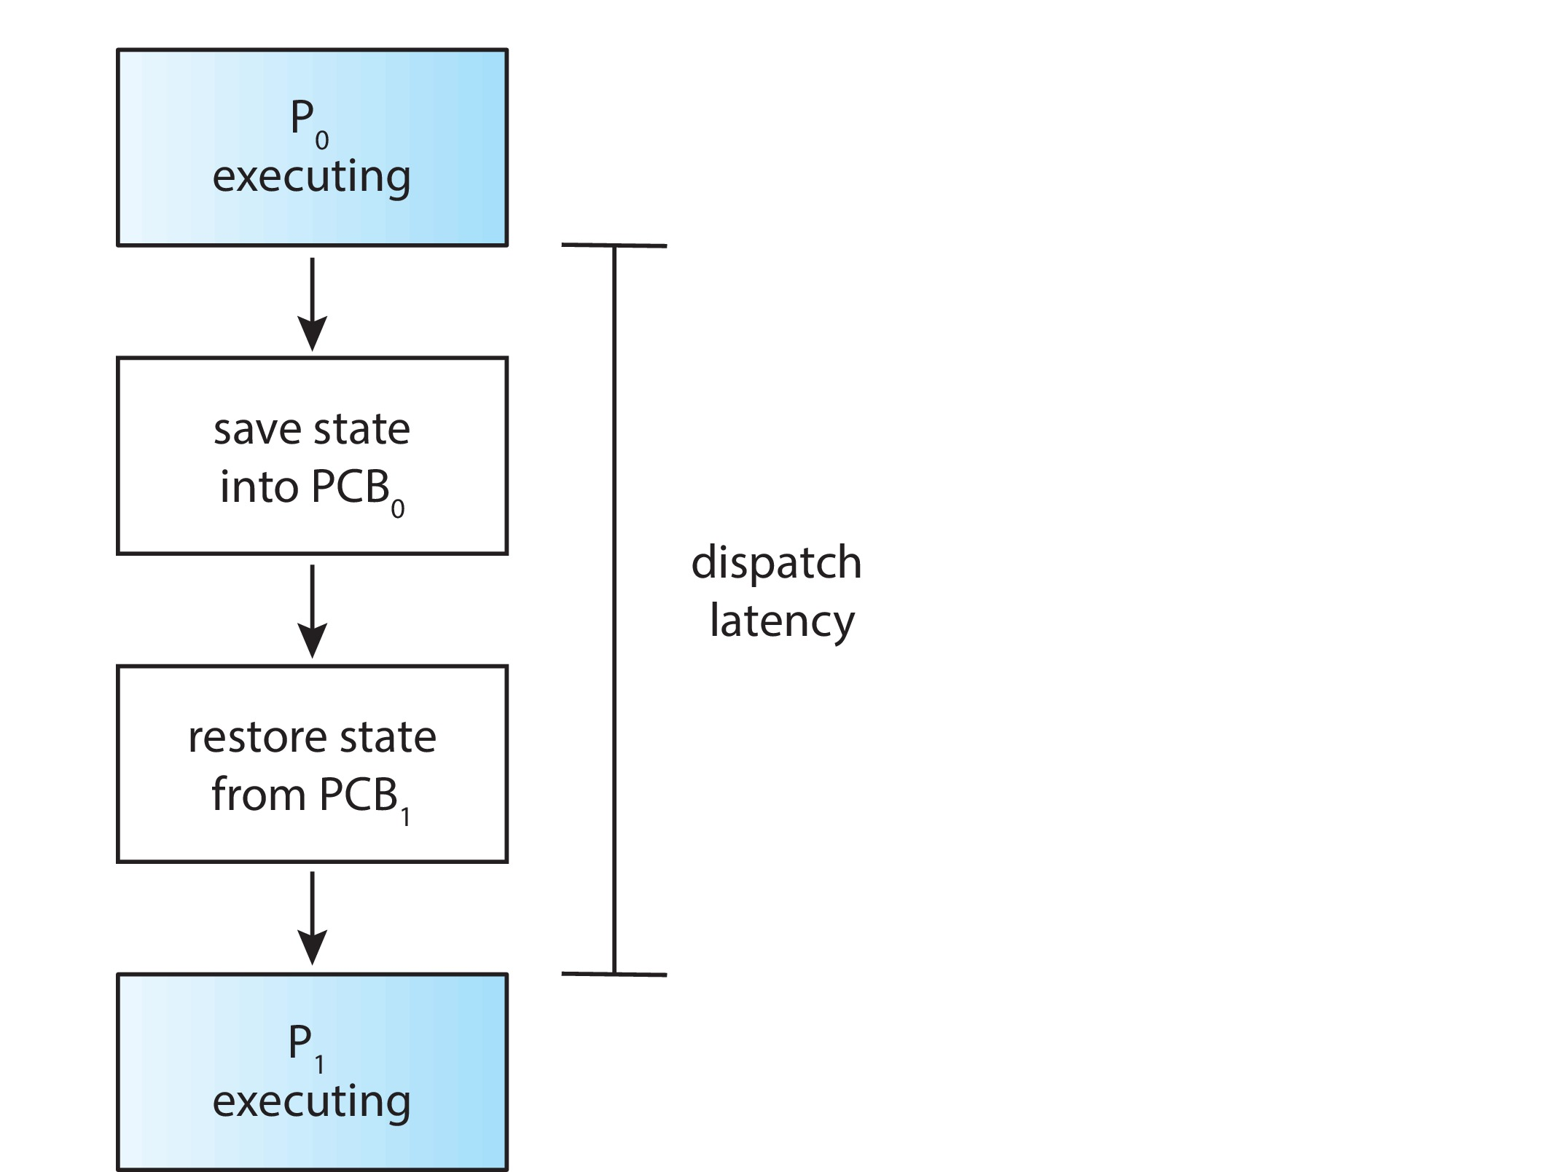
Dispatcher
Dispatcher module gives control of the CPU to the process selected by the CPU scheduler; this involves:
  Switching context
  Switching to user mode
  Jumping to the proper location in the user program to restart that program
Dispatch latency – time it takes for the dispatcher to stop one process and start another running

Slide 8
Scheduling Criteria
CPU utilization – keep the CPU as busy as possible
Throughput – # of processes that complete their execution per time unit
Turnaround time – amount of time to execute a particular process
Waiting time – amount of time a process has been waiting in the ready queue
Response time – amount of time it takes from when a request was submitted until the first response is produced, not output (for time-sharing environment)

Slide 9
Scheduling Algorithm Optimization Criteria
Max CPU utilization
Max throughput
Min turnaround time
Min waiting time
Min response time

Slide 10
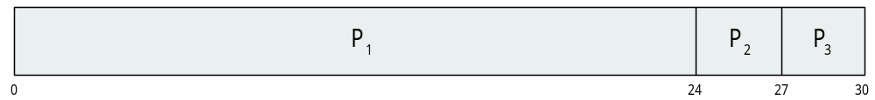
First- Come, First-Served (FCFS) Scheduling
Process Burst Time
P₁ 24
P₂ 3
P₃ 3
Suppose that the processes arrive in the order: P₁ , P₂ , P₃
The Gantt Chart for the schedule is:
Waiting time for P₁ = 0; P₂ = 24; P₃ = 27
Average waiting time: (0 + 24 + 27)/3 = 17

Slide 11

FCFS Scheduling (Cont.)
Suppose that the processes arrive in the order:
P₂ , P₃ , P₁
The Gantt chart for the schedule is:
Waiting time for P₁ = 6; P₂ = 0; P₃ = 3
Average waiting time: (6 + 0 + 3)/3 = 3
Much better than previous case
Convoy effect - short process behind long process
  Consider one CPU-bound and many I/O-bound processes

Slide 12
Shortest-Job-First (SJF) Scheduling
Associate with each process the length of its next CPU burst
  Use these lengths to schedule the process with the shortest time
SJF is optimal – gives minimum average waiting time for a given set of processes
  The difficulty is knowing the length of the next CPU request
  Could ask the user

Slide 13
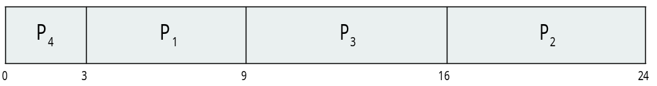
Example of SJF
ProcessArriva l Time Burst Time
P₁ 0.0 6
P₂ 2.0 8
P₃ 4.0 7
P₄ 5.0 3
SJF scheduling chart
Average waiting time = (3 + 16 + 9 + 0) / 4 = 7

Slide 14
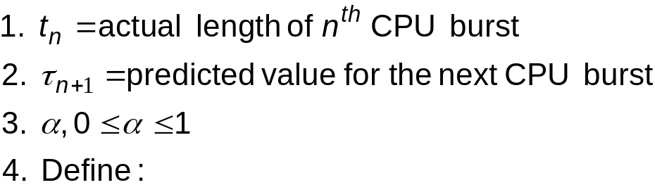

Determining Length of Next CPU Burst
Can only estimate the length – should be similar to the previous one
  Then pick process with shortest predicted next CPU burst
Can be done by using the length of previous CPU bursts, using exponential averaging
Commonly, α set to ½
Preemptive version called shortest-remaining-time-first

Slide 15

Example of Shortest-remaining-time-first
Now we add the concepts of varying arrival times and preemption to the analysis
ProcessA arri Arrival TimeT Burst Time
P₁ 0 8
P₂ 1 4
P₃ 2 9
P₄ 3 5
Preemptive SJF Gantt Chart
Average waiting time = [(10-1)+(1-1)+(17-2)+5-3)]/4 = 26/4 = 6.5 msec

Slide 16
Priority Scheduling
A priority number (integer) is associated with each process
The CPU is allocated to the process with the highest priority (smallest integer ≡ highest priority)
  Preemptive
  Nonpreemptive
SJF is priority scheduling where priority is the inverse of predicted next CPU burst time
Problem ≡ Starvation – low priority processes may never execute
Solution ≡ Aging – as time progresses increase the priority of the process

Slide 17
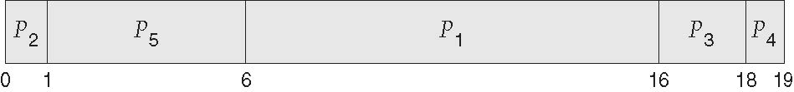
Example of Priority Scheduling
ProcessA arri Burst TimeT Priority
P₁ 10 3
P₂ 1 1
P₃ 2 4
P₄ 1 5
P₅ 5 2
Priority scheduling Gantt Chart
Average waiting time = 8.2 msec

Slide 18
Round Robin (RR)
Each process gets a small unit of CPU time (time quantum q), usually 10-100 milliseconds. After this time has elapsed, the process is preempted and added to the end of the ready queue.
If there are n processes in the ready queue and the time quantum is q, then each process gets 1/n of the CPU time in chunks of at most q time units at once. No process waits more than (n-1)q time units.
Timer interrupts every quantum to schedule next process
Performance
  q large ⇒ FIFO
  q small ⇒ q must be large with respect to context switch, otherwise overhead is too high

Slide 19

Example of RR with Time Quantum = 4
Process Burst Time
P₁ 24
P₂ 3
P₃ 3
The Gantt chart is:
Typically, higher average turnaround than SJF, but better response
q should be large compared to context switch time
q usually 10ms to 100ms, context switch < 10 usec

Slide 20
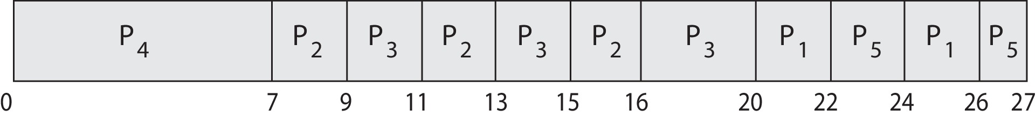
Priority Scheduling w/ Round-Robin
Run the process with the highest priority. Processes with the same priority run round-robin
Example:
Process a Burst Time Priority
P₁ 4 3
P₂ 5 2
P₃ 8 2
P₄ 7 1
P₅ 3 3
Gantt Chart with time quantum = 2

Slide 21
Multilevel Queue
Ready queue is partitioned into separate queues, eg:
  foreground (interactive)
  background (batch)
Process permanently in a given queue
Each queue has its own scheduling algorithm:
  foreground – RR
  background – FCFS
Scheduling must be done between the queues:
  Fixed priority scheduling; (i.e., serve all from foreground then from background). Possibility of starvation.
  Time slice – each queue gets a certain amount of CPU time which it can schedule amongst its processes; i.e., 80% to foreground in RR
  20% to background in FCFS

Slide 22
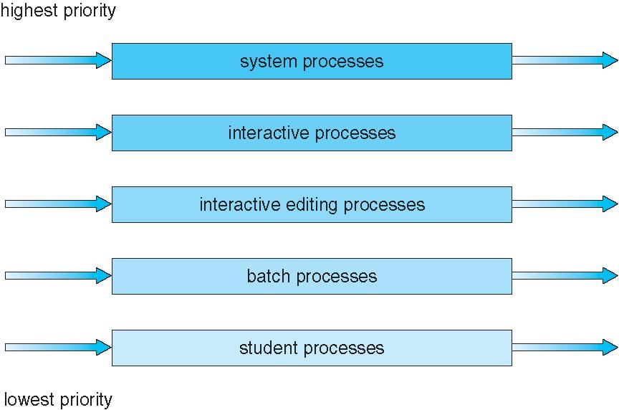
Multilevel Queue Scheduling

Slide 23
Multilevel Feedback Queue
A process can move between the various queues; aging can be implemented this way
Multilevel-feedback-queue scheduler defined by the following parameters:
  number of queues
  scheduling algorithms for each queue
  method used to determine when to upgrade a process
  method used to determine when to demote a process
  method used to determine which queue a process will enter when that process needs service

Slide 24

Example of Multilevel Feedback Queue
Three queues:
  Q₀ – RR with time quantum 8 milliseconds
  Q₁ – RR time quantum 16 milliseconds
  Q₂ – FCFS
Scheduling
  A new job enters queue Q₀ which is served FCFS
    When it gains CPU, job receives 8 milliseconds
    If it does not finish in 8 milliseconds, job is moved to queue Q₁
  At Q₁ job is again served FCFS and receives 16 additional milliseconds
    If it still does not complete, it is preempted and moved to queue Q₂

Slide 25
Multiple-Processor Scheduling
CPU scheduling more complex when multiple CPUs are available
Homogeneous processors within a multiprocessor
Asymmetric multiprocessing – only one processor accesses the system data structures, alleviating the need for data sharing
Symmetric multiprocessing (SMP) – each processor is self-scheduling, all processes in common ready queue, or each has its own private queue of ready processes
  Currently, most common
Processor affinity – process has affinity for processor on which it is currently running
  soft affinity
  hard affinity
  Variations including processor sets

Slide 26
Multiple-Processor Scheduling
CPU scheduling more complex when multiple CPUs are available
Multiprocess may be any one of the following architectures:
  Multicore CPUs
  Multithreaded cores
  NUMA systems
  Heterogeneous multiprocessing

Slide 27
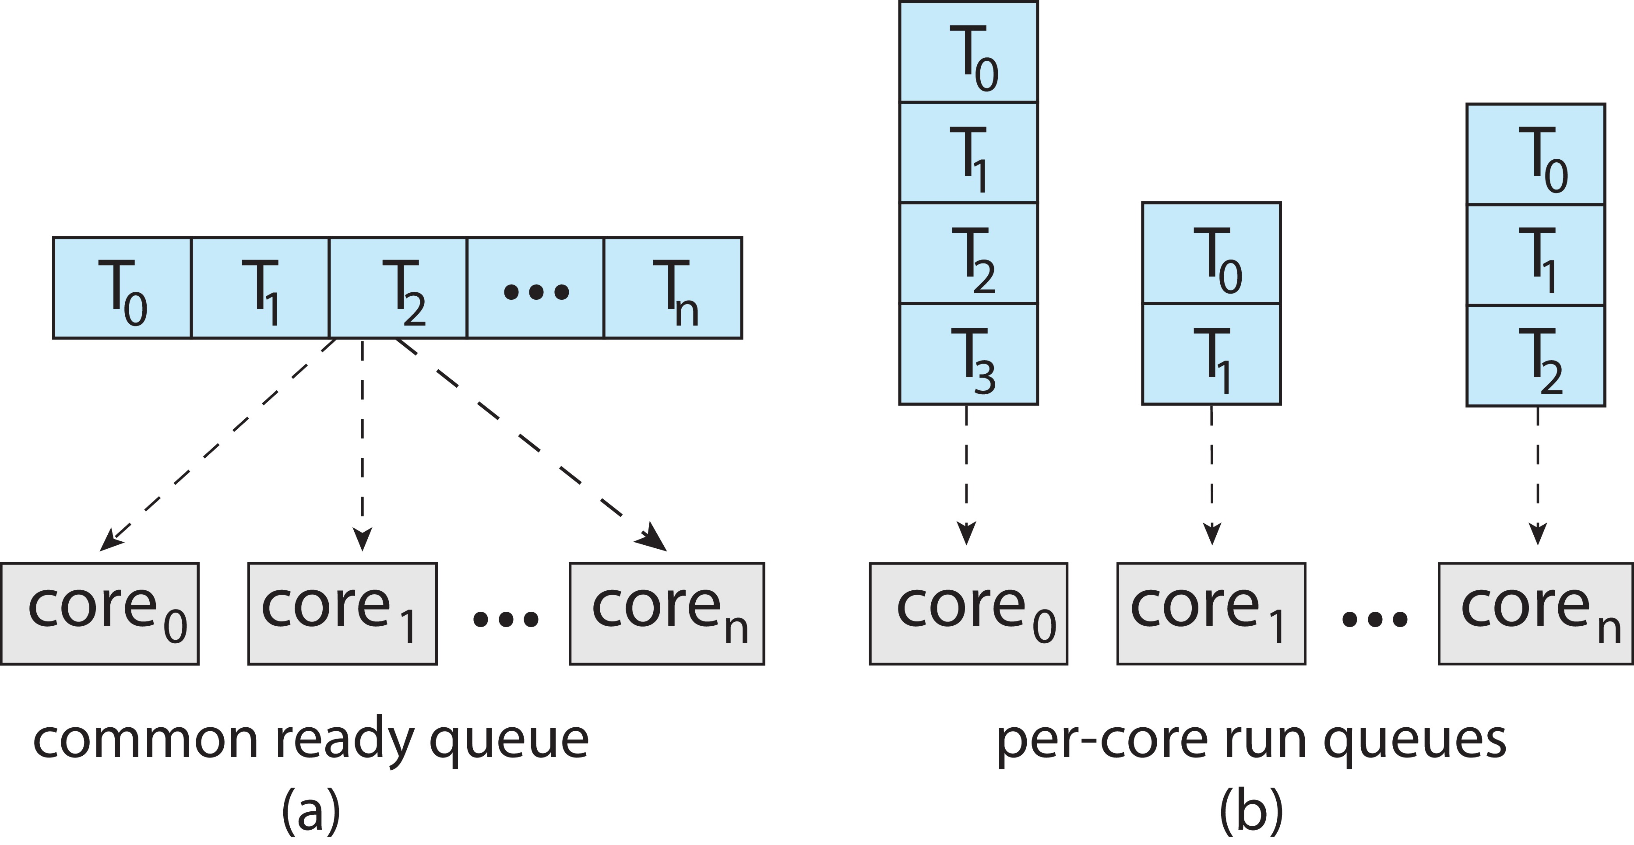
Multiple-Processor Scheduling
Symmetric multiprocessing (SMP) is where each processor is self scheduling.
All threads may be in a common ready queue (a)
Each processor may have its own private queue of threads (b)

Slide 28
Multiple-Processor Scheduling – Load Balancing
If SMP, need to keep all CPUs loaded for efficiency
Load balancing attempts to keep workload evenly distributed
Push migration – periodic task checks load on each processor, and if found pushes task from overloaded CPU to other CPUs
Pull migration – idle processors pulls waiting task from busy processor

Slide 29
System Model
System consists of resources
Resource types R₁, R₂, . . ., R_{m}
    CPU cycles, memory space, I/O devices
Each resource type R_{i} has W_{i} instances.
Each process utilizes a resource as follows:
  request
  use
  release

Slide 30
Deadlock Characterization
Deadlock can arise if four conditions hold simultaneously.
Mutual exclusion: only one process at a time can use a resource
Hold and wait: a process holding at least one resource is waiting to acquire additional resources held by other processes
No preemption: a resource can be released only voluntarily by the process holding it, after that process has completed its task
Circular wait: there exists a set {P₀, P₁, …, P_{n}} of waiting processes such that P₀ is waiting for a resource that is held by P₁, P₁ is waiting for a resource that is held by P₂, …, P_{n–1} is waiting for a resource that is held by P_{n}, and P_{n} is waiting for a resource that is held by P₀.

Slide 31
Resource-Allocation Graph
A set of vertices V and a set of edges E.
V is partitioned into two types:
  P = {P₁, P₂, …, P_{n}}, the set consisting of all the processes in the system
  R = {R₁, R₂, …, R_{m}}, the set consisting of all resource types in the system
request edge – directed edge P_{i} → R_{j}
assignment edge – directed edge R_{j} → P_{i}

Slide 32
Resource-Allocation Graph (Cont.)
Process
Resource Type with 4 instances
P_{i} requests instance of R_{j}
P_{i} is holding an instance of R_{j}
P_{i}
R_{j}
P_{i}
R_{j}

Slide 33
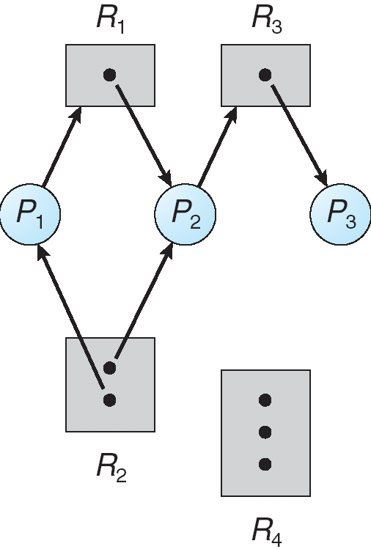
Example of a Resource Allocation Graph

Slide 34
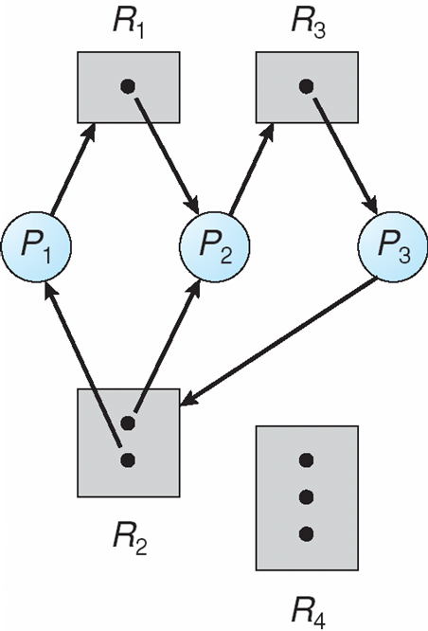
Resource Allocation Graph With A Deadlock

Slide 35

Graph With A Cycle But No Deadlock

Slide 36
Basic Facts
If graph contains no cycles ⇒ no deadlock
If graph contains a cycle ⇒
  if only one instance per resource type, then deadlock
  if several instances per resource type, possibility of deadlock

Slide 37
Methods for Handling Deadlocks
Ensure that the system will never enter a deadlock state:
  Deadlock prevention
  Deadlock avoidence
Allow the system to enter a deadlock state and then recover
Ignore the problem and pretend that deadlocks never occur in the system; used by most operating systems, including UNIX

Slide 38
Deadlock Prevention
Restrain the ways request can be made
Mutual Exclusion – not required for sharable resources (e.g., read-only files); must hold for non-sharable resources
Hold and Wait – must guarantee that whenever a process requests a resource, it does not hold any other resources
  Require process to request and be allocated all its resources before it begins execution, or allow process to request resources only when the process has none allocated to it.
  Low resource utilization; starvation possible

Slide 39
Deadlock Prevention (Cont.)
No Preemption –
  If a process that is holding some resources requests another resource that cannot be immediately allocated to it, then all resources currently being held are released
  Preempted resources are added to the list of resources for which the process is waiting
  Process will be restarted only when it can regain its old resources, as well as the new ones that it is requesting
Circular Wait – impose a total ordering of all resource types, and require that each process requests resources in an increasing order of enumeration

Slide 40
Deadlock Example
/* thread one runs in this function */
void *do_work_one(void *param)
{
pthread_mutex_lock(&first_mutex);
pthread_mutex_lock(&second_mutex);
/** * Do some work */
pthread_mutex_unlock(&second_mutex);
pthread_mutex_unlock(&first_mutex);
pthread_exit(0);
}
/* thread two runs in this function */
void *do_work_two(void *param)
{
pthread_mutex_lock(&second_mutex);
pthread_mutex_lock(&first_mutex);
/** * Do some work */
pthread_mutex_unlock(&first_mutex);
pthread_mutex_unlock(&second_mutex);
pthread_exit(0);
}

Slide 41
Deadlock Example with Lock Ordering
void transaction(Account from, Account to, double amount)
{
mutex lock1, lock2;
lock1 = get_lock(from);
lock2 = get_lock(to);
acquire(lock1);
acquire(lock2);
withdraw(from, amount);
deposit(to, amount);
release(lock2);
release(lock1);
}
Transactions 1 and 2 execute concurrently. Transaction 1 transfers $25 from account A to account B, and Transaction 2 transfers $50 from account B to account A

Slide 42
Deadlock Avoidance
Requires that the system has some additional a priori information
available
Simplest and most useful model requires that each process declare the maximum number of resources of each type that it may need
The deadlock-avoidance algorithm dynamically examines the resource-allocation state to ensure that there can never be a circular-wait condition
Resource-allocation state is defined by the number of available and allocated resources, and the maximum demands of the processes

Slide 43
Safe State
When a process requests an available resource, system must decide if immediate allocation leaves the system in a safe state
System is in safe state if there exists a sequence <P₁, P₂, …, P_{n}> of ALL the processes in the systems such that for each P_{i}, the resources that P_{i} can still request can be satisfied by currently available resources + resources held by all the P_{j}, with j < I
That is:
  If P_{i} resource needs are not immediately available, then P_{i} can wait until all P_{j} have finished
  When P_{j} is finished, P_{i} can obtain needed resources, execute, return allocated resources, and terminate
  When P_{i} terminates, P_{i +1} can obtain its needed resources, and so on

Slide 44
Basic Facts
If a system is in safe state ⇒ no deadlocks
If a system is in unsafe state ⇒ possibility of deadlock
Avoidance ⇒ ensure that a system will never enter an unsafe state.

Slide 45
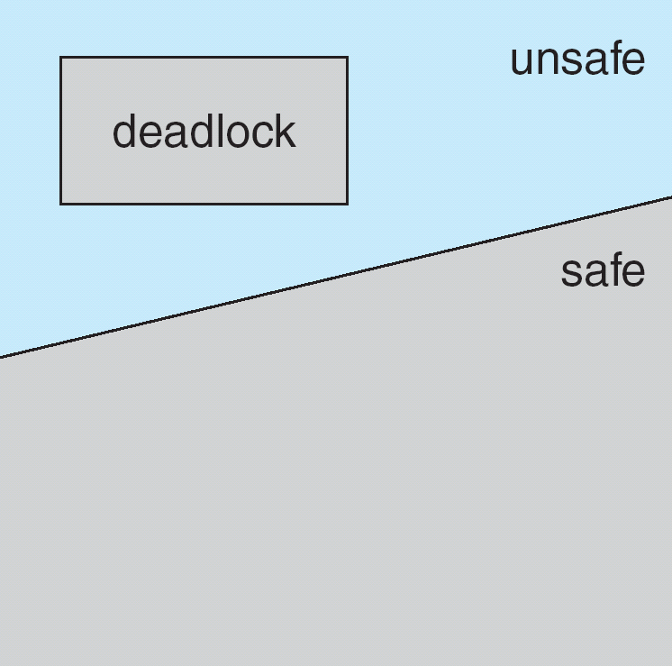
Safe, Unsafe, Deadlock State

Slide 46
Avoidance Algorithms
Single instance of a resource type
  Use a resource-allocation graph
Multiple instances of a resource type
  Use the banker’s algorithm

Slide 47
Resource-Allocation Graph Scheme
Claim edge P_{i} → R_{j} indicated that process P_{j} may request resource R_{j}; represented by a dashed line
Claim edge converts to request edge when a process requests a resource
Request edge converted to an assignment edge when the resource is allocated to the process
When a resource is released by a process, assignment edge reconverts to a claim edge
Resources must be claimed a priori in the system

Slide 48
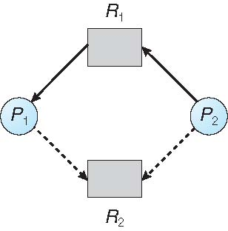
Resource-Allocation Graph

Slide 49
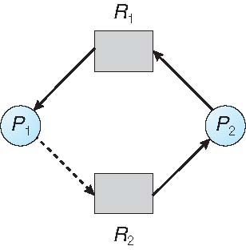
Unsafe State In Resource-Allocation Graph

Slide 50
Resource-Allocation Graph Algorithm
Suppose that process P_{i} requests a resource R_{j}
The request can be granted only if converting the request edge to an assignment edge does not result in the formation of a cycle in the resource allocation graph

Slide 51
Banker’s Algorithm
Multiple instances
Each process must a priori claim maximum use
When a process requests a resource it may have to wait
When a process gets all its resources it must return them in a finite amount of time

Slide 52
Data Structures for the Banker’s Algorithm
Let n = number of processes, and m = number of resources types.
Available: Vector of length m. If available [j] = k, there are k instances of resource type R_{j} available
Max: n x m matrix. If Max [i,j] = k, then process P_{i} may request at most k instances of resource type R_{j}
Allocation: n x m matrix. If Allocation[i,j] = k then P_{i} is currently allocated k instances of R_{j}
Need: n x m matrix. If Need[i,j] = k, then P_{i} may need k more instances of R_{j} to complete its task
    Need [i,j] = Max[i,j] – Allocation [i,j]

Slide 53
Safety Algorithm
1. Let Work and Finish be vectors of length m and n, respectively. Initialize:
      Work = Available
      Finish [i] = false for i = 0, 1, …, n- 1
2. Find an i such that both:
  (a) Finish [i] = false
  (b) Need_{i} ≤ Work
  If no such i exists, go to step 4
3. Work = Work + Allocation_{i}
Finish[i] = true
go to step 2
4. If Finish [i] == true for all i, then the system is in a safe state

Slide 54
Resource-Request Algorithm for Process P_{i}
Request_{i} = request vector for process P_{i}. If Request_{i} [j] = k then process P_{i} wants k instances of resource type R_{j}
  1. If Request_{i} ≤ Need_{i} go to step 2. Otherwise, raise error condition, since process has exceeded its maximum claim
  2. If Request_{i} ≤ Available, go to step 3. Otherwise P_{i} must wait, since resources are not available
  3. Pretend to allocate requested resources to P_{i} by modifying the state as follows:
      Available = Available – Request_{i};
      Allocation_{i} = Allocation_{i} + Request_{i};
      Need_{i} = Need_{i} – Request_{i};
    If safe ⇒ the resources are allocated to P_{i}
    If unsafe ⇒ P_{i} must wait, and the old resource-allocation state is restored

Slide 55
Example of Banker’s Algorithm
5 processes P₀ through P₄;
3 resource types:
A (10 instances), B (5instances), and C (7 instances)
Snapshot at time T₀:
Allocation Max Available
A B C A B C A B C
P₀ 0 1 0 7 5 3 3 3 2
P₁ 2 0 0 3 2 2
P₂ 3 0 2 9 0 2
P₃ 2 1 1 2 2 2
P₄ 0 0 2 4 3 3

Slide 56
Example (Cont.)
The content of the matrix Need is defined to be Max – Allocation
Need
A B C
P₀ 7 4 3
P₁ 1 2 2
P₂ 6 0 0
P₃ 0 1 1
P₄ 4 3 1
The system is in a safe state since the sequence < P₁, P₃, P₄, P₂, P₀> satisfies safety criteria

Slide 57
Example: P₁ Request (1,0,2)
Check that Request ≤ Available (that is, (1,0,2) ≤ (3,3,2) ⇒ true
Allocation Need Available
A B C A B C A B C
P₀ 0 1 0 7 4 3 2 3 0
P₁ 3 0 2 0 2 0
P₂ 3 0 2 6 0 0
P₃ 2 1 1 0 1 1
P₄ 0 0 2 4 3 1
Executing safety algorithm shows that sequence < P₁, P₃, P₄, P₀, P₂> satisfies safety requirement
Can request for (3,3,0) by P₄ be granted?
Can request for (0,2,0) by P₀ be granted?

Slide 58
Deadlock Detection
Allow system to enter deadlock state
Detection algorithm
Recovery scheme

Slide 59
Single Instance of Each Resource Type
Maintain wait-for graph
  Nodes are processes
  P_{i} → P_{j} if P_{i} is waiting for P_{j}
Periodically invoke an algorithm that searches for a cycle in the graph. If there is a cycle, there exists a deadlock
An algorithm to detect a cycle in a graph requires an order of n² operations, where n is the number of vertices in the graph

Slide 60
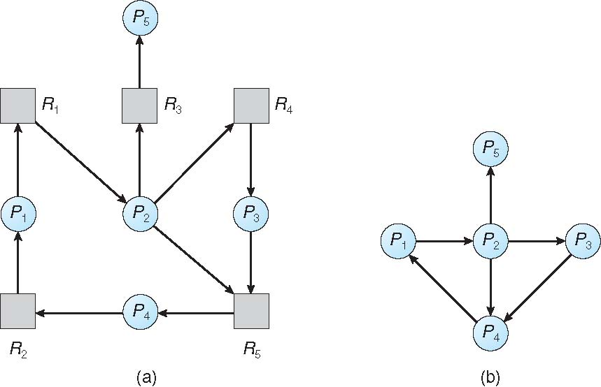
Resource-Allocation Graph and Wait-for Graph
Resource-Allocation Graph
Corresponding wait-for graph

Slide 61
Several Instances of a Resource Type
Available: A vector of length m indicates the number of available resources of each type
Allocation: An n x m matrix defines the number of resources of each type currently allocated to each process
Request: An n x m matrix indicates the current request of each process. If Request [i][j] = k, then process P_{i} is requesting k more instances of resource type R_{j}.

Slide 62
Detection Algorithm
1. Let Work and Finish be vectors of length m and n, respectively Initialize:
  (a) Work = Available
  (b) For i = 1,2, …, n, if Allocation_{i} ≠ 0, then
  Finish[i] = false; otherwise, Finish[i] = true
2. Find an index i such that both:
  (a) Finish[i] == false
  (b) Request_{i} ≤ Work
  If no such i exists, go to step 4

Slide 63
Detection Algorithm (Cont.)
3. Work = Work + Allocation_{i}
Finish[i] = true
go to step 2
4. If Finish[i] == false, for some i, 1 ≤ i ≤ n, then the system is in deadlock state. Moreover, if Finish[i] == false, then P_{i} is deadlocked
Algorithm requires an order of O(m x n²) operations to detect whether the system is in deadlocked state

Slide 64
Example of Detection Algorithm
Five processes P₀ through P₄; three resource types
A (7 instances), B (2 instances), and C (6 instances)
Snapshot at time T₀:
Allocation Request Available
A B C A B C A B C
P₀ 0 1 0 0 0 0 0 0 0
P₁ 2 0 0 2 0 2
P₂ 3 0 3 0 0 0
P₃ 2 1 1 1 0 0
P₄ 0 0 2 0 0 2
Sequence <P₀, P₂, P₃, P₁, P₄> will result in Finish[i] = true for all i

Slide 65
Example (Cont.)
P₂ requests an additional instance of type C
Request
A B C
P₀ 0 0 0
P₁ 2 0 2
P₂ 0 0 1
P₃ 1 0 0
P₄ 0 0 2
State of system?
  Can reclaim resources held by process P₀, but insufficient resources to fulfill other processes; requests
  Deadlock exists, consisting of processes P₁, P₂, P₃, and P₄

Slide 66
Detection-Algorithm Usage
When, and how often, to invoke depends on:
  How often a deadlock is likely to occur?
  How many processes will need to be rolled back?
    one for each disjoint cycle
If detection algorithm is invoked arbitrarily, there may be many cycles in the resource graph and so we would not be able to tell which of the many deadlocked processes “caused” the deadlock.

Slide 67
Recovery from Deadlock: Process Termination
Abort all deadlocked processes
Abort one process at a time until the deadlock cycle is eliminated
In which order should we choose to abort?
  Priority of the process
  How long process has computed, and how much longer to completion
  Resources the process has used
  Resources process needs to complete
  How many processes will need to be terminated
  Is process interactive or batch?

Slide 68
Recovery from Deadlock: Resource Preemption
Selecting a victim – minimize cost
Rollback – return to some safe state, restart process for that state
Starvation – same process may always be picked as victim, include number of rollback in cost factor

