Slide 1
Audio Steganography
Group I

Slide 2
Introduction
Audio Steganography is a technique used to transmit hidden information by modifying an audio signal in an imperceptible manner
By substituting the least significant bit of each sampling point with a binary message.
In implementations of LSB coding, the least significant bits of a sample are replaced with message bits.

Slide 3
Objective
The main objective of this project is to design, develop a system that hides information (text, image) in another medium (audio file).
To conceal Plain text in an Audio File.
To design and develop the system to enhance the strength of steganography using some encryption mechanism.
Password Encryption DES (Data Encryption Standards).

Slide 4
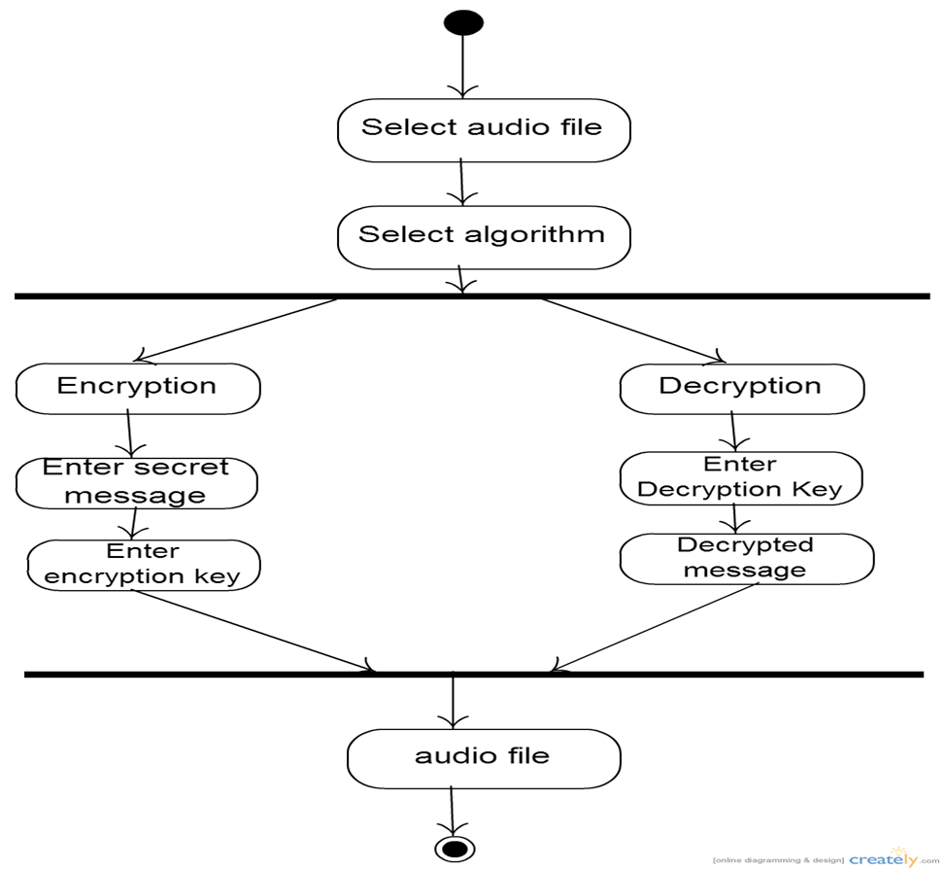
Activity Diagram

Slide 5
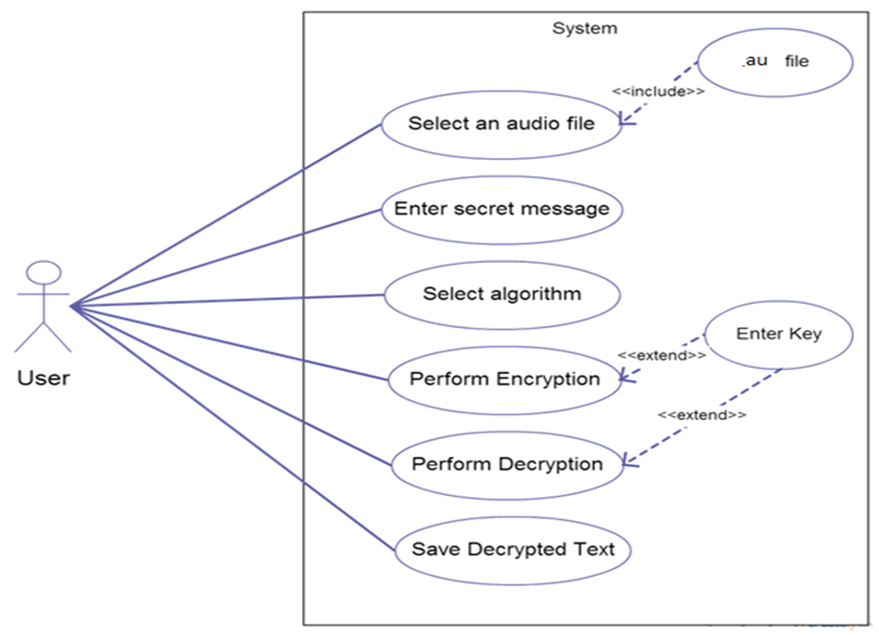
Use case diagram

Slide 6
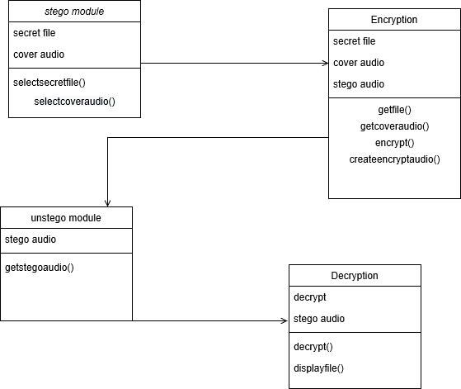
Class Diagram

Slide 7
GUI
Prototype has minimal GUI

