Slide 1
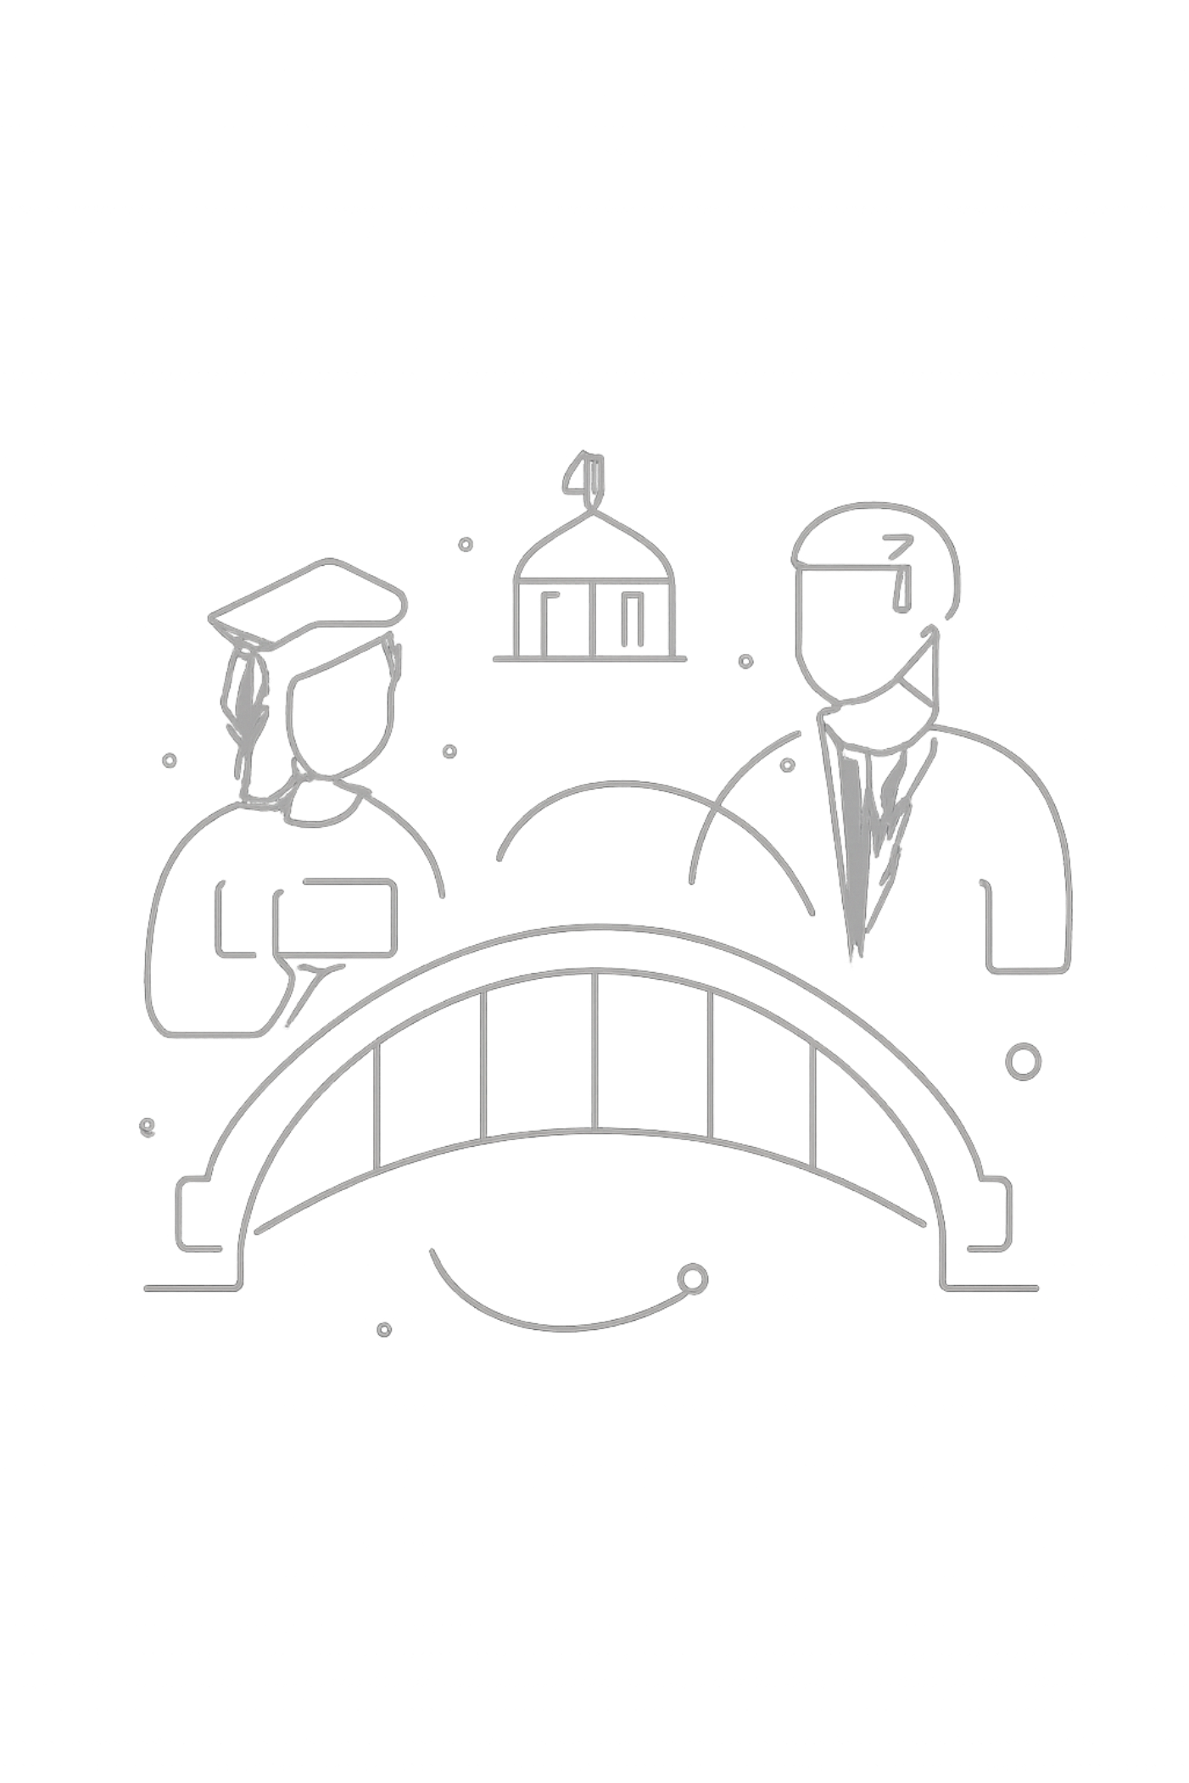
CampusBridge
Connecting Students and Mentors for
Career Growth
Samrat Saha 25MCC20059
Barsha Mahajan 25MCC20058
Deepsa Baidya 25MCC20004

Slide 2
Work Accomplished So Far
Core Architecture
Mentorship Ecosystem
Real-time Communication
Fully functional Client-Server architecture with secure authentication.
Profiles for students and mentors, connection requests, and 1:1 session management.
Built-in live chat and dynamic support messaging system.
Engagement Features
Admin Dashboard
Community feed with post creation, commenting, liking, and job listings.
Centralized management system for events, users, and platform settings.

Slide 3
Frontend Technologies
Framework
Styling
Authentication
React 19 (built with Vite for fast performance)
Tailwind CSS & Framer Motion (for smooth animations)
Clerk (Secure, modern identity management)
Real-Time Data
Data Visualization
Socket.io-client (for live chat)
Recharts (for dashboard analytics)

Slide 4
Backend Technologies
Runtime & Framework
Database
Node.js & Express.js
MongoDB & Mongoose
Real-Time
File Management
Socket.io (WebSocket connections)
Cloudinary (Profile images & media uploads)
Email Services
Security
Resend & @emailjs/browser (Notifications & Reminders)
Helmet, Express-mongo-sanitize, XSS-clean

Slide 5
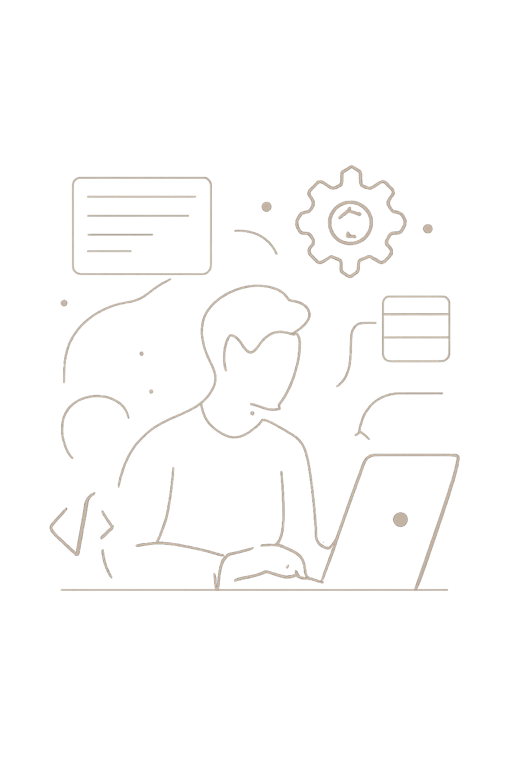
Key Contributions:
Samrat Saha
1
Full-Stack Architecture
Initialized the full-stack architecture and database schemas.
2
Mentor Ecosystem
Developed the Mentor Ecosystem (Dashboards, 1:1 sessions, job management).
3
Real-time Chat
Implemented Real-time Chat functionality, push notifications, and email reminders.
4
Community Features
Built the user connection system and interactive community features (posts, comments, replies).

Slide 6
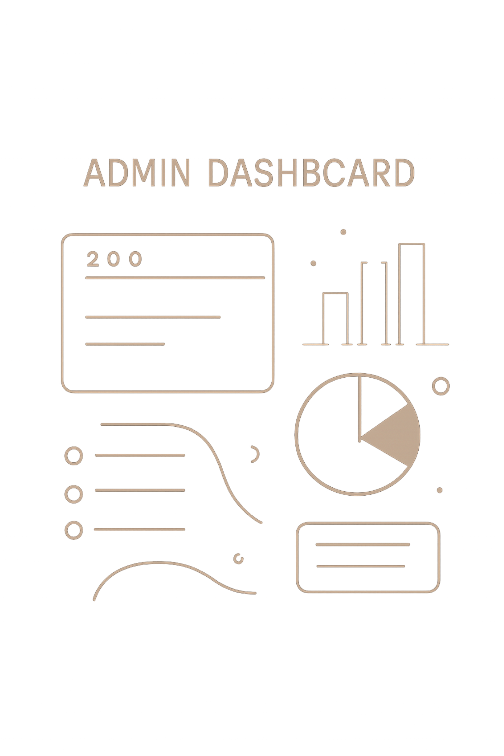
Key Contributions:
Barsha Mahajan
1
Admin Dashboard
Architected the Admin Dashboard with protected routing and role-based access.
2
Event Management
Developed the complete CRUD Event Management system.
3
Support Message Interface
Built the dynamic Support Message interface utilizing real-time sockets.
4
Mentor Onboarding
Implemented Mentor onboarding flows, account settings, and verification management tools.

Slide 7

Key Contributions: Deepsa Baidya
1
Clerk Authentication
Led the transition to Clerk Authentication for robust security.
2
UX/UI Animations
Created engaging UX/UI animations, including festival-themed page transitions (Holi/Diwali fireworks).
3
Router Layout Architecture
Developed the global event popup system and router layout architecture.
4
Platform & Documentation
Managed backend platform settings models, contact messaging systems, and project documentation.

Slide 8
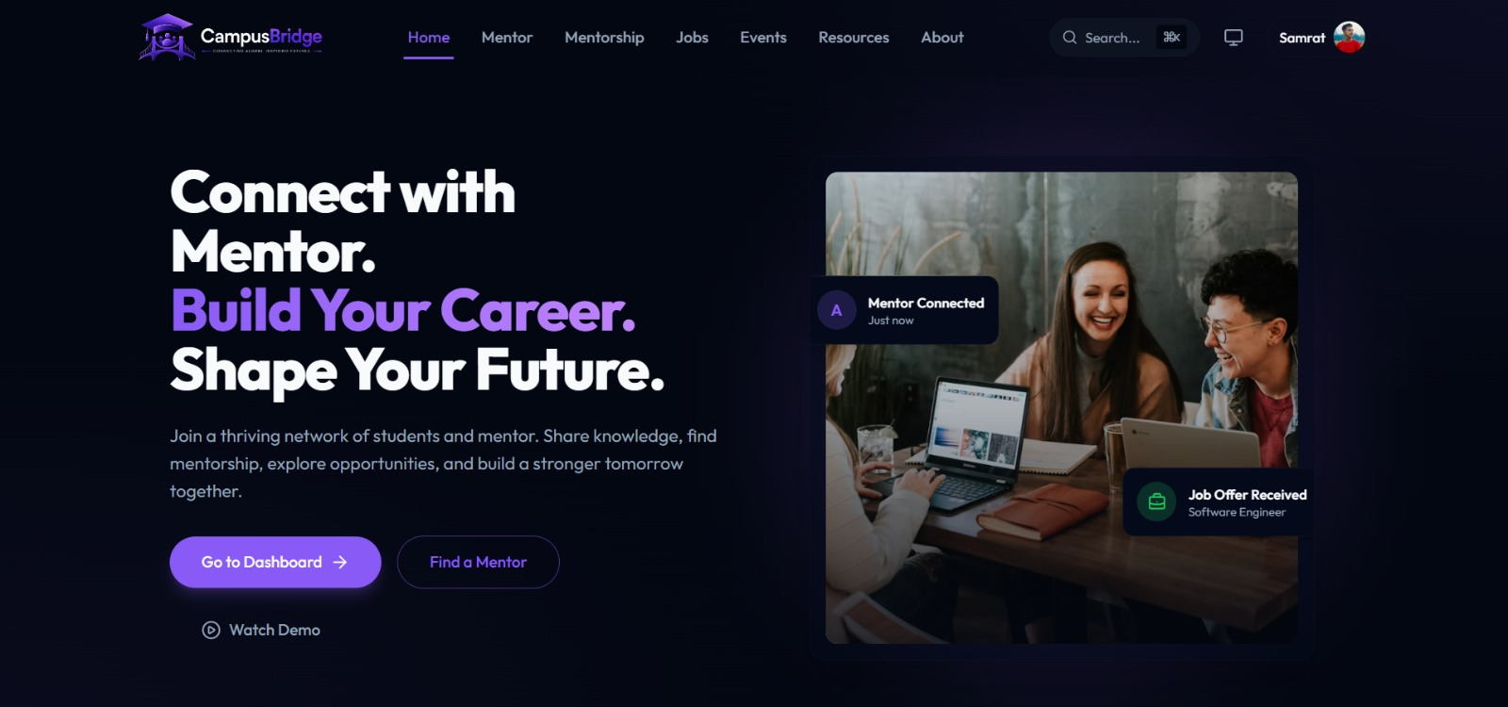
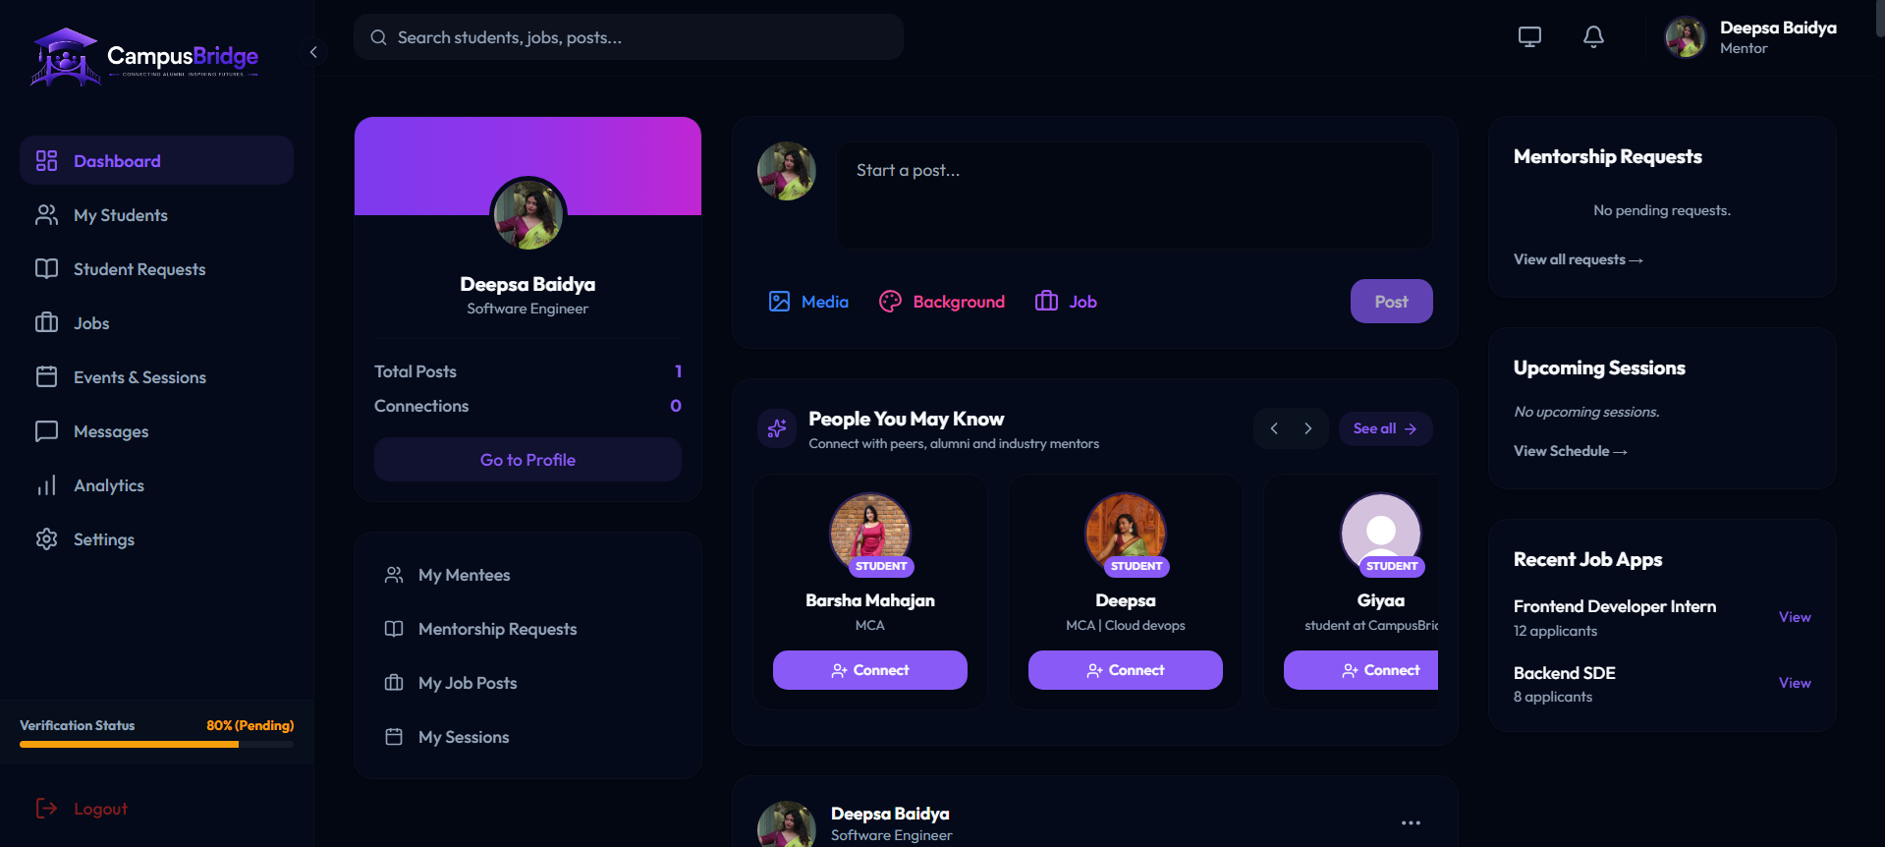
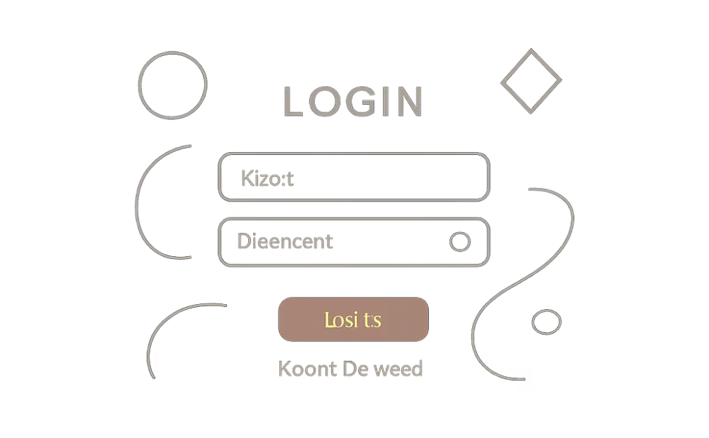
Application Showcase
Mentor Dashboard
Main Landing Page

Slide 9
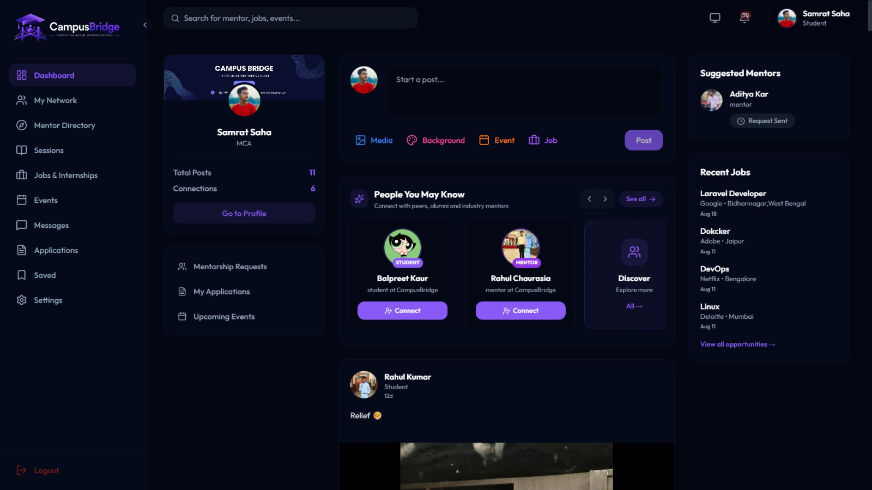
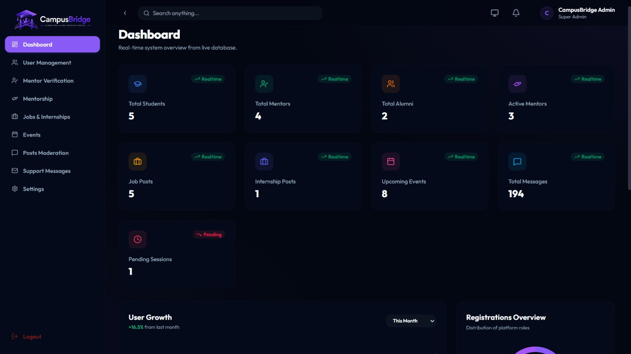
Application Showcase
Community Feed & Real-time Chat
Admin Dashboard

