Slide 1

Mortgage Eligibility Calculator
Built using AWS Serverless Architecture

Slide 2

Project Overview
A serverless Mortgage Eligibility Calculator that evaluates user’s financial details and determines eligibility based on predefined rules. Built using AWS services such as Lambda, S3, and DynamoDB.

Slide 3
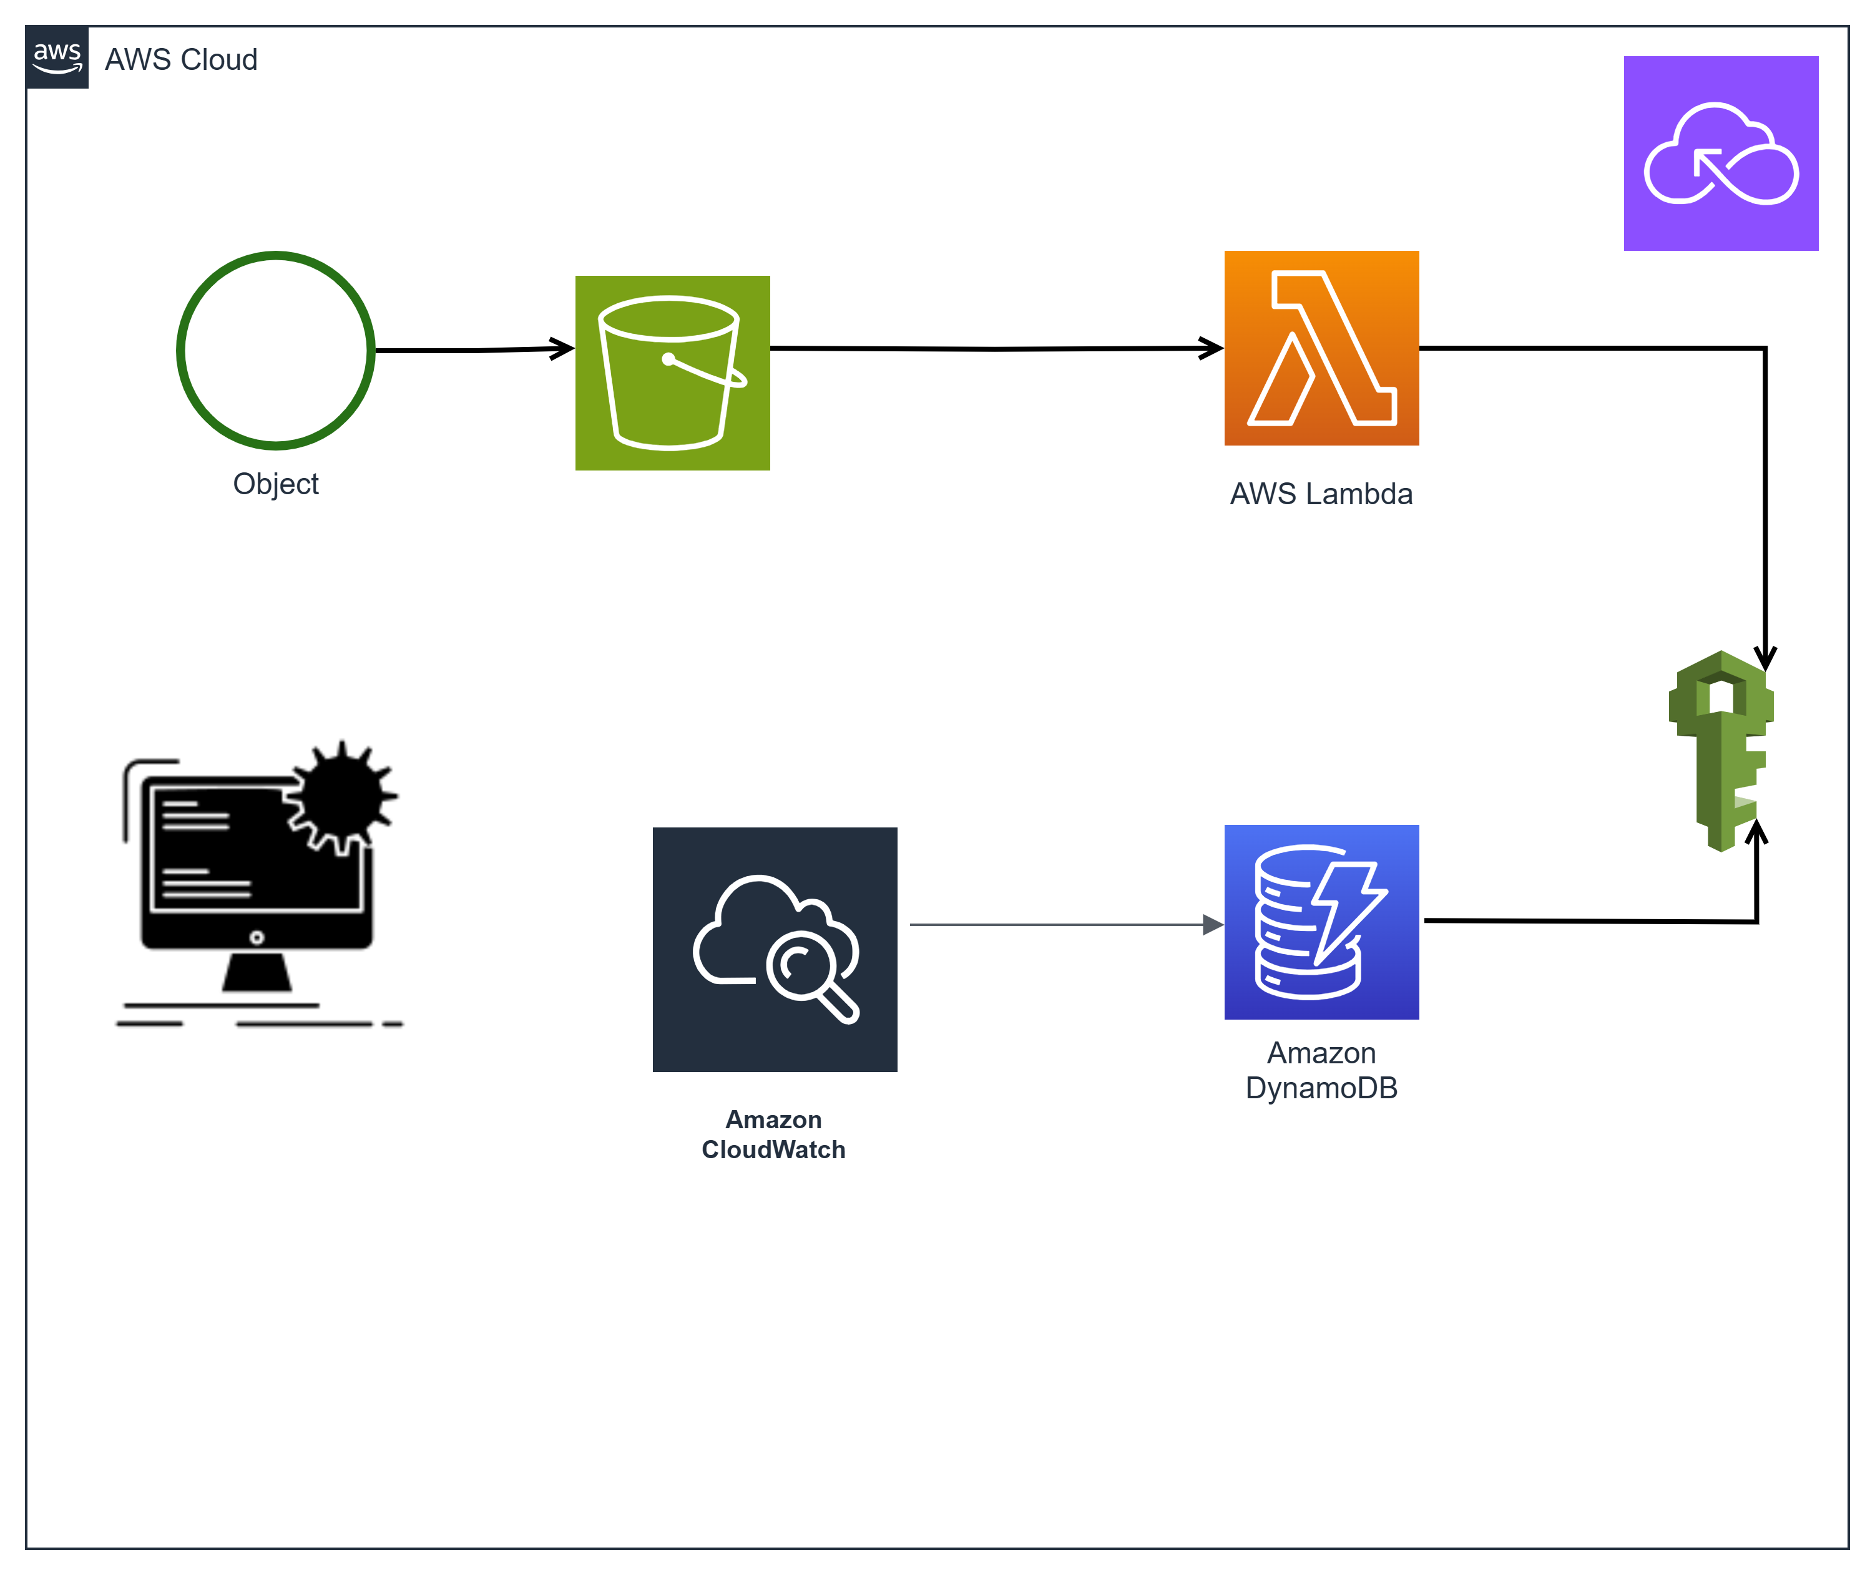
Architecture Diagram

Slide 4
Technologies Used
- AWS S3 (Frontend Hosting)
- AWS Lambda with Function URL (Business Logic)
- AWS DynamoDB (Database)
- AWS IAM (Security & Permissions)
- AWS CloudWatch (Monitoring)

Slide 5
Workflow Explanation
1. The user submits financial details via a web form hosted on S3.
2. The request is sent directly to the AWS Lambda Function URL.
3. Lambda processes the request and queries DynamoDB.
4. The eligibility result is returned directly to the user.
5. CloudWatch logs track execution, and IAM roles enforce security

Slide 6
Key Features & Benefits
- Fully serverless and cost-effective
- Highly scalable and secure
- Quick response time using AWS Lambda
- No infrastructure management required
- Data persistence using DynamoDB

Slide 7
Project Team & Roles
Project Manager & Visionary (Samreen)
Conceptualized the mortgage eligibility calculator idea.
Managed project execution, team coordination, and deliverables, IAM roles.
Ensured smooth execution and issue resolution.
Frontend (HTML Form in S3) (Doyin)
Uploaded an HTML form to S3.
Used JavaScript fetch API to send user input to the backend.
Backend (AWS Lambda Function) (Shumaila)
Validated data, and performed eligibility calculations.
Stored results in DynamoDB.
Data Storage (DynamoDB) (Aliya)
Designed and managed the DynamoDB table.
Ensured unique storage with a primary key.
Testing & Debugging (Candida)
Configured Lambda Function URL CORS settings.
Used CloudWatch Logs and Browser Console for debugging.
Fixed CORS errors, decimal mismatches, and function permissions.

Slide 8
Thank You
Samreen
Doyin
Aliya
Shumaila
Candida

