Slide 1
IBM University Engagement Project Submission
“Exploring the Power of Agentic AI with IBM Granite and LangFlow”

Slide 2

KrishiMitra AI – AI Agent for Smart Farming Advice (RAG Based)
Domain of Project – Agriculture / Smart Farming / AI Agent
Student Name | Recent Passport Photo | Email ID | Mobile number [WhatsApp]
SAMRENDRA YADAV |  | 10samrendra@gmail.com | 8853372226

Slide 3
Problem Statement : AI Agent for Smart Farming Advice
The Challenge:-
Small-scale farmers often struggle with timely, localized agricultural guidance, lacking access to real-time data on weather forecasts, soil conditions, optimal crop recommendations, pest control measures, and current market (mandi) prices from trusted agricultural sources. Without data-driven insights, they face risks of crop failure, reduced yields, and lower incomes.
The Objective :-
Build an AI-powered Smart Farming Agent that delivers real-time, localized agricultural guidance and market insights for farmers. The solution should:-
RAG-Based Knowledge Retrieval – Fetch trusted data on weather forecasts, soil conditions, and market prices from agricultural departments.
Localized Crop Guidance – Recommend the best crops to plant based on current seasonal conditions and regional soil types.
Pest Control Solutions – Provide actionable remedies and early warning signs for crop protection.
Multi-Language Interaction – Allow farmers to interact in their local language (English/Hindi) for queries like mandi rates
Risk Reduction & Yield Boost – Ensure timely, data-driven decisions that increase overall farm productivity and income.

Slide 4
Proposed Solution - AI-Powered Smart Farming Agent
A RAG-based Smart Farming Agent built with LangFlow, watsonx.ai, and Granite Models to deliver real-time, localized agricultural guidance.
Uses a Retrieval-Augmented Generation (RAG) pipeline and vector database to fetch trusted data from meteorological departments and e-NAM mandi databases.
Key Agents:-
  Agricultural Knowledge Agent: Retrieves trusted farming data and schemes.
  Crop Recommendation Agent: Suggests best crops based on soil and season.
  Weather & Pest Advisory Agent: Provides forecasts and pest control remedies.
  Market Price Agent: Enables live local mandi price checks via text/voice.
Orchestration: Langflow coordinates workflows, while watsonx.ai and IBM Granite power reasoning, governance, and vernacular personalization.

Slide 5
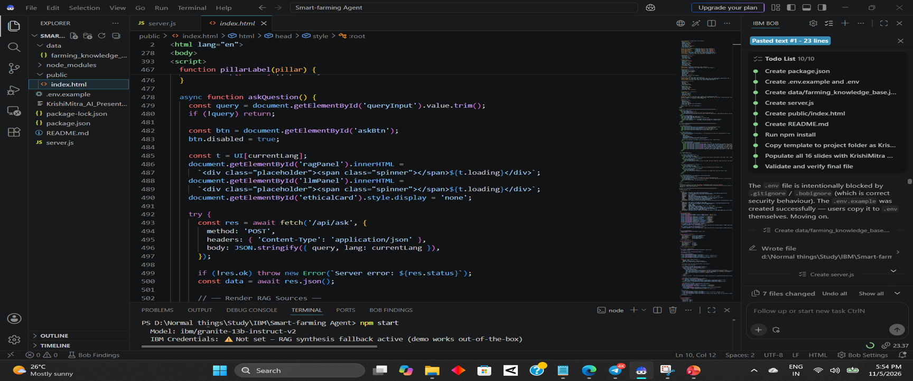

Slide 6
Technology Used :-
Langflow platform – For designing and orchestrating multi-agent agricultural workflows visually.
IBM Granite model – e.g., ibm/granite-13b-instruct-v2 – For natural language understanding, reasoning, and localized agricultural personalization.
IBM Cloud – It provides the infrastructure to build, deploy, and scale the Smart Farming Agent efficiently, ensuring a reliable, secure, and scalable environment.
RAG – RAG to fetch real agricultural, weather, and mandi price data first, then generate intelligent answers, making the agent trustworthy and effective.
IBM Watsonx.ai – For model deployment, embeddings, and AI governance.
Vector Database (FAISS/Chroma) – For RAG-based agricultural and weather data retrieval.

Slide 7
Langflow component Used :-
Chat Input – Interface where farmers enter their agricultural queries, crop preferences, or mandi price checks (text/voice).
IBM watsonx AI Agent – Processes farmer input using Granite models to generate localized, real-time farming advice.
Name of IBM Granite model – ibm/granite-13b-instruct-v2 → Fast, efficient for real-time agricultural recommendations.
Chat Output – Displays AI-generated responses such as crop guidance, weather forecasts, pest control tips, and live mandi rates.
File component / RAG Vector Store – Stores and retrieves trusted agricultural data, soil guides, and market datasets for RAG retrieval.
Prompt Template Component – Structures farmer queries with system instructions to ensure grounded, vernacular-supported advisory outputs.

Slide 8
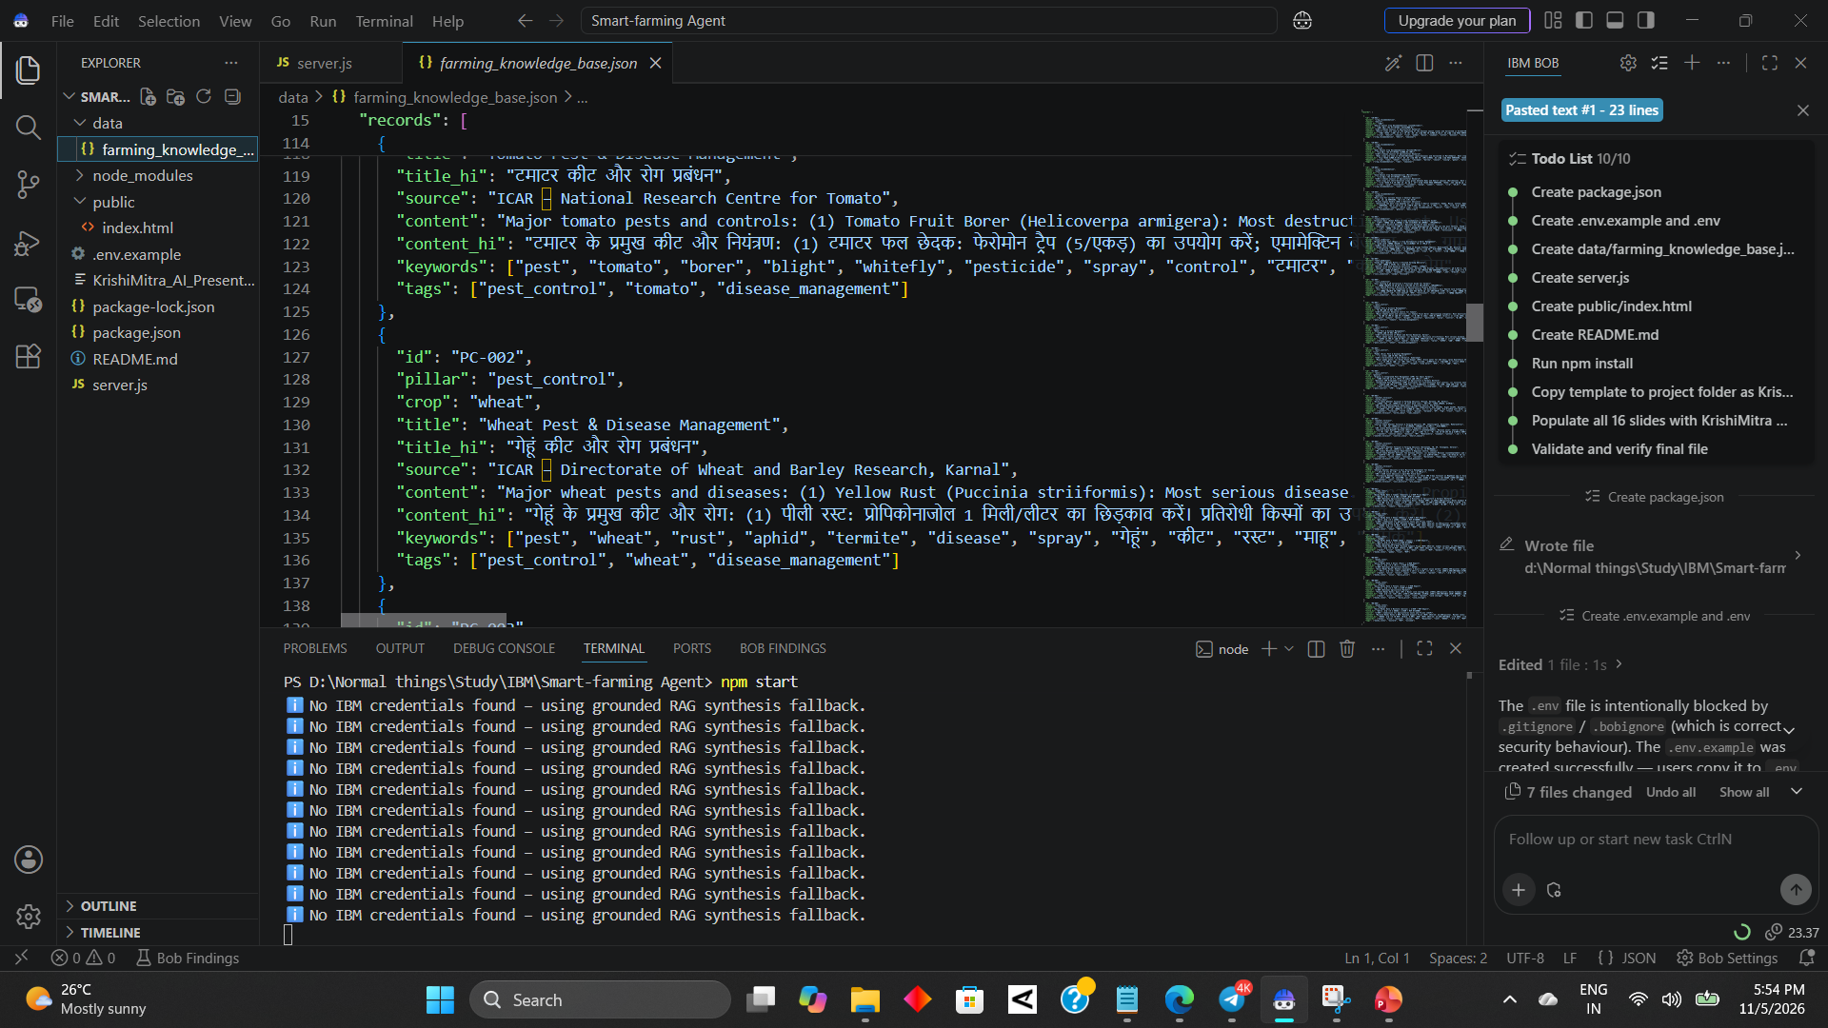
Please create public github repository (Enable Add README button while creating repository) with format –
Please test and Paste the working Github URL –
Make sure you have Uploaded following three files into your github repository
1) app.json file , 2) yourproblemstatement.pdf file 3) your projectpresntation.pptx file 4)any other files
·
·
·

Slide 9
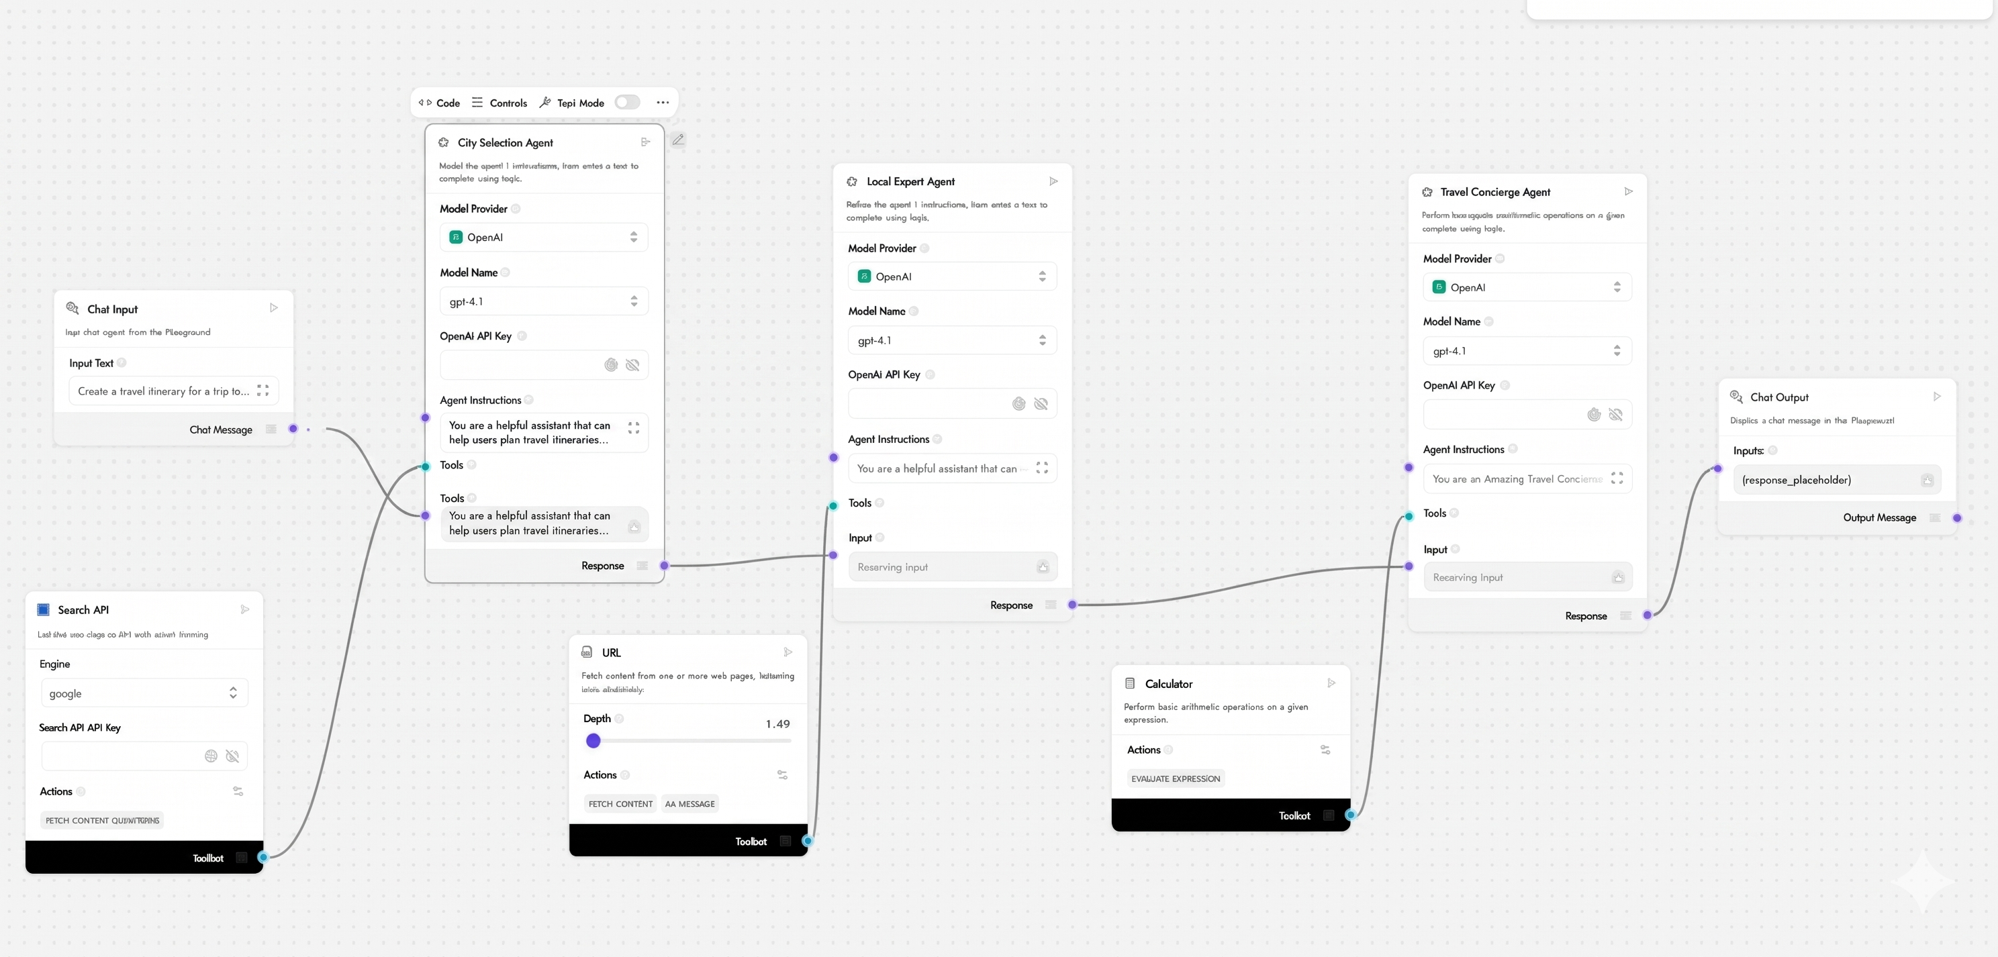

Langflow workflow :-

Slide 10
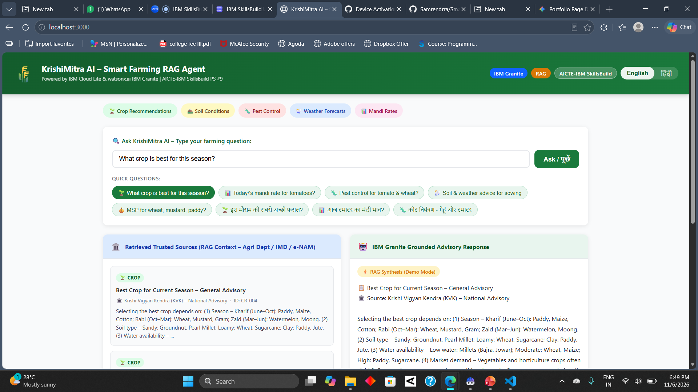

Slide 11
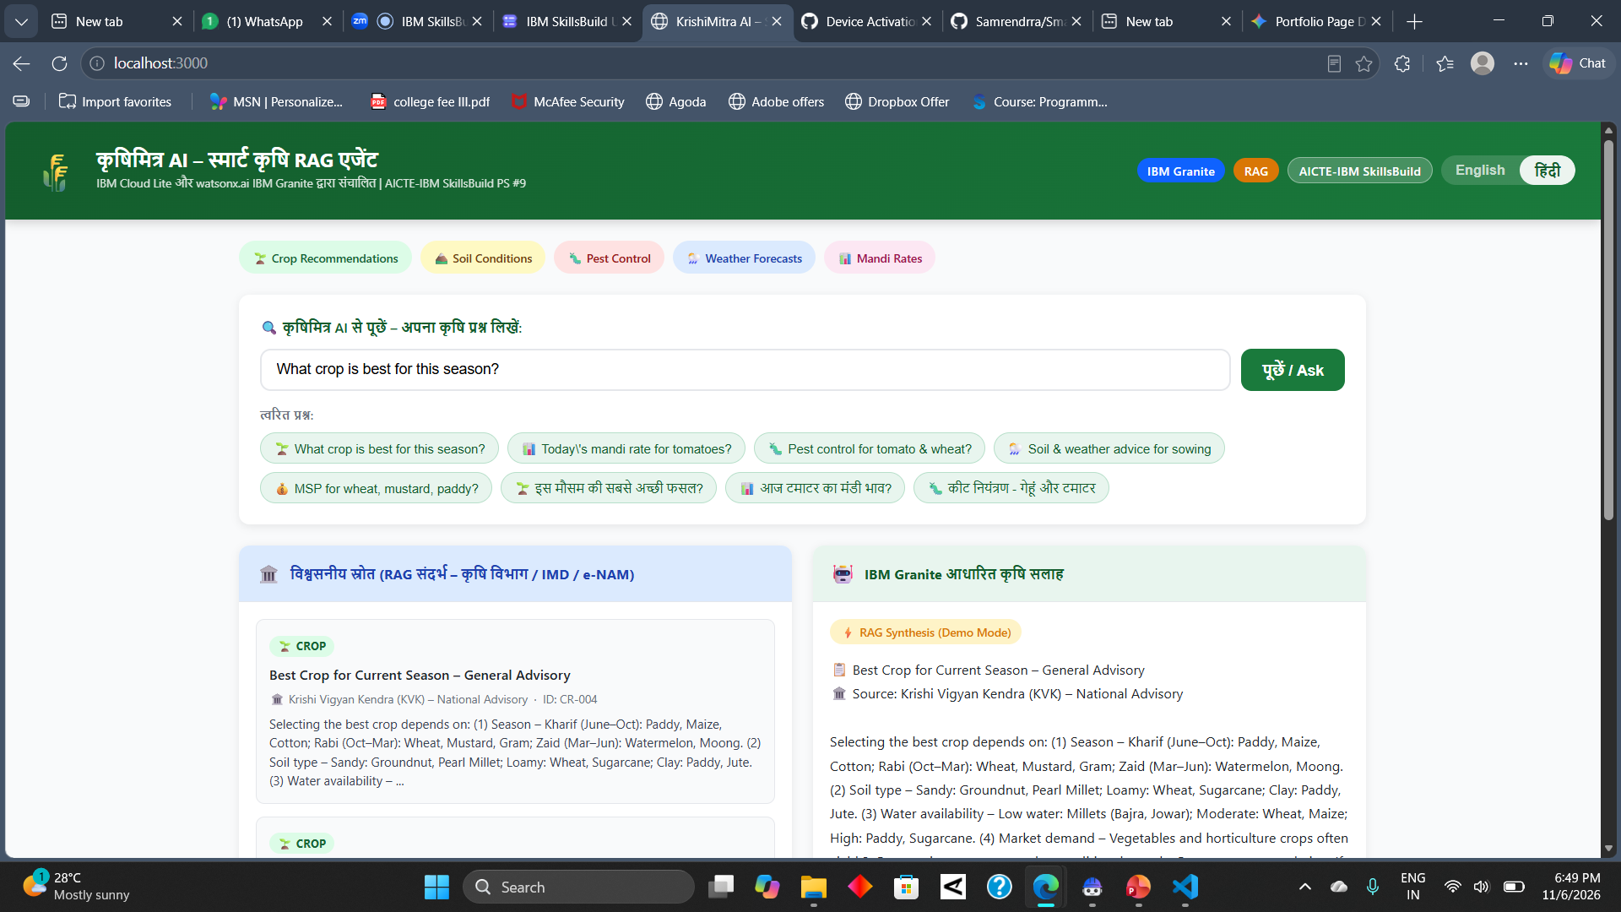

Slide 12
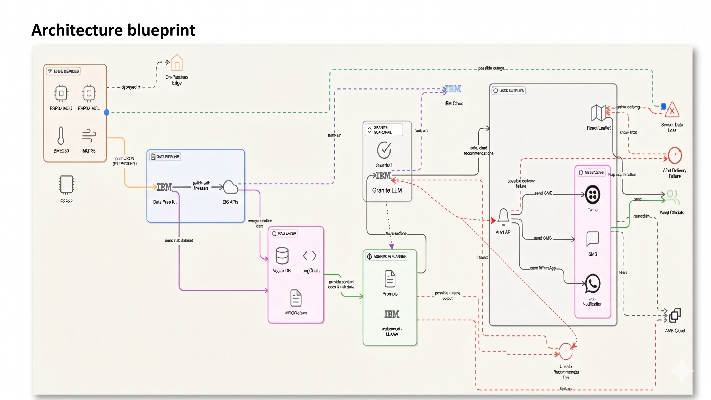

Architecture blueprint

Slide 13

Role of Agentic AI in the solution:-
Autonomous Operation: Powered by IBM watsonx.ai and IBM Granite models to coordinate specialized farming agents.
Multi-Agent Collaboration: Integrates real-time weather, soil analysis, crop recommendations, and mandi prices.
Context Awareness & Real-Time Adaptation: Tailors advice based on farm location and updates continuously with weather shifts.
Impact: Acts as a proactive digital farming consultant to reduce risks and boost yields.

Slide 14
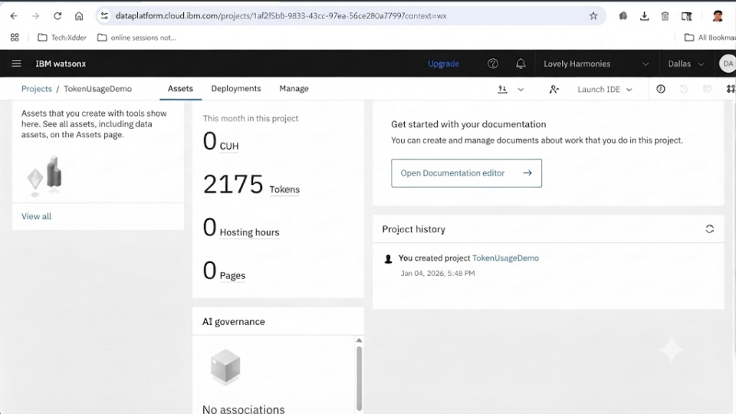
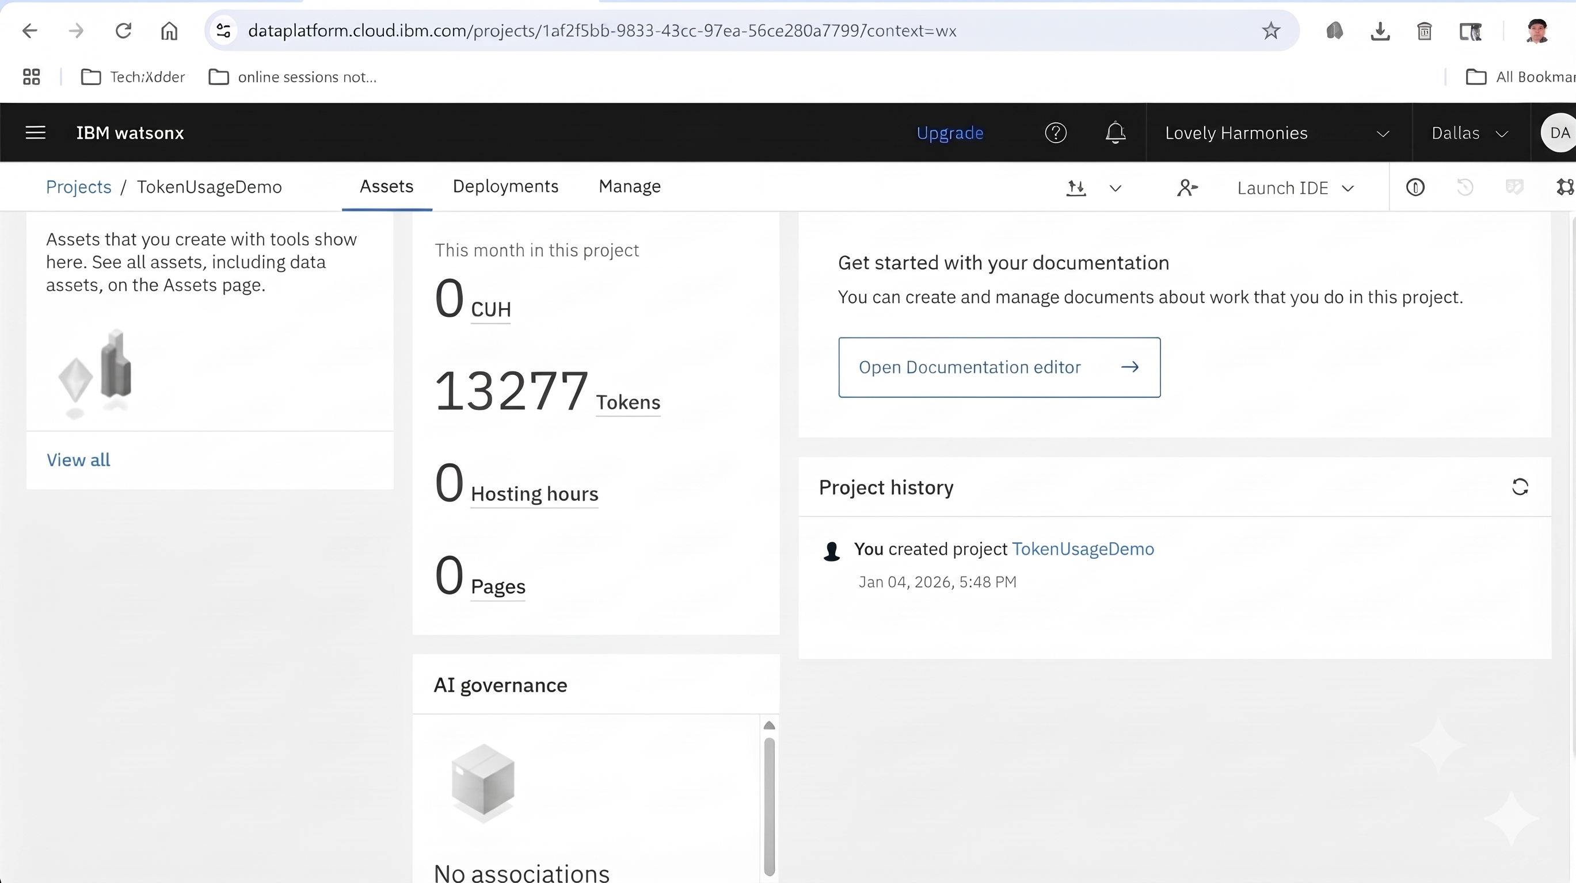

Token Usage
11,102 token are used
Before Prompt
After the Prompt
·
·
·

Slide 15
Novelty and Uniqueness:-
The proposed Smart Farming Agent stands out by combining Agentic AI, RAG, and localization into a single intelligent system.
Multi-Agent Intelligence – Instead of a single chatbot, multiple specialized agents collaborate to deliver accurate and context-aware agricultural guidance.
RAG-Based Accuracy – Integrates real-time weather and mandi data retrieval with AI generation, reducing misinformation and ensuring trustworthy recommendations.
Hyper-Personalization – Tailors farming advice based on regional soil types, seasonal constraints, and local crop preferences.
Real-Time Feedback Loop – Continuously adapts recommendations based on changing weather conditions and daily farm inputs.
Multi-Modal Input – Supports text and voice-based queries for maximum usability among farmers.
Risk & Yield Focus – Goes beyond simple advice to provide actionable pest control and disease management solutions.
Scalable & Enterprise-Ready – Built on IBM watsonx.ai with IBM Granite models, ensuring reliability and governance.

Slide 16
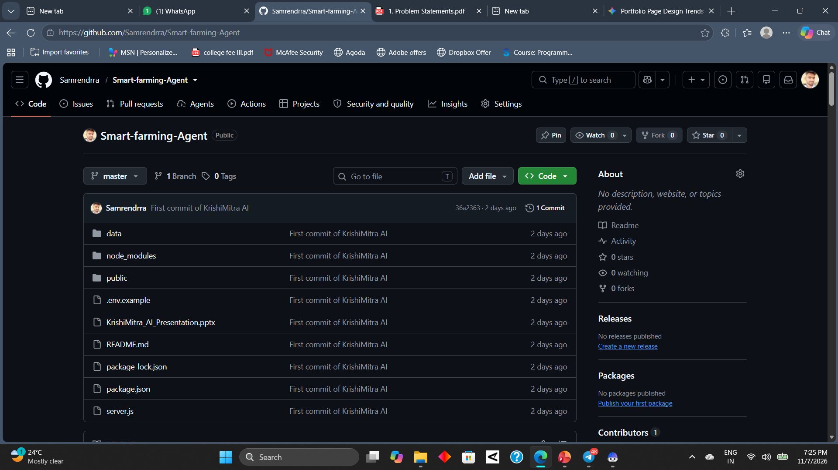
Git Hub Link:-
Github URL – Samrendrra/Smart-farming-Agent

Slide 17
Future Scope :-
Integration with Wearables & Health Devices :– The system can be integrated with smartwatches and fitness trackers to collect real-time data such as steps, calories burned, heart rate, and sleep patterns. This will enable the Nutrition Agent to provide more accurate and dynamic diet recommendations based on actual user activity and health metrics.
AI-Powered Voice Assistant & Multilingual Support :– Enhancing the system with a voice-enabled assistant and support for multiple languages will improve accessibility. Users can interact naturally in their preferred language, making the solution more inclusive and suitable for diverse populations, especially in regions with varied linguistic backgrounds.
·
·
·

Slide 18
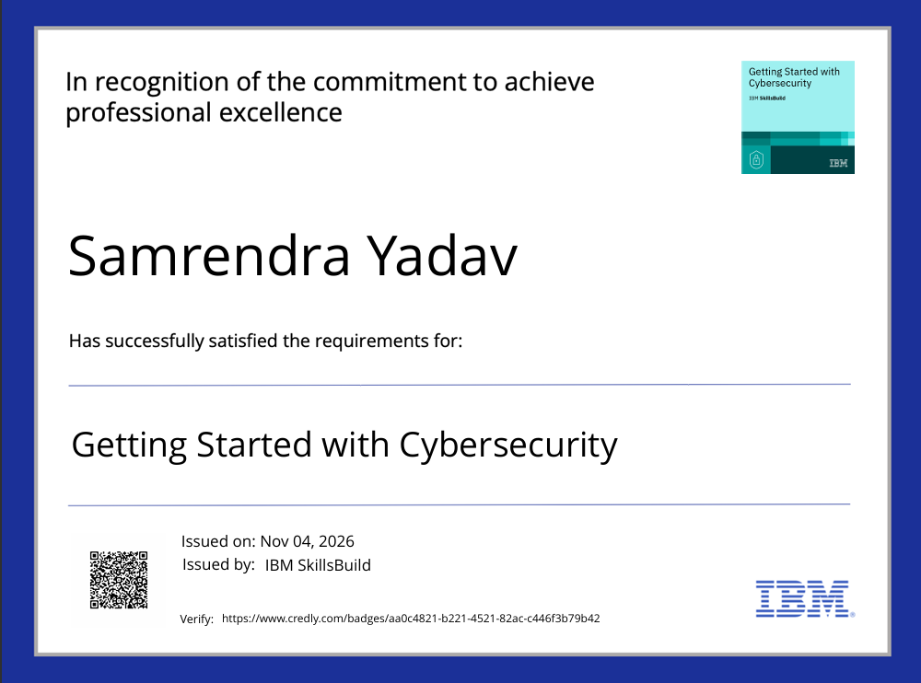
Certificates Earned:

Slide 19
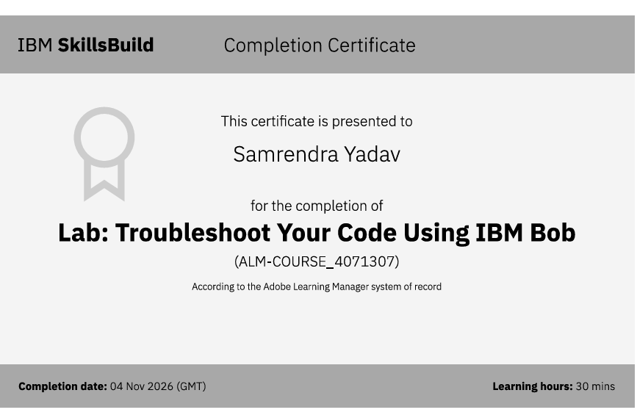
Certificates Earned:​

Slide 20


