Slide 1
CREDIT- CARD FRAUD DETECTION
TEAM - 7

Slide 2

UNDERSTANDING
CREDIT CARD FRAUD DETECTION?

Slide 3
Credit card fraud detection is the process of identifying and preventing fraudulent transactions before they can cause financial damage. It involves using advanced algorithms and machine learning techniques to analyze transaction data in real-time and detect patterns that may indicate fraudulent activity.

Slide 4
TALKING ABOUT SOME KEY FEATURES:
Enormous Data Processing: Credit card companies handle massive data daily, requiring fast fraud detection.
Imbalanced Data: About 99.8% of transactions are legitimate, making fraud detection challenging.
Data Privacy: Protecting user privacy is vital; dimensionality reduction techniques help maintain privacy.
Misclassified Data: Improving detection accuracy requires addressing misclassified transactions.
Adaptive Techniques: Scammers evolve tactics; simple, interpretable models enable quick deployment of new detection methods.

Slide 5
HERE IS A PRACTICAL EXAMPLE FOR IT:
To illustrate, let’s explore a practical example using a dataset. Suppose we have a dataset containing credit card transactions. We’ll use machine learning techniques to identify fraudulent transactions. Here’s a brief overview of the steps:
Data Loading: Load the credit card transaction data into a Jupyter notebook or GoogleColab.
Data Exploration: Understand the data by examining its shape, summary statistics, and distribution.
Imbalance Analysis: Calculate the fraction of fraudulent transactions (outliers) compared to valid ones. In most cases, only a tiny percentage of transactions are fraudulent.
Model Building: Develop a model that quickly detects anomalies and classifies them as fraudulent. Techniques like oversampling, undersampling, or synthetic data generation can help address data imbalance.

Slide 6
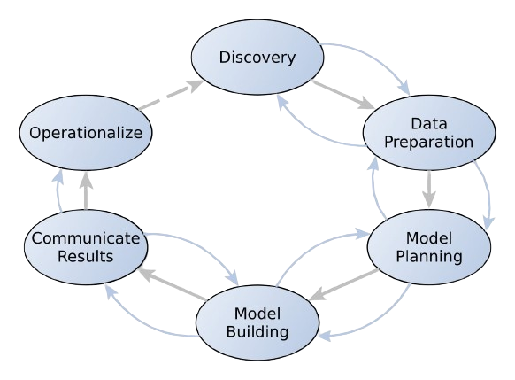
Discovering Patterns: Credit Card Fraud Detection
in the Data Analytics Lifecycle

Slide 7
EXPLORING THE ROLE OF CREDIT CARD FRAUD DETECTION IN THE DATA DISCOVERY PHASE
Discovery

Slide 8
LEARNING THE BUSINESS DOMAIN
1.
ASSESSING RESOURCE AVAILABILITY
2.
FRAMING THE PROBLEM
3.
IDENTIFYING KEY STAKE HOLDERS
4.
INTERVIEWING THE ANALYTICS SPONSOR
5.
FINDING POTENTIAL DATA SOURCES
6.
DEVELOPING INITIAL HYPOTHESIS
7.

Slide 9
Learning the Business Domain:
Grasping the intricacies of credit card transactions, fraud detection regulations, and prevalent fraud schemes.
Assessing Resource Availability:
We assessed the resources available for our project, including access to data, computational resources, software tools, and expertise. We considered whether we could obtain real-world credit card transaction data or use simulated data for our analysis. Additionally, we identified relevant libraries or frameworks for data analysis and machine learning that we could leverage.
Framing the Problem:
Defining specific objectives, constraints, and success criteria for the fraud detection system.
Considering factors such as fraud detection accuracy, false positive rates, regulatory compliance, and customer experience.
Identifying Key Stakeholders:
Engaging with financial institutions, payment processors, merchants, regulatory bodies, and cardholders to understand their perspectives and requirements.
Interviewing the Analytics Sponsor:
Conducting interviews with senior executives or decision-makers to gain insights into strategic goals, risk tolerance, and expectations for fraud detection.
Finding Potential Data Sources:
Identifying and exploring various data sources such as transaction logs, user profiles, merchant information, and external databases to gather relevant information for fraud detection.
Developing the Initial Hypothesis:
Formulating educated guesses about potential fraud patterns and behaviors based on domain knowledge. Hypothesizing factors such as transaction timing, amounts, merchant categories, and user behavior.

Slide 10
THE PROBLEM STATEMENT
To Develop an effective fraud detection system exclusively for credit card transactions, aiming to identify and prevent unauthorized activities while maintaining the integrity of legitimate transactions and ensuring customer satisfaction.

Slide 11
OPTIMIZING DATA FOR FRAUD DETECTION: STRATEGIES IN DATA PREPARATION
Data Preparation

Slide 12
Sandbox Setup:
Objective: Create workspace for modelling.
Actions: Establish isolated environment, install essential tools.
Example: Setup Python environment for analysis.
ETLT Process:
Objective: Extract, transform, load, and validate data.
Actions: Extract transaction data, clean, transform, test quality.
Example: Extract records, clean timestamps, ensure integrity.
Data Understanding:
Objective: Understand data structure and context.
Actions: Explore schema, identify key features, learn limitations.
Example: Study transaction dataset for attributes.
Data Cleaning:
Objective: Address inconsistencies and missing values.
Actions: Remove duplicates, impute missing values, correct errors.
Example: Remove duplicate transactions, fill missing timestamps.
Survey & Visualization:
Objective: Explore distribution, detect anomalies.
Actions: Plot histograms, analyse stats, detect outliers.
Example: Visualize transaction amounts over time.
Common Tools:
Objective: Utilize tools for streamlined processing.
Actions: Use Pandas for filtering and cleaning data.
Examples: Pandas, NumPy, Seaborn/Matplotlib, SQL.

Slide 13
ABOUT DATASET
Dataset source:
The dataset contains credit card transactions made by European cardholders in September 2013. Due to confidentiality issues, the specific source of the dataset is not disclosed, but it's likely obtained from a financial institution or research institution.
Site link: https://www.kaggle.com/datasets/mlg-ulb/creditcardfraud
Attributes:
The attributes in the dataset can vary, but the one taken by us includes:
Time: Time elapsed between this transaction and the first transaction in the dataset (in seconds).
Amount: Transaction amount.
V1, V2, ..., V28: Principal components obtained with PCA transformation (to protect sensitive information).
Class: Binary variable indicating whether the transaction is fraudulent (1) or not (0).

Slide 14

DATA CLEANSING JOURNEY OF OUR PROJECT: ENSURING ROBUSTNESS IN FRAUD DETECTION DATASET

Slide 15
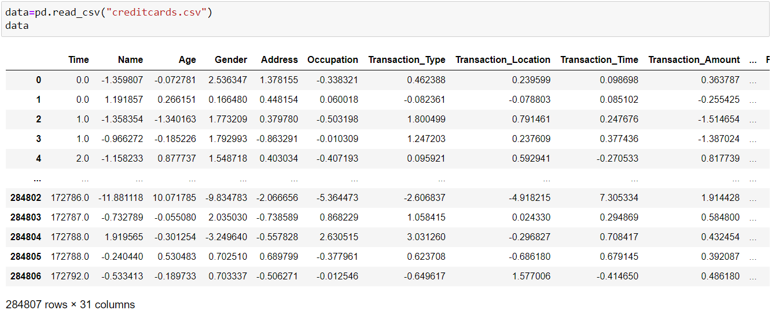
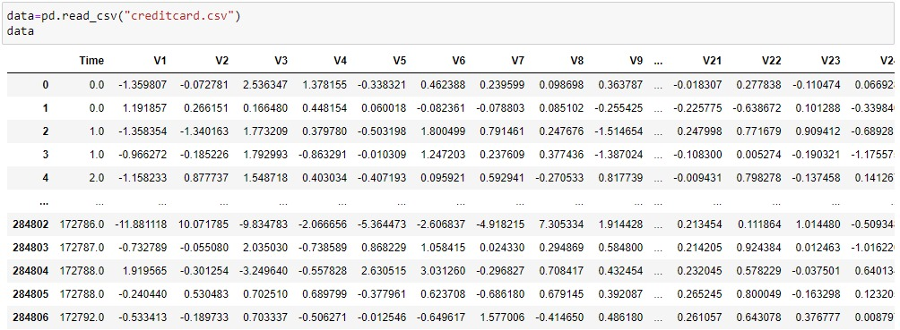
DATA REVIEW: UNDERSTANDING THE DATASET

Slide 16
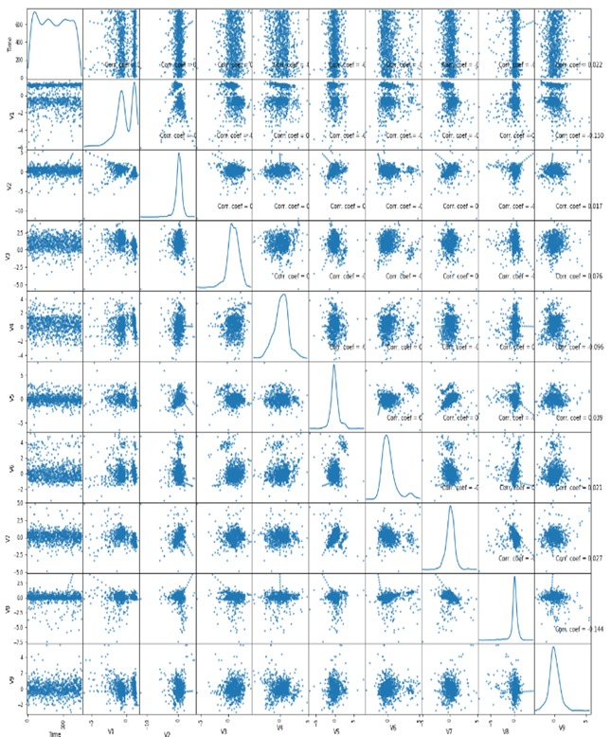
SCATTER PLOT FOR THE INITIAL DATA

Slide 17
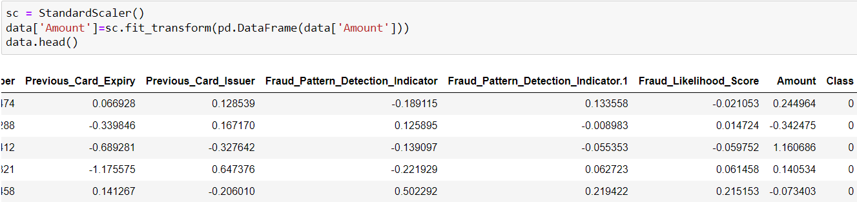
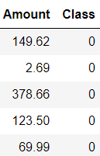
TRANSFORMING TRANSACTION AMOUNT FOR CLARITY AND USABILITY

Slide 18
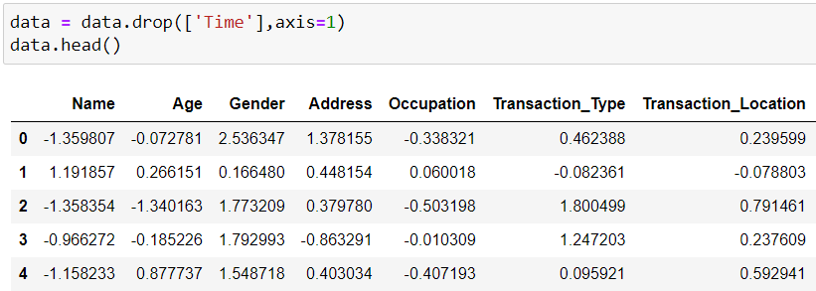
EXCLUDING TIME COLUMN FOR STREAMLINED ANALYSIS

Slide 19
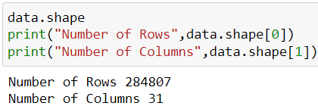
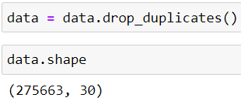
REMOVING DUPLICATE ENTRIES FOR DATA CONSISTENCY

Slide 20
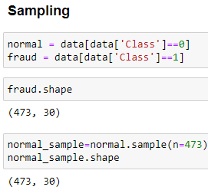
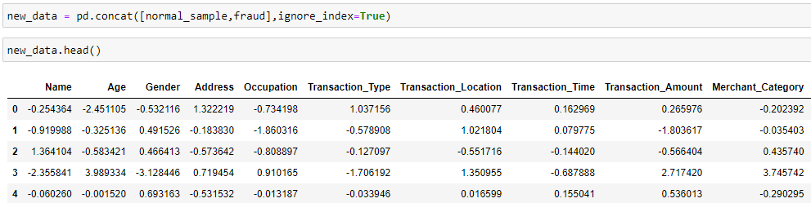

IDENTIFYING NORMAL AND FRAUDULENT TRANSACTIONS

Slide 21
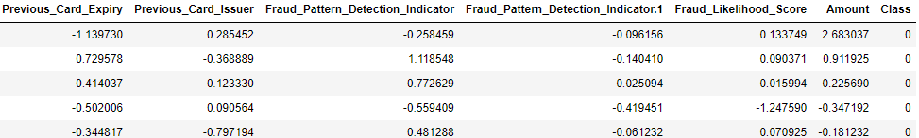
FINAL DATA REVIEW AND VALIDATION

Slide 22
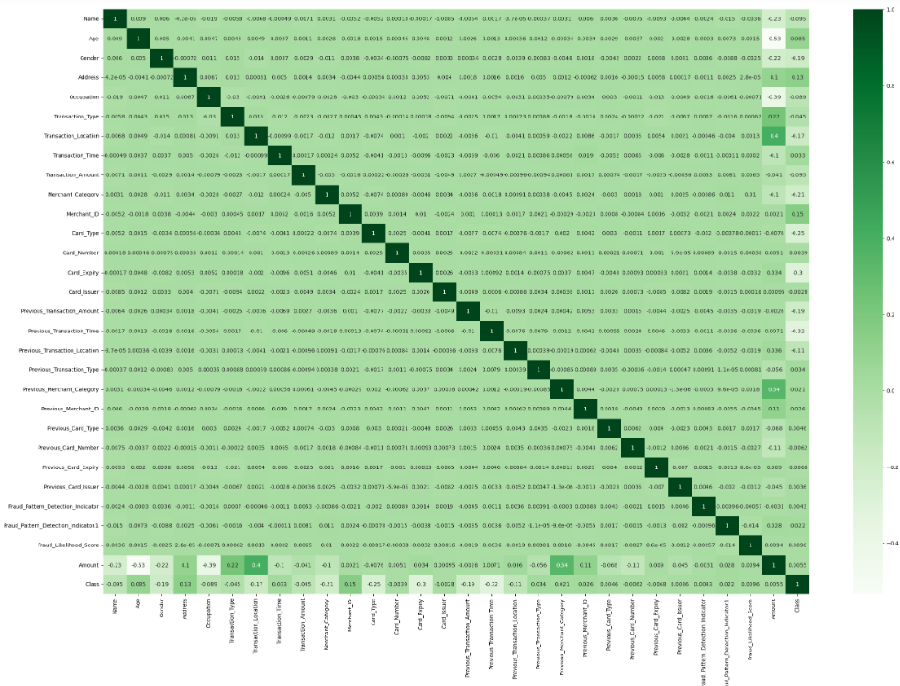
Correlation Matrix

Slide 23
BUILDING THE BRAINS: DATA-DRIVEN MODEL PLANNING FOR ACCURATE FRAUD DETECTION
Model Planning

Slide 24
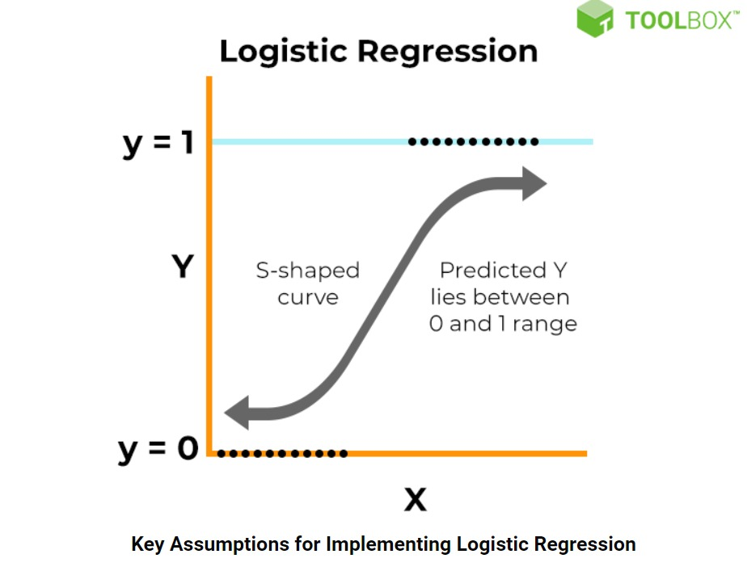
Logistic Regression:
Logistic regression is a statistical method used for binary classification, which means predicting the probability of occurrence of an event or outcome.
Simple and interpretable.
dependent variable is dichotomous(binary).
explain the relationship between one dependent binary variable and one or more independent variables.
It assumes a linear relationship between the independent variables and the log-odds of the outcome.
Fast Training and Prediction: Logistic regression is computationally efficient and can handle large datasets with relatively low memory and CPU requirements. Training and prediction times are typically faster compared to more complex models like neural networks.
Example: Good starting point for its simplicity.

Slide 25
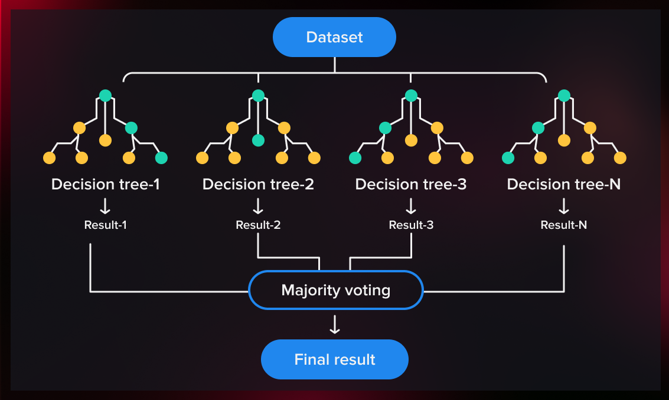
Random Forest (RF):
Handles non-linear relationships.
Random Forest is a classification algorithm that is comprised of many Decision Trees.
Each tree has nodes with conditions, which define the final decision based on the highest value.
­It is like a group decision-making team in machine learning.
­It combines the opinions of many “trees” (individual models) to make better predictions of model.
­It tackle both classification and regression problems effectively.
It has ability to handle complex Datasets & Robust against overfitting.
It can handle the data set containing continuous variables, as in the case of regression, and categorical variables, as in the case of classification.
Example: Suitable for imbalanced data, captures complex patterns.
.

Slide 26
Data Instances:
Data instances for credit card fraud detection typically consist of individual credit card transactions, each represented as a data point.
Each instance contains various features (attributes) that describe the transaction, and a label indicating whether the transaction is fraudulent or legitimate.
Amount with transaction location.
Amount with Previous transaction Location.
Card Holder’s Information.
class with merchant_id.
Type of Transaction.
Fraudulent or legitimate: A binary label indicating whether the transaction is fraudulent (1) or legitimate (0).
Key Features:
Time since last transaction.
Frequency of transactions.
Transaction amount relative to cardholder's typical spending pattern.
According to the Correlation matrix these three features are the most dependent variables to consider whether the fraud has been detected or not.

Slide 27
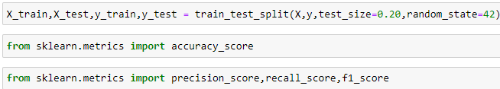
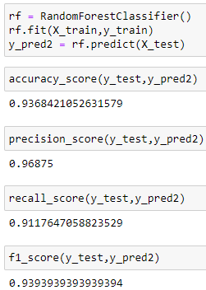
RANDOM FOREST IMPLEMENTATION

Slide 28
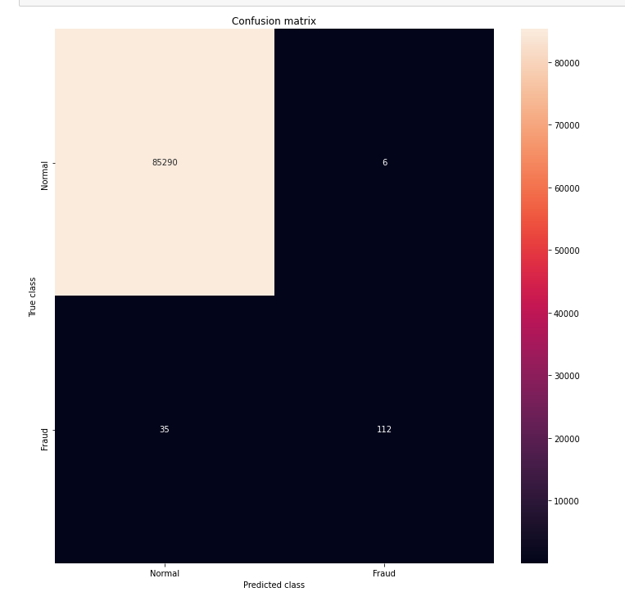

Slide 29
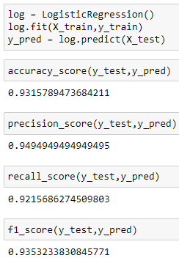
LOGISTIC REGRESSION IMPLEMENTATION

Slide 30
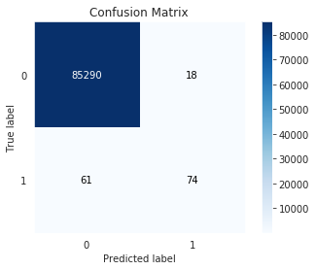

Slide 31
SHAPING THE SOLUTION: THE MODEL DEVELOPMENT PROCESS
Model Building

Slide 32
WHY RANDOM FOREST?
Handles Imbalanced Data: Credit card fraud data is imbalanced, with far more legitimate transactions than fraudulent ones. Random Forest performs well even with imbalanced datasets because it trains multiple decision trees and averages their predictions.
Robust to Overfitting: Random Forests are less prone to overfitting the training data compared to some other models like decision trees. This is because each tree uses a random subset of features, reducing the chance of memorizing irrelevant patterns.
Interpretability: Unlike complex models like neural networks, Random Forest allows you to understand the features that contribute most to fraud detection. This can be valuable for improving future models and explaining decisions.
Accuracy: Random Forest often achieves high accuracy in fraud detection tasks. It aggregates predictions from multiple trees, leading to a more robust and generalizable model.

Slide 33
WHY RANDOM FOREST STANDS OUT FOR FRAUD DETECTION OVER OTHER MODELS?
Logistic Regression: While interpretable and good for binary classification, it might struggle with complex fraud patterns and imbalanced data.
Gradient Boosting: (e.g., XGBoost) Can be very powerful but requires careful hyperparameter tuning and might be less interpretable than Random Forest.
Support Vector Machine (SVM): Effective for some fraud detection tasks, but can be computationally expensive for large datasets and might be less robust to imbalanced data.
Neural Networks: Can be very powerful, especially for complex patterns, but require significant data and computational resources. They also lack interpretability.
Ensemble Methods (including Random Forest): These can be even more powerful than individual models like Random Forest by combining multiple models. However, interpretability can become a challenge.
Anomaly Detection Models: These are good for identifying outliers, but might not be ideal for classification tasks like fraud detection where specific patterns need to be learned.

Slide 34
A DECISION TREE TO SUMMARIZE
Do you need interpretability?
Do you have a highly
imbalanced dataset?
Are computational resources
a constraint?
YES?
YES?
YES?
If interpretability is crucial,
Random Forest is a good choice.
Random Forest handles
imbalanced data well.
Random Forest is generally less
computationally expensive than
complex models like neural
Networks.

Slide 35
EMPOWERING DECISION-MAKING: COMMUNICATING FRAUD DETECTION FINDINGS
Communicate Results

Slide 36

The team succeeded in making a credit card fraud detection model. The results were statistically significant and valid.
The effectiveness of different models in detecting credit card fraud, highlighting the best-performing model(s) based on evaluation metrics
We had 2 models to start with. These were logistic regression and random forest. We then went on to choose random forest as it’s real world implications are better and also is more efficient to use for a bigger data.
Insights into the importance of various features in identifying fraudulent transactions
Transaction Amount: Unusual transaction amounts, especially those significantly higher or lower than the cardholder's typical spending patterns
Transaction Frequency and Timing: Unusual patterns in transaction frequency or timing, such as a sudden increase in transactions or transactions occurring at odd hours
Geolocation: Monitoring the geographic location of transactions can help detect fraudulent activities

Slide 37
Any patterns or trends observed in fraudulent activities, such as time of day, transaction amount, or geographical location
Time of Day: Fraudulent activities often occur during off-peak hours when monitoring systems may be less active
Transaction Amount: Fraudulent transactions often involve unusually high amounts, which may exceed the cardholder's typical spending patterns
Geographical Location: Fraudulent transactions may occur in locations that are different from the cardholder's usual spending areas
Recommendations for improving fraud detection accuracy or stratergies for preventing fraudulent activities based on the analysis results
Enhance anomaly detection techniques, implement real-time monitoring, utilize advanced machine learning algorithms, incorporate behavioral analytics, implement multi-layered authentication, enhance data sharing and collaboration and educate cardholders.

Slide 38
SHAPING THE SOLUTION: THE MODEL DEVELOPMENT PROCESS
Operationalize

Slide 39
OPERATIONALIZE
Key Findings:
Critical Predictors Identified:
Transaction timing, amounts, and user behavior are key fraud indicators.
Fraud Patterns Discovered:
Fraud peaks at specific times and locations, revealing distinct trends.
Improvement Recommendations:
Strengthen anomaly detection, implement real-time monitoring, and deploy advanced ML algorithms.
Deployment Considerations:
While various aspects of credit card fraud detection have been explored, deployment strategies were not thoroughly discussed.
Deployment involves integrating the developed model into production systems, considering scalability, reliability, and integration with existing infrastructure.
Effective deployment requires collaboration with IT teams, ensuring seamless integration and adherence to regulatory standards.

Slide 40
Model Deployment: Implement the selected Random Forest model into a real-time environment. This involves integrating the model into the existing credit card transaction processing system of the financial institution.
Privacy Preservation: Ensure that the model training process respects user privacy. Employ techniques like differential privacy or federated learning to train the model without exposing sensitive user information. Must not violates RBI guidelines for customers Data.
Collaboration with Financial Institutions: Foster collaboration between financial institutions to collectively benefit from the fraud detection system. Share insights, methodologies, and best practices to improve fraud detection across the industry. Eg:- Mastercard and Visa have collaboration with transaction data provided by bank for fraud detection.
Compliance and Regulation: Address regulatory compliance requirements and adhere to industry standards for fraud detection and data privacy. Work closely with regulatory bodies to ensure that the deployed system meets all necessary legal and ethical guidelines. Must follow all RBI guidelines.
Security Measures: Implement robust security measures to safeguard the deployed system against potential cyber threats and attacks. Eg:-Tokenization replaces sensitive credit card data with unique tokens. These tokens are meaningless to attackers.
Training and Education: Provide training and education to stakeholders, including bank personnel, on the use and benefits of the fraud detection system. Build confidence among users and decision-makers regarding the effectiveness and reliability of the deployed technology.

Slide 41
CONCLUSION
1. Basic Understanding:
Credit card fraud detection is the process of identifying and preventing fraudulent transactions by using advanced algorithms and machine learning techniques. Credit card companies handle massive amounts of data on a daily basis, and to top it off about 99.8% of transactions are legitimate, making fraud detection even more challenging.
2. Phases :
In the above example also we go through the 6 phases of Data Analytics Lifestyle which are -
Data Discovery : Involves Grasping credit card fraud nuances, assessing resources, framing objectives, engaging stakeholders, finding potential data source etc
Data preparation :Includes setting up sandbox, ETLT process, data understanding, data cleaning and survey.
Model Planning : Herein we decide which model to choose and in our case we have taken the Random forest model

Slide 42
Model Development : In this phase we implement the random forest model
Communicating Results : The outcome is that our team has successfully implemented the model
Operationalize : This phase mainly deals with model deployment for real world application.
3. Random Forest Model :
Random forest algorithm is basically a supervised machine learning algorithm that works using multiple decision trees and since it is an ensemble algorithm , it works using multiples of itself resulting in a forest of trees
4. Implementation and result :
The use of Random Forest model for credit card fraud detection was successful as its ability to handle imbalanced data, prevent overfitting, and providing crucial interpretability came in very handy as it very effectively Identified critical predictors, including transaction timing, amounts, user behaviour , geographic location and transaction frequency to offer actionable insights , which would show potential fraudulent transactions.

Slide 43
5. Key Advantages of Random Forest Model :
The random forest algorithm is not biased, since, there are multiple trees and each tree is trained on a subset of data. Basically, the random forest algorithm relies on the power of "the crowd" therefore, the overall biasedness of the algorithm is reduced.
This algorithm is very stable. Even if a new data point is introduced in the dataset the overall algorithm is not affected much since new data may impact one tree, but it is very hard for it to impact all the trees.
The random forest algorithm works well when you have both categorical and numerical features and also the algorithm performs better with a larger number of training data
The Random Forest Algorithm is among the best performers and is known to have fantastic accuracy and precision score and also is pretty efficient and fast

