Slide 1

EVENT HANDLING
:- Samriddhi Agarwal

Slide 2
INTRODUCTION
Necessity :
Knowledge in HTML and CSS
At least basic of JS
Understanding of ES6
How to Install :
Install node js
Node Js command prompt
npm install –g create-react-app
Create-react-app my_app
Cd my_app
npm start

Slide 3
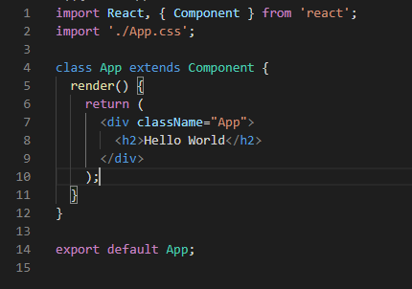
Basic Structure
Importing React and component
Class
Render method
<div>

Slide 4
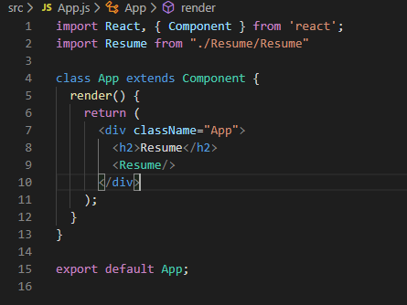
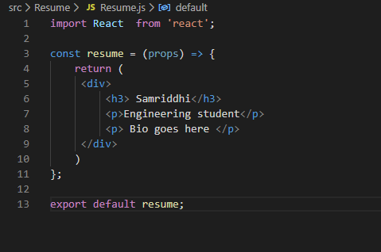
React Components
Main Page
Resume Component

Slide 5
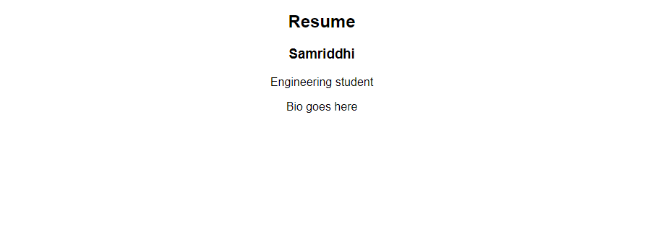

Slide 6
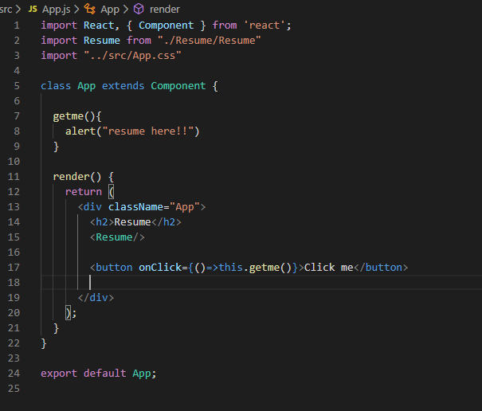
Event Handling
Button
“onClick” event
Arrow Function
Binding
Some common error

Slide 7
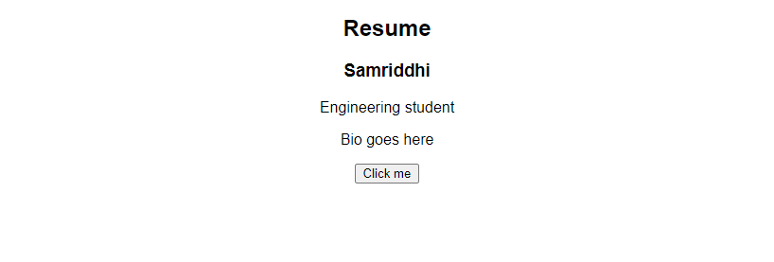
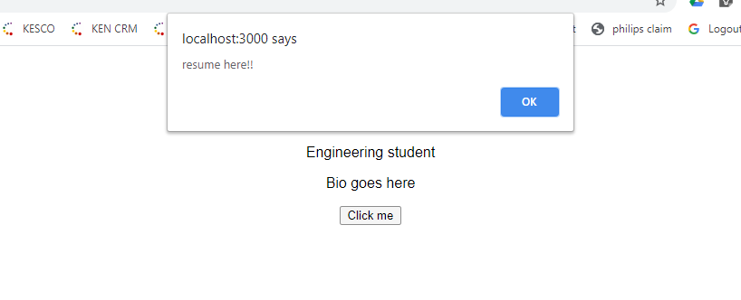

Slide 8
Thank you !!

