Slide 1
Adaptive Medical Dialogue Triage and Automated Clinical Documentation
1
Policy
2
Wording
A tripartite modular architecture
Samridhi agarwal | Saachin | dr. Saurabh Kumar
School of Computer Science, Engineering and Technology
3
Note
Notes:
Hello everyone. Our project is about automating the first part of a clinical visit, the history-taking, with a system made of three cooperating models. I will go through the problem, the design, the results, and the limits of what we measured.

Slide 2
Why automated intake is hard
1
2
3
Ask adaptively
Stay safe
Document
Work out which history is still missing and ask for it one question at a time, across several turns.
Never drift into diagnosis. Recognise red flags such as radiating chest pain and escalate at once.
Turn the free-text dialogue into a standard note a physician can scan in seconds.
No existing systems does all three. That is the gap our project addresses.
Notes:
Intake looks simple but needs three things at once. First, the agent has to decide what to ask next and adapt as the patient answers. Second, it has to be safe: no diagnosing, and immediate escalation for red flags. Third, at the end somebody has to write it all down in a usable form. Existing systems cover pieces of this, not all of it.

Slide 3
What existing systems miss
Chen & Chang [1]
Kumar et al. [2]
Retrieval-augmented QA
Secure intent-based chatbot
Does well
DPR retrieval + PEGASUS summaries
Frozen LLaMA-3 8B, 74.00% on PubMedQA
Does well
Fine-tuned BERT + PII redaction
Multi-turn conversation
Falls short
No dialogue state or follow-up questions
No patient record at the end
Falls short
Only 5 coarse intents, template replies
No emergency interrupt, no summary
Notes:
These are the two reference papers. Chen and Chang answer biomedical questions from retrieved literature, which is good for knowledge but each question stands alone. Kumar and colleagues hold a conversation with privacy handling, but classify into only five coarse intents and answer from templates, with no summary. Read together, they leave a clear gap.

Slide 4
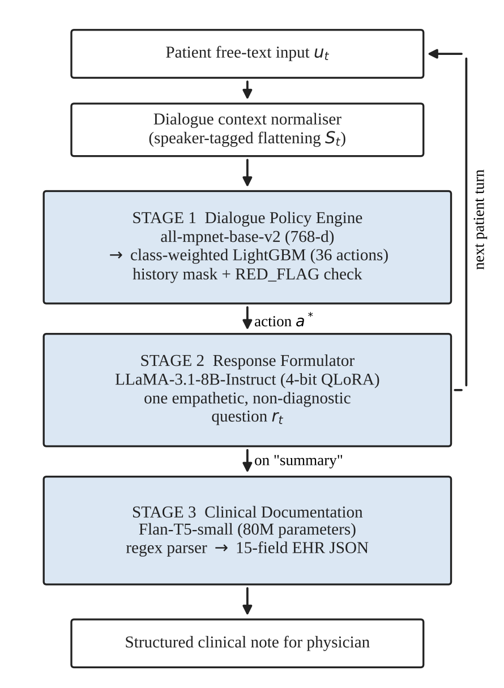
Our approach: three specialised stages
1
Policy engine
MPNet embeddings + LightGBM choose one of 36 actions in 4.2 ms on CPU.
2
Response formulator
QLoRA-tuned LLaMA-3.1-8B turns the action into one empathetic question.
3
Summary generator
Flan-T5-small writes a 15-field clinical note when the session ends.
Notes:
The core idea is separation of concerns. One small, fast model decides what to ask. A language model only handles the wording. A third model writes the note at the end. This keeps the safety-critical decision out of the language model.

Slide 5
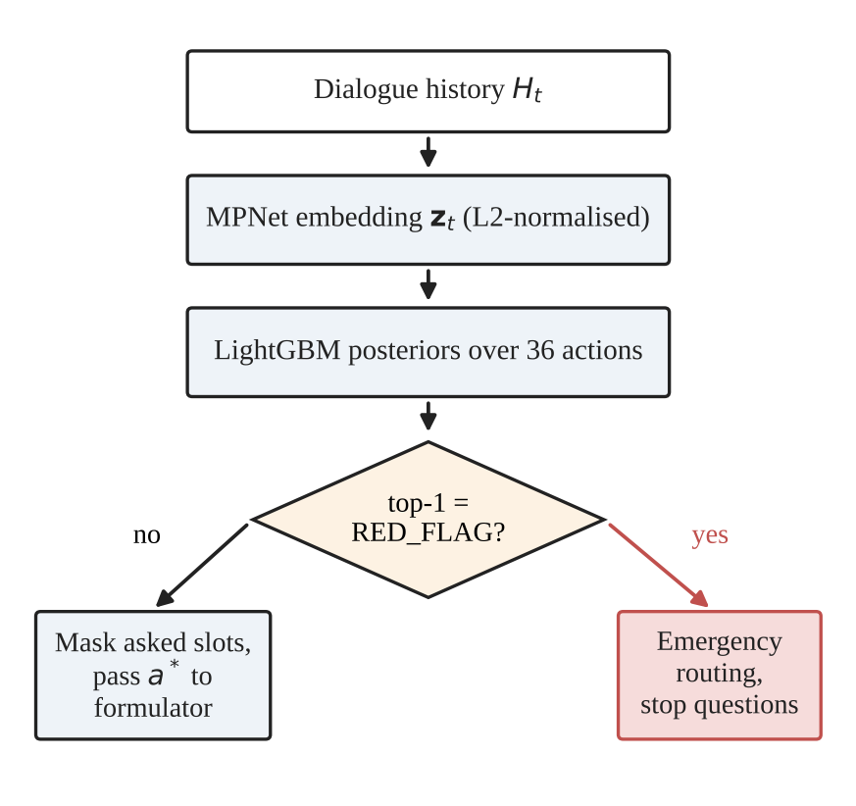
Stage 1: dialogue policy engine
Dialogue history serialised and embedded by frozen all-mpnet-base-v2 (768-d, L2-normalised)
Class-weighted LightGBM over 36 actions: 150 trees, depth 6, learning rate 0.05
History mask stops repeated questions
RED_FLAG as top-1 overrides the mask and routes to emergency care
4.2 ms
CPU latency per decision
36
fine-grained clinical actions
Notes:
The history is flattened into one speaker-tagged string and embedded. LightGBM gives a probability over 36 actions, weighted by inverse class frequency because some actions are much rarer. A history mask removes slots already asked. The red-flag check is a simple comparison on the classifier output, so it can be tested independently of the language model.

Slide 6
Stage 2: response formulator
The safety prompt requires the model to:
LLaMA-3.1-8B-Instruct
4-bit NF4 + QLoRA
Ask exactly one concise question about the target slot
Acknowledge what the patient already said
Avoid any diagnostic statement
Stop and give emergency instructions on RED_FLAG
Base model, weights frozen
Double quantisation, adapters only
r = 16, alpha = 32
AdamW, cosine, 2e-4
Dropout 0.05, 3 epochs
Batch 2, gradient accumulation 4
The policy engine decides what to ask; the LLM only decides how.
Notes:
QLoRA lets us adapt an 8 billion parameter model on a single modest GPU: the base weights stay in 4-bit and only small low-rank matrices are trained. The prompt enforces four rules, most importantly one question per turn and no diagnosis.

Slide 7
Stage 3: 15-field clinical note
Chief complaint
Onset
Location
Characteristics
Medical history
Duration
Severity
Relieving factors
Negative findings
Associated symptoms
Medications
Triggers
Social context
Allergies
Red flags
89% or higher
Moderate (50%)
Sparse slots (under 50%)
Flan-T5-small (about 80M parameters) writes the note as text; a regex parser converts it to JSON and an indented note for the physician. Colours show exact-match accuracy on the test set.
Notes:
At the end of the session the whole transcript goes to a fine-tuned Flan-T5-small. It outputs 15 fields as text, and a deterministic parser converts that into JSON. The colours preview the results: the blue fields are strong, and the three sparse fields at the end are where we see problems, which I will explain in the limitations.

Slide 8
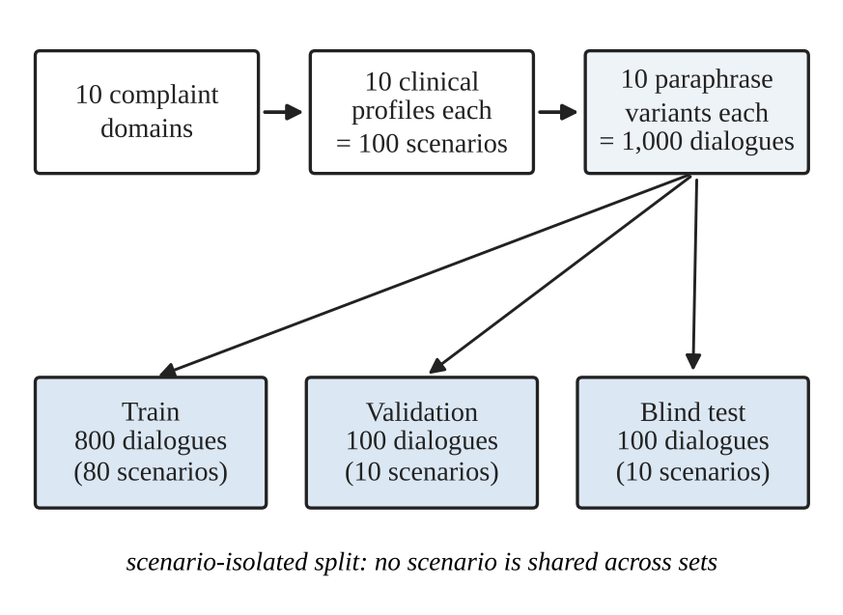
Evaluation data: synthetic benchmark
1,000
multi-turn dialogues, 14 to 22 turns each
10
complaint domains
800 / 100 / 100
train / validation / test, by scenario
Notes:
Because real transcripts are protected, we built a synthetic benchmark: 10 complaints, 10 clinical profiles each, 10 paraphrases per profile. The split is by scenario, so no scenario and no paraphrase of it appears in two sets. The limitation is that test scenarios are few, which I come back to.

Slide 9
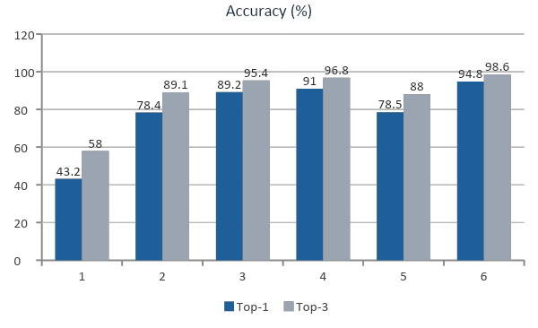
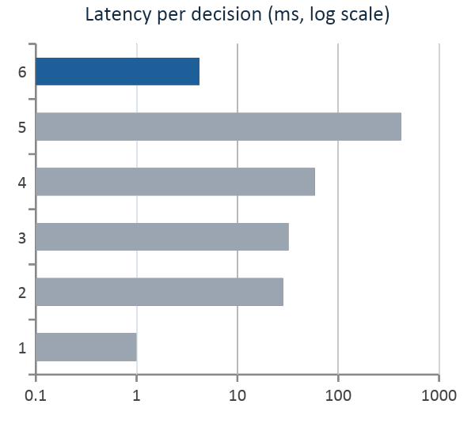
Results: action selection
94.80% top-1 and 98.60% top-3, 3.8 points above RoBERTa-large and about 14x faster. Rule matcher latency is reported as under 1 ms.
Notes:
Our MPNet plus LightGBM policy is the most accurate of the six systems and also fast. Compared with RoBERTa-large it is 3.8 points higher at top-1 and around 14 times faster; compared with prompting LLaMA for the policy it is 16 points better and about 100 times faster. Only the rule matcher is quicker, but it gets under half of the actions right. Note the latency chart uses a log scale.

Slide 10
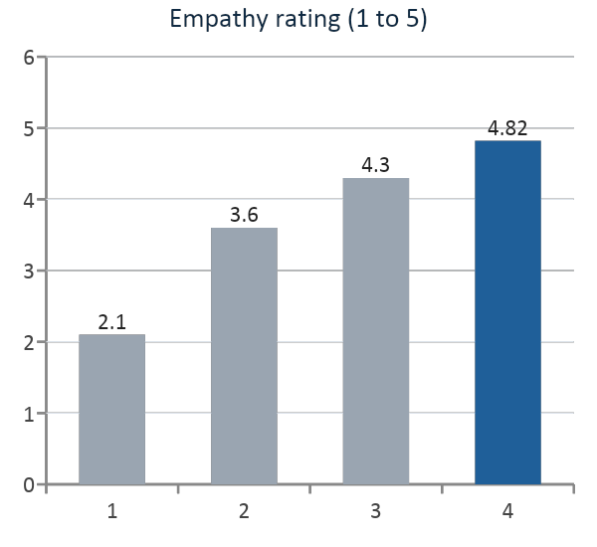
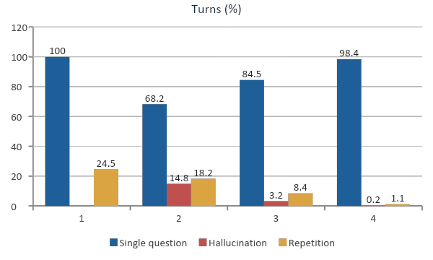
Results: response quality
Templates are safe but robotic; zero-shot is fluent but breaks the one-question rule. Only the fine-tuned model scores well on all four measures.
Notes:
200 interaction turns, empathy rated by medical evaluators. Templates never hallucinate and always ask one question, but sound mechanical and repeat in a quarter of turns. Zero-shot LLaMA sounds more natural but breaks the single-question rule in nearly a third of turns and hallucinates in 14.8 percent. Our fine-tuned model is the only one that is good on all four measures together. For single-question compliance higher is better; for hallucination and repetition lower is better.

Slide 11
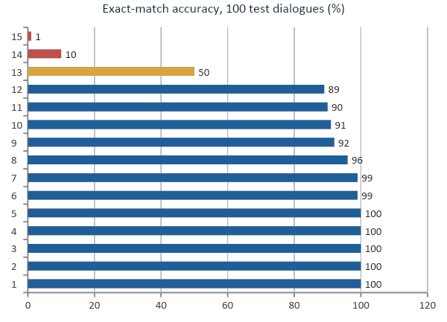
Results: clinical documentation
5 fields
exact in 100 of 100 dialogues
100%
of outputs parsed, zero schema errors
3 weak fields
social context, allergies, red flags
Notes:
On the 100 blind test transcripts five core fields are exact every time, duration and severity are 99, and all outputs parse. The three weak fields are social context, allergies and red flags. For allergies and red flags, 94 percent of dialogues have an explicit negative as the right answer, and exact string matching punishes paraphrases of that, so part of the low score is the metric. We have not verified that with a normalised comparison, so please treat it as plausible rather than proven.

Slide 12
Limitations we want to be upfront about
1
Synthetic data
2
Emergency evaluation
Only 10 test scenarios, 10 paraphrases each. 100% scores suggest regular, template-like dialogues.
Red-flag rule was tested on a mostly non-emergency set. Sensitivity is unproven.
3
Metric and raters
4
Missing comparison
Exact matching hurts negative fields. Empathy used 200 turns; agreement not reported.
No head-to-head against prompted JSON generation for the note.
Notes:
We want to be clear about what these numbers do and do not show. The benchmark is synthetic with a small test set, the emergency rule has not been stress-tested on real emergencies, the metric is harsh on negative statements, and we did not compare the summarizer against prompted JSON generation. This is a research prototype.

Slide 13
Conclusion and next steps
What we built
What comes next
Policy: 94.80% top-1 in 4.2 ms on CPU
Wording: one empathetic, non-diagnostic question per turn
Note: 15 fields, exact on core history
Emergency check kept outside the LLM
Whole pipeline under 6 GB of VRAM
Test on real or clinician-written dialogues
Normalised metric for negative-finding fields
Emergency-heavy test set for the red-flag rule
Head-to-head test for the summarizer
Add more recent related work
Notes:
To summarise: separating what to ask, how to ask it, and how to document it gave us a fast, inspectable pipeline. The next steps are mostly about stronger evaluation: real dialogues, a fairer metric for negative fields, and an emergency-heavy test set.

Slide 14
Thank you.
References
[1] O. T.-C. Chen and C.-H. Chang, "Enhancing medical question-answering chatbot with RAG-based retrieval and summarization," ICCE-Taiwan, 2025, pp. 209-210.
[2] M. K. A, T. M. A, and A. Saranya, "A secure and explainable dialogue system for adaptive symptom assessment in medical chatbots," ICESIC, 2026, pp. 18-22.
Notes:
Thank you. Happy to take questions on any component, the evaluation, or the limitations.

