Slide 1
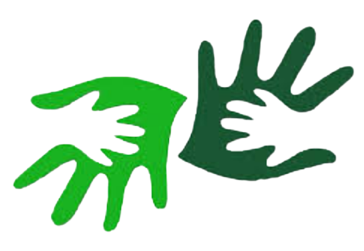
allTalks
One platform,connecting All

Slide 2
01
PROBLEM AND SOLUTION

Slide 3
Problem statement
Web conferencing tools are available in plenty. Not every platform is suited to conduct group meetings are convenient for users with listening and speaking disabilities.
Need of real-time solution for gesture detection and speech recognition to provide a way of communication for speech and hearing-impaired people during online meetings.
There isn’t a “one size, fits all” solution that will ensure that your video meetings go smoothly
This can prove to be helpful in communication as knowing sign language is not something that is common to all.

Slide 4
SOLUTION
To develop a real-time web application with simple UI that provide users with built-in features such as chat, speech recognition and gesture recognition along with translated subtitles for detected gestures and speech..

Slide 5
Solution metrics:
01
02
03
Smooth Real-time video streaming
Accurate detection and recognition of gestures and speech.
Accurate translated subtitles.

Slide 6
Frameworks/Technologies stacks
Html5 , CSS3 , Ejs , peer.js to be used to build the Web conferencing platform along with UUID , socket.io.
Opencv2, LSTM model, Tensorflow , mediapipe Holistic model are used in the hand gesture recognition system.
Tensorflow is an open source framework that makes it easy to construct, train and deploy training models.
Mediapipe holistic pipeline intgrates separate models for pose, face and hand components, each optimized for their particular domain.
LSTM model processes entire sequence of data and single data points, input from last step is fed as an input in current step capable of learning order dependence in sequence prediction problems

Slide 7
Methodology
A real-time application with a peer-to-peer connectivity.
The algorithm for detecting the presence of a hand and determining hand gestures consists of two steps:
To locate the hand area and eliminate noise.
Seek for angles of the fingers and location of fingertip. With these features, the correct recognition of each fingerspell is achieved.
Gesture recognition consists of three basic levels:
Detection: With the help of a camera, a device detects hand or body movements, and a machine learning algorithm segments the image to find hand edges and positions.
Tracking: A device monitors movements frame by frame to capture every movement and provide accurate input for data analysis.
Recognition: The system tries to find patterns based on the gathered data . When the system finds a match and interprets a gesture and thereby displays the in textual format (preferably subtitles).

Slide 8
Hand gesture recognition system using image processing looks for patterns using algorithms trained on input data captured by web camera:
The system distinguishes a hand from the background using colour and depth data. The hand sample is further divided into the arm, wrist, palm, and fingers. The system ignores the arm and wrist since they don’t provide gesture information.
Next, the system obtains information about the distance from the fingertips to the centre of the palm, the elevation of the fingertips, the shape of the palm, the position of the fingers, and so on.
Lastly, the system collects all extracted features into a feature vector that represents a gesture. A hand gesture recognition solution, using AI, matches the feature vector with various gestures in the database and recognizes the user’s gesture.

Slide 9
Future Scope
Relevance : Wide range of audience could be targeted as it not only serves a portion of community but is also beneficial for people with hearing & speech impairment
Optimization : Regress training & testing of the implemented ML models for better accuracy rates in detecting and recognizing of the gestures.
Scope for modification : New algorithms could be designed and implemented.

Slide 10
Societal Impact / Novelty
Sign language is the medium for hearing and speech impaired people to share their feelings or thoughts with others.
Their communication is restricted with able bodied people as they struggle to learn to sign language.
The vision-based solutions can overcome some of their difficulties and disadvantages, they appear to be the best choice for raw data collection.
This system converts the sign language into text and speech to text, which will be displayed on screen which is easily understandable by all.

Slide 11
THANK YOU

