Slide 1
Transliterator :- Recurrent Neural Network For Machine Translation
Samridhi Murarka - 17BCE2038
Rajvardhan Deshmukh - 17BCE0919
Tejas Jambhale – 17BCE0861

Slide 2
Modules
Module 1 -This module consists of converting “what we speak” into text. To do this we will be using the Google Speech Recognition API.
Module 2 -Converting the text found out from the previous module into a different language. We will use the deep neural networks to develop a model based on RNN
Module 3 -This module is where the translated text has to be converted into speech again
Our project will listen to what you say, translate into different languages and speak up for you when required. To do this we will be using the gTTs API and Google Speech Recognition API along with out RNN model. We used a GPU instead of CPU to improve the training speed
Dataset – Two files with English and French Sentences with total of 1.4 lakh sentences

Slide 3
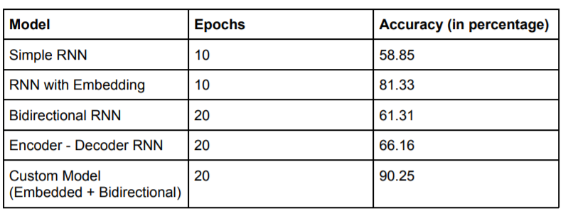
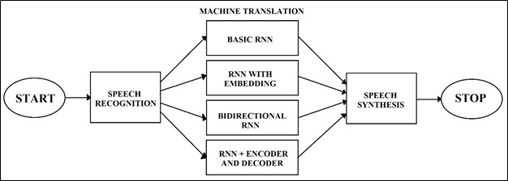

Slide 4
Errors Handled
To import the speech_recognition package of SpeechRecognition Library we need to download pyaudio for it to run even though we are not explicitly importing it.
Training of the model using CPU is slow thus we used the free GPU provided in Kaggle for the training
Kaggle does not support the use of Google Speech Recognition API, which is why the trained model is saved and tested using Jupyter Notebook.
The output sequence returned by the model is of a fixed length due to which it appends PAD in case of a small output.

