Slide 1
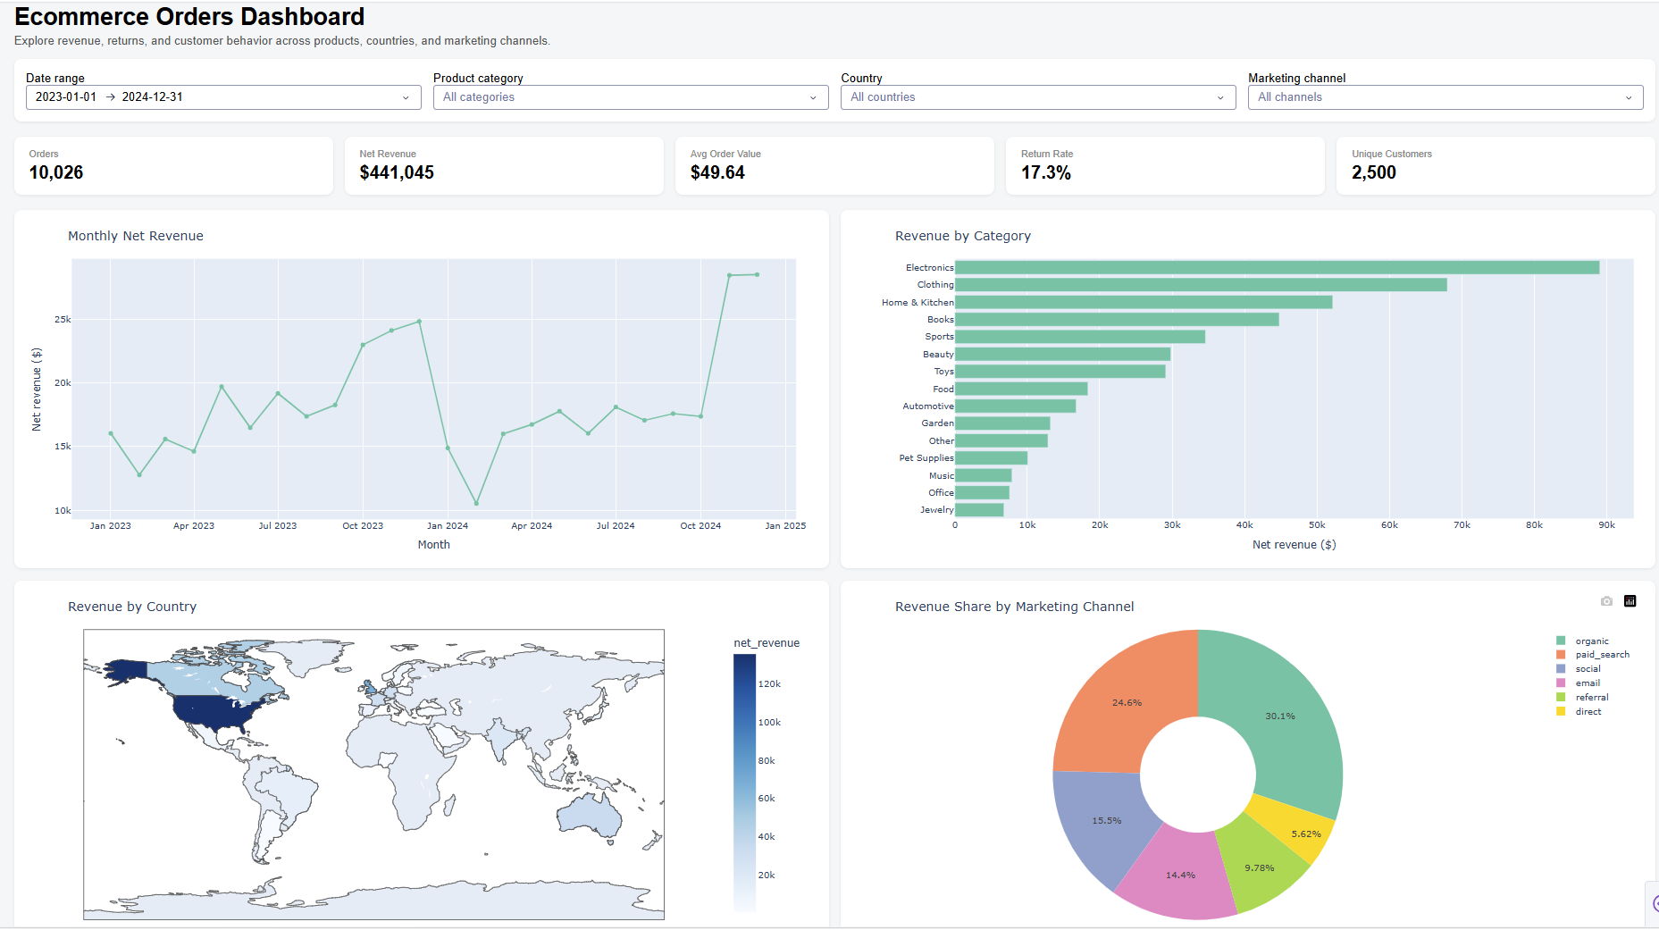
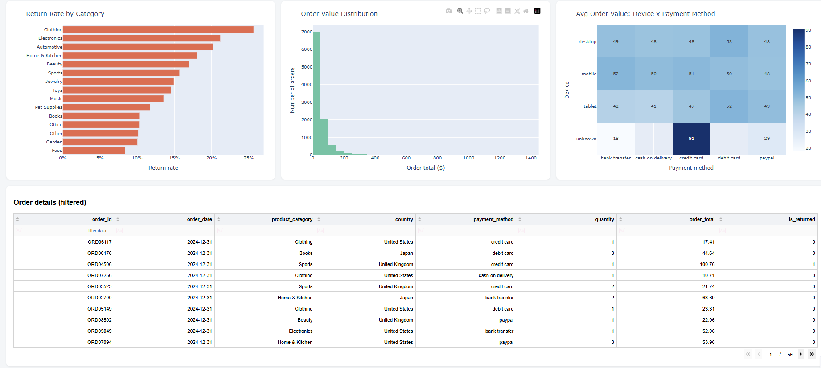
E-Commerce Orders Data Analysis
NPower Canada
AIDA20263T3A
SCRUM Group 5

Slide 2
Project Overview
Objective: Understand sales, revenue , returns, customers, payment methods and order patterns using data analysis.
Dataset: E-commerce orders from multiple countries and product categories.
Tools: Python, Pandas, Matplotlib, Seaborn, Plotly and Dash.
Workflow:
Raw Data → Data Cleaning → Data Wrangling → Exploratory Data Analysis → Visualization → Interactive Dashboard

Slide 3
Key Areas/ Business Problem
Analyze E-Commerce Transaction data to understand:
Revenue and transaction performance
Category-level sales performance
Monthly/yearly revenue trends
Geographic/customer-location distribution
Discount and payment-method patterns
Revenue outliers
Relationships between transaction variables
Business KPIs through an interactive dashboard

Slide 4
Dataset Details
Source: Kaggle – E-Commerce Orders
Published by: Mohammed Slimane
Dataset: https://www.kaggle.com/datasets/mohammedslimane/ecommerce-orders
Time Period: 2023–2024
Shape: 10,035 rows, 20 columns
Data includes: Order, customer, product, revenue, return, payment, device, country and marketing-channel information.
Analysis focus: Sales performance, customer behaviour and returns.
Collab link : E-Commerce Orders Data Analytics

Slide 5
Data Cleaning
Loading the dataset using Pandas/KaggleHub.
Checking for duplicate orders using order_id.
Removing duplicate order records.
Checking the dataset for missing values.
Filling missing country information using the known country associated with the same customer.
Filling missing device types using the most frequently used device for each customer.
Replacing remaining missing categorical values with "Unknown" and missing refund amounts with 0.
Converting order_date and signup_date to appropriate datetime formats.
Checking all columns for unnecessary leading or trailing spaces.
Validating numeric values such as unit price and quantity.

Slide 6
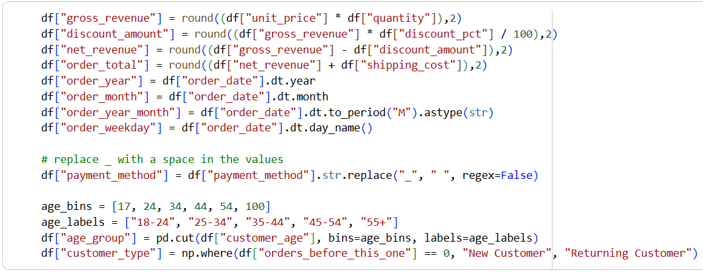
Exploratory Data Analysis & Feature Engineering

Slide 7
Features Engineering Contents and Rationales
Purpose: Identify key drivers of net revenue and returns across time, customer segments, and purchasing behaviour
Revenue Metrics: Gross Revenue, Discount Amount, and Net revenue to measure real sale performance after discounts
Order Value: Order total, net revenue and shipping cost applied to determine customer’s total transaction value
Time Features: Extracted Year, Month, Year-Month, Weekdays from order dates to show trends and identify strong/weak shopping periods
Customer Segments: Divided customers into age groups to investigate purchasing/return behaviour
Customer loyalty: New vs Returning Customers to determine customer distribution
Category Cleanup: Payment Method without underscore to look cleaner

Slide 8
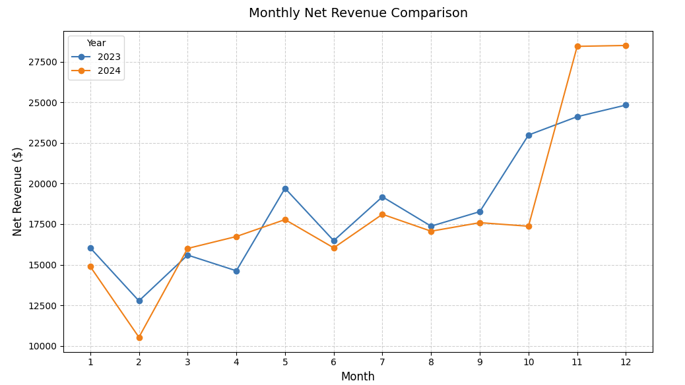
2024 falls behind 2023 for much of the year which suggests weaker performance before the late year recovery
November and December 2024 recorded the highest monthly revenue, at approximately $28K+, exceeding the corresponding 2023 values.
The strong year-end increase suggests a significant seasonal or promotional effect during the final two months.
First 2 months experienced sharp decrease which is due to post holiday slowdown
Notes:
-both 2023 and 2024 experienced a recovery trend between September to December. The increase itself may suggest an increase holiday preparation (thanksgiving, Christmas, new years) or year end vacation spending. However, 2024 experienced much sharper uptick, which may suggest higher-order volume, lower returns (refund issued), stronger marketing advertisement, and purchase higher-value product mix (more share of expensive products)
-holiday slowdown: usually eases after december and novemrber shopping peak

Slide 9
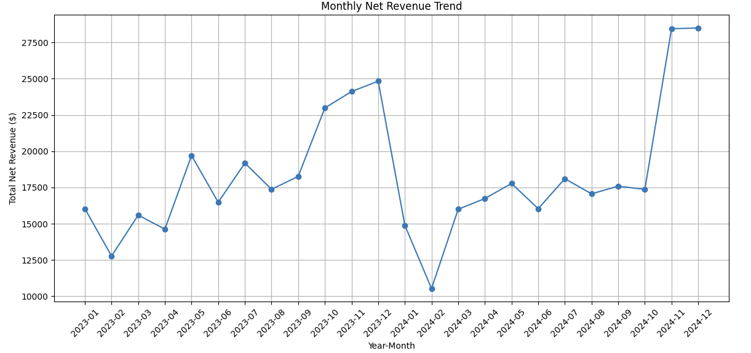
Revenue shows several month-to-month fluctuations rather than a consistent upward trend.
December 2023 was one of the strongest months, followed by a sharp decline in January–February 2024.
Revenue recovered progressively from February and March 2024, then stabilized onward.
The largest revenue levels occur in November and December 2024, indicating strong year-end performance
Notes:
-revenue is volatile instead of steadily growing. This is evident through a sharp decline in start of 2024 followed by recovery. Mid 2024 stabilized between 16-18$K which implies a well established revenue guideline to compare and identify key drivers. However, the November-December is the major outlier. This is worth investigating with order count, average order value, product/customer mix, promotions, discounts, and return rates to pinpoint its drivers.
-promotion means increase sales demand by reuciing effective price or ading value encourages customers to buy or purchase sooner

Slide 10
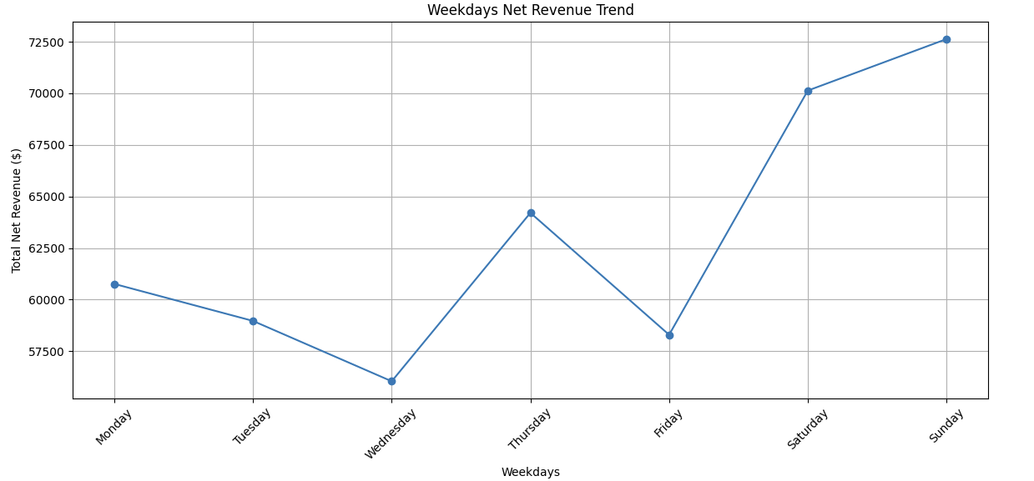
Sunday generated the highest total net revenue, followed closely by Saturday.
Wednesday recorded the lowest revenue among the weekdays.
Revenue increases noticeably toward the weekend.
This indicates that customer purchasing activity is stronger during Saturday and Sunday.
Notes:
-Wednesday is exceptionally weak even relative to other weekdays, with lowest revenue of $55K, which may not be explainable by work schedules. I would test by lower promotional activity, inventory constraints or weaker channel conversion (many customers visit through social meda adv but few end up buying). This would allow us to determine if the dip is operational and behavioural. However, on weekends, because there can be more leisure time where people normally do not work or go to school that could be stimulator of the spending.

Slide 11
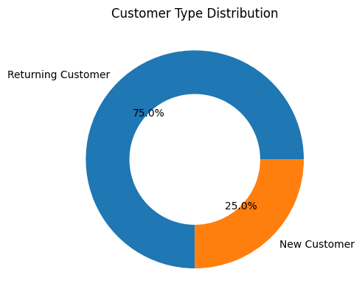
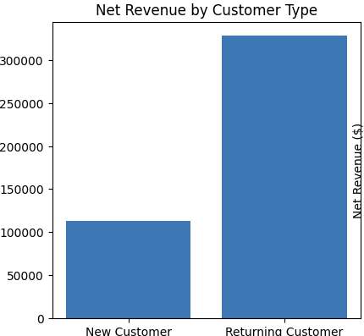
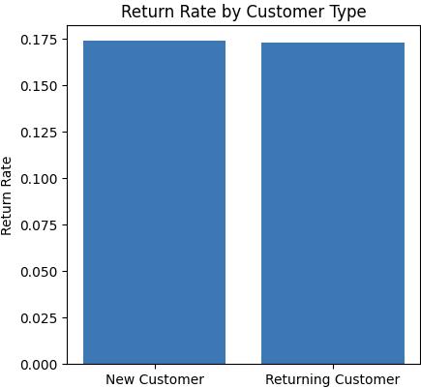
New vs Returning Customer
Returning customers account for 75% of the customer volume, compared with 25% for new customers, indicating a strong existing customer base.
Returning customers generated over $300K in revenue, nearly three times the ~$110K generated by new customers.
With similar return rates, the smaller share of new customers suggests new customer acquisition is a potential growth opportunity.
Notes:
Customer type: returning customers account for 75% of the volume while new customers only 25%. This suggests business has a strong existing customer base and could be beneficial from repeated purchasing or customer loyalty. However, the relatively small share of new customers could mean slower new customer acquisition. I compare revenue per customer and acquisition channel to determine if growth is driven by retention or new demand. Based on the bar plot, returning customers generated revenue of over 300K which is nearly triple of the new customer with 110 K. so, the new customer shares suggest acquisition may be bigger growth opportunity. Acquisition effort is pororitized given same level of return rate.

Slide 12
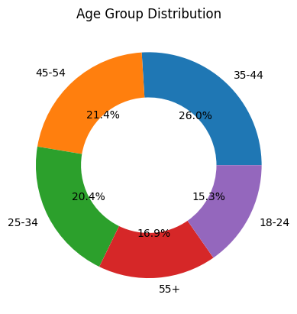
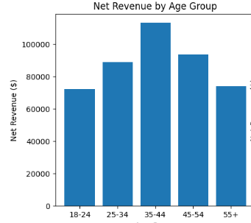
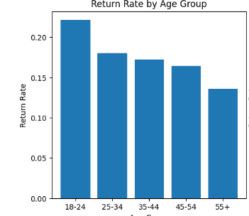
Age Group
35–44 is the largest age segment (26%), followed by 45–54 (21.4%) and 25–34 (20.4%); overall volume is concentrated among ages 25–54.
The 35–44 groups generate the highest revenue (above 100K), while 18–24 and 55+ generate less (~$70K).
18–24 has the lowest revenue but the highest return rate (~25%), suggesting an opportunity to improve younger-customer acquisition and retention.
Notes:
Intuition: customers may have greater purchasing power and consumption demands, due to higher disposable income from working age group. This particularly evident through the bar chart net revenue by age group where 25-55 has highest revenue generated ranging from 90-110K. Weaker 18-24, 55+ representation could imply lower disposable income, mismatch between product types and demands, impleid from lowest 70K. expanding acquisiton among younger customer due to lowest revenue received as well as highet return rate, which could be driver of the losses, highest return rate of nearly 25%. This can be due to younger customers may be more picky to price, willing to try products before deciding to keep or return them, especially with easy online returns.

Slide 13
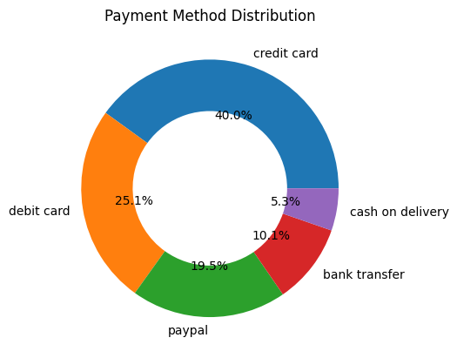
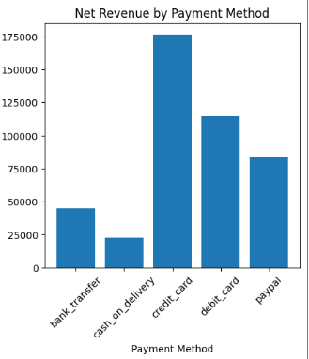
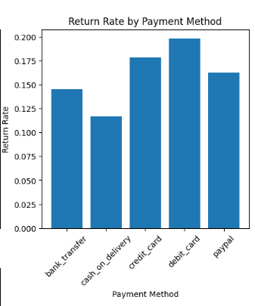
Payment Methods
Credit card accounts for 40%, debit card for 25.1%, paypal for 19.5% because these approaches make inline checkout fast, familiar without need to travel long distance.
Credit card is the largest contributor to net revenue, followed by debit card.
Cash on delivery contributes the least revenue among the displayed payment methods.
Notes:
credit card accounts for 40%, debit card for 25.1%, paypal for 19.5% because these approaches make inline checkout fast, familiar without need to travel long distance. Cash on delivery abdn bankt answer requires more process and time, so less customers choose them. Easy payment means less stress on purchase. Customer make faster/accidental mistakes in purchase as check out is straightforward. After buying procut, some may realize they does not meet their expectations, leading to higher returns. Bank transfer and cash-on-delivery prompt customers to think more careful prior to complete purchase as payment requires more steps.

Slide 14
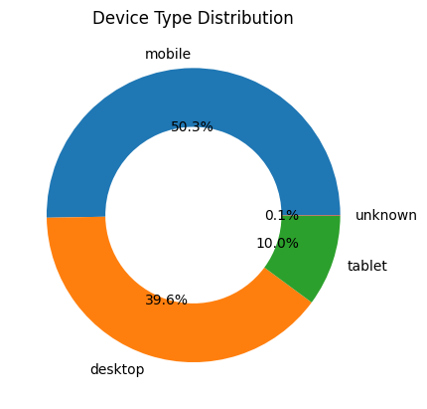
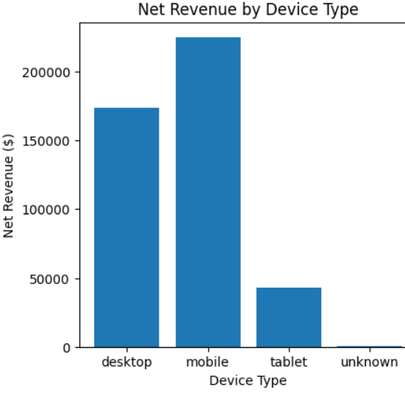
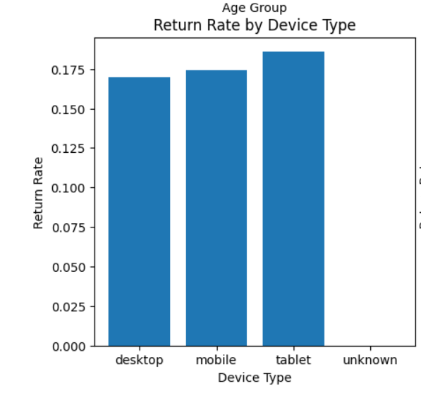
Device Type Distribution
Mobile/desktop/tablet account for nearly all of sales, priority channels for customer experience and targeted product strategies
The revenue also shows a consistent pattern of the net revenue where desktop and mobile have highest between 160K to nearly 250K compared to tablets of under 50K.
Mobile/Desktop/Tablet experience consistent rate of return (16-18%), implies convenience of the online returns.
Notes:
Pt : Mobile and desktop accounting for 50.3% and 39% of the sales volume, where tablet contributes merely 10%, unknown devices is negligible at 0.1%. Half of customers are mobile, making mobile/large screen experience is important. Desktop means customers prefer a larger screen for product comparison for more targeted purchases. Tablet is a secondary channel.
half of customers are mobile, making mobile/large screen experience is important. Desktop means customer prefer a larger screen for product comparison for more targeted purchases. Tablet is secondary channel. The revenue also shows a consistent pattern of the net revenue where desktop and mobile have highest between 160K to nearly 250K compared to tablet of under 50K. mobile/desktop/tablet experience highest return rate 15-18% convenience of the online returns.

Slide 15
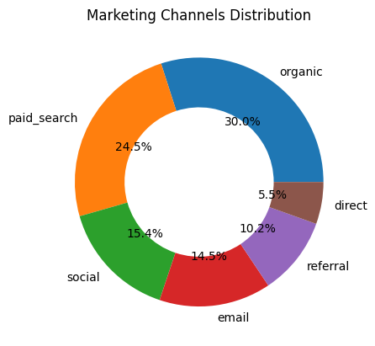
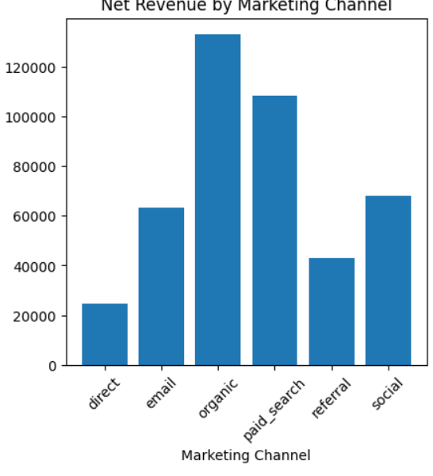
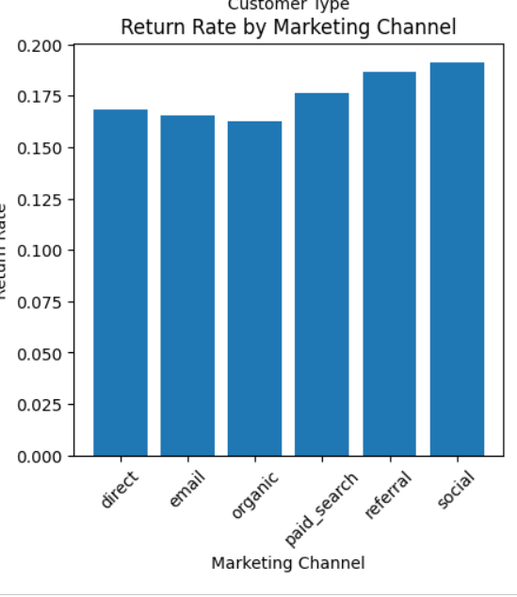
Market Channel Distribution
The organics largest source at 30% followed by paid search at 24.5% drive over half of customer volume, making them dominant acquisition channels
Organic leads the revenue, followed by paid search, while direct contributes the least
Social and referral leads the highest return rates (18-19%), implying a need to investigate product fit, promotions, customer opinions from these channels
Notes:
The organics largest source at 30% followed by paid search at 24.5%. direct is smallest at 5.5%, while social is 15.4%, email 14.3%, and referral 10.2%. This implies the company depends mostly on search-based discovery like organic and paid search.
Organic also leads the highest revenue, with paid search second. Direct brings the least.
Higher return rates do not automatically mena social referral are poor channels. They may be attracting customers through promotions or impulse purchases, so I would investigate the causes before making any reduction in marketing spend
Social and referral leads the highest return rates, while organic is the lowest/lower channels. Some channels may generate customers, not automatically meaning high quality sales. Some may be more impacted by trends,promotions, impulse purchases, which lead to further returns.

Slide 16
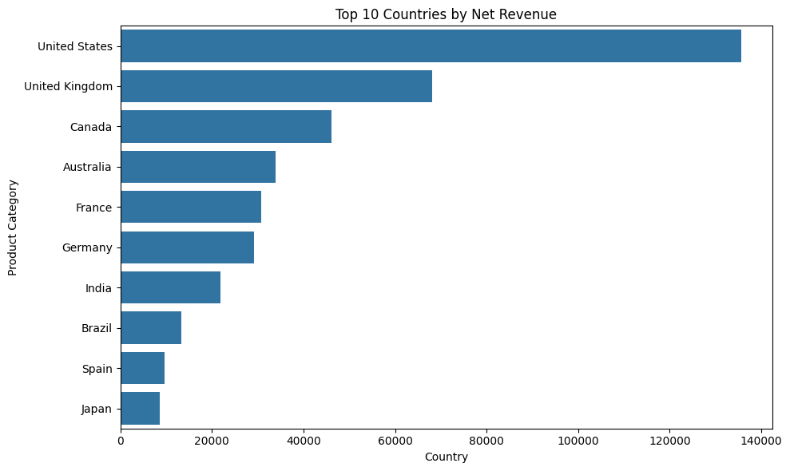
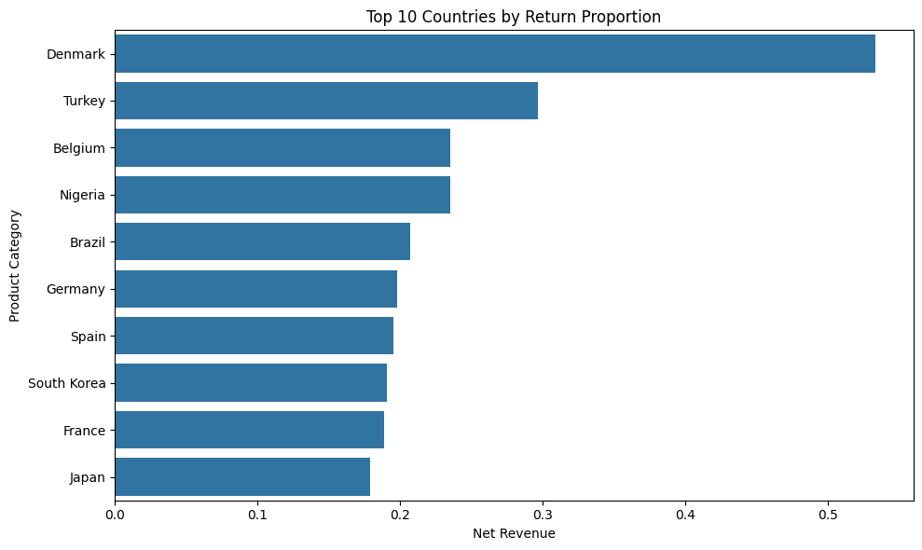
Countries
The United States is the largest revenue market by a wide margin, followed by the UK and Canada, showing revenue is concentrated in a few countries
Denmark has by far the highest return proportion, followed by Turkey and Belgium, though not major revenue contributors
Management should focus on markets with both high revenue and high returns: high financial impact, high-return but low-revenue markets are less material
Notes:
-not treat the highest-rate country as automatically biggest problem. The priority is where high return rates overlap with meaningful revenue, because this is where returns has the largest financial impact
The United States is the strongest revenue market by a wide margin, followed by the UK and Canada, so a large share of sales is concentrated in a few countries.
Denmark has by far the highest return proportion, followed by Turkey and Belgium, despite not being among the biggest revenue contributors.
From a management perspective, this means the highest-return countries are not necessarily the biggest financial risks—the priority should be countries that combine meaningful revenue with elevated returns, while extreme return rates in low-revenue markets should be investigated but may have lower overall dollar impact.

Slide 17
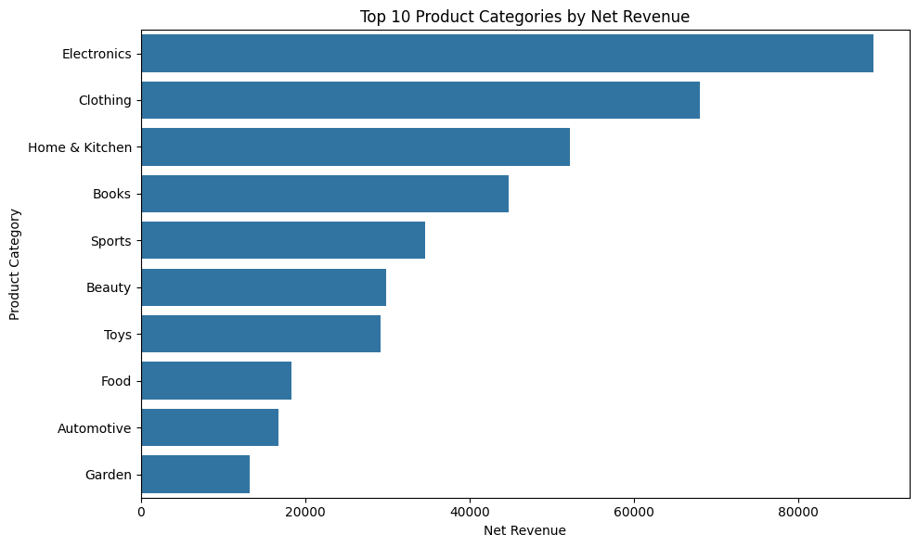
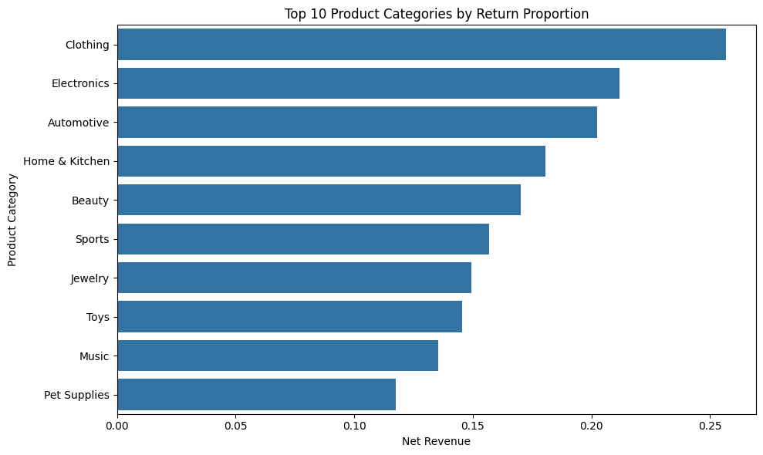
Product Types
Electronics and Clothing are the main priorities, combine high net revenue with high return proportions
Home & Kitchen is another key watch area , with 3rd highest revenue and higher return rate .
In contrast, Automotive has a high return rate (3rd) but relatively low revenue(9th), so its overall profitability is low.
Books appear healthier, generating meaningful revenue with a comparatively lower return rate .
Notes:
Return rate does not determine importance. electronics/clothing matter most cuz they combine high revenue with high returns, so reducing returns on thee ecould have greatest financial impact. home/kitchen is another area to monitor, wile books has a healthier benchmark cuz it geenrates meaningful revenue with lower returns
Pt 1:Electronics generate the most revenue, while Clothing has the highest return rate, so reducing returns in these categories could have the largest financial impact.
Pt3: In contrast, Automotive has a high return rate (3rd) but relatively low revenue(9th), so its overall profitability is low.
Last pt: Books look healthier because they generate meaningful revenue(4th highest) with a comparatively lower return rate ( not top 10 highest rate return)

Slide 18
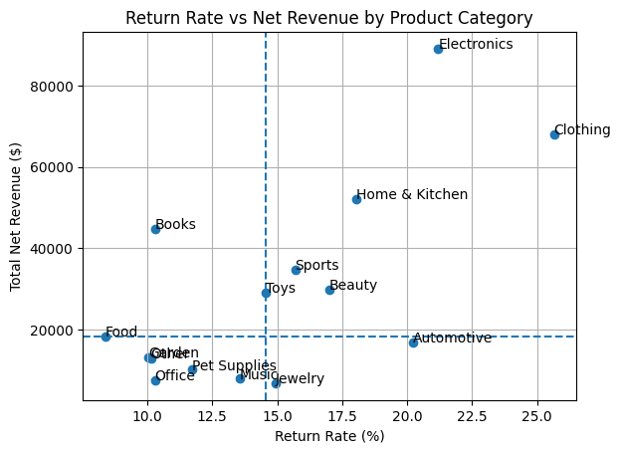
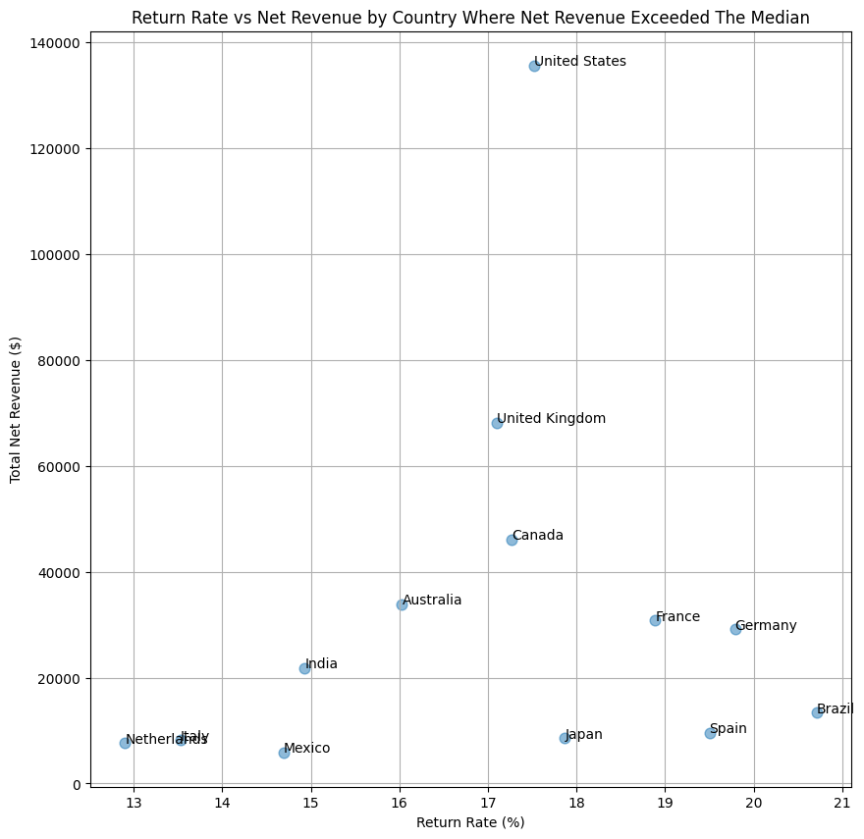
Scatter Plots
Notes:
I used the median as the cutoff for both net revenue and return rate because the distributions are somewhat skewed by a few very high or very low observations, so the median gives a more robust benchmark than the mean. This creates four practical business segments. High revenue and low return rate is the ideal area because the business is generating strong sales while minimizing refund-related losses. High revenue and high return rate is the main focus area because these categories or countries generate significant revenue, but a larger portion may be lost through returns, so I would investigate the causes of those returns. Low revenue and low return rate is less material because both the revenue contribution and potential refund loss are relatively small, while low revenue and high return rate may indicate underperforming areas but with a smaller overall financial impact. For presentation clarity, I therefore shortlisted the observations above the median revenue level so that the analysis focuses on the areas with the greatest business impact rather than overcrowding the chart with lower-value observations.

Slide 19
Scatter Plots
Used the median, instead of mean as the cutoff for both net revenue and return rate
High revenue and low return rate: Preferred, because the business is generating strong sales while minimizing refund-related losses.
High revenue and high return rate: Most important, because these categories or countries generate significant revenue, but a larger portion may be lost through returns
Low revenue and low return rate: less material because both the revenue contribution and potential refund loss are relatively small
Low revenue and high return rate may indicate underperforming areas but with a smaller overall financial impact
Notes:
Pt 1: distributions are somewhat skewed by a few very high or very low observations, so the median gives a more robust benchmark than the mean. This creates four practical business segments.
Pt 2: so I would investigate the causes of those returns.
Provide reasoning on plots

Slide 20
E-Commerce Orders Dashboard

Slide 21
Continued…

Slide 22
Summary
This analysis examined sales performance, customer behavior, and return patterns in the E-Commerce Orders dataset using Python-based EDA.
Revenue: 2024 was weaker than 2023 for most of the year but showed a strong recovery toward year-end.
Customers: Returning customers represent 75% of the customer volume and generate significantly higher revenue than new customers.
Demographics: The 35–44 age group is the largest customer segment, while customers aged 25–54 contribute the highest revenue.
Products & Geography: Electronics is the leading revenue category, and the United States is the largest revenue-generating market.
Returns: Clothing has the highest return proportion among product categories, highlighting an area for further investigation.
Overall: The analysis identifies opportunities around new customer acquisition, year-end sales growth, and reducing returns in high-return segments.

Slide 23
Link to resources
Dataset: https://www.kaggle.com/datasets/mohammedslimane/ecommerce-orders
Collab link : E-Commerce Orders Data Analytics
Final Report: Final Report

Slide 24
NPower Canada
SCRUM Group 5- AIDA20263T3A
Anuj Popli
Mohammed Ali
Noel Isip
Savita Salunke
Samridhi Dhingra
Sybal Dsilva
Yulong(Allen) Peng
Yanting Zhu
Yuhan Zhao

Slide 25
Thank you!

