Slide 1
Loan & Transaction Data Analysis Using SQL
- A Real-world Approach To Risk, Trends And Customer Insights
Created By,
Samridhya Roy
B Com (Hons.)|Calcutta University
Data Analyst Trainee | Ivy Professional School
Date : 04.07.2025

Slide 2


Business Problem Statement
Business Problem :
A financial institution/bank is looking to evaluate loan applicant risk and analyze customer transaction behavior. Rising application volumes, possible fraud indicators, and inconsistent approval patterns have made it difficult to make confident, efficient lending decisions.
Business Goal & Solution :
To enable data-backed credit decision-making by uncovering actionable insights from loan and transaction data. The aim is to optimize the lending strategy, detect anomalies or fraud, and enhance customer segmentation through SQL-based analysis.

Slide 3
Project Objectives
- Project Objectives & Business Goals
Analyse approval trends by demographics
Track high-value customers
Detect fraud via flags/IP/activity
Segment applicants by risk
📊This project simulates real-world banking analytics by solving actual business problems using structured SQL queries.

Slide 4
Tools, Functions & SQL Techniques Used
- What makes this project stand out?
Tools Used
Key SQL Functions Applied
MySQL Workbench
Coolors (for colours)
Microsoft PowerPoint (for presentation)
Joins – JOIN, LEFT JOIN
Filtering – WHERE, IN, BETWEEN, LIKE
Grouping & Aggregation – GROUP BY, HAVING, COUNT, AVG, SUM
Conditional Logic - CASE WHEN, IF
TXT & date Functions - STR_TO_DATE(), LEFT(), REGEXP
Window Functions - DENSE_RANK(), ROW_NUMBER()
Subqueries - Correlated & Non-Correlated
Views - Created custom views for reusable logic
Stored Procedures – For dynamic monthly trend analysis.

Slide 5
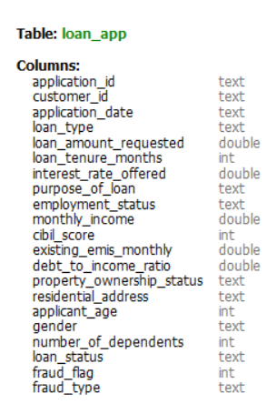
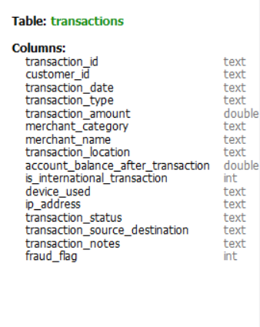
Data Sources & Schema Structure
Table Loan_app
Primary Key : Customer_id
Table transactions
Foreign Key : Customer_id
Database name : loansdata_linkedin
Schema Relationship Type :
One-to-Many
(One customer can have many transactions)

Slide 6
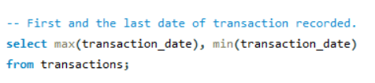
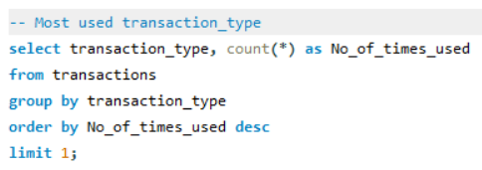
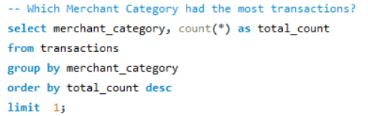




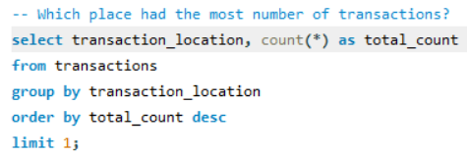
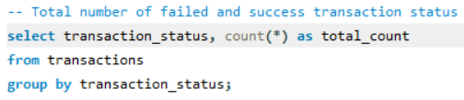



Quick Business Insights
Before diving into deeper business problems, I explored the data to find common trends and outliers,
which helped shape the more targeted use cases that follow.
Transactions were only recorded in the month of January, 2022.
Debit cards were mostly used with 5,088 instances
The Utilities category recorded the highest number of transactions at 4,256
The maximum transaction amount recorded was 76,531 /-
Ghaziabad and Maharashtra initiated the highest number of transactions.
A total of 49,745 successful and 255 failed transactions were recorded

Slide 7

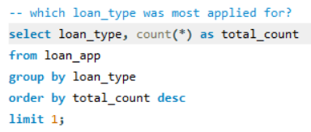




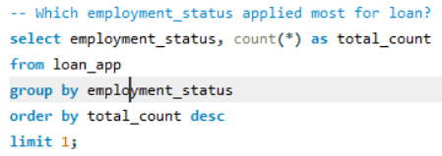
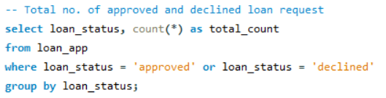




The maximum loan amount requested was 16,18,000/-
CIBIL scores ranged from a low of 476 to a high of 888 across applicants
Home loan was the most applied loan type with a count of 10,056
The average age of loan applicants was 43
The majority of applicants were retired individuals with 8,534 loan requests
A total of 40,882 loans were approved, while 8,092 were declined

Slide 8
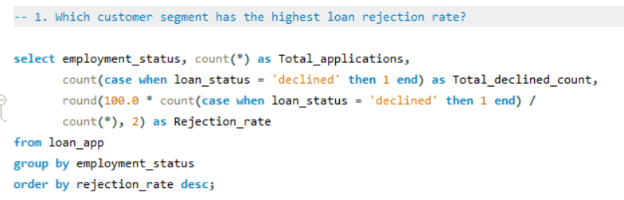
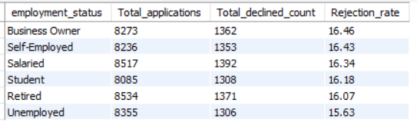
Business Case Study 1
1. Which customer segment has the highest loan rejection rate?
- This insight helps risk teams focus on high-rejection segments and improve screening policies for better approval efficiency.
Business Insight :
Business Owners had the highest loan rejection rate at 16.46%, indicating higher risk or stricter scrutiny in their evaluation process.

Slide 9
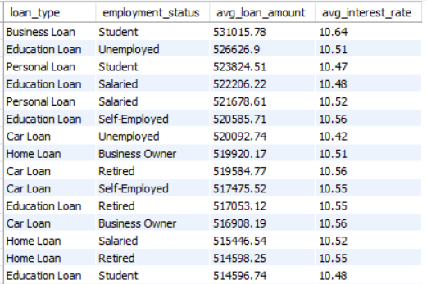
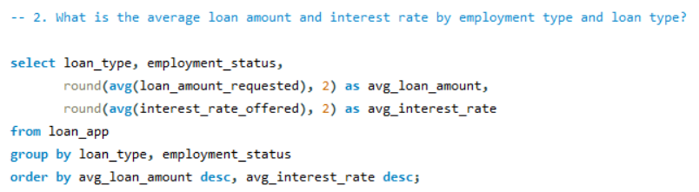
Business Case Study 2
2. What is the average loan amount and interest rate by employment type and loan type?
- Helps benchmark loan offers across segments and detect inconsistencies in lending terms
Business Insight :
Students and unemployed applicants are receiving the highest average loan amounts and interest rates, particularly for Business and Education loans, indicating higher perceived risk.

Slide 10
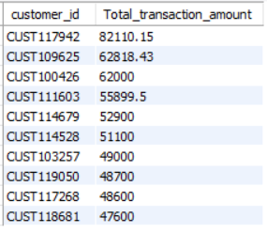
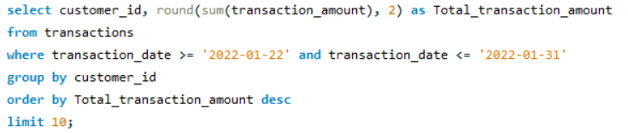
Business Case Study 3
3. Who are the top 10 customers (by ID) with the highest total transaction value in the last 10 days?
– Helps identify high-value customers for potential premium services, personalized offers, or fraud monitoring in recent activity.
Business Insight :
These are the top 10 customers generating over ₹47K–₹82K transaction within 10 days, which highlights potential high-value clients for targeted retention or premium service strategies.

Slide 11
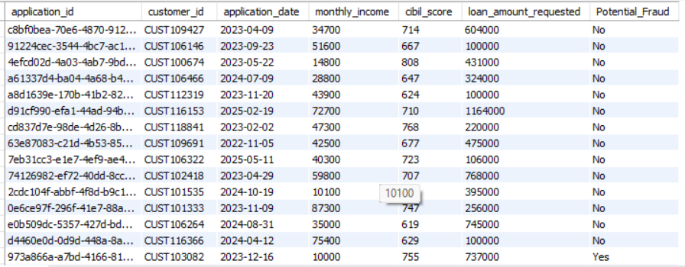
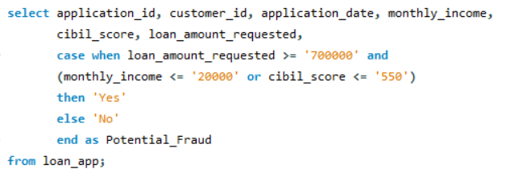
Business Case Study 4
4. Identify potentially fraudulent loan applications where loan amount requested is high, but income or CIBIL score is low.
– Helps flag high-risk or potentially fraudulent applications for manual review
Business Insight :
These customers, along with their loan application ids have been flagged as potential fraudulent due to their high loan requests despite low CIBIL scores and monthly incomes.

Slide 12
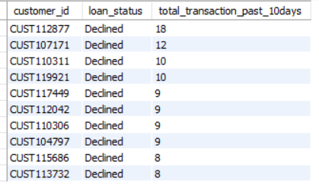
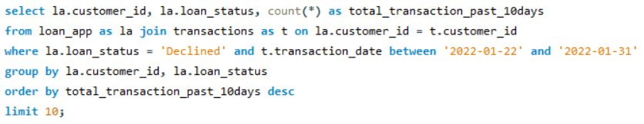
Business Case Study 5
5. Find customers who were declined a loan but had high transaction activity in the last 10 days.
- Helps identify financially active customers whose loan rejections may warrant reconsideration or alternate credit offerings.
Business Insight :
Several customers were declined loan in spite of making 8-18 transactions in past 10 days. This clearly suggests an opportunity to reassess credit criteria or offer alternative lending products to retain valuable customers.

Slide 13
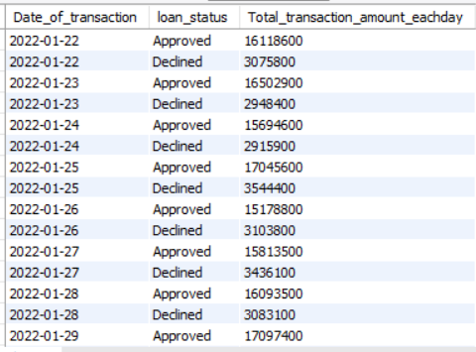
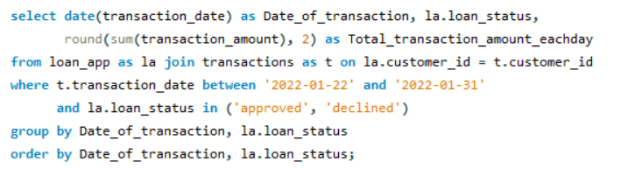
Business Case Study 6
6. Compare transaction totals between customers who were approved vs declined for loans for the last 10 days.
- Enables comparison of financial activity between approved and declined applicants to validate lending decisions and uncover overlooked creditworthy customers.
Business Insight :
The numbers clearly signifies that customers with high rate of transaction are more inclined towards getting a loan. Thus, the spending behaviour actually correlates with loan approval.

Slide 14
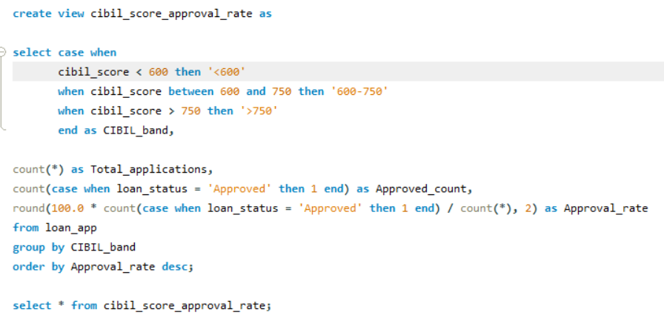

Business Case Study 7
7. Create a view that shows loan approval rates by CIBIL score bands
– Supports credit risk teams in aligning approval decisions with CIBIL score ranges for smarter, score-based lending.
Business Insight :
It is evident that customers scoring above 750 had a 98% approval rate, while those below 600 had a 0% approval rate. This highlights a clear score-based lending pattern and the need for alternative evaluation methods for low-score applicants.

Slide 15
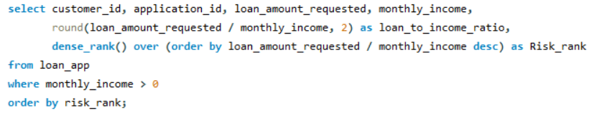
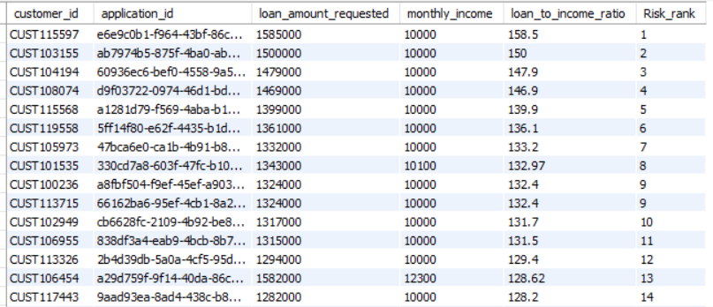
Business Case Study 8
8. Rank customers based on their loan-to-income ratio.
– Helps identify customers with dis-proportionately high loan requests relative to income, assisting in risk assessment and responsible lending
Business Insight :
Customers with the highest loan-to-income ratios may pose elevated credit risk, indicating the need for stricter scrutiny or alternative verification before loan approval.

Slide 16
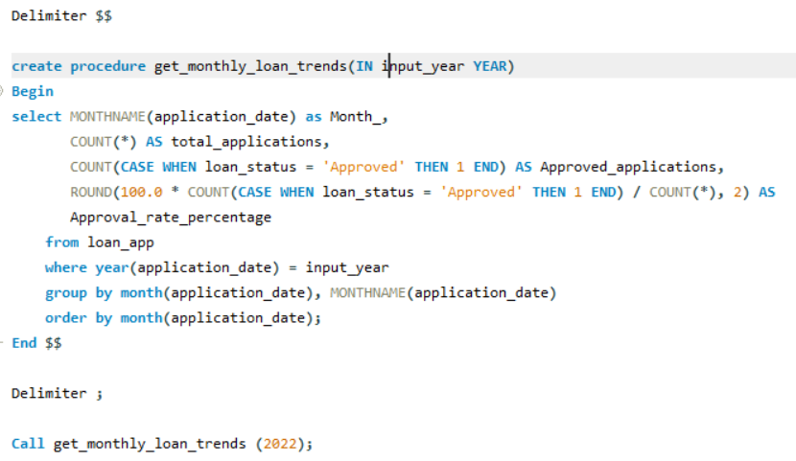
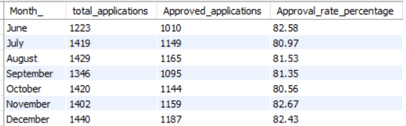
Business Case Study 9
9. Develop a stored procedure that returns monthly loan application trends, including total application count and approval rate for the year.
– Helps track monthly loan performance trends to guide strategic planning and seasonal campaign decisions.
Business Insight :
Loan application volumes remained steady from June to December, with approval rates consistently around 81–83%, indicating stable lending performance and predictable seasonal demand.

Slide 17
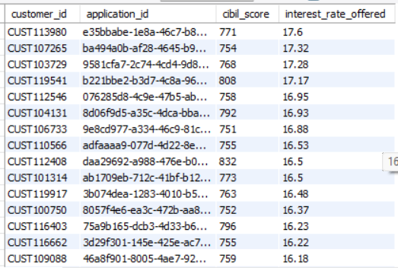
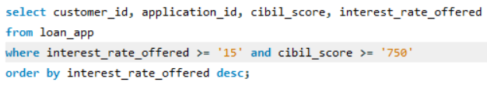
Business Case Study 10
10. Identify customers who were offered high interest rates despite having a high CIBIL score.
– Helps detect inconsistencies in risk-based pricing and ensures fair interest rate allocation for creditworthy customers.
Business Insight :
Several customers with CIBIL scores above 750 were offered high interest rates (16–17.6%), indicating potential misalignment in credit risk pricing that could affect customer trust and competitiveness.

Slide 18
Conclusion & Key Takeaways
- Business Insights Delivered :
Uncovered risk patterns, customer behavior trends, and operational inefficiencies across loan and transaction data.
Decision making & conclusion :
Focus on smarter lending, fair pricing, and fraud detection through data-driven segmentation.

