Slide 1
CIA 2 · DATA STORYTELLING PROJECT
The Customers Who Disappear
Understanding Customer Loyalty and Churn in Online Retail
Archee · Adnan Ulde · Samrin Chaudhari
Dataset: UCI Online Retail II | Analysis: Python · Pandas · Seaborn

Slide 2
THE HOOK
At first glance, loyalty looks healthy.
72.39%
40.83%
of customers made repeat purchases
of customers haven't purchased in over 180 days
Look deeper, and a more concerning pattern appears.
This isn’t simply a story about inactivity — it’s about finding valuable customers before potential churn becomes permanent.
The Customers Who Disappear
2

Slide 3
PROJECT OVERVIEW
Four questions guided the analysis
A customer may buy repeatedly and then gradually become inactive. Rather than looking only at overall sales, we analysed customers individually using recency, frequency, and revenue.
01
How many customers have become inactive, and how long have they been away?
02
How common are repeat purchases compared with one-time purchases?
03
Are high-value customers also becoming inactive?
04
What does customer cohort behaviour reveal about retention over time?
The Customers Who Disappear
3

Slide 4
THE DATASET
Online Retail transaction data
From this dataset we derived:
We used the UCI Online Retail II dataset, containing transaction-level records from a UK-based online retailer. Each row represents an item within an invoice. After cleaning, the transaction data was transformed into customer-level behavioural features for retention analysis.
Recency
Days since last purchase
InvoiceNo — transaction ID
StockCode — product ID
Description — product name
Quantity — units purchased
InvoiceDate — date & time
UnitPrice — price per unit
Frequency
Number of unique orders
CustomerID — customer ID
Country — customer location
Revenue — derived at cleaning
Monetary Value
Total historical revenue
Total Quantity
Units purchased overall
The Customers Who Disappear
4

Slide 5
METHODOLOGY
An end-to-end analytics workflow
01
02
03
04
05
06
Data
Cleaning
Customer-Level
Aggregation
Customer
Segmentation
Inactivity &
Risk Analysis
Cohort
Retention
Data
Storytelling
After cleaning and validation, transaction records were aggregated into one record per customer for segmentation, risk and retention analysis.
Tools: Python · Pandas · NumPy · SciPy · Matplotlib · Seaborn · Jupyter Notebook · Git / GitHub
The Customers Who Disappear
5

Slide 6
SEGMENTATION
How we defined the customer segments
One-Time
Repeat
High-Value
At-Risk
Made a single purchase and never returned.
Placed more than one order over time.
Customers identified as top contributer’s based on historical revenue.
More than 90 days since their last purchase.
Threshold note: 90+ days inactive → classified "at risk". 180+ days inactive → treated as "highly inactive" for the inactivity analysis.
The Customers Who Disappear
6

Slide 7
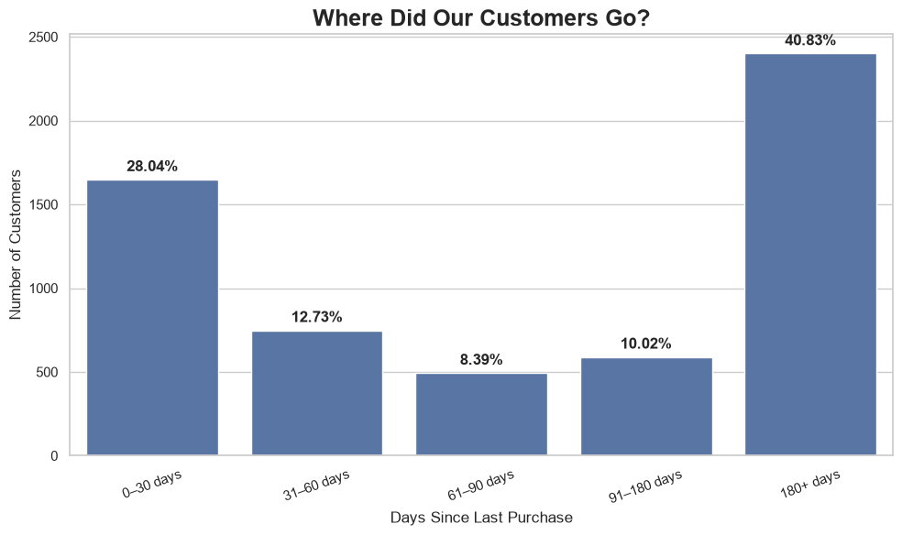
FINDING 01
Where did our customers go?
Customer inactivity becomes substantial after the 90-day threshold, with the largest group having gone 180+ days without a purchase.
40.83%
of all customers have not purchased in over 180 days — a substantial dormant segment.
The Customers Who Disappear
7

Slide 8
FINDING 02
Repeat purchasing is common
Most customers return, but more than one in four customers purchased only once. This creates an opportunity to encourage a second purchase.
72.39% made repeat purchases
27.61%
made only one purchase
The one-time segment is a prime target for follow-up communication and personalised recommendations .
The Customers Who Disappear
8

Slide 9
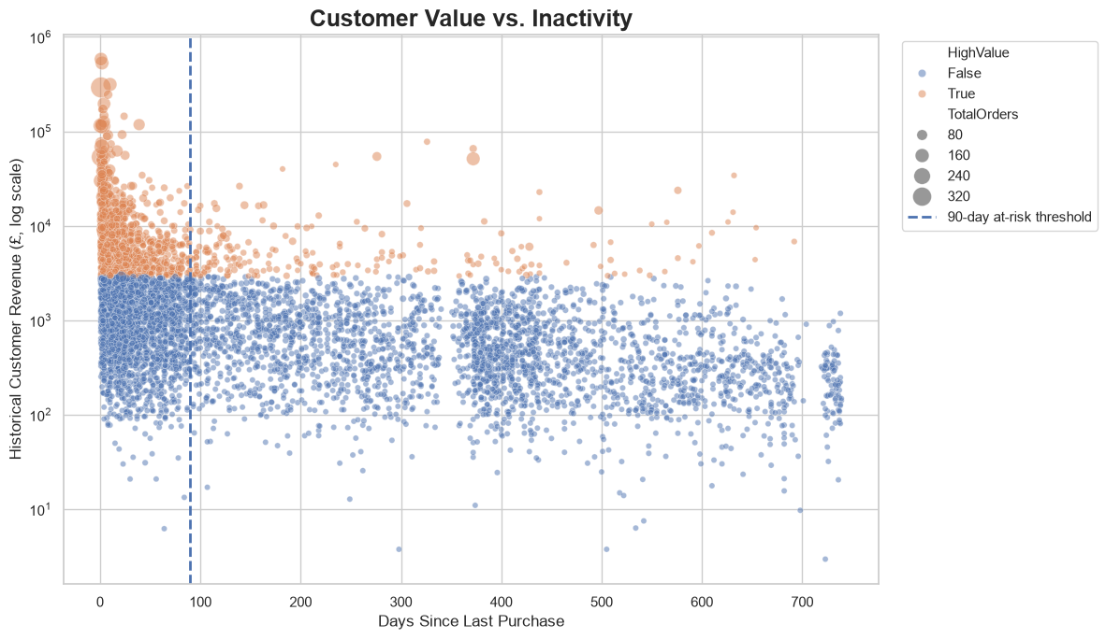
FINDING 03
Customer Value vs. Inactivity
Being a high-value customer doesn't guarantee continued activity. 208 of 1,176 high-value customers (17.69%) were classified as at-risk. These customers are associated with £1.55M in historical revenue.
£1,546,445
(82.31%) high-value customers identified
(17.69%) classified as at-risk
historical revenue tied to at-risk customers
The Customers Who Disappear
9

Slide 10
FINDING 04
High-value customers are disappearing too
Being a high-value customer doesn't guarantee continued activity. 208 of 1,176 high-value customers (17.69%) were classified as at-risk. These customers are associated with £1.55M in historical revenue.
1,176
208
£1,546,445
(82.31%) Active Share
(17.69%) classified as at-risk
historical revenue tied to at-risk customers
Active vs. At-Risk within the high-value segment
82.31% active
17.69% at risk
→ "This identifies a high-value group that could be prioritised for retention efforts.“
The Customers Who Disappear
9

Slide 11
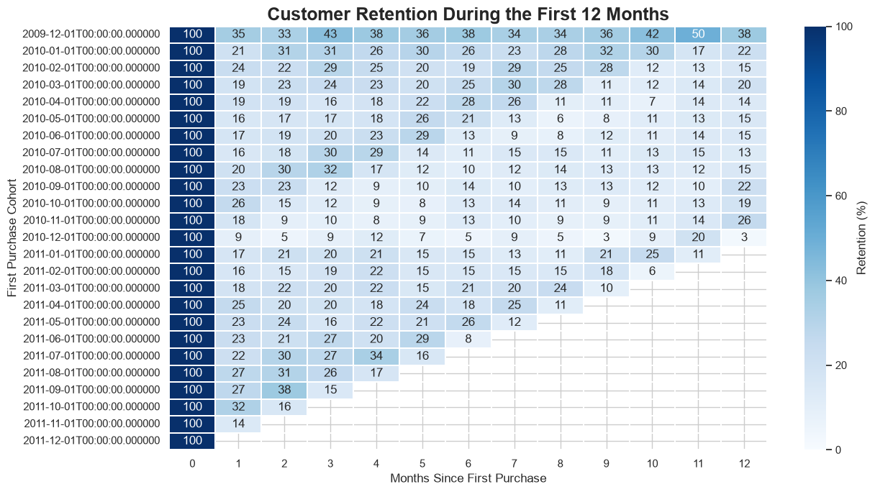
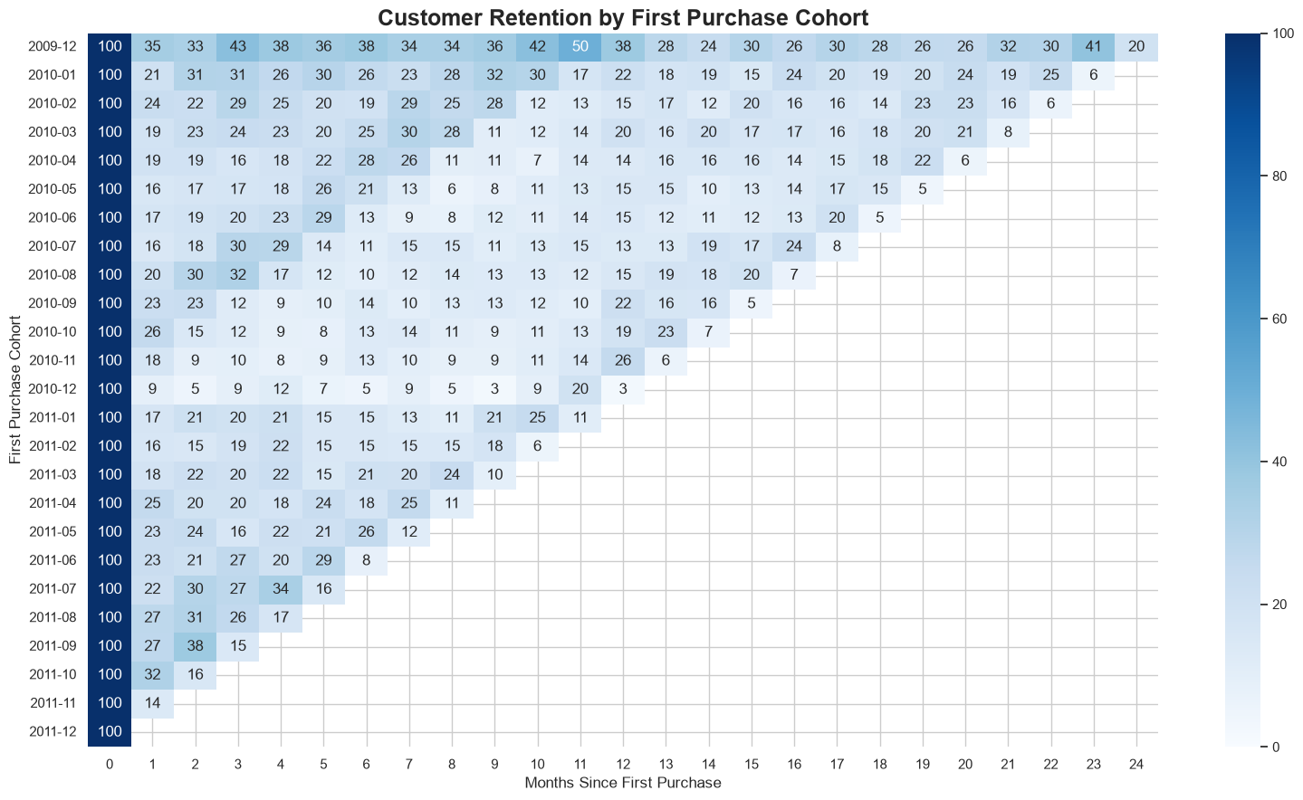
FINDING 05
What cohorts reveal about retention
Grouping customers by the month of their first purchase and tracking them forward shows how retention actually decays over time — a more detailed view than a single repeat-purchase rate.
100%
100%
100%
100%
47%
100%
Newer cohorts are retaining slightly better than older ones — an early, encouraging signal worth monitoring monthly.
The Customers Who Disappear
10

Slide 12
RECOMMENDATIONS
Turning insight into retention strategy
1
Prioritise high-value at-risk customers
The 208 high-value at-risk customers should be first in line for retention and win-back campaigns.
2
Personalise win-back campaigns
Target inactive customers using their past purchasing behaviour and product interests.
3
Convert one-time buyers
Use follow-up communication and tailored recommendations to earn a second purchase.
4
Differentiate by value
High-value inactive customers get high-touch outreach; lower-value ones get automated, lower-cost campaigns.
5
Monitor cohorts continuously
Track retention by first-purchase cohort to identify changes in customer engagement over time.
The Customers Who Disappear
11

Slide 13
LIMITATIONS
What this analysis can't tell us
No explicit churn label exists — inactivity is used as a proxy, not confirmed churn.
The 90-day "at risk" threshold is an analytical assumption, not the retailer's own definition.
At-risk revenue reflects past transactions, not guaranteed future loss.
Patterns shown are associations, not proven causes.
Promotions, marketing, and demographics aren't in the data and may explain some behaviour.
The Customers Who Disappear
12

Slide 14
Not every inactive customer is equally important.
By combining recency, frequency and historical revenue , business can identity valuable customers showing signs of inactivity and prioritise retention where it matters most.
Thank you
github.com/Archee10/online-retail-customer-story
Archee · Adnan Ulde · Samrin Chaudhari

