Slide 1
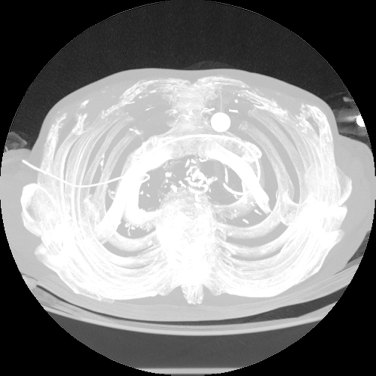
3D Heart CT Scan Imaging for Early Disease Detection
A Graph-Based Approach to Flagging At-Risk Patients

Slide 2


<T>he Adaptors
Naledi: 218104732
Refiloe: 221014292
Samrin: 222005020
Thato: 224022442

Slide 3
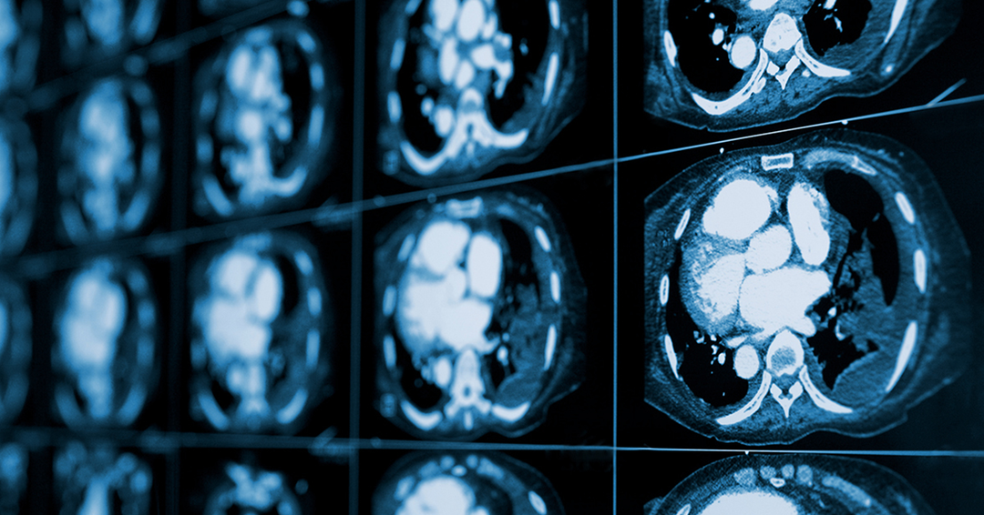
<T>he Problem
South Africa’s healthcare system faces a heavy burden from chronic lifestyle diseases.
CT scans are widely used but mainly for reactive diagnosis rather than early detection of cardiac risks.
There is a lack of automated tools to identify early warning signs like heart calcification.
Manual analysis of 3D DICOM scans is time-consuming and labor-intensive for radiologists.

Slide 4

<T>he Solution
We model heart scans using 3D graph structures to analyze calcification patterns.
Each scan is converted into a feature vector capturing intensity, density, and connectivity.
A KD-Tree organizes historical data for fast similarity matching.
New scans are compared to known cases to classify risk and flag patients for review.

Slide 5
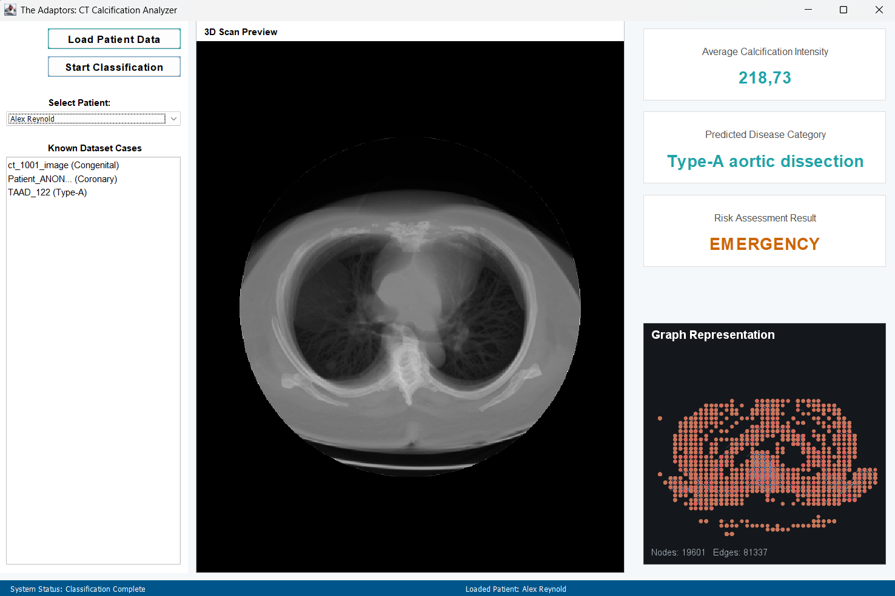
System Implementation

