Slide 1
BellaBeat
Samrita

Slide 2
R Markdown
Bellabeat, a high-tech manufacturer of health-focused products for women.
Stakeholders:
Urška Sršen: Cofounder and Chief Creative Officer
Sando Mur: Cofounder and executive team member
Bellabeat marketing analytics team

Slide 3
Problem statement
Analyse smart device usage to gain insight.
Provide high-level recommendations for Bellabeat’s marketing strategy

Slide 4
Data Analysis tools
Data cleaning, processing and analysis is done in BigQuery
Data visualisation is done in R studio

Slide 5
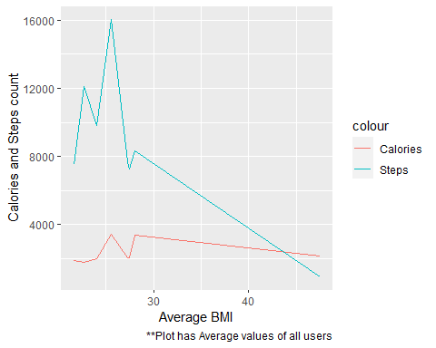
BMI vs Steps and Calories

Slide 6
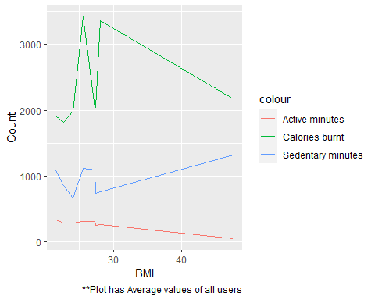
BMI vs Calories burnt, active and sedentary minutes

Slide 7
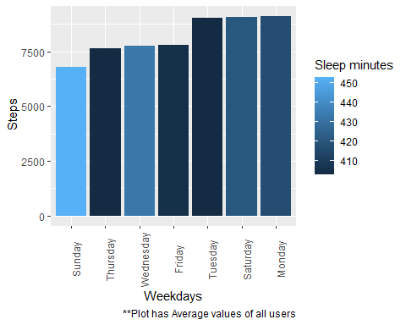
Average steps, sleep time vs days of week

Slide 8
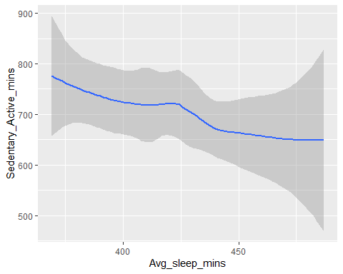
Average sleep time vs Sedentary minutes

Slide 9
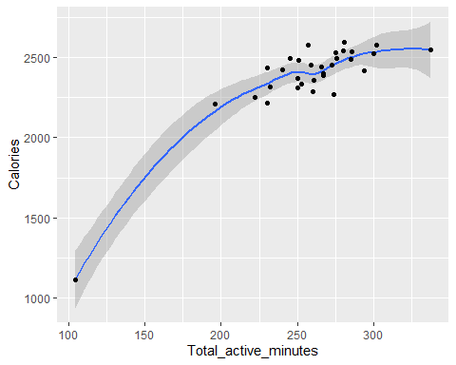
Calories burnt vs Active minutes

Slide 10
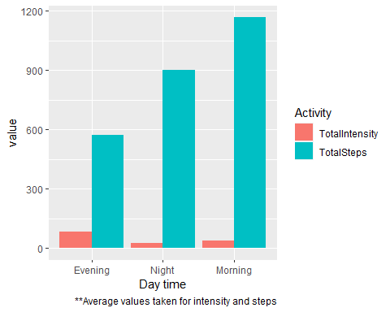
Activity time in a day

Slide 11
Conclusion
We notice only 24 % of users log their weight and BMI details. We must encourage them to enter the same regularly.
Only 72% of people tracked their sleep on a daily basis.
Most users tend to get lazy on Sunday.
People looking to burn more calories should spend more time being active rather than sedentary which helps with good sleep.
Many users like to walk in the morning and do high intensity activities in the evening or night.

Slide 12
Recommendation
Marketing team should make the customers aware of the benefits of tracking their sleep.
so Bellabeat can organize Sunday-Funday walking or running competitions among the users.
Collaborate with local gyms for trial sessions for regular premium members. This can be used in advertisements.
Keep a weekly target of walk and high intensity activities, upon reaching refer users for free trial of bellabeat premium membership.

