Slide 1
Hospitality Analysis
Content:
Title: "Hospitality Analysis"
Tools Used: Excel, Power BI, Tableau, and MySQL
Description:
Start by introducing the project as a comprehensive analysis of hospitality industry data aimed at uncovering trends, improving customer experiences, and optimizing operational efficiency.
Highlight the use of advanced tools like Excel for data management, Power BI and Tableau for visual insights, and MySQL for robust database operations.

Slide 2
Objectives of the Project
Content:
Key Objectives:
To analyze revenue, booking trends, and customer satisfaction across different dimensions.
To identify areas of improvement for better resource utilization and profitability.
To provide actionable insights for strategic decision-making.
Description:
Emphasize the purpose of the project, focusing on delivering insights that drive growth in the hospitality sector.
Mention how the analysis addresses critical business questions such as the most profitable regions, top-performing room categories, and customer satisfaction trends.

Slide 3
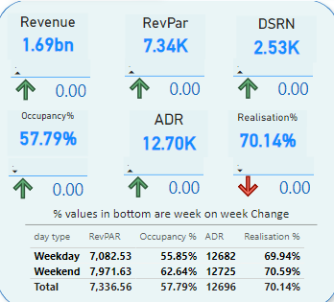
Revenue: The total income generated from all bookings, reflecting overall business performance.
RevPAR (Revenue Per Available Room): Measures revenue earned per available room, indicating efficiency in room utilization.
DSRN (Days Sales Outstanding): Tracks the average time to collect revenue after a booking, highlighting payment efficiency.
Occupancy %: Shows the percentage of occupied rooms out of total available rooms, indicating demand and operational success.
ADR (Average Daily Rate): The average revenue earned per occupied room, assessing pricing and revenue management effectiveness.
Realization %: The proportion of actual bookings fulfilled compared to the total capacity, reflecting operational efficiency.
These percentage values indicate the week-on-week change for key metrics such as revenue, bookings, and ratings.
Positive changes reflect improvements, while negative changes help pinpoint areas requiring corrective actions.
A quick overview of performance trends for management and strategy planning.

Slide 4
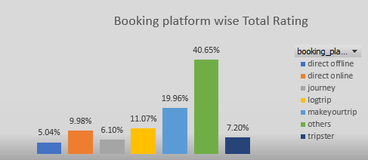
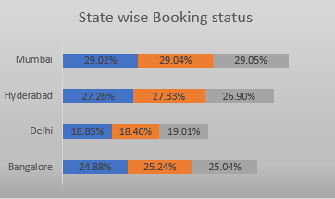
This visual chart shows the average customer ratings segmented by booking platforms such as Booking.com, Expedia, Agoda, etc.
It helps identify which platform is bringing in the highest-rated customers and provides insights into customer satisfaction trends based on the platform used.
For example, platforms with consistently high ratings may reflect better service or a targeted audience, while platforms with lower ratings may require closer attention to customer feedback.
This chart displays the number of bookings across various states, providing insights into the geographical distribution of hotel bookings.
It helps identify high-demand states and areas with growth opportunities for targeted marketing strategies.
States with low bookings might need promotional campaigns to boost visibility.

Slide 5
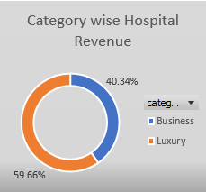
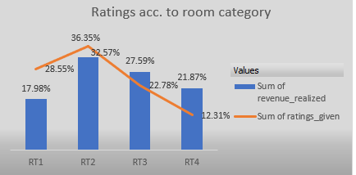
This visual highlights the occupancy status of rooms, categorized as Booked, Available, or Under Maintenance.
It provides real-time insights into room availability, helping manage operational efficiency and reduce idle inventory.
Trends in booking status can be analyzed to optimize pricing and promotional offers.
This visualization presents the average customer ratings for different room categories, such as Deluxe, Suite, and Standard.
It helps understand customer satisfaction levels based on the type of room they booked.
Room categories with lower ratings might indicate issues like inadequate amenities, cleanliness, or service quality, requiring immediate action to enhance the guest experience.
Higher-rated categories can be leveraged for marketing purposes to attract more bookings.

Slide 6
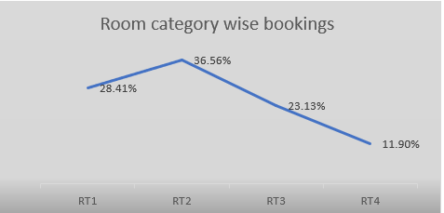
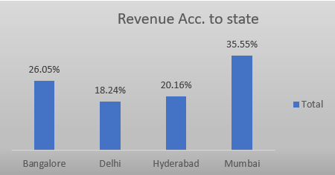
This chart breaks down bookings based on room categories such as Deluxe, Suite, or Standard.
It helps identify which room categories are more popular among customers and align offerings accordingly.
Categories with fewer bookings may indicate pricing or value perception issues that require attention.
This visualization displays the total revenue generated across various states.
It helps analyze the financial performance of different regions, providing actionable insights to focus on high-revenue states.
States with lower revenue may need operational or pricing adjustments to improve profitability.

Slide 7
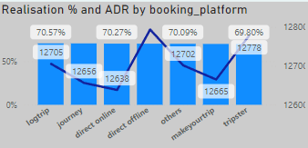
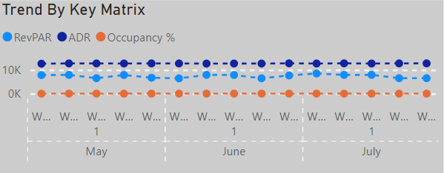
This chart highlights the average revenue generated per occupied room segmented by booking platforms.
It helps identify platforms that yield higher room rates and profits, aiding decisions about platform partnerships.
Platforms with lower ADR might require different pricing strategies or promotional efforts.
This chart provides a comparative trend analysis of multiple metrics like Revenue, Bookings, and Ratings over time.
Helps identify patterns, anomalies, or correlations among metrics for strategic decision-making.
Key for understanding how various factors impact overall business performance.

Slide 8
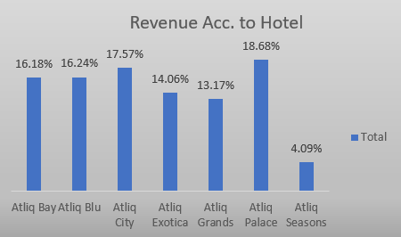
This visualization displays the total revenue generated across various states.
It helps analyze the financial performance of different regions, providing actionable insights to focus on high-revenue states.
States with lower revenue may need operational or pricing adjustments to improve profitability.
This chart shows the revenue contribution of individual hotels, making it easier to evaluate the performance of each property.
High-performing hotels can be studied for replicable practices, while low-performing ones can receive focused interventions.
Useful for portfolio analysis and improving overall business revenue.

Slide 9
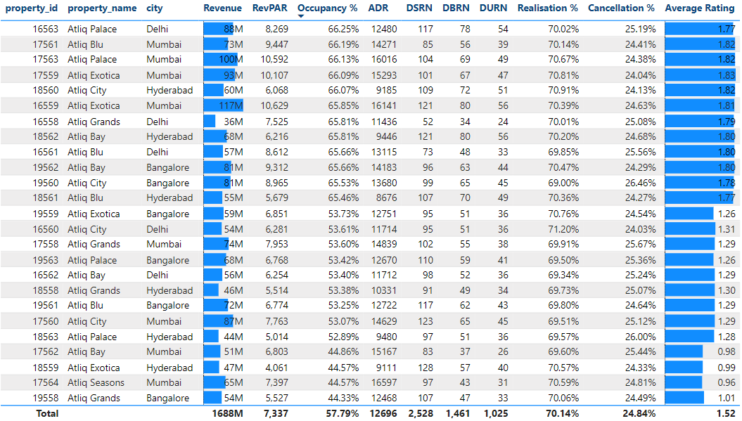
Structure:
The table provides a comprehensive view of metrics like Revenue, Occupancy %, ADR, RevPAR, Realization %, and DSRN.
It is segmented by dimensions such as states, hotels, or booking platforms for granular analysis.
Purpose:
Enables quick comparisons across different categories or time periods.
Helps identify trends, outliers, and areas needing improvement.
Key Insights:
Top Performers: Highlight states, hotels, or platforms with the highest revenue, ADR, or Occupancy %.
Underperformers: Identify categories with lower realization % or high DSRN to address inefficiencies.
Trends: Spot recurring patterns, such as consistently high RevPAR in certain regions or timeframes.
Usage in Decision-Making:
Guides targeted strategies like marketing, resource allocation, or pricing adjustments.
Serves as a baseline for tracking performance improvements over time.
This table acts as a central repository of actionable insights for stakeholders to make data-driven decisions.

Slide 10
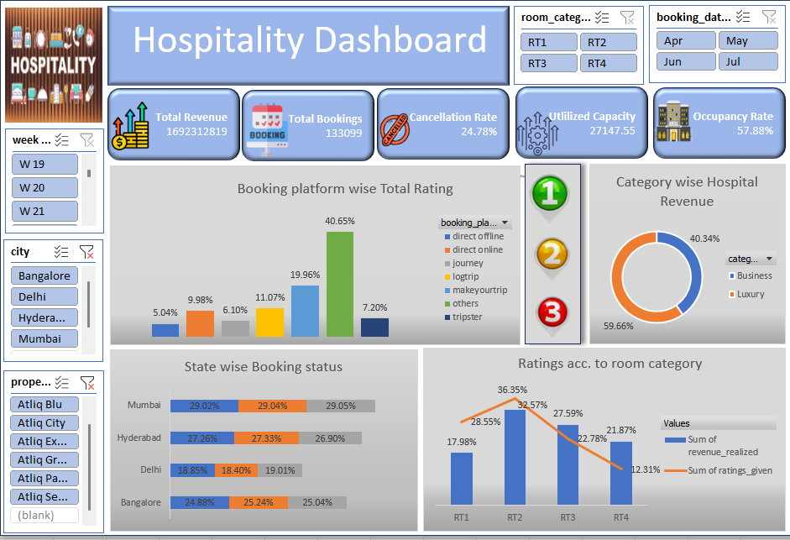

Slide 11
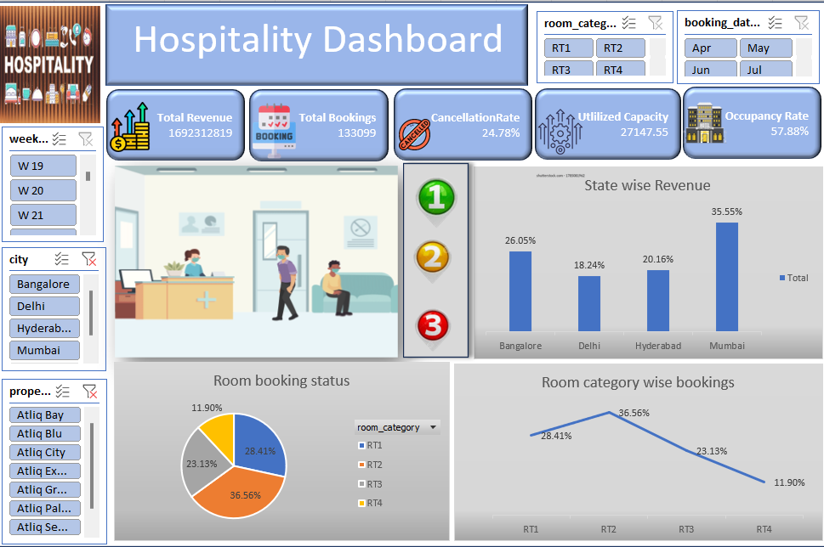

Slide 12
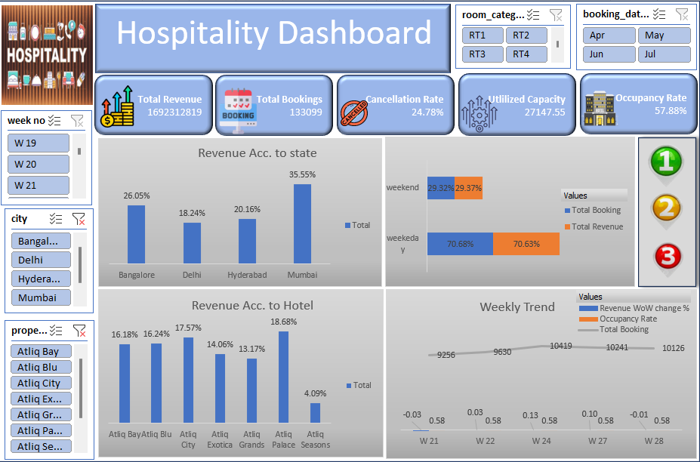

Slide 13
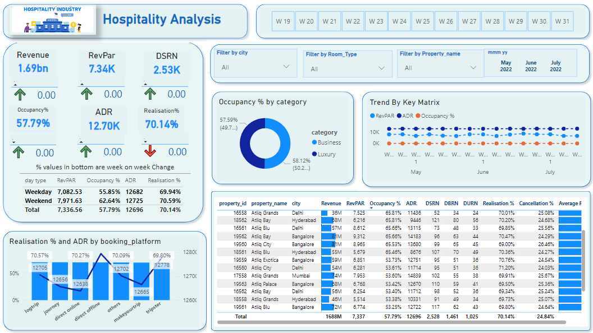

Slide 14
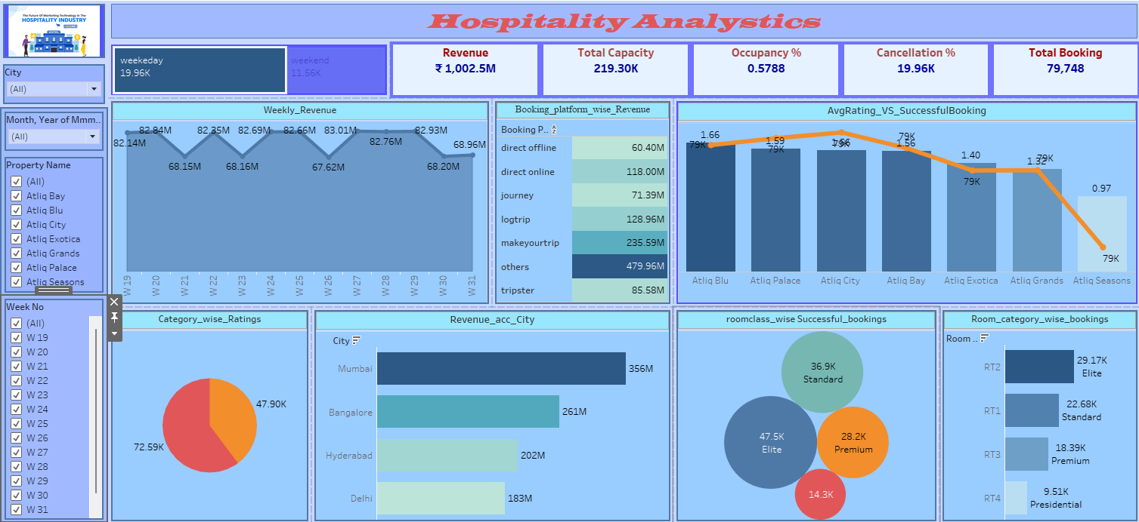

Slide 15
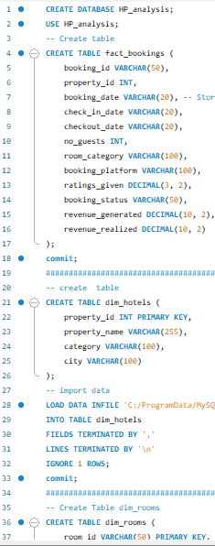
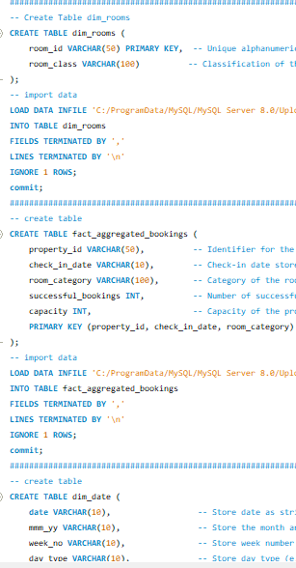
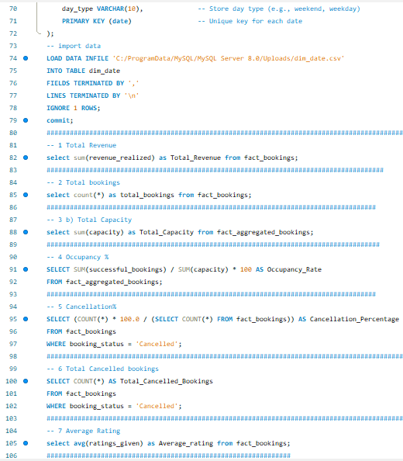
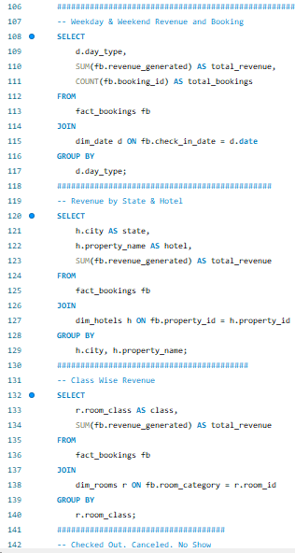
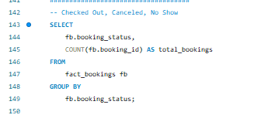

Slide 16
Introduction to Personal Growth & Learning
Personal Growth: This project has significantly contributed to my growth as a Data Analyst. It provided me with
the opportunity to deepen my understanding of data analysis concepts, tools like Excel,
Tableau, MySQL, and Power BI, and their practical applications.
I enhanced my problem-solving skills, learning to analyze large datasets and derive meaningful insights.
The project taught me how to handle complex data, clean it, and create meaningful reports and dashboards, which will be invaluable in my career.

Slide 17
Group Coordination & Teamwork
Importance of Group Coordination: Collaboration played a key role in the success of our project. Although each team member was
responsible for individual tasks like Excel analysis, MySQL queries, and Power BI visualizations,
teamwork ensured that we were aligned and our results were integrated effectively.
We maintained clear communication to avoid misunderstandings and kept everyone updated on progress.
Regular team meetings allowed us to brainstorm solutions, share insights, and resolve any roadblocks.
Each member's contribution, whether in data analysis, dashboard creation, or final report compilation, was crucial to completing the project on time.

Slide 18
Overcoming Challenges & Difficulties
Difficulties We Faced: Throughout the project, we encountered a range of challenges, but each was an opportunity to learn and improve.
Data Cleansing Issues:
Initially, there were problems with data integrity (incorrect dates, missing values). We worked through these by cleaning and formatting the data in Excel and MySQL, ensuring that the data was ready for analysis.
Tool Integration:
Integrating the data from Excel into MySQL was a bit tricky at first. We had to ensure the data was structured correctly for seamless import into the database.
Creating relationships in Tableau and Power BI posed challenges, but we navigated through them by researching solutions on YouTube and collaborating within the team.
Learning Power BI on the Go:
As Power BI was not initially our preferred tool, we faced a learning curve. But with YouTube tutorials and
determination, we built an effective dashboard, providing dynamic visuals for our analysis.

Slide 19
On-Time Project Completion
Meeting Deadlines: Despite facing challenges, our team worked efficiently, ensuring that we adhered to the project timelines. By breaking the project into smaller, manageable tasks, we were able to allocate time to each section of the analysis and report-building without feeling overwhelmed.
We used collaborative tools (like Google Docs/Sheets) to track progress and ensure that no task was overlooked.
Regular check-ins allowed us to assess our progress and adjust workloads, which helped in completing the project on time.
On-Time Project Completion
Meeting Deadlines: Despite facing challenges, our team worked efficiently, ensuring that we adhered to the project timelines. By breaking the project into smaller, manageable tasks, we were able to allocate time to each section of the analysis and report-building without feeling overwhelmed.
We used collaborative tools (like Google Docs/Sheets) to track progress and ensure that no task was overlooked.
Regular check-ins allowed us to assess our progress and adjust workloads, which helped in completing the project on time.

Slide 20
Impact on Team Dynamics & Communication
Team Dynamics: Working in a team environment provided me with insights into effective communication and collaboration. We all had different strengths, and by coordinating our efforts, we were able to accomplish more than we could individually.
Effective Communication: We ensured there were no communication gaps by holding regular meetings, using shared platforms, and being open to feedback.
Problem-Solving as a Team: Whenever we faced roadblocks, we collaborated to find solutions and made use of each team member's expertise.
Key Takeaways and Final Thoughts
Key Takeaways from the Project:
The Power of Collaboration: Working with a team made us more efficient and creative.
Hands-on Experience: The project gave me practical experience with tools that are essential in the data analysis field.
Resilience in Facing Challenges: Despite the obstacles, we were able to learn from them and improve our skills.
Time Management: Completing the project on time reinforced the importance of deadlines and effective planning.

Slide 21
Final Thoughts And Conclusion
This project has not only enhanced my technical and analytical skills but has also taught me the importance of teamwork, communication, and resilience. I’m confident that the experience I gained here will help me in future professional endeavors.
Looking Ahead:
This project has motivated me to further develop my skills in data analytics and business intelligence tools.
It has also ignited an interest in exploring how data can drive business decisions and provide actionable insights.

Slide 22
Thank
You….!

