Slide 1
End-to-End Data Analytics Project using Python and MySQL
Analyzing Sales Data using Python (Pandas) and SQL

Slide 2
Objective of the Project
• Perform a complete data analysis workflow using Python and MySQL.
• Clean, process, and analyze sales data to generate insights.
• Integrate Python (Pandas) and MySQL for data-driven decision making.

Slide 3
Tools and Technologies
• Python – Data Cleaning & Processing
• MySQL – Data Storage & Querying
• Libraries – Pandas, SQLAlchemy, PyMySQL, Zipfile
• Platform – Kaggle (Data Source)

Slide 4
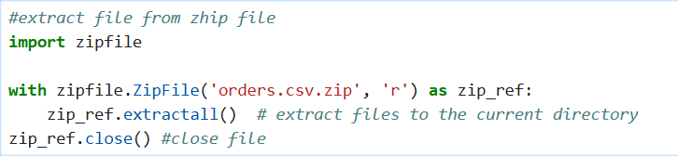
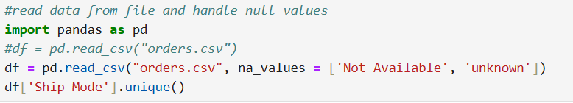
Project Workflow
1️⃣ Download dataset from Kaggle using API
2️⃣ Extract and clean data using Pandas

Slide 5
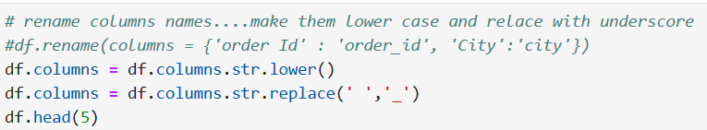
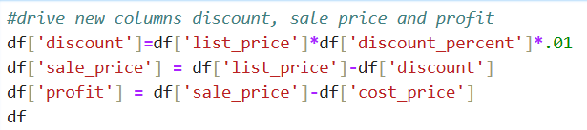


Project Workflow
2️⃣ Extract and clean data using Pandas

Slide 6
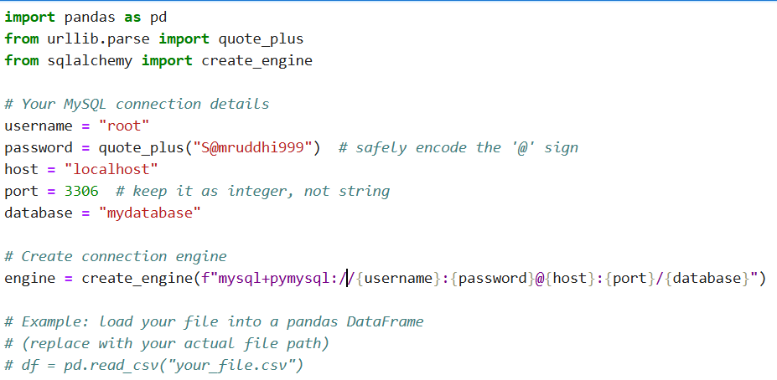
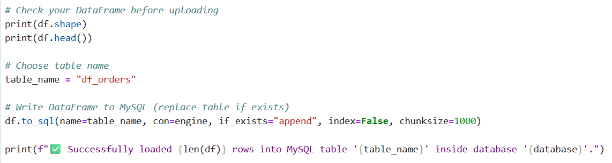
Project Workflow
3️⃣ Load transformed data into MySQL

Slide 7
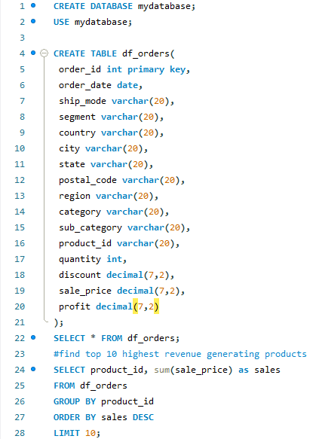
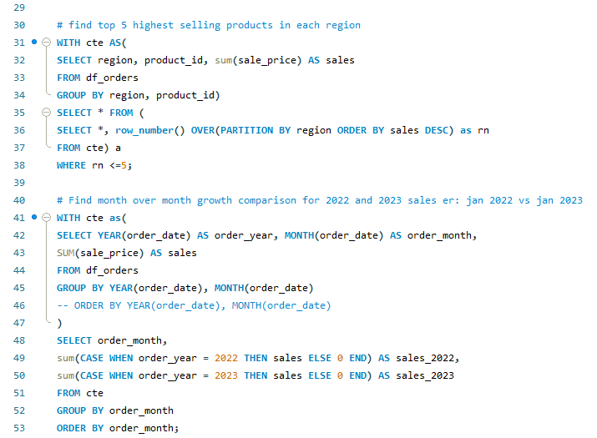
Project Workflow
4️⃣ Analyze with SQL queries

Slide 8
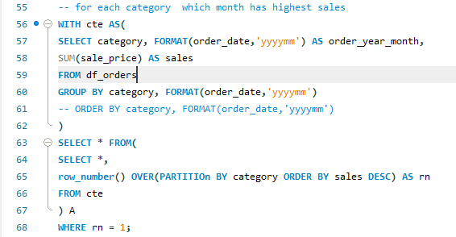
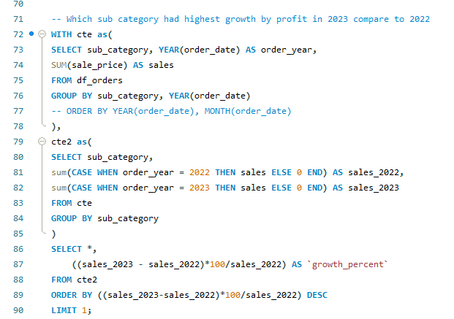
Project Workflow
4️⃣ Analyze with SQL queries

Slide 9
Data Preparation in Python
• Handled null values and standardized column names
• Derived new columns: discount, sale_price, profit
• Converted order_date to datetime format
• Dropped unnecessary columns for optimized structure

Slide 10
Loading Data into MySQL
• Created database: mydatabase and table: df_orders
• Connected using SQLAlchemy & PyMySQL
• Loaded data using Pandas to_sql()
• Verified successful insertion ✅

Slide 11
SQL Analysis (Queries)
• Top 10 highest revenue-generating products
• Top 5 highest selling products by region
• Month-over-month sales growth (2022 vs 2023)
• Month with highest sales per category
• Sub-category with highest profit growth (2023 vs 2022)

Slide 12
Key SQL Insights
• Top-selling products dominate across key regions.
• 2023 outperformed 2022 in month-over-month growth.
• Each category’s peak sales month varies.
• Sub-categories saw strong profit increases.

Slide 13
Challenges Faced
⚠️ Handling missing and inconsistent data
🔐 Password encoding issues in MySQL connection
🧮 Data type conversion mismatches
💾 Managing large data uploads efficiently

Slide 14
Learnings & Takeaways
💡 Strengthened Python–SQL integration skills
📊 Improved data cleaning and analysis proficiency
🔍 Understood end-to-end project workflow
🚀 Enhanced ability to extract insights from raw data

Slide 15
Conclusion
✔️ Completed a successful end-to-end data analytics project
✔️ Gained real-world experience in analytics workflow
✔️ Ready to apply this in professional environments

Slide 16
Thank
You…!!!

