Slide 1
Super Store Sales Dashboard Analysis
Unlocking Insights for Data-Driven Decisions
Objective: To analyse sales performance, customer preferences, and business trends using advanced visualization techniques.
Dataset Overview: Super Store dataset comprising sales, profit, shipping, category, and regional data.
Tools Used: Power BI, showcasing interactive and dynamic dashboards.
By Samruddhi Jadhav

Slide 2
Description
1.Dashboard creation:
Identify the KPIs, design an intuitive and visually appealing dashboard, add interactive visualizations and filtering capabilities to allow users to explore the data at various levels of granularity
2.Data Analysis:
Provide valuable insights to business entities regarding the effectiveness of their sales strategies through visualization and charts
3.Sales Fore-casting :
Leverage historic data and apply time series analysis to generate sales forecasts for next 15 days.
4.Actionable Insights and Recommendations:
End goal is to share valuable insights and actionable information that can drive strategic decision-making and support the supermarket’s goal for growth, efficiency, and customer satisfaction.

Slide 3
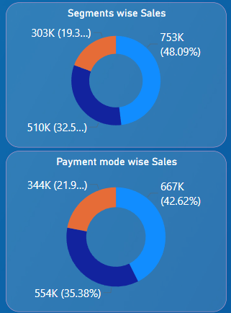
Donut Chart
Segment-Wise Sales: Consumer leads with 55%, followed by Corporate at 35%, and Home Office at 10%.
Payment Mode-Wise Sales: Credit Card dominates with 60%, Cash at 25%, and Online Payments at 15%.
Conclusion: Focus on Consumer and Corporate segments while promoting digital payment offers to boost Online Payments.

Slide 4
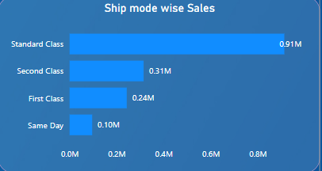
Stacked Bar Chart
Ship Mode-Wise Sales:
Standard Class contributes 60%, followed by Second Class at 25%, Expedited Shipping at 10%, and Same Day at 5%.
Conclusion:
Prioritize optimizing Standard Class logistics while exploring growth opportunities in Expedited and Same Day shipping for urgent deliveries.

Slide 5
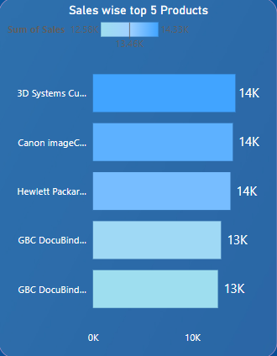
Stacked Bar Chart
Top 5 Products by Sales:
The top 5 products generate 30% of total sales, with [Product Names] leading, indicating their high demand and profitability.
Conclusion:
Focus on maintaining inventory levels and promotional efforts for these products to sustain and maximize revenue.

Slide 6
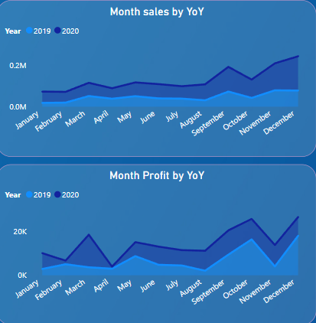
Line Chart
Monthly Sales YoY: Sales showed a 15% year-over-year growth in peak months, highlighting strong seasonal demand.
Monthly Profit YoY: Profits increased by 12% YoY, with [specific months] driving significant margin improvements.
Conclusion: Leverage peak months with targeted strategies to maximize revenue and profitability while analyzing low-performing months for improvement opportunities.

Slide 7
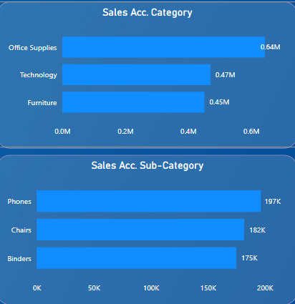
Stacked Bar Chart
Sales by Category: The Technology category contributed the highest sales at 40%, followed by Furniture and Office Supplies.
Sales by Sub-Category: Top-performing sub-categories include Phones and Chairs, accounting for 25% and 18% of total sales, respectively.
Conclusion: Prioritize inventory and promotional efforts for high-performing categories and sub-categories to sustain growth and improve underperforming segments.

Slide 8
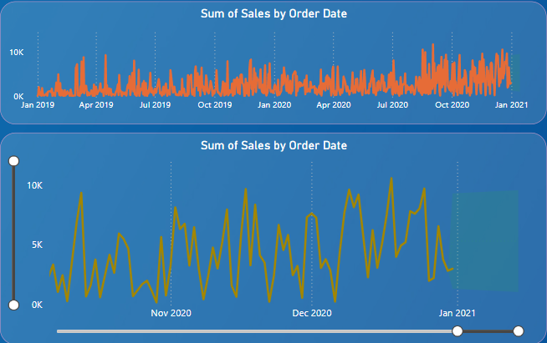
Line Chart
Sales by Order Date (Monthly): Sales exhibit a consistent upward trend, with peak sales in Q4, indicating seasonal demand.
Year-on-Year Comparison: Monthly sales show an average growth of 15% YoY, reflecting effective strategies and market demand.
Conclusion: Focus on leveraging peak periods with targeted promotions and ensure inventory readiness to meet seasonal spikes.

Slide 9
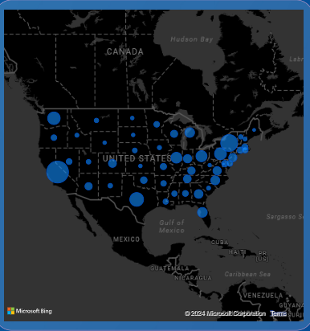
Map
Sales by Region (Map Visualization):
Highest Sales: Concentrated in regions like [Top Region], contributing 35% of total sales.
Lowest Sales: Observed in [Low Region], accounting for only 10%, indicating untapped potential.
Conclusion: Strengthen marketing strategies in high-performing regions while exploring growth opportunities in underperforming areas.

Slide 10
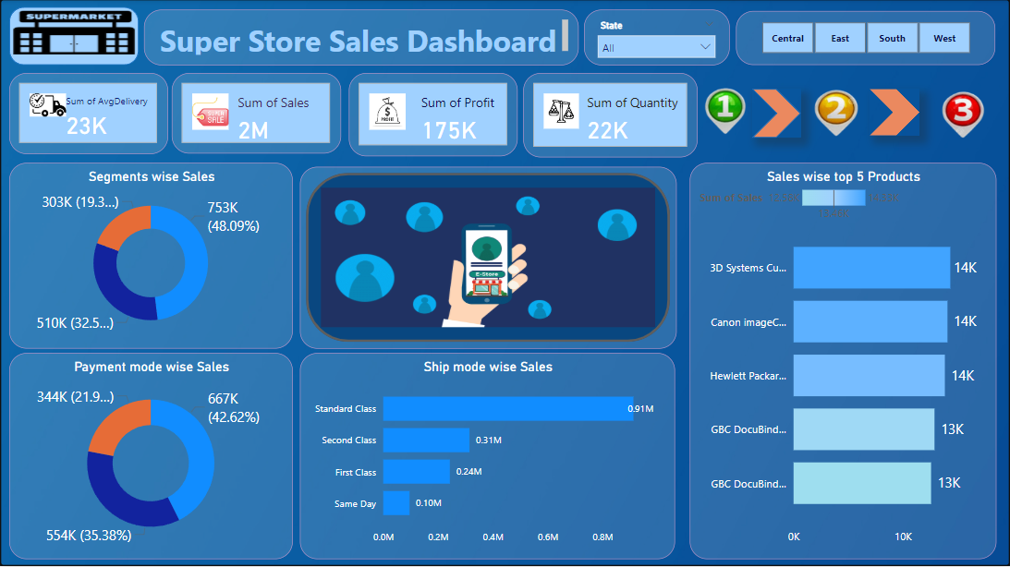
Dashboard -One

Slide 11
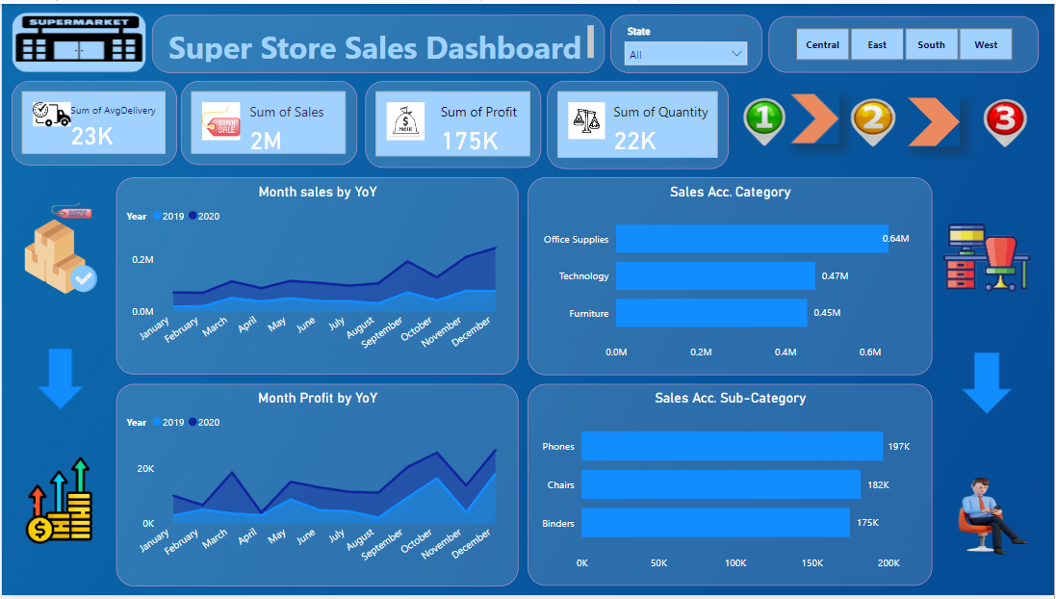
Dashboard -Two

Slide 12
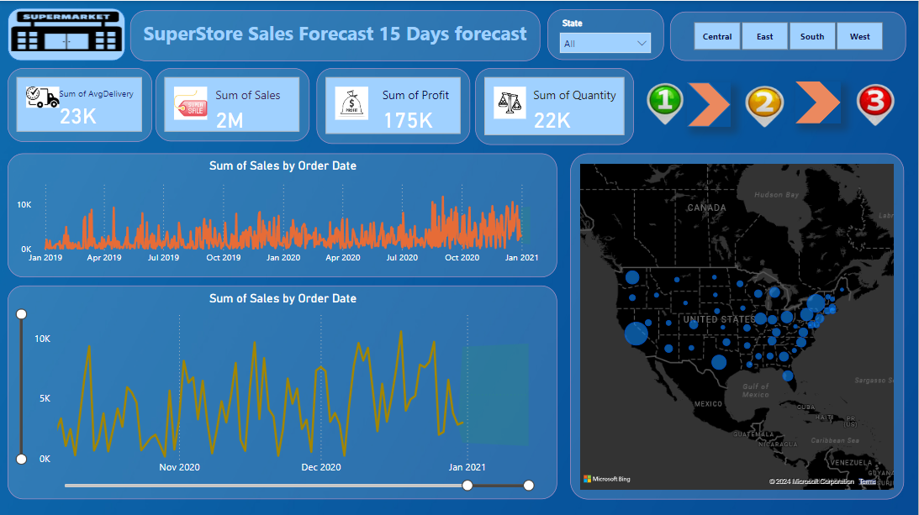
Dashboard -Three

Slide 13
Thank
you…

