Slide 1
Customer Voice Analysis
Team Members
Abhishek Bhardwaj - A20360197
Rohan Digambar Gawade - A20379951
Maneesha Satyanarayanan - A20384410
Amruta Pimple - A20380183
Samruddhi Naik - A20381084
Demo Link:
https://54.191.47.212:9090/index

Slide 2
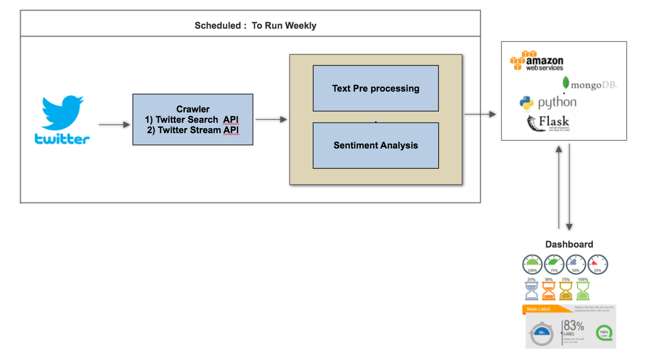
Goal
We intend to collect customer reviews from Twitter using sentiment analysis.
This will enable organizations to understand their brand value over the time and help them identify investments that delight their customers and develop new products to maximize satisfaction and profits.
Categories and Brands Selected
Category | Brands
Food | #Dominos, #Pizzahut, #PapaJohns #BurgerKing, #McDonalds
Clothing | #Zara, #Levis, #RalphLauren, #TommyHilfiger, #Nike
Retail | '#Walmart , #Walgreens, #BestBuy, #Target, #CVSPharmacy, #Costco

Slide 3
Data
Data Extraction : Twitter Search and Twitter Stream API
Data Preprocesing:
Selecting English tweets.
Replace emoticons.
Removed hyperlinks.
Removed stopwords.
Removed punctuations.
Removed ‘#’ and ‘@’.
Lower Casing
Sentiment Tagging
Lexicon based Analysis – VaderSentiment
Textblob

Slide 4
Experiment and Results
Models Used
Naïve Bayes
Logistic Regression
SGD Classifier
Support Vector Machine
PassiveAggressiveClassifier

Slide 5
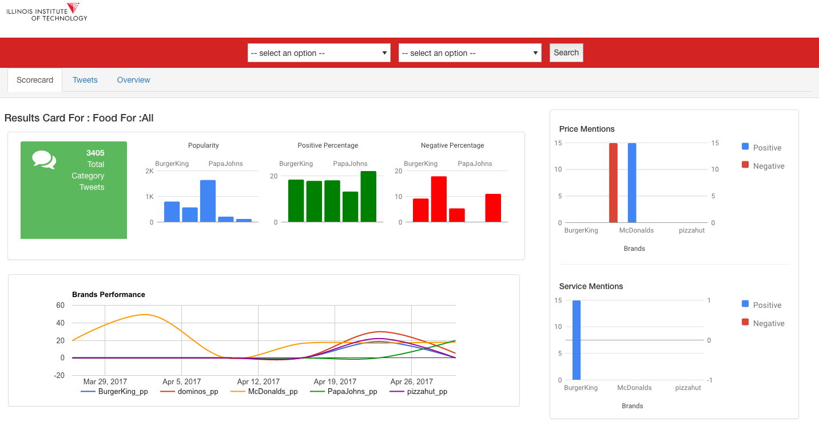
Conclusion
https://54.191.47.212:9090/index

