Slide 1
Sinhgad College of Engineering Department of Information Technology
Project Review
on
“ Indian Sign Language Interpretation Using Camera ”
By
Group No.: AB5
Roll No | Name
B120238568 | Minal Kapadnis
B120238569 | Kartik Poshattiwar
B120238592 | Samruddhi Naik
Guide
“Dr. Nilesh J Uke”

Slide 2
Indian Sign Language Interpretation Using Camera
Project Area :Human Computer Interaction via Gesture Recognition.
Sponsorship: N/A
External Guide : Prof. Nilesh Sonawane (PVGCOE)

Slide 3
Outline
Motivation
Aim
Objective
Problem Statement
Literature Survey
Problems/Gaps found in the existing system
Existing System Vs. Proposed System
Purpose & Scope of the project
System Design
Basic Functioning and Recognition
Hardware and Software Requirements
GUI of the project
OpenCV
Detailed Working
Experimental Results
Test Cases
Application of Proposed System
Result Analysis
Conclusion
References

Slide 4
Motivation
Deafness in India:
1.2 Million people with severe hearing disabilities
0.9 Million people with moderate hearing disability
7.1 Million people with mild hearing disability
9 out of 10 deaf children born are born to parents who can hear
Hearing impairment in children
Absence of any existing computer technology
Government’s negligence
Engineering skills for empowerment
Notes:
Statistics source: http://www.slideshare.net/entbangalore/deafness-statistics-causes

Slide 5
Aim
To use a real time camera for developing an application for the Indian Sign Language Interpretation.
Easy to use interface for communication.
Anytime anywhere simple to use application.
Cheap and money efficient.

Slide 6
Objective
To suggest and build a new gesture based system by using a camera.
Sign language interpretation software using Image Processing.
Provide real-time translation of sign language through computer processing.
Use innovative input methods.

Slide 7
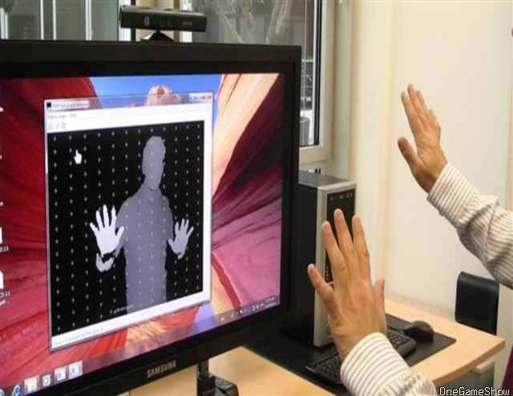
Problem Statement
To develop a desktop application for the continuous recognition of the Indian Sign Language (ISL) gestures where both the hands are used for performing the gestures.

Slide 8
Literature Survey (1)
IIT Allahabad on Humanoid And Human Interaction Implementation for the Indian Sign Language
Range Cameras are used for the implementation
Dynamic motion gesture requires more research
Tracking can be improved using multiple cameras
Overcome the restrictions of using limited gestures

Slide 9
Literature Survey (2)
Sr. No. | Reference Name (IEEE/ACM/Springer/Any other journal, etc. Paper Title) | Work description | Problems found | Publication year
1 | A Hidden Markov Model-based Continuous Gesture Recognition System for Hand Motion Trajectory | Interaction between humanoid robot and human being using Indian Sign Language | Left Right and Ergodic topologies of hidden Markov models are not preferable. | January, 2009
2 | Continuous Indian Sign Language Gesture Recognition and Sentence Formation | The Proposed framework for continuous ISL gesture gives satisfactory performance | More improvements possible in accuracy and efficiency through HMM,SVM. | August, 2015
3 | Recognizing & Interpreting Indian Sign Language Gesture for Human Robot Interaction | Approach for classification of ISL gesture for interaction between humanoid robot HOAP-2 and human being. |  | September, 2010

Slide 10
Problems/Gaps in the Existing system
Limitations in interpreting the full range of sign language as there are limitations on equipment and image noise.
Items in the background or distinct features of the users may make recognition more difficult.
Not appropriate for complex signs, especially those that require significant face or body contact.
Loses accuracy when the hand moves into a position that obstructs the controller’s ability to view.

Slide 11
Existing System vs. Proposed System
Existing system
A method had been developed by T. Shanableh for recognizing isolated Arabic sign language gestures in a user independent mode.
Another by P SubhaRajan and Dr G Balakrishnan for recognising gestures for ISL through 7 bit orientation and generation process through RIGHT and LEFT scan.
Proposed System
To establish the same for the Indian sign language, making it easy to use for the majority of crowd in India.
To make the device accessible to maximum people for promoting education through interactivity.
To fill in the gaps of the existing system.

Slide 12
Purpose & Scope of project
Enlightenment of mute people and help them learn.
Will convert signs into text and tutor students.
Can also be translated into speech improvising the scope.

Slide 13
System Architecture
Extract Frame
Preprocessing
Key Frame Extraction
Capture Video
Gradient Method
Output
Text
Audio
Feature Extraction
Recognition
ORB
Distance Techniques

Slide 14
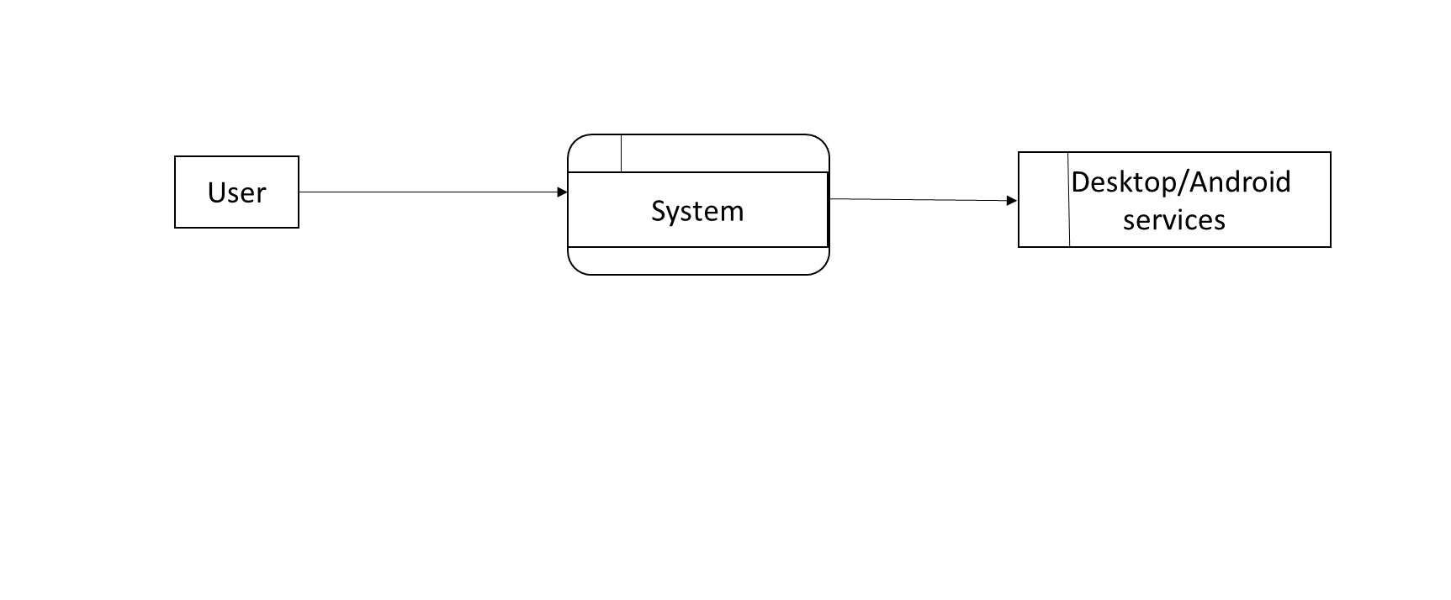
Data Flow Diagram: DFD0

Slide 15
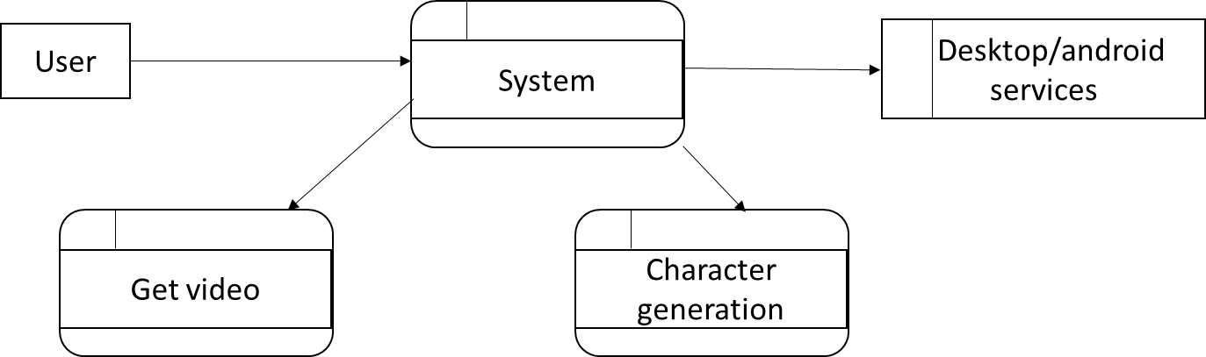
Data Flow Diagram: DFD1

Slide 16
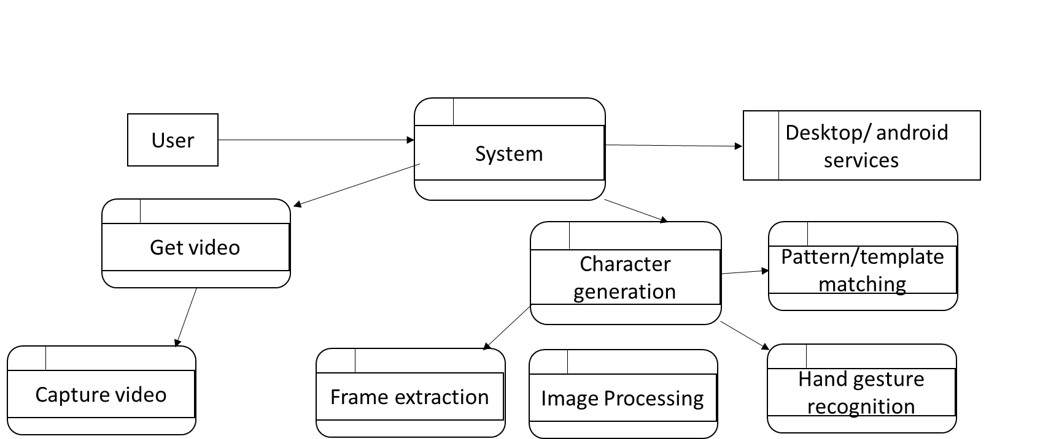
Data Flow Diagram: DFD2

Slide 17
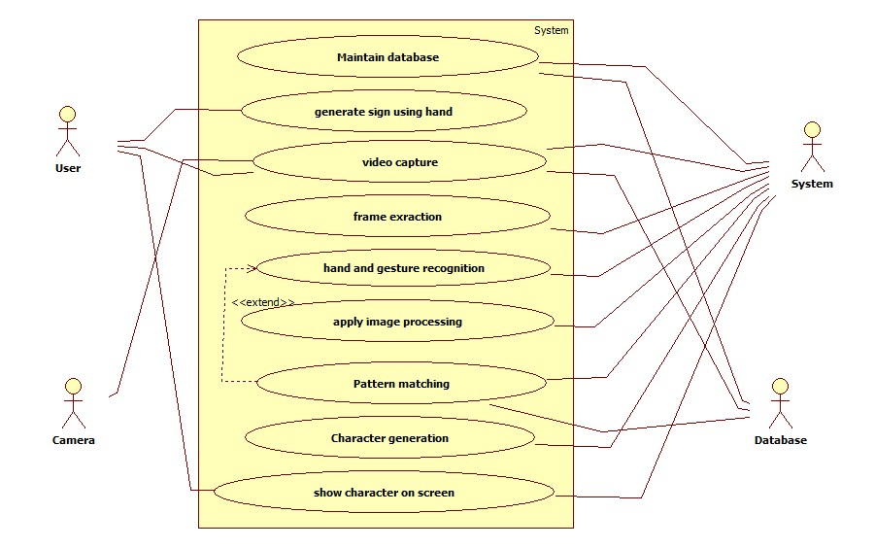
Use Case Diagram

Slide 18
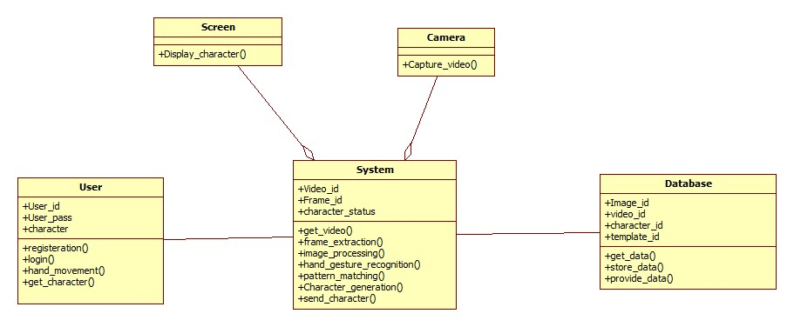
Class Diagram

Slide 19
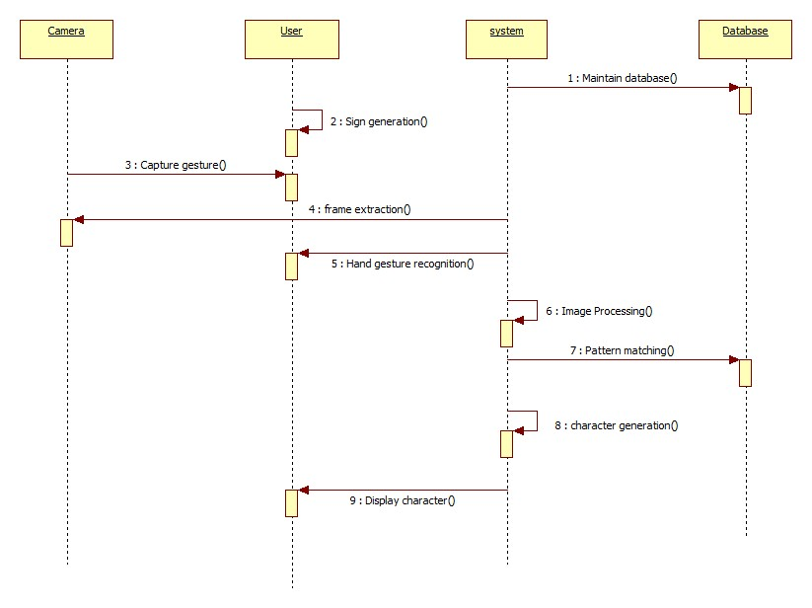
Sequence Diagram

Slide 20
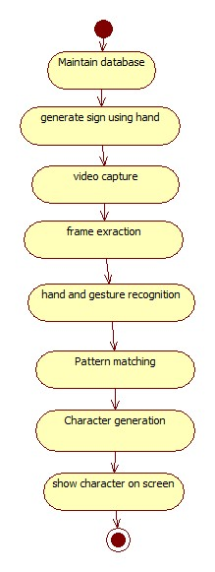
Activity Diagram

Slide 21
Basic Functioning
The end-user will present the hand sign in front of the camera. Here, the camera sensor will capture the hand sign and interpret it.
The data associated with respective hand signs will be stored in the database. As soon as the hand sign is interpreted by the camera, it will search in the database and perform the pre-set action.
The characters related to the sign language will be mapped to the hand sign in the database. This will be accessed by the device for interpretation.

Slide 22
Recognition
The programmer will store the finger point values of the hand gestures in the database. The user will show the hand gesture in front of the device.
The finger point values of the gesture of the user will be grabbed by the device and they will be compared with values stored in the database.
The recognised character for the particular hand sign will be displayed as the output.

Slide 23
Hardware & Software Requirements
Hardware Requirements (Minimum)
2 GB RAM
Windows 7/8/8.1/10
AMD Phenom II or intel i3/i5/i7
USB/Pre-installed camera
Software Requirements (Minimum)
Java
Open CV
Implementation Requirements
JDK 7.0
IDE (NetBeans)

Slide 24
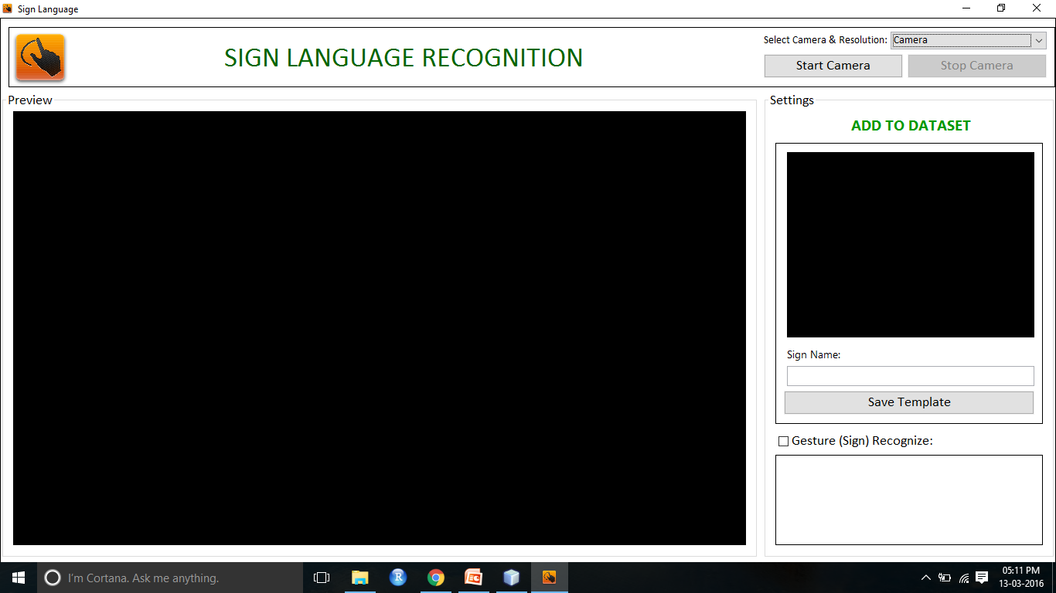
GUI of the project

Slide 25
OpenCV
OpenCV (Open Source Computer Vision) is a library of programming functions mainly aimed at real-time computer vision, originally developed by Intel research centre in Nizhny Novgorod (Russia), later supported by Willow Garage and now maintained by Itseez. The library is cross-platform and free for use under the open-source BSD license.
Packages used in the implementation:
org.opencv.core.Mat: It is an OpenCV C++ n-dimensional dense array class. The class Mat represents an n-dimensional dense numerical single-channel or multi-channel array.
org.opencv.core.MatOfByte: It is an extension of the former.

Slide 26
OpenCV
org.opencv.highgui.Highgui: It is an extension of java.lang.Object. The java.lang.Object class is the root of the class hierarchy. Every class has Object as a superclass. All objects, including arrays, implement the methods of this class.
org.opencv.core.Core: same as above.
org.opencv.imgproc.Imgproc: same as above
org.opencv.highgui.VideoCapture: It is a class for video capturing from video files or cameras.

Slide 27
Detailed Working
Brute-Force matcher takes the descriptor of one feature in first set and is matched with all other features in second set using some distance calculation. And the closest one is returned.
BFMatcher object using cv2.BFMatcher(). Two optional parameters. normType -> specifies the distance measurement to be used. crossCheck -> Boolean variable, false by default.
Two important methods
BFMatcher.match() -> returns the best match BFMatcher.knnMatch() -> returns k best matches where k is specified by the user.
ORB is a fusion of FAST keypoint detector and BRIEF descriptor with many modifications to enhance the performance.
It uses FAST to find keypoints, then apply Harris corner measure to find top N points among them.

Slide 28
Detailed Working
A feature is a point of interest on the image. In order to compare features, you "describe" them using a feature detector. Each feature is then associated to a descriptor. Features are matched by using descriptors.
A descriptor is a multidimensional vector. It can be real-valued (e.g. SIFT) or binary (e.g. BRIEF).
A matching is a pair of descriptors, one from each image, which are the most similar among all of the descriptors. To find the descriptor in image B that is the most similar to a descriptor in image A, you need a measure of this similarity.
There are multiple ways to compute a "score of similarity" between two vectors. For real-valued descriptors, the Euclidean distance is often used, when the Hamming distance is common for binary descriptors.
Distance attribute is the score of similarity between the two descriptors of a match.

Slide 29
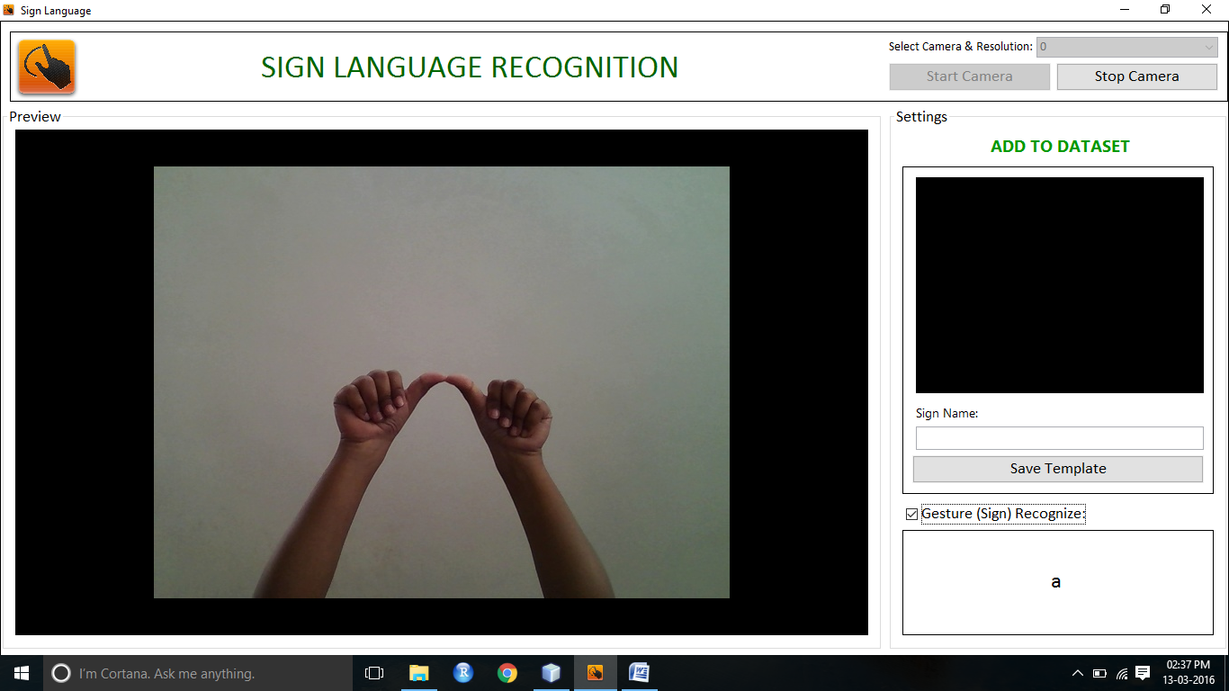
Experimental Results

Slide 30
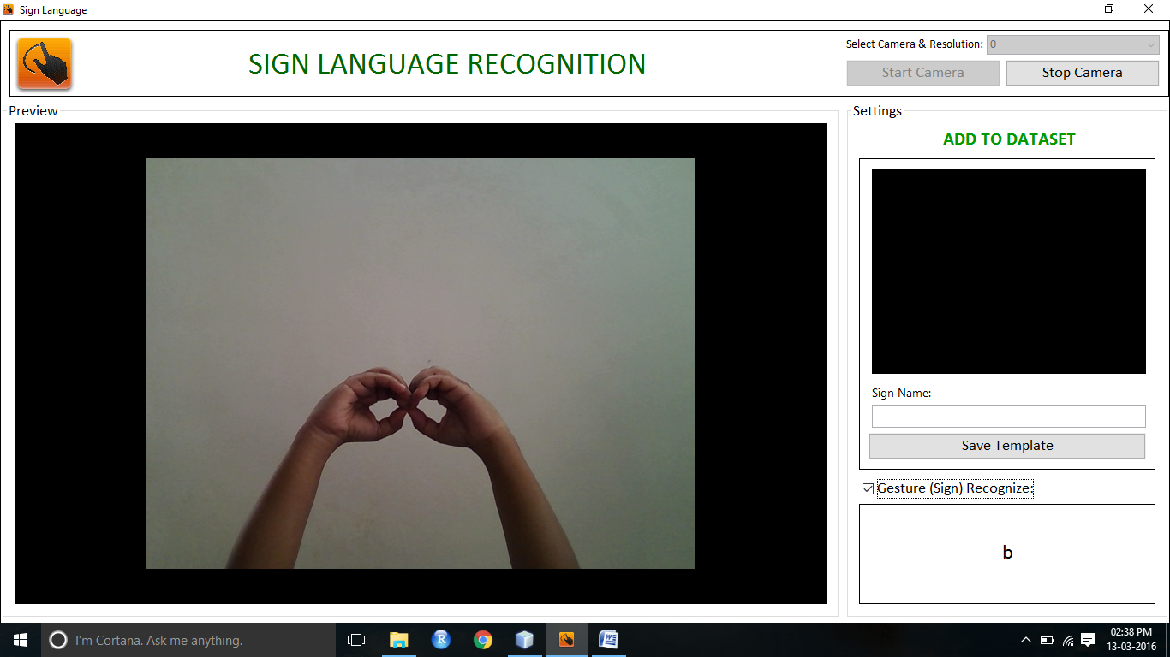
Experimental Results

Slide 31
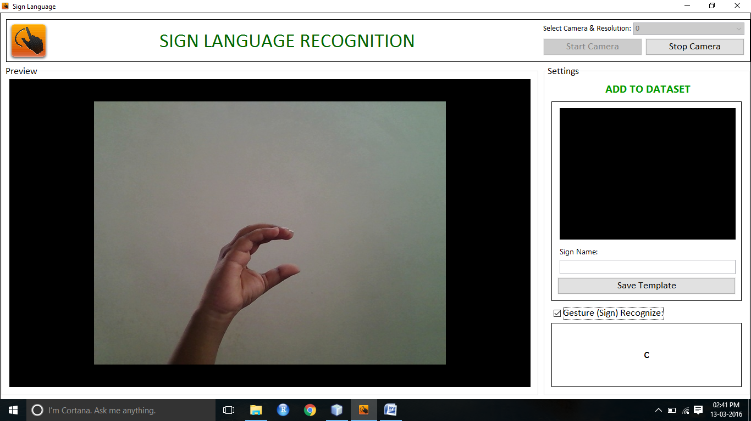
Experimental Results

Slide 32
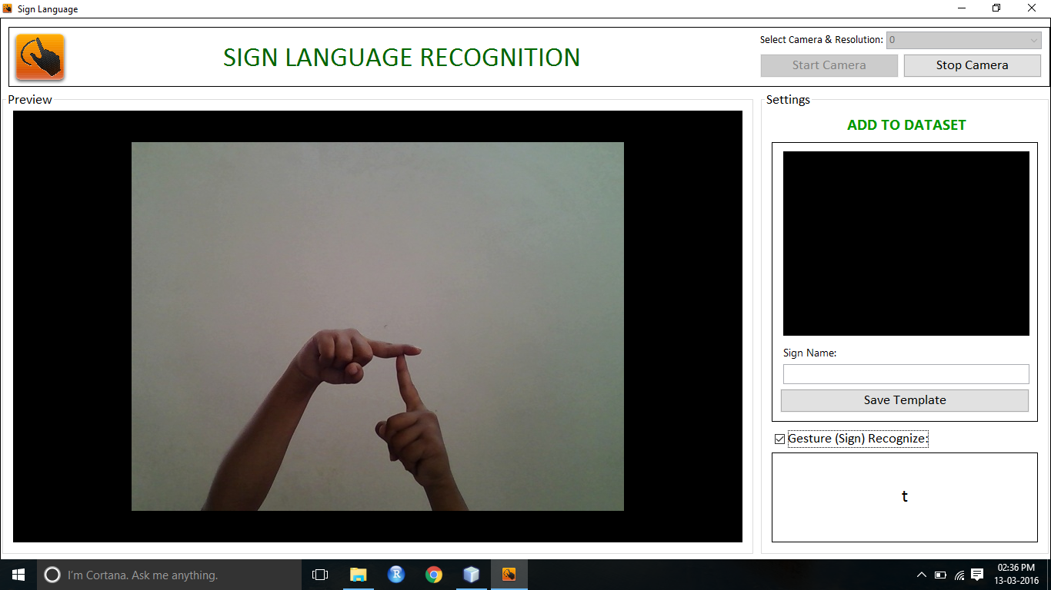
Experimental Results

Slide 33
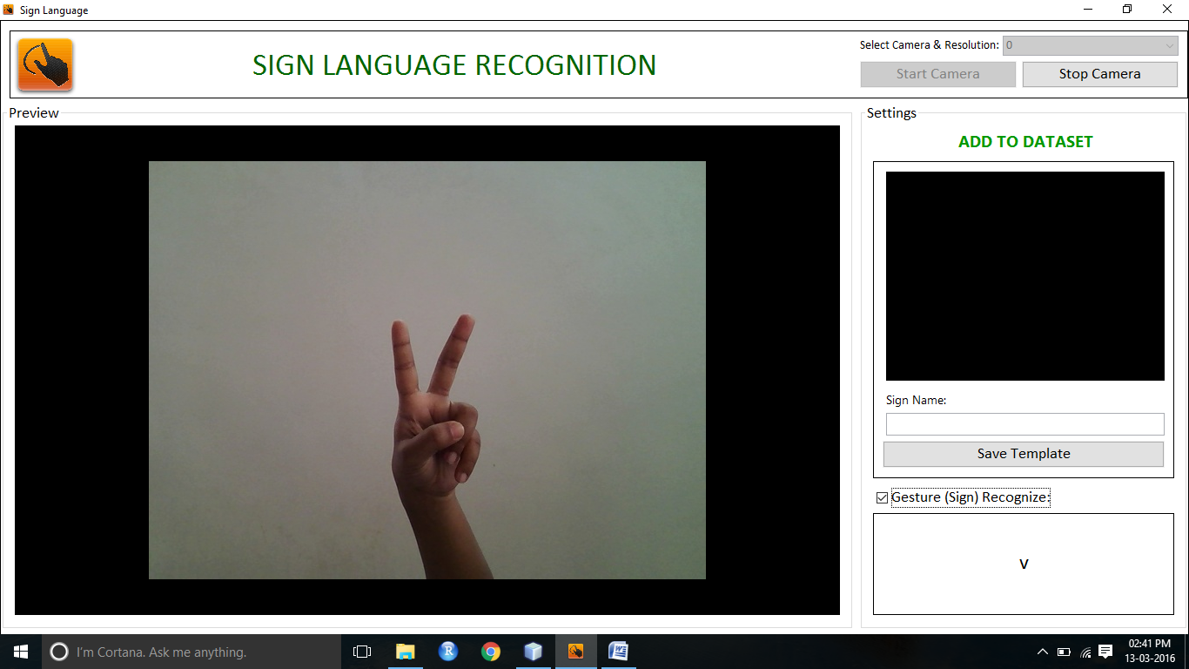
Experimental Results

Slide 34
Test Cases
TC_Name | Objective | PRE-REQUISITE | DESCRIPTION | EXPECTED RESULT | ACTUAL RESULT | STATUS
TC01_Open application | Verify open application from device. | Application should get installed on device. | 1. Click on application from device. | Application should get opened. | Application is getting opened. | Pass
TC02_Screen | Verify first screen from application. | Application should be open. | 1. Open application from. | Sign language window should be opened. | Sign language window is getting opened. | Pass
TC03_screen_group box | Verify group box from screen. | Application should be open. | 1. Open application from. | Application should show 3 group box Image processing , Training database & Result. | Application is showing 2 group on screen. | Pass

Slide 35
Test Cases
TC_Name | Objective | PRE-REQUISITE | DESCRIPTION | EXPECTED RESULT | ACTUAL RESULT | STATUS
TC04_Image processing | Verify image processing group box from application. | Application should be open. | 1. Open application from. | Application should show 4 windows in this group ie. Original screen, Skin detection, large blob, detected hand pos. | Application is showing 4 windows on screen. | Pass
TC05_Add hand Pos name | Verify Add hand pos name button from application. | Application should be open. | 1. Keep your hand with particular unique position in front of the camera. | application should draw red box to the particular position in detected hand pos screen. | Application is showing red box. | Pass
TC06_Original image | Verify original imge screen from application. | Application should be open. | 1. Keep your hand with particular unique position in front of the camera. | Application should show original image wrt Hand pos. | Application is showing original image window. | Pass

Slide 36
Test Cases
TC_Name | Objective | PRE-REQUISITE | DESCRIPTION | EXPECTED RESULT | ACTUAL RESULT | STATUS
TC07_skin detection | verify skin detection from application. | Application should be open. | 1. Keep your hand with particular unique position in front of the camera. | Application should detect skin image wrt Hand pos. | Application is showing skin detection window. | Pass
TC08_large blob | verify large blob from application. | Application should be open. | 1. Keep your hand with particular unique position in front of the camera. | Application should draw large blob wrt skin large skin detection area. | Application is drawing large blob wrt. Skin detection. | Pass
TC09_Add hand Pos name | Verify Add hand pos name button from application. | Application should be open. | 1. Keep your hand with particular unique position in front of the camera. 2. Enter hand position name. 3. Click on Add hand pos name. | Application should capture red box image as a symbolic image & should show in training template. | Application is showing captured image in training template. | Pass

Slide 37
Test Cases
TC_Name | Objective | PRE-REQUISITE | DESCRIPTION | EXPECTED RESULT | ACTUAL RESULT | STATUS
TC11_Detect & recognized | Verify detect & recognized from screen. | Application should be open. | 1. start application. 2. Click on detect & recognized button from screen. 3. Keep your saved hand position infront of the camera. | Application should match detect hand position with saved db value & should show value respectively in the result. | Application is showing saved value in the result. | Pass
TC12_clear | Verify clear button from screen. | Application should be open. | 1. Do no of hand pos in front of the camera. 2. Click on clear button. | application should show values on screen, After clicking on clear button detected result should get clear. | Detected result window is getting clear. | Pass
TC13_Close application | verify close application from device. | Application should be open. | 1. Click on close button from screen. | Application should get closed. | Application is closed. | Pass

Slide 38
Applications of Proposed System
This project will help us to develop a full-fledged working application for the Indian sign language to be used as a mode of communication using the camera.
This also has other advantages in fields like education, communication, interactivity.
The use of camera will mostly benefit the hearing impaired people to learn through gestures.

Slide 39
Result Analysis
Depth Sensing is not possible for VGA cameras using the built-in cameras in a laptop.
Using a third party camera will reduce the portability of the device.
The accuracy of the system is not 100% because of the aforementioned reasons and the system’s inability to perceive complex hand signs.

Slide 40
Conclusion
Sign Language application is an incredibly unique software with a ton of potential for mute people.
It gives a satisfactory level of detail provided by the Camera.
It also allows recognisable signs to be programmed or trained into the device for future recognition.
Based on our survey, we will be able to develop a set of criteria that a device and system meets in order to interpret sign language and create personal signs for easier communication.

Slide 41
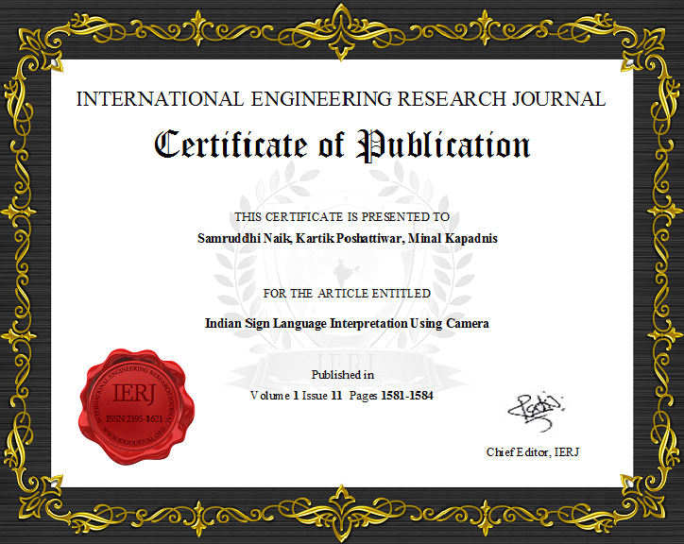
Certificate of Publication

Slide 42
References
[1] M. Elmezain, A. Al-Hamadi, J. Appenrodt and B. Michaelis, “A Hidden Markov Model-based Continuous Gesture Recognition System for Hand Motion Trajectory”, 19th International Conference on IEEE, Pattern Recognition, 2008, ICPR 2008, pp. 1–4, (2009).
[2] Kumud Tripathi∗, Neha Baranwal and G. C. Nandi, “Continuous Indian Sign Language Gesture Recognition and Sentence Formation”, Eleventh International Multi-Conference on Information Processing-2015 (IMCIP-2015), Robotics and Artificial Intelligence Lab, Indian Institute of Information Technology, Allahabad, August (2015).
[3] A. Nandy, S. Mondal, J. S. Prasad and P. Chakraborty, “Recognizing & Interpreting Indian Sign Language Gesture for Human Robot Interaction”, International Conference on Computer and Communication Technology (ICCCT), (2010), pp. 712–717, 17–19 September (2010).

