Slide 1

Credit Card Fraud Detection System
By: Samruddhi Patil

Slide 2
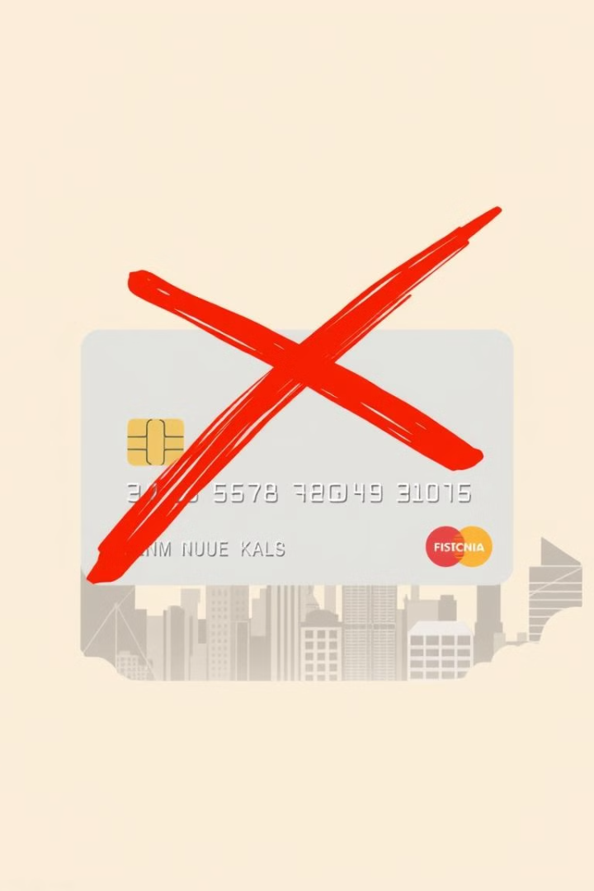
Introduction
Objective
Dataset
Develop a robust system to detect fraudulent transactions using machine learning.
Contains legitimate and fraudulent credit card transactions.
Goal
Accurately identify fraud. Minimize false positives.

Slide 3
Dataset Overview
Dataset Used
Key Features
Challenge
creditcard.csv
Time: Time elapsed since the first transaction. V1-V28: PCA-derived features. Amount: Transaction value. Class: Target variable (0: Non-fraud, 1: Fraud).
Highly imbalanced dataset.

Slide 4
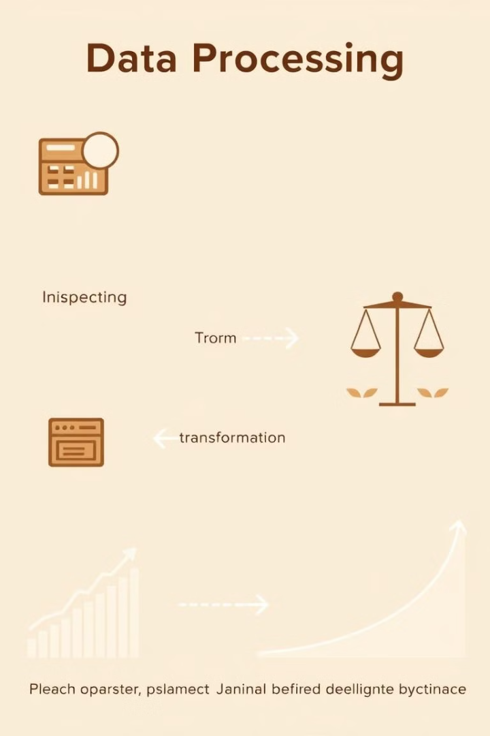
Data Preprocessing
Data Inspection
Class Imbalance Handling
Checked class distribution and visualized patterns.
Used SMOTE to balance the dataset.
Feature Scaling
StandardScaler applied to ensure all features contribute equally.

Slide 5




Feature Selection
Correlation
Recursive Feature Elimination
With target variable.
RFE.
Random Forest
Feature Importance.

Slide 6
Models Used
Logistic Regression
Decision Tree
Random Forest
XGBoost
Support Vector Machine (SVM)

Slide 7
Model Evaluation Metrics
Metrics Analyzed
Best Performers
Accuracy. Precision. Recall. F1-Score. ROC-AUC.
Random Forest: ROC-AUC 1.0000. XGBoost: ROC-AUC 1.0000.

Slide 8
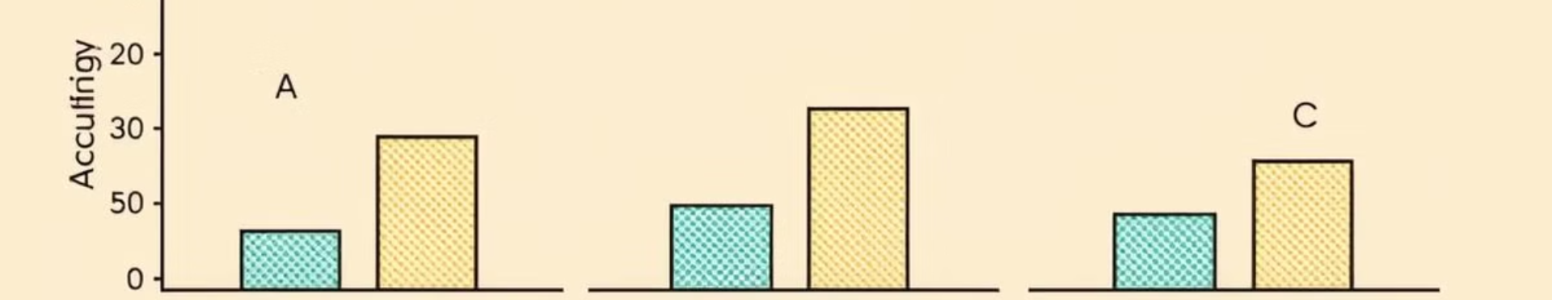
Model Results Comparison
1
2
3
Random Forest
XGBoost
Logistic Regression
Best overall.
Comparable.
Good baseline.

Slide 9
Hyperparameter Tuning
Techniques Applied
Outcome
Grid Search: Exhaustive search for best parameters. Random Search: Efficient sampling of parameter combinations. Bayesian Optimization: Probabilistic approach for optimal tuning.
Improved Logistic Regression model performance.

Slide 10

Conclusion
Key Achievements
Practical Impact
Developed an accurate fraud detection system. Balanced dataset improved model reliability. Random Forest and XGBoost showed exceptional performance.
Financial institutions can reduce fraud losses. Enhances transaction security in real-time.
Future Scope
Deploy in production, adapt to evolving fraud patterns.

Slide 11

"Thank you for your attention!“
Contact Details: @Ms.Samruddhi
Q&A Invitation: "Feel free to ask questions!"

