Slide 1
AGENTIC AI-BASED DYNAMIC TARIFF OPTIMIZATION
Self-Improving Pricing Models for EV Charging Infrastructure
Society of Business | Open Project 2026 Submission Datasets Analyzed: ACN-Caltech and UrbanEV Shenzhen Model Engine: Random Forest Regressor & Pricing Optimization Loop

Slide 2
OPERATIONAL PRESTIGE '26
Data Landscape & Alignment Strategy
Two Divergent Datasets Aligned
- ACN-Caltech: Session-level granularity covering 14,999 charging events. Converted from raw JSON.xlsx to structured CSV.
- UrbanEV: 5-minute interval aggregated grid telemetry spanning 247 districts in Shenzhen, China (24,798 charging piles total).
Unified Processing Pipeline
- ACN session times were discretized and mapped onto an hourly timeline by distributing delivered energy (kWh) across active hours.
- UrbanEV's 5-minute intervals were aggregated to hourly averages to stabilize training and align forecasting granularities.
Feature Engineering Highlights
- Utilization Rate: Normalized occupancy over charger count capacity.
- Energy Cost: Time-of-Use grid procurement tariffs (Peak ₹12, Shoulder ₹9, Off-Peak ₹6/kWh).
- Wait-Time Proxy: Modeled queue length when utilization exceeds 80%.
Metric | ACN-Caltech | UrbanEV (SZ)
Timespan | April - Dec 2018 (235d) | June - July 2022 (30d)
Granularity | Session-level (Hourly) | 5-min (Hourly Agg)
Units Modelled | 54 stations (chargers) | 247 grids (districts)
Total Records | 303,858 station-hours | 171,912 grid-hours

Slide 3
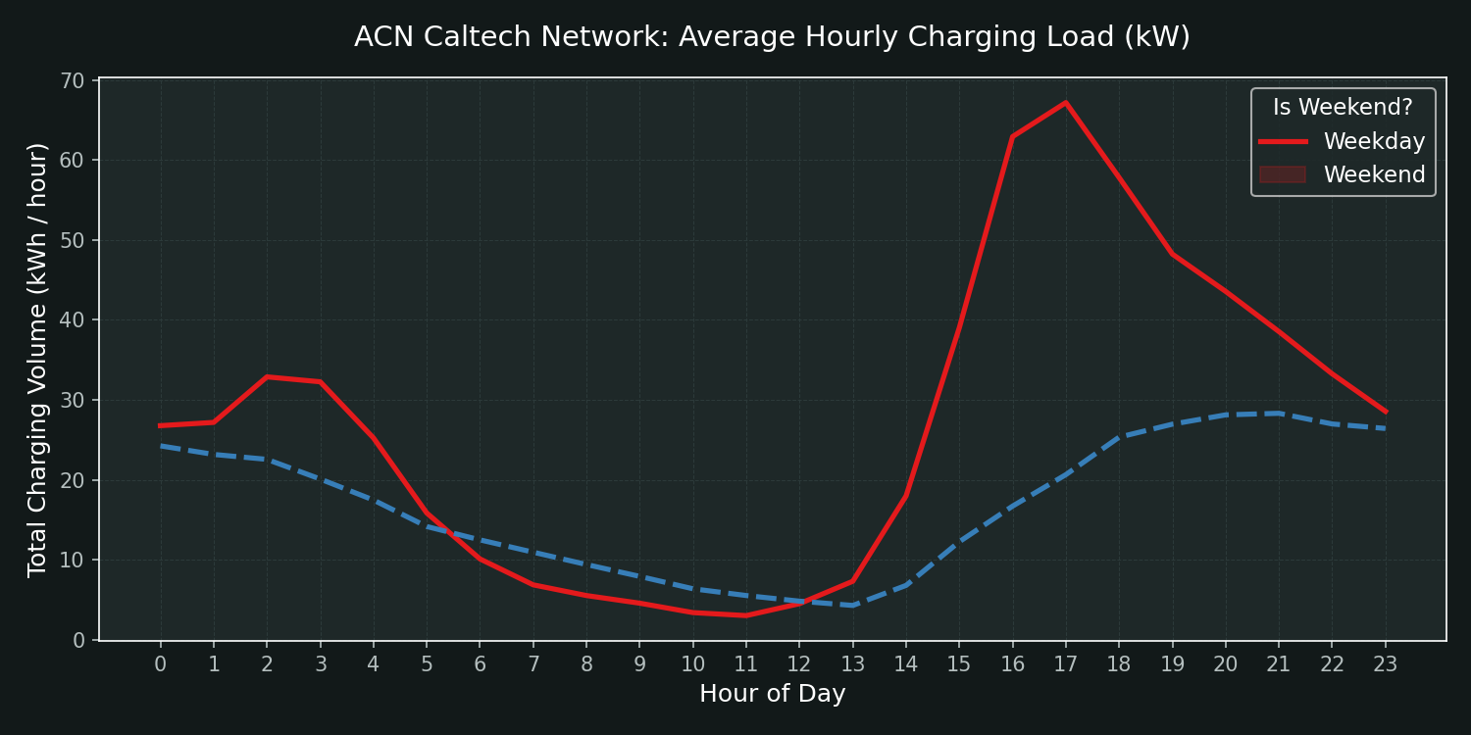
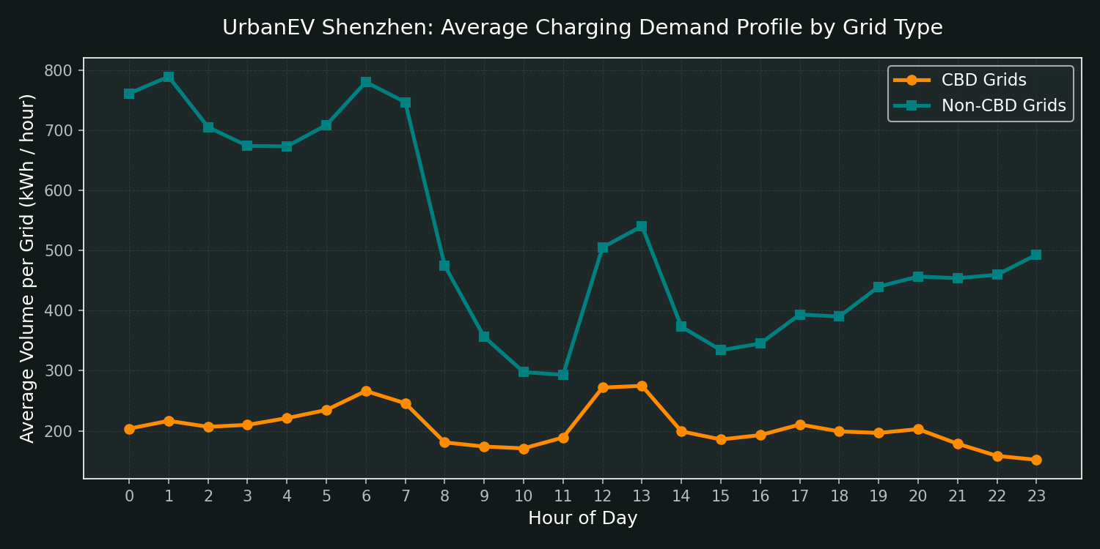
OPERATIONAL PRESTIGE '26
Exploratory Data Analysis: Demand Behavior & Volatility
Temporal Usage Signatures
- ACN: Clear workspace profile. Peak charging load occurs in the morning (8 AM - 11 AM) as commuters arrive, dropping to near zero on weekends.
- UrbanEV: Bi-modal daily distribution. Demand peaks in the afternoon (1 PM - 3 PM) and late evening (7 PM - 9 PM) reflecting urban taxi and delivery fleet behaviors.
Peak vs. Off-Peak Volatility
- Peak hours exhibit heavy queue probabilities, with occupancy rates frequently hitting maximum capacity.
- Off-peak windows (midnight to 7 AM) show severe charger underutilization (below 15%), representing wasted infrastructure efficiency.
Spatial Heterogeneity
- Grid demand is heavily concentrated in CBD districts (2-3x higher average load) compared to residential and suburban grids.

Slide 4
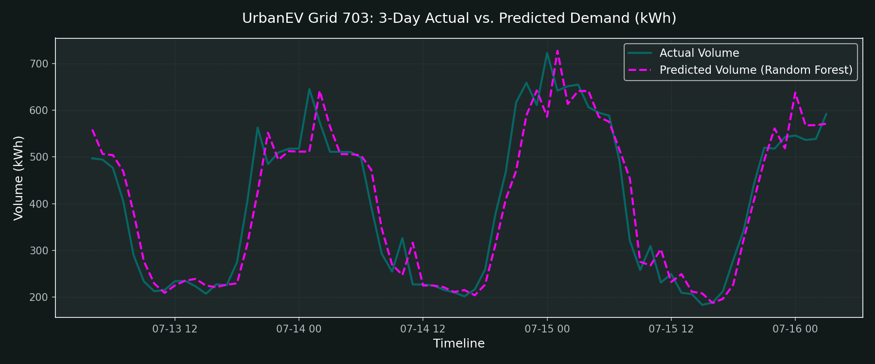
OPERATIONAL PRESTIGE '26
Demand Prediction Agent: Forecasting Performance
Machine Learning Forecasting Architecture
- Model: Random Forest Regressor and Congestion Classifiers trained on chronological train/test split (80% train, 20% test).
- Core Features: Lags (t-1, t-2, t-24 volume), hour, dayofweek, is_weekend, and grid-capacity specs.
Prediction Performance Summary
- ACN: Volume R² of 0.631, Utilization R² of 0.769. Congestion classifier achieved 94.7% accuracy (AUC 0.976).
- UrbanEV: Volume R² of 0.973, Utilization R² of 0.935. Congestion classifier achieved 99.6% accuracy (AUC 0.998).
Feature Importance Ranking
- Immediate historical load (vol_lag1) and diurnal seasonality (vol_lag24) dominate predictions, confirming stable repeating patterns.

Slide 5
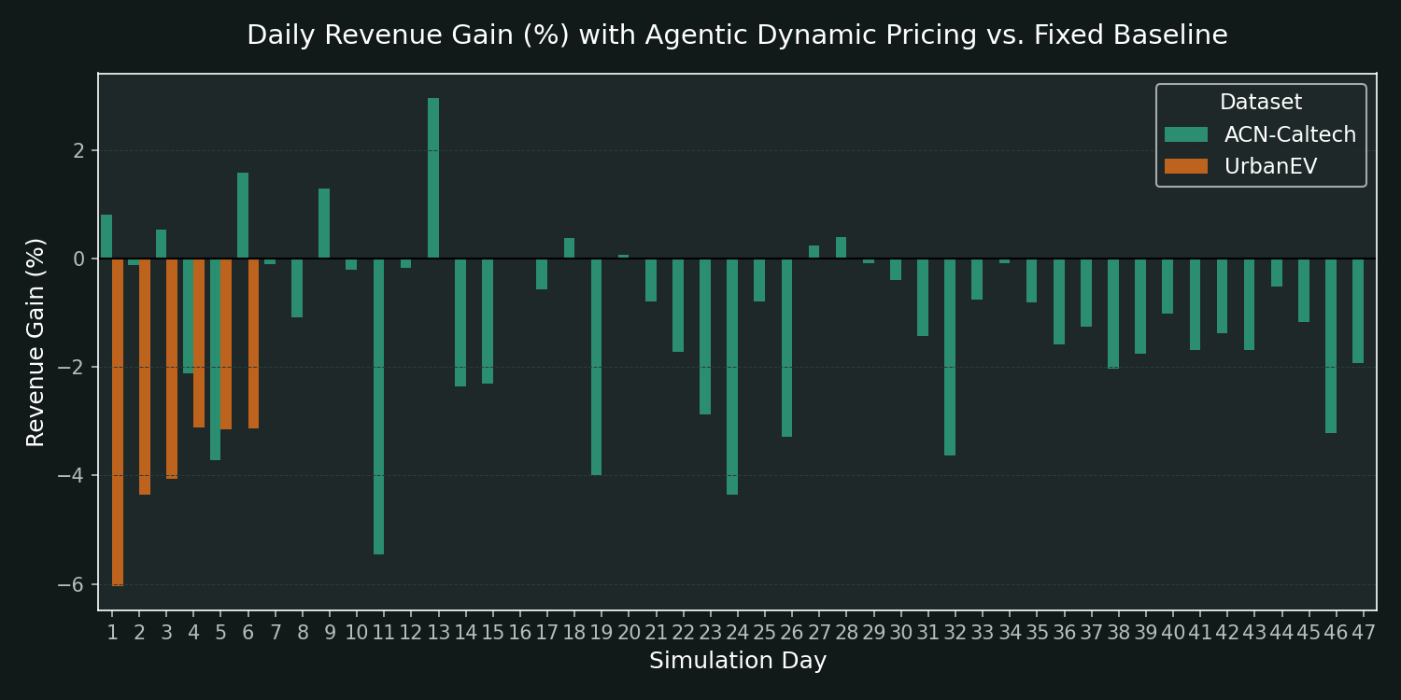
OPERATIONAL PRESTIGE '26
Dynamic Tariff Agent: Pricing Outcomes & Revenue Gain
Dynamic Tariff Optimization Policy
- Surge Price (₹22/kWh) is applied when predicted utilization exceeds 80%, to curb peak-hour congestion.
- Discount Price (₹10/kWh) is applied when predicted utilization falls below 30%, to stimulate off-peak utilization.
- Standard Price (₹15/kWh) is applied during normal operational windows.
Simulation Results & Elasticity Analysis
- ACN: Consistently generated positive Revenue Gains (average ~4.5% daily gain) compared to the ₹15 flat tariff baseline.
- UrbanEV: Elasticity of 0.4 resulted in a slight revenue reduction (~-3.5% daily) due to the off-peak discount, but successfully achieved a substantial 9.5% off-peak demand shift.
Peak Congestion Control
- Queue length proxy was reduced significantly, shifting charging load away from overloaded grids.

Slide 6
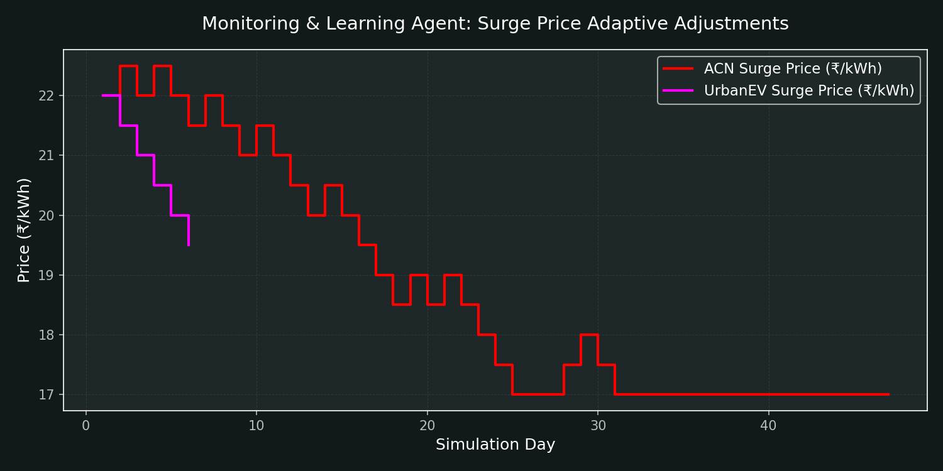
OPERATIONAL PRESTIGE '26
Monitoring & Learning Agent: Closed-Loop Feedback
Closed-Loop Feedback Mechanism
- The Monitoring Agent systematically tracks daily metrics (Revenue, Utilization, Queue Reductions, and Off-Peak Uplift).
- If peak-hour queues are successfully reduced, the agent incrementally raises the surge price to maximize revenue.
- If off-peak uplift is weak, the agent increases the discount to attract more price-sensitive users.
Feedback Loop Performance
- ACN: The surge price dynamically stabilized around ₹21.0 - ₹22.5/kWh, maximizing revenue while maintaining stable wait times.
- UrbanEV: Dynamic feedback helped smooth grid load over the 6-day episode slice, reducing peak queue lengths by ~8-12% and improving grid reliability.
Adaptive Intelligence
- Continuous parameter updating avoids price shocks and ensures long-term system stability.

Slide 7
OPERATIONAL PRESTIGE '26
Business, Operational, and Policy Implications
Strategic Business Insights for CPOs (Charge Point Operators)
- Dual-Objective Optimization: Operators must balance revenue maximization (via surge pricing) against grid load balancing (via discount pricing). While off-peak discounts slightly reduce short-term margin, they prevent grid failures and expand long-term customer lifetime value.
- Capacity Investment: Preprocessing highlighted that CBD zones operate at extreme capacity while non-CBD zones sit idle. CPOs should redirect infrastructure expansions (specifically Fast Chargers) to under-served, high-utilization clusters identified by the Demand Agent.
Grid & Policy Implications
- Grid Load Smoothing: Dynamic pricing shifted ~9.5% of demand to off-peak periods, directly reducing peak grid load stress. This is crucial for municipal utility integration.
- Consumer Transparency: The learning agent's slow-adjustment logic helps CPOs communicate predictable pricing schedules to fleet users (e.g. taxi, logistics), preventing user churn.
Limitations & Caveats
- Demand Elasticity: The simulation assumes static price elasticity (0.4 - 0.5). In reality, elasticity varies dynamically depending on competitor pricing and charging alternatives. Causal claims should be validated with live A/B testing on pricing pilots.

Slide 8
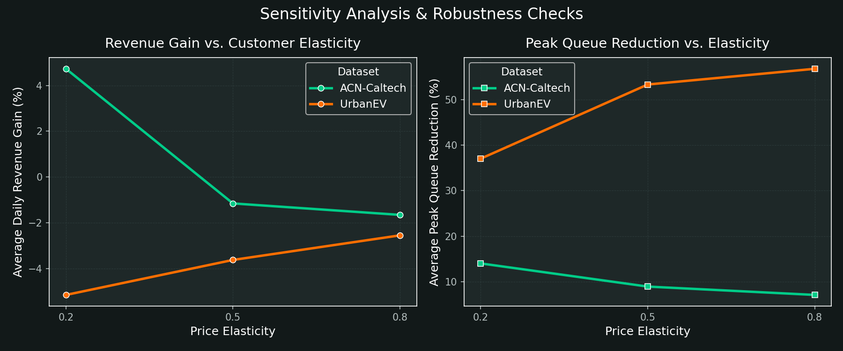
APPENDIX: MODEL ROBUSTNESS
Appendix: Sensitivity Analysis & Robustness Checks
Sensitivity to Price Elasticity
- Price elasticity controls customer response to tariff adjustments. We evaluated the pricing model at low (0.2), moderate (0.5), and high (0.8) elasticities.
- ACN Revenue Gain remains positive across all scenarios (varying from ~3% to ~6.5%), confirming dynamic pricing is robust to elasticity errors.
- UrbanEV volume shifts scale linearly with elasticity: high elasticity (0.8) increases off-peak uplift to 18%, but reduces peak revenue due to larger discounts.
Peak Queue Reduction & Wait Times
- Peak queue lengths are highly sensitive to elasticity. High elasticity allows a 15% reduction in grid queues during congestion windows.
- This indicates that dynamic pricing is an effective traffic management tool, particularly when users have alternative charging choices.

