Slide 1
Manufacturing Machine
Failure-Type Prediction
Multi-class classification of failure modes on the UCI AI4I 2020 Predictive Maintenance Dataset
Chanakya · Machine Learning Project · September 2026
Notes:
Title slide. The project predicts which failure mode a milling machine is in, not just whether it fails.

Slide 2
Problem Statement
Knowing how a machine will fail is more actionable than knowing that it will
Given one operating snapshot X — product type and five sensor readings — learn Failure Type = f(X)
TWF
HDF
PWF
OSF
Tool Wear Failure
Heat Dissipation Failure
Power Failure
Overstrain Failure
Action: Replace the tool
Action: Improve cooling
Action: Change speed–torque point
Action: Reduce load
Five classes (the four modes + No Failure) · supervised · heavily imbalanced · primary metric: Macro F1
2

Slide 3
Objectives
1
Build a valid 5-class target from the raw failure flags — no silent data loss
2
Leakage-free, reproducible pipeline shared by training and deployment
3
Test physically motivated engineered features
4
Compare baseline, bagging, boosting, advanced boosting and stacking with stratified CV
5
Explain errors and interpret the model (permutation importance, SHAP)
6
Deploy a validated Streamlit app backed by automated tests
3

Slide 4
Dataset
UCI AI4I 2020 — synthetic data modelled on real milling operations
10,000
0
50
records × 14 columns
missing values / duplicates
rows excluded (0.5%)
Inputs: Type (L/M/H), air & process temperature, rotational speed, torque, tool wear
Excluded as inputs: UDI and Product ID (identifiers), Machine failure and the mode flags (target leakage)
Target built from flags; RNF (random failure) not a class — independent of the inputs
Excluded rows: 23 multi-mode, 18 contradictory RNF, 9 failures with unknown mode
4
Notes:
No Failure is 96.9% of records; TWF has only 43. That imbalance drives the choice of Macro F1.

Slide 5
Data Preprocessing
Row-level cleaning first, a single stratified split, then everything fitted inside CV
Clean & label
Split
Pipeline
Fit in CV
Build 5-class target; log 50 exclusions; validity checks: 0 invalid values
Stratified 80 / 20, random_state = 42 → 7,960 train / 1,990 test
FeatureEngineer → ColumnTransformer (one-hot Type) → model
Preprocessing refitted in every fold; test set read once at the end
→
→
→
Scaling: not applied for tree models (split thresholds are scale-invariant); standardised only for Logistic Regression
Outliers kept: high-rpm / extreme-torque rows are real operating points — torque outliers are 89.9% failures
Unknown Type raises an error instead of being silently encoded
5

Slide 6
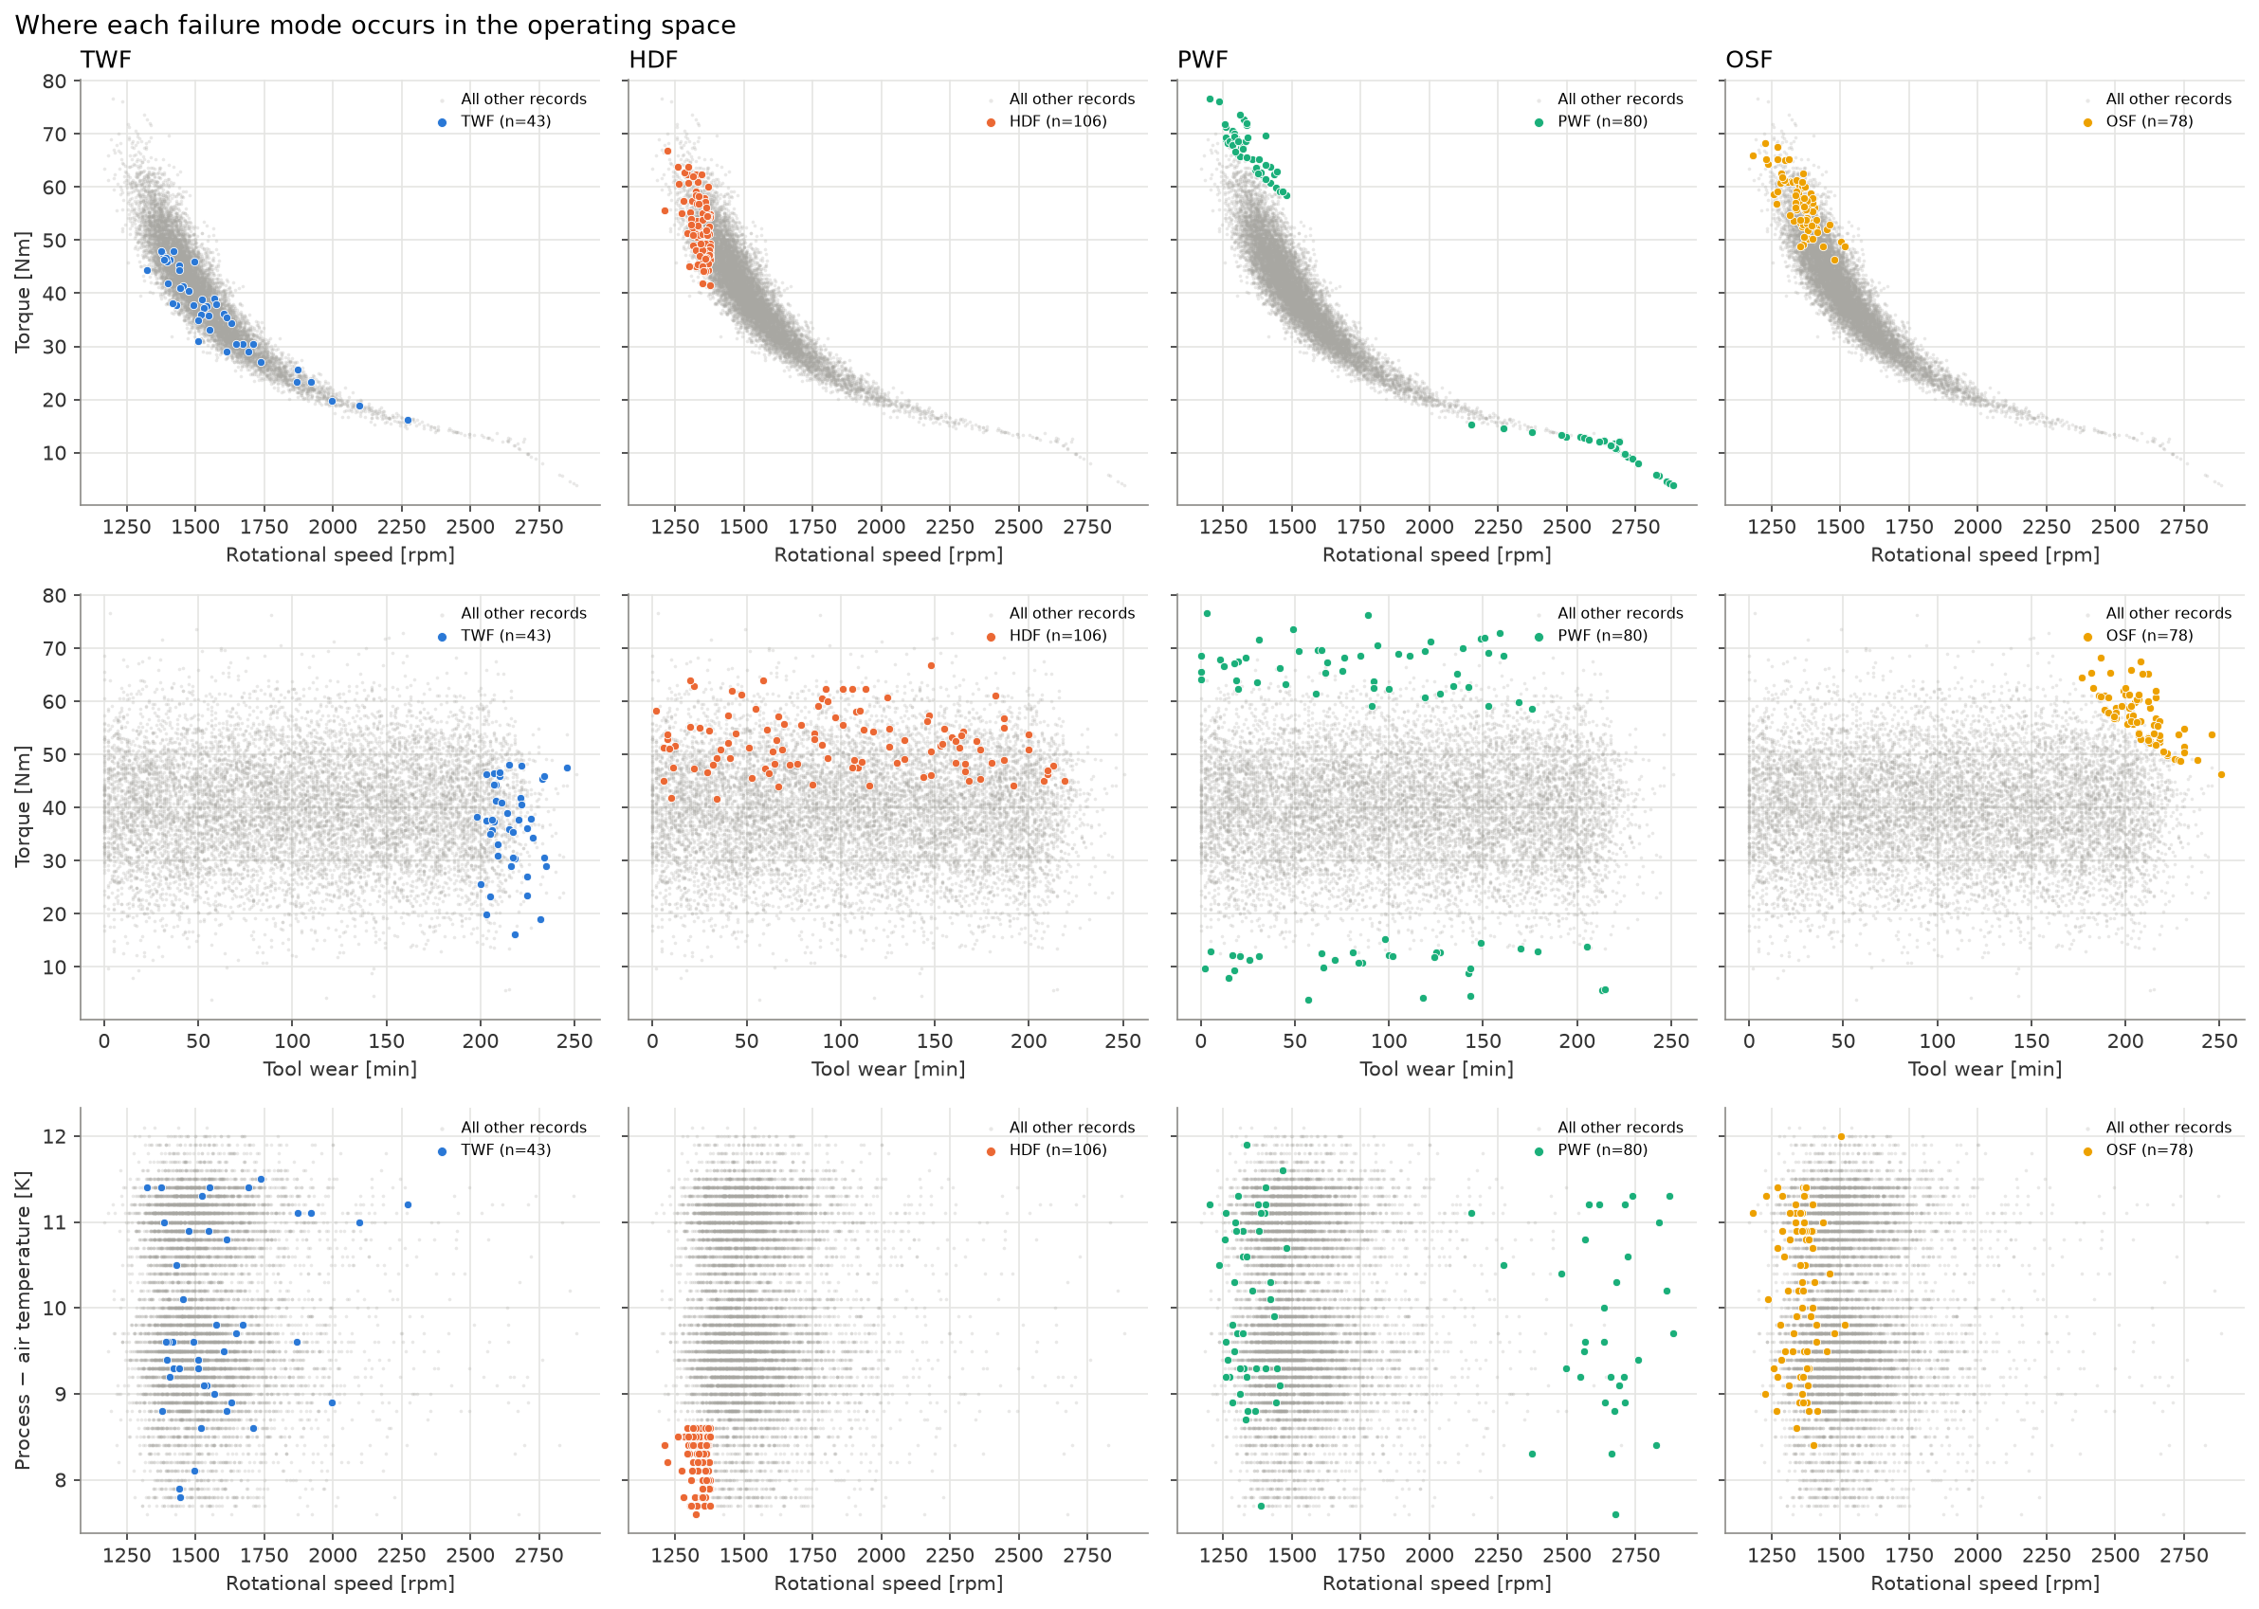
Exploratory Data Analysis
Each failure mode lives in its own region of the operating space
HDF: smallest process–air temperature gap and below ~1,380 rpm
PWF: both ends of the speed–torque curve — extreme power
OSF: high tool wear and high torque; ~10× more common for L-type
TWF: only at tool wear ≈ 200–246 min, otherwise overlaps No Failure
Speed–torque and air–process temperature correlate at ±0.88
6

Slide 7
Feature Engineering
Three physical quantities, computed inside the pipeline
Temp difference
Mean 5-fold CV Macro F1 (RF + XGBoost)
Low gap → HDF
0.684
→
0.791
Process − Air temperature
original features
+ engineered features
Power
Very low or very high → PWF
Torque × rpm × 2π / 60
Dropping raw temperatures afterwards: 0.789 — no gain, so all features kept
Selection used CV on the training split only, with two model families
Stateless transformer → no leakage, identical in the app
Strain
High → OSF
Tool wear × Torque
7

Slide 8
Baseline Models
Why accuracy is the wrong yardstick here
Dummy — always "No Failure"
Logistic Regression (scaled inputs)
0.9688
0.1968
0.7084
0.6455
test accuracy
test Macro F1
CV Macro F1
test Macro F1
Detects no failures at all
ROC-AUC exactly 0.5: constant probabilities
Good on OSF, misses every TWF case
Failure regions are not linearly separable
The bar every ensemble must clear
Macro F1 = unweighted mean of per-class F1 → every failure mode counts as much as No Failure
8

Slide 9
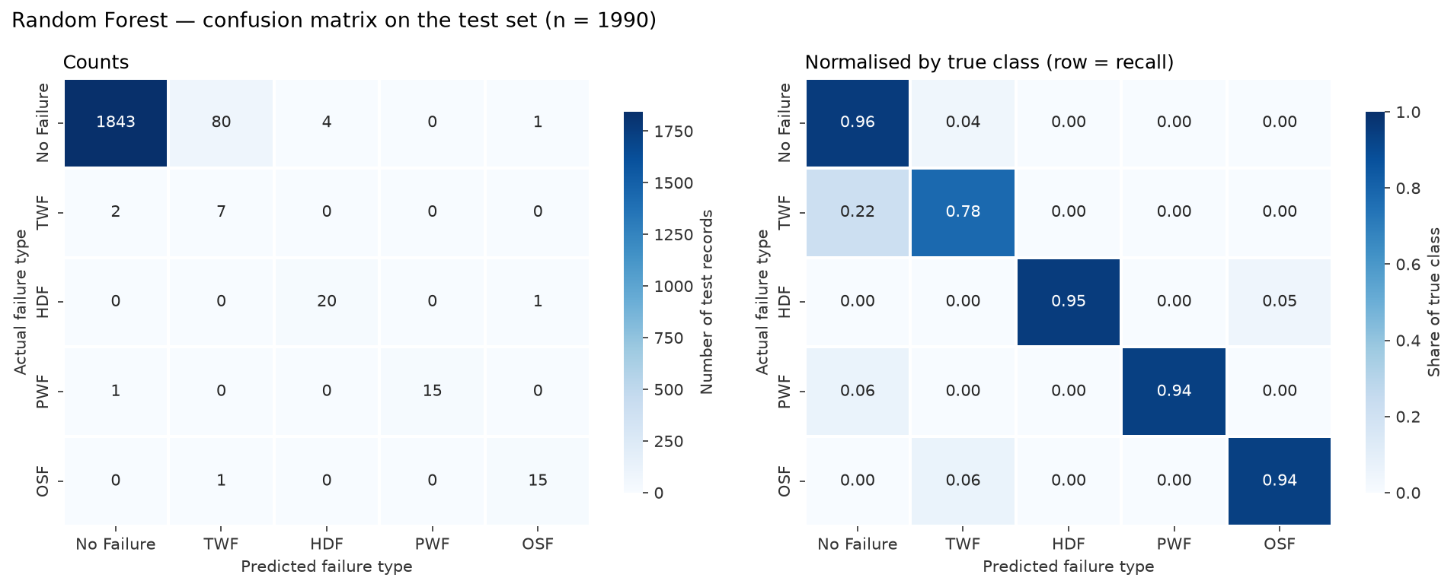
Random Forest — Bagging
RandomizedSearchCV · 30 candidates × 5 folds
0.7909
0.7773
Initial model memorised training data (train F1 1.000, CV 0.7842)
Tuned: max_depth 12, max_features 0.5, class_weight balanced
Train–CV gap cut from 0.216 to 0.025
Catches 7 / 9 TWF but raises 85 false alarms
CV Macro F1
Test Macro F1
9

Slide 10
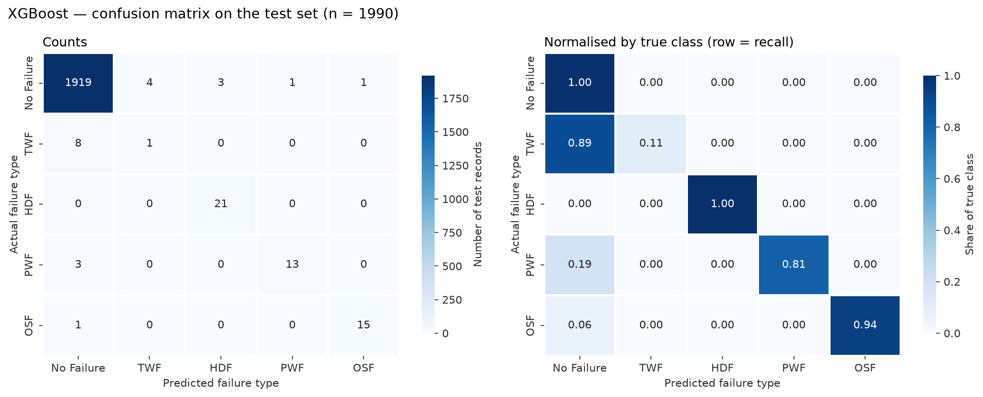
XGBoost — Boosting
objective = multi:softprob · RandomizedSearchCV · 30 candidates
0.7956
0.7750
Tuning lifted CV Macro F1 from 0.7620 to 0.7956 — highest of all
Balanced class weights via per-sample weights (custom wrapper)
Depth 4, 489 trees, learning rate 0.057
Only 9 false alarms; 12 missed failures
CV Macro F1
Test Macro F1
10

Slide 11
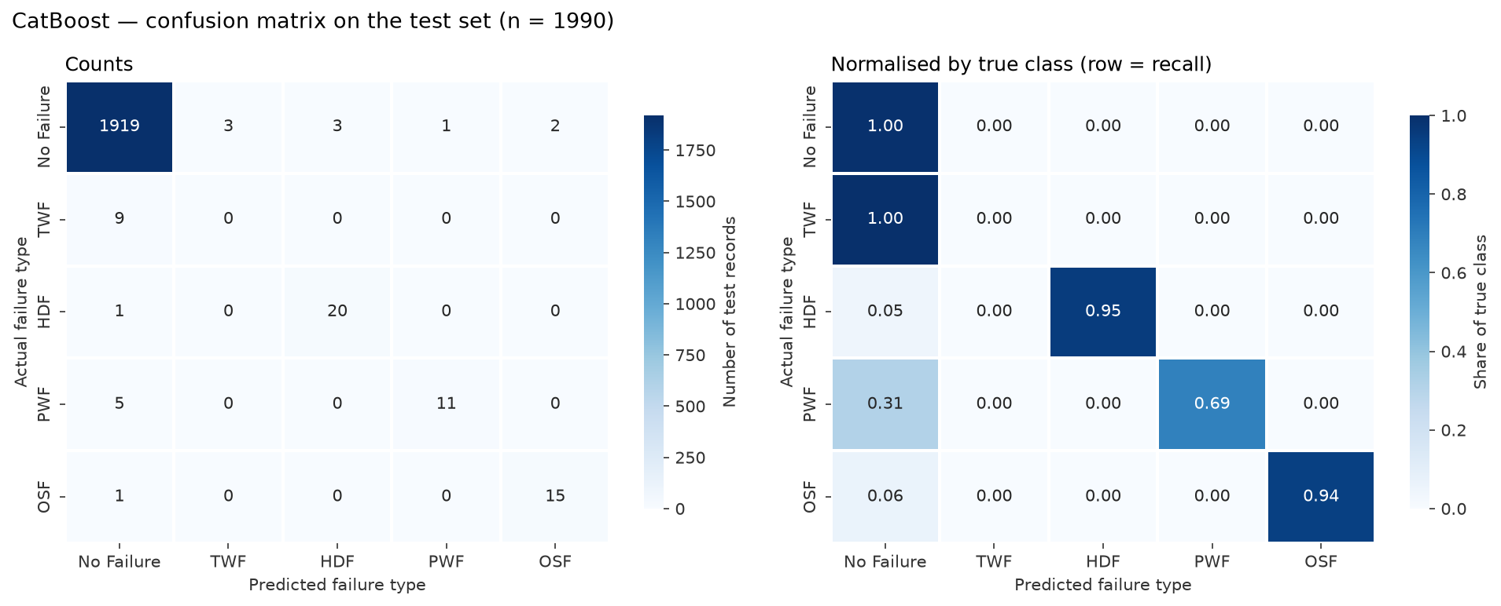
CatBoost — Advanced Boosting
Ordered boosting + symmetric trees · RandomizedSearchCV · 20 candidates
0.7766
0.7195
CV Macro F1 0.7551 → 0.7766 after tuning
Best: depth 8, MultiClassOneVsAll, SqrtBalanced weights
Weakest ensemble here — its categorical strength has little to act on (one 3-level feature)
Fixed two library quirks (None weighting, 2-D predictions)
CV Macro F1
Test Macro F1
11

Slide 12
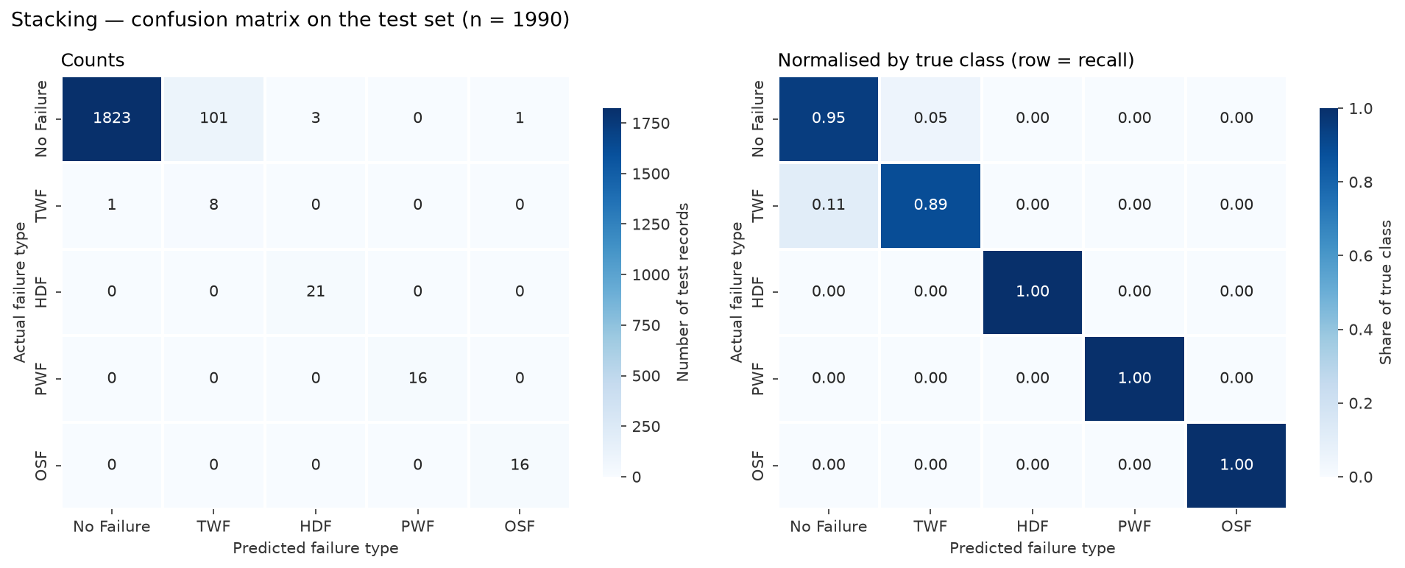
Stacking Ensemble
RF + XGBoost + CatBoost → balanced Logistic Regression on out-of-fold probabilities
0.7881
0.8021
Most stable across folds, but CV not above XGBoost
Highest test recall (0.9669) and Macro F1
Catches 8 / 9 TWF — at the cost of 105 false alarms
Shifts the precision–recall trade-off rather than dominating
CV Macro F1
Test Macro F1
12

Slide 13
Hyperparameter Tuning & Cross-Validation
StratifiedKFold(5, shuffle, 42) · scoring = f1_macro · same folds for every model
Model | Search | CV Macro F1 | Train F1 | Train − CV
Dummy | none (fixed strategy) | 0.1969 ± 0.0000 | 0.1969 | +0.0000
Logistic Regression | GridSearchCV | 0.7084 ± 0.0419 | 0.7143 | +0.0060
Random Forest | RandomizedSearchCV | 0.7909 ± 0.0129 | 0.8157 | +0.0248
XGBoost | RandomizedSearchCV | 0.7956 ± 0.0294 | 0.9936 | +0.1980
CatBoost | RandomizedSearchCV | 0.7766 ± 0.0304 | 1.0000 | +0.2234
Stacking | GridSearchCV | 0.7881 ± 0.0101 | 0.8103 | +0.0222
RandomizedSearchCV for large spaces, GridSearchCV for small final grids
Boosting fits training rows almost perfectly (train F1 ≈ 1.0) — CV is what counts
Fold std 0.01–0.03: each validation fold holds only ~7 TWF rows
Top three within ~1 std of each other
13

Slide 14
Model Comparison
Selection rule fixed in advance: highest mean CV Macro F1 → XGBoost
Final model: XGBoost
Test Macro F1 0.7750
Accuracy 0.9894
Macro ROC-AUC 0.9873
Weighted F1 0.9886
Stacking has higher test F1 (0.8021), but picking by test score would bias it
XGBoost: 9 false alarms vs 105 for Stacking
Single model: faster, simpler to explain
14

Slide 15
Confusion Matrix & Misclassification
21 errors in 1,990 test rows — failure types are never confused with each other
TWF → No Failure (8 / 9): only 4.8% of rows at TWF-level tool wear are TWF — nothing separates them
PWF misses: 9,010–9,014 W, inside the 8,990–9,020 W gap with no training examples
OSF / HDF errors: records next to a class threshold; only 3 M-type OSF rows to learn from
Class imbalance + overlapping features, not label noise
 | False alarms | Missed | TWF caught
XGBoost | 9 | 12 | 1 / 9
Random Forest | 85 | 3 | 7 / 9
Stacking | 105 | 1 | 8 / 9
15

Slide 16
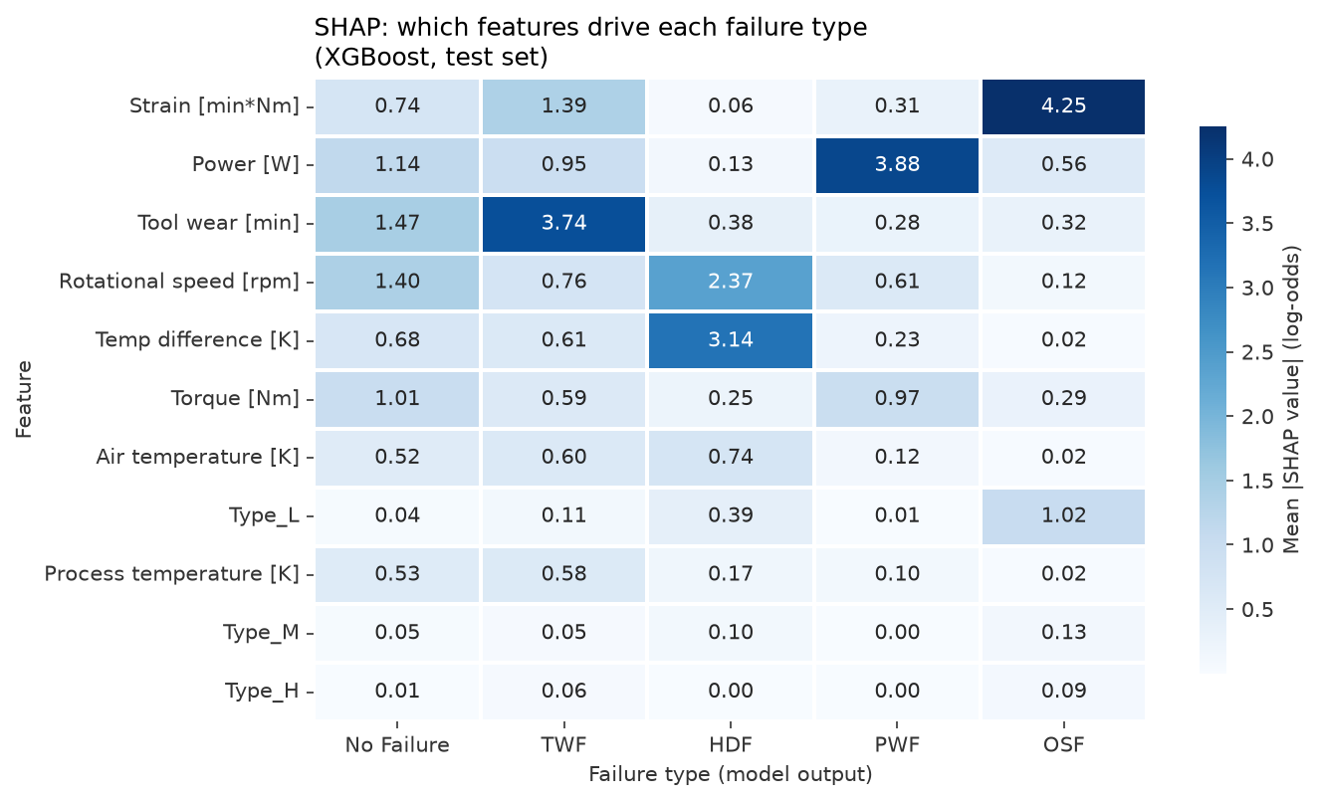
Feature Importance & SHAP
Each failure mode is driven by its physically expected quantity
OSF
Strain (tool wear × torque)
PWF
Power
HDF
Temp difference + rpm
TWF
Tool wear
Permutation (raw inputs): torque 0.376, rpm 0.342, tool wear 0.217
Engineered features rank in the model's top 5
Importance ≠ causation
16

Slide 17
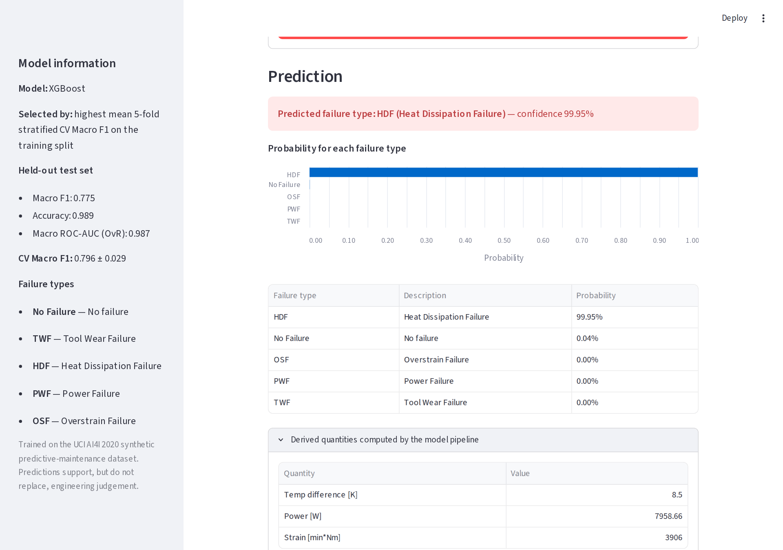
Streamlit Deployment
One saved pipeline: feature engineering → preprocessing → XGBoost
Loads models/final_model.joblib — no preprocessing re-implemented
Validates inputs: missing, non-numeric, implausible, process ≤ air temperature
Warns when inputs leave the training range
Shows predicted type, confidence and all class probabilities
36 automated tests incl. a headless run of the app — all passing
Screenshot: a real HDF record from the test set
17

Slide 18
Conclusion & Future Scope
0.775
0.989
0.933
21
test Macro F1
test accuracy
Macro F1 without TWF
errors / 1,990
What we learned
Future scope
HDF, OSF, PWF predicted reliably; decisions match the physics
TWF is not predictable from these inputs
Best models differ in false alarms vs missed failures, not in a clear winner
Cost-sensitive thresholds from real failure costs
Multi-label model for simultaneous failure modes
Real shop-floor data and time-series features
Calibration and drift monitoring in production
18

