Slide 1

Java Full Stack Internship
A Project Presentation on
Bike Rental System
Under the guidance of
Archana
Software Engineer
DLithe
Presented by,
Sahan Santhosh Shetty-309CS21033
Srivathsa -309CS21045
Samrudh -309CS21034
Vignesh Prasad -309CS21050

Slide 2
Contents
Introduction
Problem statement
Objectives
Methodology
Implementation
Results and analysis
Conclusion
References

Slide 3
Introduction
In today's bustling urban landscapes, finding efficient and convenient transportation solutions is essential. Introducing the Bike Rental System a game-changing platform simplifying the process of renting Bikes for various city journey. With the Bike Rental System, users can effortlessly book Bike for rent, whether it's for daily commutes, quick errands. This system offers a seamless solution that promotes eco-friendly transportation and enhances mobility within City.

Slide 4
Problem Statement
In urban environments, traditional transportation options contribute to traffic congestion, limited parking availability, and environmental pollution. Additionally, existing transit systems often fail to provide efficient last-mile connectivity. These challenges underscore the need for a bike rental system to offer accessible, convenient, and eco-friendly transportation alternatives for urban dwellers.

Slide 5
Objectives
Provide a user-friendly platform for renting bikes.
Offer a wide selection of well-maintained bikes catering to diverse preferences and needs of users.
Encourage sustainable transportation choices by promoting the use of bikes as efficient alternatives to cars in urban areas.
Ensure flexibility in rental options, including various rental durations and convenient pickup/drop-off locations across the city.

Slide 6
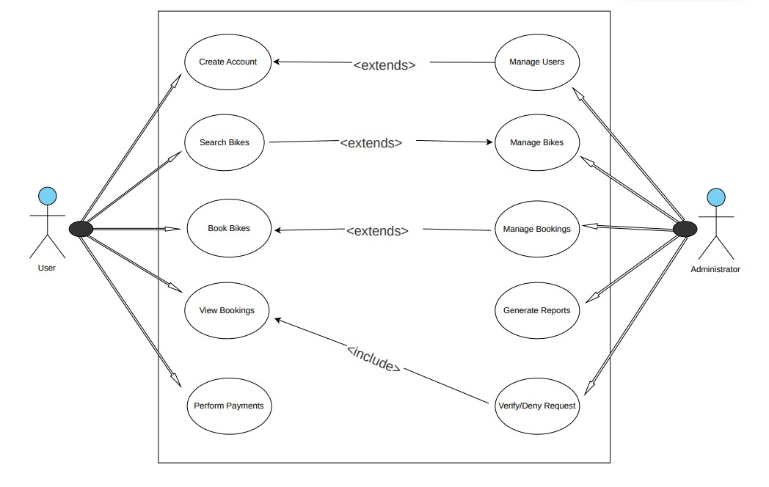
UseCase Diagram
Block diagram of data transmission using li-fi

Slide 7
Implementation
Requirement Gathering and Analysis: Understanding the specific needs and goals of the bike rental system. Gathering requirements from users, administrators, and other relevant parties.
Frontend Development: Developing user interfaces for the web applications, Ensuring that the interfaces are responsive, and accessible
Backend Development: Implementing the backend services and business logic to support the functionality of the system.

Slide 8
Database Design: Designing the database using mysql to store information about users , bikes, and bookings etc.
Integration and Testing: Integrating the frontend and backend components of the system and perform thorough testing to ensure that all features work as expected.

Slide 9
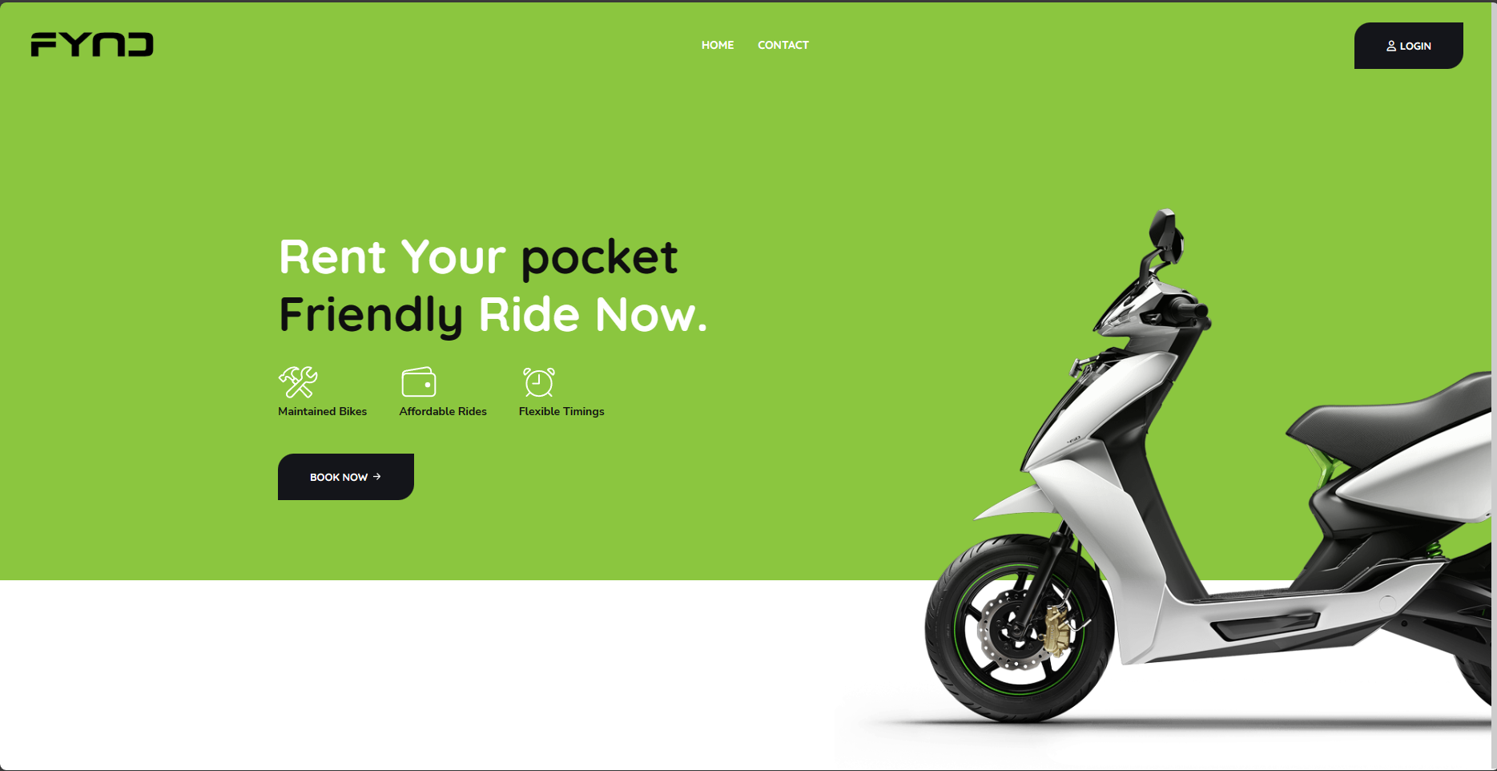
RESULTS AND ANALYSIS User Module
Figure 1

Slide 10
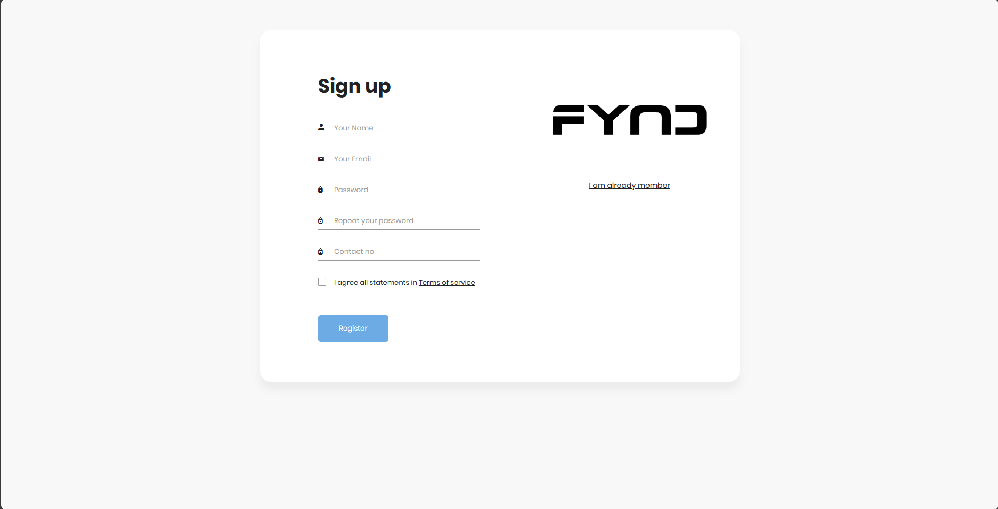
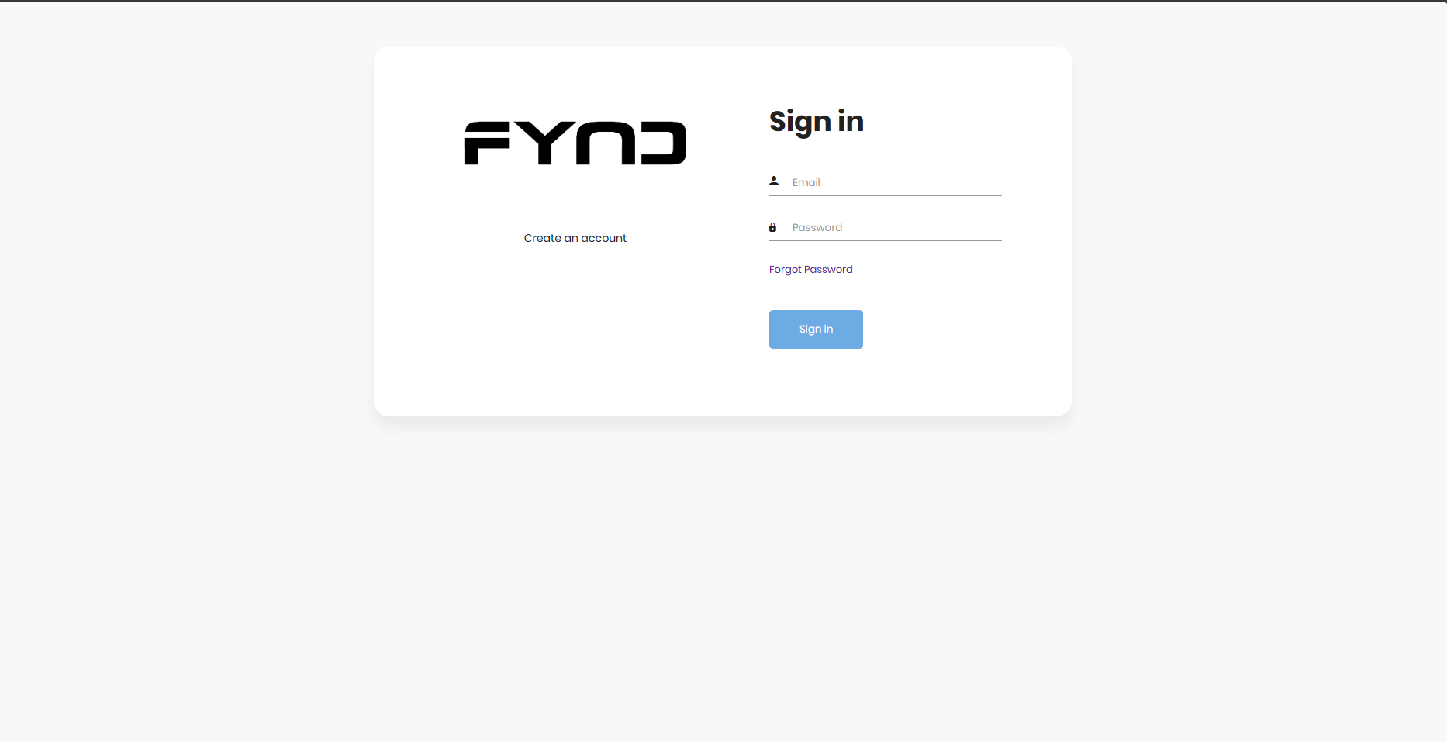
Figure-3
Figure-2

Slide 11
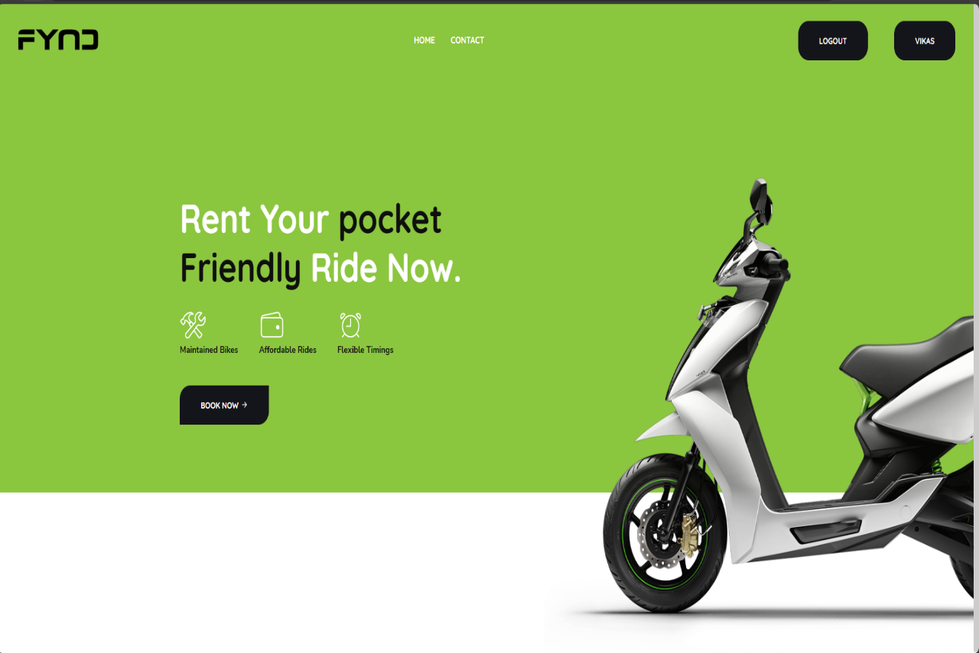
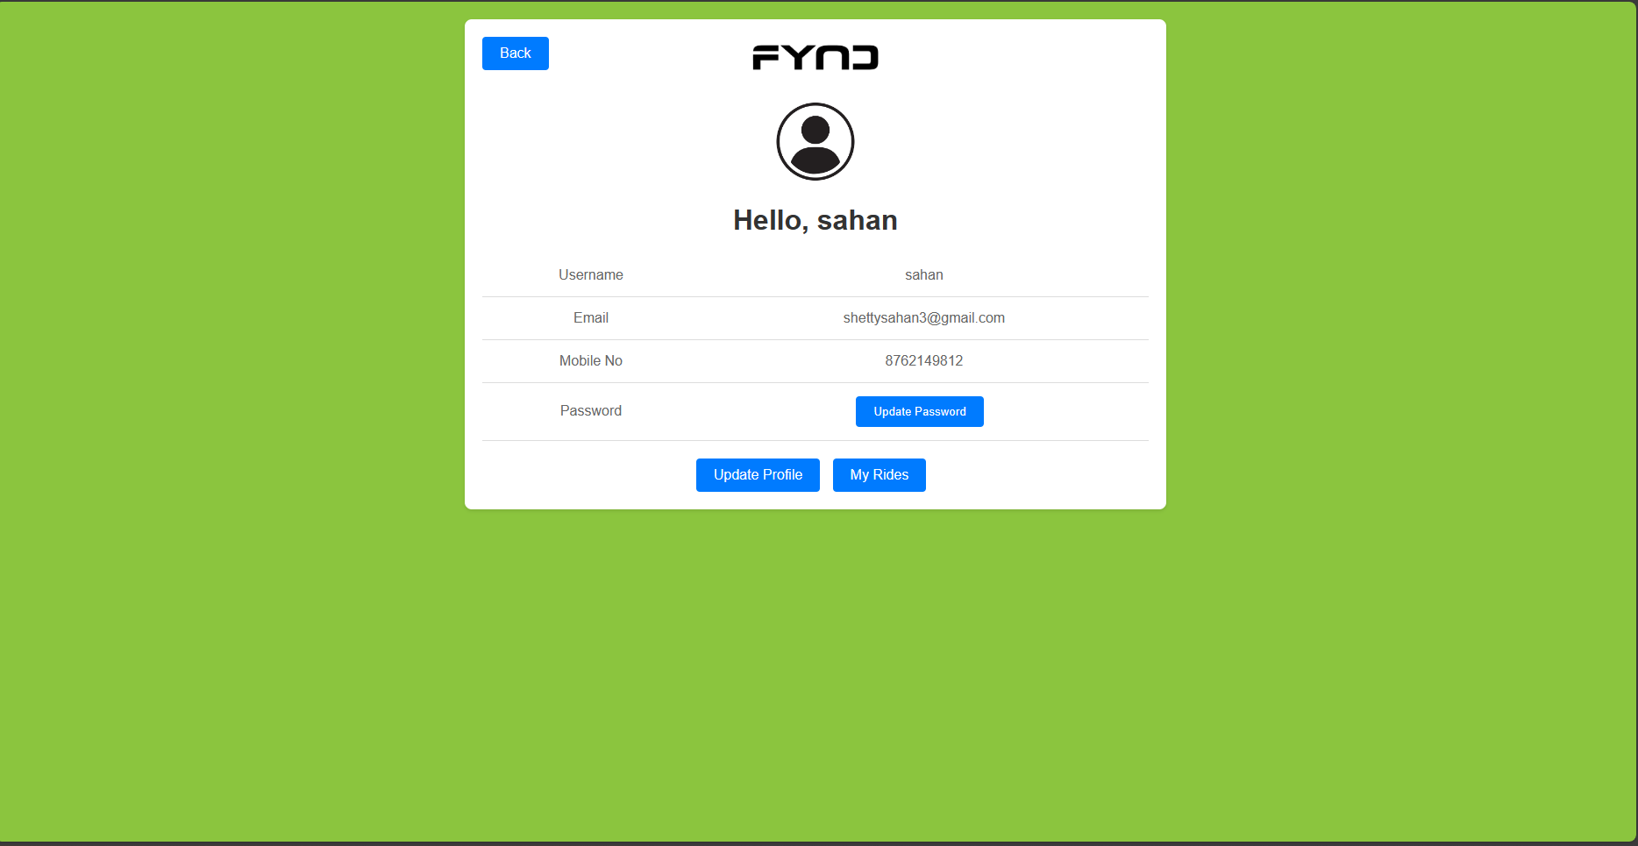
Figure-4
Figure-5

Slide 12
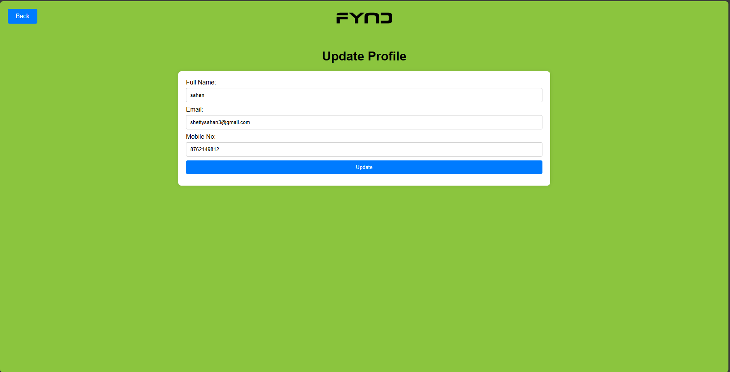
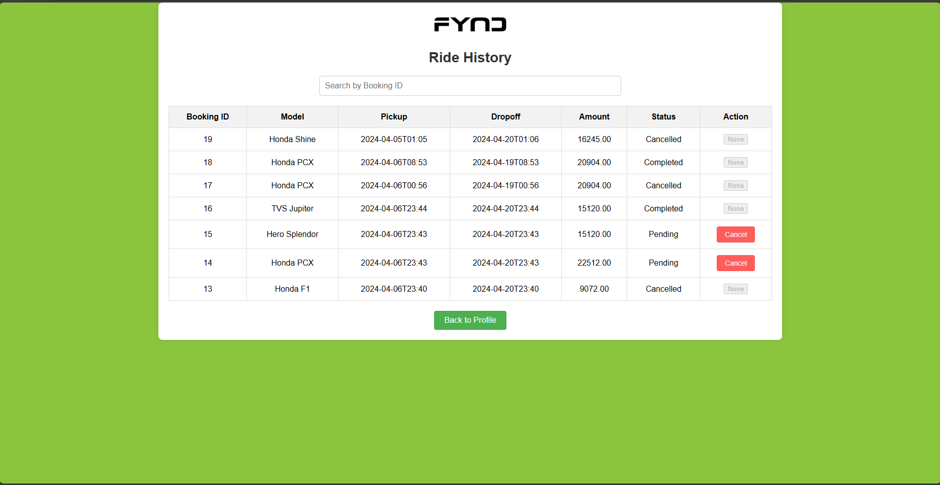
Figure-6
Figure-7

Slide 13
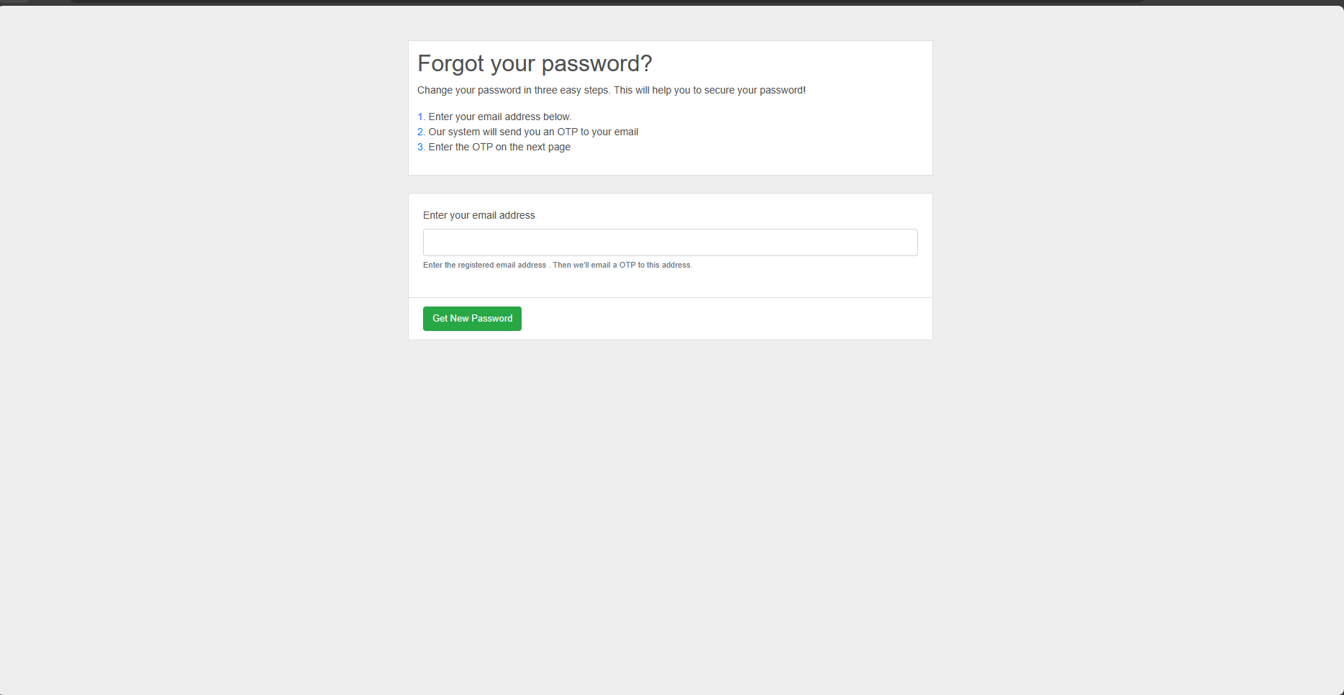
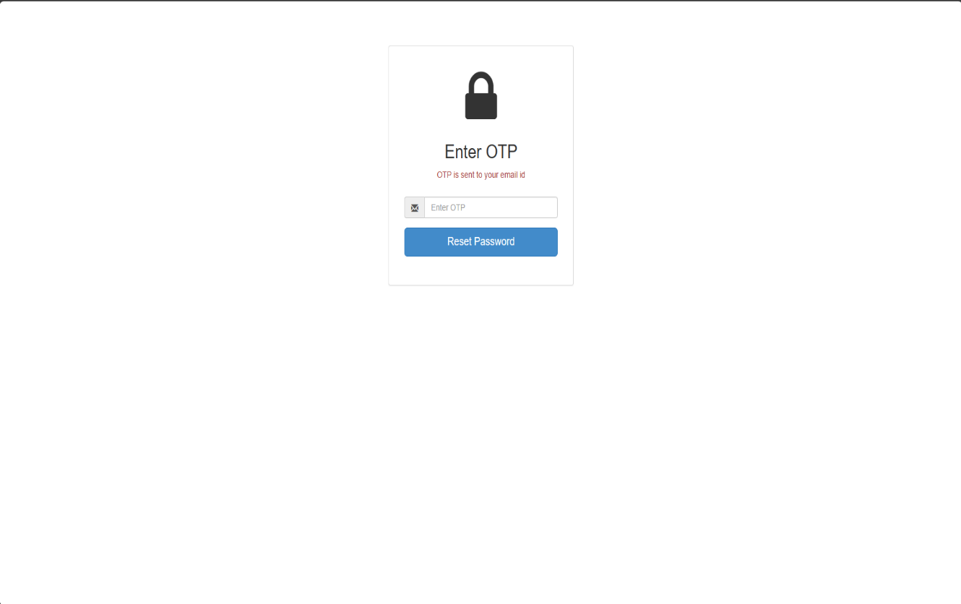
Figure-8
Figure-9

Slide 14
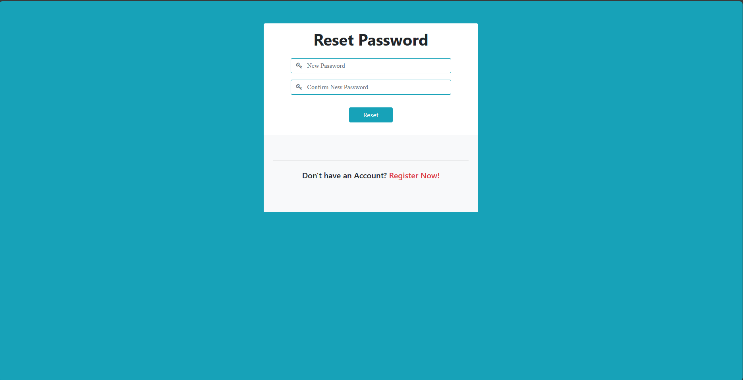
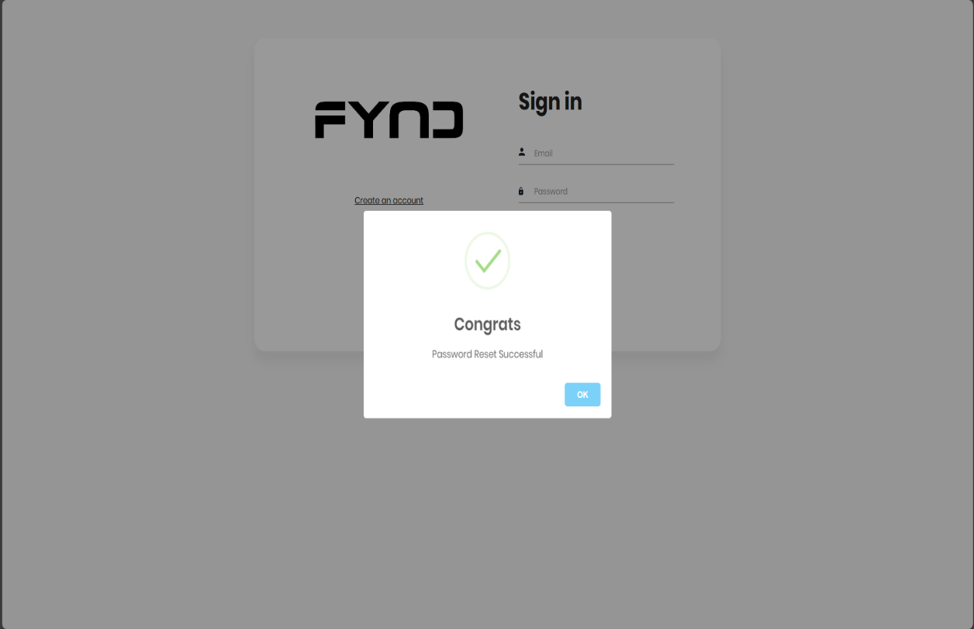
Figure-10
Figure-11

Slide 15
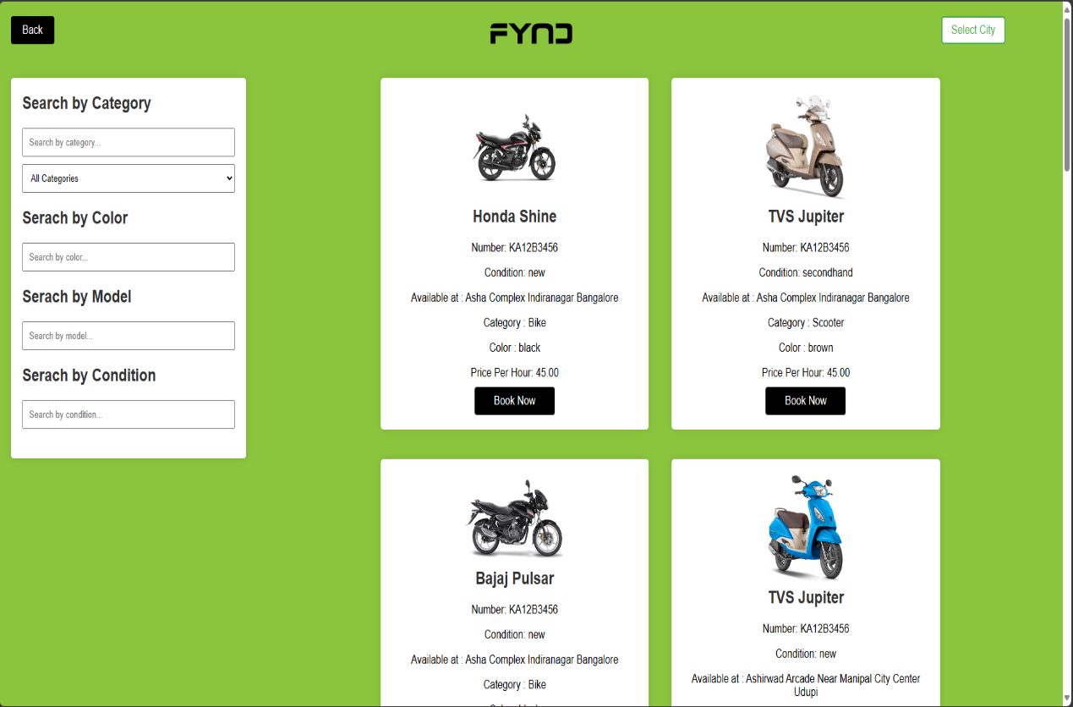
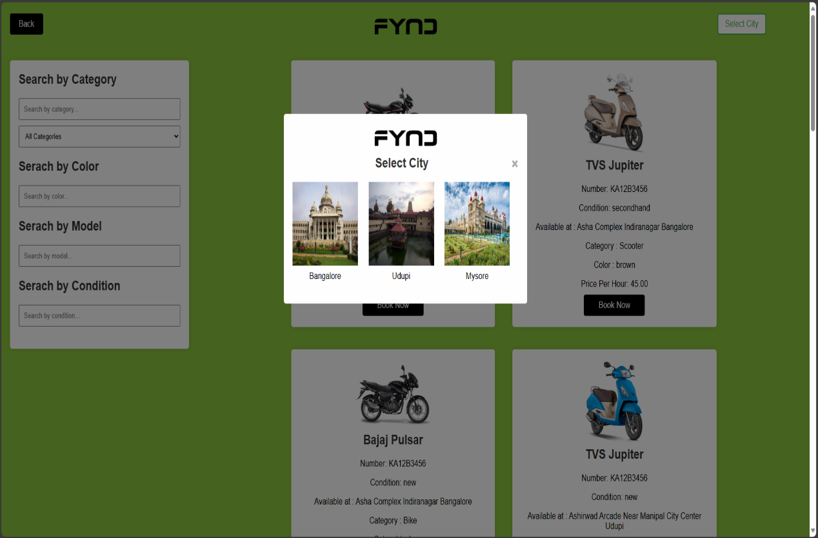
Figure-12
Figure-13

Slide 16
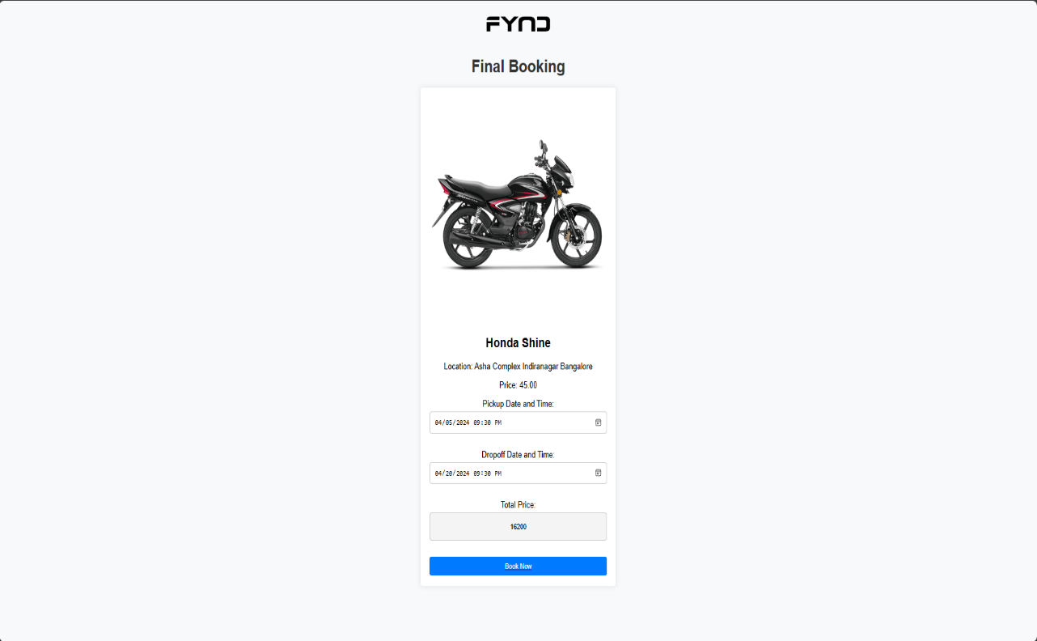
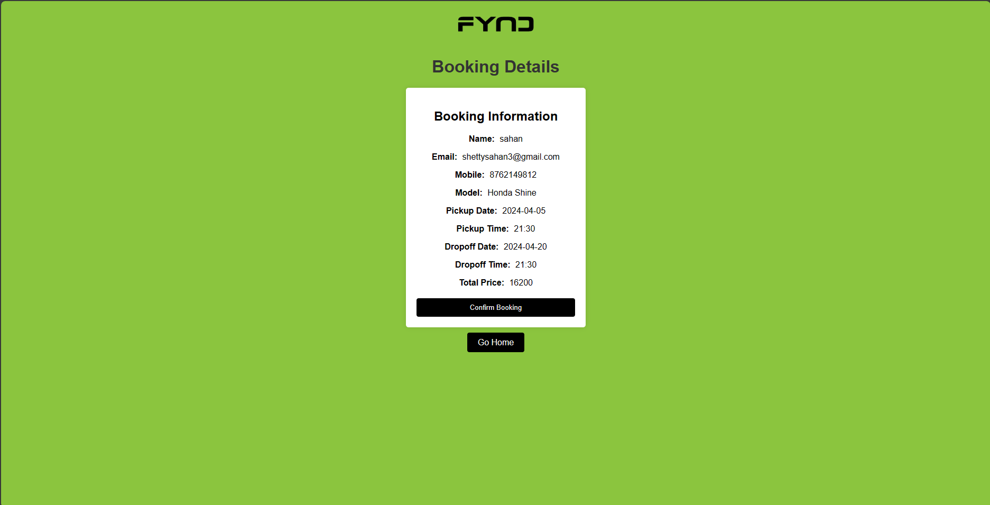
Figure-14
Figure-15

Slide 17
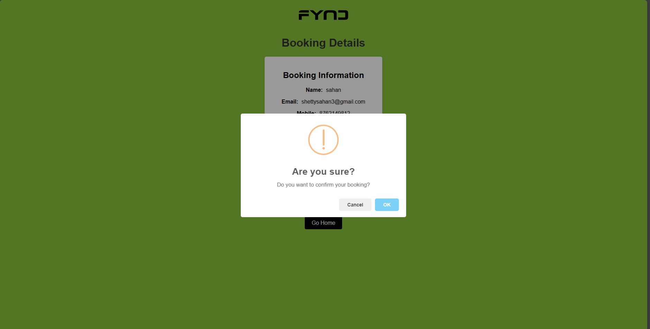
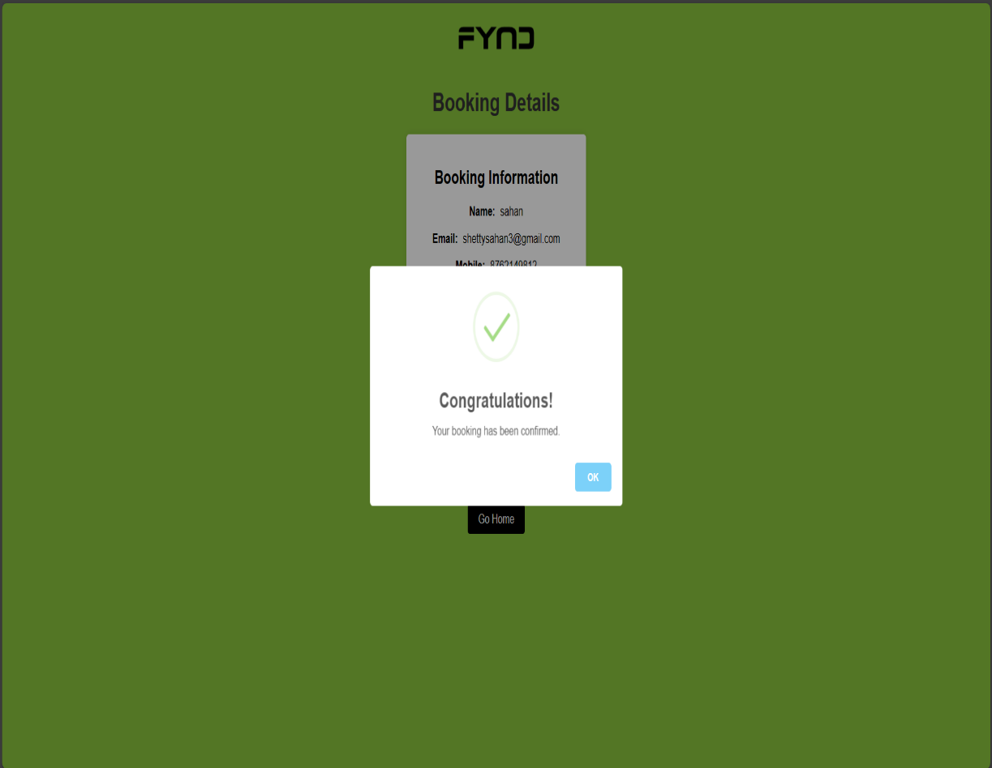
Figure-16
Figure-17

Slide 18
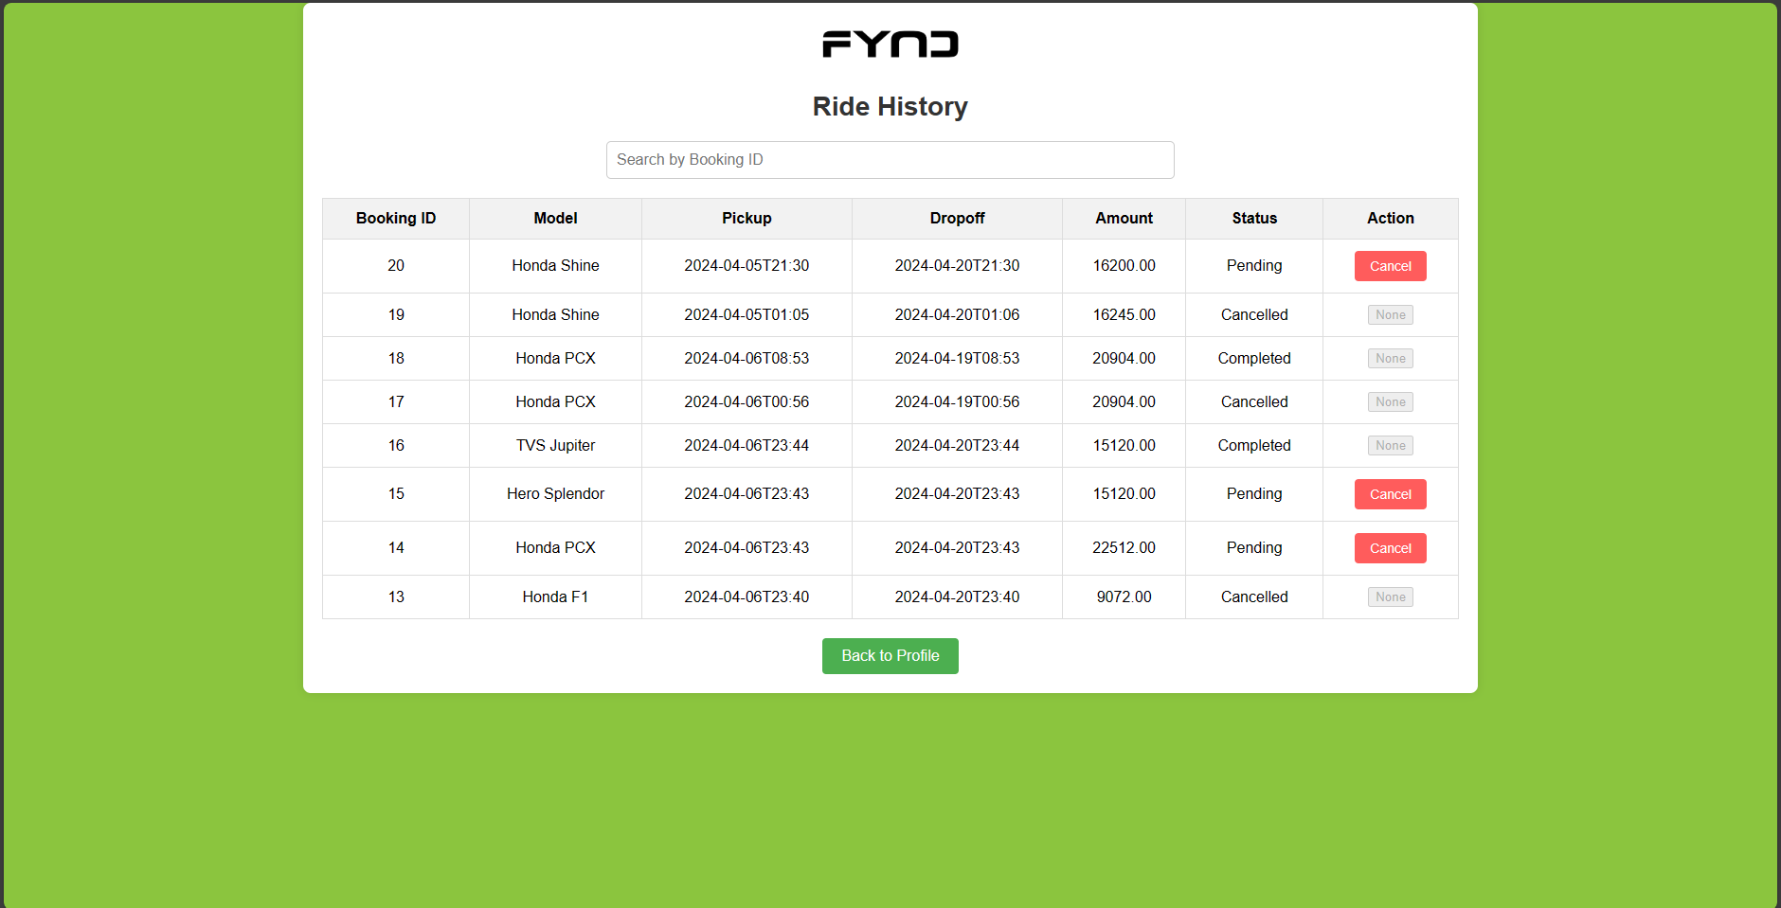
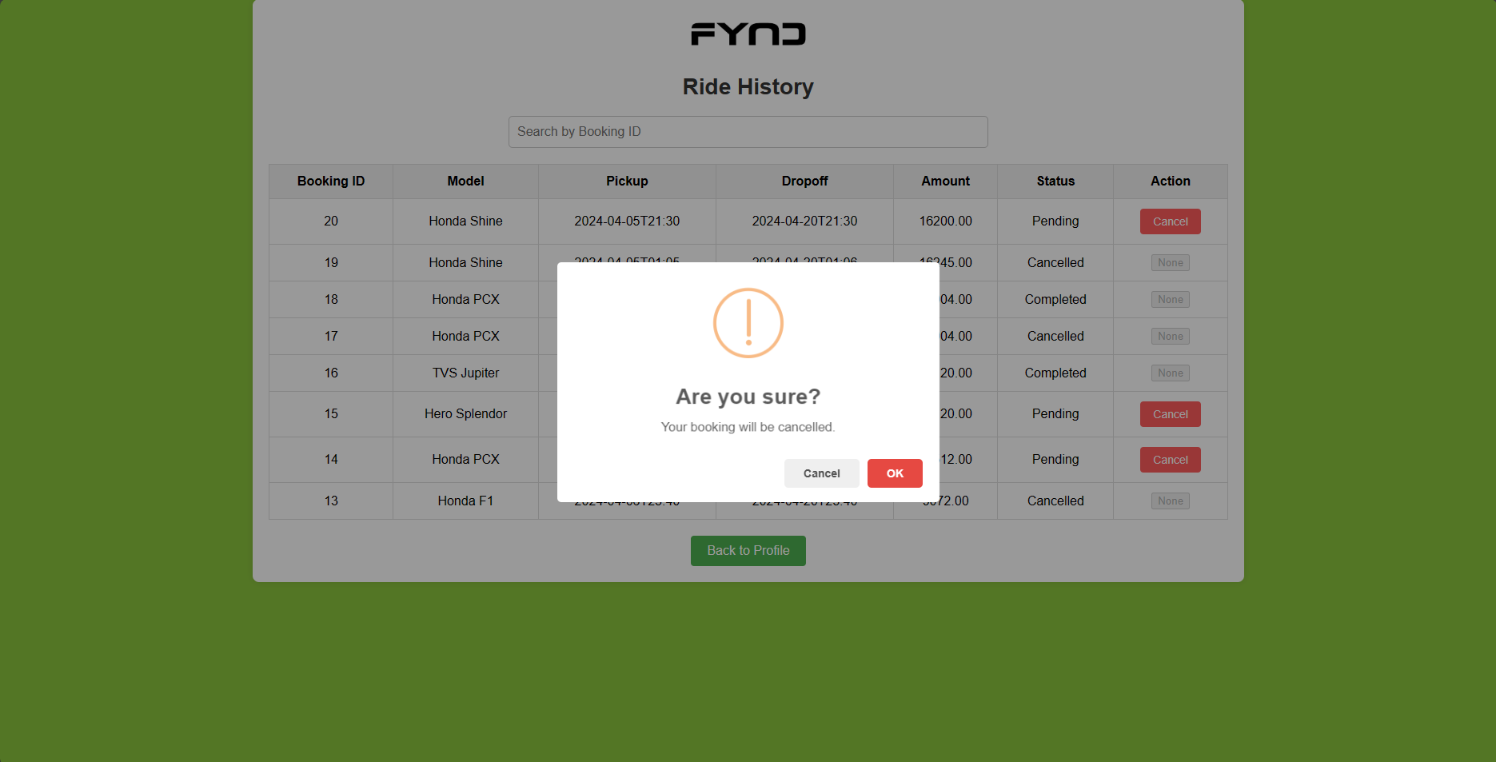
Figure-18
Figure-19

Slide 19
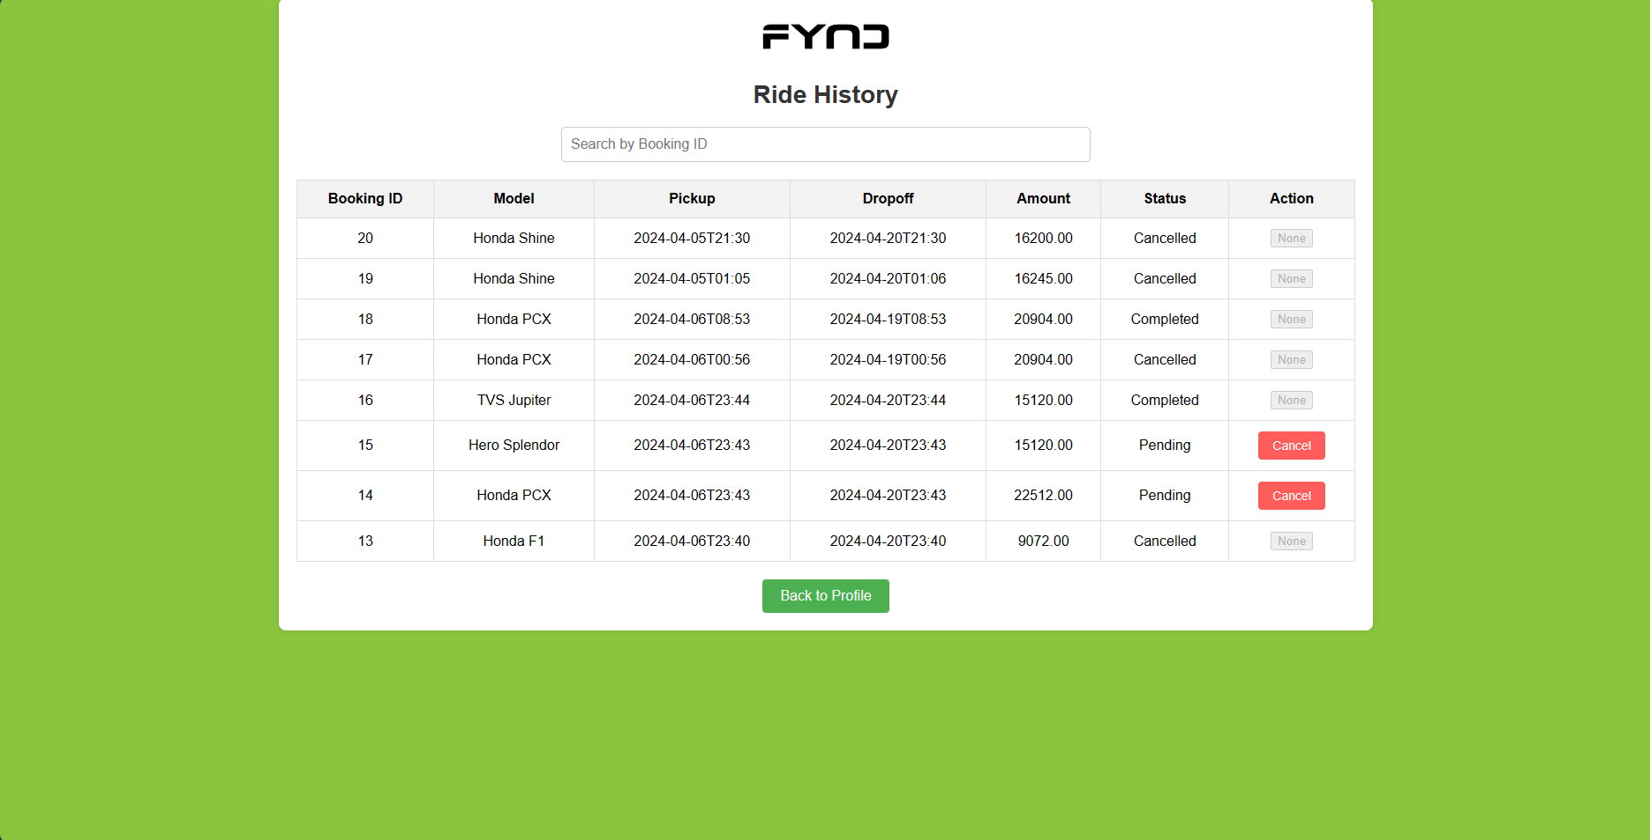
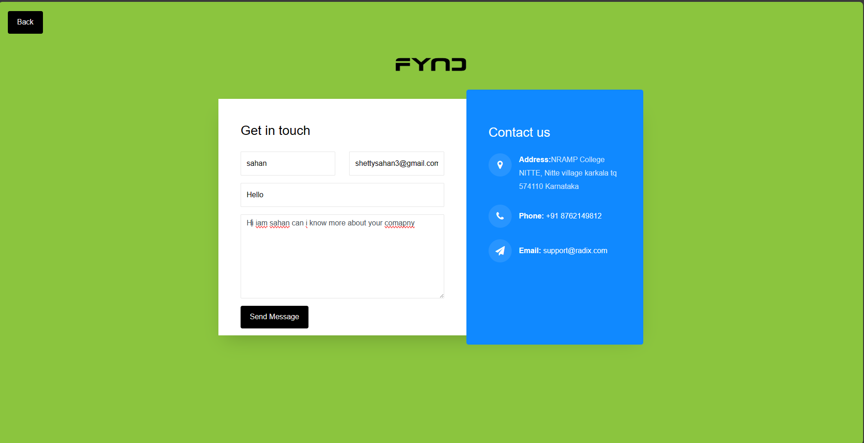
Figure-20
Figure-21

Slide 20
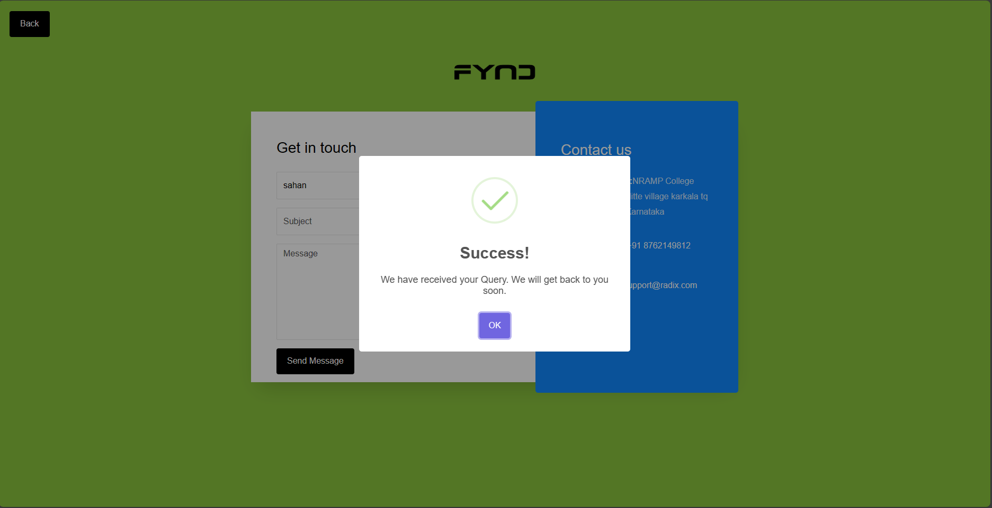
Figure-22

Slide 21

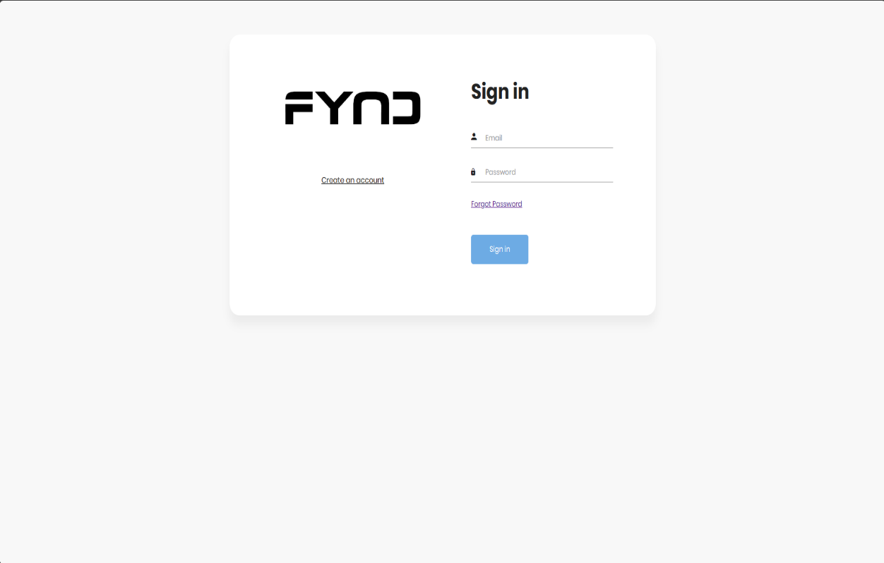
Admin Module
Figure-23
Figure-24

Slide 22
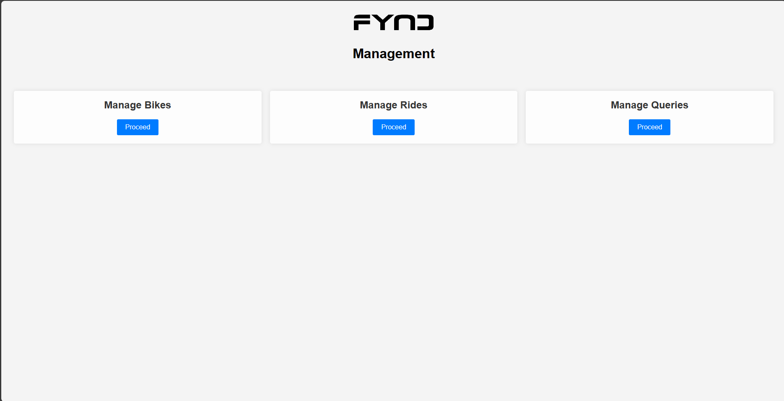
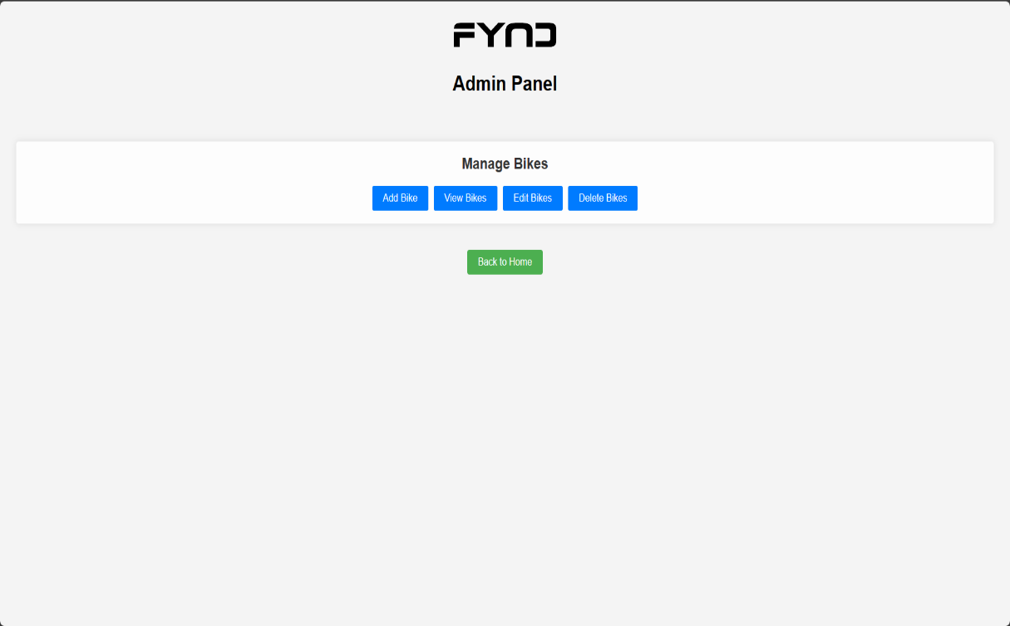
Figure-25
Figure-26

Slide 23
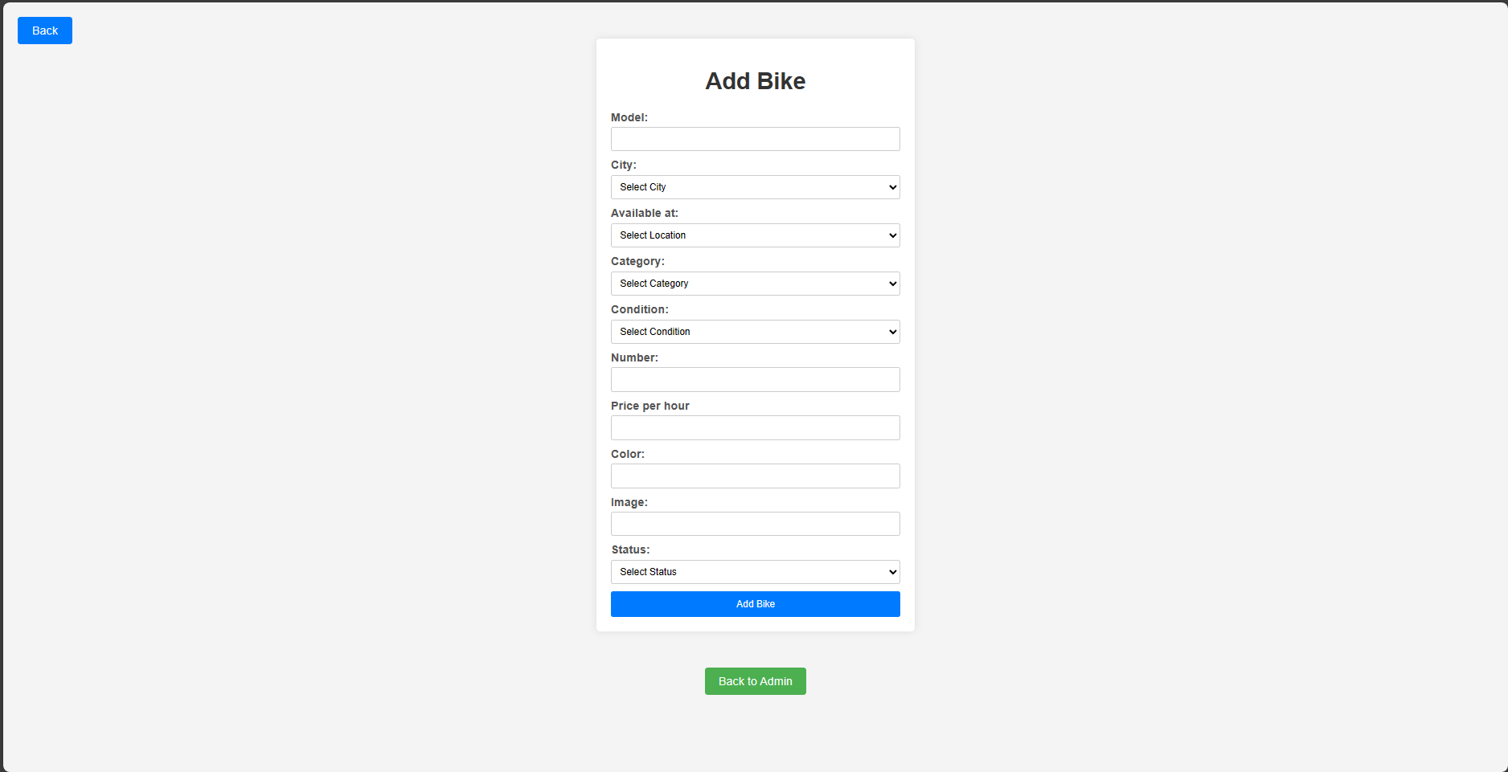
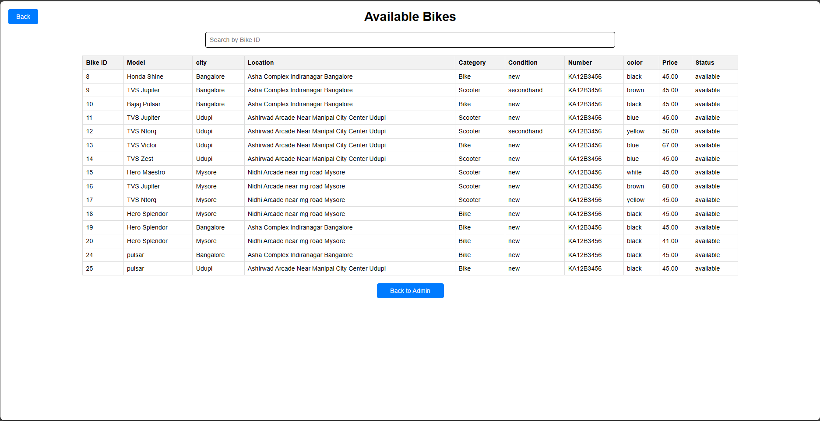
Figure-27
Figure-28

Slide 24
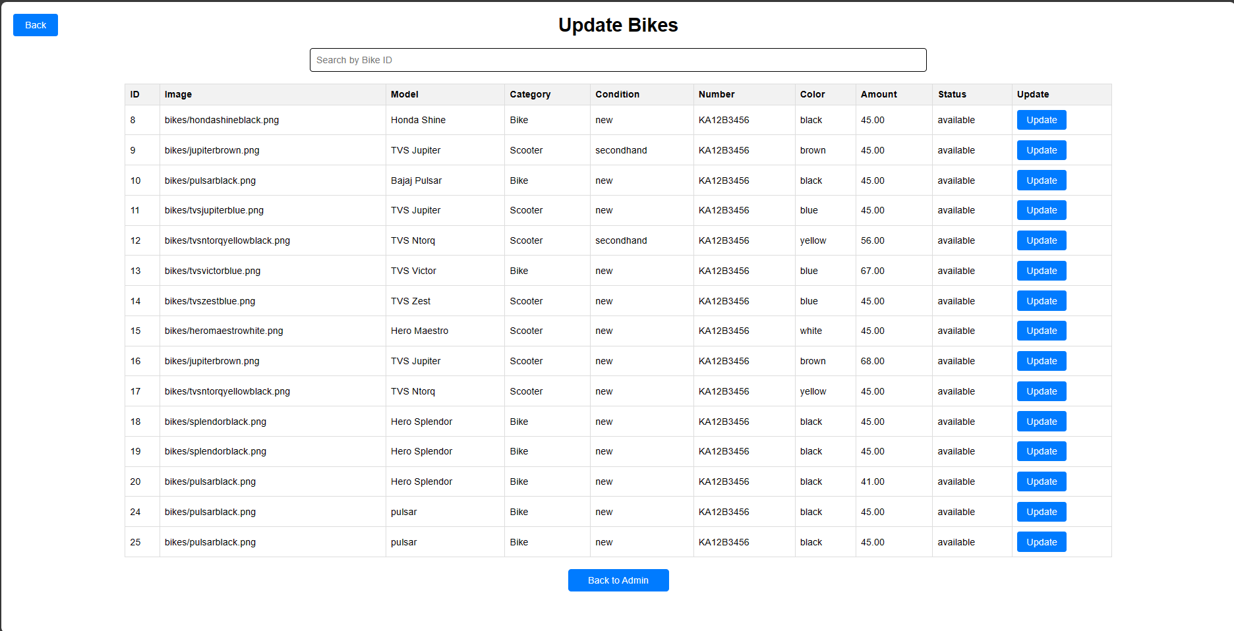
Figure-29
Figure-30

Slide 25
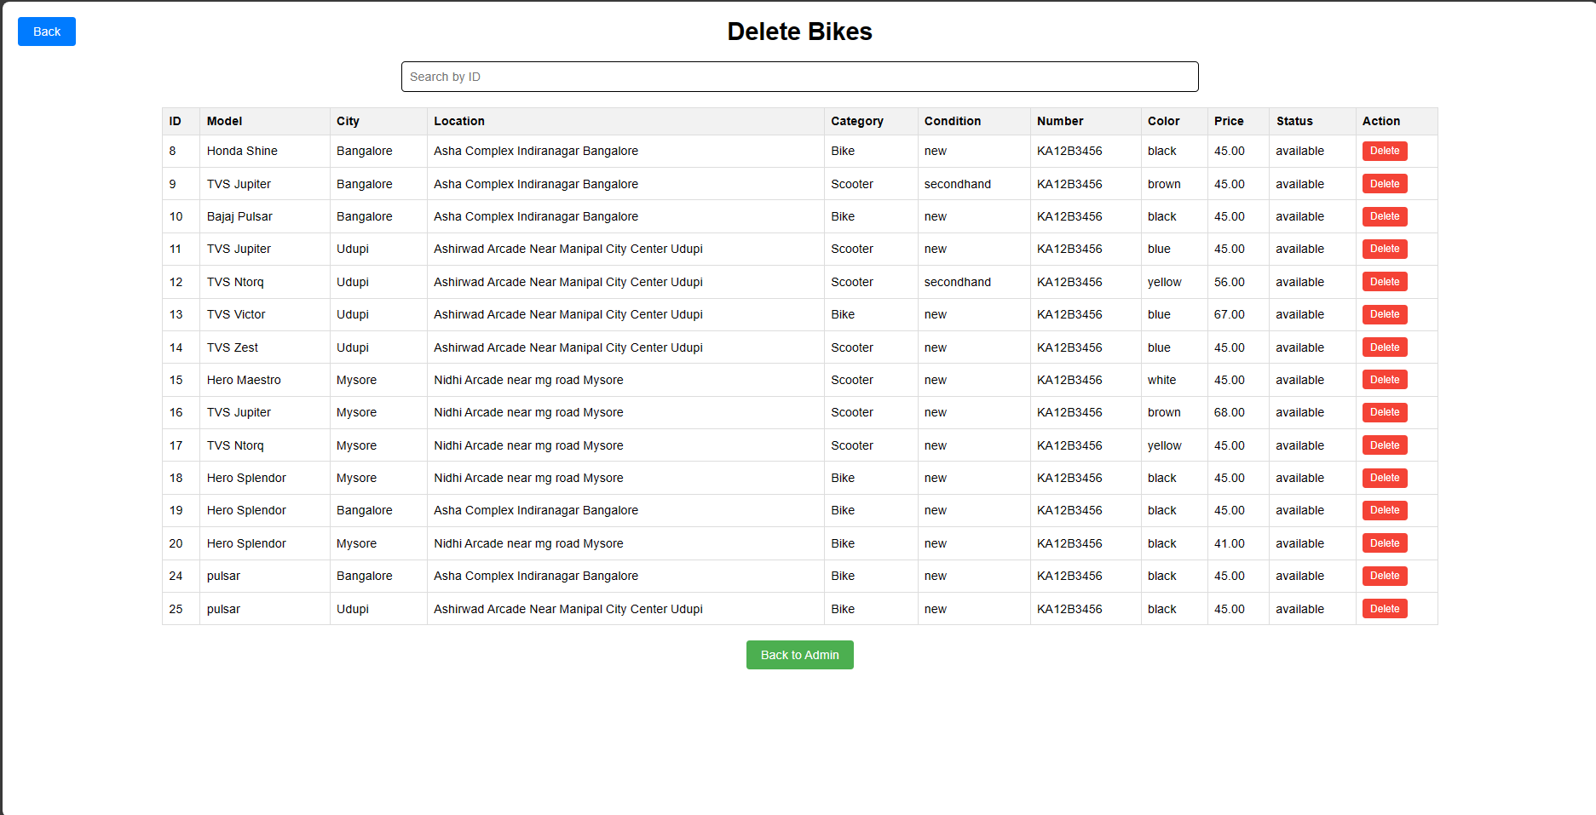
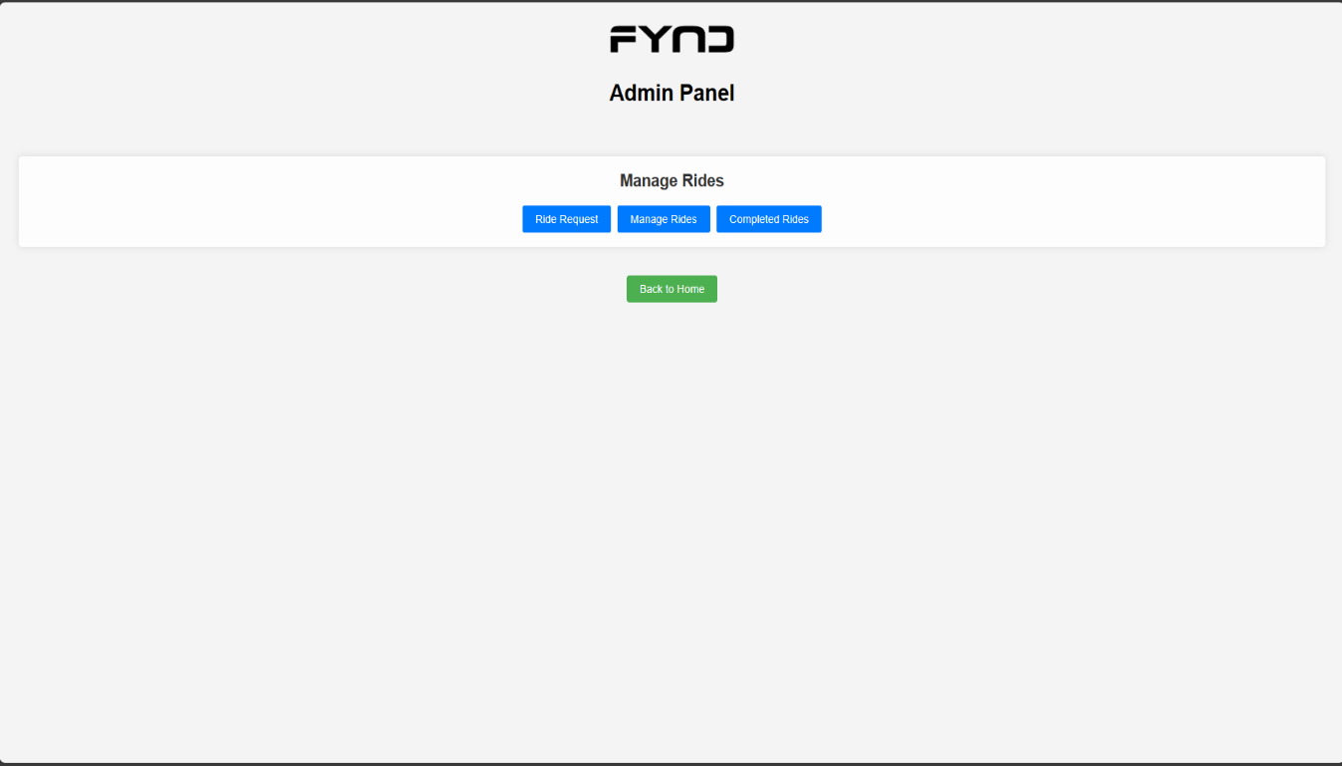
Figure-31
Figure-32

Slide 26
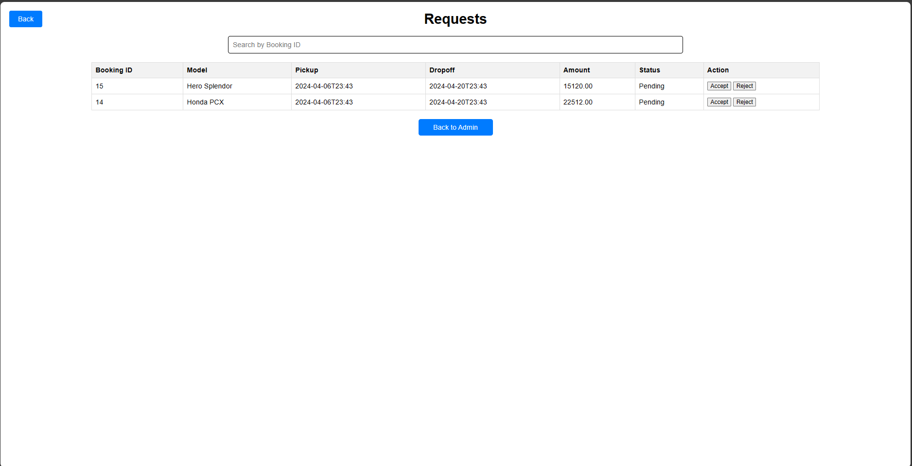
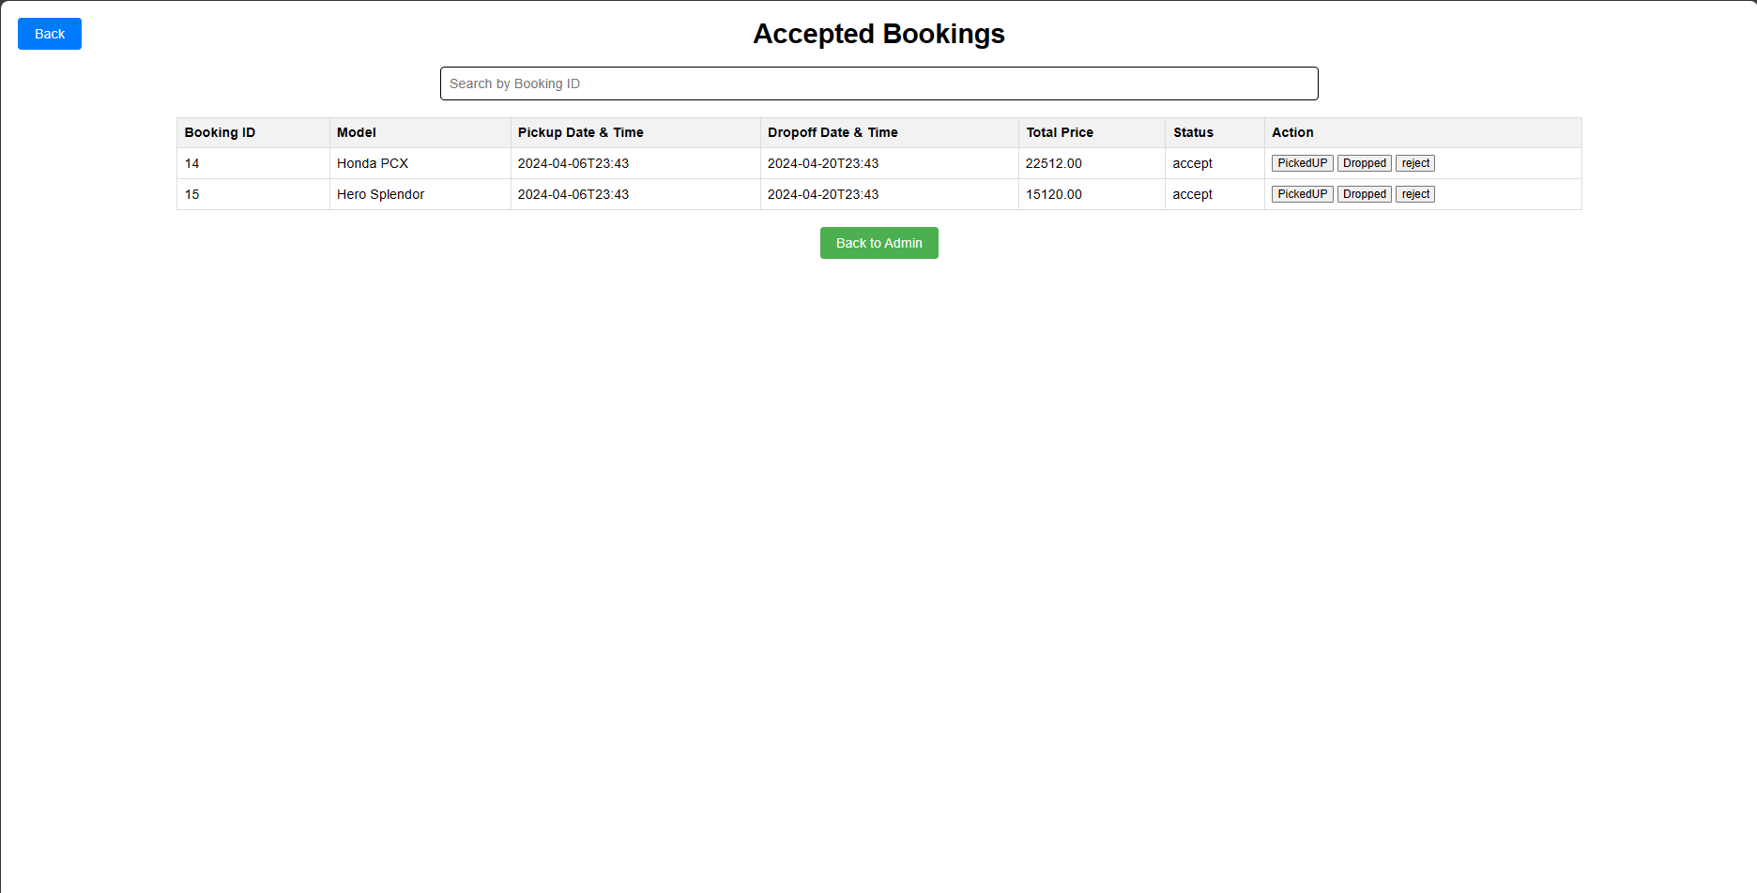
Figure-33
Figure-34

Slide 27
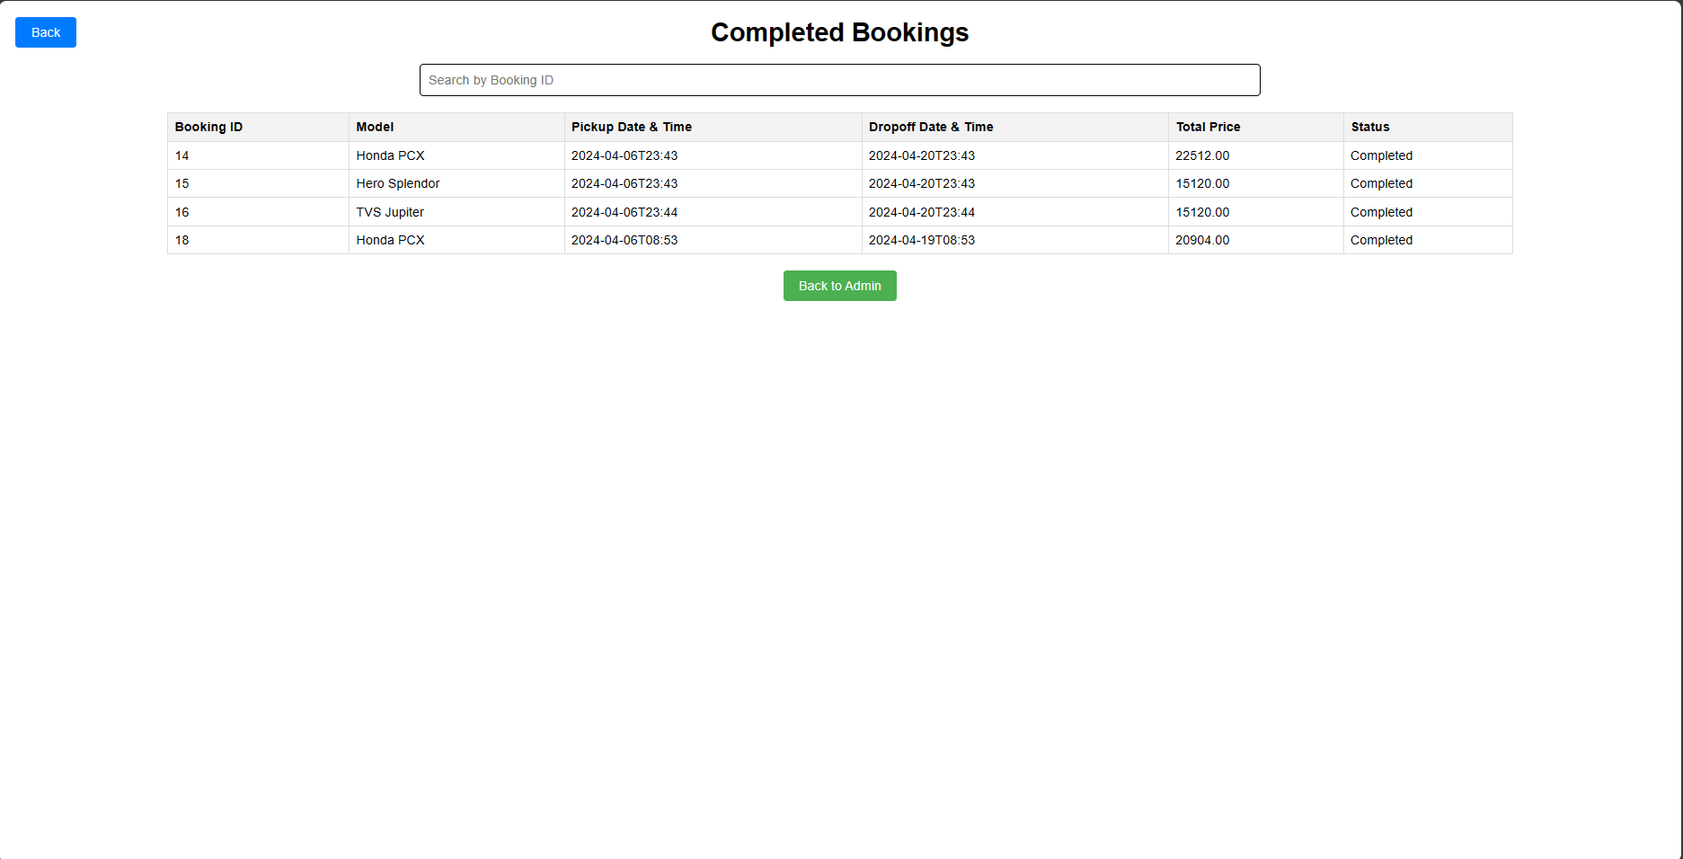
Figure-35

Slide 28
Bike Rental System is based on the concept for booking the Bike for rent. This application consists 2 categories: Admin and customer section.
Admin Section: The Admin login to the system using login credentials. Add the Bike details (Bike name, colour, plate number, Price per day and location). And approve the customer request to rent a Bike. And performs CRUD operation.
Customer section: The user has to register first. Here one can book a Bike by selecting the location and pickup date and time, dropoff date and time Based on Rental days the amount will be calculated. Book a Bike by clicking on book now button and wait for the approval. After booking the system will generate a unique ID and status of the booking can be viewed by Booking ID.

Slide 29
Conclusion
In this project, we have successfully developed and implemented a Bike Rental System, providing users with a convenient and sustainable solution for urban mobility. The system offers a user-friendly platform for booking bikes, catering to diverse needs such as daily commuting, and exploring the city.
Throughout the development process, we have prioritized accessibility, flexibility, and safety. Users can easily access a diverse

Slide 30
fleet of well-maintained bikes, choose from flexible rental options, and enjoy convenient pickup and drop-off locations.
In conclusion, our Bike Rental System represents a paradigm shift in urban transportation, our dedication to sustainability, innovation, and user-centric design. By continuing to iterate, refine, and expand our offerings.

Slide 31
References
In developing our Bike Rental System, we referenced various resources, including studies published on platforms such as YouTube, Google, and other online platform. Insights from these sources informed our approach to implementing innovative features, optimizing system efficiency. our system was influenced by research findings available on platforms like YouTube, where experts emphasized the importance of enhancing user experience in similar projects.

Slide 32
THANK YOU

