Slide 1
Challenge: Customer Service Bank of Baroda Hackathon 2024
Your Team Name : WeBuild
Your team bio :
Samrudhi Shete (BTECH –PASSED 2024 BATCH – PLACED AT CAPGEMINI ),
Saurabh Kumar (BTECH –PASSED 2024 BATCH – PLACED AT Tata Technology),
Date : 30 June 2024

Slide 2
Problem Statement
Customer Service: To enhance the customer service experience by leveraging generative AI technologies to provide personalized, efficient, and proactive support across multiple channels.
Why did we decided to solve this Problem statement?
Massive Impact: Generative AI technologies will make it possible for us to, simultaneously, try and address the customer service needs of hundreds of millions of people with a view to changing how customer support across the globe is given.
Current Limitations of Existing Solutions: Existing customer service solutions are often inadequate, offering limited interactivity and failing to meet the dynamic needs of users. With our approach, this constraints can be overcome thereby providing a more complete and sensitive support system.
Personalization: Generative AI can offer individual responses that suits each customer’s need which will, in turn improve customer experience and satisfaction.
Proactive Support: Generative AI can predict the behavior of customers based on data analysis unlike focusing on issues after they have already occurred.
Scalability: When compared to human agents, artificial intelligence can answer almost an unlimited number of inquiries at once irrespective of how numerous requests are made ensuring uninterrupted and dependable service levels any time.

Slide 3
Existing Model
The existing chat support model of Bank of Baroda has many limitations we addressed through our research:
Lack of Real-Time Chat Support: Existing model has no instant assistance for customer queries, leading to delayed resolutions and the absence of real-time interaction reduces customer satisfaction and engagement.
Inadequate FAQ System: It provides generic responses that fail to address individual customer needs. Users must sift through a list of questions, making it difficult and time-consuming to find specific answers.
Lack of Personalization: Utilizes basic AI or rule-based systems that cannot offer tailored responses and customers receive standard replies that do not consider their unique profiles or previous interactions.
Customer Experience: Customers experience frustration due to the time-consuming keyword-based search for FAQs.
Scalability Issues: Struggles to manage and respond to a large number of inquiries efficiently.

Slide 4
Our Solution
Introducing BoBAssist – a automated chatbot with personalized assistance in real-time , an advanced AI solution designed to elevate customer service through automation, personalization, and continuous improvement.
An automated customer chat support which will provide instant real-time communication addressing customers intent, sentiment, entity by utilizing NLP models to train the chat support and integrating framework to design the chatbot frontend.
Customers will receive personalized assistance on their queries that are tailored to their logged-in profiles. By seamlessly integrating with customer accounts, the system enhances navigation, providing a more intuitive and customized user experience.
A one-click query suggestions will be available to everyone based on FAQs and frequent queries receives by bank employee from their customer, it will result in quickly resolving numbers of queries in real-time instantly.
A Personalized recommendations will be provided to user on their bank account considering the various parameters like as account activity, saving goals, investment, demographic, credit usage etc.
A feedback management system to collects and integrates customer feedback, leveraging user input to continuously improve its services. This iterative process ensures that customer needs and preferences are promptly addressed, fostering a responsive and customer-centric support environment.

Slide 5
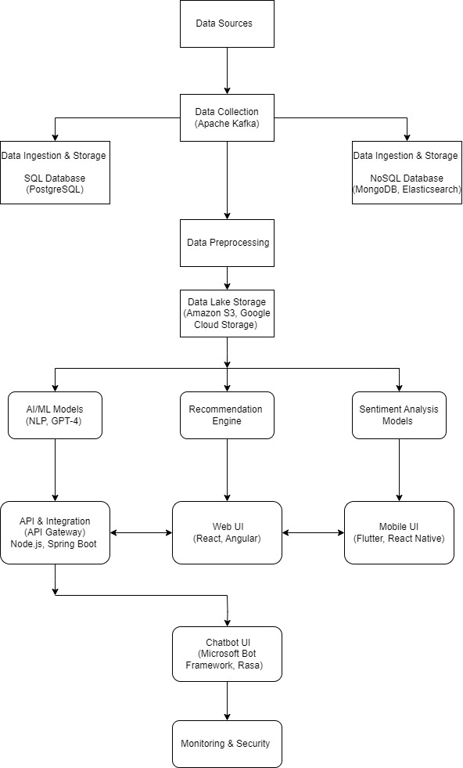
Methodology
This architectural diagram depicts the methodology for BobAssist, highlighting the necessary steps which will be considered to develop BobAssist – an automated chat support. This Methodology highlighting the process:
Data collection & preprocessing
NLP Model Training & Testing
Chatbot Modeling: BobAssist will use the Microsoft Bot Framework to design and develop the chatbot.
Chatbot Integration with frontend
Data storage in azure data lake storage
Backend Development: Implement backend services and integrate with bank APIs using NodeJS and ExpressJS.
Cloud Integration: Set up Azure services for scalable storage and processing.
Fig: BobAssist Architectural Diagram

Slide 6
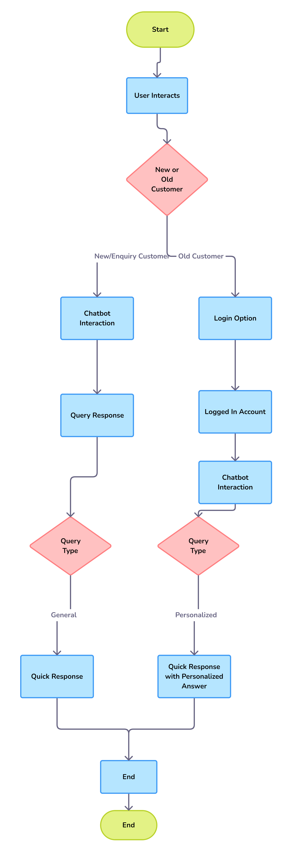
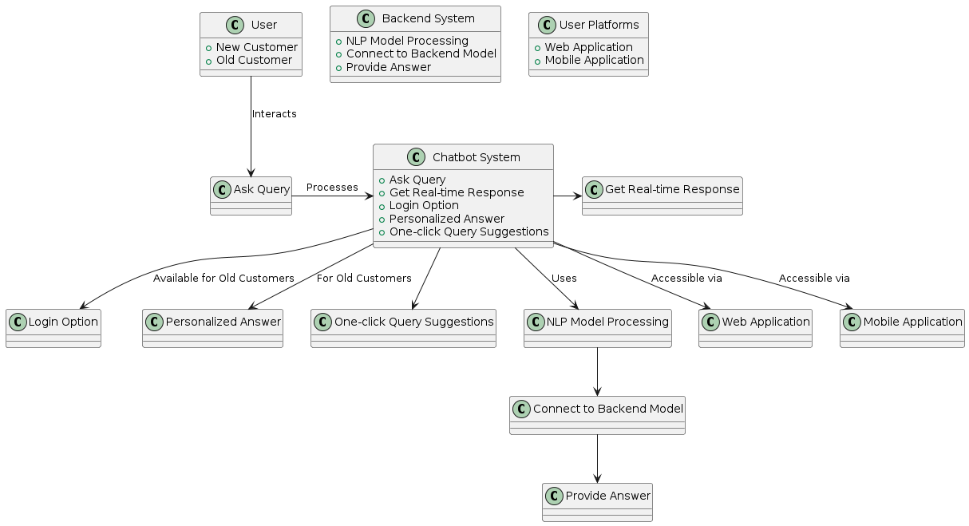
Approach: Flow Chart
Fig: User-Chatbot Interaction flow
Fig: BobAssist flow chart

Slide 7
Uniqueness of Approach and Solution
Our solution offers five unique features & approach:
One-Click Query Suggestions: An one-click query suggestions based on FAQs, resolving common issues instantly.
Real-Time Response: It will deliver immediate responses to customer inquiries and provides proactive solutions, reducing the need for follow-up queries.
NLP model training: A continuous improvement will be made utilizing NLP model to train the chat service and ensure the chatbot stays current with language trends and customer needs.
Integrated Login and Navigation: It will allows customers to log in directly to their bank profiles through the chat interface, ensuring secure access. And provides an intuitive user experience with seamless navigation to personalized account information.
Robust Security Measures: Implements strong security protocols to protect customer data and ensure compliance with privacy regulations.

Slide 8
User Experience
BoBAssist will significantly improves the user experience, making interactions more efficient, personalized, and secure, due to following reasons:
Instant Responses
Personalized Interactions
Multi-Channel Availability
Proactive Assistance
Easy Access to Information
24/7 Availability
Seamless Integration
Enhanced Security

Slide 9
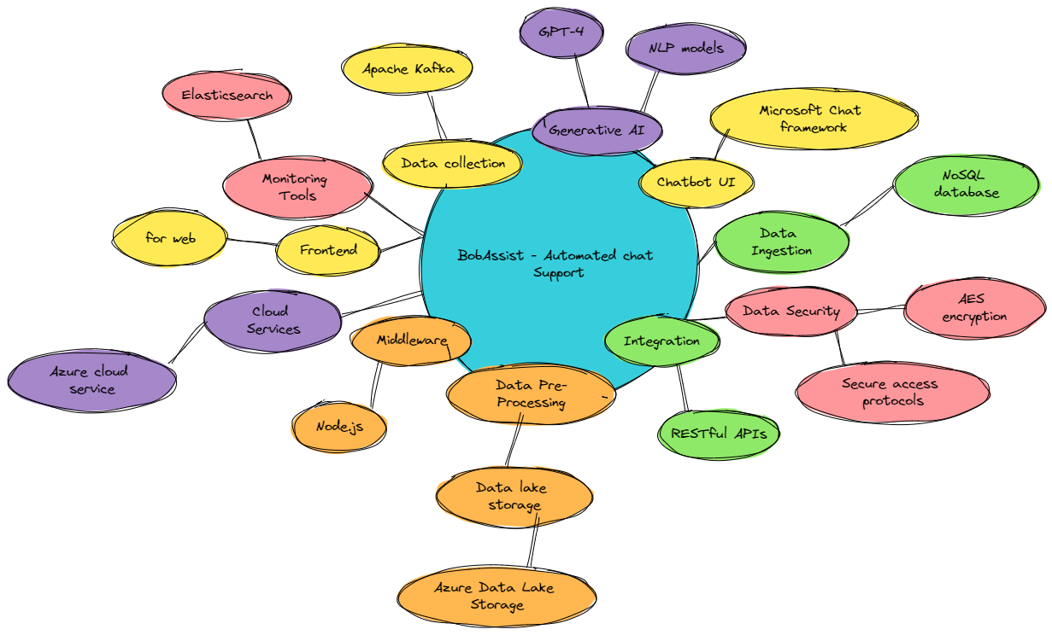
Tools or resources
Few of azure resources we will be utilizing to build BobAssist:
Azure Bot Service
Azure Machine Learning: Create and deploy machine learning models, enabling personalized recommendations based on customer data.
Azure Cognitive Services: Integrate AI capabilities such as natural language understanding and sentiment analysis for enhanced customer interactions.
Azure Data Lake Storage: Securely store and analyze large volumes of customer interaction data for insights and reporting.
Azure DevOps: Facilitate agile development, CI/CD pipelines, and collaboration for efficient deployment and updates of BoBAssist.
Azure Active Directory (Azure AD): Manage identities and provide secure access to BoBAssist applications and services with single sign-on capabilities.
Azure Security Center
Mind map diagram – Depicting technology utilization for BobAssist, highlighting each steps.

Slide 10
Business Potential and Relevance
Following these approaches, BoBAssist addresses key business applications effectively, making a significant impact on the business side:
Enhanced Customer Satisfaction: BobAssist will provide immediate and tailored responses to customer inquiries, enhancing their experience and loyalty which will further leads to long-term customer retention.
Cost Reduction: Automation reduces the need for a large customer support team, leading to significant savings on staffing costs. And By minimizing the need for manual intervention, the bank can lower operational expenses related to customer support.
Personalized Marketing: BoBAssist will able to analyze customer data to provide personalized product and service recommendations, enhancing the relevance of marketing efforts. And Personalized marketing drives higher engagement, leading to increased cross-selling and upselling opportunities, and ultimately boosting sales.
Data-Driven Insights: Analyzing interactions with BoBAssist will provides valuable insights into customer behavior, preferences, and pain points.These insights can inform strategic decisions, helping the bank to refine its products, services, and marketing strategies.

Slide 11
Key Differentiators & Adoption Plan
Our solution approach(BobAssist) & the features it will enriched with makes us key differentiators and its able to deal with the existing model limitation, our user understanding research helped us to identify the right approach & features for BobAssist. By implementing these features we will able to deal with large number of customer queries at a single time and able to provide quick and real-time chat communication.
Adoption Strategy
Targeted Marketing Campaigns
Partnerships and Collaborations
Free Trials and Demonstrations
Customer Success Stories
Comprehensive Training and Support
Competitive Pricing
Community Engagement

Slide 12
Scalability
Following these approach, BoBAssist can effectively scale to accommodate growth without compromising performance:
System Architecture and Scalability: Break down the chatbot system into independent, modular microservices(e.g., authentication, NLP processing, query handling, feedback management). And utilize Azure’s scalable cloud infrastructure to host and manage microservices.
NLP Model Optimization: Use advanced NLP models and continually train them on updated datasets to improve accuracy and response time and deploy these models using Azure Machine Learning Services to ensure they are accessible and can scale based on real-time demand.
Real-Time Data Processing: Implement an event-driven architecture with tools like Azure Event Hubs or Kafka for real-time data processing and communication between services. And utilize in-memory databases like Redis for caching frequently accessed data to reduce latency and improve real-time response times.
Personalized Recommendations: Use machine learning algorithms to analyse user data (account activity, savings goals, investments, demographics, credit usage) and generate personalized recommendations and implement a feedback loop to refine algorithms based on user interactions and feedback.
Integration and Deployment: Use CI/CD pipelines to automate the testing and deployment process. Tools like Azure DevOps can help streamline this process.

Slide 13
Ease of Deployment and Maintenance
Implementation and maintainenance of our solution, BobAssist, provides long-term value with minimal complexity.
User-Friendly Integration: It will easily integrated with existing customer service platforms using standardized APIs and integration process ensures minimal disruption to ongoing operations.
Scalable Architecture: Built with a modular architecture, allowing easy scaling and customization as per business needs and leveraging azure cloud services for scalable and flexible deployment.
Pre-Trained Models: It utilizes pre-trained NLP models that require minimal tuning to start delivering value and allows further training with specific data to enhance performance for unique use cases.

Slide 14
Security Considerations
To ensure the security and integrity of our solution, we will implement following security measures:
Data Encryption: To ensure data security utilize SSL/TLS protocols to encrypt data between users and servers. and AES-256 encryption for storing sensitive information.
Authentication and Authorization: A Multi-Factor Authentication (MFA) adds an extra layer of security by requiring multiple forms of verification. And Role-Based Access Control (RBAC) which limits access to sensitive data based on user roles and permissions.
Secure API Integration: OAuth 2.0 will ensures secure authentication for accessing bank APIs.
Data Integrity Checks: Utilizing cryptographic hashing to ensure data integrity and detect any unauthorized modifications and conducting regular data backups to prevent data loss and ensure recovery in case of an incident.

Slide 15
GitHub Repository Link & supporting diagrams, screenshots, if any
GitHub Repo link:
https://github.com/Samrudhi00/BoBAssist-Bank-of-Baroda-Hackathon-
All the necessary diagrams are uploaded on above github repository.

Slide 16
Thank You
Samrudhi Shete
Saurabh Kumar

