Slide 1
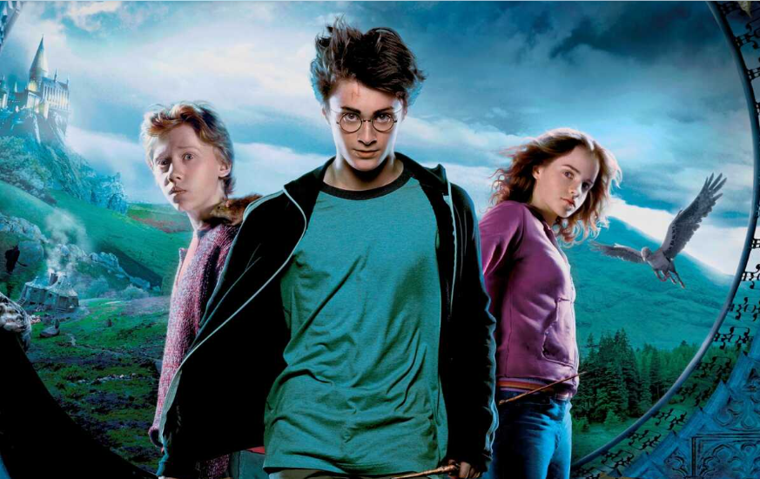
By - Samrudhi Jagtap
Harry Potter Movies
Analysis
( SQL Project)

Slide 2

I leveraged SQL to dive into the world of Harry Potter movies, extracting key insights such as:
Total Runtime: Calculated the combined screen time of all movies.
Character Appearances: Identified characters who consistently appeared across multiple films.
Character Pairings: Analyzed which pairs of characters shared the most screen time together.
Movie Performance: Examined box office figures and runtimes to assess individual movie success.
This analysis offered a deeper look into character dynamics, screen presence, and the overall cinematic structure of the Harry Potter series.

Slide 3
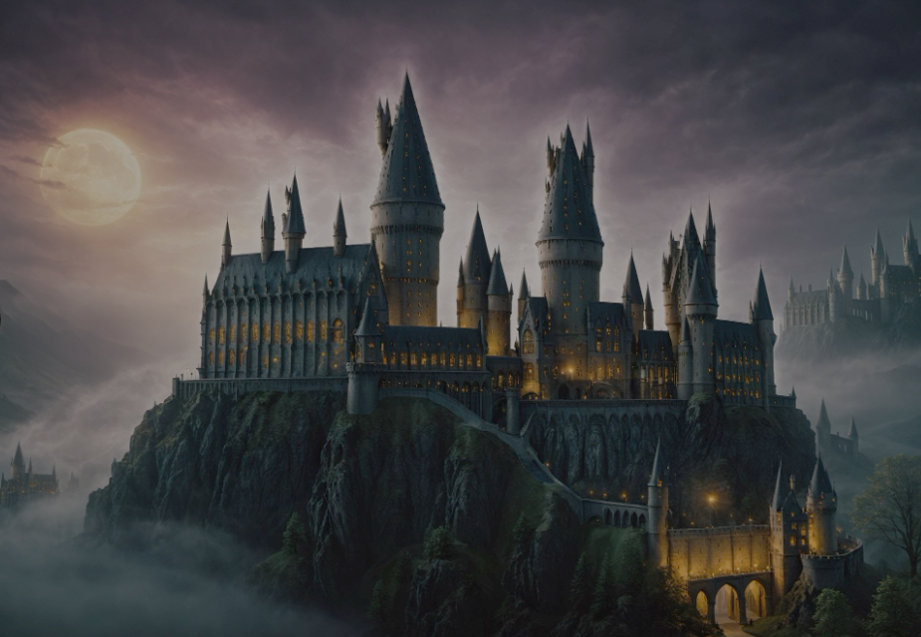

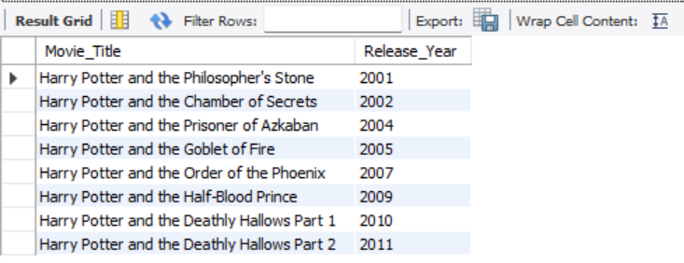


Slide 4



Slide 5

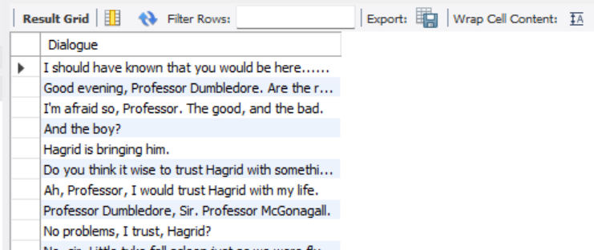

Slide 6

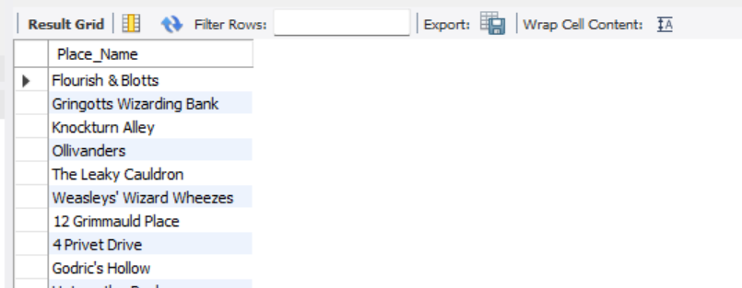

Slide 7
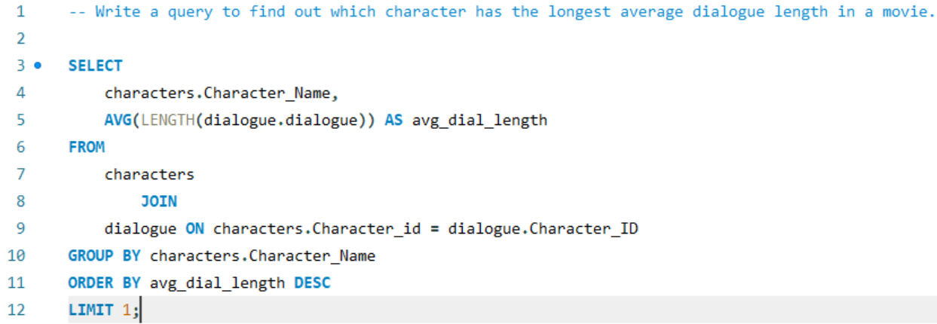


Slide 8
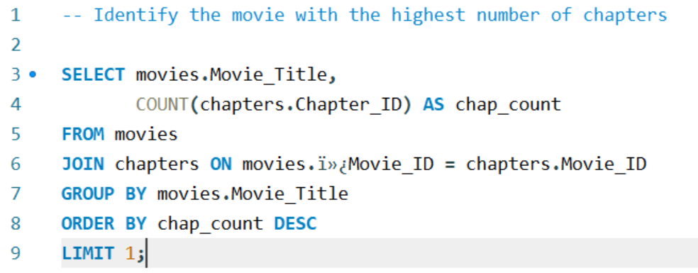


Slide 9
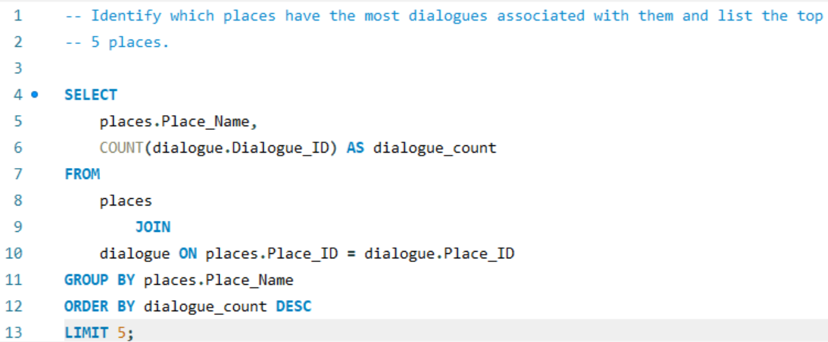


Slide 10



Slide 11
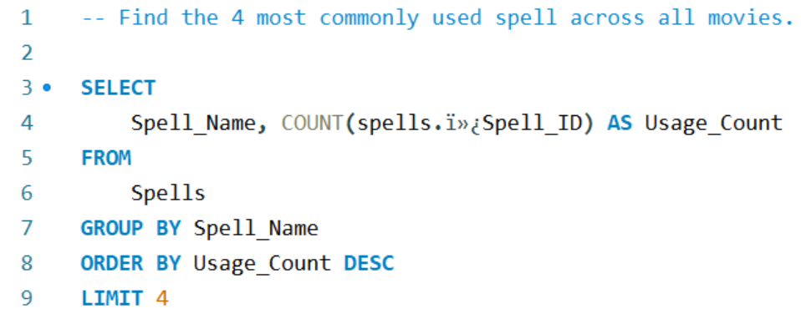


Slide 12
