Slide 1
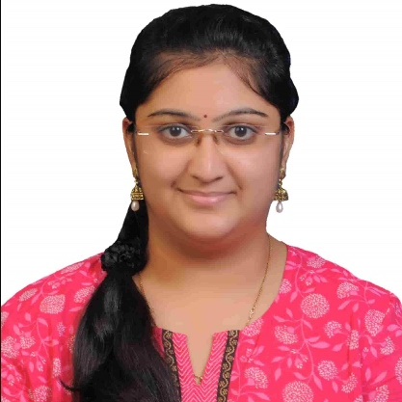

Samrudhi Deepak Raut
Analyst/Software Engineer
Bachelor of Computer Science and Engineering : 2016 - 2021
Skills
Java​ | Java Basics, OOPS, Generics,​ Collections, Array, Loops​
Spring | Spring Boot, Spring Rest Services, Spring Restful Services
React​ | Components, Hooks, Routing, Forms & Validation​
Database​ | Postgre SQL
UI Tech​ | HTML 5 & CSS, Bootstrap 4, JavaScript, ES6
Tools | Eclipse, STS, GitHub, Postman, Swagger, Visual Studio Code, Pg Admin 4, SQL Shell
Add On skills​ ​ | Immersive Learning​, Team management
Mumbai
Samrudhi.Deepak-raut@capgemini.com
7083710333
A4
Full Stack Developer
Hands on experience on Core Java, Postgre-Sql, Spring Restful Services
Proficient in creating Single page Web Application in React with Authentication with routing
Has working knowledge on React and Java Development using Spring framework on an intermediate level.
Ready to learn new technologies and implement them for the future knowledge improvement.
E-Vehicle User dashboard and Admin
Case study of e- Vehicle showroom for user dashboard and admin pages along with API Gateway, Swagger, responsive UI with HTML5, CSS, Bootstrap and React used as User Interface.
Check out my work on GitHub

