Slide 1
Theme : 1. MultiModal AI
Title: GenAI-Powered Real-Time Multimodal Anomaly Detection with Neuro-Symbolic Reasoning.
Team details : TriFusion
Samrudh P 1ms23cs162@msrit.edu
Sagar S R 1ms23cs158@msrit.edu
Ranjita V Nayak 1ms23cs150@msrit.edu

Slide 2
Problem Statement:
Traditional AI Systems Fail at Contextual Anomaly Detection — We Built One That Doesn’t.
Most real-world anomaly detection relies on single modality models and lacks contextual reasoning. They fail in detecting.
Silent or slow-motion anomalies (e.g., crawling, subtle movements)
Mismatches across modalities (e.g., tone vs. body language)
Textual misdirection or visual misinformation
Proposed Solution:
We built a GenAI-powered, real-time anomaly detection pipeline that:
Ingests synchronized video, audio, pose, and scene text
Uses tiered processing: lightweight screening + deep GenAI reasoning
Supports early & late fusion with modality control
Performs neuro-symbolic reasoning using LLMs + rules
Outputs real-time alerts with score + natural language explanation

Slide 3
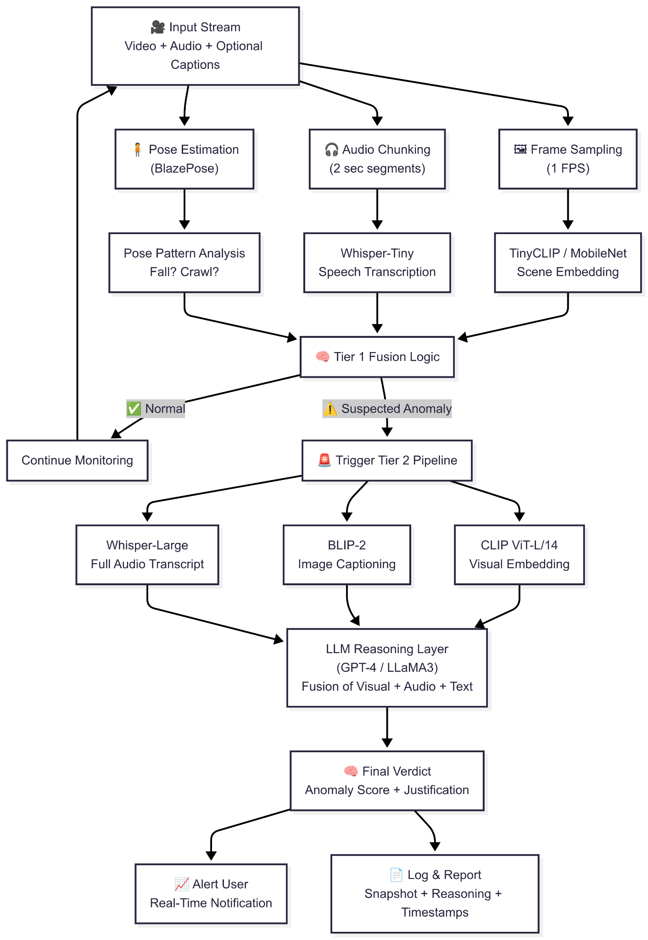
Architecture Diagram Output format forfoformat
{
"frame_id": "A107F", "visual_score": 0.84, "audio_score": 0.67, "text_alignment_score": 0.45, "multimodal_agreement": 0.71, "reasoning_summary": "Unusual gathering detected outside normal hours with motion deviation.", "threat_severity_index": 0.89
}

Slide 4
Innovation Highlights
Aspect | Our GenAI-Based System | Traditional Systems
Multimodal Intelligence | Integrates video, audio, pose, and scene text in real-time | Typically unimodal (video or audio only)
Reasoning Capability | LLM + symbolic rule-based contextual reasoning with explainability | No reasoning or explainability
Fusion Control | Dynamic early & late fusion with modality gating | Static or late fusion (if any)
Interpretability | Generates natural language explanations + anomaly trace | Black-box models with no transparency
Responsiveness Design | Two-tiered system: fast pre-checks + deep GenAI processing on trigger | Uniform heavy models → slower, less responsive

Slide 5
Tools and Tech Stack
Input Ingestion : OpenCV, FFmpeg, WebRTC
Pose Estimation : MediaPipe BlazePose
Audio Processing : Whisper-Tiny (Tier-1), Whisper-Large (Tier-2)
Visual Understanding : TinyCLIP, MobileNet, CLIP ViT-L/14, BLIP-2
Scene Text Parsing : Tesseract OCR, MiniLM
Reasoning Engine : GPT-4 / LLaMA3 + Symbolic Rule Engine
Backend & APIs : FastAPI, Redis, MongoDB, WebSocket
Tailored for Samsung's Real-World Needs
Smart TV & Surveillance Systems → Detect silent intrusions, motionless anomalies, or environmental mismatches in user surroundings.
Industrial Automation (R&D Bangalore) → Auto-detect sound-visual misalignments (e.g., faulty motor sounds with normal visuals).
Training & Remote Monitoring→ Detect distraction, fatigue, or behavioral anomalies in Simulations or remote sessions.
Smart Home & Embedded AI → Integrate lightweight anomaly detection in edge devices for proactive safety monitoring

