Slide 1
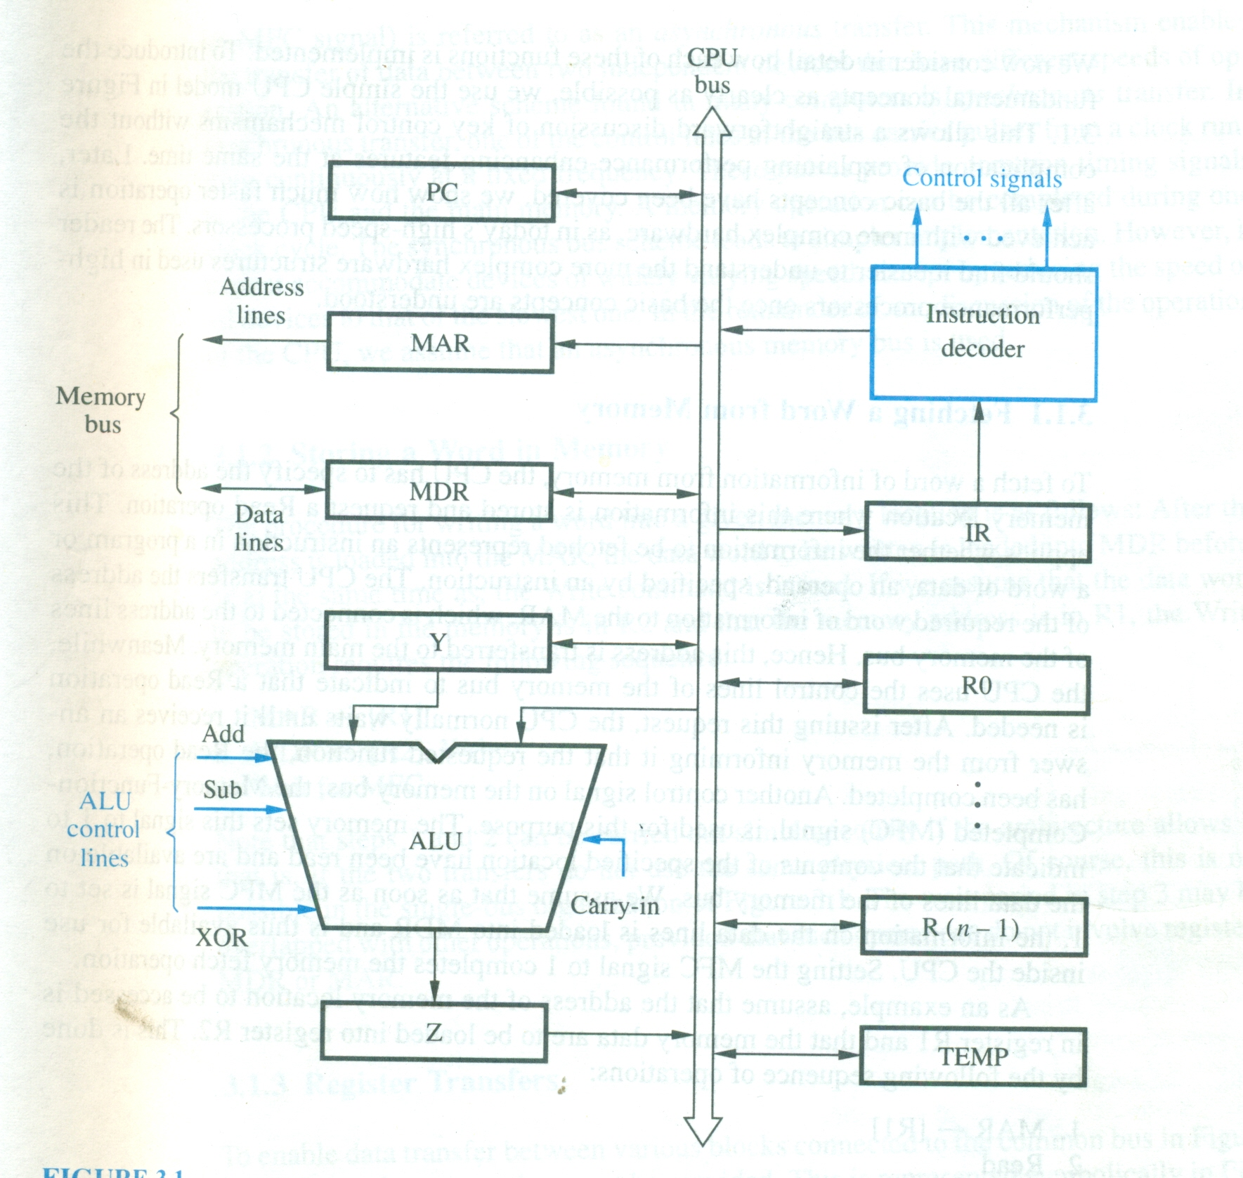
Single-bus organization of Datapaths inside CPU

Slide 2
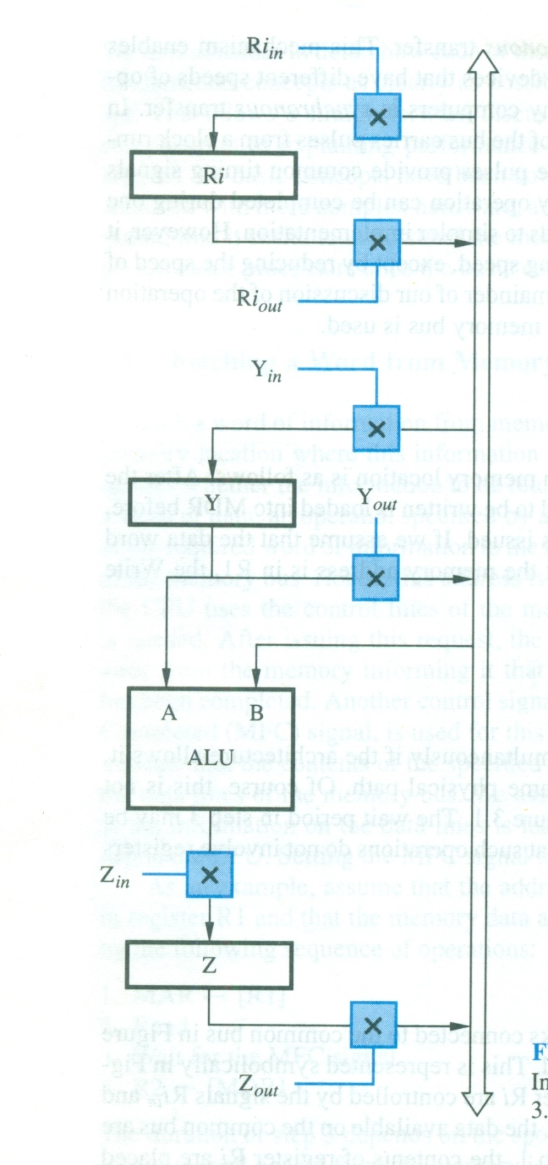
Input-output gating for registers

