Slide 1
CS5346 OTOT-C Video Pre
Introduction: Geographic information
visualization tools in python
Student Name: Yang Xufeng
Metric Number: A0254371H

Slide 2

Introduction
Geospatial data exists everywhere
Threshold for programmers to learn professional Vis software
Python: Simple and easy to use, most people (not limited to programmers) can achieve basic use of python
Notes:
Geospatial data exists everywhere. People cannot go about their daily lives without maps that represent all kinds of information. In this Covid-19 pandemic, we have seen various styles of maps produced by various statistical agencies using different geospatial data visualization tools.
For programmers, there are times when they need to handle some simple data visualization needs, but specialist software such as Tableau has a certain learning threshold.
Python is famous for its multiple functions and ease of use, and many people are able to make simple use of Python. Therefore, using Python for data visualization is attractive.

Slide 3
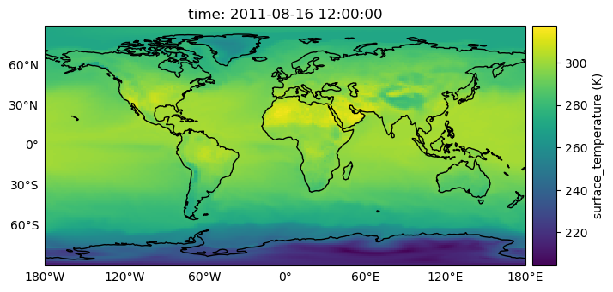
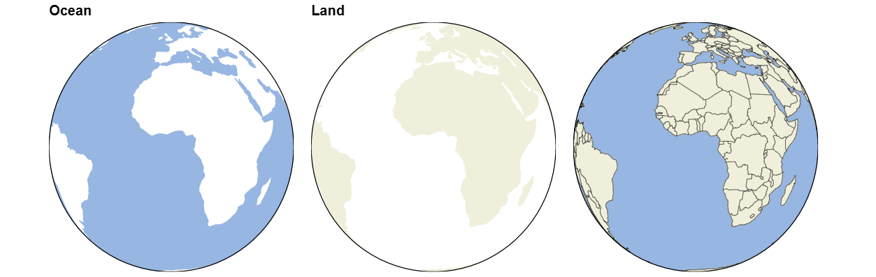
II.I: PyViz/HoloViz(Geoviews, Datashader, HvPlot)
Rich ecology and support
Syntax is simple, easy to use
Good interaction with other
modules such as Geopandas
Notes:
PyViz is a collection of visualization components that maintain implementations and wrappers for a variety of charts, GeoView is a Python library maintained by PyViz to visualise geographic, meteorological and marine data, and other datasets closely related to weather, atmosphere and remote sensing.
The great advantage of GeoView is that the syntax is simple, it works out of the box and it works well with components such as Geopandas.
The PyViz ecosystem also provides other libraries for working with geospatial data, such as HvPlot, Datashader, etc., as well as the Panel library for creating dashboard apps.

Slide 4
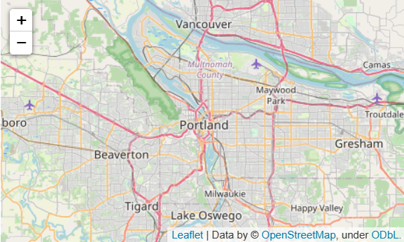
II.II: Folium
Concentrate on map data
import folium
m = folium.Map(location=[45.5236, -122.6750])
Rely on real map data
Flexibility, customization and
variety of presentation formats
Notes:
Folium is the well-known web map visualisation library Leaflet.js which opens up an interface to Python and works with a number of interesting plugins to create interactive online maps. Folium is very easy to get started with, you can quickly see the base map by calling Folium.Map and also overlay different layers on it depending on your data.
The main advantages of folium are its flexibility, the ability to customise the drawing area and the variety of presentation formats.
The limitation of Folium is that it only has good support for map type charts, which can be used in conjunction with other components to achieve additional requirements.

Slide 5
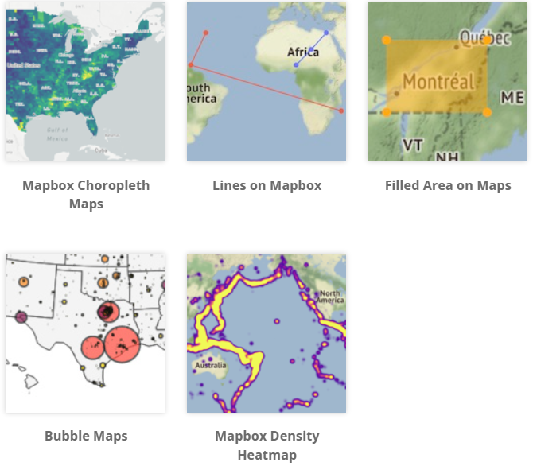
II.III: Plotly
Powerful with Plotly Express
Good interactivity, a little
hard to understand and deploy
Nice expressiveness and
ease of distribution
Notes:
Plotly and its advanced API library Plotly Express have expanded features for geospatial data visualisation, and although interaction with geopandas is not yet supported, there is enough to create many types of maps, and with the launch of Plotly Express in 2019, creating maps with Plotly is becoming easier and easier.
The biggest advantage of Ployly is the good interactivity, which allows users to adjust and interact with the charts at will. But in comparison, plotly is more complicated to get started and deploy locally.
And based on Dash, Plotly makes it easy to create web applications that help you showcase your visualisations to a wider audience.

Slide 6
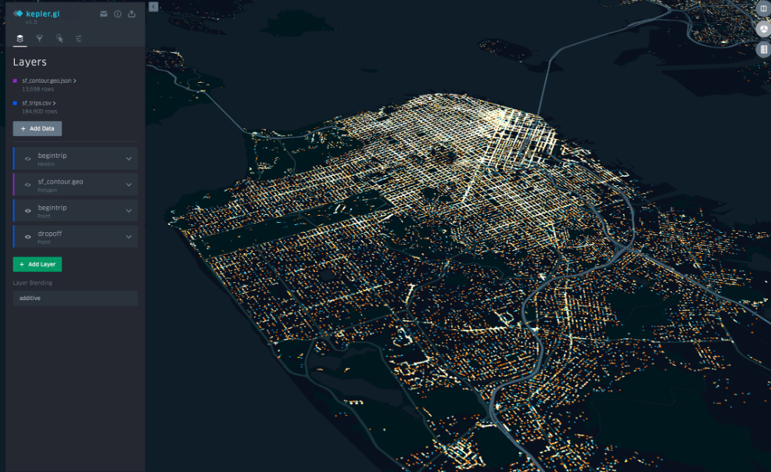
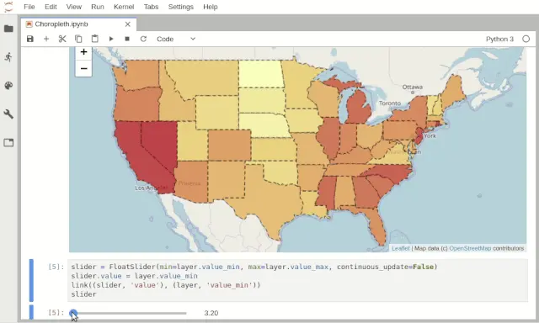
II.IV: KeplerGl and IpyLeaflet
KeplerGL provides good large-scale
geospatial data visualisation
IpyLeaflet richer more support for
jupyter based on Folium
Easy to replicate, but difficult to customise
Notes:
kepler.gl for jupyter is a great tool for large-scale geospatial data visualisation. It embeds kepler.gl, which is widely used worldwide and open sourced by Uber, into the jupyter interface.
Similar to folium, IpyLeaflet is another Leaflet-based visualisation library that can be used to create online interactive maps. It has richer support for jupyter than folium and can be combined with the many web controls in ipywidgets to achieve more complex and richer web interaction.
Both are typical visualisation libraries capable of performing well in the interactive notepad of the jupyter environment. On top of the native functionality, they present the original presentation of the diagram well in python. However, because of this, it is more difficult to personalise the diagrams they produce.

Slide 7
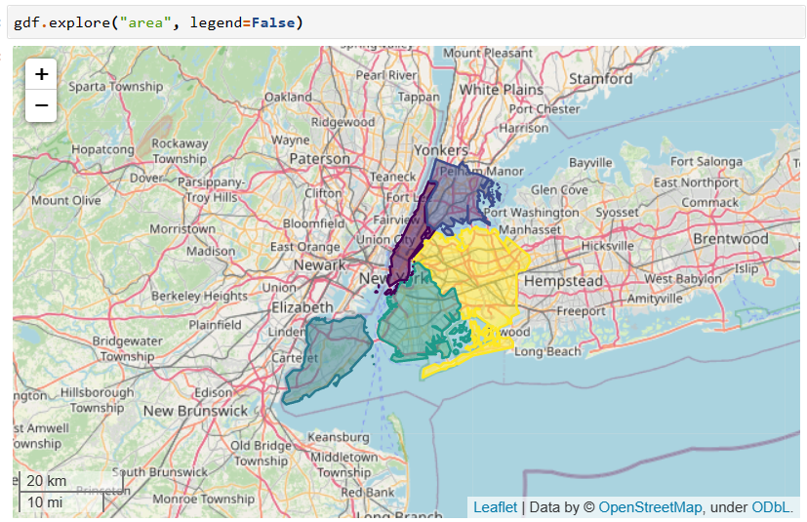
II.V: GeoPandas
Perfect combination with pandas
Multiple features and ease of use,
shapel provides multi-geometric
configurations
Powerful pyogrio engine to
deal with vector data
Notes:
geopandas is a python third-party library for working with geospatial data. It is built on top of pandas, incorporating pandas data types perfectly, combining the functionality of pandas and shaply, and providing interfaces for spatial manipulation under pandas and high-level handling of multi-geometric configurations under shapel, making it possible to perform GIS operations in python. GeoPandas further relies on fiona for file access and descartes, and matplotlib for mapping.
New since geopandas version 0.11 is the pyogrio engine, based on the Python library of the same name developed by the geopandas team, which is based on OGR, a major branch library of the well-known open source raster spatial data conversion framework GDAL, focusing on high-performance conversion of vector data.

Slide 8
Appendix. References
[1] https://geoviews.org/
[2] https://python-visualization.github.io/folium/
[3] https://plotly.com/python/
[4] https://docs.kepler.gl/
[5] https://github.com/jupyter-widgets/ipyleaflet
[6] https://geopandas.org/
Notes:
The richness of the python ecosystem actually brings up the question of tool selection. When faced with a data visualisation problem, developers may be confused by the wide range of visualisation modules available and wonder what is more appropriate to use. There is no definitive answer to this question, and it needs to be analysed according to the specific problem. This presentation introduces the features and benefits of common python visualisation tools, and will hopefully serve as a reference for those who are new to python visualisation. Thanks!

