Slide 1
CS4110 COMPILER CONSTRUCTION · SUMMER 2026
Lexical and Syntactic Analysis of Informal Urban Communication in Yaoundé
A regular-expression lexer and a table-driven LL(1) parser for code-mixed English, French, Pidgin and slang
A real utterance from our data, coloured by language:
Lef
me
for
that
achombo
house
NJUNG GLORIOUS SAMSIMBOM (leader) · ICTU20241398
NDENGUE TAMOKOUE VAN BROWN · ICTU20241479
BONGANG BERINYUY MEGHEN · ICTU20241385
Instructor: Engr. Tanwi Nkiamboh
Notes:
SPEAKER 1 (about 15 seconds).
Good afternoon. We are group ... [say your names]. Our project analyses the informal speech people use every day in Yaoundé - a mix of English, French, Pidgin and slang. We built a lexer and an LL(1) parser for it, and we tested it on 50 real phrases collected in a survey.
The coloured words show why it is hard: in "Lef me for that achombo house" a Pidgin verb, English words and a slang noun sit in one short phrase.
TIMING: whole deck about 9 minutes of speaking plus about 1 minute of handovers = 10 minutes. Each of the 3 speakers gets 4 slides and about 3 minutes.

Slide 2
Yaoundé speaks in mixtures
Part 1 · Data and lexer
One real utterance from our survey (E05)
I
send
my
aza
make
you
fund
me
fapnkolo
“Should I send my account details so you can send me 5000frs” (contributor’s translation)
English
French
Pidgin
Slang
50
9
74%
57%
real utterances tested
survey contributors
of utterances mix two or more languages
of tagged words are not English
2
Notes:
SPEAKER 1 (about 40 seconds).
Yaoundé speech mixes languages inside a single sentence. This example, E05, is from our data: English words, a slang noun "aza" meaning account, the Pidgin conjunction "make", and another slang word "fapnkolo" meaning an amount of money. The contributor translated it for us.
We collected 50 usable phrases from a survey answered by 9 people, on taxis, money, rain, internet, market, electricity, mobile money, food and fuel.
Two numbers matter: 74% of the utterances mix two or more languages, and 57% of the words we could tag are not English.
CLUE FOR QUESTIONS: the brief asks for 10-15 statements; we have 50. The data are written survey answers, not audio - say this honestly if asked.

Slide 3
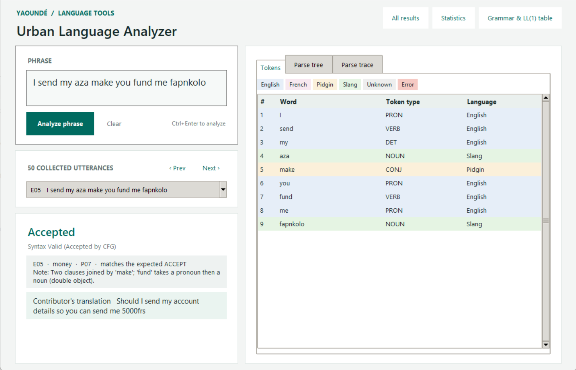
From survey to tagged tokens
Part 1 · Data and lexer
1
Survey form
9 people typed phrases and their own translation.
2
corpus.csv
50 usable utterances kept verbatim; 10 entries excluded.
3
Lexer
One regular expression per token type, built from vocabulary.csv (134 words).
4
Tagged tokens
18 token types, plus a language tag: English, French, Pidgin, Slang.
Our analyzer’s Tokens tab for E05: each word gets a type and a language colour.
3
Notes:
SPEAKER 1 (about 50 seconds).
Step 1: nine people filled an online form. Step 2: we kept every phrase exactly as typed, with the contributor's translation, in corpus.csv - 50 usable phrases; 10 entries were excluded, for example empty answers or swapped columns.
Step 3: the lexer. Like a LEX file, each token type - noun, verb, slang and so on - has its own regular expression, generated from a vocabulary file of 134 words. First matching rule wins, and nothing is silently dropped.
Step 4: every word comes out with a type and a language tag. In the screenshot, "aza" and "fapnkolo" are green (slang), "make" is yellow (Pidgin), the rest are English. This tag is how we detect code-mixing.
CLUE: adding a word to vocabulary.csv regenerates the regular expression automatically.

Slide 4
What the numbers say
Part 1 · Data and lexer
Same meaning, many words
MONEY
argent
nkap
pongos
fapnkolo
majumbum
EXPENSIVE
deer
chère
73%
of distinct words appear only once (101 of 139)
4
Notes:
SPEAKER 1 (about 55 seconds).
Frequency and variation, computed by analysis.py. Of 194 words that carry a language tag, only 84 are English. French is 50, Pidgin 45 and local slang 15.
Variation: the same idea is written in many ways. Money appears as argent in French and nkap, pongos, fapnkolo and majumbum in slang. Expensive is "deer" in Pidgin - spelled the way it sounds - and "chère" in French.
And 73% of distinct words appear only once, so the vocabulary is very diverse; a fixed word list will never be complete. The type-token ratio is 0.69.
Now I hand over to [Speaker 2], who will explain the grammar.
CLUES: 211 tokens in total, 3 unknown words (yacob, ns, half). The unknown-word rate is low only because the lexicon was built from these same phrases.

Slide 5
From grammar rules to a parsing table
Part 2 · Grammar and parser
1
2
3
4
5
Design the CFG
Remove left recursion
Left-factor
FIRST and FOLLOW
LL(1) table
20 rules written from the sentence shapes in the data.
UTT, ADJP and NBAR call themselves on the left.
CLAUSE, COMP and NBAR start alike; split off a helper.
What can start each rule, and what can come after it.
Which rule to use for (symbol, next token).
20 rules
3 rewritten
3 factored
26 symbols
153 cells, 0 conflicts
Result: a grammar a parser can follow with just one token of lookahead.
5
Notes:
SPEAKER 2 (about 40 seconds).
A context-free grammar is a set of rewrite rules that says which token sequences are valid sentences. We wrote 20 rules by looking at the shapes in our data: imperatives like "Fou le camp", subject plus predicate like "Petrol don short", French negation "ne ... pas", double objects, and clauses chained by "make" or "et".
To let a top-down parser use it, we applied five steps, all implemented as generic algorithms in grammar.py: design the grammar, remove left recursion, left-factor, compute FIRST and FOLLOW, then build the LL(1) table. The final table has 153 filled cells and zero conflicts - the builder raises an error if two rules ever land in one cell.
CLUE: LL(1) means Left-to-right scan, Leftmost derivation, 1 token of lookahead.

Slide 6
Two rewrites that make it parseable
Part 2 · Grammar and parser
1
Remove left recursion
2
Left-factor
A rule that starts with itself makes a top-down parser loop forever without reading a token.
Two rules that start the same way force the parser to guess with one token of lookahead.
BEFORE
BEFORE
UTT -> UTT CONJ CLAUSE | CONJ CLAUSE | CLAUSE
CLAUSE -> NP PRED | NP | VP | COP COMP | ADV ADJP
AFTER
AFTER
UTT -> CONJ CLAUSE UTT' | CLAUSE UTT'
UTT' -> CONJ CLAUSE UTT' | ε
CLAUSE -> NP CLAUSE' | VP | COP COMP | ...
CLAUSE' -> PRED | ε
The helper UTT' handles the repetition: several clauses joined by “make” or “et”.
Read the noun phrase first, then decide whether a predicate follows.
6
Notes:
SPEAKER 2 (about 55 seconds).
Two rewrites were needed. First, left recursion. Our rule UTT calls itself first: "UTT goes to UTT CONJ CLAUSE". A top-down parser would expand UTT forever without reading a word. The standard fix introduces a helper symbol UTT-prime that does the repeating. Three rules needed this: UTT for chained clauses, ADJP for several adjectives, NBAR for noun compounds such as "achombo house".
Second, left factoring. CLAUSE had two rules that both begin with a noun phrase: one with a predicate and one without. With one token of lookahead the parser cannot choose. We pull the shared noun phrase out and put the difference in CLAUSE-prime: either a predicate or nothing. CLAUSE, COMP and NBAR were factored.
CLUE: in the report, Section 5.2 and 5.3 show the before and after for every changed rule. Both algorithms are unit-tested on tiny grammars.

Slide 7
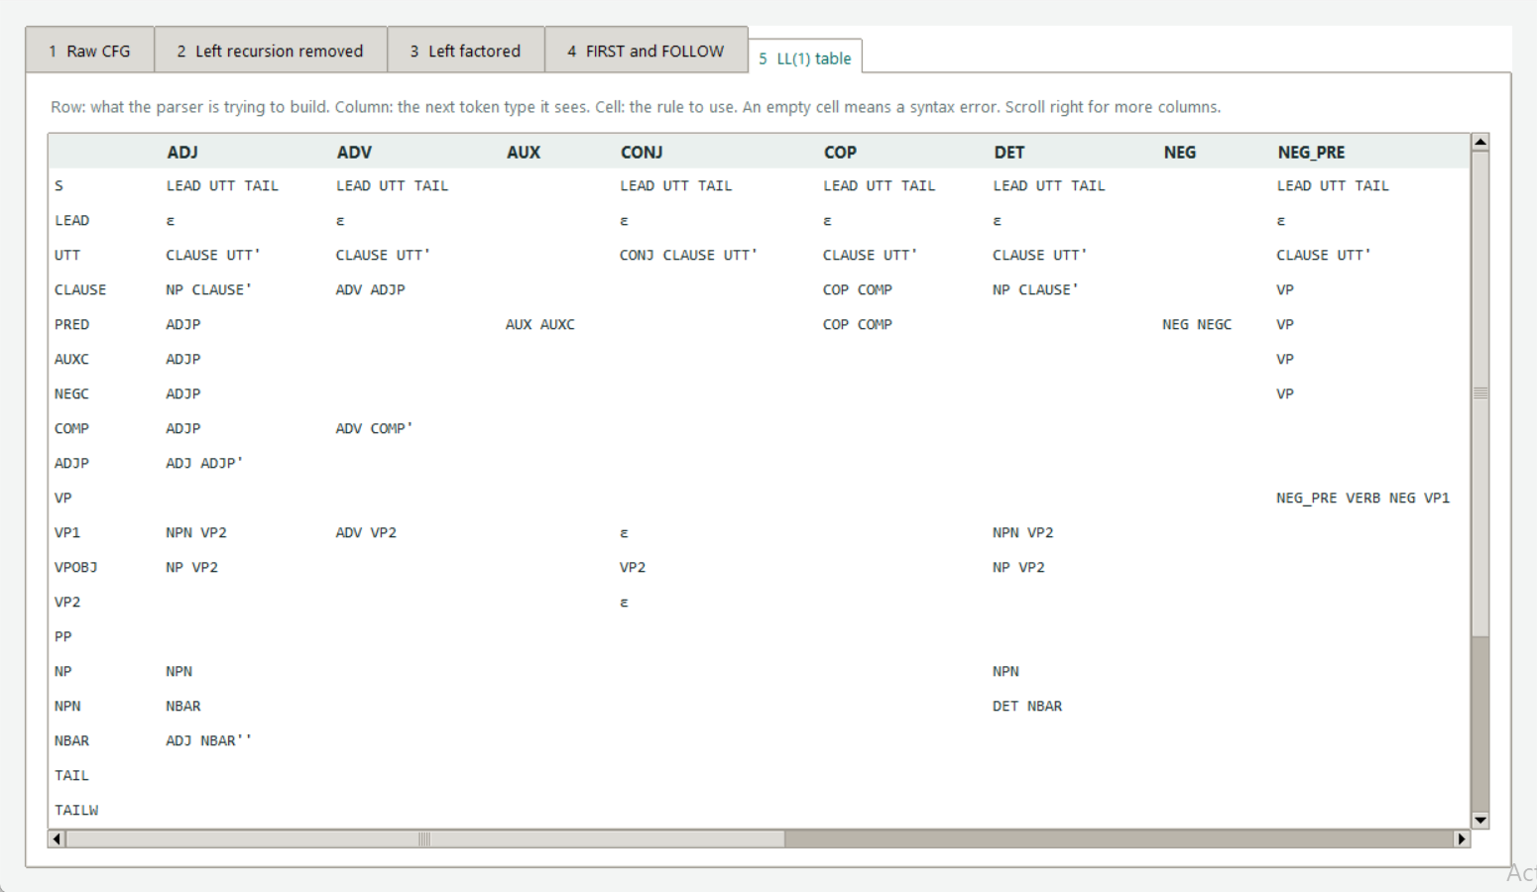
The LL(1) parsing table
Part 2 · Grammar and parser
153
filled cells
0
conflicts: the grammar is LL(1)
Row: the symbol being built. Column: the next token. Cell: the rule to use. Empty cell = syntax error.
7
Notes:
SPEAKER 2 (about 45 seconds).
This is the parsing table from the Grammar window of our analyzer. Each row is a symbol the parser is trying to build, each column is the next token type it sees, and the cell says which rule to use. An empty cell means a syntax error.
It is built from the FIRST and FOLLOW sets: FIRST says which tokens can start a rule, FOLLOW says what may come after, which tells the parser when to choose the empty rule.
It has 153 filled cells and no cell holds two rules, so the grammar is LL(1). Worked example: in row VP1, column PREP, the rule is "PP VP2" - so a verb followed by a preposition, like "Levam for this price", reads a prepositional phrase.
CLUES: the report lists FIRST and FOLLOW for all 26 symbols (Section 5.4) and the full table on two landscape pages (5.5).

Slide 8
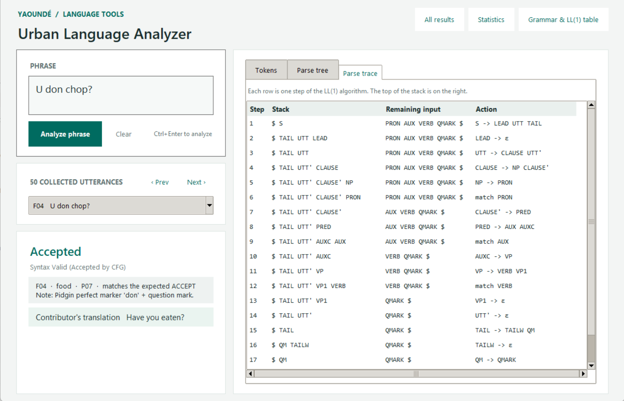
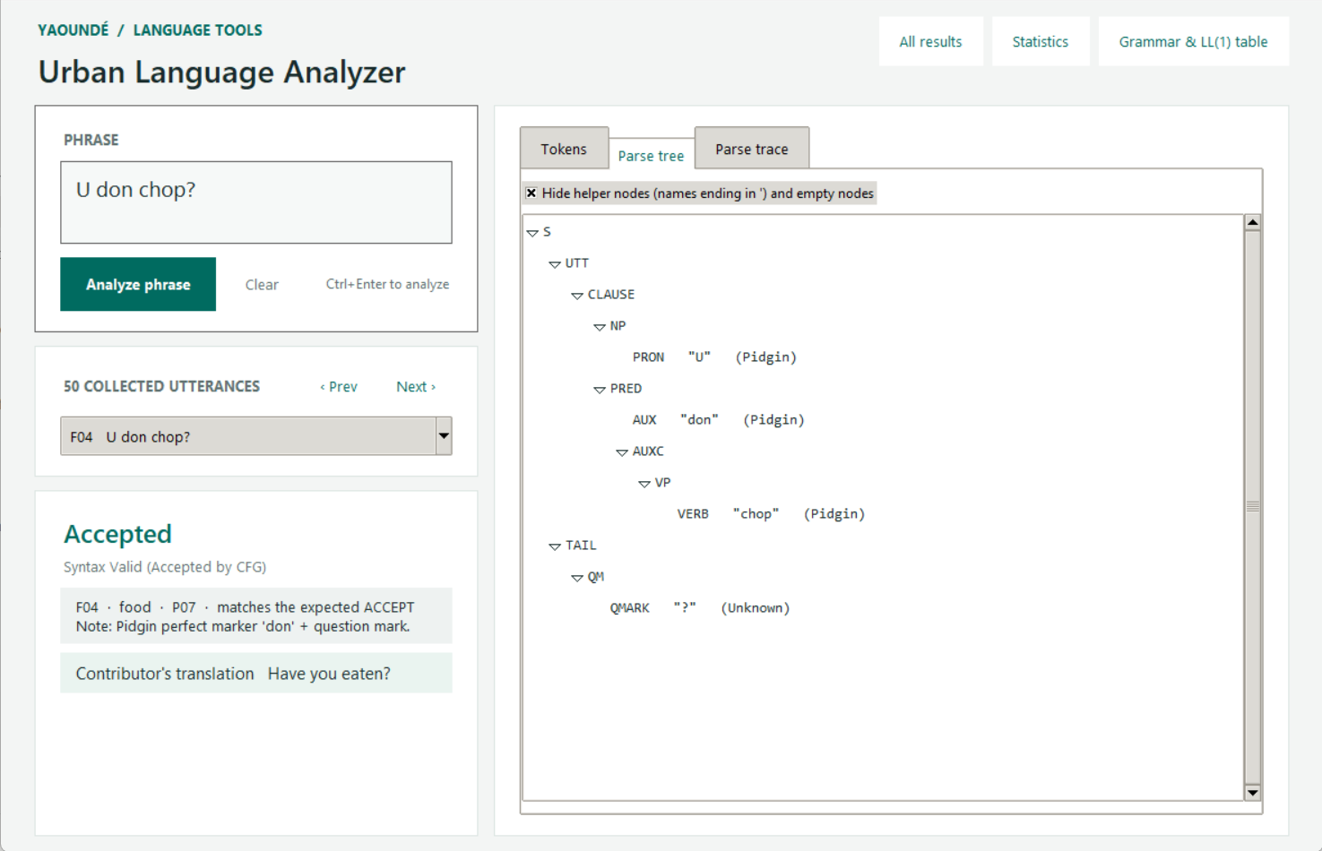
The parser: a stack and one token of lookahead
Part 2 · Grammar and parser
Step-by-step trace for “U don chop?” (Have you eaten?)
The parse tree the trace builds
match a token · or expand the top symbol with table[symbol, next token] · accept when $ meets $
8
Notes:
SPEAKER 2 (about 50 seconds).
The parser is a stack machine. It starts with the end marker and the start symbol S. At each step it looks at the symbol on top of the stack and the next token type. If the top is a token type it must match; otherwise it looks up the table and replaces the top symbol with the rule's right-hand side.
The trace on the left is for "U don chop?" - "have you eaten?". S expands to LEAD UTT TAIL; the pronoun U is matched as the subject; "don" is a Pidgin aspect marker; "chop" is the verb; the question mark is matched by TAIL; the end marker ends the parse and it is accepted.
While it runs the parser also builds the tree on the right. On failure it tells you the offending token and which token types would have been accepted.
Now I hand over to [Speaker 3] for the live demo.
CLUE: the parser never backtracks - one token of lookahead always decides the rule.

Slide 9
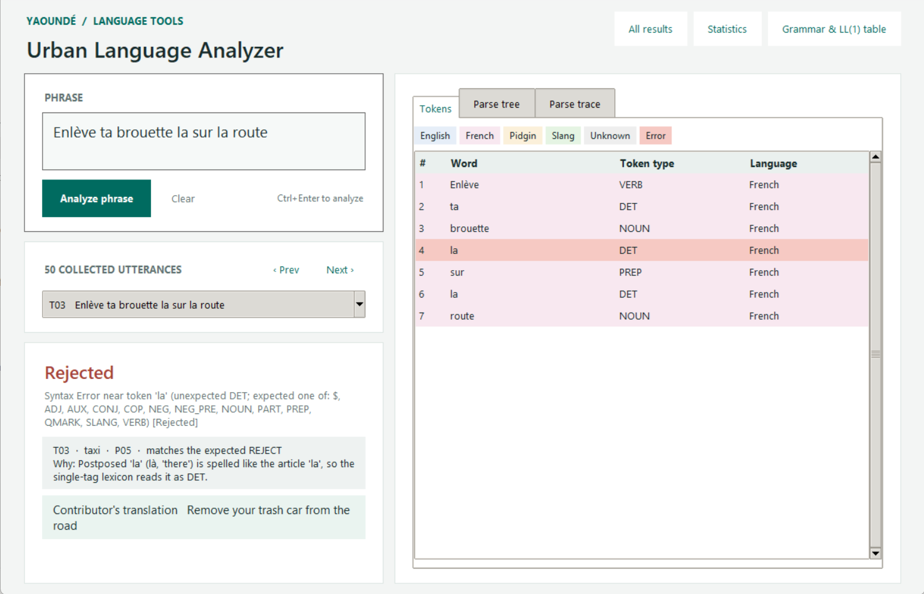
Live demo
Part 3 · Demo and results
1
Open the app
py gui.py
2
Accepted, three languages
E05 I send my aza make you fund me fapnkolo
3
Parse tree tab
F04 U don chop?
4
Rejected, with the reason
T03 Enlève ta brouette la sur la route
5
All results window
31 green rows, 19 red rows
What the audience should see for T03: a red row where the parser stopped, and the reason.
9
Notes:
SPEAKER 3 (about 75 seconds - the demo). Have the app already open and the phrase list ready.
1) "This is our analyzer." Pick E05 from the dropdown: "It is accepted. The Tokens tab shows English, Pidgin and slang words in different colours."
2) Pick F04 "U don chop?" and click the Parse tree tab: "This is the structure the parser found - subject, aspect marker, verb, question mark."
3) Pick T03 "Enlève ta brouette la sur la route": "This one is rejected. The red row is where the parser stopped: the word 'la'. The panel gives the reason - here 'la' means 'there', but our lexicon tags it as the article 'la'."
4) Click All results: "Every one of our 50 phrases: green accepted, red rejected, with the reason."
IF THE APP FAILS: use the screenshots in the report (Figures 8, 9 and 12 to 16) and say what each shows. Backup command: py main.py --no-interactive.

Slide 10
31 accepted, 19 rejected, every one explained
Part 3 · Demo and results
31
19
accepted
rejected
62%
accepted overall
62% is optimistic: the grammar was designed on these same 50 utterances. A held-out test set is future work.
10
Notes:
SPEAKER 3 (about 35 seconds).
Across the 50 phrases, 31 are accepted and 19 rejected: 62% accepted. Electricity, mobile money and fuel are fully covered; rain and food are the hardest because they use the most unusual constructions.
Important honesty point: the grammar was designed from these same phrases, so 62% shows how well the rules describe our sample, not how they would do on new speech. We would need a held-out test set for that.
Every rejection is labelled in the corpus with its reason, and our automated test fails if any verdict changes.
CLUE: 9 unit tests pass; the last one re-checks all 50 verdicts.

Slide 11
Why Yaoundé speech resists a simple grammar
Part 3 · Demo and results
Aa
?
…
Unknown or noisy input
One word, several roles
Shapes we do not model
yacob, ns, emoji, a stray full stop
la (the / there), chop (eat / food), dey, na
serial verbs (Venez me tromper), wh-clefts, floating “tous”
Caught by the lexer as unknown words or invalid characters.
One tag per word cannot tell which role is meant.
Valid speech outside our grammar fragment.
Only 43% of tagged words are English, and 74% of utterances mix languages. A fixed grammar and lexicon age fast.
11
Notes:
SPEAKER 3 (about 40 seconds).
Our 19 rejections fall into three groups, and together they explain why this speech is linguistically complex.
One: unknown or noisy input - words not in the vocabulary, emoji, stray punctuation. The lexer catches these.
Two: one word with several roles. "la" is an article in "la nouriture" but means "there" in "Le pater la". "chop" is a verb in "U don chop?" and a noun, food, in "You get chop for house". "dey" and "na" behave the same way. Our lexicon gives each word one tag, so the parser cannot decide.
Three: shapes we did not model, like serial verbs.
Behind this: only 43% of tagged words are English, and slang and spelling change quickly.
A fuller solution would use context to tag words, spelling normalisation, and a parser that tolerates ambiguity such as Earley or GLR.

Slide 12
What we built
Part 3 · Demo and results
1
A data-driven lexer
One regular expression per token type, language tags, and a vocabulary you can edit.
2
A real LL(1) pipeline
Left recursion removed, left factoring, FIRST/FOLLOW and a conflict-free table drive the parser.
3
Honest results
31 of 50 accepted; every rejection explained. Next: spoken data, contextual tagging, a held-out test.
Thank you. Questions?
github.com/Samsi11/compiler_contruction_yaounde
12
Notes:
SPEAKER 3 (about 25 seconds), then all three take questions.
To conclude: we built a data-driven lexer, an LL(1) pipeline with a conflict-free table, and we tested it on 50 real utterances: 31 accepted and 19 rejected, each explained. The rejections are the most interesting result because they show where Yaoundé speech resists a conventional compiler front end.
Next steps: transcribe spoken data, use context to tag ambiguous words, and evaluate on a held-out set.
Thank you. We are happy to take questions.
See Demo_and_Speaker_Guide.md for likely questions and answers.

