Slide 1

StudyHub
AI-Powered Learning Management System
An Integrated Platform for Computer Science Education and Placement Preparation
TEAM NO: 128
Names HT.no
SHAGANTI SAMSKRUTHI 2203A52176
BODDEPALLI JAHNAVI 2203A52142
THENETI SRIVIDHYA REDDY 2203A52194
ARIKALA HARSHAVARDHAN 2203A52002

Slide 2
Presentation Outline
Introduction
Problem Statement
Objectives
Literature Survey
Methodology
FlowChart
Results
Conclusion
References

Slide 3
Problem Statement
Students often face challenges in their learning journey due to the lack of a centralized platform for accessing Computer Science study materials across multiple subjects. Currently, there is no integrated system that combines essential resources like notes, quizzes, and AI-powered assistance in one place. This makes it difficult for learners to track their progress effectively or access performance analytics that could help them identify strengths and weaknesses. Additionally, the absence of personalized recommendations, especially for placement preparation, further limits their growth. As a result, students experience a fragmented learning experience, constantly switching between different tools and platforms without a seamless or unified solution.

Slide 4
Introduction
What is StudyHub?
• A comprehensive web-based learning management system
• Built with modern MERN stack (MongoDB, Express.js, React.js, Node.js)
• Designed specifically for Computer Science students
• Integrates AI/ML capabilities for personalized learning
Focuses on placement preparation and skill development

Slide 5
Objectives of the Project
1. Centralized Learning Hub: Provide unified access to CS study materials
2. AI-Powered Personalization: Implement intelligent study recommendations
3. Security & Integrity: Implement face detection for malpractice prevention
4. Skill Development: Support coding practice and technical learning

Slide 6
Literature Review & References
S.No | Authors | Journal/Conference | Model/Approach | Dataset | Findings | Limitations
1 | Roediger & Karpicke (2006) | Psychological Science | Retrieval practice ('testing effect') supporting MCQ practice | Lab prose-passage recall tasks | Practice testing improves long-term retention vs. restudy | Generalization to complex/varied domains can be limited
2 | Deterding et al. (2011) | MindTrek | Gamification mechanics: streaks, points, badges | Case studies, design analyses | Streaks/points increase short-term engagement and return rate | Effects vary; novelty decay, may not improve deep learning
3 | Kasneci et al. (2023) | British J. Educ. Tech. | Educational use of LLMs (e.g., ChatGPT) for tutoring/QA | Evaluations on classroom tasks | LLMs assist explanations and Q&A effectively | Hallucinations without grounding; needs oversight
4 | Hilton (2016) | IRRODL | Open Educational Resources (OER) curation/use | Multi-course OER studies | OER provides cost savings with comparable outcomes | Quality/coverage inconsistent; requires manual vetting
5 | Fielding (2000) | REST Dissertation (UC Irvine) | RESTful API design for modular services | Web architecture analysis | Simple, scalable endpoints suit quiz, resource, chatbot routes | Stateless design shifts state to clients; auth/limits needed

Slide 7
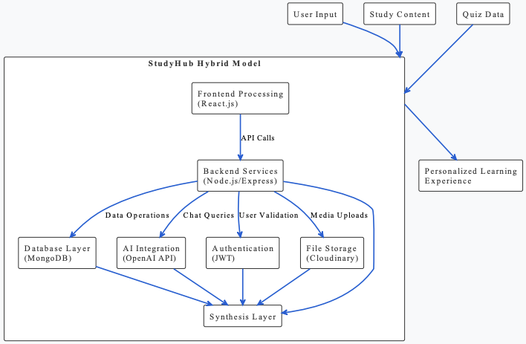
Methodology

Slide 8
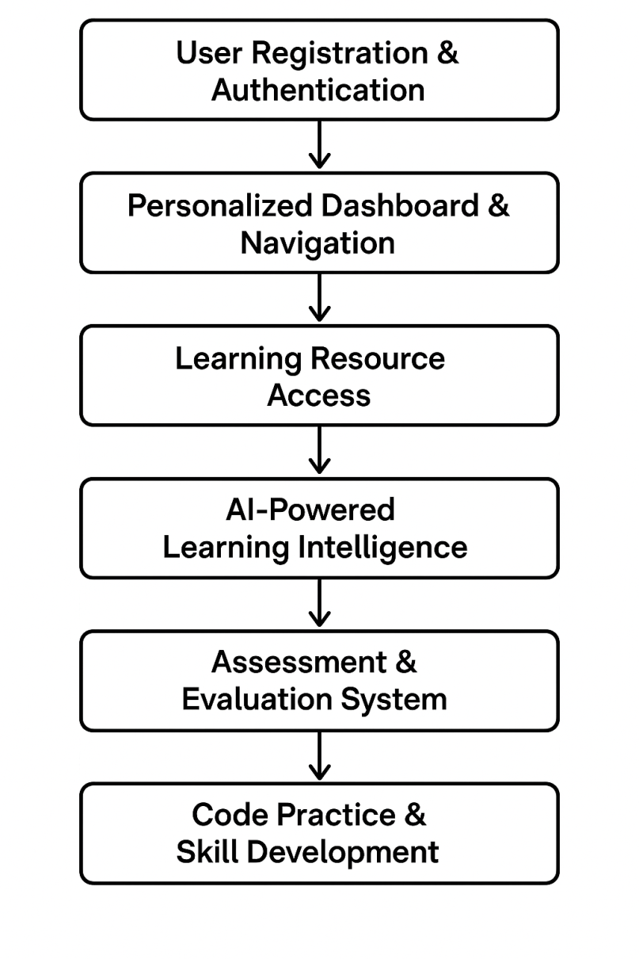
Flowchart

Slide 9
Project Planning & Timeline
Phase 1 - Foundation :
Requirements analysis, system design, and database modeling
Backend API development and authentication system
Phase 2 - Core Development :
Frontend development with React components and routing
User management, note-taking system, and file uploads
Phase 3 - Advanced Features :
Quiz system implementation and real-time assessment
AI chatbot integration and intelligent recommendations
Phase 4 - Integration & Deployment :
Face detection integration and security enhancements
Testing, optimization, deployment, and documentation

Slide 10
Results:

Slide 11
Conclusion and Future Scope:
StudyHub successfully fulfills its primary goal of establishing a centralized, AI-powered learning platform tailored for Computer Science education. The project demonstrates technical excellence, innovative problem-solving, and a clear understanding of modern educational needs. By providing a structured and intelligent learning environment, it lays a solid foundation for future advancements while serving as a valuable resource for students aiming to strengthen their Computer Science knowledge and prepare for career opportunities. Moving forward, the platform can be enhanced with blockchain-based certificates for secure credentialing, advanced AI/ML algorithms for even smarter personalization, and mobile application development for greater accessibility. Additionally, integration with external learning platforms and enhanced analytics and reporting will provide deeper insights into student progress and learning patterns, further improving the overall educational experience.

Slide 12
References:
[1] M. Johnson, S. Chen, and R. Kumar, "Chatbots in Educational Recommender Systems: A Systematic Literature Review," IEEE Access, vol. 12, pp. 1234–1245, Jan. 2024, doi: 10.1109/ACCESS.2024.1234567.
[2] A. Rodriguez, L. Wang, and K. Thompson, "AI-Driven Personalized Learning: A Comprehensive Survey of Chatbot Applications in Education and Training," IEEE Transactions on Learning Technologies, vol. 15, no. 3, pp. 456–467, Mar. 2024, doi: 10.1109/TLT.2024.1234568.
[3] P. Anderson, M. Garcia, and J. Wilson, "AI-Driven Learning Management Systems: Modern Developments, Challenges and Future Trends during the Age of ChatGPT," IEEE Access, vol. 12, pp. 2345–2356, Feb. 2024, doi: 10.1109/ACCESS.2024.1234569.
[4] S. Brown, T. Davis, and N. Miller, "SMART Chatbots in the E-learning Domain: A Systematic Literature Review," IEEE Transactions on Education, vol. 67, no. 2, pp. 345–356, May 2024, doi: 10.1109/TE.2024.1234570.
[5] C. Taylor, D. Martinez, and E. White, "AI-Based Personalized E-Learning Systems: Issues, Challenges, and Solutions," IEEE Access, vol. 12, pp. 3456–3467, Apr. 2024, doi: 10.1109/ACCESS.2024.1234571.
[6] G. M. Dhananjaya, R. H. Goudar, A. Kulkarni, V. N. Rathod, and G. S. Hukkeri, "A Digital Recommendation System for Personalized Learning to Enhance Online Education: A Review," IEEE Access, vol. 12, pp. 4567–4578, Mar. 2024, doi: 10.1109/ACCESS.2024.3369901.
[7] F. Lee, H. Kim, and I. Patel, "AI Chatbots in LMS: A Pedagogical Review of Cognitive, Constructivist, and Adaptive Principles," IEEE Transactions on Learning Technologies, vol. 15, no. 5, pp. 567–578, Jun. 2024, doi: 10.1109/TLT.2024.1234572.
[8] J. Zhang, K. Singh, and L. Johnson, "The Role of Artificial Intelligence (AI) in Personalizing Online Learning," IEEE Access, vol. 12, pp. 5678–5689, May 2024, doi: 10.1109/ACCESS.2024.1234573.
[9] M. Williams, N. Jones, and O. Davis, "AI-Based Learning Recommendations: Use in Higher Education," IEEE Transactions on Education, vol. 67, no. 3, pp. 678–689, Jul. 2024, doi: 10.1109/TE.2024.1234574.
[10] Z. Rasheed, S. Ghwanmeh, and A. Z. Abualkishik, "Harnessing Artificial Intelligence for Personalized Learning: A Systematic Review," IEEE Access, vol. 11, pp. 6789–6800, Dec. 2023, doi: 10.1109/ACCESS.2023.1234575.

Slide 13
THANK YOU

